Slide 1
RESPeCT PD pROGRAM
Day 2
RESPeCT Summer Institute
Notes:
3 min
a. Take care of any housekeeping issues.

Slide 2
Trends in Reflections
Lesson Analysis | Science Content Learning
Notes:
5 min
a. Give participants time to review your summary of their reflections from day 1 and offer reactions and comments or ask follow-up questions.

Slide 3
Norms for Working Together: The Basics
Purpose: Build trust and develop a productive study group for all participants.
The Basics
Arrive prepared and on time; stay for the duration; return from breaks on time.
Remain attentive, thoughtful, and respectful; engage and be present.
Eliminate interruptions (turn off cell phones, email, and other electronic devices; avoid sidebar conversations).
Make room for everyone to participate (monitor your floor time).
Notes:
5 min
a. Provide context: “Since we’ll be working together throughout the Summer Institute and the academic year, we need norms that will enable us to build trust and productivity as a group. Today we’ll start our analysis of other teachers’ classroom videos. In the fall, we’ll analyze videos from each other’s classrooms. For this work to be meaningful, we’ll need to push and challenge each other. This will require mutual respect and a common understanding of our goals.”
b. “Do you want to clarify or revise any of these norms?”
Note: Have participants locate the half-page sheet of norms they pasted into their science notebooks on day 1. Remind them to leave space for revising the norms.
c. Encourage participants to ask clarifying questions regarding the meaning of any of the norms and jot notes in their science notebooks.
d. Ask participants if they’re willing to live with these norms today, and let them know they’ll have an opportunity to revise them tomorrow. Remind them of this at the end of the session.

Slide 4
Norms for Working Together: The Heart
Purpose: Build trust and develop a productive study group for all participants.
The Heart of RESPeCT Lesson Analysis and Content Deepening
Keep the goal in mind: analysis of teaching to improve student learning.
Share your ideas, uncertainties, confusion, disagreements, questions, and good humor. All points of view are welcome.
Expect and ask questions to deepen everyone’s learning; be constructively challenging.
Listen carefully; seek to understand other participants’ points of view.
Notes:
5 min
a. “Now let’s review the norms at the heart of the RESPeCT PD program.”
b. “Do you want to clarify or revise any of these norms?”
c. “Do you want to add any norms to this list?”
d. Ask participants if they’re willing to live with these norms today, and announce that they’ll have an opportunity to revise them tomorrow.

Slide 5
Agenda for Day 2
Day-1 reflections
Focus questions
Review of STL strategies 1–3
STL lesson analysis: elicit and probe questions
STL lesson analysis: probe and challenge questions
Practice using elicit and probe questions
Lunch
Content deepening: weather and seasons
Summary, homework, and reflections
Notes:
Less than 1 min
a. Talk through the agenda for the day.

Slide 6
Today’s Focus Questions
Lesson Analysis
Content Deepening
How can lesson analysis help us better understand how elicit, probe, and challenge questions can reveal and challenge student thinking?
What do we notice about our weather from month to month?
What do we notice about weather patterns from morning to afternoon?
Notes:
1 min
a. Introduce the focus questions that will guide today’s session.
b. “Each day we’re going to have at least one lesson analysis focus question and one content deepening focus question.”
c. “Here are our focus questions for today’s session.”

Slide 7
Notes:
1 min
a. Point out the strategies highlighted on the slide.
b. “During today’s session, we’ll focus again on the first three Student Thinking Lens strategies: elicit, probe, and challenge questions.”

Slide 8
Probe versus Challenge Questions
Read one of the dialogue examples for STL strategy 3 in the STeLLA strategies booklet.
With an elbow partner, try to justify why each question is labeled probe or challenge.
For help, refer to the STL Z-fold summary chart and the explanations, examples, and general questions for strategy 3 in the strategies booklet.
Be ready to share your ideas.
Notes:
10 min
a. Have participants look in the STeLLA strategies booklet at a dialogue example for STL strategy 3 that highlights probe and challenge questions.
b. The purposes of this activity are as follows:
1. To get participants’ heads back into the questioning strategies discussed on day 1.
2. To make sure participants understand the distinct purposes of probe and challenge questions:
Probe questions seek to understand what students are saying/writing and encourage them to explain their ideas more clearly or fully (not to change their thinking).
Challenge questions seek to engage students in ways that will challenge them to think, reconsider their ideas, change their initial ideas, and move toward more-scientific understandings.

Slide 9
Lesson Analysis Focus Question
How can lesson analysis help us better understand how elicit, probe, and challenge questions can reveal and challenge student thinking?
Notes:
Less than 1 min
a. “Today we’ll explore this focus question: How can lesson analysis help us better understand how elicit, probe, and challenge questions can reveal and challenge student thinking?”
b. “But first let’s discuss what lesson analysis involves.”

Slide 10
RESPeCT Lesson Analysis Protocol
1. Identify the strategy
What STeLLA lens and strategy was the teacher using in the video clip?
2. Analyze the video
What student thinking was made visible (or not)?
How did the use of the STeLLA strategy impact student thinking?
3. Reflect and apply
What did you learn from identifying and analyzing the strategy in the video?
Notes:
3 min
a. “This is the three-step protocol that will guide our video-based lesson analysis work. Although we’ll follow the protocol a bit more loosely during the Summer Institute, we’ll rely heavily on this explicit three-step format as we move into the fall study groups.”
b. Review the steps on the slide; then tell participants, “Framing our analysis in this way and following specific steps will help us focus more holistically on the teaching and the impact of the STeLLA strategies on student thinking and learning and the storyline students are constructing (i.e., the Student Thinking Lens and the Science Content Storyline Lens).”

Slide 11
Lesson Analysis Process
Review the lesson context:
What is the ideal student response to the focus question?
How is the clip situated in the content storyline?
Identify and discuss the strategy that is the focus of analysis for each clip.
Watch video clip(s).
Analyze the lesson using the lesson analysis protocol.
Reflect on the lesson analysis experience:
As a reviewer
As a teacher in the clip
Notes:
3 min
a. “The lesson analysis protocol includes this five-step process.”
b. Review the steps on the slide and note that in the study groups, these steps will be followed more explicitly than they will be during the Summer Institute.

Slide 12
Lesson Analysis: Viewing Basics
Viewing basic 1: Look past the trivial, or little things, that bug you.
Viewing basic 2: Avoid the “This doesn’t look like my classroom!” trap.
Viewing basic 3: Avoid making snap judgments about the teaching or learning in the classroom you’re viewing.
Note: Find out more about the viewing basics on page 1 of in the STeLLA strategies booklet.
Notes:
2 min
a. Ask: “Why is each of these viewing basics important? Which will be hardest for you?”
b. Tell participants they can find details on the viewing basics in the STeLLA strategies booklet and refer to this information later.
c. Highlight: “The videos we’ll be viewing throughout the program aren’t necessarily exemplary, but rather they provide real-world examples of teachers implementing the STeLLA strategies. Examples like these deepen our thinking because we can see the sometimes unintended results of teacher decisions and consider missed opportunities.”
d. Honor the videocase teachers! All of these courageous teachers are not only working hard to improve their own teaching practice but are also willing to make their practice public so that others can learn from it. None of them would claim to be exemplary science teachers.

Slide 13
Our First Video Clip
Video Clip 1
Context:
An interview with a kindergarten student before the teacher begins instruction about weather and seasons.
The interviewer shows Alan different pictures and asks him to describe the weather in each one.
Notes:
2 min
a. Describe the context of the first video clip participants will watch. (See the top of the transcript—handout 2.1 in the PD program binder.)
b. “This student interview showcases the use of elicit and probe questions. Even though this clip doesn’t take place in the context of an actual classroom, the idea is to look at the quality and form of the questions. Our second video clip will feature probe and challenge questions in a classroom context.”

Slide 14
Identify Elicit and Probe Questions
Video Clip 1
Watch the video clip for examples of the interviewer or teacher asking the student elicit and probe questions.
Identify the questions on your transcript and mark them E (elicit) and P (probe).
Share your evidence with the group.
Remember:
Not all questions will fall into the E and P categories.
Elicit questions start a conversation and ask for student ideas without expecting right answers.
Probe questions try to figure out what a student means.
Probe questions can paraphrase a student’s idea.
Link to video clip 1: 2.1_mspcp_kinder_weather_johnson_pre.Alan_c1
Notes:
20 min
a. Provide instructions for watching video clip 1 and using the transcript to identify questions that elicit (E) and probe (P) student ideas and predictions.
b. Remind participants that the purpose of watching the video clip is to deepen their shared understandings of these strategies and to build their individual and collective lesson analysis skills.
c. Individuals: Allow time for participants to review the video transcript and mark E and P questions.
d. Whole group: Discuss what participants found in the transcript. Encourage them to use evidence from the transcript and reasons from their Z-fold summary charts or the STeLLA strategies booklet to support their ideas. Participants should work to differentiate elicit and probe questions and distinguish them from other types of teacher questions or statements.
Examples of elicit questions:
Video segment 00:00:17: “What can you tell me about the weather that day?”
Segment 00:01:43: “OK. So now I want to look at this picture. What can you tell me about the weather that day?”
Segment 00:02:23: “OK. So tell me about … this day.”
Examples of probe questions:
Video segment 00:00:24: “What makes you say that?”
Segment 00:00:31: “OK. And the wind is making it a little cold. Can you tell?”
Segment 00:00:53: “What do you mean ‘the waves are different’?”
Segment 00:01:35: “OK. A little hot and sweaty. And … and in this picture, you think it’s colder because it’s windier?”
Segment 00:02:01: “What makes you say that?”
Segment 00:02:08: “OK. And what makes you think the wind go … [is] blowing?”
Note: This video clip contains other questions and comments that probe student thinking, but they aren’t as clear cut. For example, at segments 00:02:48–03:02, the interviewer tries to find out what Alan thinks about the likelihood of rain at different times of year (seasons). In this instance, the interviewer is trying to find out what Alan thinks, not looking for correct answers. several of these questions sound more like probe questions to me, since they follow a student statement and are asking for more information to clarify student thinking. Am I missing something?
these questions sound more like elicit questions because they’re asking for students’ initial ideas/observations about the weather.

Slide 15
Analyze Student Thinking
Video Clip 1
Review the interview transcript.
What student thinking was revealed through the interviewer’s elicit and probe questions?
What ideas did Alan have about weather?
Were there places you wished the interviewer had probed Alan’s thinking more? Why?
Notes:
20 min
a. Give participants time to review the video transcript and develop an answer to one of the analysis questions on this slide. Encourage them to write down their answers.
b. For this first video analysis, do a round-robin and have each participant share. Ask probe and challenge questions to support participants in communicating their ideas clearly and completely:
Probe question: “Can you say more about what you mean by …?”
Challenge question: “Can you point to a specific place in the transcript that supports your idea?”
c. As participants share, encourage others to respond by asking questions like these:
Do others have additional evidence to support (or challenge) this idea?
Do others have a different interpretation?
Observations:
Alan seems to think it’s always hot when the Sun is hot (video segments 00:01:13–01:35) and that it’s always cold when it’s windy (00:00:22–00:31; 00:01:42; 00:02:04) and cloudy (00:02:04). However, Alan recognizes (possibly from experience?) that rainy days are hot in Mexico (00:03:28–03:40).
Alan thinks it only rains in the spring (segments 00:02:29–00:03:02).
Alan doesn’t seem to recognize that the weather in Mexico is different from the weather in Denver. Instead of comparing the weather in the two places, he describes the weather in Mexico (00:03:17–03:40). Further probing would have helped to clarify whether Alan think the weather in Mexico and Denver is different. For example, at segment 00:03:40, the teacher could have asked, “Is that the same in Denver?”

Slide 16
Identify Probe and Challenge Questions
Video Clip 2
Now we’ll look at a classroom video and focus on identifying probe and challenge questions.
Read the context at the top of the video transcript (handout 2.2).
Identify probe (P) and challenge (C) questions and mark them on your transcript.
Mark “missed opportunity” (MO) next to places you would like to know more about student thinking.
Remember:
Not all questions will fall into these categories.
Probe questions try to figure out what a student means or is thinking. Challenge questions try to move student thinking toward a more scientifically accurate idea.
Link to video clip 2: 2.2_mspcp_kinder_weather_gaines_L1_c1
Notes:
20 min
a. Provide instructions for watching video clip 2 and using the transcript (handout 2.2) to identify questions that probe student ideas and predictions and challenge student thinking.
b. Encourage participants to refer to the strategy charts from day 1 (STL strategies 1–3), their Z-fold summary charts, and the STeLLA strategies booklet for help differentiating probe and challenge questions. Remind them that other types of questions (such as elicit questions) may appear in this video clip.
c. Set the context: Read the context for video clip 2 (at the top of the transcript).
d. Emphasize that the students in this class haven’t yet studied anything about weather.
e. Show the video clip and allow time for participants to study the transcript before advancing to the next slide.

Slide 17
Identify Probe and Challenge Questions
Video Clip 2
What are good examples of probe questions in the video transcript (if any)?
What are good examples of challenge questions in the transcript (if any)?
Notes:
5 min
a. After each suggested probe or challenge question, ask participants the following:
“What makes this a probe/challenge question?”
“Did others mark this as a probe/challenge question?”
“Can you point to any of our resources (the Z-fold summary chart, our strategy charts from day 1, or the STeLLA strategies booklet) to support your answer?”
b. Don’t worry about debate and lack of agreement on some questions. The important thing is that participants clearly understand the difference between the purposes of probe and challenge questions. Sometimes it’s hard to tell whether the teacher in the video intended to find out what a student meant (probe) or move student thinking toward more-scientific understandings (challenge). The teacher may also be asking elicit questions to reveal student ideas and misconceptions.
Examples of probe questions:
There aren’t any strong probe questions in this video clip (e.g., “Can you tell me more about that?”), but the teacher does ask Caden and Emma for clarification (Caden at segment 00:00:44, “You notice it’s what?” and Emma at 00:01:15, “It’s cold?”).
The most successful probe question is when the teacher asks Emma, “What tells you that it’s cold up here [on the calendar]?” (segment 00:01:15). At segment 00:01:19, Emma gives an unexpected response (“The … rain”), which tells us that she associates rain with cold weather, a common misconception.
Possible example of a challenge question:
At segment 00:00:50, the teacher asks Caden, “How did you know that it was sunny?” and at 00:01:15, she asks Emma, “What tells you that it’s cold up here [on the calendar]?” In both instances, you could argue that the teacher is challenging students to move toward correct science ideas. You could also argue that these are probe questions, asked simply to find out what Caden and Emma think, or that they’re leading questions. For example, when the teacher asks Caden, “How did you know that it was sunny?” instead of waiting for a response, she immediately asks, “What picture did you see up here [on the calendar]?” (00:00:50). So it seems that she just wanted students to show her that they understood the symbols on the calendar.

Slide 18
Identify Missed Opportunities to Probe Student Thinking
Video Clip 2
Individuals: Locate one missed opportunity in the video where the teacher could have asked a probe question. Suggest a probe question to better understand student thinking.
Turn and Talk: Turn to a partner and share your possible probe question. Provide each other with feedback. Ask, “Is this a probe question? Why or why not?”
Whole group: Do you need any clarification?
Notes:
10 min
a. Individuals: “Identify a missed opportunity for a probe question in the video transcript.”
b. Turn and Talk: Have participants pair up and discuss their suggested probe questions. Listen to their conversations to assess whether they truly comprehend that a probe question is designed to help them understand what students are thinking.
c. Whole group: Participants may need guidance about when to ask probe questions. Remind them that probe questions are appropriate when students make vague or abbreviated statements, or when they simply use a vocabulary term without saying what it means. Do they really understand the term or concept, or do they have misconceptions? Ask a probe question to find out!
d. Remind participants: “Don’t probe everything a student says. Just probe responses that seem relevant to the lesson’s main learning goal and might reveal interesting student thinking.”
Possible missed opportunities:
Video segment 00:00:46: When students look at some pictures and observe that it’s “sunny,” the teacher could have asked, “Why do you say that? Can you come up to the calendar and tell us more about what you’re noticing?”
Segment 00:01:19: When Emma observes that the rain in the picture told her that it’s cold, the teacher could have asked, “So rain makes you think it’s cold? Why?”
Segment 00:02:17: When Alessandra mentions clouds in the photo, the teacher could have asked, “Can you tell me what you notice about clouds?”

Slide 19
Common Student Ideas
Video Clip 2
Locate Common Student Ideas about Weather and Seasons (in lesson plans binder).
Read through the left-hand column.
Have you observed any of these common ideas among your students? (Mark these ideas with a red dot.)
Have you ever held any of these ideas yourself? (Mark these ideas with a blue dot.)
Can you think of other misconceptions you’ve held or observed in students?
Pairs: Share your observations with a partner.
Whole group: What patterns do you notice in the red and blue dots? What did this analysis make you think about?
Notes:
15 min
a. “Now let’s consider some commonly held student ideas (misconceptions). Then we can analyze whether any of these ideas appear in our video clips.”
b. Have participants locate the Common Student Ideas chart in the resources section of their lesson plans binders.
c. “This Common Student Ideas chart shows some commonly held student ideas that are interesting but aren’t scientifically accurate.”
d. Individuals: Have participants mark with a red sticker dot any ideas they’ve observed among their students, and mark with a blue sticker dot any ideas they’ve had themselves.
e. Pairs: Have participants discuss their observations with a partner.
f. Whole-group discussion: Ask participants to share which ideas they’ve observed in their students and themselves. During this share-out, apply sticker dots to the Common Student Ideas chart at the front of the room as participants to highlight patterns in the results. Then discuss the following questions:
“What conceptual patterns do you notice in the red and blue dots?”
“What reactions do you have to this analysis? What did it make you think about?”
Note: If time is short, skip this pattern analysis and discussion.
g. “We’ve recognized these common ideas in students or held them ourselves. It’s important to be aware of them when we’re analyzing student thinking in the video clips or planning and teaching lessons in the future.”
h. “Now let’s look for evidence of these common student ideas in a video clip.”

Slide 20
Common Student Ideas
Video Clip 2
Individuals: Read the scientific explanations for your assigned idea on the Common Student Ideas chart.
Pairs: Discuss these explanations briefly with a partner. What was new to you? Write on sticky notes any content questions you have and place them on the Parking Lot poster.
Notes:
10 min
a. Have participants count off in ones and twos (1, 2, 1, 2, 1, 2). “Ones” will focus on the odd-numbered ideas on the Common Student Ideas chart, and “twos” will focus on the even-numbered ideas.
b. Individuals: “Read the scientific explanations for your assigned idea on the Common Student Ideas chart.”
c. Pairs: “Discuss these explanations briefly with a partner. What was new to you? Write on sticky notes any content questions you have and place the notes on the Parking Lot poster.”

Slide 21
Lesson Analysis Basics
Analysis basic 1: Focus on student thinking and the science content storyline.
Analysis basic 2: Look for evidence to support any claims.
Analysis basic 3: Look more than once (in the video and transcript).
Analysis basic 4: Consider alternative explanations and teaching strategies.
Note: Find out more about the analysis basics on page 2 of the STeLLA strategies booklet.
Notes:
5 min
a. “Before we analyze the video clip, let’s think about our lesson analysis process.”
b. Review the analysis basics on the slide.
Note: Direct participants to page 2 in the strategies booklet if they have specific questions that require more information.
c. Why the analysis basics are important: “The analysis basics will help us dig deeper and learn more from our videocase analyses while keeping us focused on the ultimate goal of improved student learning.”
Note: This lesson analysis process is not about critiquing teachers but about improving student learning.
d. “We’ll use a more structured lesson analysis protocol when we begin reviewing each other’s videos in the fall study-group sessions.”

Slide 22
Analyze Questions That Probe and Challenge Student Thinking
Video Clip 2
Analysis question: What student thinking is made visible (or not) through the use of probe or challenge questions? Be specific. Consider whether you observed any of the common student ideas or correct scientific explanations in the video.
Individuals: Make notes or highlight questions/responses on the video transcript. Develop a claim to answer the question. Support the claim with
evidence from the transcript,
ideas from the Common Student Ideas chart, and/or
ideas from the STeLLA strategies booklet.
Whole group: Share claims and evidence.
Notes:
15 min
a. Remind participants of the purposes of video analysis: to deepen understandings of STeLLA strategies; to develop their ability to analyze student thinking; and, ultimately, to improve student learning.
b. Tell participants: “Remember to refer to your Common Student Ideas chart as you analyze the video clip.”
c. Individuals: Review the slide instructions before participants begin working independently on the tasks.
d. Whole group:
Have several participants share their claims and evidence.
Ask: “Did you recognize any of the common student ideas in the students’ responses?”
Ask: “What probe or challenge questions might you ask to better understand student thinking?”
Note: Remember to use probe and challenge questions as you interact with participants.

Slide 23
Identify Probe, Challenge, and Leading Questions
Video Clip 3
Now we’ll look at another classroom video. Read the context in the video transcript (top of handout 2.3).
Individuals: Mark the transcript to identify probe (P), challenge (C), or leading (L) questions. Then mark any missed opportunities (MO).
Remember:
Not all questions (or statements) will fall into these three categories: P, C, or L.
Review the viewing basics and analysis basics.
Whole-group share-out: Give reasons for marking the questions the way you did.
Link to video clip 3: 2.3_mspcp_kinder_weather_gaines_L3_c1-3
Notes:
20 min
a. Read the context for this video clip at the top of the transcript (handout 2.3). Make sure participants understand that the students in this clip are continuing to wrestle with the three claims from the previous lesson.
b. Provide instructions for watching video clip 3 and using the transcript to identify questions that probe student ideas and predictions and challenge student thinking. Participants should also be on the lookout for leading questions and missed opportunities. (Note: Leading questions provide hints or make it easy for students to give the “right” answer.) Remind participants that other types of questions (such as elicit questions) may appear in this video clip.
c. Show the video clip.
d. Individuals: Review the slide instructions before participants begin working independently on the tasks.
e. Whole group:
Challenge participants to clearly state their reasons for identifying a question as probe, challenge, or leading.
Encourage participants to provide evidence from the STeLLA strategies booklet to support their claims.
Possible probe questions:
Video segment 00:01:36: “And the Sun was more?”
Segment 00:02:13: “It’s what?”
Segment 00:03:31: “What paper?”
You could also make a good argument that 00:02:37 is a probe question: “The Sun’s lesser than what?”
Possible challenge questions:
Video segment 00:00:25–00:45: “Tell me what you remember about a [weather] pattern in the month of September in Colorado Springs.”
Segment 00:01:51: “Who can … tell me the pattern that you see in December?”
Segment 00:02:33: “What can you tell me about the Sun?”
Segment 00:02:37: “The Sun’s lesser than what?”
Segments 00:02:53 and 00:03:02: “Is the weather pattern the same month to month? … How do you know that?”
Possible leading questions:
The teacher asks multiple times, “Do you guys agree with that?” It seems as if students know that she always wants them to say yes to this question (see segments 00:01:38, 00:02:17, and 00:03:35).
The question at segment 00:03:37 is also a leading question: “And then we made a ….”
At segment 00:03:02 the teacher asks a challenge question (“How do you know that?”) but immediately follows with a question that hints at the answer she wants: “Where do you look for that information?”
Missed opportunities for probe questions:
Video segment 00:00:45: When a student mentioned a repetitive pattern of sunny and cloudy days, the teacher could have asked, “Show me where you see that pattern on our graph” or “Show me how you’re thinking about this.”
Segment 00:02:14: When a student observed that there were “more clouds” on the graph, the teacher could have said, “Tell me what you mean by “more clouds.”
Missed opportunities for challenge questions:
Video segment 00:03:02: The teacher could have paused after asking, “And how do you know that?” and let students respond rather than following immediately with a leading question.
Segment 00:03:09: When Paisley said that she could see the weather pattern on the class calendar, the teacher could have said, “Show me where you see the weather pattern on the calendar” or “How does the calendar tell us that the weather pattern is different from month to month?”
Segment 00:03:20: When a student referred to the graph, the teacher could have said, “Show me how the graph tells us that the weather pattern is different from month to month.”

Slide 24
Analyze Student Thinking
Video Clip 3
Analysis question: What student thinking is made visible (or not) through the use of probe or challenge questions? Be specific.
Individuals: Develop a claim to answer the analysis question. Support the claim with
evidence from the video transcript,
ideas from the Common Student Ideas chart, and/or
ideas from the STeLLA strategies booklet.
Whole group: Share claims and evidence.
Notes:
10 min
a. Emphasize: “Remember to refer to your Common Student Ideas chart as you analyze the video.”
b. Individuals: Review the slide instructions before participants begin working independently on developing a claim to answer the analysis question.
c. Whole group:
Have several participants share their claims and evidence.
Ask: “Did you recognize any of the common student ideas in the students’ responses?”
Ask: “What probe or challenge questions might you ask to better understand student thinking?”
Note: Remember to use probe and challenge questions as you interact with participants.

Slide 25
Summarize: Elicit, Probe, and Challenge Questions
What makes a good elicit question? A good probe question? A good challenge question?
What do you need to know to ask good elicit, probe, and challenge questions?
To ask good questions that make student thinking visible, you need a clear understanding of
the science concepts you are teaching, and
alternative ideas that students may hold.
Notes:
5 min
a. Pose the first question on the slide. If participants need support, point them to the descriptions of strategies 1, 2, and 3 in the STeLLA strategies booklet (especially the Summary of STeLLA Student Thinking Lens Strategies).
b. Pose the second question. Do participants come up with the idea that science-content knowledge is essential for asking good elicit, probe, and challenge questions?
c. Use the rest of the time to highlight the importance of knowing science content and being aware of common student ideas.

Slide 26
Reflect on Your Learning
Respond to these questions in a quick write:
What did you learn about student thinking from analyzing these videos?
How did the analysis process help you better understand the questioning strategies?
Be prepared to share your ideas.
Notes:
5 min
a. Ideally, participants will first respond to the questions in a quick write and then share their ideas with the group. But if time is running short, you can have them simply think for a minute and then share their ideas. But be sure to give them time to think before opening up the discussion.

Slide 27
Practice Elicit and Probe Questions: Interview Planning
The challenge: Pair up and practice using elicit and probe questions. First ask your partner an elicit question and then ask only probe questions to find out what your partner thinks.
To prepare:
Read your elicit question.
Read the common student ideas and scientific explanations that relate to your question.
Plan probe questions to clarify ideas you think might emerge.
Notes:
12 min
a. Describe the challenge: “Next, you and a partner will practice using elicit and probe questions by interviewing each other. The challenge is to ask your partner an elicit question and then follow up by asking only probe questions.”
b. Give each participant a different elicit question (from the PD leader master cards).
c. Direct participants to prepare for the interviews by following the slide instructions.
Note: Participants may refer to the Common Student Ideas chart as a resource for this activity.

Slide 28
Practice Elicit and Probe Questions: Interview Process
Ask your partner the elicit question.
Probe your partner’s thinking without providing any new information. (Keep going for at least 2 minutes!)
Debrief with your partner:
What probe questions did you ask?
Did you ask questions that weren’t probe questions?
What did your probe questions reveal about your partner’s understanding of the concept?
Switch roles and repeat the interview process, with the other partner asking the questions.
Notes:
12 min
a. Review the instructions on the slide.
b. “Each interviewer will have 5 minutes to ask questions. Try to keep going with your probe questions for at least 2 minutes.”
c. Interviewees: “Don’t pretend to be an elementary student; be yourself. Help your partner by pushing yourself to explain things in more depth than you actually understand. Try to come up with possible explanations that go beyond the surface vocabulary. Don’t worry about being wrong; this will actually make the task more like what you might encounter in the classroom.”

Slide 29
Group Discussion
How did the interviews go? What did you find difficult as an interviewer? As a responder?
Which probe questions revealed some interesting clarifications or elaborations?
Did any of your questions end up challenging your partner’s thinking? (Did your questions move your partner’s thinking toward a more scientifically accurate response?)
Notes:
6 min
a. Whole group: Discuss the questions on the slide.
b. If there’s time, ask participants, “How might it help your teaching to do more of this type of practice (with a partner or small group)?”

Slide 30
WEATHER and Seasons
SCIENCE CONTENT DEEPENING Kindergarten
Notes:
Less than 1 min
a. “Now let’s work together to deepen our understandings of weather and weather patterns.”
Note: Throughout this content deepening phase, refer as needed to the content background document, the Common Student Ideas chart, and Weather and Seasons: Learning Goals for Students and Teachers.

Slide 31
Weather and Seasons
Content Deepening
Day 2
Developed by
Dr. Jeff Marshall
Geological Sciences
Cal Poly Pomona
Used by permission
Photo courtesy of Pixabay.com
Photo courtesy of pixabay.com
Notes:
Less than 1 min
a. “Today’s content deepening work will focus on science ideas from lessons 2 and 3 of the Weather and Seasons unit. We’ll also explore ideas about weather patterns that aren’t part of this lesson series.”

Slide 32
Unit Central Questions
Is weather the same everywhere all of the time? How do you know?
Notes:
Less than 1 min
a. Review the unit central questions on the slide.
b. Remind participants that these questions will guide student learning throughout the Weather and Seasons lesson sequence.
c. “Today we’ll continue exploring the key science ideas that will help us answer these questions.”

Slide 33
Weather and Seasons
Lesson 2
Photo courtesy of Pixabay.com
Photo courtesy of pixabay.com
Notes:
Less than 1 min
a. “First, we’ll explore key science ideas about weather from lesson 2.”

Slide 34
Content Deepening: Focus Question 1
What do we notice about our weather from month to month?
Notes:
Less than 1 min
a. Read the focus question on the slide.
b. Have participants copy this question into their science notebooks and leave space to write a response.

Slide 35
Pomona’s Weather in January and July
Think about what the weather in Pomona is typically like in January and July.
Then discuss these questions with an elbow partner:
How would you compare the weather in January with the weather in July?
What do you think causes any similarities or differences?
Notes:
3 min
a. “Think for a moment about what the weather in Pomona is typically like in January and July.”
b. “How would you compare the weather in January with the weather in July? What do you think causes any similarities or differences?”
c. Pairs: “Discuss these questions with an elbow partner and work together to develop concise answers. Be prepared to share your ideas and reasoning with the group.”

Slide 36
Pomona’s Weather in January and July
Similarities and Differences
January Weather | July Weather
Notes:
5 min
a. Create a two-column table on chart paper like the one on the slide.
b. “So how would you compare the weather in January with the weather in July here in Pomona? What do you think causes any similarities or differences?”
c. Invite participants to share their ideas and reasoning. Elicit differing points of view during this discussion and ask questions to probe and challenge participants’ thinking.
d. As participants share similarities and differences between the weather in January and July, record key ideas on the table. Also note the possible causes.

Slide 37
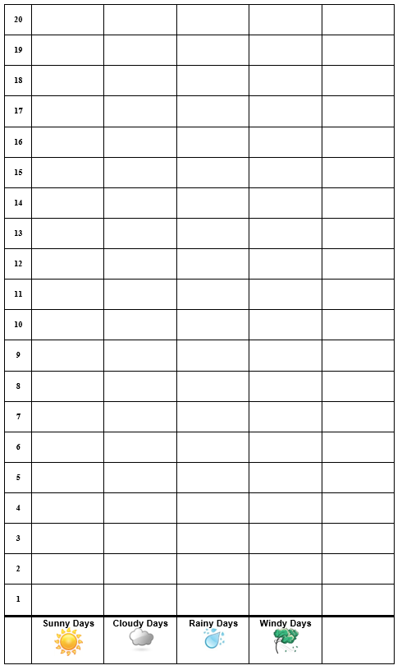
Monthly Weather Data
 | Month 1: _____________ | Month 2: ______________
Sunny Days | _____ days | ____ days
Cloudy Days | _____ days | ____ days
Rainy Days | _____ days | ____ days
Windy Days | _____ days | ____ days
Hot Days | _____ days | ____ days
Notes:
1 min
a. “In our first content deepening session, we talked about the kind of weather data students will collect over a period of several months before the Weather unit begins.”
b. “After recording their data on a class weather calendar for each month, students look for weather patterns.”
c. “To help them identify weather patterns, students count the number of sunny, cloudy, rainy, and windy days on their class weather calendars and record them on monthly observation charts like the one on the left side of the slide. They also count the total number of hot, warm, cool, and cold days every month. Then they use weather stickers to create picture or bar graphs for each month like the one on the right side of the slide.”
d. “These graphs make it easier for students to identify weather patterns and compare these patterns from month to month.”

Slide 38
Weather Patterns in January and July
The January weather pattern in Pomona is ______ [sunny, cloudy, rainy, windy, and/or hot]. Our evidence is ______.
The July weather pattern in Pomona is _______ [sunny, cloudy, rainy, windy, and/or hot]. Our evidence is ______.
Notes:
5 min
a. “When students compare weather patterns for different months, they use sentence starters like the ones on this slide to describe their findings.”
b. Turn and Talk: “Pair up again with your elbow partner and describe the weather in January and July using these sentence starters. Also include evidence to support your descriptions. The evidence would be stronger if we had actual weather data to use instead of relying on our memories and experiences.”
c. Whole group: Invite participants to share their descriptions and evidence with the group. Record key ideas on chart paper and work toward a group consensus about the weather patterns in January and July, as well as evidence that supports the weather pattern.

Slide 39
Key Ideas about Weather Patterns
Over time, we see patterns in the weather.
Weather can change from one month to the next.
Notes:
2 min
a. Read the key ideas about weather patterns on the slide.
b. “Do you think these ideas will be easy or challenging for your kindergartners to understand? Why or why not?”
c. Elicit a variety of responses and record possible challenges on chart paper.
Possible challenges for students:
Understanding what a weather pattern is
Understanding what a month is
Noticing weather changes if the weather doesn’t change dramatically
Interpreting monthly weather data (How will students be able to use data to draw conclusions?)

Slide 40
Investigating Temperature Patterns: Part 1
Photo courtesy of NOAA
Notes:
7 min
a. “Next, we’ll engage in activities that are designed to enhance your knowledge of weather patterns even though they don’t appear in the kindergarten lessons.”
b. “The map on this slide shows average temperatures across the United States from December 2012 through February 2013.”
c. Have participants pair up and locate handout 2.4 (Map of Average Temperatures in the United States, December–February) in their PD program binders.
d. Pairs: “What temperature patterns do you notice on this map? Discuss this question with an elbow partner and be ready to share your observations. Look at overall temperature patterns, as well as how patterns vary from north to south and east to west.”
e. Whole group: Invite participants to share the patterns they identified on the map. Record key ideas on chart paper.
f. Ask participants the following questions during the discussion:
What overall temperature patterns do you see?
How do temperatures vary from north to south?
How do temperatures vary from east to west?
What other patterns do you notice?
g. Encourage participants to agree or disagree, ask questions, or add on during the discussion. Work together to reach a consensus about the temperature patterns in January.

Slide 41
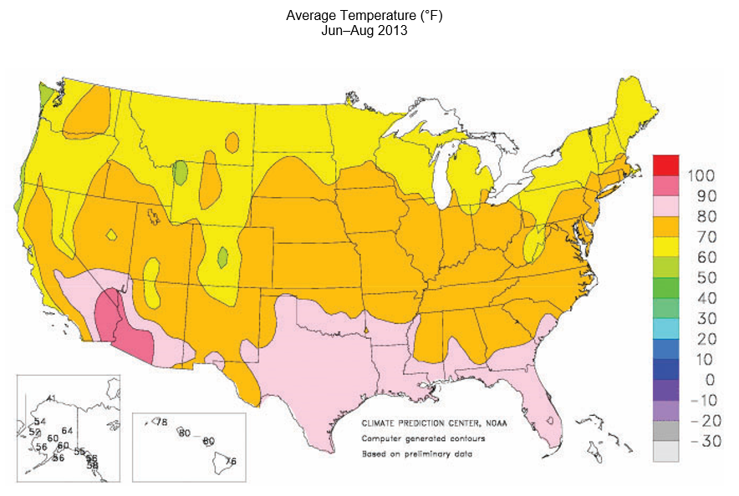
Investigating Temperature Patterns: Part 2
Source unknown
Notes:
7 min
a. “This map shows average temperatures across the United States from June 2013 through August 2013.”
b. Have participants locate handout 2.5 (Map of Average Temperatures in the United States, June–August) in their PD program binders.
c. Pairs: “What temperature patterns do you notice on this map? Discuss this question with an elbow partner and be ready to share your observations. Look at overall temperature patterns, as well as how patterns vary from north to south and east to west. Then compare this map with the first map and discuss similarities and differences.”
d. Whole group: Invite participants to share the patterns they identified on the map, as well as any similarities or differences they observed when they compared the two maps. Record key ideas on chart paper.
e. Ask participants the following questions during the discussion:
What overall temperature patterns do you see?
How do temperatures vary from north to south?
How do temperatures vary from east to west?
What other patterns do you notice?
What similarities and differences in weather patterns did you observe when you compared the two maps?
What do the maps tell us about weather patterns in Pomona in January and July?

Slide 42
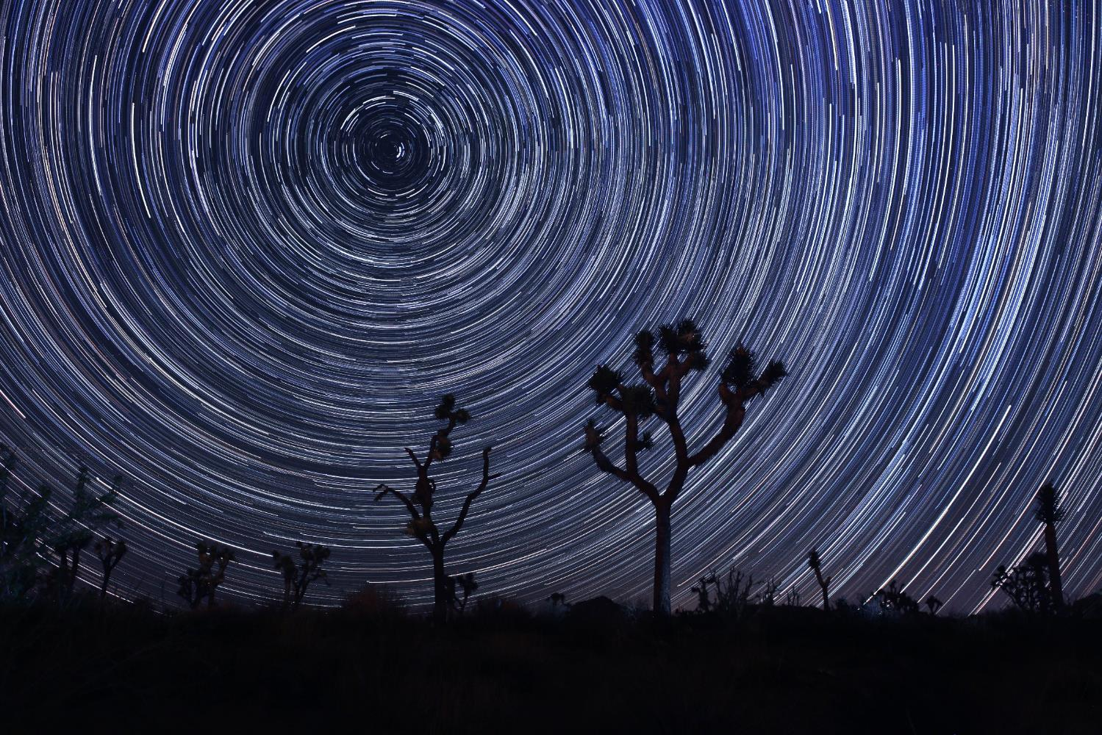
Investigating Patterns: Mojave Desert
What pattern do you notice?
What do you think caused this pattern?
Photo courtesy of Stock.Adobe.com
Notes:
6 min
a. “This time-lapse photograph shows the night sky in California’s Mojave Desert, just to the east of Los Angeles.”
b. Pairs: “Discuss the questions on the slide with your partner and be prepared to share your ideas with the group.”
c. Whole group: Elicit ideas and questions from participants about the pattern they observed in the photograph. Encourage participants to wonder and try to explain the possible cause. Summarize their ideas on chart paper before advancing to the next slide.

Slide 43
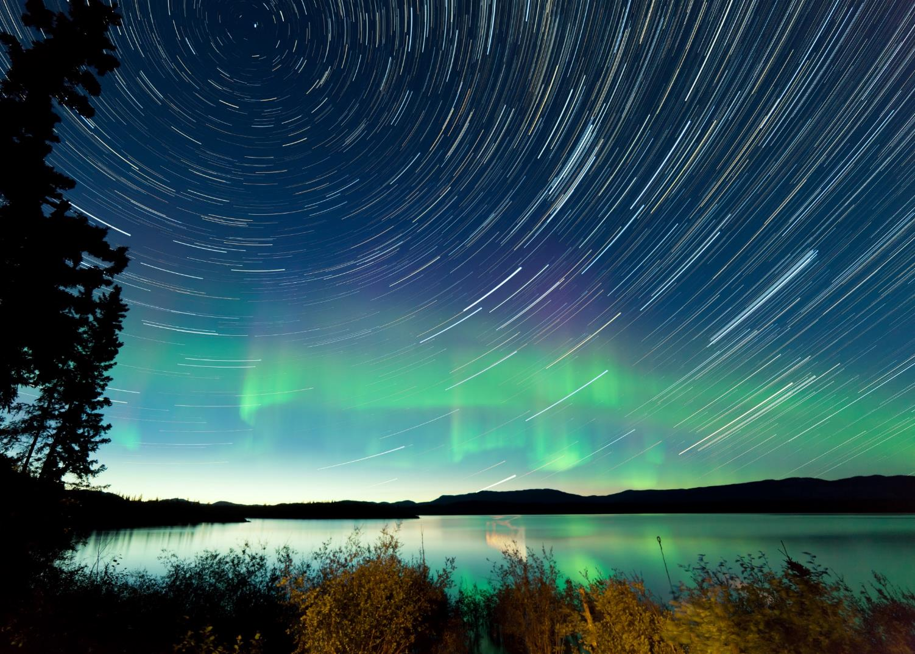
Investigating Patterns: Yukon, Canada
What pattern do you notice?
What do you think caused this pattern? Could it be the same as the last photo?
Photo courtesy of Stock.Adobe.com
Notes:
6 min
a. “This time-lapse photograph shows the night sky above a lake in Yukon, Canada.”
b. Pairs: “Discuss the questions on the slide with your partner. What are the similarities and differences between this photo and the previous one? Be prepared to share your ideas with the group.”
Note: As needed toggle back and forth between this slide and the previous slide so that participants can compare the photographs.
c. Whole group: Elicit ideas from participants about the pattern they observed in the photo and the possible cause. Ask participants about the similarities and differences they observed when they compared the two images. Summarize their ideas on chart paper before advancing to the next slide.

Slide 44
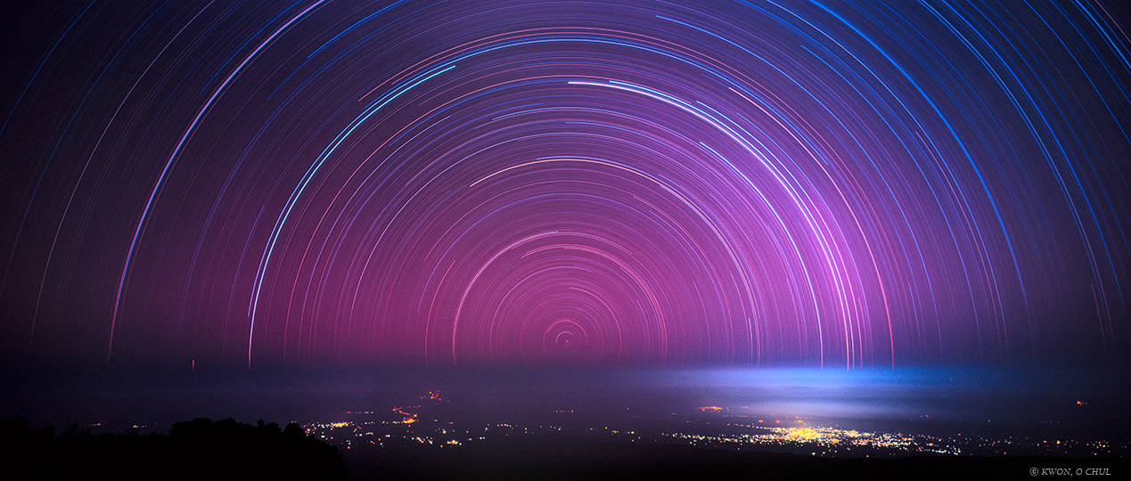
Investigating Patterns: Mt. Kilimanjaro
What pattern do you notice?
What do you think caused this pattern? Could it be the same as the other photos?
Photograph by Kwon O Chul
Notes:
6 min
a. “This time-lapse photograph shows the night sky above Mount Kilimanjaro, Tanzania.”
b. Pairs: “Discuss the questions on the slide with your partner. What are the similarities and differences between this photo and the previous two? Be prepared to share your ideas with the group.”
Note: As needed toggle back and forth between the three photos (slides 42–44) so that participants can compare them.
c. Whole group: Elicit ideas from participants about the pattern in the photo and the possible cause. Ask participants about the similarities and differences they observed when they compared the three images. Summarize their ideas on chart paper before advancing to the next slide.

Slide 45
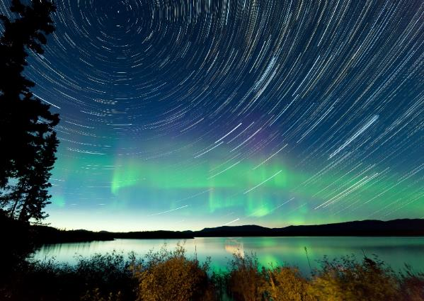
Explaining the Pattern: The North Star
Photo courtesy of Stock.Adobe.com
Photo courtesy of Stock.Adobe.com
Photograph by Kwon O Chul
Notes:
Less than 1 min
a. “The patterns we observed in these photos are circular star trails spiraling around the North Star, which seems to remain in a fixed position. These star trails are caused by Earth rotating on its axis, which is aligned with the North Star or Polaris. The North Star appears higher in the sky to someone farther from the equator, such as in Canada, and lower in the sky to someone at a latitude closer to the equator, such as Tanzania.”

Slide 46
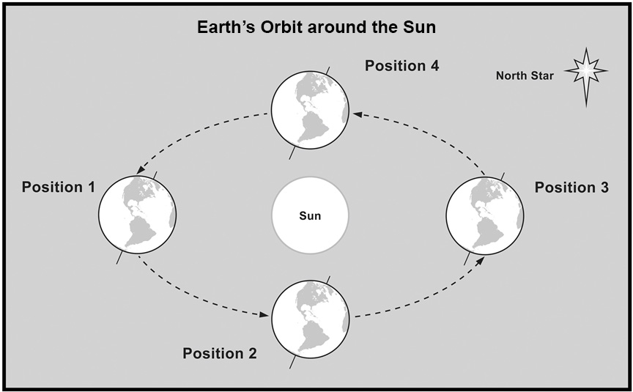
Earth’s Orbit around the Sun
Source unknown
Notes:
7 min
a. “This idealized figure shows Earth in four different positions along its orbit around the Sun. Note that Earth’s axis, which passes through the North and South Poles, always stays aligned with or points toward the North Star. This means that the Northern Hemisphere tilts toward the Sun part of the year and away from the Sun the other part of the year.”
b. “Look at all four positions of Earth’s orbit on the diagram. What season do you think it is in the United States in each position?”
c. Pairs: “Share your ideas and reasoning with an elbow partner, and be prepared to share with the group.”
d. Whole group: “So which season do you think it is in each of the four positions in Earth’s orbit around the Sun? Let’s hear your ideas and reasons.”
e. Record participants’ ideas on chart paper and make sure everyone understands that winter occurs in the United States when Earth is tilted away from the Sun in its orbit (position 3). Summer occurs when Earth is tilted toward the Sun (position 1), and spring and fall occur when Earth is tilting neither toward nor away from the Sun (positions 2 and 4).
Ideal response:
Position 1: summer
Position 2: fall
Position 3: winter
Position 4: spring

Slide 47
Position 1: Summer in the United States
Source unknown
Notes:
6 min
a. “Now let’s think about how the positions in Earth’s orbit around the Sun affect average temperatures in the United States. This map shows temperatures from June through August when Earth is in position 1 in its orbit around the Sun.”
b. Toggle back and forth between this slide and the next slide to show how average US temperatures change between position 1 (summer) and position 3 (winter).
c. Ask participants, “How do the temperature patterns on these maps relate to Earth’s orbit around the Sun?”
Ideal response:
In position 1, the Northern Hemisphere is tilting toward the Sun, which results in warmer temperatures (summer). In position 3, the Northern Hemisphere is tilting away from the Sun, which results in cooler temperatures (winter). added; please revise as needed.

Slide 48
Position 3: Winter in the United States
Photo courtesy of NOAA
Notes:
Less than 1 min
a. Toggle back and forth between this slide and the previous slide to show how average US temperatures change between position 1 (summer) and position 3 (winter).

Slide 49
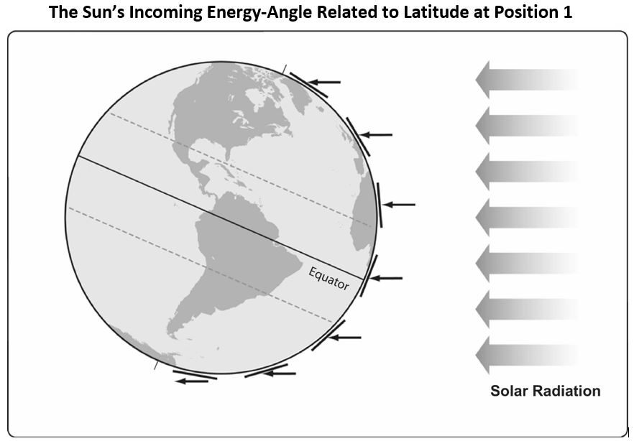
Earth’s Orbit and Seasons
Courtesy of BSCS
Notes:
7 min
a. Have participants pair up with an elbow partner and locate handout 2.6 (The Sun’s Incoming Energy—Angle Related to Latitude at Position 1) in their PD program binders.
b. “In our last content deepening session, we used a flashlight and a tray to simulate light energy from the Sun striking Earth’s surface at different angles based on latitude.”
c. “This diagram is similar to the diagram we used last time to illustrate the Sun’s incoming energy, but there’s one very important difference. In this version of the diagram, Earth is tilted on its axis 23.5 degrees. Another difference is that Earth is in orbital position 1, with the Northern
Hemisphere tilting toward the Sun. So the light energy is approaching Earth from the right side instead of the left side.”
d. Pairs: “Using this diagram, how would you explain the temperature patterns in the United States during the summer? Briefly discuss this question with your elbow partner and develop a concise explanation to share with the group.”
Note: For this activity, have pairs refer to handout 2.5 (Map of Average Temperatures in the United States, June–August).
e. Whole group: Invite participants to share their explanations with the group. Ask questions to clarify their thinking and work toward a consensus.

Slide 50
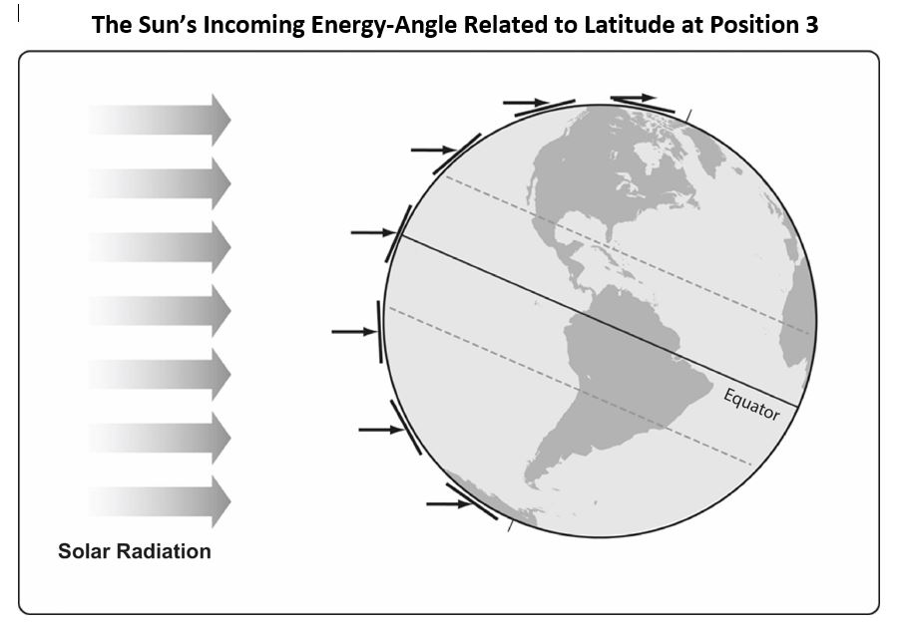
Earth’s Orbit and Seasons
Courtesy of BSCS
Notes:
5 min
a. Have participants locate handout 2.7 (The Sun’s Incoming Energy—Angle Related to Latitude at Position 3) in their PD program binders.
b. “This diagram shows Earth in orbital position 3, with the Northern Hemisphere tilting away from the Sun.”
c. Pairs: “Using this diagram, how would you explain the temperature patterns in the United States during the winter? Briefly discuss this question with your elbow partner and develop a concise explanation to share with the group.”
Note: For this activity, have pairs refer to handout 2.4 (Map of Average Temperatures in the United States, December–February).
d. Whole group: Invite participants to share their explanations with the group. Ask questions to clarify their thinking and work toward a consensus.

Slide 51
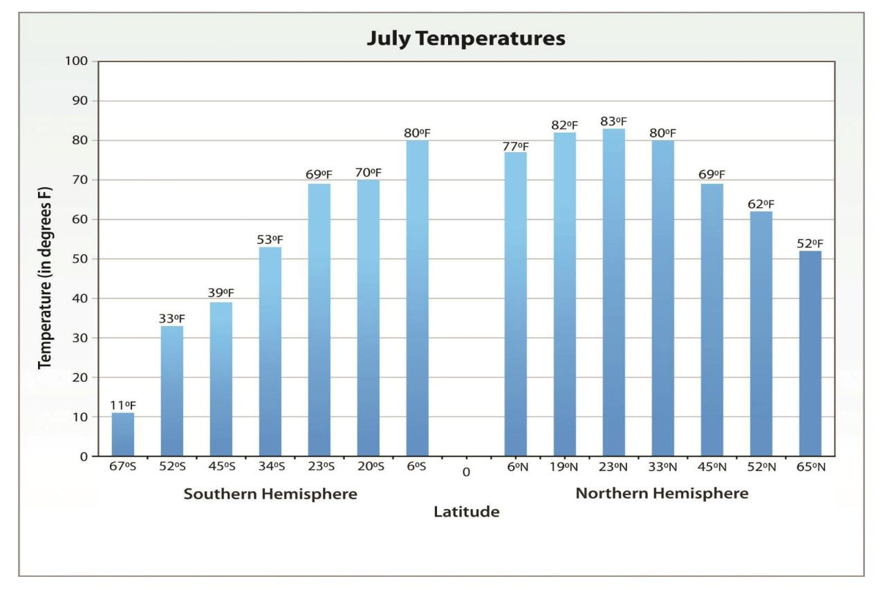
Average Worldwide Temperatures for July
Orbital Position 1
Courtesy of NOAA
Notes:
5 min
a. “This bar graph shows average temperatures around the world during the month of July. The x-axis shows different latitudes, with the equator at 0 degrees in the center. Latitude increases moving north toward the North Pole on the right side of the graph and south toward the South Pole on the left side. The y-axis shows the temperature in degrees Fahrenheit.”
b. Pairs: Ask pairs to compare this graph with handout 2.6 and explain how the temperature patterns on the graph relate to position 1 of Earth’s orbit.
c. Whole group: Invite participants to share their explanations with the group. Ask questions to clarify their thinking and work toward a consensus.

Slide 52
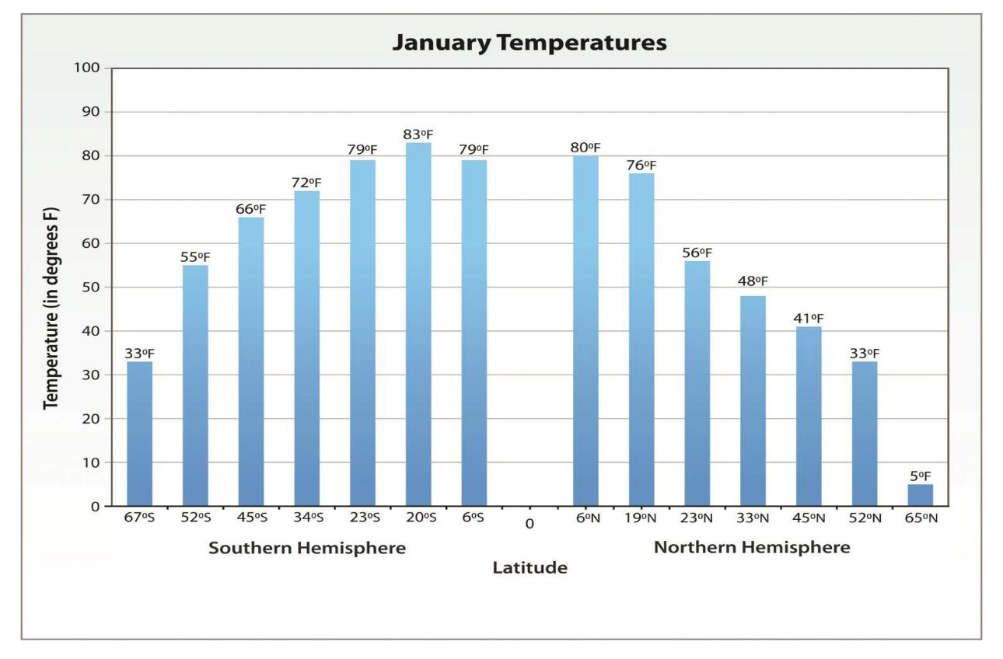
Average Worldwide Temperatures for January
Orbital Position 3
Courtesy of NOAA
Notes:
5 min
a. “This bar graph shows average temperatures for different latitudes around the world during the month of January.”
b. Toggle back and forth between this slide and the previous slide to compare the average temperatures in January and July.
c. Pairs: Ask pairs to compare this graph with handout 2.7 and explain how the temperature patterns on the graph relate to position 3 of Earth’s orbit.
d. Whole group: Invite participants to share their explanations with the group. Ask questions to clarify their thinking and work toward a consensus.

Slide 53
Average Annual Global Temperatures
Courtesy of Robert A. Rohde/ Wikimedia Commons
Notes:
3 min
a. “In our last session, we identified patterns on this map of average annual global temperatures. We observed that temperatures are generally warmer near the equator and cooler moving north and south toward the poles.”
b. “How would you explain the temperature patterns on this map now, based on what we’ve learned about Earth’s orbital positions in relationship to the Sun?”
c. Elicit a variety of ideas from participants and reach a group consensus that this map represents annual average temperatures in all positions of Earth’s orbit around the Sun.

Slide 54
Reflect: Content Deepening Focus Question 1
What do we notice about our weather from month to month?
Notes:
5 min
a. Review the focus question on the slide.
b. Individuals: Have participants answer the question in their science notebooks.
c. Whole group: Invite a few participants to share their answers, using ideas and evidence from the investigations they just completed.
d. As participants share their answers, write down key ideas on chart paper.

Slide 55
Weather and Seasons
Lesson 3
Photo courtesy of Pixabay.com
Photo courtesy of pixabay.com
Notes:
Less than 1 min
a. “Next, we’ll explore key science ideas from lesson 3 of the Weather and Seasons unit.”

Slide 56
Content Deepening: Focus Question 2
What do we notice about weather patterns from morning to afternoon?
Notes:
Less than 1 min
a. Read the focus question on the slide.
b. Have participants copy this question into their science notebooks and leave space to write a response.

Slide 57
Pomona’s Weather—Morning to Night
Think about what the weather in Pomona is typically like throughout the day.
Then discuss these questions with an elbow partner:
How does the weather in Pomona change from morning to afternoon?
How does the weather change from afternoon to night?
What do you think causes these variations?
Notes:
3 min
a. Read the questions on the slide.
b. Pairs: “Discuss these questions with an elbow partner and work together to develop concise answers. Think about similarities and differences in the weather from morning to afternoon and from afternoon to night. Be prepared to share your ideas and reasoning with the group.”

Slide 58
Pomona’s Weather—Morning to Night
Similarities and Differences
Morning | Afternoon | Night
Notes:
6 min
a. Create a three-column table on chart paper like the one on the slide.
b. Invite participants to share their answers to the questions from the previous slide:
How does the weather in Pomona change from morning to afternoon?
How does the weather change from afternoon to night?
What do you think causes these variations?
c. Record key ideas on the table and note possible causes. Elicit differing points of view and ask probe and challenge questions to clarify participants’ thinking.

Slide 59
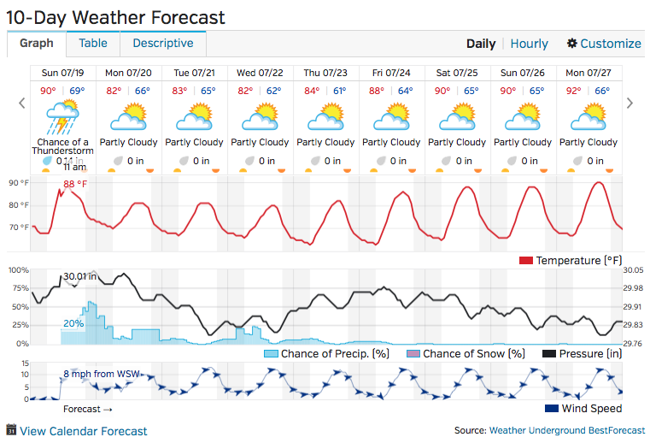
Summer Weather Forecast for Pomona
Pomona, CA, 11:00 AM PDT, July 19, 2015, Lincoln Park Weather Station
Notes:
6 min
a. “This slide shows a weather forecast for Pomona over a 10-day period in July.”
b. Point out that this forecast is for a specific weather station (Lincoln Park) that records weather data every day all day long. This data is used to make predictions about how the weather will change in coming days.
c. Also highlight the temperature, precipitation, and wind data that shows predicted changes throughout the day.
d. Pairs: “What patterns can you identify in this forecast that show how the weather is expected to change from morning to afternoon and from afternoon to night each day? Be prepared to support your claims with evidence from the weather chart.”
e. Whole group: Invite participants to share the patterns and evidence they identified on the chart. Encourage them to agree or disagree with one another’s claims and add ideas and evidence to the discussion. Work toward a group consensus and record the patterns on chart paper.

Slide 60
Daily Temperature Chart
 | Monday | Tuesday | Wednesday | Thursday | Friday
Morning Temperatures
What patterns do you predict your students will notice in the morning temperatures?
Notes:
3 min
a. “Students will use a chart like the one on this slide to record the morning temperatures they measure outside each day with a thermometer. Then they’ll use the chart to help them identify patterns.”
b. “What patterns do you predict your students will notice in the morning temperatures? Will morning temperatures in July be hot, warm, cool, or cold?”
c. Ask participants to list some temperature patterns they think their students will notice. Record their ideas on chart paper.

Slide 61
Daily Temperature Chart
 | Monday | Tuesday | Wednesday | Thursday | Friday
Morning Temperatures
Afternoon Temperatures
What patterns do you predict your students will notice in the afternoon temperatures?
How do you predict afternoon temperatures will compare with morning temperatures?
Sentence starter: I predict that afternoon temperatures will be [cooler than/the same as/hotter than] morning temperatures.
Notes:
3 min
a. “Students will also record afternoon temperatures on this chart and use the data to help them identify patterns. Then they’ll compare morning and afternoon data to identify patterns in how temperatures change throughout the day.”
b. “What patterns do you predict your students will notice in the afternoon temperatures? Will afternoon temperatures in July be hot, warm, cool, or cold? How do you predict afternoon temperatures will compare with morning temperatures?”
c. Ask participants to list some temperature patterns they think their students will notice in the afternoon temperatures. Record their ideas on chart paper. Then invite one or two participants to use the sentence starter on the slide to predict how afternoon and morning temperatures will differ.
d. Ask, “What will you do if the temperature data don’t reveal the expected pattern?”

Slide 62
Pomona Temperature Pattern: Morning to Afternoon
What is the temperature pattern from morning to afternoon in Pomona during the month of July?
Sentence starter:
The temperature pattern in Pomona during July [gets warmer/stays about the same/gets cooler] from morning to afternoon. Our evidence is ___________.
Notes:
3 min
a. Have participants look at the weather patterns they identified earlier on the July weather forecast table for Pomona. These patterns should have been recorded on chart paper, but you may also want to toggle back and forth between this slide and the forecast table on slide 59.
b. “What is the temperature pattern from morning to afternoon in Pomona during the month of July?”
c. Ask participants to use the sentence starter on the slide to describe the temperature patterns they identified on the weather-forecast table for Pomona (slide 59) and use evidence from the table to support their claims.

Slide 63
Reflect: Content Deepening Focus Question 2
What do we notice about weather patterns from morning to afternoon?
Notes:
5 min
a. Review the focus question on the slide.
b. Individuals: Have participants answer the question in their science notebooks.
c. Whole group: Invite a few participants to share their answers, using ideas and evidence from the investigations they just completed.
d. As participants share their answers, write down key ideas on chart paper.

Slide 64
Key Science Ideas
We can observe weather patterns over time.
Weather patterns can change from month to month and from morning to afternoon.
Notes:
Less than 1 min
a. Read the key science ideas on the slide.

Slide 65
Summary: Today’s Focus Questions
What progress have we made in addressing today’s focus questions?
How can lesson analysis help us better understand how elicit, probe, and challenge questions can reveal and challenge student thinking?
What do we notice about our weather from month to month?
What do we notice about weather patterns from morning to afternoon?
Notes:
8 min
a. Divide participants into three groups. Have Group 1 come up with some conclusions/key ideas related to focus question 1. Have Group 2 come up with conclusions/key ideas for focus question 2, and have Group 3 do the same thing for focus question 3.
b. Give each group 2 minutes to come up with ideas and conclusions.
c. Allow a 2-minute share-out for each group.

Slide 66
Homework
For tomorrow, read the STeLLA strategies booklet and complete the Z-fold summary chart for these two Student Thinking Lens strategies:
Strategy 4: Engage students in analyzing and interpreting data and observations.
Strategy 5: Engage students in constructing explanations and arguments.
Don’t forget about the lesson-plan reading-and-reporting assignment due on day 4.
Notes:
1 min
a. Forecast that tomorrow you’ll tackle two new, closely interconnected Student Thinking Lens strategies.
b. Have participants copy the homework assignment into their notebooks.
c. Remind participants about their homework for Friday (becoming experts on the lesson plan assigned to them).

Slide 67
Reflections on Today’s Session
Complete the Daily Reflections sheet (handout 2.8 in PD program binder).
What value do you see in analyzing student thinking and practicing questions that elicit, probe, and challenge student thinking? What concerns do you have about enacting these practices?
Did you identify any science ideas that you are unclear about? If so, what helped you identify this uncertainty?
What questions do you have about the purposes and goals of the RESPeCT PD program?
Which norms are we successfully implementing? Which norms need more work?
Notes:
6 min
a. Make sure participants have at least 5 minutes to think about the questions on the reflections sheet (handout 2.8 in the PD program binder) and write down their reflections.

