Slide 1
RESPeCT PD pROGRAM
Day 6
RESPeCT Summer Institute
Notes:
5 min
a. Take care of any housekeeping issues.

Slide 2
Agenda for Day 6
Day-5 reflections
Review: science content storyline
Today’s focus questions
Lesson analysis: STeLLA strategies B, I, and 7
Content deepening: plants and animals
Lunch
Content deepening (continued)
Lesson analysis: SCSL strategy C
Summary, homework, and reflections
Notes:
5 min
a. Go over the agenda for the day.

Slide 3
Trends in Reflections
Lesson Analysis | Science Content Learning
Notes:
7 min
a. Give participants time to review your feedback on their reflections from day 5 and offer reactions, comments, or follow-up questions.

Slide 4
Review: Science Content Storyline
In your notebooks, jot down …
things you remember from yesterday’s session,
ideas that seem important to you, and
question you have.
Be prepared to share one idea and question with the group.
3
2
1
Notes:
10 min
a. Point out the three tasks on the slide. Allow 4–5 minutes for participants to write their responses in their science notebooks.
b. Have each participant share one idea about the science content storyline that she or he thinks is really important.
c. Then ask participants to share their questions. If you can answer them quickly, go ahead and do so. If a question needs a more detailed response, write it down and schedule a time to address it.

Slide 5
Today’s Focus Questions
How can we begin and end a lesson to help students develop a coherent science content storyline?
How can selecting appropriate science activities help students develop a coherent science content storyline?
What do plants need from their environment to live and grow? Why do they need these things?
Notes:
2 min
a. Introduce today’s focus questions.

Slide 6
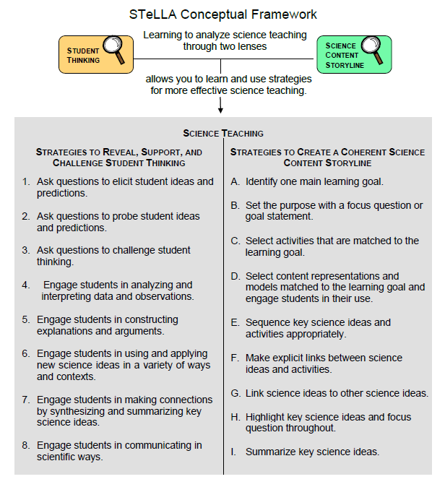
Notes:
1 min
a. “Today we’ll be looking at four new STeLLA strategies. Three of them are Science Content Storyline Lens strategies, and one is a Student Thinking Lens strategy. Throughout the session, think about how these strategies are different from one another and how they are closely linked to each other.”

Slide 7
Lesson Analysis: Focus Question 1
How can we begin and end a lesson to help students develop a coherent science content storyline?
Notes:
Less than 1 min
a. “Now let’s dig into our first focus question.”

Slide 8
Strategies B, I, and 7: Purposes and Key Features
Group 1: What are the purpose and key features of strategy B?
Why is a focus question or goal statement important for science content storyline coherence?
Group 2: What are the purpose and key features of strategy I?
Why is summarizing key science ideas important for science content storyline coherence?
Group 3: What are the purpose and key features of strategy 7?
How does strategy 7 compare with strategy I?
All groups: Make sure to cite ideas from the STeLLA strategies booklet in your answers.
Notes:
25 min
a. Pairs (3 min): Direct participants to retrieve their Z-fold summary charts and share with a partner what they learned from their homework assignment about STeLLA strategies B, I, and 7.
b. Small groups (12 min): Divide participants into three small groups and have them make charts that capture the purposes and key features of the three strategies.
Note: Challenge participants to imagine themselves in a Teacher Leader role. Ask them, “How would you explain these strategies to the teachers you’re leading?”
c. Whole group (10 min): Have small groups share their charts in a whole-group share-out.
Key ideas:
Make sure participants understand that a focus question is designed to do more than just get students interested in the lesson. It gets them thinking about a phenomenon or something else they’ve never thought about before. It also reveals important things about the knowledge and experiences they’re bringing to the lesson, it conceptually situates the learning, and it’s referred to throughout the lesson.
STeLLA strategies B, I, and 7 are like bookends that mark the beginning and end of a lesson. The science ideas used in the summary should match the focus question from the beginning of the lesson, and both the focus question and the summary should match the lesson’s main learning goal.

Slide 9
Discussion Questions: Strategy B
What is the difference between focus questions and goal statements?
Which do you think would be more useful in engaging student interest and making their thinking visible—focus questions or goal statements?
Notes:
7 min
a. Whole group: Discuss the questions on the slide as a group.
Key ideas:
A focus question is designed to be answered using the lesson’s main learning goal and supporting science ideas. A goal statement describes the main science idea to be learned.
Focus questions are always used in RESPeCT lesson plans because they’re useful in engaging student interest, making their thinking visible, and eliciting initial ideas at the beginning of a lesson. When posed at the end of a lesson, focus questions challenge students to use new ideas developed during the lesson.

Slide 10
Discussion Questions: Strategies I and 7
What are various ways a lesson or unit can be synthesized and/or summarized?
How are strategies I and 7 similar and different?
SCSL strategy I: Summarize key science ideas.
STL strategy 7: Engage students in making connections by synthesizing and summarizing key science ideas.
Notes:
7 min
a. Whole group: Discuss the first question on the slide. Participants can refer to the information on strategy 7 in the STeLLA strategies booklet to identify a variety of ways in which key science ideas in a lesson can be synthesized.
b. Emphasize: “Toward the end of a unit, an entire lesson may be devoted to strategy 7, which engages students in synthesizing and summarizing science ideas across several lessons.”
c. Discuss the second question on the slide.
Key ideas:
In strategy I, the teacher creates a summary of key science ideas in the lesson. Strategy 7, however, engages students in synthesizing and summarizing key science ideas in the lesson. When students themselves perform this work, it makes their thinking visible, engages them in active sensemaking, and reveals to the teacher any misunderstandings or gaps in knowledge. Using both strategies brings coherence to a science lesson and is a powerful way to end it.
In strategy 7, summarizing involves making connections between key science ideas, which helps students synthesize the main learning goal or big idea in a lesson.
Summaries should focus on key science ideas, not activities; that is, focusing on “what we learned” versus “what we did.”
For a variety of reasons, a lesson sometimes ends before the main learning goal has been fully developed. However, summarizing work should still take place. For example, the teacher might say, “Our focus question today was How do plants get their food? What have we found out so far?” After students respond, the teacher could reply, “Yes, so far we’ve discovered that water and soil aren’t food for plants. But we still haven’t figured out what is food for plants. We’ll continue working on this question next time.”

Slide 11
Video-based Lesson Analysis
Next we’ll analyze two video clips from the beginning and end of a lesson on plants and animals.
Notes:
Less than 1 min
a. Transition: This slide marks the transition to video-based lesson analysis.

Slide 12
Lesson Analysis: Strategy B
In Analysis Guides B and I (handout 6.1), review the four criteria for strategy B: Setting the purpose.
Read the lesson context at the top of the video transcript (handout 6.2).
Watch the first video clip, keeping in mind the criteria for strategy B.
Analyze the transcript using the analysis guide.
How well does the beginning of this lesson match the criteria for strategy B?
Share and compare your analyses.
Link to video clip 1: 6.1_mspcp_kinder.pa.tanguma_L5_c1
Notes:
20 min
a. Have participants locate Analysis Guides B and I (handout 6.1 in PD program binder) and spend 1 or 2 minutes reading the criteria for strategy B: Setting the purpose.
b. Ask: “Do you have any questions about these criteria?”
c. Emphasize: “Keep the criteria for strategy B in mind as you watch the first clip from the beginning of a lesson about plants and animals.”
d. Individuals: Give participants a couple of minutes to read and think about the lesson context at the top of the video transcript (handout 6.2).
e. Show the video clip.
f. Whole group: “How well does the beginning of this lesson match the criteria for strategy B?
Note: During the discussion, be on the lookout for opportunities to clarify science-content ideas.
Sample analysis from Analysis Guide B:
Implied main learning goal: The focus question Do plants need food? suggests that the main learning goal will be “Plants need food to live and grow.” However, in the introductory discussion, the teacher asks “How do [plants] get food?” (video segment 00:14). This assumes that students already know plants need food. But later (segments 00:55 and 01:34), the teacher asks students, “Do you think plants need food?” However, the discussion that follows focuses predominantly on what is food for plants and where or how they get their food rather than on whether they need food. So the main learning goal seems to go beyond the focus question to address how plants get their food. Perhaps the part of the focus question that asks students to explain their thinking is intended to get them to consider how plants get their food, not just whether they need food.
Uses everyday language: The focus question uses everyday language that kindergartners can understand.
Scientifically accurate: Food is a challenging word because it has a different meaning in science than it does in everyday life. It’s good that the focus question uses this word, since it not only reflects everyday language but is also scientifically appropriate. Hopefully, the lesson will clarify how scientists define food.
Goal statement: There is no goal statement.
Content deepening opportunities:
At segments, 00:25–00:30 and 02:35–02:36, students suggest that seeds may be food for plants. This is partly true. Seeds do provide food for plants, but only at the very beginning of their lives. The adult plant stores some of the food it makes in the seeds so that the young seedlings have a food source as they begin to grow. Once the seedlings grow leaves, they begin to make their own food.
At segment 01:48, a student explains that dirt is food for plants because it makes them grow. This idea is incorrect. It’s true that dirt contains some minerals that support plant growth and health, but minerals don’t supply energy plants need to live and grow. Plants get their energy exclusively from the food they make during photosynthesis.
At segment 02:04–02:31, a student states that water is food for plants. While it’s true that water is necessary for plants to make their own food, it doesn’t provide energy-supplying food that plants need to live and grow.

Slide 13
Lesson Analysis: Strategy I
In Analysis Guides B and I (handout 6.1), review the six criteria for strategy I: Summarizing key science ideas.
Review the lesson context at the top of the video transcript (handout 6.3).
Watch the second video clip, keeping in mind the criteria for strategy I.
Analyze the transcript using the analysis guide.
How well does the end of this lesson match the criteria for strategy I?
Share and compare your analyses.
Link to video clip 2: 6.2_mspcp_kinder.pa.tanguma_L5_c2
Notes:
20 min
a. Allow participants 1 or 2 minutes to read the six criteria in the analysis guide for strategy I: Summarizing key science ideas.
b. Ask: “Do you have any questions about these criteria?”
c. Emphasize: “Keep the criteria for strategy I in mind as you watch the next clip from the end of the same P&A lesson.”
d. Individuals: Give participants a couple of minutes to review the lesson context at the top of the video transcript (handout 6.3).
e. Show the video clip.
f. Whole group: “How well does the end of this lesson match the criteria for strategy I? How well does the summary statement match the beginning of the lesson?
Note: During the discussion, be on the lookout for opportunities to clarify science-content ideas.
Sample analysis from Analysis Guide I:
Summary statement/activity: The teacher gives a summary statement at video segment 01:34–01:44. In addition, students are engaged in summarizing key ideas when they explain how the grass and the tree in the picnic picture are getting their food (segment 00:27–01:09).
Conceptual understanding: The summary focuses on the big idea (concept) that plants and animals get their food in fundamentally different ways. There isn’t a focus on memorizing details and facts.
Matched to the MLG and FQ: The science ideas in the teacher’s summary statement don’t directly address the focus question, Do plants need food? but focus instead on how plants make food using sunlight, air, and water. The ideas students summarize also focus on how plants get their food rather than whether plants need food. A better focus question might be, How do plants get their food? or What is food for plants?
Scientifically accurate: The summary statement is scientifically accurate and emphasizes that plants make food “inside of themselves.” The summary could have been improved if the teacher had emphasized that plants make food out of water, air, and sunlight and that none of these substances are food for plants.
Sensemaking: The teacher engaged students in sensemaking with a Turn and Talk about what the tree and the grass in the picnic picture were doing to get food. Some probe questions might have clarified the extent of students’ understandings. For example, did the student at segment 00:45 understand that Sun, water, and air aren’t the plants’ food but are used to make their food? The teacher also could have challenged students to critique her summary (“Did I leave anything out?”), or she could have asked them to create their own summary statements.
Improvements: The summary statement could be improved by getting more students involved in sensemaking and by highlighting the differences between how plants and animals get their food. For example, the teacher could have asked students to imagine making food inside their bodies using water, air, and sunlight.
Content deepening opportunity:
It’s important for students to understand that that plants and people “make” food in completely different ways. Plants don’t make their own food the way we make dinner! Plants take nonenergy-supplying materials into their bodies and, through complex internal chemical reactions, turn them into energy-supplying food. Humans take matter that already has energy-supplying potential and cook it, thereby rearranging the molecules by heating the food matter. As humans, we can’t make energy-supplying food inside our own bodies! We must find food in our environment that already has energy stored in it, and then we must prepare (cook) and eat it to get the energy we need.

Slide 14
The P&A Lesson Plans: Reading and Analysis
Examine the main learning goal, the lesson focus question, and the lesson summary for your assigned P&A lesson plan.
Answer these questions in your notebooks, keeping in mind the analysis-guide criteria for strategies B and I:
What do you notice?
What do you wonder about?
Notes:
10 min
Note: This slide can be abridged or skipped if time is running short.
a. Read the instructions on the slide and assign a two-part lesson plan (parts A and B) to each participant.
Note: Some of the P&A lessons have more than two parts (lessons 1, 3, and 5), so you’ll need to decide how you want to divide them up among participants.
b. Ask participants if they have any questions about the assignment.
c. Individual reading-and-analysis time (5 min): “Answers the slide questions in your notebooks, keeping in mind the analysis-guide criteria.”
d. Whole-group discussion (5 min): Briefly discuss participants’ observations and questions for their assigned lesson plans.
Note: Participants should see a close match between the main learning goal, the lesson focus question, and the summary. However, also welcome critiques and suggestions for improvement. Just make sure critiques are based on good understandings of the strategies involved.

Slide 15
Plants and Animals
SCIENCE CONTENT DEEPENING Kindergarten
Notes:
Less than 1 min
a. Transition: This slide marks the transition to the content deepening work.

Slide 16
Content Deepening Focus Question
What do plants need from their environment to live and grow? Why do they need these things?
Notes:
Less than 1 min
a. Read the focus question on the slide.
b. Ask participants to write the questions in their science notebooks and leave space to write a response later.
c. Note that in the Plants and Animals lesson series, students explore what plants need from their environment, but not why they need these things.

Slide 17
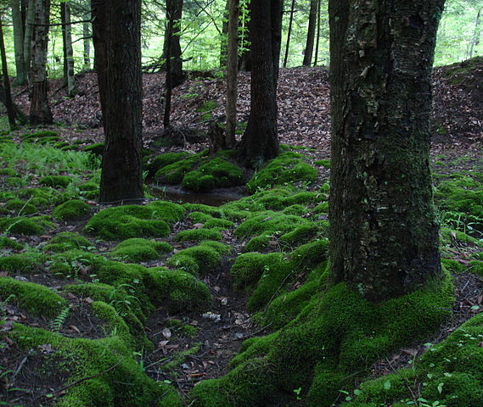
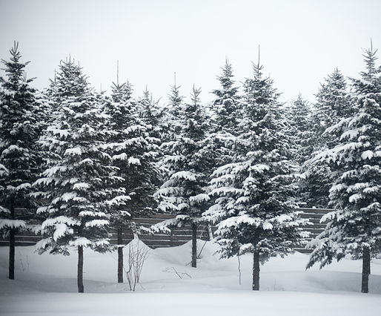
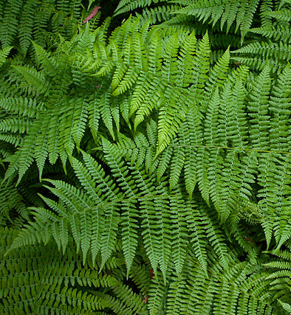
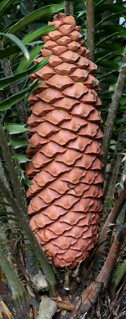
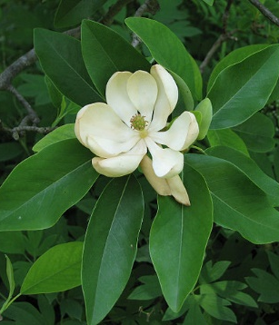
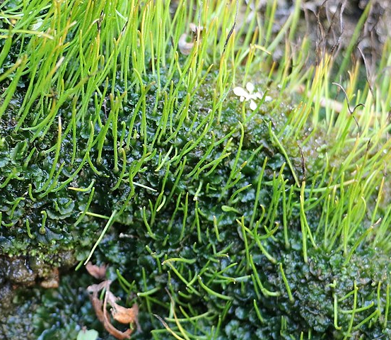
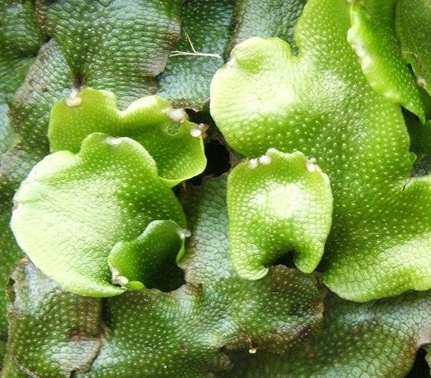
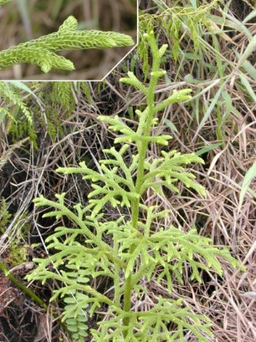
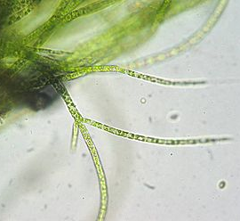
What Do Plants Need to Live and Grow?
Gymnosperms Seed producing plants
Mosses
Conifers
Ferns
Photo courtesy of IvoShandor/ Wikimedia Commons
Photo courtesy of Wikimedia Commons
Photo courtesy of Sanjay ach/
Wikimedia Commons
Photograph by Muhammad Mahdi Karim / Wikimedia Commons
Flowering
plants
Hornworts
Liverworts
Clubmosses
Green Algae
Photograph by Derek Ramsey/ Wikimedia Commons
Photo courtesy of Peter Woodard/
Wikimedia Commons
Photo courtesy of Lairich Rig/
Wikimedia Commons
Photo courtesy of Eric Guinther/ Wikimedia Commons
Photo courtesy of Kristian Peters/ Wikimedia Commons
Notes:
8 min
a. Individuals and pairs: “Make a list in your science notebooks of what you think plants need to live and grow. Then share your ideas with an elbow partner.”
b. Whole-group share-out: “So what do you think plants need from their environment to live and grow? Let’s hear your ideas.”
c. As participants share their ideas, record them on chart paper. Accept all ideas at this point without correcting them. Ask probe questions to clarify participants’ thinking, but don’t label ideas as right or wrong.
Possible responses:
Air (carbon dioxide)
Water
Food
Soil
Light
Nutrients/minerals from the soil
Fertilizer/plant food
The right temperature and/or conditions

Slide 18
What Do Plants Need to Live and Grow?
Do plants need food to live and grow?
How would you define food?
How do you think your students would define food?
Notes:
6 min
a. “First, let’s think about whether plants need food to live and grow.”
b. Read the questions on the slide.
c. Individuals: Ask participants to answer the questions in their science notebooks.
d. Whole group: Invite participants to share their definitions with the group. Accept all ideas at this point. Ask probe questions to clarify participants’ thinking, but don’t correct their ideas or label them as right or wrong.

Slide 19
A Scientific Definition of Food
Food is matter (building materials) that contains energy living things can use to live and grow, to heal wounds, and to keep all their parts working.
Matter is made up of atoms and molecules.
The energy in food is stored (potential) energy or chemical energy in molecules.
Notes:
6 min
Note: Initially show only the definition at the top of the slide.
a. “Now let’s look at a scientific definition of food.”
b. Read the definition on the slide.
c. Ask participants, “How does this definition compare with the definitions you wrote? How is it similar or different?”
d. Draw participants’ attention to the highlighted words in the definition; then reveal the rest of the slide.
e. Emphasize that food is matter, but energy isn’t. Matter is made up of atoms and molecules. The energy in food is referred to as stored or potential energy because the energy is stored in molecules and has the potential of being released and used when the chemical bonds are broken. Potential energy is also called chemical energy.
f. Write this definition on chart paper and post it to the wall so that everyone can refer to it. Also have participants copy the definition into their science notebooks.

Slide 20
What Is Food for Plants?
My Ideas
Evidence
Notes:
10 min
a. “Next, we’ll think about the question, “What is food for plants?”
b. Have participants make a two-column chart in their notebooks like the one on the slide and write the title “What Is Food for Plants?” at the top.
c. Individuals (5 min): “In the first column on your chart, write down everything you can think of that might be food for plants. In the second column, write down any evidence you can think of to support your ideas. Your evidence can include facts or information from science resources, as well as your own observations and experiences. It’s OK if you aren’t able to provide evidence for all of your ideas.”
d. While participants are working on the task, create a three-column chart on chart paper titled “Our Ideas and Evidence.” Use the column headings “Our Ideas,” “Supporting Evidence,” and “Challenging Evidence.”
e. Whole group (5 min): Invite participants to share their ideas and evidence with the group. Accept all ideas and evidence at this point and record them on the group chart. Encourage participants to agree or disagree with one another’s ideas and add any evidence that supports or challenges the ideas. For example:
Idea: Water is food for plants.
Supporting evidence: If you don’t water plants, they die.
Challenging evidence: Water has no energy (Calories), so it doesn’t meet the scientific definition of food.
f. “Now let’s investigate some of these ideas and see if the evidence we find supports or challenges them.”
Note: Participants will likely list water, soil, air, and minerals/nutrients from the soil on their charts. If participants mention that plants make their own food by photosynthesis or that they’ve seen gardeners add manure, hair clippings, and coffee grounds to the soil, add these to the group chart as well.

Slide 21
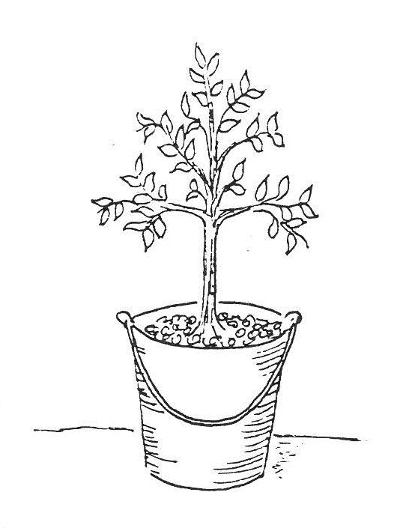
Is Soil Food for Plants?
To find out whether soil is food for plants, Dutch scientist Jan van Helmont grew a willow tree in a bucket of soil for five years. He weighed the tree and soil at the beginning and the end of the experiment.
What do you predict happened to the mass of the tree and the soil by the end of the experiment? Why?
Mass at the Beginning
Tree: 5 pounds
Soil: 200 pounds
Source unknown
Notes:
5 min
a. “First, we’ll investigate the idea that soil is food for plants.”
b. “In the mid-1600s, a Dutch scientist named Jan van Helmont designed an experiment to test the dominant theory that plants ate soil to live and grow. Van Helmont’s experiment involved planting a young willow tree in a bucket of soil and giving it only water. First, he weighed the soil and found that its mass was 200 pounds. Then he weighed the tree and found that its mass was 5 pounds. Five years later, he weighed the tree and the soil again. What do you predict happened to the mass of the tree and the soil by the end of the experiment? Did the mass increase, decrease, or stay about the same? Why do you think so?”
c. Individuals: “Write your predictions and reasoning in your science notebooks and be prepared to share your ideas with the group.”
d. Whole group: Invite participants to share their ideas with the group. Record their predictions and reasoning on chart paper. Ask probe questions to clarify participants’ thinking.

Slide 22
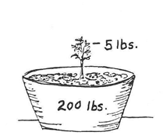
Is Soil Food for Plants?
This diagram shows the results of Van Helmont’s experiment.
Tree: 169 pounds (77 kg)
The tree gained 164 pounds.
Soil: 200.18 pounds (90.8 kg)
The soil lost about 2 ounces.
Tree: 5 pounds (2.3 kg)
Soil: 200.4 pounds (90.9 kg)
Source unknown
Source unknown
Mass at the Beginning
Mass at the End (5 years later)
What can you conclude from these results?
Notes:
10 min
a. “This slide shows the results of Van Helmont’s experiment. In the five-year period when the tree only received water, its mass increased from 5 pounds to 169 pounds, an increase of 164 pounds. But the soil only lost around 2 ounces.”
b. Think-Pair-Share: “Study this diagram and think about what you can conclude from these results. Then share your ideas with an elbow partner and come to a consensus about the conclusion you can draw from the results. Develop a claim stating your conclusion and support your claim with evidence. Be prepared to share your claims and evidence with the group.”
Note: Challenge participants to be precise in their claims. Emphasize that their claims and evidence should be limited to willow trees.
c. Whole group: Invite pairs to share their claims and evidence with the group. Encourage participants to agree or disagree with one another’s ideas and add any supporting or challenging evidence. Record claims and evidence on chart paper and work together to reach a consensus.
Ideal response:
Claim: Soil could not have been food for the willow tree.
Evidence: The tree gained about 164 pounds, but the soil only lost a couple of ounces. Assuming conservation of matter, the additional mass of the tree didn’t come from the soil. It must have come from somewhere else.
d. “Van Helmont concluded that the willow tree grew by drinking water. Do you agree or disagree with his claim? Why?”
Ideal response:
Van Helmont’s experiment didn’t provide evidence that the willow tree used water as a source of food or that water caused the tree to grow. However, water is a logical variable to research, and it’s reasonable to hypothesize that water is food for plants.

Slide 23
Is Soil Food for Plants?
Does this photo provide any evidence to support or challenge the idea that soil is food for plants?
What claim can you make based on this evidence?
Photograph by Kirsty Lawson
Notes:
8 min
a. “The bean seed in this picture is growing in a glass filled with moist, wadded-up paper towels.”
b. Turn and Talk: “Study this photo; then discuss the questions on the slide with an elbow partner and work together to develop a claim based on this evidence. Be prepared to share your claim and evidence with the group.”
Note: Challenge participants to be precise in their claims. Emphasize that their claims and evidence should be limited to bean seeds.
c. Whole group: Ask a few pairs of participants to share their claims and evidence with the group. Record the claims and evidence on chart paper and encourage participants to agree or disagree, ask questions, or add evidence that supports or challenges the claims.
Ideal response:
Claim: Soil isn’t food for bean seeds.
Evidence: The bean seed is growing without soil, so the food it needs to grow must come from somewhere else.
A strong challenge: But the plant might eventually die without soil. Maybe it can use the food stored in the seed as it begins to grow, but when it gets bigger, it will need soil.
d. Ask participants, “Why do you think the plant can still grow in the absence of soil?” Elicit a variety of responses.
Possible response: “Maybe the plant can get everything it needs from the air, and it only needs soil for support and as a conduit for water. I’ve heard that plants that can grow hydroponically with their roots in water, not soil. Maybe different plants get food in different ways.”
e. Ask participants, “How do you think your kindergartners would interpret this experiment?”
f. “So our evidence shows that soil isn’t food for plants. Now let’s investigate some of our other ideas.”

Slide 24
What Is Food for Plants?
Is water food for plants?
Is carbon dioxide food for plants?
Is “plant food” or fertilizer food for plants?
Let’s find out!
Remember: Food is matter (building materials) that contains energy living things can use to live and grow, to heal wounds, and to keep all their parts working.
Notes:
2 min
Note: Hide the definition at the bottom of the slide.
a. “Next, we’ll investigate other possible sources of food for plants.”
b. Read the questions on the slide.
c. Ask participants, “What two things must food provide that living things can use to live and grow?”
Ideal response: Matter and energy.
d. Show the definition of food at the bottom of the slide and ask participants to read it aloud. Then emphasize the following ideas:
Food provides living things with both matter and energy.
Living things use food matter to grow bigger.
Living things need energy from food to power all of their functions, including digestion, breathing, growth, cell repair and maintenance, and movement.

Slide 25
Investigation: Food versus Not Food
Predict which items on the handout are food and which are not.
Material | Food | Not Food
Apple Juice
Cheez-It Crackers
Orange Juice
Bottled Water
Mints
Seltzer Water (Carbon-Dioxide Bubbles in Water)
Multivitamin
Plant Food (Fertilizer)
Sugar
Salt
Notes:
15 min
a. Direct participants to locate handout 6.9 (Food versus Not Food) in their PD program binders.
b. Individuals: Ask participants to indicate on their handouts which items they think are food and which aren’t.
c. Pairs: After participants finish marking their handouts, have them pair up with an elbow partner and discuss their predictions and reasoning.
d. “Now let’s find out whether our predictions are correct.”
e. Have participants locate handout 6.10 (Nutrition Labels) in their PD program binders. Then take a moment to orient participants to the labels.
f. Whole group: Discuss the information on the labels and what it indicates about the materials listed on the chart. Then compare the evidence from the nutrition labels with participants’ predictions. Ask participants to explain the reasons for their selections.
g. Work toward a consensus about which items on handout 6.9 are food and which aren’t. Record the group’s decisions on chart paper or mark a copy of the handout on a document reader.

Slide 26
Make a Claim!
Are water, carbon dioxide, and “plant food” or fertilizer food for plants?
Make a claim based on the evidence you’ve collected.
Notes:
7 min
a. Read the question on the slide.
b. Pairs: Ask participants to work with an elbow partner to develop a claim that answers the question and support the claim with evidence.
c. Whole group: Invite a few participants to share their claims and evidence with the group. Record key ideas on chart paper and ask questions to clarify participants’ thinking.
Ideal response:
The evidence shows that water, carbon dioxide (carbonated water), and “plant food” (fertilizer) are not food by the scientific definition. These materials don’t contain any energy (Calories) that living things can use to live and grow, so they can’t be food for plants. Plants must get the energy they need from a different source.

Slide 27
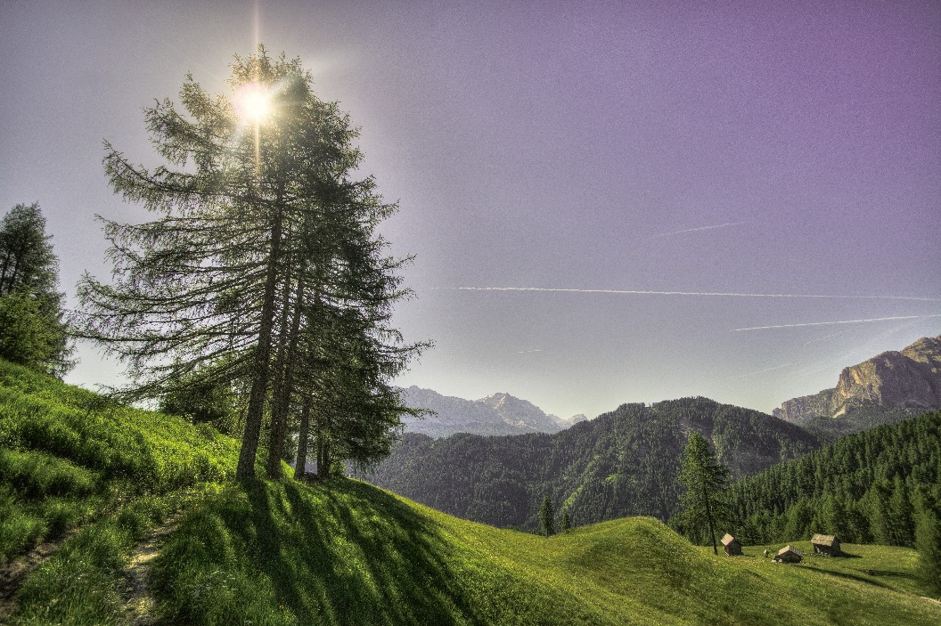
Where Do Plants Get Energy?
Where do you think plants get the energy they need to live and grow?
Do you think that sunlight is food for plants? Why or why not?
What arguments support or challenge this idea?
Photo courtesy of Pexels.com
Notes:
8 min
Note: Hide the sunlight photograph and the corresponding question.
a. “Based on the evidence we’ve collected, we know that soil, water, carbon dioxide, and plant food or fertilizer provide matter for plants, but they don’t provide the energy plants need to live and grow. So these materials can’t be food for plants by the scientific definition.”
b. “Where do you think plants get the energy they need to live and grow? Let’s hear your ideas.”
Note: Participants will likely say that plants get the energy they need from the Sun.
c. Reveal the next set of questions and the Sun photograph on the slide.
d. Individuals: “Is sunlight food for plants? Why or why not? Think about these questions for a moment and be prepared to share your ideas and reasoning with the group. What arguments can you think of that support or challenge this idea?”
e. Whole group: “So do you think that sunlight is food for plants? Let’s hear your ideas. Make sure to explain your reasoning, as well as any arguments that support or challenge this idea.”
Ideal responses:
Supporting arguments:
Plants die if they’re left in the dark. They need light to stay alive.
Plants need light to grow. Without light, they wither.
Sunlight is a form of energy, so it can provide plants with the energy they need to live and grow.
Challenging arguments:
Many healthy plants live and grow in the shade and inside where they don’t get sunlight.
Light might be helpful for plants, but it’s not food. We know that plants die without water, but the evidence shows that water isn’t food for plants. So maybe it’s the same with sunlight. Plants need it, but it’s not their food.

Slide 28
More about Sunlight
The Sun gives off energy that we can detect as either heat or light.
Energy has no mass, so we can’t weigh it.
Energy doesn’t take up any space, so we can’t measure it in terms of width, length, or diameter.
Since energy has no mass and doesn’t take up any space, it is not matter.
Notes:
3 min
a. Read the key science ideas on the slide.
b. Ask participants, “Does this information give you any new ideas to consider in our debate about whether sunlight is food for plants?”
c. “It’s strange to think about something we can see that doesn’t have mass or take up space, isn’t it? So if energy isn’t matter, can it be food for plants? Think about the scientific definition of food.”
d. Based on this information, participants should quickly conclude that sunlight by itself isn’t food for plants because it doesn’t provide any matter that living things can use to grow and develop.

Slide 29
What Do Plants Need to Live and Grow?
Today’s focus questions: What do plants need from their environment to live and grow? Why do they need these things?
We know that plants need water, air (carbon dioxide), and sunlight to live and grow.
We also know that plants need food to provide them with the matter and energy they need to live and grow. But what is food for plants?
Is carbon dioxide food for plants?
Is water food for plants?
Is soil or minerals in the soil (plant food or fertilizer) food for plants?
Is sunlight food for plants?
Notes:
3 min
Note: Initially show only the focus question on the slide.
a. “Let’s take stock of what we know so far that can help us answer today’s focus questions.”
b. Review the focus questions on the slide. Then reveal and read each of the following bullet points one at a time.
c. Then ask the question, “But what is food for plants.”
d. Reveal one question on the slide at a time and ask participants what they’ve learned so far about each item and whether it is food for plants.
e. Concluding statement: “So all of these materials seem important, but none of them are food for plants because they don’t provide both the matter and energy plants need to live and grow. But if none of these things are food for plants, what is? That’s what we’ll explore next.”

Slide 30
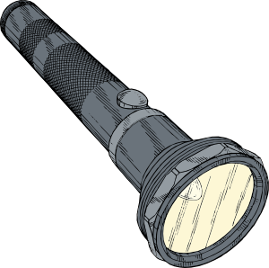
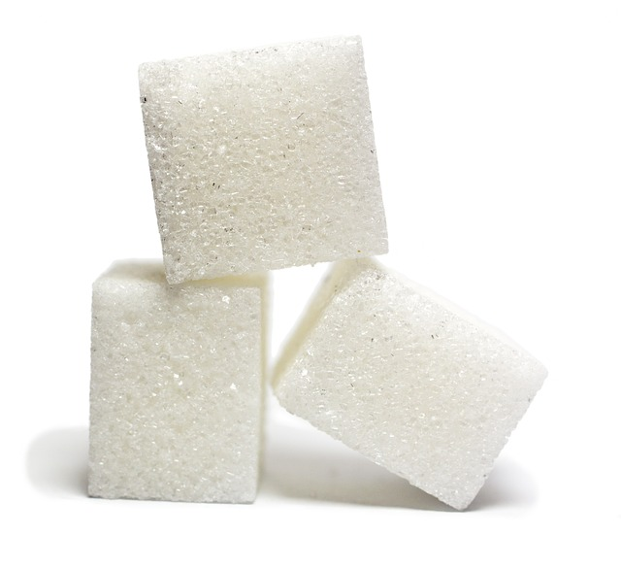
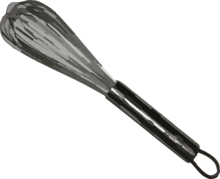
What Happens Inside a Plant?
Notes:
7 min
Note: Gather the materials you need to demonstrate the mixing-bowl analogy of photosynthesis. You can use the following lesson script for the demonstration or your own explanation.
a. “Over the course of many years and experiments, scientists have discovered water, carbon dioxide, and sunlight are not, by themselves, food for plants. But plants do something with these two kinds of matter (water and carbon dioxide) and one form of energy (sunlight). Let me show you one way you can help your students visualize what happens inside a plant.”
b. “This green bowl represents a plant leaf. The leaf takes in water from the roots. Can someone pour some water into this leaf?”
c. “The leaf also takes in carbon dioxide from the air that enters through tiny holes in the leaf. I have a baggie filled with air that contains carbon dioxide. Can someone give the leaf some carbon dioxide?”
d. “Now we need someone to be the Sun and shine this flashlight on the leaf.”
e. “When water, carbon dioxide, and sunlight come together, an amazing set of chemical reactions take place in the leaf. I’ll represent those chemical reactions with this mixer, but keep in mind that these materials aren’t just mixing together.”
f. “In the presence of sunlight, the plant can break apart molecules of water and carbon dioxide and rearrange the atoms to form new kinds of molecules: sugar molecules and oxygen molecules. At the same time, light energy from the Sun is being transformed into food or chemical energy that is stored in the sugar molecules. So the sugar molecules contain both matter and a new form of stored energy that we call food energy.” [Show some sugar or sugar cubes.]
g. “So carbon dioxide by itself isn’t food for plants, water by itself isn’t food for plants, and sunlight by itself isn’t food for plants. But plants can take these three things and make or produce their own food in the form of simple sugars called glucose. This is why we call plants producers.”

Slide 31
What Is Food for Plants?
Plants use water, carbon dioxide, and sunlight from their environment to produce sugar molecules (glucose) in their leaves.
These sugar molecules meet the scientific definition of food:
Food is matter (building materials) that contains energy living things can use to live and grow, to heal wounds, and to keep all their parts working.
Notes:
Less than 1 min
a. Read the key science ideas on the slide.

Slide 32
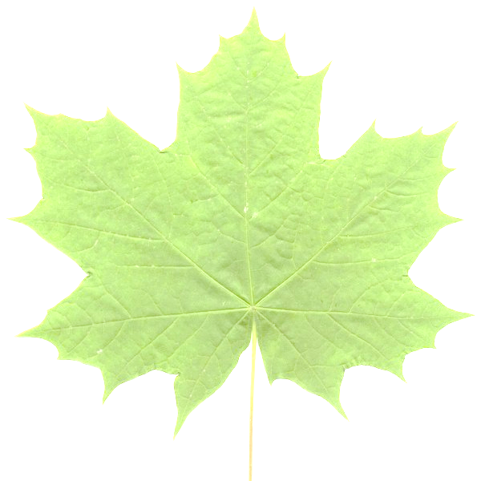
How Plants Make Food
H₂O
(Water)
Food
(Glucose or Sugar)
CO₂
(Carbon Dioxide)
Oxygen
Photosynthesis
Notes:
2 min
a. “Plants make their own food through a biochemical process called photosynthesis in which light, water, and carbon dioxide react chemically to produce glucose. A byproduct of this process is oxygen.”
b. The word photo means light and synthesis means “putting together” or “producing.”
c. “What are plants putting together or synthesizing during photosynthesis?”
Ideal response:
Plants are synthesizing or putting together sugar molecules from water and carbon-dioxide molecules that break down and rearrange in a chemical reaction with sunlight.

Slide 33
Three Representations of Photosynthesis
Notes:
10 min
a. Have participants locate handout 6.11 (Three Representations of Photosynthesis) in their PD program binders. Then walk participants through the instructions.
b. Individuals: Have participants work independently to complete the tasks on the handout.
c. Whole group: Invite participants to display their diagrams on a document reader and explain them to the group.
d. Ask participants, “What are the strengths and weaknesses of each representation?”

Slide 34
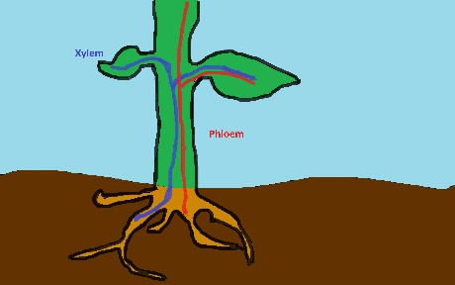
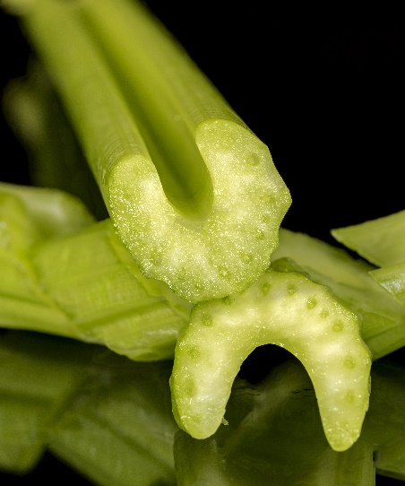
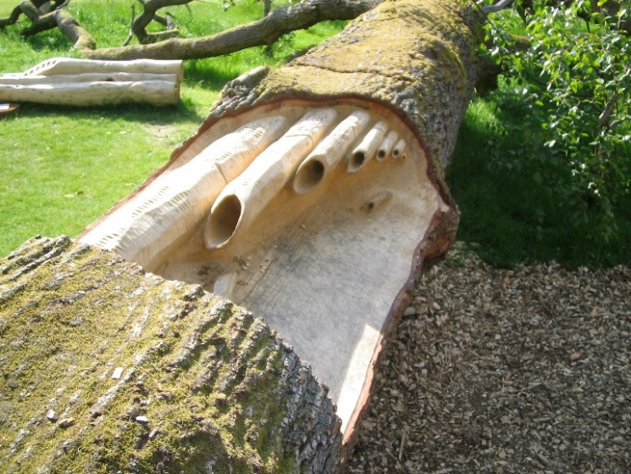
How Plants Take In Water
Xylem
Phloem
Water
Food
Courtesy of Cal Poly Pomona
Courtesy of Stock.Adobe.com
Photograph by Clinton Chaloner
Notes:
1 min
a. “Plant structures are essential to ensure that plants get what they need from the environment so they can make food.”
b. “The top left-hand image on this slide shows how plants take in water through their roots. The water is then carried up to the leaf through tubes called xylem. These tubes are visible in the pictures of the tree trunk and the celery stalks.”
Note of interest: Phloem carries food down from the leaves to all of the plant cells. The photograph of the tree trunk shows xylem tubes for carrying water up to the tree leaves and phloem tubes for carrying maple sap down to “feed” the cells in the roots. To make maple syrup, people tap into the phloem tubes in the spring when the new leaves are producing a lot of sugar and transporting it to cells throughout the tree.

Slide 35
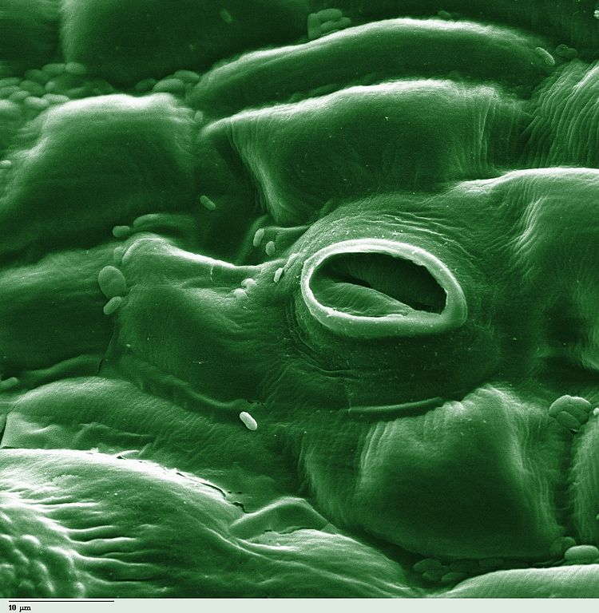
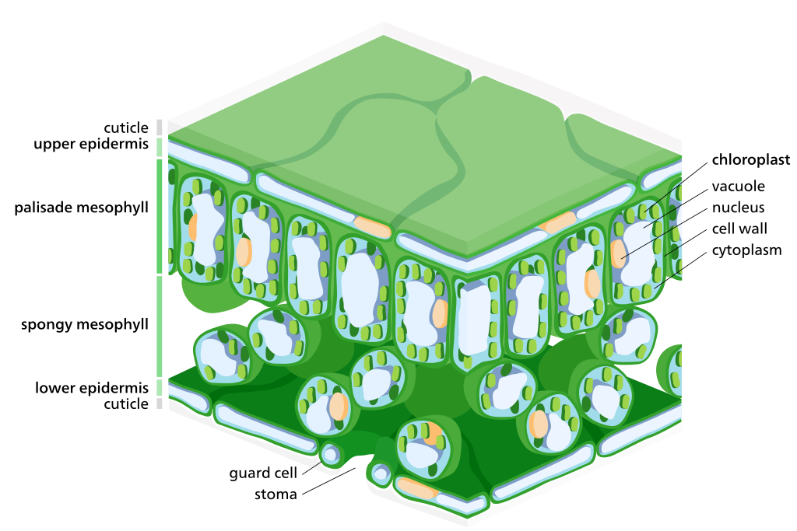
How Plants Take In Carbon Dioxide
Courtesy of Photohound/Wikimedia Commons
Courtesy of Zephyris/Wikimedia Commons
Notes:
1 min
a. “Plants take in carbon dioxide through holes in the underside of the leaf called stoma or stomata. Stomata also allow water vapor and oxygen escape from the leaf. The leaf is able to control how much water vapor escapes by opening or closing the stomata.”
b. “Can you identify the stomata in these diagrams?”

Slide 36
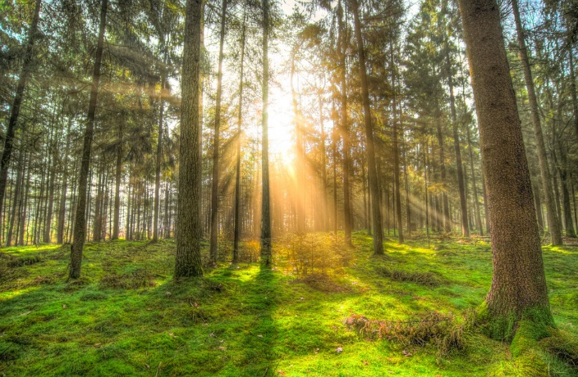
How Do Plants Take In Sunlight?
Photo courtesy of Pixabay.com
Photo courtesy of Hana Kirana/Wikimedia Commons
Notes:
2 min
a. “How do you think plants take in sunlight? Let’s hear your ideas.”
b. As participants share their ideas, record them on chart paper.
Note: Participants are likely to say that the leaves of the plant absorb the light. This explanation is accurate but limited. The following slide will elaborate.

Slide 37
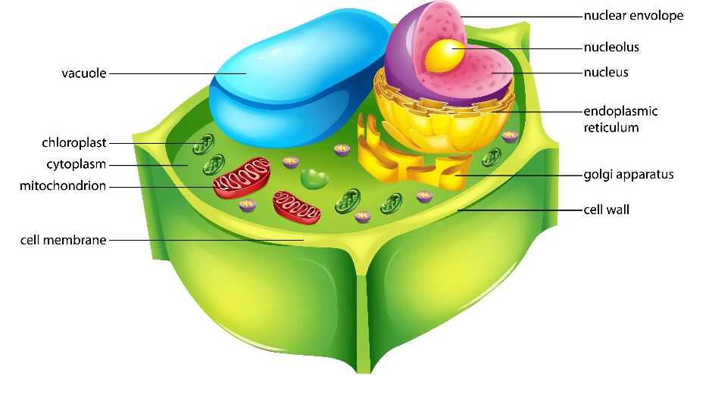
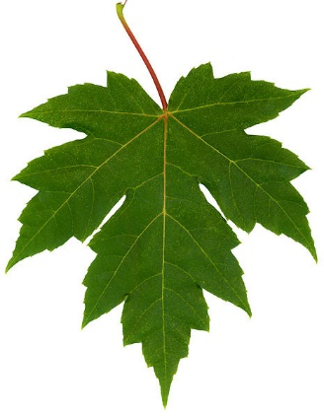
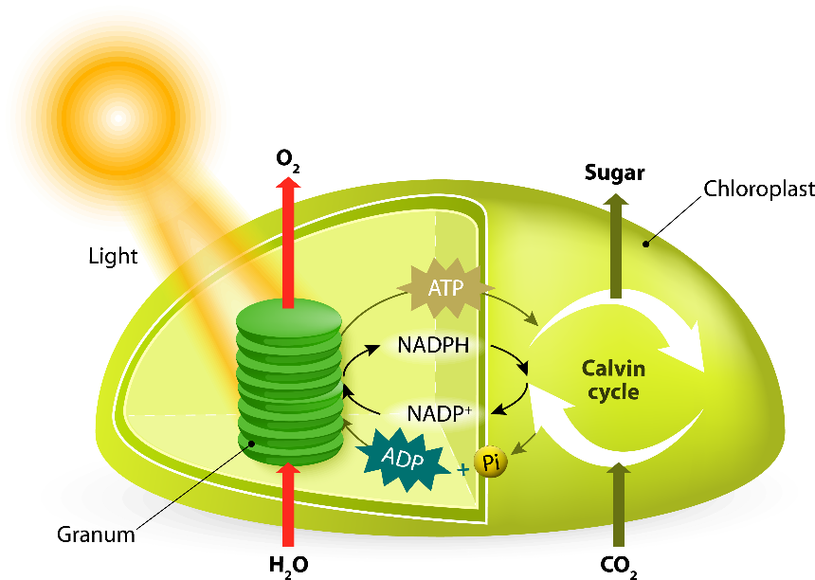
Photosynthesis on a Microscopic Level
Leaf
Plant Cell
Photo courtesy of Jaknouse
Chloroplasts
Courtesy of Stock.Adobe.com
Notes:
10 min
a. “Next, we’ll explore photosynthesis on a microscopic level. This slide shows the relationship between a leaf, a cell within the leaf, and the chloroplast inside the cell.”
b. “Imagine that you’re Ms. Frizzle taking your class on a Magic School Bus tour inside a leaf to find out where photosynthesis is occurring. What would you say about your travels and what you learned about photosynthesis? You don’t need to use all the details on the slide.”
c. Pairs: “Pair up with an elbow partner and study the diagrams on the slide. Then work together to write a description of your journey inside a leaf. Be prepared to share with the group.”
d. Whole group: Invite pairs to describe their journey inside a leave and what they discovered about photosynthesis.
Note: Participants’ descriptions should include the observation that the biochemical reaction called photosynthesis occurs in the chloroplast.

Slide 38
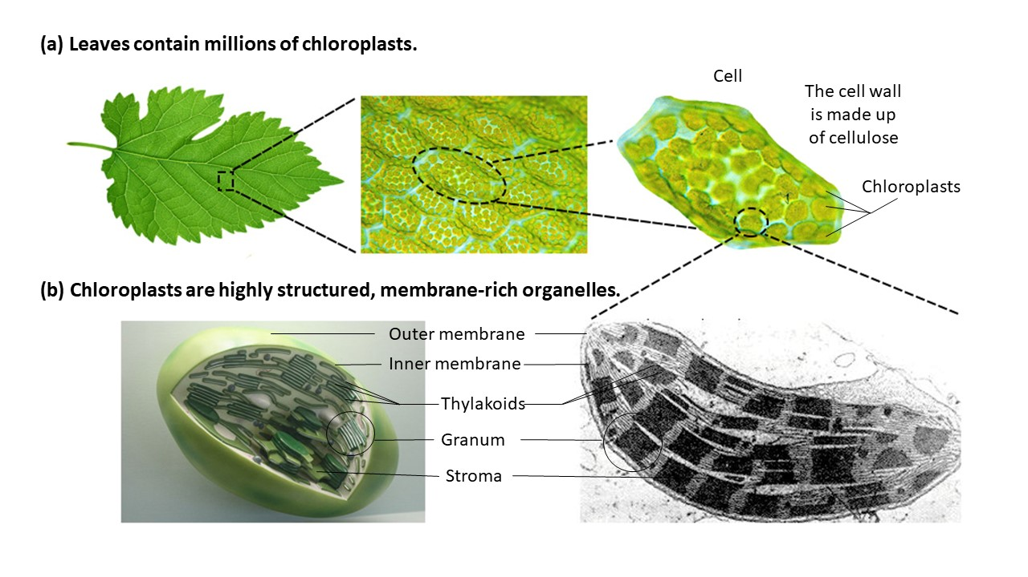
Digging Even Deeper
Courtesy of pixabay.com and wikimedia.org
Notes:
2 min
Note: You can skip this slide if time is running short.
a. “This slide shows a macroscopic view of a plant leaf and then zooms in to show a microscopic view of the cell wall, an individual cell, and chloroplasts, the organelles within the cell where photosynthesis occurs.”
b. “What do these diagrams show that you didn’t see in the previous diagrams?”
Ideal responses:
These diagrams show the arrangement of the chloroplasts in cells and the membrane-rich structure of chloroplasts.
This view highlights the large surface area in a leaf for the chlorophyll to absorb sunlight.

Slide 39
Reflect: Content Deepening Focus Questions
What do plants need from their environment to live and grow? Why do they need these things?
Write/diagram your ideas for answering the focus question. Include as many details as you can using all of the following terms:
Carbon dioxide
Light/sunlight
Food (matter, energy)
Water
Sugar/glucose
Oxygen
Chloroplast
Notes:
10 min
a. Review the focus question on the slide.
b. Individuals: “Answer the question in your science notebooks using as many details as you can, including all of the words on the slide. You may also include a diagram to illustrate your ideas. Be prepared to share your ideas and reasoning with the group.”
c. Whole group: Invite participants to share their answers and reasoning with the group. Have them display their diagrams on a document reader as they explain their ideas. Ask probe and challenge questions to clarify their reasoning and encourage others to agree or disagree, ask questions, or add on. Record key ideas on chart paper.

Slide 40
Key Science Ideas
Plants take in carbon dioxide and water from their environment and combine them with sunlight to make energy-supplying food they can use to live and grow. This process is called photosynthesis.
Photosynthesis involves a biochemical reaction in which water and carbon-dioxide molecules are broken down and rearranged into sugar (glucose) molecules (and oxygen) in the presence of sunlight.
Photosynthesis takes place within highly structured, membrane-rich organelles called chloroplasts. Each leaf contains millions of chloroplasts.
Notes:
3 min
a. Highlight the key science ideas on the slide that answer the content deepening focus questions.
b. Ask: “Does everyone agree that these key ideas answer our focus questions? Would you like to add or revise anything?”
c. Have participants write these key ideas in their science notebooks.

Slide 41
Content Deepening Homework
Read sections 4.5 (How Plants Get Their Food), 5.1 (Photosynthesis), and 5.2 (Chemosynthesis) in the Plants and Animals Content Background Document.
Questions to think about:
What new ideas does the reading contribute to your understanding of photosynthesis?
Does it clarify anything we talked about today?
Does it raise any new questions?
Notes:
1 min
a. Go over the content deepening homework on the slide and have participants copy it into their science notebooks.
b. “Be prepared to discuss the questions in our next content deepening session.”

Slide 42
Lesson Analysis: Focus Question 2
How can selecting appropriate science activities help students develop a coherent science content storyline?
Notes:
1 min
a. Read the focus question on the slide.
b. “To help us answer this focus question, we’re going to explore STeLLA strategy C: Select activities that are matched to the learning goal.”

Slide 43
Strategy C: Purpose and Key Features
According to the strategies booklet, what are the purpose and key features of strategy C: Select activities that are matched to the learning goal?
Notes:
25 min
a. Ask participants to locate the section on strategy C in the STeLLA strategies booklet.
b. Have one participant lead the group in creating a chart that summarizes the purpose and key features of strategy C: Select activities that are matched to the learning goal.
c. Ask: “What does the strategies booklet say about science activities that are fun and engaging for students?
Ideal responses:
Activities should be selected because they can support students in understanding the main learning goal, not because they’re fun or easy to do.
Avoid activities that are only topically related (e.g., something about plants); instead, activities should focus on a specific science idea that is closely linked to the main learning goal (e.g., Plants get their food by making it out of carbon dioxide, water, and light energy).
Activities should not just be interesting supplements to the science content storyline; they should help develop it.
d. Follow-up: “Think back on science-lab activities in high school or college. Did these activities play a key role in helping you better understand the science concepts presented in textbooks or lectures? Or were they more like add-on activities that were only loosely related to the science concepts being taught?”

Slide 44
Lesson Analysis Question
Main learning goal: Plants use sunlight, water, and air from their environment to make their own food. Animals can’t do this.
Focus question: Do plants need food? Explain your thinking.
Activity: Students work in small groups to examine pictures of plants and read information to find out what plants use as food.
Analysis question: Is the activity well matched to the main learning goal?
Notes:
2 min
a. For this lesson analysis, participants will view a set of four video clips from one P&A lesson.
b. Review the main learning goal, focus question, and activity on the slide. Then introduce the analysis question: Is the activity well matched to the main learning goal?

Slide 45
Lesson Analysis: Strategy C
Write this main learning goal at the top of Analysis Guide C (handout 6.5):
Plants use sunlight, water, and air from their environment to make their own food. Animals can’t do this.
For this analysis, we’ll watch four video clips from the same P&A lesson.
Before each clip: Read the lesson context at the top of the corresponding video transcript.
After each clip: Complete part 1 of the analysis guide.
Links to video clips: 6.3_mspcp_kinder.pa.tanguma_L5_c3-4; 6.4_mspcp_kinder.pa.tanguma_L5_c5-6; 6.5_mspcp_kinder.pa.tanguma_L5_c7; 6.6_mspcp_kinder.pa.tanguma_L5_c8-9
Notes:
60 min
Note: Refer to the content background document as needed throughout this lesson analysis.
a. Have participants locate Analysis Guide C (handout 6.4) in their PD binders and write the main learning goal for the selected P&A lesson at the top. Then orient them to part 1 of the analysis guide.
b. Before each video clip: Have participants read the lesson context at the top of the corresponding video transcript (handout 6.5 for clip 3, handout 6.6 for clip 4, handout 6.7 for clip 5, and handout 6.8 for clip 6).
c. Show each video clip.
d. After each clip (individuals or pairs): Allow time for participants to review the analysis guide, write down science ideas revealed in the activity, and assess how well matched these ideas are to the main learning goal.
Note: For a sample analysis of the video clips, see PD Leader Master: Analysis Guide C: Selecting Activities Matched to the Learning Goal (Answer Key).

Slide 46
Lesson Analysis: Strategy C
Discuss these questions with a partner:
Were the activities well matched to the learning goal? Provide evidence to support your response.
Suggest ways to improve the match between the activities and the main learning goal (part 2, Analysis Guide C).
Be prepared to share your ideas in a group discussion.
Notes:
15 min
a. Pairs: “Discuss the questions on the slide and be ready to share your ideas with the group.”
b. Whole group: Assess how well the activities in the video clips matched the main learning goal, and ask participants to offer suggestions for improving the match.
Observations:
The small-group folder activity had too many different questions:
Blue folder: How do plants get the water they need?
Yellow folder: How do plants get the sunlight they need?
Red folder: How do plants get the air they need?
Green folder: Do plants need food? How do they get their food?
During the activity, only the students using the green folder had access to ideas that were closely matched to the main learning goal. The ideas the other groups were exploring distracted students from the main learning goal.
The ideas in the book that the teacher read to the class were quite well matched to the main learning goal.
This lesson really had more than one learning goal. It would have been better to keep the focus on how plants make food. A separate lesson could focus on the main learning goal that plants use their leaves and roots to take in the sunlight, air, and water they need to make food.
The activity didn’t focus on the part of the main learning goal that animals aren’t able to make food.
The folder activity could be improved by having all students focus on the questions that best match the main learning goal: Do plants need food? How do plants get their food?
Note: For a sample analysis, see the PD leader master for Analysis Guide C.

Slide 47
Lesson Analysis: Strategy C
Study the video transcripts again and gather evidence to answer these questions:
What kept students focused on the main learning goal?
What distracted students from the learning goal?
Notes:
7 min
a. Read the questions on the slide.
b. Individuals: Direct participants to look for evidence in the video transcripts that will help them answer these questions.
c. Whole group: Ask one or two participants to share their ideas and evidence in response to the questions.
Observations:
The small-group folder activity had too many different questions:
Blue folder: How do plants get the water they need?
Yellow folder: How do plants get the sunlight they need?
Red folder: How do plants get the air they need?
Green folder: Do plants need food? How do they get their food?
During the activity, only the students using the green folder had access to ideas that were closely matched to the main learning goal. The ideas the other groups were exploring distracted students from the main learning goal. Having all students focus on the questions that were closely matched to the main learning goal (Do plants need food? How do they get their food?) would have prevented distractions.

Slide 48
Today’s Focus Questions
How can we begin and end a lesson to help students develop a coherent science content storyline?
How can selecting appropriate science activities help students develop a coherent science content storyline?
What do plants need from their environment to live and grow? Why do they need these things?
Notes:
Less than 1 min
a. Remind participants of today’s focus questions.

Slide 49
Summarize Today’s Work
Hold up three fingers when you have all of these in mind:
One idea you’re taking away about strategy C: Select activities that are matched to the learning goal
One idea you’re taking away about strategies B, I, and 7:
Set the purpose with a focus question or goal statement (strategy B)
Summarize key science ideas (strategy I)
Engage students in making connections by synthesizing and summarizing key science ideas (strategy 7)
One science idea about plants and animals that you’re taking away from today’s content deepening work.
Notes:
7 min
a. Individuals: Read the instructions on the slide and give participants enough time to come up with three ideas to summarize today’s work.
b. Whole group: In a round-robin, invite participants to share a key idea for each category on the slide. (Allow participants to pass if they wish.)

Slide 50
Homework
In the STeLLA strategies booklet, read about SCSL strategy D:
Select content representations and models matched to the learning goal and engage students in their use.
Fill in the appropriate column on your SCSL Z-fold summary chart.
Notes:
Less than 1 min
a. Go over the homework assignment and have participants write it in their notebooks.
b. Make sure participants understand each part of the assignment.

Slide 51
Reflections on Today’s Session
How are STeLLA strategies B, I, 7, and C related to one another?
What new insights or questions have emerged about plants and animals?
Only two more days are left of our time together at the Summer Institute. What burning questions do you think should be answered before the end of the week?
Notes:
7 min
a. Allow participants at least 5 minutes to think about today’s session and write their reflections and feedback on the Daily Reflections sheet (handout 6.12 in PD program binder).

