Slide 1
RESPeCT PD pROGRAM
Day 7
RESPeCT Summer Institute
Notes:
5 min
a. Take care of any housekeeping issues.

Slide 2
Agenda for Day 7
Day-6 reflections
Focus questions
Introducing SCSL strategy D
Sample analysis of content representations
Lesson analysis: SCSL strategy D
Lunch
Content deepening: food webs
Summary, homework, and reflections
Notes:
5 min
a. Talk through the agenda for the day.

Slide 3
Trends in Reflections
Lesson Analysis | Science Content Learning
Notes:
5 min
a. Give participants time to review your feedback on their reflections from day 6 and offer reactions, comments, or follow-up questions.

Slide 4
Norms for Working Together: The Basics
Purpose: Build trust and develop a productive study group for all participants.
The Basics
Arrive prepared and on time; stay for the duration; return from breaks on time.
Remain attentive, thoughtful, and respectful; engage and be present.
Eliminate interruptions (turn off cell phones, email, and other electronic devices; avoid sidebar conversations).
Make room for everyone to participate (monitor your floor time).
Notes:
2 min
a. Review the norms and ask participants to think about areas where they could improve individually or as a group.
b. “How do you think we’re doing individually and as a group applying these norms? Do you have any comments or suggestions about areas where we could improve?”

Slide 5
Norms for Working Together: The Heart
Purpose: Build trust and develop a productive study group for all participants.
The Heart of RESPeCT Lesson Analysis and Content Deepening
Keep the goal in mind: analysis of teaching to improve student learning.
Share your ideas, uncertainties, confusion, disagreements, questions, and good humor. All points of view are welcome.
Expect and ask questions to deepen everyone’s learning; be constructively challenging.
Listen carefully; seek to understand other participants’ points of view.
Notes:
5 min
a. Review the norms that are at the heart of the RESPeCT program and ask participants to think about areas where they could improve individually or as a group.
b. Emphasize: “We’re doing quite well with our norms, but as we approach the fall, I hope to see our interactions evolving so that you feel comfortable interacting less through your PD leaders as the ‘teachers’ and direct more of your questions and comments to one another, challenging each other, piggybacking on each other’s ideas, and listening carefully to one another so that everyone is contributing to the kind of productive analysis that will help us figure out ways to strengthen our students’ science learning.”
c. Offer an opportunity for participants to comment on how the group is doing with these norms. Ask, “Are there any areas where we could improve? Any suggested changes?”

Slide 6
Today’s Focus Questions
How do you know when a content representation is appropriate and matched to the main learning goal?
How can we engage students in using content representations and models in meaningful ways?
What happens to matter as it moves from organism to organism in a food chain?
Notes:
1 min
a. Introduce the focus questions on the slide.

Slide 7
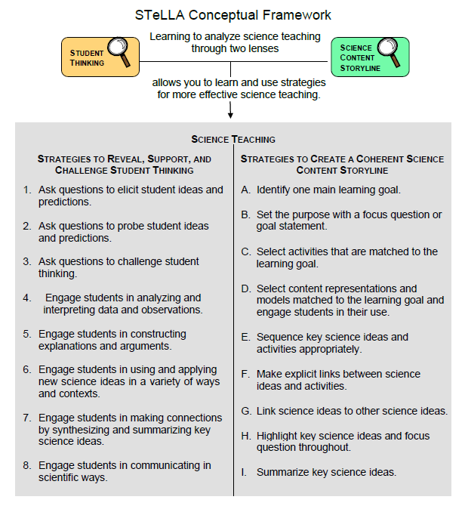
Notes:
2 min
a. “We’ll be focusing on STeLLA strategy D today. Notice that this SCSL strategy has two parts. The first part—select content representations and models matched to the learning goal—sounds similar to strategy C—select activities that are matched to the learning goal. The second part focuses on engaging students in the use of content representations. This ensures that students aren’t just looking at diagrams or models but are actively engaging with them.”

Slide 8
Lesson Analysis: Focus Question 1
How do you know when a content representation is appropriate and matched to the main learning goal?
Notes:
Less than 1 min
a. “Now let’s explore the first part of strategy D and our first focus question.”
b. Read the focus question on the slide.

Slide 9
SCSL Strategy D: Purpose and Key Features
What are the purpose and key features of this strategy?
Cite ideas and examples from the STeLLA strategies booklet and your SCSL Z-fold summary chart.
Notes:
25 min
a. Small groups (12 min): Divide participants into two groups and have each group make a chart identifying the purpose and key features of strategy D described in their SCSL Z-fold summary charts and the STeLLA strategies booklet.
b. Whole group (8 min): Have groups report out. Then ask, “What differences do you notice between the two charts?”
Key ideas:
Content representations can help students envision things that are too big or too small for them to see firsthand in the classroom, or processes that take place too quickly or slowly for them to perceive.
Content representations give students access to different ways of making sense of key science ideas.
If content representations or models are closely matched to the main learning goal, they can be especially useful in helping students see how the science content storyline fits together.
There are many different types of content representations (analogies, metaphors, and visual representations, such as diagrams, charts, graphs, concept maps, models, and role-plays).
Content representations can reveal and challenge student thinking if students are involved in creating, modifying, and analyzing the representations (instead of just listening to the teacher explain them).

Slide 10
Strategy D: Discussion Questions
How is this strategy similar to or different from selecting activities matched to the learning goal (strategy C)?
How might good content representations be especially helpful for English language learners?
Notes:
10 min
a. Whole group: Discuss the questions on the slide.
Key ideas:
Slide question 1: Both strategy C and strategy D emphasize that all activities must be matched to the main learning goal. Strategy D, however, emphasizes a very important kind of activity: content representations. It also emphasizes that teachers should actively engage students in creating, modifying, and using content representations.
Slide question 2: Good content representations can benefit all students, but they especially benefit ELL students because they present science ideas in pictures, images, and other visual formats in addition to words.

Slide 11
Analysis Guide for Strategy D
Read through Analysis Guide D (handout 7.1 in your PD program binder).
Keep this question in mind: What do you notice about how this guide is organized?
Notes:
6 min
a. Have participants locate Analysis Guide D in their PD program binders (handout 7.1).
b. Individuals : “As you read the analysis guide, keep in mind the discussion question on the slide.”
c. Whole group: Discuss the question on the slide.
Key ideas:
This analysis guide focuses on the main learning goal by having participants write that down first.
The guide is divided into three parts. Part 1 focuses on how well matched the content representation is to the main learning goal. Part 2 focuses on how well engaged students are in using the content representation.
The guide ends with identifying ways to improve the content representation and its use in a lesson (part 3).

Slide 12
Content Representation 1: Photosynthesis Diagram
Read the main learning goal and the description of the content representation in Analysis Guide D1 (page 1 of handout 7.1).
Main learning goal: Plants are producers that make their own food by using energy from the Sun to transform matter from the air (carbon dioxide) and matter from the soil (water) into energy-supplying food.
Description of content representation: photosynthesis “equation” diagram
Notes:
2 min
a. Set the context: “Now we’re going to analyze a content representation to see how well it’s matched to the learning goal stated on the slide.”
b. Have participants read the main learning goal and the description of the content representation in Analysis Guide D1 (page 1 of handout 7.1).

Slide 13
Plants Are Producers That Make Food!
Food Molecules (Sugar)
Carbon Dioxide
Water
Oxygen
PRODUCES
MATTER THAT CONTAINS STORED ENERGY
MATTER THAT DOES NOT PROVIDE ENERGY
Notes:
8 min
Individuals: Have participants work independently on part 1 of Analysis Guide D1.
Pairs: “Now pair up and discuss your answers to the analysis questions.”

Slide 14
Does Content Representation 1 Match the Main Learning Goal?
How did you answer these questions from part 1 of Analysis Guide D1?
Is the content representation scientifically accurate?
Is it closely matched to the main learning goal?
Does it present science ideas to students in comprehensible ways?
Does it reinforce/introduce any misconceptions?
Does it address common misconceptions?
Does it contain distracting details?
Notes:
10 min
a. Whole group: Discuss participants’ responses to the questions in part 1 of Analysis Guide D1. (See ideal responses below.)
b. Ask: “How might this photosynthesis content representation be improved? Would you use it with your students?”
Ideal responses to Analysis Guide D1 (part 1):
Question 1: Although the photosynthesis diagram is scientifically accurate, it could be misleading because of its simplicity. The role of the Sun isn’t clear, and the lack of labeling might lead some students to conclude that sunlight is like water and carbon dioxide—another kind of matter that doesn’t provide energy for living things.
Question 2: The diagram closely matches all parts of the main learning goal. It does a nice job of contrasting water and carbon dioxide with food (only food provides energy living things can use). The idea that food production occurs in plants and that plants are producers is conveyed only in the title, not in the diagram itself.
Question 3: Students might have trouble interpreting some of the diagram. Teachers will likely have many ideas about the difficulties students may experience, as well as suggestions for how the diagram might be improved. For example, students might not understand the word produces. To clarify, the label on the arrow could be modified to read “is changed into.” Also, students might not understand that all of this production is taking place inside a plant leaf. And they might have trouble understanding the distinction between matter that provides energy for living things and matter that doesn’t. It’s also unclear what the Sun represents. It might appear to students that sunlight is matter that doesn’t provide energy for living things. It might help to add a label to the Sun that says “Light Energy.”
Question 4: The diagram isn’t likely to introduce, reinforce, or promote misconceptions.
Question 5: The diagram is seeking to address the misconception that water and carbon dioxide are food for plants; however, it could be done more effectively. For example, the label on the left side underneath water and carbon dioxide could say “NOT FOOD.” And on the right side, the equation could say “Glucose Molecules,” and underneath it could say “FOOD.”
Question 6: Oxygen is included in this representation to make it scientifically accurate, but this may distract students from the central idea that plants make food.
Take-home message: Trying to address all six criteria in the analysis guide is a balancing act or trade-off. To make complex science ideas meaningful and comprehensible to students, the content representation needs to be simplified, but simplifications can sometimes be misleading in terms of scientific accuracy. The important thing is for teachers to be aware of such problems so they can be addressed.

Slide 15
Content Representation 2: Mixing-Bowl Model of Photosynthesis
Read the main learning goal and the description of the content representation in Analysis Guide D2 (page 2 of handout 7.1).
Main learning goal: Plants are producers that make their own food by using energy from the Sun to transform matter from the air (carbon dioxide) and matter from the soil (water) into energy-supplying food.
Description of content representation: mixing-bowl model of photosynthesis
Notes:
5 min
a. Set the context for analyzing another content representation.
b. Have participants turn to Analysis Guide D2 (page 2 of handout 7.1) and read the main learning goal and description of the content representation.
c. Demonstrate the mixing-bowl model of photosynthesis from Food Webs lesson 2b. In this activity, students simulate how plants make their own food.
Note: Distribute handout 7.4 (Mixing-Bowl Model to Illustrate Photosynthesis) for this demonstration.

Slide 16
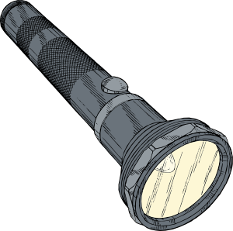
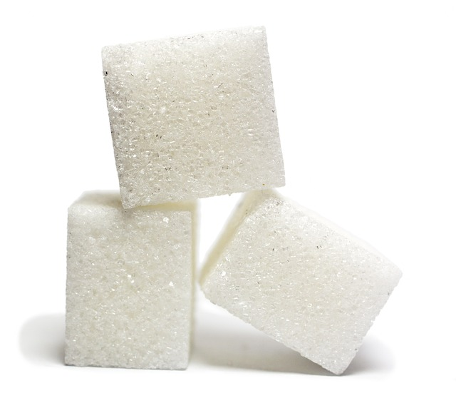
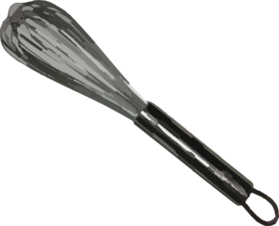
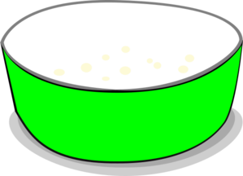
Content Representation 2: Mixing-Bowl Model of Photosynthesis
Notes:
7 min
a. Individuals: Have participants work independently on part 1 of Analysis Guide D2.
Note: If time is short, just do partner work.
b. Pairs: “Now pair up and discuss your answers to the analysis questions.”
https://www.google.com/search?q=image+green+mixing+bowl&tbm=isch&imgil=NCou8aSRVi3pZM%253A%253Bc0gQhldDtHGB_M%253Bhttp%25253A%25252F%25252Fwww.amazon.co.uk%25252FQuality-Plastic-Extra-Large-Mixing%25252Fdp%25252FB008GTX2FC&source=iu&pf=m&fir=NCou8aSRVi3pZM%253A%252Cc0gQhldDtHGB_M%252C_&usg=__kBR4ZsQ-5SQ_Oq3c8hzD6j_9FpA%3D&biw=1322&bih=859&ved=0ahUKEwifzIf3o_3KAhVDy2MKHfjHAegQyjcIJg&ei=uJvDVp-QNsOWjwP4j4fADg#imgrc=_

Slide 17
Does Content Representation 2 Match the Main Learning Goal?
How did you answer these questions from part 1 of Analysis Guide D2?
Is the content representation scientifically accurate?
Is it closely matched to the main learning goal?
Does it present science ideas to students in comprehensible ways?
Does it reinforce/introduce any misconceptions?
Does it address common misconceptions?
Does it contain distracting details?
Notes:
10 min
a. Whole group: Discuss participants’ responses to the questions in part 1 of Analysis Guide D2. (See ideal responses below.)
b. Ask: “How might this mixing-bowl content representation be improved? Would you use it with your students?”
Ideal responses to Analysis Guide D2 (part 1):
Question 1: The mixing-bowl model of photosynthesis is accurate, but as a content representation, it can be misleading. It might suggest that the materials are simply mixed together, but photosynthesis is not a mixing process; it is a chemical change in which water and carbon dioxide (the inputs) are transformed into a completely new kind of material (sugar/food molecules). Showing the sugar at the end of the demonstration would emphasize that something new is created.
Question 2: The content representation is well matched to the main learning goal.
Question 3: The model is a simple representation that students are likely to comprehend. They might need help remembering that the bowl represents a plant leaf, and placing a real plant next to the bowl would emphasize this point.
Question 4: By emphasizing that water, carbon dioxide, and sunlight are used to make something new (sugar/food molecules), the model could be helpful in challenging the misconception that these three elements are food for plants.
Question 5: The model might introduce a misconception that photosynthesis is magic (i.e., the materials are mixed together, and sugar/food magically appears).
Question 6: The model is simple, with no distracting details.
Take-home message: Trying to address all six criteria in the analysis guide is a balancing act or trade-off. To make complex science ideas meaningful and comprehensible to students, the content representation needs to be simplified, but simplifications can sometimes be misleading in terms of scientific accuracy. The important thing is for teachers to be aware of such problems so they can be addressed.

Slide 18
Content Representation 3: Linking-Cubes Model of Growth
Read the main learning goal and the description of the content representation in Analysis Guide D3 (page 3 of handout 7.1).
Main learning goal: Animals consume the Matter originally made by plants (in the form of food molecules). This matter moves from one organism to another in food chains, and each organism uses it to build body structures and to grow bigger.
Description of a content representation: linking-cubes model of growth showing how organisms in a food chain make and use food
Notes:
5 min
Note: If time is running short, this content representation can be skipped.
a. Have participants turn to Analysis Guide D3 (page 3 of handout 7.1) and read the main learning goal and the description of the content representation.
b. Demonstrate the linking-cube activity from Food Webs lesson 3. In this activity, students break apart water and carbon-dioxide linking-cube molecules to create sugar/food linking-cube molecules. The sugar molecules are first used to make the tree grow bigger. Then they’re passed on to the squirrel and from the squirrel to the mountain lion, enabling each organism to grow bigger.
Note: If participants haven’t already done this as a content-deepening activity, have them do it interactively instead of watching a demonstration.

Slide 19
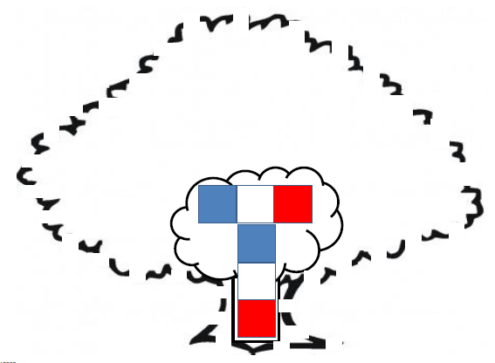
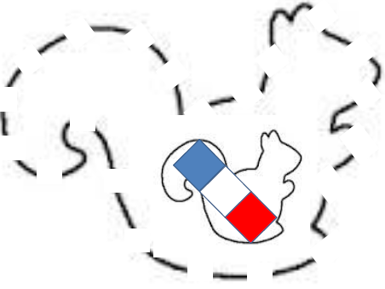
How Do Plants and Animals Grow Bigger?
Notes:
7 min
a. Individuals: Have participants work independently on part 1 of Analysis Guide D3.
Note: If time is short, just do partner work.
b. Pairs: “Now pair up and discuss your answers to the analysis questions.”

Slide 20
Does Content Representation 3 Match the Main Learning Goal?
How did you answer these questions from part 1 of Analysis Guide D3?
Is the content representation scientifically accurate?
Is it closely matched to the main learning goal?
Does it present science ideas to students in comprehensible ways?
Does it reinforce/introduce any misconceptions?
Does it address common misconceptions?
Does it contain distracting details?
Notes:
10 min
a. Whole group: Discuss participants’ responses to the questions in part 1 of Analysis Guide D3. (See ideal responses below.)
b. Ask: “How might this linking-cube content representation be improved? Would you use it with your students?”
Ideal responses to Analysis Guide D3 (part 1):
Question 1: The linking-cube content representation is highly simplified, so many details aren’t exactly accurate. However, the basic concept represented in this activity is accurate: Plants use water, carbon dioxide, and sunlight to create food they can use for growth, and other organisms eat and use this food to grow bigger. Following are some of the inaccuracies:
Obviously, molecules are much, much smaller than linking cubes!
The chemical structure of glucose (sugar) molecules is actually C₆H₁₂O₆, but glucose is represented in this activity with just one atom of carbon, one atom of hydrogen, and one atom of oxygen.
The process of photosynthesis is much more complicated than the simplified version represented here.
The growth of organisms is much more complicated than simply piling on more and more glucose molecules.
Question 2: There is a close match to the main learning goal.
Question 3: Students are likely to find this representation comprehensible but would need to go through it more than once to understand it fully. They don’t always pick up on the idea that food molecules are becoming part of the organisms’ bodies, and that’s why the organisms are growing bigger.
Question 4: Without a discussion of ways this model has been simplified, it could introduce a misconception about the size of molecules. Participants may come up with other interesting ways this representation might introduce or reinforce misconceptions.
Question 5: This representation is one way to challenge the misconception that water, carbon dioxide, and sunlight are food for plants. Breaking down the water and carbon-dioxide molecules and rearranging them to form food molecules should help students begin to understand the notion of a chemical change taking place to produce food. The representation is also designed to challenge the misconception that plants and animals “have” some molecules (like red blood cells in your body) and to physically emphasize the point that plants and animals are completely made up of molecules. Growth occurs because plants and animals are made up of more molecules.
Question 6: Participants are likely to conclude that there are no distracting details in this content representation.
Take-home message: Trying to address all six of these criteria is a balancing act or trade-off. To make complex science ideas meaningful and comprehensible to students, the content representation needs to be simplified, but simplifications can sometimes be misleading in terms of scientific accuracy. The important thing is for teachers to be aware of such problems so they can be addressed.

Slide 21
Lesson Analysis: Focus Question 2
How can we engage students in using content representations in meaningful ways?
Notes:
Less than 1 min
a. Transition slide: “Next we’ll watch two video clips of strategy D in use in a Food Webs lesson. In addition to completing part 1 of Analysis Guide D4, we’ll focus on parts 2 and 3: How well engaged are students in using the content representation? And what suggestions do you have for improving the content representation and its use with students?”

Slide 22
Lesson Analysis 1: Strategy D (Role-Play)
Read the context for the first video clip at the top of the transcript (handout 7.2).
Review the main learning goal and description of the content representation at the top of Analysis Guide D4.
Watch the video clip, keeping in mind the criteria for strategy D (part 1 of the analysis guide).
Work with a partner to complete part 1 of the analysis guide.
Share your responses with the group.
Link to video clip: 7.1_stella_FW_belcastro_L3_c1
Notes:
25 min
a. Orient participants to Analysis Guide D4 and the transcript for video clip 1 (handout 7.2 in PD binder).
b. Have participants read the main learning goal and description of the content representation at the top of the analysis guide.
Note: The teacher in this clip is reviewing the main learning goal from previous lessons.
c. Show the video clip.
d. Pairs: Have participants pair up and complete part 1 of the analysis guide.
e. Whole group: Discuss participants’ responses to the questions in part 1 of the guide. (See ideal responses below.)
Ideal responses to Analysis Guide D4 (part 1):
Question 1: This role-play has some of the same problems as the mixing-bowl model. It’s accurate but so highly simplified that students might think of the process of plants making food as magic. The linking cubes do a better job of challenging the “magic” misconception by exploring what is happening at a molecular level.
Question 2: There is a close match between this activity and the main learning goal.
Question 3: The role-play is highly comprehensible to students, which is the beauty of this representation.
Question 4: Whether misconceptions are challenged or reinforced depends on how the teacher leads the role-play. There are opportunities to emphasize that water, carbon dioxide, and sunlight by themselves are not food for plants. In this clip, the idea of a chemical change is mentioned (01:59.3; 02:14.1) but not emphasized. Some students may still be thinking that plants get their food from water, carbon dioxide, and sunlight, and by making it. That is, like humans, plants have lots of different kinds of food.
Question 5: Same response as point 4.
Question 6: There are no distracting details in this content representation.

Slide 23
Lesson Analysis 1: Strategy D (Role-Play)
Analysis Guide D4
Part 2
Are students engaged in modifying or creating the content representation?
Are students engaged in analyzing the meaning of the content representation?
Are students engaged in critiquing the content representation?
Part 3
What did you learn from watching the video clip that might suggest ways to improve the content representation?
Notes:
25 min
a. “Now we’re going to turn our attention to part 2 of strategy D, which engages students in using content representations. We’ll also consider ways the content representation could be improved.”
b. Individuals: “Study the video transcript again and think about parts 2 and 3 of Analysis Guide D4. Be ready to share evidence that supports your conclusions.”
c. Pairs: “Compare your conclusions about student engagement with the role-play representation.”
d. Whole group: Review participants’ responses to parts 2 and 3 of the analysis guide. Challenge participants to support their answers with evidence from the video transcript.
e. If it didn’t already come up in the discussion, ask participants, “How might the teacher have engaged these students in analyzing or critiquing the representation?”
Ideal responses for Analysis Guide D4 (part 2):
Questions 1 and 2: Students are modestly involved in helping create the role-play and analyze its meaning. The teacher asks questions during the role-play to engage students in helping create and make sense of the representation (see video segments 00:35.8; 00:45.9; 01:08.1; 01:50.0; 02:10.9; 02:45.4; 02:50.2). Not many students participate in this discussion, and most of their responses are quite brief. But there is significant student involvement in segments 02:14.1–02:31.6 (Water and carbon dioxide are mixing together to make something different: food). Another significant instance of student involvement occurs during segments 02:49.4–03:06.3 (Plants also need sunlight to make the energy).
Question 3: In segment 05:31.8, a student notices a discrepancy between the role-play representation of plants and the video of plant growth that the teacher showed. The teacher takes this opportunity to point out the limitations of models (05:53.5–06:04.7).
Ideal responses for Analysis Guide D3 (part 3):
Participants should come up with ways to get students more actively involved in deriving meaning from this role-play. In addition, they might suggest ideas that could be emphasized in the role-play, such as the idea that the “mixing” process in the leaves is transforming matter with no energy for living things (water and carbon dioxide) into new matter that contains energy living things can use (food).

Slide 24
Lesson Analysis 2: Strategy D (Linking Cubes)
Read the context for the second video clip at the top of the transcript (handout 7.3).
Review the main learning goal and description of the content representation at the top of Analysis Guide D3.
Watch the video clip, keeping in mind the criteria for part 2 of the analysis guide and looking for ways the content representation might be improved (part 3).
Pairs: Complete parts 2 and 3 of the analysis guide.
Link to video clip: 7.2_stella_FW_belcastro_L3_c2
Notes:
25 min
a. “Next, we’ll return to the linking-cube activity from Food Webs lesson 3, but this time we’ll see it in action in a classroom. For this analysis, we’ll focus only on parts 2 and 3 of Analysis Guide D3: How well engaged are students in using the content representation? And what suggestions do you have for improving the content representation and its use with students?”
b. Orient participants to Analysis Guide D3 and the transcript for the second video clip (handout 7.3 in PD binder).
c. Have participants review the main learning goal and description of the content representation at the top of the analysis guide.
d. “For this analysis, we’re going to look at a new classroom clip and examine how students are (or are not) engaged in using the linking-cube content representation.”
e. Show the video clip.
f. Pairs: Have participants pair up and complete parts 2 and 3 of the analysis guide.

Slide 25
Lesson Analysis 2: Strategy D (Linking Cubes)
Analysis Guide D3
Part 2
Are students engaged in modifying or creating the content representation?
Are students engaged in analyzing the meaning of the content representation?
Are students engaged in critiquing the content representation?
Part 3
What did you learn from watching the video clip that might suggest ways to improve the content representation?
Notes:
15 min
a. Whole group: Discuss participants’ responses to parts 2 and 3 of Analysis Guide D3. Challenge participants to support their answers with evidence from the video transcript.
b. If it didn’t already come up in the discussion, ask participants, “How might the teacher have engaged these students in analyzing or critiquing the representation?”
Ideal responses for Analysis Guide D3 (part 2):
Question 1: Students in this video clip are definitely engaged in manipulating the linking cubes, breaking down the water and carbon-dioxide “molecules” and rearranging the “atoms” to form sugar molecules. They’re arranging these food molecules to show the tree growing bigger and food moving to the squirrel and then to the mountain lion, enabling these organisms to grow bigger. However, although students are busy manipulating the linking cubes, they aren’t truly helping create the content representation; they’re simply following the teacher’s directions.
Question 2: The teacher asks questions to get students thinking about the meaning of the content representation, but students are struggling. It’s challenging to get them thinking about the ideas when they’re so focused on manipulating the cubes. The teacher tries to get students thinking about the food molecules being used to build up the organisms—to match the learning goal about how living things grow bigger. She has some success with one student (segments 04:10.8–04:19.5) when she asks, “And where’s the food going to go?” A student replies that it’s going to “grow out the tree” (04:16.1), and “It’s going to blossom and grow like the apple trees do” (04:19.5). Right on target! But later the teacher asks a different student the same question, and this student replies that the food will go “into dirt” (05:07.6). The teacher follows up with this student, emphasizing that the food is going to make the tree grow “bigger and bigger” (05:17.1).
Question 3: Students don’t critique the content representation in this video clip.
Ideal response for Analysis Guide D3 (part 3):
The content representation itself seems strong in a variety of ways; the problem is getting students to engage in meaningful ways with it. Participants should come up with a variety of ways to improve student engagement with the content representation. For example, students could be asked to stop and do a thinking activity after the first step when they broke apart the water and carbon-dioxide molecules and made food molecules. They could draw and label what they did or answer part of the focus question: What do we know about how plants grow bigger? They could stop again and think after the squirrel step and then again after the mountain lion step.

Slide 26
Strategy D: Synthesize and Summarize
What new ideas do you have about these aspects of today’s lesson analysis work?
How to select content representations
How to engage students in using content representations
Did our content-representation work give you any new insights about photosynthesis or food webs?
Notes:
10 min
a. Individuals (5 min): Have participants work on the slide questions. Encourage them to use their resources (e.g., the strategies booklet, their Z-fold summary charts, the content background document, notes they’ve taken).
b. Whole group (5 min): Have participants share out their new ideas for each question in a round-robin format, if time allows. Otherwise, have a couple of volunteers share their ideas for each question.

Slide 27
FOOD Webs
SCIENCE CONTENT DEEPENING Grade 5
Notes:
Note: Throughout this content deepening phase, refer as needed to the Food Webs Content Background Document and Common Student Ideas about Food Chains and Food Webs.
PD leader talk: “Now let’s begin our content deepening work on food webs.”
Timing note: To keep things moving so you don’t run out of time during this phase, adhere as closely as possible to the time you’ve allotted for each slide. If you’re running short on time, you may need to abridge or skip some of the group discussion.

Slide 28
Review: The Science Content Storyline in Previous Sessions
The focus question for our first day working with the SCSL strategies was How can we trace the matter and energy in food?
The focus question for yesterday’s session was How do plants get the food they need to live and grow?
Task: Develop either a short cartoon panel or two “tweets” (less than 140 characters each) to summarize the big ideas involved in answering these questions.
Notes:
PD leader move: To remind participants of the science content storyline in previous sessions, ask them to complete one of the tasks on the slide.
PD leader talk: “As you work on these tasks, be creative and demonstrate what you’ve learned in different ways. If you need ideas, you can look through your notebooks.”

Slide 29
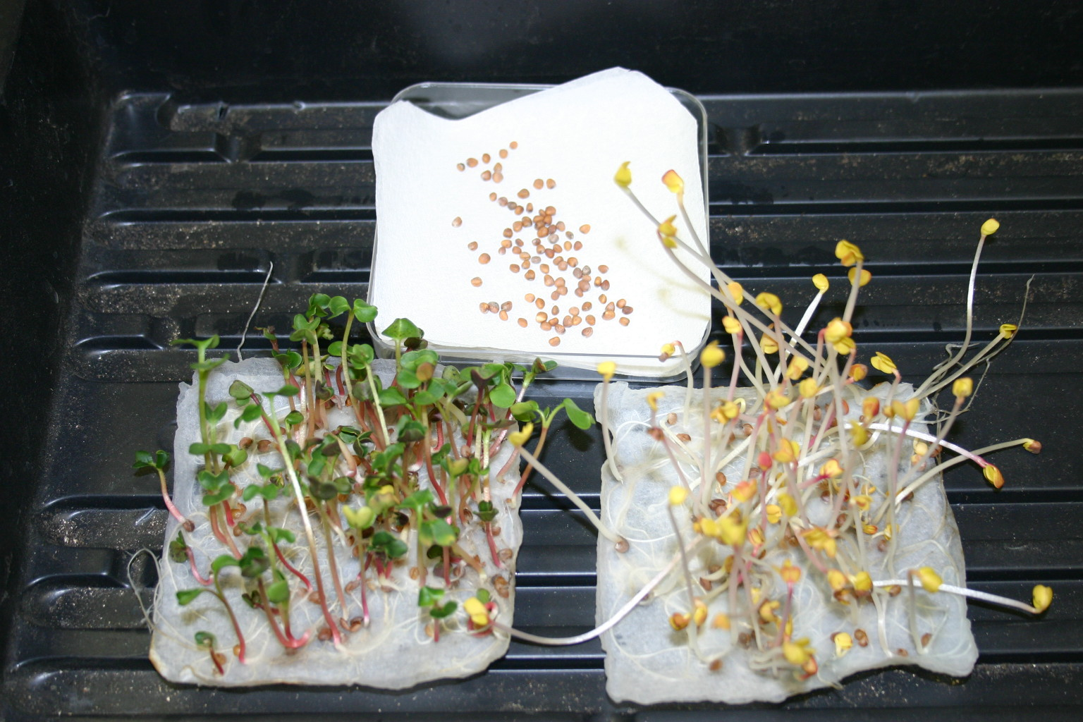
What happens to matter as it moves from organism to organism in a food chain?
Today’s Content Deepening Focus Question
(+) Water
(-) Light
(-) Water
(+) Water
(+) Light
Photograph by Paul Beardsley
Notes:
PD leader move: Read the focus question on the slide; then have participants copy it into their science notebooks and draw a box around it.
PD leader talk: “In the previous session, we started thinking about what happens to matter in a food chain. Let’s review what we’ve learned so far.”
PD leader move: Ask one or two participants to summarize what they’ve learned so far about how matter moves from organism to organism in a food chain.
PD leader move: Emphasize the following science ideas:
In producers (plants), water and carbon dioxide combine to form sugars.
Plants use these sugars to grow.
A squirrel eats the plant and uses its matter and energy to grow.
A mountain lion eats the squirrel and uses its matter and energy to grow.
PD leader talk: “The plants on this slide are radish seedlings grown under three different conditions. The plant at the top had light but no water. The plant on the bottom left had light and water, and the plant on the bottom right had water but no light.”
PD leader talk: “We’ll use this experiment to help us consider in more detail what happens to matter in producers.”

Slide 30
Experimenting with Mass
Which of the following treatments will increase mass?
Treatment | Initial Mass of Seeds (g) | Initial Mass of Paper-Towel Circles (g) | Final Mass (after Drying) (g) | Change in Mass (g)
+ light, + water | 1.00 | 0.61 | ??? | ???
– light, + water | 1.00 | 0.61 | ??? | ???
+ light, – water | 1.00 | 0.62 | ??? | ???
Photograph by Paul Beardsley
Notes:
PD leader talk: “At the beginning of this experiment, researchers measured the mass of the seeds and the paper towels holding the seeds before the seeds received different treatments. Then after two weeks, the plants and paper towels were dried to remove all the water.”
PD leader move: Ask participants to predict which treatment(s) will result in an increase of mass.
PD leader move: Have participants share their predictions with an elbow partner.

Slide 31
The Results!
Treatment | Initial Mass of Seeds (g) | Initial Mass of Paper- Towel Circles (g) | Final Mass (after Drying) (g) | Change in Mass (g)
+ light, + water | 1.00 | 0.61 | 1.71 | +0.10
– light, + water | 1.00 | 0.61 | 1.42 | –0.19
+ light, – water | 1.00 | 0.62 | 1.61 | –0.01
Notes:
PD leader talk: “As you can see from the slide, the plant grown with both light and water gained mass, but the plant grown in the dark actually lost mass.”
PD leader move: Ask participants to compare the results of the experiment with their original predictions.

Slide 32
Document Your Ideas
Describe what is happening with the biomass and carbon of the plant grown in the dark?
Describe what is happening with the biomass and carbon of the plant grown in the light?
Notes:
PD leader talk: “In your notebooks, write your ideas for answering the two questions on the slide. We’ll review the responses as a group during the following activities.”

Slide 33
What Happened with the Matter?
How did the plant gain mass?
Food Molecules (Sugar)
Carbon Dioxide
Water
PRODUCES
Oxygen
Notes:
PD leader move: Summarize what happened to the matter in the plant that had both light and water.

Slide 34
What Happened with the Matter?
How did the plant LOSE mass?
ENERGY
Food Molecules (Sugar)
Carbon Dioxide
Oxygen
RELEASES
Water
MATTER THAT CONTAINS STORED ENERGY
MATTER THAT DOES NOT PROVIDE ENERGY:
RELEASED TO AIR
Notes:
PD leader move: Next, summarize what happened to the matter in the plant that had water but no light. Point out that this process, called cellular respiration, occurs in all living plants and animals.
PD leader talk: “The main point of this diagram is that an individual plant or animal can lose mass from its body by burning food and releasing carbon dioxide and water.”

Slide 35
Where Did the Mass Go?
Your friend decides to take advantage of the wonderful exercise opportunities around Cal Poly and loses 25 pounds. Where did most of the fat/mass go?
The fat was converted into heat.
The mass left her/his system as urine.
The mass left her/his system as feces.
The mass left her/his system as carbon dioxide and water.
None of these
Notes:
PD leader talk: “To see how well you understand the science ideas we’ve been discussing, use what you’ve learned so far to answer the question on the slide.”
PD leader move: Ask participants to identify the common misconceptions for each incorrect answer. They should identify the following misconceptions:
Matter is converted into energy.
All the lost mass is water.
Undigested food is how our bodies lose mass.
Correct answer
PD leader move: Remind participants that matter is lost as CO₂ through cellular respiration.

Slide 36
A Challenge Question
Was the plant grown in the light also performing cellular respiration?
Treatment | Initial Mass of Seeds (g) | Initial Mass of Paper-Towel Circles (g) | Final Mass (after Drying) (g) | Change in Mass (g)
+ light, + water | 1.00 | 0.61 | 1.71 | +0.10
– light, + water | 1.00 | 0.61 | 1.42 | –0.19
+ light, – water | 1.00 | 0.62 | 1.61 | –0.01
Notes:
PD leader talk: “So here’s a challenge question to consider: Was the plant grown in the light also engaging in cellular respiration?”
PD leader move: Discuss this question as a group and elicit participants’ ideas.
PD leader move: Point out that the plant in the light was performing both photosynthesis and cellular respiration, but it was performing photosynthesis at a faster rate.

Slide 37
Our Content Deepening Focus Question
Focus question: What happens to matter as it moves from organism to organism in a food chain?
To help us answer this question, let’s build a physical model!
Pair up with a partner and gather these supplies:
Food-chain organism “place mats” (laminated posters).
Baggies containing 16 linking-cube CO₂ molecules (each molecule = 2 white cubes and 1 red cube) and 8 linking-cube water molecules (each molecule = 2 blue cubes and 1 white cube) (Total cubes: 16 red, 16 blue, 40 white)
4 small bowls labeled Water, CO₂, Oxygen, Wastes
Notes:
Timing note: Allow 40 minutes for this activity (slides 38–60).
PD leader move: Ask participants to pair up and collect the items they’ll need for this activity from Food Webs lesson 3.
PD leader talk: “Make sure to give yourselves plenty of space for the place mats, waste bowls, linking cubes, and your notebooks.”

Slide 38
Building Organisms: Three Kinds of Matter
Water Molecule (H₂O)
Food Molecule (Sugar)
Carbon-Dioxide Molecule (CO₂)
Notes:
PD leader move: Remind participants of the three different types of molecules that will be used at the beginning of the activity.
PD leader talk: “You may want to make a key for these molecules in your notebooks. Remember that the blue linking cubes are hydrogen, the white ones are oxygen, and the red ones are carbon.”

Slide 39
Lesson 4 Science Content Storyline
To prepare for this activity, read the science content storyline on the opening page of lesson 4 in your lesson plans binder.
Notes:
PD leader move: Give participants 1 or 2 minutes to read the science content storyline on the overview page for lesson 4.
PD leader talk: “Make sure to refer back to this science content storyline as we work through the activity.”

Slide 40
Let’s Create a Content Representation!
During this food-chain simulation from lesson 4, you’ll create a diagram in your notebooks that summarizes how matter moves from organism to organism in a food chain (tree, squirrel, mountain lion, decomposer).
Notes:
PD leader talk: “Your main task in this activity is to create a content representation in your notebooks showing how matter moves from organism to organism in a food chain and back into the environment.”

Slide 41
What Happens to the Matter?
What do you think happens to the molecules (matter) as they move from organism to organism in a food chain? Let’s find out!
First, count how many pieces of matter you’re starting with. (Each linking cube represents a piece of matter, so you should begin with 72 pieces of matter: 16 red, 16 blue, and 40 white linking cubes.)
Throughout the activity, make sure to keep track of how many pieces of matter you have.
Notes:
Note: The content on this slide comes from lesson 4.
PD leader move: To help orient participants to the activity, lead them through the information on the slide. Make sure participants have all the necessary materials.

Slide 42
What Happens to Matter in the Tree?
1. | 2.
3. | 4.
5.
Draw this chart in your notebooks. Then write and draw in boxes 1 and 2 to show two things that happen to matter in the tree.
Notes:
PD leader move: Ask participants to complete the task on the slide.
Note: The first two boxes should say “Make food” and “Use food to grow.”

Slide 43
Show the Tree Making Food and Growing
Use linking cubes to show the tree making food and growing:
Use up all of your carbon-dioxide and water molecules to make food molecules in the tree.
Put leftover oxygen “atoms” in the oxygen bowl (or in the air around the tree).
Show how the tree grows bigger with all these food molecules.
Notes:
PD leader talk: “You’ll be working with a partner to carry out each step in this simulation.”
PD leader move: Use the PowerPoint slides to guide participants through each step (the way they’ll guide their students).
PD leader talk: “Students won’t need to learn all the details about the chemical reactions represented in this simulation, but you should gain some familiarity with them. Here are the most important points to remember:
1. Energy-supplying food matter is moving from one organism to another in this simulation.
2. Each organism
uses food matter to grow bigger;
breaks down some of its food molecules to release the energy it needs to live and grow, creating carbon dioxide and water in the process;
leaves behind some food matter as wastes; and
can be consumed by another organism.
3. Despite all these (chemical) changes and the movement of matter from one organism to another, no matter is ever lost or destroyed. Matter constantly moves around and is rearranged, but it never disappears.”
PD leader move: Encourage participants to jot down this information in their science notebooks.

Slide 44
Other Uses for the Food Molecules
What else can the tree do with the food molecules besides using them to grow? What else do food molecules contain besides matter?
The tree needs energy to live, so it breaks down the food molecules to release the stored energy.
Break apart four food molecules (linking cubes). The clicking sound you hear represents energy being released.
The tree uses this energy to live. But what happens to the leftover pieces of matter?
Notes:
PD leader move: Walk participants through the steps on the slide.

Slide 45
What Happens to the Leftovers?
In nature, the leftover pieces of matter immediately start matching up to make CO₂ and H₂O molecules.
So use your leftover pieces to make as many CO₂ and H₂O molecules as you can. If you need more oxygen molecules, take them from the oxygen bowl (or from the air around the tree).
Put your new CO₂ and H₂O molecules in their labeled bowls.
Notes:
PD leader move: Walk participants through the steps on the slide.

Slide 46
Other Uses for the Food Molecules
What else can the tree do with the food molecules it made?
Some of the matter can fall to the ground as wastes—like when leaves, branches, berries, or nuts fall to the ground.
So drop one food molecule into the bowl labeled Wastes.
Notes:
PD leader move: Walk participants through the steps on the slide.

Slide 47
How the Tree Uses Food Molecules
To grow bigger
To get energy (and give off CO₂ and H₂O)
As wastes that fall to the ground
And one more thing …
Notes:
PD leader move: Read through the bullet points on the slide.

Slide 48
What Else Happens to the Food Matter?
It gets passed on to another organism!
So move nine food molecules from the tree to the squirrel.
What does this matter help the squirrel do?
Grow bigger!
Notes:
PD leader move: Walk participants through the steps on the slide.

Slide 49
Let’s Add to Our Tree Chart
What are five things that can happen to the matter in the tree?
We already have two things on our chart. Let’s add three more!
Notes:
PD leader talk: “So what are five things that can happen to the matter from the tree?”
PD leader move: Participants should come up with the following five things the tree does with matter:
Makes new food from carbon dioxide and water
Uses the matter for growth
Uses the matter for energy
Gives off matter as waste
Becomes a source of food for another organism

Slide 50
Stop and Summarize!
Create a content representation that summarizes what happens to matter in the tree. Label your arrows and use the following terms in your diagram:
Photosynthesis
Respiration
Waste
Growth
Source of food for another organism
What aspects of the science content storyline have we covered so far?
Notes:
PD leader talk: “Now I’d like you to create a content representation showing what happens to matter in the tree. Use two full blank pages in your science notebooks and make sure to leave space to add the other organisms to your food chain. Also use different colors to label wastes, respiration, and other items on your drawings.”
PD leader move: Examine participants’ drawings to assess whether the arrows and terms are in the correct locations and the arrows have been labeled.
PD leader move: When participants have finished their diagrams, refer them back to the science content storyline in lesson 4. Ask them to think about the aspects that have been covered thus far.

Slide 51
What Happens to Matter in the Squirrel?
1. | 2.
3. | 4.
Draw a new chart in your notebooks. Then in box 1, draw and write about one thing that can happen to the food matter the squirrel takes from the tree.
Notes:
PD leader move: Ask participants to complete the tasks on the slide.

Slide 52
Other Uses for the Food Molecules
What else can the squirrel do with the food matter?
Just like the tree, the squirrel uses food matter for … energy!
So take apart two of the squirrel’s food molecules to release energy.
What do you think you should do with the leftover pieces of matter?
Yes! Make CO₂ and H₂O molecules and put them in the appropriate bowls.
Notes:
PD leader move: Walk participants through the steps on the slide.

Slide 53
Other Uses for the Food Molecules
What else can the squirrel do with the food molecules?
It leaves wastes on the ground!
So take one food molecule and put it in the bowl labeled Wastes.
Notes:
PD leader move: Walk participants through the steps on the slide.

Slide 54
What Else Happens to the Food Matter?
One day a mountain lion eats part of the squirrel.
So move five food molecules from the squirrel to the mountain lion.
Notes:
PD leader move: Walk participants through the steps on the slide.

Slide 55
Stop and Summarize!
Add to your diagram, summarizing what happens to matter in the squirrel. Label your arrows and use the following terms:
Respiration
Waste
Growth
Source of food for other organism
Add to the squirrel chart three more things that can happen to food matter in a squirrel.
What aspects of the science content storyline have we covered so far?
Notes:
PD leader talk: “Add to your diagrams using the same colors to label your arrows and drawings.”
PD leader move: When participants have finished their diagrams, have them add to their squirrel charts three more things that can happen to food matter in a squirrel. Then refer them back to the science content storyline in lesson 4. Ask them to think about the aspects that have been covered thus far.

Slide 56
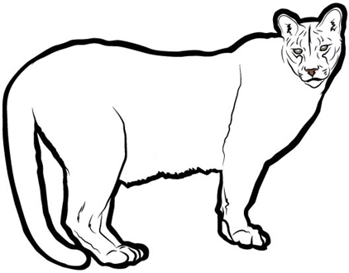
What Happens to Matter in the Mountain Lion?
1. | 2.
3. | 4.
Draw a new chart in your notebooks. Then in box 1, draw and write about one thing that can happen to the food matter the mountain lion gets from eating the squirrel.
Notes:
PD leader move: Have participants complete the tasks on the slide.

Slide 57
Mountain Lion Chart
Let’s start a class chart for the mountain lion.
What is one thing the mountain lion can do with the food molecules it gets from eating the squirrel?
Notes:
PD leader move: “Let’s create a new chart for the mountain lion and list one thing it can do with the food matter from the squirrel.”

Slide 58
Other Uses for the Food Molecules
What else can the mountain lion do with the food matter?
Just like the tree and the squirrel, the mountain lion uses the food matter for … energy!
So take apart two of the mountain lion’s food molecules to release energy.
What do you think you should do with the leftover pieces of matter?
Yes! Make CO₂ and H₂O molecules and put them in the appropriate bowls.
Notes:
PD leader move: Walk participants through the steps on the slide.

Slide 59
Other Uses for the Food Molecules
What else can the mountain lion do with the food molecules?
It leaves wastes on the ground.
So take one food molecule and put it in the bowl labeled Wastes.
Could the mountain lion pass on food molecules to other organisms?
Notes:
PD leader move: Walk participants through the steps on the slide.

Slide 60
Stop and Summarize!
Add to your diagram, summarizing what happens to matter in the mountain lion. Label your arrows and use the following terms:
Respiration
Waste
Growth
Source of food for other organism
Add to the mountain lion chart three more things that can happen to food matter in a mountain lion.
What aspects of the science content storyline have we covered by now?
Notes:
PD leader talk: “Now add to your diagrams again using the same colors to label your arrows and drawings.”
PD leader move: When participants have finished their diagrams, refer them back to the science content storyline in lesson 4. Ask them to think about the aspects that have been covered thus far.

Slide 61
Lesson 5 Focus Question
The organisms in our ecosystem model left behind a good deal of matter as wastes.
Guess where we’re headed next!
Here’s a clue: Turn to the first page of lesson 5 and read the focus question.
Notes:
PD leader talk: “Next, we’re going to talk about the wastes our organisms left behind! The focus question for this Food Webs lesson is What happens to the matter that makes up wastes and dead organisms?”

Slide 62
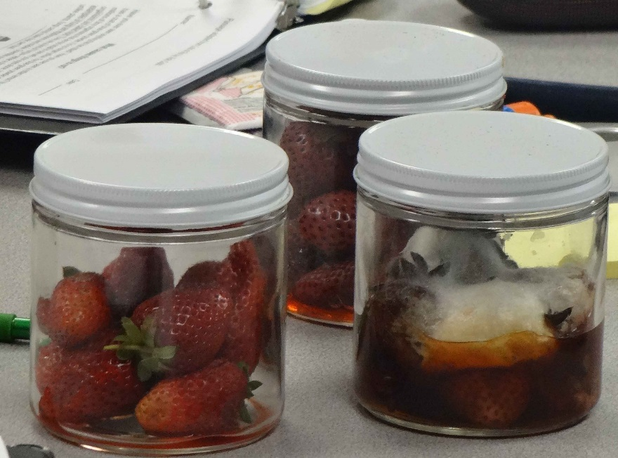
What Helps Decomposers Grow?
In a previous session, we encountered decomposers when we explored what happens to the mass of fresh strawberries compared to rotting strawberries in a jar.
At the beginning of the experiment, we asked, “What will happen to the mass of the strawberry jar after the strawberries decompose compared to the mass before decomposition?”
Where does the matter come from that helps decomposers grow?
Photo courtesy of Cal Poly Pomona
Notes:
PD leader move: Read the first point and the first question on the slide.
PD leader talk: “What major principle are we using to answer this question?”
PD leader move: Confirm that the principle is conservation of mass. Then ask the group to rephrase it in kid-friendly language.
PD leader move: Ask the second question on the slide and have participants pair up to discuss it.
PD leader talk: “Let’s hear your ideas about where the matter comes from that helps decomposers grow.”

Slide 63
The Role of Decomposers in Food Chains
Return to the food-chain model you created at the beginning of the session and add decomposers to your diagram. Then add as many details as you can to explain what is happening to the matter in this food chain. Be sure to label your arrows.
Word bank to draw from:
Decomposers | Minerals
Recycle | Matter
Food | Carbon dioxide
Water | Growth
Wastes | Energy
Notes:
PD leader move: Ask participants to add decomposers to their food-chain diagrams from earlier and include as many details as they can about what happens to the matter. Note that this is similar to the task students complete in lesson 5.

Slide 64
More about Decomposers
Read Rotting Is a Good Thing! (handout 5.2 in your lesson plans binders).
Then go back through the reading independently and answer the Stop and Think questions in your notebooks.
Notes:
PD leader move: Have participants locate Food Webs lesson handout 5.2 (Rotting Is a Good Thing!) in their lesson plans binders and read the essay individually, in pairs, or as a group.
PD leader talk: “Now go back through the reading independently and answer the Stop and Think questions in your notebooks.”

Slide 65
What Causes Things to Rot?
In lesson 5, students read the handout Rotting Is a Good Thing! after examining decomposing strawberries. Then they refer back to the reading to answer these questions:
How do the strawberries decompose?
Why did the mass of the strawberry jar stay the same?
What strong evidence can you find in the reading to support your answers to these questions?
Notes:
PD leader move: Read through the slide and ask participants the questions. Then direct them to the relevant pages in lesson 5b to see if their answers align with the answers in the lesson materials (see follow-up activity).
PD leader talk: “Now read the science content storyline for lesson 5 on the overview page of the lesson plan.”
PD leader talk: “Does anyone have any questions about the ideas in this storyline?”

Slide 66
How Do Organisms Get the Matter They Need?
The focus question for lesson 5 is What happens to matter as it moves from organism to organism in a food chain?
Add words and arrows to the diagram on handout 7.5—Matter in a Simple Food Chain—to show how each organism gets the matter it needs.
Also add to the diagram any major groups of organisms that may be missing!
Write a brief summary describing how this diagram can be used to answer the focus question.
Notes:
PD leader move: Distribute PD handout 7.5 (Matter in a Simple Food Chain) from Food Webs lesson 5a.
PD leader talk: “How do you think each organism in the food chain gets the matter it needs to live and grow? Answer this question by adding words and arrows to the diagram on the handout. Make sure to label your arrows.”
PD leader move: Have participants complete the other tasks on the slide.
PD leader talk: “Your final task is to write a brief summary describing how this diagram can be used to answer the focus question.”
PD leader move: Collect participants’ responses to gain insight into any questions they still have about this focus question.

Slide 67
Content Representation: Ecosystem Model of Matter and Energy
Copy the following information on a blank copy of Analysis Guide D (last page of handout 7.1).
Main learning goal:
Matter cycles between the air and soil and among plants, animals, and microbes as these organisms live and die.
In the process of cellular respiration, food molecules and oxygen molecules in living organisms react to release the energy needed for life processes (such as growth, movement, warmth, and repair).
The process of photosynthesis converts light energy to stored chemical energy in food molecules.
Description of content representation: summary diagram of matter and energy flow in an ecosystem
Notes:
Note: If time is running short, work as a group on part 1 of Analysis Guide D and skip the next slide.
PD leader talk: “Locate the blank copy of Analysis Guide D on page 5 of handout 7.1. Then choose one of the main learning goals on the slide and record it at the top of your handout, and copy the description of the content representation shown at the bottom of the slide.”

Slide 68
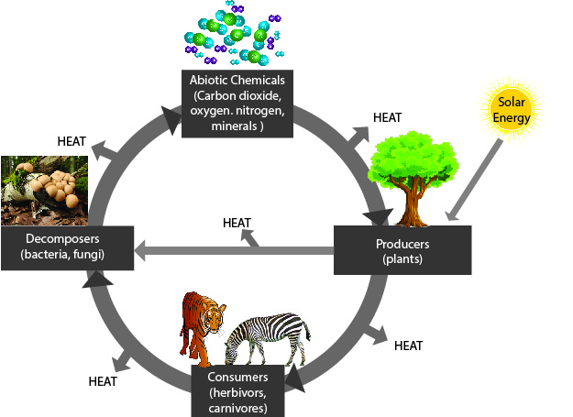
Ecosystem Model
Image courtesy of Nicole Garcia
Notes:
PD leader talk: “Closely examine this content representation of an ecosystem and answer the questions in part 1 of the analysis guide.”

Slide 69
Does the Content Representation Match the Main Learning Goal?
How did you answer these questions from part 1 of the analysis guide?
Is the content representation scientifically accurate?
Is it closely matched to the main learning goal?
Does it present science ideas to students in comprehensible ways?
Does it reinforce/introduce any misconceptions?
Does it address common misconceptions?
Does it contain distracting details?
Notes:
PD leader move: Go over participants’ responses to the questions in part 1 of the analysis guide.
Ideal responses:
Question 1: This model is somewhat accurate. The problem is that it would be very easy for novices to conflate matter and energy.
Question 2: Yes, the representation closely matches the main learning goal.
Question 3: The model could cause comprehension problems.
Question 4: Misconceptions could be reinforced if students conflate matter and energy.
Question 5: The model doesn’t address possible misconceptions.
Question 6: Colors representing matter and energy aren’t consistent (sometimes heat is black, and sometimes white), which could confuse or distract students.

Slide 70
Summarizing Today’s Work
Think about the Science Content Storyline Lens strategies we’ve studied so far:
Think about your science-content-learning work today.
Reflect: What ideas or questions do you want to remember from today and refer back to?
A—Identify one main learning goal.
B—Set the purpose with a focus question or goal statement.
C—Select activities that are matched to the learning goal.
D—Select content representations and models matched to the learning goal and engage students in their use.
I—Summarize key science ideas.
Notes:
6 min
a. Individuals (4 min): Ask participants to think about the first two tasks on the slide and respond to the reflection question in their notebooks.
b. Whole group (2 min): Ask for volunteers to share an idea or question from their responses to the reflection question.

Slide 71
Homework
Read about SCSL strategies F, G, and H in the STeLLA strategies booklet and complete the Z-fold summary chart for these strategies.
Be ready to share your assigned lesson in the Food Webs lesson series.
Bring your calendar for the academic year so we can schedule the dates for our school-year study-group meetings!
Notes:
3 min
a. Review the homework assignment and have participants write it in their notebooks.
b. Make sure participants understand the assignment.
c. “We won’t address strategy E about sequencing science ideas and activities until the school year, since you’ll learn a lot about sequencing from teaching the RESPeCT lesson plans.”

Slide 72
Reflections on Today’s Session
What are your reactions to the strategy of selecting content representations and models that are matched to the lesson’s main learning goal?
What is something new you’ve learned about matter and energy in food webs? Did your content-representation analyses support this learning in any way?
Provide feedback about today’s session and the PD program so far (likes, dislikes, questions, concerns, and suggestions).
Notes:
6 min
a. Allow at least 5 minutes for participants to think about today’s session and write their reflections and feedback on the Daily Reflections sheet (handout 7.5 in PD program binder).

Slide 73
Norms for Working Together: The Basics
Purpose: Build trust and develop a productive study group for all participants.
The Basics
Arrive prepared and on time; stay for the duration; return from breaks on time.
Remain attentive, thoughtful, and respectful; engage and be present.
Eliminate interruptions (turn off cell phones, email, and other electronic devices; avoid sidebar conversations).
Make room for everyone to participate (monitor your floor time).
Notes:
Hidden slide—available for use as needed.

Slide 74
Norms for Working Together: The Heart
Purpose: Build trust and develop a productive study group for all participants.
The Heart of RESPeCT Lesson Analysis and Content Deepening
Keep the goal in mind: analysis of teaching to improve student learning.
Share your ideas, uncertainties, confusion, disagreements, questions, and good humor. All points of view are welcome.
Expect and ask questions to deepen everyone’s learning; be constructively challenging.
Listen carefully; seek to understand other participants’ points of view.
Notes:
Hidden slide—available for use as needed.

