Slide 1
RESPeCT PD pROGRAM
Day 2
RESPeCT Summer Institute
Notes:
3 min
a. Take care of any housekeeping issues.

Slide 2
Trends in Reflections
Lesson Analysis | Science Content Learning
Notes:
5 min
a. Give participants time to review your summary of their reflections from day 1 and offer reactions and comments or ask follow-up questions.

Slide 3
Norms for Working Together: The Basics
Purpose: Build trust and develop a productive study group for all participants.
The Basics
Arrive prepared and on time; stay for the duration; return from breaks on time.
Remain attentive, thoughtful, and respectful; engage and be present.
Eliminate interruptions (turn off cell phones, email, and other electronic devices; avoid sidebar conversations).
Make room for everyone to participate (monitor your floor time).
Notes:
5 min
a. Provide context: “Since we’ll be working together throughout the Summer Institute and the academic year, we need norms that will enable us to build trust and productivity as a group. Today we’ll start our analysis of other teachers’ classroom videos. In the fall, we’ll analyze videos from each other’s classrooms. For this work to be meaningful, we’ll need to push and challenge each other. This will require mutual respect and a common understanding of our goals.”
b. “Do you want to clarify or revise any of these norms?”
Note: Have participants locate the half-page sheet of norms they pasted into their science notebooks on day 1. Remind them to leave space for revising the norms.
c. Encourage participants to ask clarifying questions regarding the meaning of any of the norms and jot notes in their science notebooks.
d. Ask participants if they’re willing to live with these norms today, and let them know they’ll have an opportunity to revise them tomorrow. Remind them of this at the end of the session.

Slide 4
Norms for Working Together: The Heart
Purpose: Build trust and develop a productive study group for all participants.
The Heart of RESPeCT Lesson Analysis and Content Deepening
Keep the goal in mind: analysis of teaching to improve student learning.
Share your ideas, uncertainties, confusion, disagreements, questions, and good humor. All points of view are welcome.
Expect and ask questions to deepen everyone’s learning; be constructively challenging.
Listen carefully; seek to understand other participants’ points of view.
Notes:
5 min
a. “Now let’s review the norms at the heart of the RESPeCT PD program.”
b. “Do you want to clarify or revise any of these norms?”
c. “Do you want to add any norms to the list?”
d. Ask participants if they’re willing to live with these norms today, and announce that they’ll have an opportunity to revise them tomorrow.

Slide 5
Agenda for Day 2
Day-1 reflections
Focus questions
Review of STL strategies 1–3
STL lesson analysis: elicit and probe questions
STL lesson analysis: probe and challenge questions
Practice using elicit and probe questions
Lunch
Content deepening: water cycle
Summary, homework, and reflections
Notes:
Less than 1 min
a. Talk through the agenda for the day.

Slide 6
Today’s Focus Questions
Lesson Analysis
Content Deepening
How can lesson analysis help us better understand how elicit, probe, and challenge questions can reveal and challenge student thinking?
How does the movement of a water molecule change based on its physical state?
Can we make water vapor reappear as liquid water?
Can the movement of water molecules (in various physical states) be modeled as a dance (or shown in a simulation)?
Notes:
1 min
a. Introduce the focus questions that will guide today’s session.
b. “Each day we’re going to have at least one lesson analysis focus question and one content deepening focus question.”
c. “Here are our focus questions for today’s session.”

Slide 7
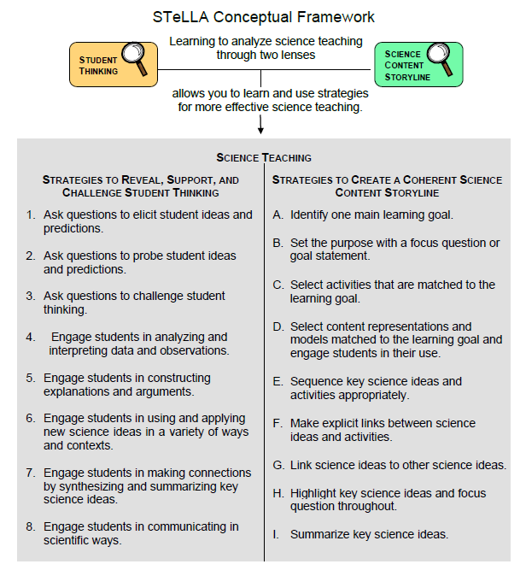
Notes:
Less than 1 min
a. Point out the strategies highlighted on the slide.
b. “During today’s session, we’ll focus again on the Student Thinking Lens strategies: elicit, probe, and challenge questions.”

Slide 8
Probe versus Challenge Questions
Read one of the dialogue examples for STL strategy 3 in the STeLLA strategies booklet.
With an elbow partner, try to justify why each question is labeled probe or challenge.
For help, refer to the STL Z-fold summary chart and the explanations, examples, and general questions for strategy 3 in the strategies booklet.
Be ready to share your ideas.
Notes:
15 min
a. Have participants look in the STeLLA strategies booklet at a dialogue example for strategy 3 that highlights probe and challenge questions.
b. The purposes of this activity are as follows:
1. To get participants’ heads back into the questioning strategies discussed on day 1.
2. To make sure participants understand the distinct purposes of probe and challenge questions:
Probe questions seek to understand what students are saying/writing and encourage them to explain their ideas more clearly or fully (not to change their thinking).
Challenge questions seek to engage students in ways that will challenge them to think, reconsider their ideas, change their initial ideas, and move toward more-scientific understandings.

Slide 9
Lesson Analysis Focus Question
How can lesson analysis help us better understand how elicit, probe, and challenge questions can reveal and challenge student thinking?
Notes:
Less than 1 min
a. “Today we’ll explore this focus question: How can lesson analysis help us better understand how elicit, probe, and challenge questions can reveal and challenge student thinking?”
b. “But first let’s discuss what lesson analysis involves.”

Slide 10
RESPeCT Lesson Analysis Protocol
1. Identify the strategy
What STeLLA lens and strategy was the teacher using in the video clip?
2. Analyze the video
What student thinking was made visible (or not)?
How did the use of the STeLLA strategy impact student thinking?
3. Reflect and apply
What did you learn from identifying and analyzing the strategy in the video?
Notes:
Less than 1 min
a. “This is the three-step protocol that will guide our video-based lesson analysis work. Although we’ll follow the protocol a bit more loosely during the Summer Institute, we’ll rely heavily on this explicit three-step format as we move into the fall study groups.”
b. Review the steps on the slide; then tell participants, “Framing our analysis in this way and following specific steps will help us focus more holistically on the teaching and the impact of the STeLLA strategies on student thinking and learning and the storyline students are constructing (i.e., the Student Thinking Lens and the Science Content Storyline Lens).”

Slide 11
Lesson Analysis Process
Review the lesson context:
What is the ideal student response to the focus question?
How is the clip situated in the content storyline?
Identify and discuss the strategy that is the focus of analysis for each clip.
Watch video clip(s).
Analyze the lesson using the lesson analysis protocol.
Reflect on the lesson analysis experience:
As a reviewer
As a teacher in the clip
Notes:
Less than 1 min
a. “The lesson analysis protocol includes this five-step process.”
b. Review the steps on the slide and note that in the study groups, these steps will be followed more explicitly than they will be during the Summer Institute.

Slide 12
Lesson Analysis: Viewing Basics
Viewing basic 1: Look past the trivial, or little things, that bug you.
Viewing basic 2: Avoid the “This doesn’t look like my classroom!” trap.
Viewing basic 3: Avoid making snap judgments about the teaching or learning in the classroom you’re viewing.
Note: Find out more about the viewing basics on page 1 of the STeLLA strategies booklet.
Notes:
2 min
a. Ask: “Why is each of these viewing basics important? Which will be hardest for you?”
b. Tell participants they can find details on the viewing basics in the STeLLA strategies booklet and refer to this information later.
c. Highlight: “The videos we’ll be viewing throughout the program aren’t necessarily exemplary, but rather they provide real-world examples of teachers implementing the STeLLA strategies. Examples like these deepen our thinking because we can see the sometimes unintended results of teacher decisions and consider missed opportunities.”
d. Honor the videocase teachers! All of these courageous teachers are not only working hard to improve their own teaching practice but are also willing to make their practice public so that others can learn from it. None of them would claim to be exemplary science teachers.

Slide 13
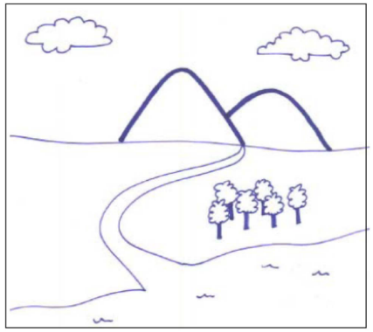
Our First Video Clip
Video Clip 1
Context:
An interview with a 5th-grade student (Amber) before the teacher begins instruction on the water cycle.
Read the context at the top of the video transcript (handout 2.1 in your PD program binder).
Amber and the interviewer refer to this diagram:
Courtesy of BSCS
Notes:
2 min
a. Describe the context of the first video clip participants will watch. (See the top of the transcript—handout 2.1 in the PD program binder.)
b. “This student interview showcases the use of elicit and probe questions. Even though this clip doesn’t take place in the context of an actual classroom, the idea is to look at the quality and form of the questions. Our second video clip will feature probe and challenge questions in a classroom context.”

Slide 14
Identify Elicit and Probe Questions
Video Clip 1
Watch the video clip for examples of elicit and probe questions.
Individuals: Mark E (elicit) and P (probe) on your transcript.
Share your evidence with the group.
Remember:
Not all questions will fall into the E and P categories.
Elicit questions start a conversation and ask for student ideas without expecting right answers.
Probe questions try to figure out what a student means.
Probe questions can paraphrase a student’s idea.
Link to video clip 1: 2.1_stella_WC_dieken_amber_c1
Notes:
20 min
a. Provide instructions for watching video clip 1 and using the transcript to identify questions that elicit (E) and probe (P) student ideas and predictions.
b. Remind participants that the purpose of watching the video clip is to deepen their shared understandings of these strategies and to build their individual and collective lesson analysis skills.
c. Individuals: Allow time for participants to review the video transcript and mark E and P questions.
d. Whole group: Discuss what participants found in the transcript. Encourage them to use evidence from the transcript and reasons from their Z-fold summary charts or the STeLLA strategies booklet to support their ideas. Participants should work to differentiate elicit and probe questions and distinguish them from other types of teacher questions or statements.
Note: For examples of elicit and probe questions, see PD Leader Master: 5th-Grade Guide to Video Clips for Day 2.

Slide 15
Analyze Student Thinking
Video Clip 1
Review the interview transcript.
What student thinking was revealed through the interviewer’s elicit and probe questions?
What ideas did Amber have about how clouds are formed?
Were there places you wished the interviewer had probed more into Amber’s thinking? Why?
Notes:
20 min
a. Give participants time to review the video transcript and develop an answer to one of the analysis questions on this slide. Encourage them to write down their answers in their science notebooks.
b. For this first video analysis, do a round-robin and have each participant share. Ask probe and challenge questions to support participants in communicating their ideas clearly and completely:
Probe question: “Can you say more about what you mean by …?”
Challenge question: “Can you point to a specific place in the transcript that supports your idea?”
c. As participants share, encourage others to respond by asking questions like these:
Do others have additional evidence to support (or challenge) this idea?
Do others have a different interpretation?
Note: For examples of elicit and probe questions, see PD Leader Master: 5th-Grade Guide to Video Clips for Day 2.

Slide 16
Identify Probe and Challenge Questions
Video Clip 2
Now we’ll look at a classroom video and focus on identifying probe and challenge questions.
Read the context at the top of the video transcript (handout 2.2).
Identify probe (P) and challenge (C) questions and mark them on your transcript.
Mark “missed opportunity” (MO) next to places you would like to know more about student thinking.
Remember:
Probe questions try to figure out what a student means or is thinking.
Challenge questions try to move student thinking toward a more scientifically accurate idea.
Link to video clip 2: 2.2_stella_WC_duin_web_c2
Notes:
15 min
a. Provide instructions for watching video clip 2 and using the transcript to identify questions that probe student ideas and predictions and challenge student thinking.
b. Encourage participants to refer to the strategy charts from day 1 (STL strategies 1–3), their Z-fold summary charts, and the STeLLA strategies booklet for help differentiating probe and challenge questions. Remind them that other types of questions (such as elicit questions) may appear in this video clip.
c. Set the context: Read the context for video clip 2 (at the top of the transcript).
d. Emphasize that the students in this class haven’t yet studied anything about molecules, evaporation, or the water cycle.
e. Show the video clip and allow time for participants to study the transcript before advancing to the next slide.

Slide 17
Identify Probe and Challenge Questions
Video Clip 2
What are good examples of probe questions in the video transcript (if any)?
What are good examples of challenge questions in the transcript (if any)?
Notes:
5 min
a. After each suggested probe or challenge question, ask participants the following:
“What makes this a probe/challenge question?”
“Did others mark this as a probe/challenge question?”
“Can you point to any of our resources (the Z-fold summary chart, our strategy charts from day 1, or the STeLLA strategies booklet) to support your answer?”
b. Don’t worry about debate and lack of agreement on some questions. The important thing is that participants clearly understand the difference between the purposes of probe and challenge questions. Sometimes it’s hard to tell whether the teacher in the video intended to find out what a student meant (probe) or move student thinking toward more-scientific understandings (challenge). The teacher may also be asking elicit questions to reveal student ideas and misconceptions.
Note: For examples of probe and challenge questions, see PD Leader Master: 5th-Grade Guide to Video Clips for Day 2.

Slide 18
Identify Missed Opportunities to Probe Student Thinking
Video Clip 2
Individuals: Locate one missed opportunity in the video where the teacher could have asked a probe question. Suggest a probe question to better understand student thinking.
Turn and Talk: Turn to a partner and share your possible probe question. Provide each other with feedback. Ask, “Is this a probe question? Why or why not?”
Whole group: Do you need any clarification?
Notes:
10 min
a. Individuals: “Identify a missed opportunity for a probe question in the video transcript.”
b. Turn and Talk: Have participants pair up and discuss their suggested probe questions. Listen to their conversations to assess whether they truly comprehend that a probe question is designed to help them understand what students are thinking.
c. Whole-group share-out: Participants may need guidance about when to ask probe questions. Remind them that probe questions are appropriate when students make vague or abbreviated statements, or when they simply use a vocabulary term without saying what it means. Do they really understand the term or concept, or do they have misconceptions? Ask a probe question to find out!
d. Remind participants: “Don’t probe everything a student says. Just probe responses that seem relevant to the lesson’s main learning goal and might reveal interesting student thinking.”
Note: For examples of probe and challenge questions, see PD Leader Master: 5th-Grade Guide to Video Clips for Day 2.

Slide 19
Common Student Ideas
Video Clip 2
Locate Common Student Ideas about Matter, Molecules, and the Water Cycle (in lesson plans binder).
Read through the left-hand column on the handout.
Have you observed any of these common ideas among your students? (Mark these ideas with a red dot.)
Have you ever held any of these ideas yourself? (Mark these ideas with a blue dot.)
Can you think of other misconceptions you’ve held or observed in students?
Whole group: What patterns do you notice in the red and blue dots? What did this analysis make you think about?
Notes:
12 min
a. “Now let’s consider some commonly held student ideas (misconceptions). Then we can analyze whether any of these ideas appear in our video clips.”
b. Have participants locate the Common Student Ideas chart in the resources section of their lesson plans binders.
c. “This Common Student Ideas chart shows some commonly held student ideas that are interesting but aren’t scientifically accurate.”
d. Individuals: Have participants mark with a red sticker dot any ideas they’ve observed among their students, and mark with a blue sticker dot any ideas they’ve had themselves.
e. Pairs: Have participants discuss their observations with a partner.
f. Whole group: Ask participants to share which ideas they’ve observed in their students and themselves. During this share-out, apply sticker dots to the Common Student Ideas chart at the front of the room to highlight patterns in the results. Then discuss the following questions:
“What conceptual patterns do you notice in the red and blue dots?”
“What reactions do you have to this analysis? What did it make you think about?”
Note: If time is short, skip this pattern analysis and discussion.
g. “We’ve recognized these common ideas in students or held them ourselves. It’s important to be aware of them when we’re analyzing student thinking in the video clips or planning and teaching lessons in the future.”
h. “Now let’s look for evidence of these common student ideas in a video clip.”

Slide 20
Common Student Ideas
Video Clip 2
Individuals: Read the scientific explanations for your assigned ideas on the Common Student Ideas chart.
Pairs: Discuss these explanations briefly with a partner. What was new to you? Write on sticky notes any content questions you have and place them on the Parking Lot poster.
Notes:
10 min
a. Have participants count off in ones and twos (1, 2, 1, 2). “Ones” will focus on ideas 1–7 on the Common Student Ideas chart, and “twos” will focus on ideas 8–15.
b. Individuals: “Read the scientific explanations for your assigned ideas on the Common Student Ideas chart.”
c. Pairs: “Discuss these explanations briefly with a partner. What was new to you? Write on sticky notes any content questions you have, and place the notes on the Parking Lot poster.”

Slide 21
Lesson Analysis Basics
Video Clip 2
Analysis basic 1: Focus on student thinking and the science content storyline.
Analysis basic 2: Look for evidence to support any claims.
Analysis basic 3: Look more than once (in the video and transcript).
Analysis basic 4: Consider alternative explanations and teaching strategies.
Note: Find out more about the analysis basics on page 2 of the STeLLA strategies booklet.
Notes:
5 min
a. “Before we analyze the video clip for student thinking, let’s think about our lesson analysis process.”
b. Have participants read the analysis basics on the slide.
Note: Direct participants to page 2 in the strategies booklet if they have specific questions that require more information.
c. Why the analysis basics are important: “The analysis basics will help us dig deeper and learn more from our videocase analyses while keeping us focused on the ultimate goal of improved student learning.”
Note: This lesson analysis process is not about critiquing teachers but about improving student learning.
d. “We’ll use a more structured lesson analysis protocol when we begin reviewing each other’s videos in the fall study-group sessions.”

Slide 22
Analyze Questions That Probe and Challenge Student Thinking
Video Clip 2
Analysis question: What student thinking is made visible (or not) through the use of probe or challenge questions? Be specific. Consider whether you observed any of the common student ideas or correct scientific explanations in the video.
Individuals: Make notes or highlight questions/responses on the video transcript. Develop a claim to answer the question. Support the claim with
evidence from the transcript,
ideas from the Common Student Ideas chart, and/or
ideas from the STeLLA strategies booklet.
Whole group: Share claims and evidence.
Notes:
15 min
a. Remind participants of the purposes of video analysis: to deepen understandings of STeLLA strategies; to develop their ability to analyze student thinking; and, ultimately, to improve student learning.
b. Tell participants: “Remember to refer to your Common Student Ideas chart as you analyze the video clip.”
c. Individuals: Review the slide instructions before participants begin working independently on the tasks.
d. Whole group:
Have several participants share their claims and evidence.
Ask: “Did you recognize any of the common student ideas in the students’ responses?”
Ask: “What probe or challenge questions might you ask to better understand student thinking?”
Note 1: Remember to use probe and challenge questions as you interact with participants.
Note 2: For examples of probe and challenge questions, see PD Leader Master: 5th-Grade Guide to Video Clips for Day 2.

Slide 23
Identify Probe, Challenge, and Leading Questions
Video Clip 3
Now we’ll look at another classroom video. Read the context in the video transcript (top of handout 2.3).
Individuals: Mark the transcript to identify probe (P), challenge (C), or leading (L) questions. Then mark any missed opportunities (MO).
Remember:
Not all questions (or statements) will fall into these three categories: P, C, or L.
Review the viewing basics and analysis basics.
Whole-group share-out: Give reasons for marking the questions the way you did.
Link to video clip 3: 2.3_stella_WC_dieken_c4
Notes:
15 min
a. Read the context for this video clip (at the top of the transcript). Make sure participants understand that the students in this clip have previously studied how molecules behave in evaporation and condensation, but they haven’t yet addressed any ideas about the water cycle.
b. Provide instructions for watching video clip 3 and using the transcript to identify questions that probe student ideas and predictions and challenge student thinking. Participants should also be on the lookout for leading questions and missed opportunities. (Note: Leading questions provide hints or make it easy for students to give the “right” answer.) Remind participants that other types of questions (such as elicit questions) may appear in this video clip.
c. Individuals: Review the slide instructions before participants begin working independently on the tasks.
d. Whole group:
Challenge participants to clearly state their reasons for identifying a question as probe, challenge, or leading.
Encourage participants to provide evidence from the STeLLA strategies booklet to support their claims.
Note: For examples of probe, challenge, and leading questions, see PD Leader Master: 5th-Grade Guide to Video Clips for Day 2.

Slide 24
Analyze Student Thinking
Video Clip 3
Analysis question: What student thinking is made visible (or not) through the use of probe or challenge questions? Be specific.
Individuals: Develop a claim to answer the analysis question. Support the claim with
evidence from the video transcript,
ideas from the Common Student Ideas chart, and/or
ideas from the STeLLA strategies booklet.
Whole group: Share claims and evidence.
Notes:
15 min
a. Emphasize: “Remember to refer to your Common Student Ideas chart as you analyze the video.”
b. Individuals: Review the slide instructions before participants begin working independently on developing a claim to answer the analysis question.
c. Whole group:
Have several participants share their claims and evidence.
Ask: “Did you recognize any of the common student ideas in the students’ responses?”
Ask: “What probe or challenge questions might you ask to better understand student thinking?”
Note 1: Remember to use probe and challenge questions as you interact with participants.
Note 2: For examples of probe and challenge questions, see PD Leader Master: 5th-Grade Guide to Video Clips for Day 2.

Slide 25
Summarize: Elicit, Probe, and Challenge Questions
What makes a good elicit question? A good probe question? A good challenge question?
What do you need to know to ask good elicit, probe, and challenge questions?
To ask good questions that make student thinking visible, you need a clear understanding of
the science concepts you are teaching, and
alternative ideas that students may hold.
Notes:
3 min
a. Pose the first question on the slide. If participants need support, point them to the descriptions of strategies 1, 2, and 3 in the STeLLA strategies booklet (especially the Summary of STeLLA Student Thinking Lens Strategies).
b. Pose the second question. Do participants come up with the idea that science-content knowledge is essential for asking good elicit, probe, and challenge questions?
c. Use the rest of the time to highlight the importance of knowing science content and being aware of common student ideas.

Slide 26
Reflect on Your Learning
Respond to these questions in a quick write:
What did you learn about student thinking from analyzing these videos?
How did the analysis process help you better understand the questioning strategies?
Be prepared to share your ideas.
Notes:
5 min
a. Ideally, participants will first respond to the questions in a quick write and then share their ideas with the group. But if time is running short, you can have them simply think for a minute and then share their ideas. But be sure to give them time to think before opening up the discussion.

Slide 27
Practice Elicit and Probe Questions: Interview Planning
The challenge: Pair up and practice using elicit and probe questions. First ask your partner an elicit question and then ask only probe questions to find out what your partner thinks.
To prepare:
Read your elicit question.
Read the common student ideas and scientific explanations that relate to your question.
Plan probe questions to clarify ideas you think might emerge.
Notes:
10 min
a. Describe the challenge: “Next, you and a partner will practice using elicit and probe questions by interviewing each other. The challenge is to ask your partner an elicit question and then follow up by asking only probe questions.”
b. Give each participant a different elicit question (from the PD leader master cards).
c. Direct participants to prepare for the interviews by following the slide instructions.
Note: Participants may refer to the Common Student Ideas chart as a resource for this activity.

Slide 28
Practice Elicit and Probe Questions: Interview Process
Ask your partner the elicit question.
Probe your partner’s thinking without providing any new information. (Keep going for at least 2 minutes!)
Debrief with your partner:
What probe questions did you ask?
Did you ask questions that weren’t probe questions?
What did your probe questions reveal about your partner’s understanding of the concept?
Switch roles and repeat the interview process, with the other partner asking the questions.
Notes:
15 min
a. Review the instructions on the slide.
b. “Each interviewer will have 5 minutes to ask questions. Try to keep going with your probe questions for at least 2 minutes.”
c. Interviewees: “Don’t pretend to be an elementary student; be yourself. Help your partner by pushing yourself to explain things in more depth than you actually understand. Try to come up with possible explanations that go beyond the surface vocabulary. Don’t worry about being wrong; this will actually make the task more like what you might encounter in the classroom.”

Slide 29
Group Discussion
How did the interviews go? What did you find difficult as an interviewer? As a responder?
Which probe questions revealed some interesting clarifications or elaborations?
Did any of your questions end up challenging your partner’s thinking? (Did your questions move your partner’s thinking toward a more scientifically accurate response?)
Notes:
15 min
a. Whole group: Discuss the questions on the slide.
b. If there’s time, ask participants, “How might it help your teaching to do more of this type of practice (with a partner or small group)?”

Slide 30
Water Cycle
SCIENCE CONTENT DEEPENING Grade 5
Notes:
PD leader talk: “Next, we’ll begin the content deepening phase on the water cycle.”
Timing note: To keep things moving so you don’t run out of time during this phase, adhere as closely as possible to the time you’ve allotted for each slide. If you’re running short on time, you may need to abridge or skip some of the group discussion.

Slide 31
Main Learning Goal
The phenomena of the water cycle can be explained by examining the nature of water molecules.
Notes:
PD leader talk: “The main learning goal of this content deepening phase is to explain the phenomena of the water cycle by examining the nature of water molecules.”
Note: Throughout this content deepening phase, refer as needed to the Water Cycle Content Background Document and Common Student Ideas about Matter, Molecules, and the Water Cycle.

Slide 32
Content Deepening Focus Questions
How does the movement of a water molecule change based on its physical state?
Can we make water vapor reappear as liquid water?
Can the movement of water molecules (in various physical states) be modeled as a dance (or shown in a simulation)?
Notes:
PD leader move: Read each content deepening focus question on the slide and assure participants that they’ve acquired knowledge about water over the years, and you hope to enrich their ability to teach the Water Cycle lessons. To ensure that everyone feels prepared to elicit, probe, and challenge student thinking that will be made visible during the actual lessons, some topics covered will exceed the students’ level of knowledge.

Slide 33
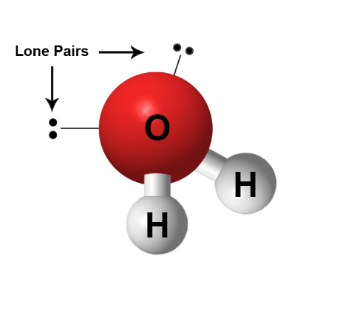
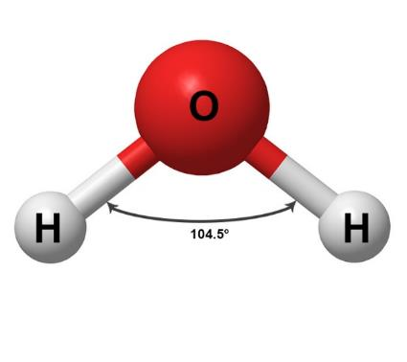
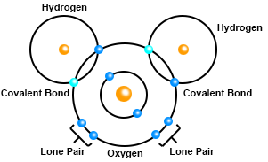
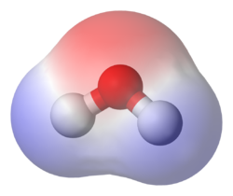
Review: Water Definition
Water is a transparent fluid that forms the world’s streams, lakes, oceans, and precipitation.
Notes:
PD leader talk: “Remember, water is ‘a transparent fluid that forms the world's streams, lakes, oceans, and precipitation.’ Please review the charts around the room, as well as your notes, to recall the physical and chemical properties of water that we discussed yesterday.”
PD leader move: After participants have shared their observations, ask probe and challenge questions to advance the knowledge of the group.

Slide 34
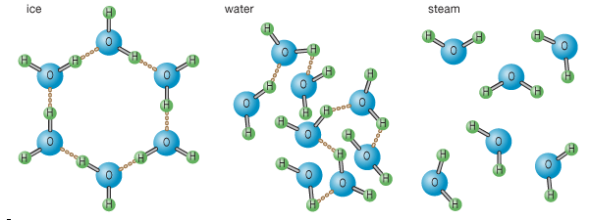
Interactions among Water Molecules
Last time, we drew water as a solid, a liquid, and a gas (water vapor) using 6 molecules and possible hydrogen bonds (H-bonds). What causes water to undergo a phase change? Can you explain which phase does not have hydrogen bonds?
Solid
Liquid
Gas
Courtesy of Encyclopaedia Britannica, © 2015, used with permission
Notes:
PD leader talk: “Yesterday we defined water as ‘a transparent fluid that can exist in a solid, liquid, or gaseous state.’ To review our learning, I have two questions:
1. “What causes water to undergo a phase change?
2. “Which phase does not have hydrogen bonds?”

Slide 35
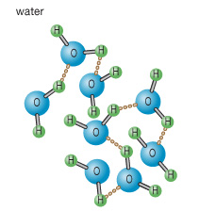
Movement of Water Molecules
If a drop of blue dye were added to this beaker of water, predict what would happen in the first 10 seconds after adding the dye. In your notebooks, draw a new picture of 6 molecules of liquid water, including at least 2 H-bonds.
Liquid water
10 Seconds
Courtesy of Encyclopaedia Britannica, © 2015, used with permission
Let’s test our hypotheses!
Notes:
PD leader talk: “Yesterday we defined a liquid as ‘a fluid that conforms to the shape of its container. It’s the only state with a definite volume but no fixed shape.’ We also drew a few diagrams showing how liquid-water molecules were attracted to one another. Let’s begin by redrawing six molecules of liquid water interacting through at least two H-bonds.”
PD leader talk: “In lesson 2, you’ll be helping students explore the movement of water molecules through experiments and simulations. The first experiment involves adding a drop of food-coloring dye to a cup of water. Without moving the cup, you’ll observe what happens to the drop of food dye. Let’s predict what will happen in the first 10 seconds after the dye is added to the water. Please write your predictions in a complete sentence in your science notebooks.”
PD leader move: A possible sentence starter could be, “I believe __________ will happen in the first 10 seconds after the dye is added to the water.

Slide 36
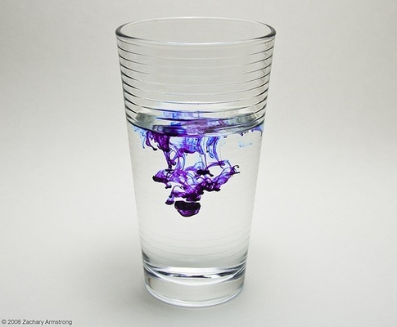
Adding the Dye
Can someone explain what happened in the first 10 seconds of this experiment?
Photograph by Zach Armstrong
Update your drawing, and be sure to show 6 water molecules!
Notes:
PD leader move: After participants have shared their predictions, add the dye to the cup of water. Be sure not to bump the cup. Tell participants to carefully observe what happens to the water as you perform a 10-second countdown. Then have them draw a picture in their notebooks of what they observed. Remove the cup from the table after a minute while participants are drawing.
PD leader talk: “Be sure to draw a new picture of six liquid-water molecules with at least two H-bonds, and include the dye.”
PD leader move: Allow participants enough time to finish their drawings. Then say, “Let’s do a gallery walk around the room to see what other team members have drawn.”
PD leader move: Once the walk is complete, ask someone to share an interesting insight gained while viewing the work of other participants.
PD leader talk: “Now that we’ve updated our drawings, can someone explain what happened in the first 10 seconds of this experiment?”

Slide 37
A Longer Experiment
Predict what will happen after dye is added and allowed to spread through the water for 5 minutes. Include a drawing with an explanation.
5 Minutes
Photograph by Zach Armstrong
Let’s test our hypotheses and explain how the movement of liquid-water molecules is effecting these phenomena!
Notes:
PD leader move: After participants have shared their ideas about the previous experiment, set up another cup of water and explain that in this experiment, a drop of dye will be added and allowed to spread through the water for 5 minutes.
Note: Caution everyone not to bump the table or disturb the cup after the dye is added.
PD leader talk: “Before we add the dye to the water, let’s predict what will happen during the initial 5 minutes after the dye has been added. Please write your predictions in a complete sentence in your science notebooks.”
PD leader move: Ask participants to share their predictions. (Don’t add anything to the sharing at this point; just let participants express their ideas.)
PD leader move: After participants have shared, add the dye to the water. Make sure to watch the clock so you’ll know when 5 minutes have elapsed.
Note: Remind participants not to bump the table or disturb the cup. Emphasize that this is a common mistake students make.
PD leader talk: “Now that 5 minutes have passed, draw a new picture of what you observed. Be sure to include in your picture six water molecules and two H-bonds along with the dye.”
PD leader talk: “Can you explain how the dye spread through the water?”
PD leader move: Push participants to use the words molecules, liquid, and flowing in their explanations. After the discussion, develop a group understanding of the movement of liquid-water molecules.
PD leader talk: “In this experiment, we observed that liquid-water molecules are moving. In fact, we can think of them as flowing past each other like beads. They are loosely attracted through temporary H-bonds when the lone-pair electrons of an oxygen molecule come into close proximity with a hydrogen molecule. This tumbling effect happens at room temperature. The use of dye made this phenomenon visible. Does anyone want to add thoughts or observations on this topic?”
PD leader talk: “Think about yesterday’s demonstration of boiling water as it applies to the movement of liquid-water molecules. How does this comparison affect your thoughts about water-vapor (gas) molecules?”
PD leader move: Have participants review their drawings of boiling water from yesterday if they can’t think of anything.
Note: Allow everyone to share before advancing to the next slide.

Slide 38
Interactions among Water Molecules
Liquid: A fluid that conforms to the shape of its container. It’s the only state with a definite volume but no fixed shape. (Water molecules are loosely attracted to each other through H-bonds.)
Water vapor (gas): When water undergoes evaporation, the molecules gain kinetic energy and are able to fill the entire space because the molecules are no longer attracted to each other in H-bonds.
Notes:
PD leader move: Ask someone to read the water-vapor definition and share any thoughts.

Slide 39
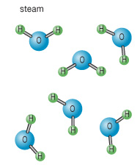
Focus Question 1
How does the movement of a water molecule change based on its physical state?
Liquid water
Gas
Evaporation Gain Energy
Courtesy of Encyclopaedia Britannica,
© 2015, used with permission
Loss of Energy
Courtesy of Encyclopaedia Britannica,
© 2015, used with permission
Visible
Invisible
Notes:
PD leader talk: “Now it’s time to answer our first focus question of the session: How does the movement of a water molecule change based on its physical state? Please be sure to use scientific vocabulary in your response.”
PD leader move: Have participants share their thoughts with an elbow partner.

Slide 40
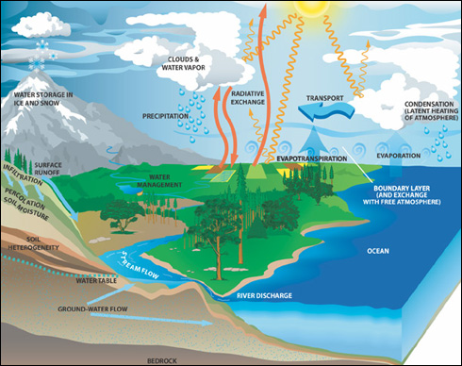
Focus Question 2
Can we make water vapor reappear as liquid water?
Courtesy of NASA.gov
Notes:
PD leader talk: “Now let’s consider our second focus question: Can we make water vapor reappear as liquid water? Basically we’re asking whether we can make the opposite of evaporation occur.”

Slide 41
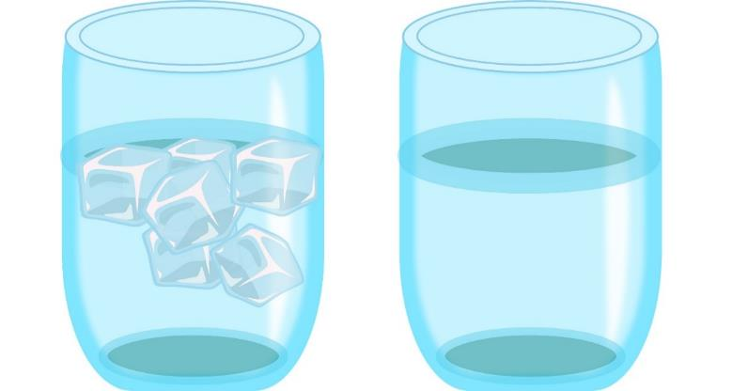
Two-Cups Experiment
Can we make water vapor from the atmosphere reappear as liquid water in this experiment with two cups of water?
Image courtesy of Cal Poly Pomona
Divide a piece of paper into four quadrants and add a new picture of what you observe every 5 minutes.
Notes:
PD leader talk: “In this experiment, we’re going to observe two cups (or jars) for 15 minutes. Both cups contain liquid water, but I’ll add ice to one of them.”
PD leader move: Add ice to one of the cups and set a timer for 15 minutes.
PD leader talk: “Now please take out a sheet of paper and divide it into four quadrants (boxes). Apply the labels Start, 5 Minutes, 10 Minutes, and 15 Minutes to each quadrant. Then draw your beginning observations in the first quadrant (the upper-left box). As always, be sure to include six water molecules and some H-bonds in your diagrams of the water in each cup.”
PD leader move: It’s fine if participants focus on the inside of each cup. Encourage them to state one interesting observation.
PD leader talk: “Now that the first 5 minutes have passed, begin drawing your observations for the next 5 minutes in the second box (or quadrant) of your chart.”
PD leader move: If some condensation is appearing on a cup, simply respond, “That’s interesting” and continue asking participants for their insights.
PD leader talk: “Now that 10 minutes have elapsed, begin drawing your observations for the next 5 minutes in the third box (or quadrant).”
PD leader move: During this 5-minute period, encourage participants to begin touching the outside of each cup and noting the differences. Use simple probe questions, such as “Where is that liquid coming from on the cup of ice water?” If someone says it’s from water in the air, see whether that detail was included in the participant’s drawing. Ask probe questions to determine whether anyone will call the water droplets condensation.
PD leader talk: “Now that the entire 15 minutes have elapsed, begin drawing your final observations in the fourth box. It may be a good idea to include water vapor (gas) in your drawing as well.”
PD leader move: Allow participants time to explain what has happened. Encourage them to build on discussions from the previous session, connecting heat energy, molecular movement and attractions, and H-bonds with the current activity.
Note: Many students have misconceptions that water droplets are attracted to a cold cup, that water droplets diffuse through a cold cup to the outside, or that some water droplets “jump” out of a cold cup and land on the outside of the cup (instead of collecting on the outside from the surrounding air).

Slide 42
Focus Question 2
Can we make water vapor reappear as liquid water?
Gas
Evaporation Gain Energy
Courtesy of Encyclopaedia Britannica,
© 2015, used with permission
Condensation
Loss of Energy
Courtesy of Encyclopaedia Britannica,
© 2015, used with permission
Visible
Invisible
Notes:
PD leader talk: “It’s time to answer our second focus question, Can we make water vapor reappear as liquid water? Be sure to use scientific vocabulary, such as the words energy loss and H-bonds, in your response.”
PD leader move: Have participants share their thoughts with the group.

Slide 43
Focus Question 3
Can the movement of water molecules (in various physical states) be modeled as a dance (or shown in a simulation)?
Notes:
PD leader talk: “Now let’s consider the final focus question of the session: Can the movement of water molecules (in various physical states) be modeled as a dance (or shown in a simulation)? The first part of this question is asking, ‘Can you design a dance where the water molecules in the air condense on the side of the cold cup of water?’”

Slide 44
Extending Content Representations: Part 1
Can our learning be extended by engaging in a role-play that illustrates the movement of water molecules during the condensation of water vapor to liquid water?
Photo courtesy of Pixabay.com
Notes:
PD leader talk: “In a few minutes, we’ll go into the hallway and extend our learning by engaging in a role-play that illustrates the movement of water molecules during condensation as water vapor changes to liquid water. A Hula-Hoop on the ground will represent a cold cup of water, and you’ll act like water molecules. Your bodies will be oxygen atoms, and your extended arms will be hydrogen atoms. As you design your dance, remember to show H-bonding between two water molecules at some point. Do you have any questions?”
PD leader move: Once participants have some time to work on designing a dance, remind them to use their mouths as well as their bodies by saying phrases like “I’m gaining heat energy” or “I’m losing heat energy” as they move around, so everyone will know what is going on.
Note: Perform the role-play two or three times.

Slide 45
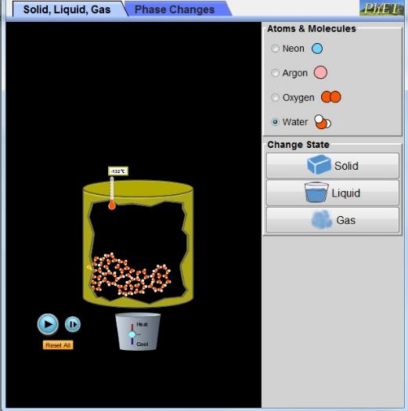
Extending Content Representations: Part 2
Can our learning about the movement of water molecules be extended and visualized with the use of technology?
Photo PhET Interactive Simulations, University of Colorado Boulder
Link to PhET simulation: https://phet.colorado.edu/en/simulation/states-of-matter-basics
Notes:
PD leader talk: “That demonstration was pretty fun, wasn’t it? We modeled the STELLA strategies by extending our learning to another context. We can also extend content by using computer technology and a PhET simulation from the University of Colorado, Boulder. Now break up into small groups and download the PhET simulation onto your group’s laptop using the link on the slide.”
PD leader talk: “Let’s start the simulation and cool the system to 3 kelvin.”
PD leader move: Engage the whole group in discussing the following questions:
What do you notice about the movement/spacing of the water molecules?
Can you see the H-bonds?
What is the definition of a solid?
PD leader talk: “Now let’s warm the system to 300 kelvin (liquid water).”
PD leader move: Engage the whole group in discussing the following questions:
What do you notice about the entire system as heat energy is added?
What do you notice about the movement/spacing of the water molecules?
Can you see the H-bonds?
What is the definition of a liquid?
PD leader talk: “Slowly heat the system to 361–365 kelvin.”
PD leader move: Engage the group in discussing the following question:
What do you notice about the movement/spacing of the water molecules?
PD leader talk: “Now heat up the system extremely high.”
PD leader move: Engage the group in discussing the following questions:
What do you notice about the entire system as heat energy is added?
What do notice about the movement/spacing of the water molecules?
Can you see the H-bonds?
What is the definition of a gas?

Slide 46
Reflect: Content Deepening Focus Questions
How does the movement of a water molecule change based on its physical state?
Can we make water vapor reappear as liquid water?
Can the movement of water molecules (in various physical states) be modeled as a dance (or shown in a simulation)?
Notes:
PD leader talk: “Reflect on your learning for the entire day. What aspect of today’s content deepening stretched your thinking the most?”
PD leader talk: “Discuss with an elbow partner the strengths of implementing the activities from lessons 2 and 3 in your classrooms.”

Slide 47
Summary: Today’s Focus Questions
What progress have we made in addressing our focus questions?
How can lesson analysis help us better understand how elicit, probe, and challenge questions can reveal and challenge student thinking?
How does the movement of a water molecule change based on its physical state?
Can we make water vapor reappear as liquid water?
Can the movement of water molecules (in various physical states) be modeled as a dance (or shown in a simulation)?
Notes:
8 min
a. Divide participants into two groups. Have Group 1 come up with some conclusions/key ideas related to focus questions 1 and 2. Have Group 2 do the same thing for focus questions 3 and 4.
b. Give each group 3 minutes to come up with ideas and conclusions.
c. Allow a 2-minute share-out for each group.

Slide 48
Homework
For tomorrow, read the STeLLA strategies booklet and complete the Z-fold summary chart for these Student Thinking Lens strategies:
Strategy 4: Engage students in analyzing and interpreting data and observations.
Strategy 5: Engage students in constructing explanations and arguments.
Don’t forget about the lesson plan reading-and-reporting assignment due on day 4.
Notes:
1 min
a. Forecast that tomorrow you’ll tackle two new, closely interconnected Student Thinking Lens strategies.
b. Have participants copy the homework assignment into their science notebooks.
c. Remind participants about their homework for Friday (becoming experts on the lesson plans assigned to them).

Slide 49
Reflections on Today’s Session
Complete the Daily Reflections sheet (handout 2.4 in PD program binder).
What value do you see in analyzing student thinking and practicing questions that elicit, probe, and challenge student thinking? What concerns do you have about enacting these practices?
Did you identify any science ideas that you are unclear about? If so, what helped you identify this uncertainty?
What questions do you have about the purposes and goals of the RESPeCT PD program?
Which norms are we successfully implementing? Which norms need more work?
Notes:
6 min
a. Make sure participants have at least 5 minutes to think about the questions on the reflections sheet (handout 2.4 in the PD program binder) and write down their reflections.

