Slide 1
RESPeCT PD pROGRAM
Day 5
RESPeCT Summer Institute
Notes:
5 min
a. Take care of any housekeeping issues.

Slide 2
Agenda for Day 5
Day-4 reflections
Focus questions
Review strategy 6: use and apply
What Is the Science Content Storyline Lens?
Introducing SCSL strategy A
Lesson analysis: SCSL strategy A
Lunch
Content deepening: energy transfer
Summary, homework, and reflections
Notes:
2 min
a. Talk through the agenda for the day.

Slide 3
Trends in Reflections
Lesson Analysis | Science Content Learning
Notes:
5 min
a. Give participants time to review your feedback on their reflections from day 4 and offer reactions, comments, or follow-up questions.

Slide 4
Norms for Working Together: The Basics
Purpose: Build trust and develop a productive study group for all participants.
The Basics
Arrive prepared and on time; stay for the duration; return from breaks on time.
Remain attentive, thoughtful, and respectful; engage and be present.
Eliminate interruptions (turn off cell phones, email, and other electronic devices; avoid sidebar conversations).
Make room for everyone to participate (monitor your floor time).
Notes:
5 min
a. Review the norms as a group.
b. Ask: “Any comments or suggested changes? How are we doing with applying these norms?”

Slide 5
Norms for Working Together: The Heart
Purpose: Build trust and develop a productive study group for all participants.
The Heart of RESPeCT Lesson Analysis and Content Deepening
Keep the goal in mind: analysis of teaching to improve student learning.
Share your ideas, uncertainties, confusion, disagreements, questions, and good humor. All points of view are welcome.
Expect and ask questions to deepen everyone’s learning; be constructively challenging.
Listen carefully; seek to understand other participants’ points of view.
Notes:
5 min
a. Review these norms as a group.
b. Ask: “Any comments or suggested changes? Which of these norms do you think we could get better at applying individually and as a group?”
c. Remind participants: “These norms will become increasingly important during the Summer Institute and throughout the academic year as we analyze one another’s classroom videos and learn together.”

Slide 6
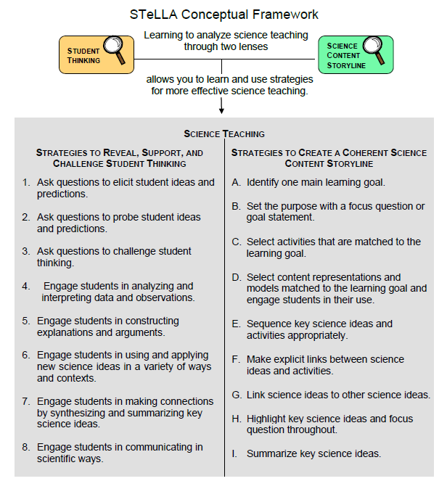
Notes:
1 min
a. Transition: This slide marks the transition from the STL strategies to the Science Content Storyline Lens strategies.
b. “Throughout the PD program, we’ll continue learning about the Student Thinking Lens (STL) strategies, but today we’ll transition to the Science Content Storyline Lens strategies.”
c. Highlight the SCSL strategies on the slide.

Slide 7
Focus for the Week
Content area 2: energy transfer (ET)
Science Content Storyline Lens
Strategies A, B, C, D, F, G, H, and I
Video-based lesson analysis (Energy Transfer lessons)
Energy Transfer lesson plans review (last day)
Academic-year schedule (last day)
Video recording
Study-group sessions
Notes:
1 min
a. “This week we’ll focus on a new content area: energy transfer. We’ll also examine the Science Content Storyline Lens strategies and the Energy Transfer lessons you’ll be teaching in the fall, analyze video clips of those lessons, and deepen your science-content knowledge related to the lesson plans.”
b. “On the last day of the RESPeCT PD program, we’ll review the lesson plans and the schedule for the academic year.”
c. “You may notice that we skip strategy E: Sequence key science ideas and activities appropriately. This strategy will be addressed during the school year as you teach the STeLLA lesson plans and analyze how they’re sequenced within each lesson and across lessons.”

Slide 8
Today’s Focus Questions
What is the Science Content Storyline Lens (SCSL)?
Why is one main learning goal essential for science content storyline coherence?
How do we know whether something has energy?
What causes a moving object to have more or less motion energy?
Notes:
1 min
a. Introduce the focus questions that will guide today’s work.

Slide 9
Check Your Understanding of Strategy 6
Jot down your responses to this multiple-choice quiz:
Use-and-apply tasks are used [before/during/after] new science ideas are introduced.
For difficult content ideas, students might need to practice applying new ideas in [one/two/many] different contexts.
[True/false]: Use-and-apply questions or activities are used primarily for student assessment at the end of a unit.
It’s appropriate for teachers to ask [elicit/probe/challenge] questions during a use-and-apply activity.
Teachers should [never/judiciously/always] tell students about science ideas they are missing or stating inaccurately.
Notes:
7 min
Note: Display this slide only if it wasn’t used on day 4.
a. “To check your understanding of STL strategy 6, jot down your responses to this multiple-choice quiz in your science notebooks.”
b. Have participants discuss their answers either in pairs or as a group. (If time is short, just read the answers aloud.)
Answer key:
1. After
2. Many
3. False
4. Challenge (and probe)
5. Judiciously (defined as “good or discriminating judgment; wise, sensible, or well advised”)

Slide 10
Use and Apply Your Content Deepening Knowledge
How do you think the Sierra Nevada Mountains were formed? Use your knowledge of the mountain-building process?
Do you think the Sierra Nevada Mountains today are being built up and getting higher or worn down and getting lower?
Photo courtesy of Pxhere.com
Notes:
8 min
a. Have participants form small groups.
b. Distribute a relief map of the United States (from ECS lesson 1a) to each group and have participants locate handout 4.1 (Map of Plate Boundaries around the World) from ECS lesson 4a in their lesson plans binders.
c. Small groups (4 min): “Discuss the use-and-apply questions on the slide with your small group, using the relief map and plate-boundaries map to support your ideas. Be ready to share your ideas and evidence from the maps.”
d. Whole-group share-out (4 min): “What ideas and evidence do you have for answering these questions?”

Slide 11
Planning Science Lessons: Quick Write
What is generally your thinking process when you plan your science lessons?
Be prepared to share your ideas with the group.
Notes:
6 min
Note: This activity is a lead-in for thinking about specific SCSL strategies. When planning science lessons, are participants thinking primarily about (1) SCSL issues, such as learning goals, (2) student misconceptions (an STL issue), which is a great start but doesn’t include SCSL strategies, or (3) activities and/or classroom management and timing issues?
a. Individuals: Direct participants to take 2–3 minutes to write down the key things they think about when planning science lessons.
b. Whole group: Ask participants to share their reflections with the group.
c. Tell participants: “The Science Content Storyline Lens strategies should provide some new or additional ways of thinking about planning your science lessons.”

Slide 12
Lesson Analysis: Focus Question 1
What is the Science Content Storyline Lens (SCSL)?
What is a science content storyline, and why is it important?
What is challenging about developing a science content storyline?
Notes:
7 min
a. Small groups: Direct half the group to focus on the first bulleted question on the slide, and the other half to focus on the second. Allow groups 2 minutes to think about their assigned questions as they review “Introduction to the Science Content Storyline Lens” in the STeLLA strategies booklet.
b. Whole group: Have each group share their ideas and responses for these questions.
c. As you listen to participants, make sure that what they’re saying is consistent with the strategies booklet. If you aren’t sure they’re interpreting the text accurately, ask them to identify the specific text they are drawing from.

Slide 13
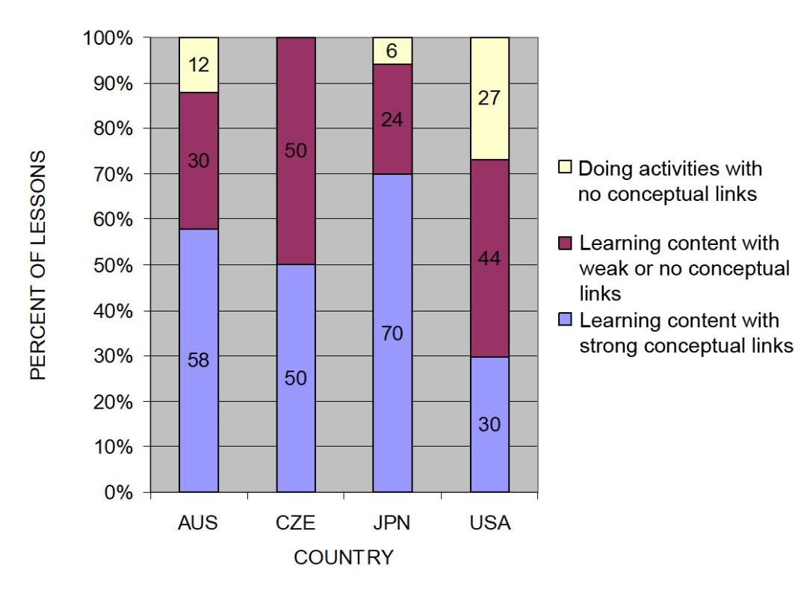
The TIMSS Video Study Findings and the Science Content Storyline Lens
Source: TIMSS study
Notes:
2 min
a. Emphasize the research basis for the Science Content Storyline Lens and its importance. Remind participants that the data on the slide was presented on day 1 of the PD program.
b. Ask: “What does this graph reveal about US science lessons compared with higher-achieving countries?”
Ideal response: According to the study, US science lessons didn’t do as well linking science ideas to lesson activities; in fact, many lessons were activity focused and included significantly fewer science ideas compared to other countries.
c. Summarize: Point to strategies F and G on the STeLLA strategies poster: Make explicit links between science ideas and activities (strategy F) and link science ideas to other science ideas (strategy G). These strategies and the idea of a Science Content Storyline Lens grew out of the TIMSS research findings.
d. “Today we’ll begin our study of the Science Content Storyline Lens, with a focus on strategy A: Identify one main learning goal.”

Slide 14
Lesson Analysis: Focus Question 2
Why is one main learning goal essential for science content storyline coherence?
Notes:
1 min
a. Read the focus question on the slide.

Slide 15
Notes:
1 min
a. “Now let’s dig into SCSL strategy A!”
b. “As you can see, strategy A is the first of nine Science Content Storyline Lens strategies. It appears first because it’s the foundation on which all the other SCSL strategies are built. This will become clearer as we delve into the other strategies and see how important it is that each of them is matched to the lesson’s main learning goal.”

Slide 16
Purpose and Key Features of Strategy A
Review your SCSL Z-fold summary charts and share with a partner the purpose and key features of strategy A: Identify one main learning goal.
Remember to cite passages from the STeLLA strategies booklet.
Be prepared to share with the group.
Notes:
25 min
a. Pairs: “Share with a partner what you wrote on your Science Content Storyline Lens Z-fold summary chart about the purpose and key features of strategy A.”
b. Whole group: Have one or two participant volunteers lead the group in creating a chart that describes the purpose and key features of strategy A.
c. Transition: “Next, we’ll review the difference between a science idea and the main learning goal of a lesson. Then you’ll practice identifying and clarifying this distinction.”

Slide 17
A Main Learning Goal Is …
A big science idea that you want students to learn
A big idea that shows the relationship among science ideas
The focus of the lesson (or series of lessons)
Stated in a complete sentence (for planning purposes)
Stated by the teacher, a student, a text, or a multimedia resource
A support for teacher planning
Notes:
1 min
a. “This slide lists some key ideas about the definition of a main learning goal.”
b. Read through the ideas.
c. Emphasize: “Notice the parenthetical reference to ‘lessons’ in the third bullet point. Each lesson should have only one main learning goal, but you might need two or more lessons to help students accomplish a difficult goal. So it’s often necessary to spend more than one lesson on a specific learning goal.”

Slide 18
A Main Learning Goal Is NOT …
A topic or phrase
An activity
A question
A performance task or objective
A supporting detail, definition, or fact
A student misconception or idea that isn’t scientifically accurate
Notes:
1 min
a. Review what is not considered a main learning goal.

Slide 19
Definitions: One Main Learning Goal and Science Ideas
Read these sections in the STeLLA strategies booklet: (1) STeLLA Strategy A: Identify One Main Learning Goal, and (2) Student Ideas and Science Ideas Defined.
Based on these readings, what are the differences between a main learning goal and a science idea?
Notes:
10 min
a. Have participants locate these two readings in the strategies booklet: (1) STeLLA Strategy A: Identify One Main Learning Goal, and (2) Student Ideas and Science Ideas Defined.
b. “After you read these sections in the strategies booklet, we’ll discuss the differences between a science idea and a main learning goal.”
c. Individuals (3 min): Give participants time to read the specified sections in the strategies booklet.
d. Whole group (7 min): Discuss the question on the slide.
e. Emphasize: “While you might incorporate several science ideas that support the main learning goal of a lesson, be careful not to plan an ‘all about’ lesson with too many different science ideas that will likely come across to students as a bunch of disconnected facts to be memorized.”

Slide 20
Practice Identifying Student Ideas and Science Ideas
Identify any student ideas and science ideas on this list:
Kinetic energy
Power is how fast or slow the energy flows into or out of a system.
How does energy transform?
Energy isn’t created or destroyed; it’s just transformed.
Stationary objects have potential energy.
Notes:
5 min
a. “Next, we’ll practice identifying student ideas and science ideas just to make sure you understand the way we’re defining these terms.”
Note: As needed, refer participants to the section in the strategies booklet where student ideas are defined (Student Ideas and Science Ideas Defined).
b. Individuals: “First, identify examples of science ideas on the slide. If you need help, refer to the document in your lesson plans binders titled Common Student Ideas about Energy. Then identify examples of student ideas on the slide.”
c. Individuals: “Next, identify examples of student ideas on the slide.”
d. Whole group: Discuss participants’ responses and the correct answers (see answer key).
Answer key:
Science ideas: 2, 4, 5
Student ideas: 1, 4

Slide 21
Practice Identifying Student Ideas and Science Ideas in a Class Discussion
Identify one student idea and one science idea in this class discussion:
T: What do you mean by “It got some energy”?
S: Well, the marble must have had the energy inside it or something, so it got it and used it to move.
T: Could the energy have come from somewhere else? Could the marble have gotten the energy from somewhere else?
S: Maybe.
T: Can you describe the energy of the marble rolling down the ramp and colliding with the other marble at the bottom?
S: The marble sped up as it rolled down the ramp, so it was getting more and more energy. When it collided with the other marble, it slowed down, and the other marble sped up. Oh! Maybe the energy moved from the first marble to the second marble.
Notes:
5 min
a. “It’s a little trickier to recognize student ideas and science ideas in class discussions because students sometimes give only one- or two-word answers to teacher questions. But if you link the teacher’s question with the student’s response, you can sometimes find a science idea or a student idea.”
Note: In the RESPeCT PD program, we encourage students to speak in complete sentences as much as possible.
b. “Let’s practice linking the teacher’s question with student responses in the sample discussion on the slide.”
c. Pairs: “Work with a partner to see if you can identify one student idea and one science idea in this discussion.”
d. Whole-group share-out: Have participants share the ideas they identified in the sample discussion. Then review the answers (see answer key).
e. Emphasize: “Here’s some food for thought: To make student thinking more visible, why not require students to speak in complete sentences during classroom discussions about science ideas?”
Answer key:
Student idea: Well, the marble must have had the energy inside it or something, so it got it and used it to move.
Science idea: The marble sped up as it rolled down the ramp, so it was getting more and more energy. When it collided with the other marble, it slowed down, and the other marble sped up. Oh! Maybe the energy moved from the first marble to the second marble.

Slide 22
Science Ideas That Support the Main Learning Goal
Main learning goal: When an object moves faster, it has more energy.
Supporting ideas:
Objects move faster down a steeper ramp.
An object that moves faster has more motion energy than when it moves slower.
A marble will roll faster down a ramp with a larger angle of inclination.
Notes:
6 min
a. Display only the main learning goal on the slide.
b. Pairs: “Work with a partner to come up with two or three science ideas that might support the development of this main learning goal. Use the content background document and the Common Student Ideas chart as resources.”
c. Whole group: Have pairs share the supporting science ideas they came up with.
d. Next, reveal the list of possible supporting science ideas one by one on the slide and compare them with participants’ ideas.
e. Highlight: “Some of these supporting science ideas could also be a main learning goal for a lesson.”

Slide 23
Practice Identifying Main Learning Goals
Small groups or pairs: Use the criteria in Analysis Guide A (handout 5.1 in binder) to analyze a list of candidate main learning goals related to energy transfer (handout 5.2: Practice Identifying One Main Learning Goal).
Select candidates from the list that you think are good main learning goals for the focus of the lesson and record the reasons for your choices on handout 5.2.
Whole group: Discuss and justify your selections.
Notes:
10 min
a. Direct participants to locate handout 5.1 (Analysis Guide A: Identifying One Main Learning Goal) and handout 5.2 (Practice Identifying One Main Learning Goal) in their PD program binders.
b. Small groups/pairs: Have participants form small groups or pairs and use the criteria from Analysis Guide A to analyze the list of possible learning goals on handout 5.2.
c. Direct participants to write yes or no on the handout to indicate whether the statement is or is not a good candidate for a lesson’s main learning goal. Then have them state the reason for each assessment using criteria from the analysis guide.
d. Whole-group share-out: Have participants share and discuss their selections.
e. Be sure to highlight what distinguishes a main learning goal from supporting science ideas, topics, phrases, activities, questions.
f. Also use this discussion to clarify science content.
Answer key: See PD Leader Master: Practice Identifying One Main Learning Goal (Answer Key).

Slide 24
Lesson Analysis: Strategy A
Next, we’ll watch a sequence of three video clips from a single lesson about energy and energy transfer.
Analysis question for all three clips: Does this lesson have one main learning goal?
Follow-up questions:
If yes, what is it?
If no, what do you think is happening in the lesson?
Notes:
1 min
a. Make sure participants understand that they will be viewing a sequence of three video clips from the same Energy Transfer lesson.
b. “For all three clips, we’ll answer the analysis question, Does this lesson have one main learning goal?”
c. “If the answer is yes, what is the learning goal? If no, why do you think that’s the case? What do you think is happening in the lesson?”

Slide 25
Lesson Analysis: Review Lesson Context, Video Clip 1
Read the lesson context on the video transcript (handout 5.3 in PD program binder).
As you watch the clip, keep the analysis question in mind: Does this lesson have one main learning goal?
If yes, what is it?
If no, what do you think is happening in the lesson?
Link to video clip 1: 5.1_stella_et_bernstein L2 c1
Notes:
5 min
a. Have participants read the lesson context at the top of the video transcript (handout 5.3 in PD program binder). (Less than 1 min)
b. Read the information on the slide. (Less than 1 min)
c. Show the video clip. (4 min)

Slide 26
Lesson Analysis: Analyze the Video, Video Clip 1
Study the video transcript and write down any science ideas the students and/or the teacher put on the table.
Pair up and compare the science ideas you identified. Then discuss the analysis question: Does this lesson have one main learning goal?
If yes, what is it?
If no, what do you think is happening in the lesson?
As a group, discuss what the main learning goal might be. Support your answers using your analysis of the science ideas you identified.
Notes:
25 min
a. Before participants analyze the video transcript, remind them of these key points: (1 min)
A science idea is a full-sentence idea that students could take away as something they learned during the lesson.
Science ideas are sometimes identified by linking the teacher’s question with the student’s response.
b. Individuals (8 min): “Study the video transcript and write in your notebooks any science ideas you identify in the discussion.”
c. Pairs (5 min): “Pair up and compare the science ideas you identified. Then discuss the questions on the slide.”
d. Whole group (11 min): Have participants share what they think might be the main learning goal of this lesson, using their analyses of the science ideas they identified.
e. List the possible learning goals on chart paper.
f. Let participants know they’ll revisit this list of possible main learning goals for the lesson after they watch the remaining video clips.

Slide 27
Lesson Analysis: Review Lesson Context, Video Clip 2
Read the lesson context on the video transcript (handout 5.4 in PD binder).
As you watch the clip, keep the analysis question in mind: Does this lesson have one main learning goal?
If yes, what is it?
If no, what do you think is happening in the lesson?
Link to video clip 2: 5.2_stella_et_bernstein_L2_c2
Notes:
5 min
a. Have participants read the lesson context at the top of the video transcript (handout 5.4 in PD binder). (Less than 1 min)
b. Review the instructions on the slide. (Less than 1 min)
c. Show the video clip. (4 min)

Slide 28
Lesson Analysis: Analyze the Video, Video Clip 2
Study the video transcript and write down any student ideas and science ideas you identify.
Pair up and compare the student ideas and science ideas you identified. Then discuss this question: Are these ideas consistent with the possible main learning goal you identified for video clip 1?
As a group, discuss the possible main learning goal for this lesson. Make sure to support your answers using your analysis of the science ideas you identified.
Notes:
25 min
a. Review the definitions of a science idea and a student idea. Remind participants that students can express correct science ideas and inaccurate student ideas at the same time. (1 min)
b. Individuals (8 min): “Study the video transcript and write in your notebooks any student ideas and science ideas you identify.”
c. Pairs (5 min): “Pair up and compare the student ideas and science ideas you identified. Then discuss the question on the slide.”
d. Whole group (11 min): Have participants share out what they think might be the main learning goal of this lesson, using their analyses of the science ideas they identified to support their suggestions.
e. List the possible learning goals on chart paper.
f. Let participants know they’ll revisit this list of possible main learning goals for the lesson after they watch one more video clip.

Slide 29
Lesson Analysis: Review Lesson Context, Video Clip 3
Read the lesson context on the video transcript (handout 5.5 in PD binder).
As you watch the clip, keep the analysis question in mind: Does this lesson have one main learning goal?
If yes, what is it?
If no, what do you think is happening in the lesson?
Link to video clip 3: 5.3_stella_et_bernstein_L2_c3
Notes:
5 min
a. Have participants read the lesson context at the top of the video transcript (handout 5.5 in PD binder). (Less than 1 min)
b. Review the instructions on the slide. (Less than 1 min)
c. Show the video clip. (4 min)

Slide 30
Lesson Analysis: Analyze the Video, Video Clip 3
Study the video transcript and write down any student ideas and science ideas you identify.
Pair up and compare the student ideas and science ideas you identified. Then discuss this question: Are these ideas consistent with the possible main learning goal you identified for clips 1 and 2?
As a group, discuss the possible main learning goal for this lesson. Make sure to support your answers using your analysis of the science ideas you identified.
Notes:
24 min
a. Individuals (8 min): “Study the video transcript and write in your notebooks any student ideas and science ideas you identify.”
b. Pairs (5 min): “Pair up and compare the student ideas and science ideas you identified on the transcript. Then discuss the question on the slide.”
c. Whole group (11 min): Have participants share what they think might be the main learning goal of this lesson. Make sure they use their analyses of the science ideas they identified to support their suggestions.
d. List the science ideas and possible learning goals on chart paper.
e. Ask: “Did the three video clips develop coherence across the lesson or include too many ideas that didn’t support the main learning goal?”

Slide 31
One Main Learning Goal?
Based on your analysis of these three video clips, does this lesson have one main learning goal? What do you think it is?
Use the criteria questions in Analysis Guide A to analyze the main learning goal identified in these clips.
Are there any supporting science ideas that don’t closely match the main learning goal?
Notes:
15 min
a. Whole group: Discuss the first question on the slide and reach a consensus on the main learning goal for the lesson.
Ideal response: The height of the ramp affects the amount of energy the marble possesses.
b. Pairs: Have participants work in pairs to answer the criteria questions in Analysis Guide A for this agreed-upon main learning goal. Also have them identify any supporting science ideas that don’t closely match the main learning goal.
c. Whole group: Discuss participants’ responses to the questions in Analysis Guide A and question 3 on the slide.

Slide 32
Examine Energy Transfer: Lessons 2a/b
Review the main learning goal for lesson 2 in the Energy Transfer scope and sequence.
Read the main science ideas that support the main learning goal (see the Science Content Storyline column for lessons 2a/b in the scope and sequence).
How do the main learning goal and supporting science ideas for lesson 2 align with what you identified in the video clips?
Notes:
5 min
Note: This slide is optional if time is running short. It’s designed to help participants see how the lesson plans are written to highlight the main learning goal and science ideas that support the main learning goal.
a. Have participants locate the scope and sequence for the Energy Transfer lessons in their lesson plans binders.
b. Direct participants to compare the main learning goal for lessons 2a/b with the goal they came up with in their analyses of the video clips. It should be a pretty close match.
c. Then have participants review the ideas in the Science Content Storyline column of the scope and sequence for lessons 2a/b. All of these ideas should support the main learning goal.
d. Pose the question on the slide and elicit participants’ ideas and observations.

Slide 33
ENERGY TRANSFER
SCIENCE CONTENT DEEPENING Grade 4
Notes:
Less than 1 min
a. Transition: This slide marks the transition to the content deepening work.
Note: Throughout this content deepening phase, refer as needed to the content background document and Common Student Ideas about Energy.

Slide 34
Your Learning and Teaching Experiences
Share your background learning about energy in school.
Share your experience teaching students about energy.
Notes:
3 min
a. Go around the room and have participants share their background learning about energy in school and/or their experience teaching students about energy.

Slide 35
Review: Science Content Storyline
A coherent science content storyline consists of carefully chosen and sequenced science ideas that build on one another to tell a story about one big science idea or crosscutting concept.
The activities in the lesson must engage students in making sense of the storyline, and the science ideas must be linked explicitly to the activities.
Notes:
Less than 1 min
a. Briefly review the characteristics of a coherent science content storyline.

Slide 36
Teaching about Energy
What do you teach your students about energy?
In your notebooks, write a typical science content storyline you’d use when teaching a lesson on energy or energy transfer.
Share your storylines with an elbow partner.
Notes:
7 min
a. Individuals (3 min): “What do you teach your students about energy? In your science notebooks, write a typical science content storyline you’d use when teaching a lesson on energy transfer.”
b. Pairs (4 min): Have participants share their science content storylines with an elbow partner.

Slide 37
Ideas about Energy
What is energy, and how can we detect it?
Notes:
7 min
a. Read the question on the slide and invite participants to share their ideas about energy.
b. As participants share their ideas, record them on chart paper.
c. Highlight the following ideas if they aren’t mentioned during the share-out:
Energy is the ability to do work or move something against a force.
We can often detect energy with our senses. Seeing motion, feeling heat, hearing a sound, and seeing light tells us that energy is present.
We can’t always perceive or detect energy using our senses, but we can often perceive the changes it causes or has the potential to cause, such as the transfer of motion energy from one object to another. Motion energy is also called kinetic energy.
Energy exists in several forms and can change or transform from one type of energy to another.
According to the law of conservation of energy, energy can’t be created or destroyed. The total energy in a system remains constant.

Slide 38
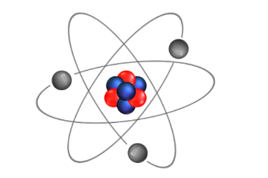
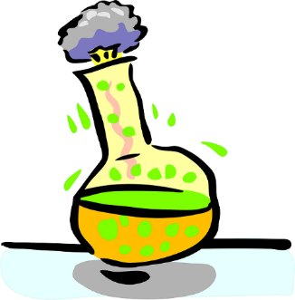
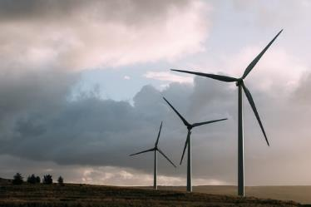
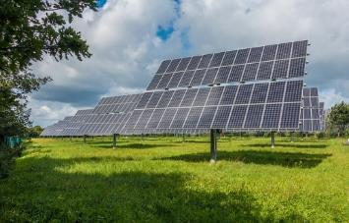
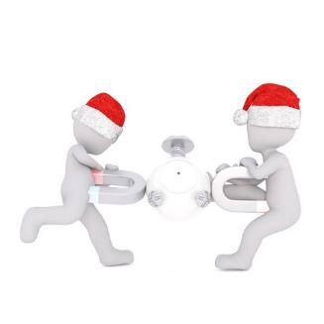
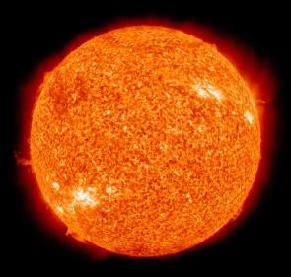
Familiar Forms of Energy
All photographs courtesy of Pixabay.com
Notes:
8 min
a. Hide the images on the slide and ask participants to name some of the different forms of energy they encounter every day.
b. Then reveal the images and ask participants the following questions:
What are some ways in which energy reveals itself to us?
How would you describe the transfer of energy in the examples on the slide?
What form of energy do any of these objects illustrate? How would you describe this energy?
Key ideas in slide images:
A lightning bolt radiates light from a region of air that is superheated and conducts heat into the air surrounding it.
Solar panels receive heat from the Sun in the form of radiation.
The Sun is an illuminated gas that releases heat to its cold environment in the form of radiation (much of the heat released is visible light).
Chemical potential energy in the molecular form of volatile chemicals is released to its environment as heat.
The nucleus of an atom is held together with a strong binding energy that remains dormant until the atom splits (as in a nuclear bomb or reactor).
Wind is the result of large masses of air moving from hot places on the planet to cold places (convective heat). This air can be captured and converted to rotational kinetic energy in a windmill.
Magnets have a strong attraction to one another, and prying them apart requires working against this magnetic force. Since work requires motion, working against this force succeeds only if the magnets actually move apart.
Electrical current is a form of work that sets charges in motion inside an electric conductor. This work is converted to light that we receive in the form of heat because it radiates away from an object (e.g., the fluorescent gas of CFL bulbs on the slide).

Slide 39
Forms of Energy
Read each description on the handout and write down at least one example of each form of energy.
See if you can match any of the definitions on the handout with the pictures on the previous slide.
Notes:
10 min
a. Distribute handout 5.6 (Forms of Energy) and read through the definitions.
b. Individuals: Ask participants to write down an example of each form of energy on their handouts. Then ask participants to see if they can match any of the definitions on the handout with the pictures on the previous slide.
Note: Return to previous slide to complete the handout. Try to elicit anything participants may remember from past courses in physics.
c. Emphasize that these are energy forms, not energy transfers. Some of these forms aren’t easy to detect with the senses.
d. Whole-group share-out: Invite participants to share their examples of various forms of energy. Then ask if they were able to match and energy definitions with the slide photos.
Examples of energy forms:
Kinetic energy: a moving bicycle
Chemical energy: gasoline, wood, coal, food
Internal energy: the random motion and arrangement of atoms in a glass of water at room temperature
Gravitational potential energy: the pull of gravity causes water at the top of a mountain to flow downhill rather than uphill
Mechanical waves: sound, water, earthquakes
Electrical energy: turning on an electrical circuit connected to a battery
Radiant energy: heat from the Sun
Nuclear energy: the source of heat inside the Sun; atoms splitting to create fuel in submarines, power plants, and bombs
Elastic energy: a stretched rubber band
Mass energy: energy released in nuclear reactions and inside the Sun

Slide 40
How Energy Is Transferred
Energy is transferred as a result of work and as heat. How can you tell?
Definitions
Work is a push-or-pull force that acts across any amount of distance on an object
Heat is a form of energy that flows automatically from a hot thing to a cold thing. The receiving object gains internal energy, causing it to warm up or change phase (e.g., liquid to gas).
Notes:
2 min
a. “Energy transfers aren’t forms of energy but ways in which energy moves from one object to another. We can detect most energy transfers with our senses.”
b. “Energy can transfer from object to object or from place to place as a result of work or as heat. Scientists make strict distinctions between work and heat.”
c. Review these definitions:
Work is a push-or-pull force that acts across any amount of distance on an object.
Heat is a form of energy that flows automatically from a hot thing to a cold thing. The receiving object gains internal energy, causing it to warm up or change phase (e.g., from a solid to a liquid as ice melts, or from a liquid to gas as water boils).
d. Ask participants, “How can you tell that energy is being transferred?” Elicit some ideas and examples.

Slide 41
How Energy Is Transferred through Work
Work
Accomplished when moving an object against a frictional force
Performed by gravity when something falls to the ground
Accomplished when lifting an object against the force of gravity
Required to squeeze an object against elastic forces
Causes an object to accelerate to a new speed
Required for charging a battery to use later
Notes:
Less than 1 min
a. Read through the information on the slide.

Slide 42
How Energy Is Transferred as Heat
Heat
Radiated by the brightness of a fire
Reaches Earth from the Sun
Rises with the hot air from a heating duct
Causes warm air to rise
Felt when holding a sleeping baby
Melts ice in your hand
Transfers from a hot iron to your hand when you burn it
Causes a kettle of water to change temperature
Notes:
Less than 1 min
a. Read through the information on the slide.

Slide 43
Energy Sources
Where does the energy come from for the following objects to achieve something useful?
Coasting bicycle
Flowing water
Speeding car
Burning log
Shining lightbulb
Ringing cell phone
Bouncing soccer ball
Crawling baby
Notes:
4 min
a. Read the question on the slide.
b. Whole group: Elicit ideas from participants; then quickly review the answers from the answer key.
Answer key:
Moving bicycle: Kinetic energy generated from motion
Flowing water: Gravitational potential energy from height
Speeding car: Kinetic energy from gasoline powering the engine
Burning log: Chemical energy from the chemical bonds in the wood
Shining lightbulb: Electrical energy from a power-generating plant
Ringing cell phone: Stored electrical energy from a battery
Bouncing soccer ball: Kinetic energy in the ball
Crawling baby: Kinetic energy from food

Slide 44
Unit Central Question
How does the energy of an object move and change?
Notes:
Less than 1 min
a. Read the unit central question on the slide.
b. Emphasize that this question will guide student learning throughout the entire series of Energy Transfer lessons.
c. Tell participants that the information they gather during the content deepening investigations this week will help them answer this question.
d. Have participants write the focus question in their science notebooks and draw a double-lined box around it. This practice reinforces the process they’ll follow with students in the lessons.

Slide 45
Content Deepening: Focus Question 1
How do we know whether something has energy?
Notes:
Less than 1 min
a. Read the focus question on the slide.
b. Emphasize that this question will guide student learning throughout ET lesson 1b.
c. Ask participants to write the focus question in their notebooks and draw a box around it.

Slide 46
Investigation 1: Energy Detectives
Pairs: Examine the objects in the bag. Then talk about whether these objects have energy.
What do you observe?
Which sense(s) are you using to detect energy in each object?
What evidence can you find that shows the object has energy?
Record your observations and evidence for each object on a data table in your notebooks. Include anything you did to each object to detect energy.
Notes:
10 min
a. “For this investigation, you’ll become energy detectives and see if you can detect the presence of energy in some different objects.”
b. Have participants pair up with their elbow partners. Then give each pair a plastic bag containing a windup toy, a flashlight, and a noisemaker.
c. Walk participants through the directions on the slide.
d. “As you observe and handle these objects, keep in mind that you may have to do something to them to detect energy.”
e. Direct participants to record their observations and evidence of energy for each object on a data table in their science notebooks. The table should have two columns with the headings “Object” and “Evidence of Energy.”
Note: You may want to display the sample data table from ET lesson 1a on a document reader.
f. During this investigation, circulate around the room, listening to participants’ ideas and observations and asking elicit and probe questions.

Slide 47
Investigation 1: Energy Detectives
What did you find out as energy detectives?
What did you observe about each object?
Which sense(s) did you use to detect energy in each object?
What evidence of energy did you find in each object?
Did you need to do anything to the object to detect energy? If so, what?
As others share, be ready to agree, disagree, ask questions, or add on.
Notes:
5 min
a. Whole-group discussion: Have pairs share the observations and evidence they recorded on their data tables for each object. Make sure they include which senses they used to detect the presence of energy in an object and whether they needed to do anything to the object to detect energy.
b. During this discussion, encourage participants to agree, disagree, ask questions, or add on.

Slide 48
Reflect: Content Deepening Focus Question 1
How do we know whether something has energy?
Notes:
4 min
a. Review the focus question on the slide.
b. Invite participants to share their ideas for answering the question, using observations and evidence from the previous investigation.
c. Encourage participants to agree, disagree, ask questions, or add to the ideas others share.
d. During this discussion, record key ideas on chart paper.

Slide 49
Key Science Ideas
Energy is all around us and can be detected using our senses.
Seeing objects move, hearing a sound, feeling heat, and seeing light are all ways of detecting energy.
Notes:
3 min
a. Review the key science ideas on the slide that answer the focus question. Emphasize that participants’ observations helped shape these responses.
b. Point out that detecting motion, sound, heat, and light in objects is actually evidence of energy transfer rather than energy, but this distinction isn’t necessary for students to be aware of at this point.
c. Whole-group discussion: “Does everyone agree with these ideas? Would you like to add or revise anything?”
d. Have participants copy these science ideas into their science notebooks under the focus question.

Slide 50
Content Deepening: Focus Question 2
What causes a moving object to have more or less motion energy?
Notes:
Less than 1 min
a. Read the focus question on the slide.
b. Emphasize that this question will guide student learning throughout ET lessons 2a/b.
c. Ask participants to write the focus question in their notebooks and draw a box around it.

Slide 51
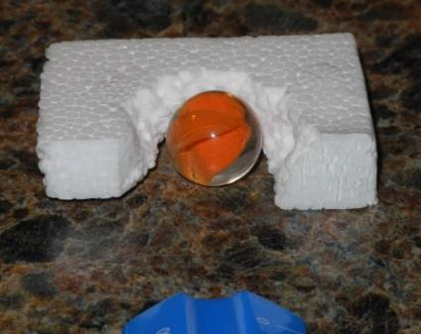
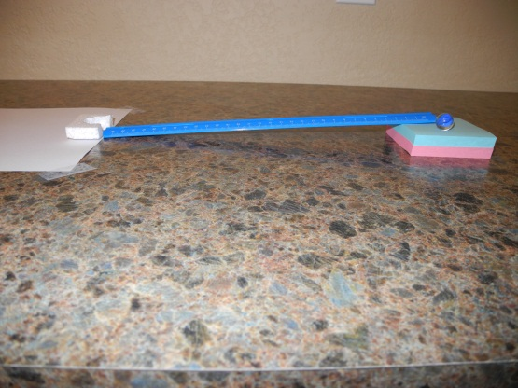
Investigation 2: High-Speed Energy
Locate ET lesson handout 2.2 (High-Speed Energy Procedure) in your lesson plans binder.
Follow the directions carefully as you set up your ramps and conduct the investigation.
Make sure to record your data on handout 5.7 (Ramps, Speed, and Energy).
Photo courtesy of BSCS
Photo courtesy of BSCS
Notes:
15 min
a. Have participants locate ET handout 2.2 (High-Speed Energy Procedure) in their lesson plans binders. Then distribute handout 5.7 (Ramps, Speed, and Energy) to each participant.
b. “For this investigation, you’ll pair up with your elbow partners again and explore the speed and energy of a marble as it rolls down ramps of different heights and moves a piece of Styrofoam.”
c. Hand out the necessary materials to each pair of participants.
d. Demonstrate the setup for participants, including how to mark the sheet of paper to indicate where the Styrofoam block stops moving (step 4 on handout 2.2) and how to measure the distance from the middle mark to the edge of the paper (step 7).
e. Inform pairs that they may have to perform several practice runs to get the marble to land in the Styrofoam groove correctly.
f. Emphasize that participants should finish steps 1–9 for Ramp 1 before setting up Ramp 2.
g. Answer any questions before directing pairs to begin their investigations. Circulate around the room during the activity to assist as needed.
Note: Make sure participants complete the entire handout during this investigation. In the actual activity, students gather data in one lesson and analyze it in the following lesson.

Slide 52
Investigation 2: High-Speed Energy
Where did you detect energy in the ramp-and-marble setups?
How did you detect motion (kinetic) energy in the marbles?
Did you detect energy in any other objects?
Which marble had more motion (kinetic) energy? What’s your evidence?
Notes:
5 min
a. Read the questions on the slide.
b. Whole-group share-out: Invite pairs to share their observations and evidence from the investigation. Probe participants’ responses and elicit differing points of view.
c. During this discussion, record participants’ observations and ideas on chart paper.
d. Try to reach a group consensus regarding question 4. Then have participants write the answers to each question in their science notebooks.

Slide 53
Reflect: Content Deepening Focus Question 2
What causes a moving object to have more or less motion energy?
Notes:
4 min
a. Review the focus question on the slide.
b. Invite participants to share their ideas for answering the question, using observations and evidence from the ramp-and-marble investigation.
c. Encourage participants to agree, disagree, ask questions, or add to the ideas others share.
e. During this discussion, record key ideas on chart paper.

Slide 54
Key Science Ideas
Energy is all around us, and we can detect its presence with our senses.
Moving objects have a form of energy called motion energy. Motion energy is also called kinetic energy.
A marble rolls faster down a higher ramp than a lower ramp of the same length.
When a faster-moving marble rolls down a higher ramp and collides with an object at the bottom, it will push that object farther than it would if it rolled down a lower ramp at a slower speed. Therefore, the faster-moving marble has more energy.
Notes:
3 min
a. Review the key science ideas on the slide that answer the focus question. Emphasize that participants’ observations and evidence from the ramp-and-marble investigation helped shape these responses.
b. Whole-group discussion: “Does everyone agree with these ideas? Would you like to add or revise anything?”
c. Have participants copy these science ideas into their science notebooks under the focus question.

Slide 55
More Than Meets the Eye: Energy Detectives
Is all energy detectable?
Where does energy go after you detect it?
What forms of energy do hyper kids have?
Does a child transfer energy when sitting still and quiet?
Notes:
8 min
a. Think-Pair-Share (4 min): Ask participants to think about the questions on the slide that relate to today’s energy-detectives investigation. Then have them pair up and discuss their ideas with an elbow partner.
b. Whole-group discussion (4 min): Invite participants to share their ideas with the group. Probe participants’ responses and elicit differing points of view.
c. Following the discussion, highlight these answers:
Question 1: Some forms of energy can’t be detected with our senses. The chemical potential energy of a match and the gravitational potential energy of an object at the top of a hill are two examples .
Question 2: The energy we detect in an object can transfer as heat to the environment. As a bouncing ball hits the ground, its energy is gradually lost as heat to the environment until it has no more energy.
Question 3: Hyper kids have kinetic energy from food (i.e., sugar from breakfast), but their energy also transfers to the environment in the form of heat (conduction), sound waves, and working against the ground’s friction as they walk and run (which leads to heat conduction). The energy of hyper kids is like the internal energy of molecules inside an object that gains heat.
Question 4: Even when perfectly still, all humans radiate heat like little space heaters and consume heat through their bodily functions.

Slide 56
More Than Meets the Eye: High-Speed Energy
Where did the marble’s energy come from in the ramp-and-marble investigation?
How did the marble’s potential energy change based on ramp height?
Where did the marble’s energy go?
How could you make the marble go faster?
What would happen if the marble were made of steel?
Notes:
8 min
a. Think-Pair-Share (4 min): Ask participants to think about the questions on the slide that relate to today’s high-speed energy investigation. Then have them pair up and discuss their ideas with an elbow partner.
b. Whole-group discussion (4 min): Invite participants to share their ideas with the group. Probe participants’ responses and elicit differing points of view.
c. Following the discussion, highlight these answers:
Question 1: The energy the marble had to roll down the ramp came entirely from its gravitational potential energy at the top of the ramp. Frictional force works on the moving marble, causing it to slow down and eventually stop. That work is proportional to distance: W = fd (f = frictional force; d = distance traveled). That work converts entirely into heat by slightly raising the temperature of the floor and the foam. Eventually, that heat radiates or conducts into other adjacent objects and is released into the air. So energy isn’t lost; it’s just transferred into heat. And heat isn’t detectable in this case.
Question 2: The marble’s total energy at the top of the ramp is in the form of gravitational potential energy, which is proportional to the ramp height and independent of steepness.
Question 3: As the marble rolls down the ramp, it loses potential energy and gains kinetic energy. As kinetic energy decreases, frictional force increases, slowing the marble down. Ultimately, energy turns to heat once the marble has reached a complete stop.
Question 4: The marble’s speed could be increased with a longer or higher ramp, but not both. The amount of potential energy and, thus, the marble’s final kinetic energy come from the height of the ramp.
Question 5: If the marble were made of steel, it would be heavier and have more mass. The kinetic energy of a heavier marble moving at the same speed as a lighter marble would depend on that mass: KE = (1/2)mv². So the heavier marble moving at the same speed as the lighter marble would have more kinetic energy because it has more mass. The heavier marble, therefore, would push the Styrofoam farther.

Slide 57
Energy Puzzles
Kinetic energy: the energy of a moving body, object, or system proportional to mass and velocity squared, or KE = (1/2)mv ²
Gravitational potential energy: the stored energy of an object above the ground (the lowest surface of Earth) proportional to mass, the object’s acceleration, and height, or GPE = mass × acceleration x height
Heat: a less useful end form of energy that transfers from one object to another as a result of temperature differences
Conduction: The flow of heat from a warmer object to a colder object through direct contact
Convection: The circular flow of heat that occurs when warmer air or water rises and then sinks as it cools
Radiation: The transfer of heat energy through electromagnetic waves
Heat automatically flows in only one direction, from hot to cold.
Notes:
8 min
a. Highlight the information about kinetic energy, gravitational potential energy, and heat on the slide.
b. With these ideas in mind, discuss the following questions with participants:
Which object has more kinetic energy at 55 miles per hour: a Hummer or a Mini Cooper?
Which of two identical cars has higher kinetic energy if one is moving faster?
How does a skier gain potential energy?
Which of two skiers at the top of a mountain has more potential energy: a fat one or a skinny one? Why?
Heat is an inescapable transfer of energy that can’t be ignored in our examples. Rub your hands together and feel your work turn into heat. But can you reverse this transfer from hot to cold?
Imagine coffee getting cold in a room. Where does heat go? Can it return to the coffee mug by itself?
Scattered heat isn’t as useful as localized heat. Would you rather have a lot of heat in your car’s pistons or heat coming out of the tailpipe and escaping into the atmosphere? The pistons’ heat is far more useful that the heat escaping from the tailpipe!

Slide 58
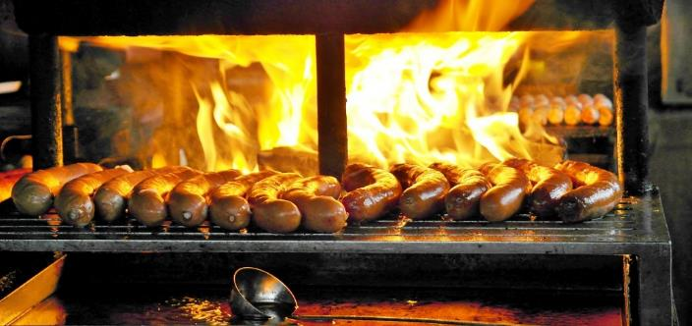
Playing Energy Detectives
Scenario 1: A jet engine climbs into the air at a high velocity, taking happy passengers to a far-away destination
Photo courtesy of Pixabay.com
Scenario 2: Tasty sausages are cooking on a wood-burning grill.
Photo courtesy of Pixabay.com
Notes:
8 min
a. “As energy detectives, let’s investigate the scenarios on this slide.”
b. Introduce each scenario and ask participants the following questions:
Which forms of detectable energy are present in each scenario?
What transfers of energy are taking place in each scenario?
How does kinetic energy change in the airplane?
How does potential energy change in the airplane?
What restrictions apply to the flow of heat in these scenarios (i.e., in what directions can heat flow)?
Answer key:
Question 1: kinetic energy and light energy
Question 2: Chemical energy in the aircraft fuel is converted to kinetic energy, gravitational potential energy, heat (exhaust), and the roaring sound of the engine.
Question 3: The plane’s kinetic energy increases because the engine is working to keep the plane climbing into the air.
Question 4: The plane’s potential energy also increases because the engine is working against Earth’s gravitational pull.
Question 5: Heat can flow in only one direction, from hot to cold.

Slide 59
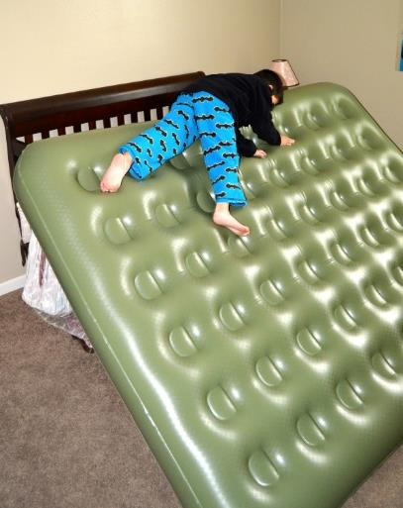
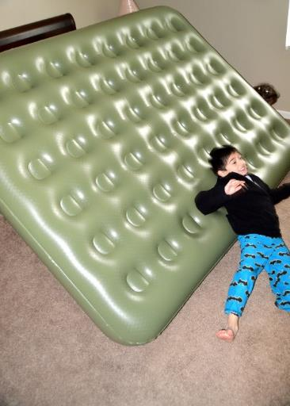
An Energy Challenge
A boy climbs to the top of a bumpy air mattress and then slides down to the floor, where he comes to a gentle stop.
What forms of energy are present when the boy is at the top of the mattress?
What forms of energy are present as the boy slides halfway down the mattress?
Where did the energy go when the boy finds himself on the floor?
What would happen if there were no friction between the boy and adjacent objects?
Photo courtesy of Hector Mireles
Notes:
8 min
a. Read the scenario and questions on the slide.
b. Individuals: Direct participants to answer the questions in their science notebooks, using evidence and reasoning to support their ideas.
Note: The challenge highlights the transfer of kinetic energy to heat energy through friction in everyday experiences.
c. Whole group: Call on a few participants to share their answers and reasoning. Probe participants’ responses and elicit differing points of view.
Note: If time is limited, skip the group share-out and just read through the answer key.
d. Quickly highlight the correct answers (see answer key).
Answer key:
Question 1: Potential energy is present at the top of the mattress.
Question 2: Potential energy, kinetic energy, and frictional heat are all present when the boy is halfway down the mattress.
Question 3: All of the energy converted to heat.
Question 4: All of the boy’s initial potential energy would transfer to kinetic energy once he reached the bottom of the mattress.

Slide 60
Common Energy Misconceptions
Energy is a “thing,” a material object.
Energy is the same thing as force and power.
If an object isn’t part of some action, it has no energy.
Energy has human qualities like want or desire.
Energy can be used up or destroyed.
Energy can be created.
Only mechanical things and loud things have energy.
We can do useful things with all forms of energy.
There’s no need for energy conservation, since all energy is conserved.
Notes:
8 min
a. Read through the common energy misconceptions on the slide.
b. Ask volunteers to contribute a scientifically accurate statement that replaces each misconception.
c. Probe participants’ responses and elicit differing points of view. Highlight ideas in the answer key as needed.
Answer key:
Question 1: Energy isn’t a concrete thing. Objects themselves aren’t energy; they possess energy in various forms.
Question 2: Force transfers energy when it acts on an object over a certain distance. Power is the rate at which energy is transferred.
Question 3: Action isn’t necessary for energy to be present. Potential energy is stored energy quietly waiting to be released (e.g., a fuel tank, matches, a boulder at the top of a hill, a squeezed spring).
Question 4: It’s common to use everyday language to explain scientific phenomena. Students might say, “Heat wants to move from hot to cold,” or “The marble likes being at the bottom of the ramp,” or “The packing peanut needs to stop.” Inanimate objects don’t have human qualities associated with volition or emotion. Qualities such as love, hate, want, need, intention, and desire don’t affect the laws of nature.
Questions 5 and 6: Energy is always conserved. It may change from one form (maybe a visible form) to another form (maybe an invisible form), but it can never be created, used up, or destroyed.
Question 7: The Sun is the source of most of our energy, and it isn’t mechanical or loud.
Question 8: Heat energy that escapes into the atmosphere or outer space isn’t useful and can’t be recaptured even though it’s still energy.
Question 9: Useful forms of energy, such as different types of fuel and localized heat sources, are hard to access, extract, and refine. When we use them, they turn into heat energy and spread out into the atmosphere, which isn’t useful.

Slide 61
Today’s Focus Questions
What is the Science Content Storyline Lens (SCSL)?
Why is one main learning goal essential for science content storyline coherence?
How do we know whether something has energy?
What causes a moving object to have more or less motion energy?
Notes:
Less than 1 min
a. Review the focus questions addressed during today’s session.

Slide 62
Summary: Today’s Lesson Analysis Work
Reflect on today’s session:
STL strategy 6: use and apply
The Science Content Storyline Lens (SCSL)
Science ideas and student ideas
SCSL strategy A: identify one main learning goal
Based on our work today, do you have any suggestions for modifying our image of effective science teaching?
Notes:
3 min
a. Individual think time (1 min): Ask participants to reflect on the work they accomplished during today’s lesson analysis and then think about the question on the slide.
b. Whole-group share-out (2 min): Invite participants to share their ideas for modifying the image of effective science teaching based on today’s work. Revise the chart as needed.

Slide 63
Summary: Today’s Content Deepening Work
Name one main learning goal for today’s content deepening work.
OR
Name one supporting science idea you learned about energy transfer and/or transformation today.
OR
Name one common student idea (misconception) about energy and energy transfer.
Notes:
3 min
Individual think time (1 min): Present the options on the slide and give participants 1 minute to come up with a statement that summarizes today’s content deepening work in one of these areas.
Whole-group round-robin (2 min): Go quickly around the room and have each participant share one summarizing statement. Push for complete sentences!

Slide 64
Homework
Read in the STeLLA strategies booklet:
SCSL strategy B: Set the purpose with a focus question or goal statement
SCSL strategy C: Select activities that are matched to the learning goal
SCSL strategy I: Summarize key science ideas
STL strategy 7: Engage students in making connections by synthesizing and summarizing key science ideas
Fill in the appropriate columns on your SCSL Z-fold summary charts.
Notes:
2 min
a. Review the homework assignment on the slide and have participants write it in their notebooks.
b. Make sure participants are clear about the reading and writing tasks.

Slide 65
Extended Homework
Locate handout 5.8 (Extended Homework) in your PD program binder.
Between now and Friday, read your assigned two-part lesson plan (parts A and B).
Be prepared to share your findings in a study-group conversation on our last day.
Notes:
2 min
a. Go over the information on this slide.
b. Have participants review the Extended Homework assignment sheet (handout 5.8), which provides further details about the assignment.
c. Remind participants that like the extended homework they were assigned on the Earth’s Changing Surface lessons during week 1, participants are responsible for reading parts A and B of their assigned lesson plan.
d. Assign a two-part lesson plan to each participant.
e. Ask if there are any questions about the assignment.
f. Emphasize: The group share-out on the last day of the PD program (day 8) should focus on the assignment-sheet questions (section 2). Participants won’t have time to share all the details of each lesson plan.

Slide 66
Reflections on Today’s Session
Reflect on lesson analysis: In what way(s) did our lesson analysis work and/or our study of SCSL strategy A (one main learning goal) stretch your thinking? Give an example to support your response.
Reflect on content deepening: Describe how our content deepening work today helped you clarify a science-content idea.
Feedback: Provide feedback about today’s session and the program so far (likes, dislikes, questions, concerns, suggestions).
Notes:
5 min
a. Ask participants to think about today’s session and write their reflections and feedback on the Daily Reflections sheet (handout 5.9 in PD program binder).

