Slide 1
RESPeCT PD pROGRAM
Day 2
RESPeCT Summer Institute
Notes:
3 min
a. Take care of any housekeeping issues.

Slide 2
Trends in Reflections
Lesson Analysis | Science Content Learning
Notes:
5 min
a. Give participants time to review your summary of their reflections from day 1 and offer reactions and comments or ask follow-up questions.

Slide 3
Norms for Working Together: The Basics
Purpose: Build trust and develop a productive study group for all participants.
The Basics
Arrive prepared and on time; stay for the duration; return from breaks on time.
Remain attentive, thoughtful, and respectful; engage and be present.
Eliminate interruptions (turn off cell phones, email, and other electronic devices; avoid sidebar conversations).
Make room for everyone to participate (monitor your floor time).
Notes:
5 min
a. Provide context: “Since we’ll be working together throughout the Summer Institute and the academic year, we need norms that will enable us to build trust and productivity as a group. Today we’ll start our analysis of other teachers’ classroom videos. In the fall, we’ll analyze videos from each other’s classrooms. For this work to be meaningful, we’ll need to push and challenge each other. This will require mutual respect and a common understanding of our goals.”
b. “Do you want to clarify or revise any of these norms?”
Note: Have participants locate the half-page sheet of norms they pasted into their science notebooks on day 1. Remind them to leave space for revising the norms.
c. Encourage participants to ask clarifying questions regarding the meaning of any of the norms and jot notes in their science notebooks.
d. Ask participants if they’re willing to live with these norms today, and let them know they’ll have an opportunity to revise them tomorrow. Remind them of this at the end of the session.

Slide 4
Norms for Working Together: The Heart
Purpose: Build trust and develop a productive study group for all participants.
The Heart of RESPeCT Lesson Analysis and Content Deepening
Keep the goal in mind: analysis of teaching to improve student learning.
Share your ideas, uncertainties, confusion, disagreements, questions, and good humor. All points of view are welcome.
Expect and ask questions to deepen everyone’s learning; be constructively challenging.
Listen carefully; seek to understand other participants’ points of view.
Notes:
5 min
a. “Now let’s review the norms at the heart of the RESPeCT PD program.”
b. “Do you want to clarify or revise any of these norms?”
c. “Do you want to add any norms to the list?”
d. Ask participants if they’re willing to live with these norms today, and announce that they’ll have an opportunity to revise them tomorrow.

Slide 5
Agenda for Day 2
Day-1 reflections
Focus questions
Review of STL strategies 1–3
STL lesson analysis: elicit and probe questions
STL lesson analysis: probe and challenge questions
Practice using elicit and probe questions
Lunch
Content deepening: Earth’s changing surface
Summary, homework, and reflections
Notes:
Less than 1 min
a. Talk through the agenda for the day.

Slide 6
Today’s Focus Questions
Lesson Analysis
Content Deepening
How can lesson analysis help us better understand how elicit, probe, and challenge questions can reveal and challenge student thinking?
What happens to Earth’s surface that causes mountains to form?
Are the moving plates of Earth’s crust involved in building up Earth’s surface and forming mountains? If so, how?
What evidence can we find to support the idea that mountains form when Earth’s crustal plates collide?
Notes:
1 min
a. Introduce the focus questions that will guide today’s session.
b. “Each day we’re going to have at least one lesson analysis focus question and one content deepening focus question.”
c. “Here are our focus questions for today’s session.”

Slide 7
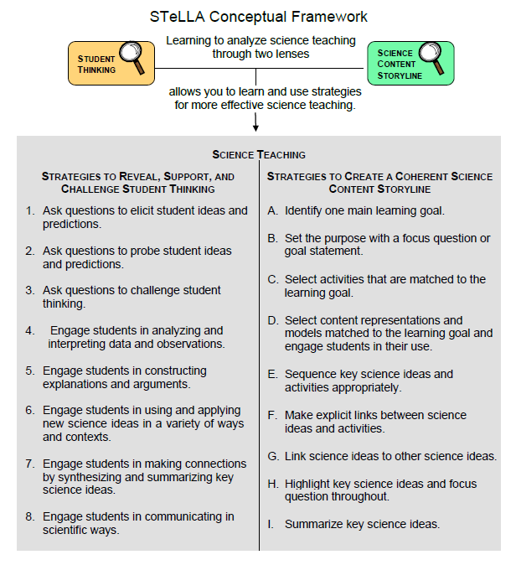
Notes:
Less than 1 min
a. Point out the strategies highlighted on the slide.
b. “During today’s session, we’ll focus again on the Student Thinking Lens strategies: elicit, probe, and challenge questions.”

Slide 8
Probe versus Challenge Questions
Read one of the dialogue examples for STL strategy 3 in the STeLLA strategies booklet.
With an elbow partner, try to justify why each question is labeled probe or challenge.
For help, refer to the STL Z-fold summary chart and the explanations, examples, and general questions for strategy 3 in the strategies booklet.
Be ready to share your ideas.
Notes:
15 min
a. Have participants look in the STeLLA strategies booklet at a dialogue example for strategy 3 that highlights probe and challenge questions.
b. The purposes of this activity are as follows:
1. To get participants’ heads back into the questioning strategies discussed on day 1.
2. To make sure participants understand the distinct purposes of probe and challenge questions:
Probe questions seek to understand what students are saying/writing and encourage them to explain their ideas more clearly or fully (not to change their thinking).
Challenge questions seek to engage students in ways that will challenge them to think, reconsider their ideas, change their initial ideas, and move toward more-scientific understandings.

Slide 9
Lesson Analysis Focus Question
How can lesson analysis help us better understand how elicit, probe, and challenge questions can reveal and challenge student thinking?
Notes:
Less than 1 min
a. “Today we’ll explore this focus question: How can lesson analysis help us better understand how elicit, probe, and challenge questions can reveal and challenge student thinking?”
b. “But first let’s discuss what lesson analysis involves.”

Slide 10
RESPeCT Lesson Analysis Protocol
1. Identify the strategy
What STeLLA lens and strategy was the teacher using in the video clip?
2. Analyze the video
What student thinking was made visible (or not)?
How did the use of the STeLLA strategy impact student thinking?
3. Reflect and apply
What did you learn from identifying and analyzing the strategy in the video?
Notes:
Less than 1 min
a. “This is the three-step protocol that will guide our video-based lesson analysis work. Although we’ll follow the protocol a bit more loosely during the Summer Institute, we’ll rely heavily on this explicit three-step format as we move into the fall study groups.”
b. Review the steps on the slide; then tell participants, “Framing our analysis in this way and following specific steps will help us focus more holistically on the teaching and the impact of the STeLLA strategies on student thinking and learning and the storyline students are constructing (i.e., the Student Thinking Lens and the Science Content Storyline Lens).”

Slide 11
Lesson Analysis Process
Review the lesson context:
What is the ideal student response to the focus question?
How is the clip situated in the content storyline?
Identify and discuss the strategy that is the focus of analysis for each clip.
Watch video clip(s).
Analyze the lesson using the lesson analysis protocol.
Reflect on the lesson analysis experience:
As a reviewer
As a teacher in the clip
Notes:
Less than 1 min
a. “The lesson analysis protocol includes this five-step process.”
b. Review the steps on the slide and note that in the study groups, these steps will be followed more explicitly than they will be during the Summer Institute.

Slide 12
Lesson Analysis: Viewing Basics
Viewing basic 1: Look past the trivial, or little things, that bug you.
Viewing basic 2: Avoid the “This doesn’t look like my classroom!” trap.
Viewing basic 3: Avoid making snap judgments about the teaching or learning in the classroom you’re viewing.
Note: Find out more about the viewing basics on page 1 of the STeLLA strategies booklet.
Notes:
2 min
a. Ask: “Why is each of these viewing basics important? Which will be hardest for you?”
b. Tell participants they can find details on the viewing basics in the STeLLA strategies booklet and refer to this information later.
c. Highlight: “The videos we’ll be viewing throughout the program aren’t necessarily exemplary, but rather they provide real-world examples of teachers implementing the STeLLA strategies. Examples like these deepen our thinking because we can see the sometimes unintended results of teacher decisions and consider missed opportunities.”
d. Honor the videocase teachers! All of these courageous teachers are not only working hard to improve their own teaching practice but are also willing to make their practice public so that others can learn from it. None of them would claim to be exemplary science teachers.

Slide 13
Our First Video Clip
Video Clip 1
Context:
An interview with a student (Nick) before the teacher begins instruction on Earth’s changing surface.
Read the context at the top of the video transcript (handout 2.1 in your PD program binder).
Nick and the interviewer refer to a relief map of the United States that shows various topographical features.
Notes:
2 min
a. Describe the context of the first video clip participants will watch. (See the top of the transcript—handout 2.1 in the PD program binder.)
b. “This student interview showcases the use of elicit and probe questions. Even though this clip doesn’t take place in the context of an actual classroom, the idea is to look at the quality and form of the questions. Our second video clip will feature probe and challenge questions in a classroom context.”

Slide 14
Identify Elicit and Probe Questions
Video Clip 1
Watch the video clip for examples of elicit and probe questions.
Individuals: Mark E (elicit) and P (probe) on your transcript.
Share your evidence with the group.
Remember:
Not all questions will fall into the E and P categories.
Elicit questions start a conversation and ask for student ideas without expecting right answers.
Probe questions try to figure out what a student means.
Probe questions can paraphrase a student’s idea.
Link to video clip 1: 2.1_stella2-04-torres4-SI_pre_nick_c1
Notes:
20 min
a. Provide instructions for watching video clip 1 and using the transcript (handout 2.1) to identify questions that elicit (E) and probe (P) student ideas and predictions.
b. Remind participants that the purpose of watching the video clip is to deepen their shared understandings of these strategies and to build their individual and collective lesson analysis skills.
c. Individuals: Allow time for participants to review the video transcript and mark E and P questions.
d. Whole group: Discuss what participants found in the transcript. Encourage them to use evidence from the transcript and reasons from their Z-fold summary charts or the STeLLA strategies booklet to support their ideas. Participants should work to differentiate elicit and probe questions and distinguish them from other types of teacher questions or statements.

Slide 15
Analyze Student Thinking
Video Clip 1
Review the interview transcript.
What student thinking was revealed through the interviewer’s elicit and probe questions?
What ideas did Nick have about how mountains are formed?
Were there places you wished the interviewer had probed more into Nick’s thinking? Why?
Notes:
20 min
a. Give participants time to review the video transcript and develop an answer to one of the analysis questions on this slide. Encourage them to write down their answers in their science notebooks.
b. For this first video analysis, do a round-robin and have each participant share. Ask probe and challenge questions to support participants in communicating their ideas clearly and completely:
Probe question: “Can you say more about what you mean by …?”
Challenge question: “Can you point to a specific place in the transcript that supports your idea?”
c. As participants share, encourage others to respond by asking questions like these:
Do others have additional evidence to support (or challenge) this idea?
Do others have a different interpretation?

Slide 16
Identify Probe and Challenge Questions
Video Clip 2
Now we’ll look at a classroom video and focus on identifying probe and challenge questions.
Read the context at the top of the video transcript (handout 2.2).
Identify probe (P) and challenge (C) questions and mark them on your transcript.
Mark “missed opportunity” (MO) next to places you would like to know more about student thinking.
Remember:
Probe questions try to figure out what a student means or is thinking.
Challenge questions try to move student thinking toward a more scientifically accurate idea.
Link to video clip 2: 2.2_stella2-04-torres4-L1_c1
Notes:
20 min
a. Provide instructions for watching video clip 2 and using the transcript (handout 2.2) to identify questions that probe student ideas and predictions and challenge student thinking.
b. Encourage participants to refer to the strategy charts from day 1 (STL strategies 1–3), their Z-fold summary charts, and the STeLLA strategies booklet for help differentiating probe and challenge questions. Remind them that other types of questions (such as elicit questions) may appear in this video clip.
c. Set the context: Read the context for video clip 2 (at the top of the transcript).
d. Show the video clip and allow time for participants to study the transcript before advancing to the next slide.

Slide 17
Identify Probe and Challenge Questions
Video Clip 2
What are good examples of probe questions in the video transcript (if any)?
What are good examples of challenge questions in the transcript (if any)?
Notes:
5 min
a. After each suggested probe or challenge question, ask participants the following:
“What makes this a probe/challenge question?”
“Did others mark this as a probe/challenge question?”
“Can you point to any of our resources (the Z-fold summary chart, our strategy charts from day 1, or the STeLLA strategies booklet) to support your answer?”
b. Don’t worry about debate and lack of agreement on some questions. The important thing is that participants clearly understand the difference between the purposes of probe and challenge questions. Sometimes it’s hard to tell whether the teacher in the video intended to find out what a student meant (probe) or move student thinking toward more-scientific understandings (challenge). The teacher may also be asking elicit questions to reveal student ideas and misconceptions.

Slide 18
Identify Missed Opportunities to Probe Student Thinking
Video Clip 2
Individuals: Locate one missed opportunity in the video where the teacher could have asked a probe question. Suggest a probe question to better understand student thinking.
Turn and Talk: Turn to a partner and share your possible probe question. Provide each other with feedback. Ask, “Is this a probe question? Why or why not?”
Whole group: Do you need any clarification?
Notes:
10 min
a. Individuals: “Identify a missed opportunity for a probe question in the video transcript.”
b. Turn and Talk: Have participants pair up and discuss their suggested probe questions. Listen to their conversations to assess whether they truly comprehend that a probe question is designed to help them understand what students are thinking.
c. Whole-group share-out: Participants may need guidance about when to ask probe questions. Remind them that probe questions are appropriate when students make vague or abbreviated statements, or when they simply use a vocabulary term without saying what it means. Do they really understand the term or concept, or do they have misconceptions? Ask a probe question to find out!
d. Remind participants: “Don’t probe everything a student says. Just probe responses that seem relevant to the lesson’s main learning goal and might reveal interesting student thinking.”

Slide 19
Common Student Ideas
Video Clip 2
Locate Common Student Ideas about Earth’s Changing Surface (in lesson plans binder).
Read through the left-hand column on the handout.
Have you observed any of these common ideas among your students? (Mark these ideas with a red dot.)
Have you ever held any of these ideas yourself? (Mark these ideas with a blue dot.)
Can you think of other misconceptions you’ve held or observed in students?
Whole group: What patterns do you notice in the red and blue dots? What did this analysis make you think about?
Notes:
12 min
a. “Now let’s consider some commonly held student ideas (misconceptions). Then we can analyze whether any of these ideas appear in our video clips.”
b. Have participants locate the Common Student Ideas chart in the resources section of their lesson plans binders.
c. “This Common Student Ideas chart shows some commonly held student ideas that are interesting but aren’t scientifically accurate.”
d. Individuals: Have participants mark with a red sticker dot any ideas they’ve observed among their students, and mark with a blue sticker dot any ideas they’ve had themselves.
e. Pairs: Have participants discuss their observations with a partner.
f. Whole group: Ask participants to share which ideas they’ve observed in their students and themselves. During this share-out, apply sticker dots to the Common Student Ideas chart at the front of the room to highlight patterns in the results. Then discuss the following questions:
“What conceptual patterns do you notice in the red and blue dots?”
“What reactions do you have to this analysis? What did it make you think about?”
Note: If time is short, skip this pattern analysis and discussion.
g. “We’ve recognized these common ideas in students or held them ourselves. It’s important to be aware of them when we’re analyzing student thinking in the video clips or planning and teaching lessons in the future.”
h. “Now let’s look for evidence of these common student ideas in a video clip.”

Slide 20
Common Student Ideas
Video Clip 2
Individuals: Read the scientific explanations on the Common Student Ideas chart that correspond with these misconceptions:
[Insert student idea]
[Insert student idea]
[Insert student idea]
Pairs: Discuss these explanations briefly with a partner. What was new to you? Write on sticky notes any content questions you have and place them on the Parking Lot poster.
Notes:
10 min
a. Select three or four student misconceptions from Common Student Ideas chart and insert them on the PPT. At least one of the misconceptions should be clearly visible in the video clip.
b. Individuals: “Read the scientific explanations on the Common Student Ideas chart that correspond with the student misconceptions on the slide.”
c. Pairs: “Discuss these explanations briefly with a partner. What was new to you? Write on sticky notes any content questions you have and place the notes on the Parking Lot poster.”

Slide 21
Lesson Analysis Basics
Video Clip 2
Analysis basic 1: Focus on student thinking and the science content storyline.
Analysis basic 2: Look for evidence to support any claims.
Analysis basic 3: Look more than once (in the video and transcript).
Analysis basic 4: Consider alternative explanations and teaching strategies.
Note: Find out more about the analysis basics on page 2 of the STeLLA strategies booklet.
Notes:
5 min
a. “Before we analyze the video clip for student thinking, let’s think about our lesson analysis process.”
b. Have participants read the analysis basics on the slide.
Note: Direct participants to page 2 in the strategies booklet if they have specific questions that require more information.
c. Why the analysis basics are important: “The analysis basics will help us dig deeper and learn more from our videocase analyses while keeping us focused on the ultimate goal of improved student learning.”
Note: This lesson analysis process is not about critiquing teachers but about improving student learning.
d. “We’ll use a more structured lesson analysis protocol when we begin reviewing each other’s videos in the fall study-group sessions.”

Slide 22
Analyze Questions That Probe and Challenge Student Thinking
Video Clip 2
Analysis question: What student thinking is made visible (or not) through the use of probe or challenge questions? Be specific. Consider whether you observed any of the common student ideas or correct scientific explanations in the video.
Individuals: Make notes or highlight questions/responses on the video transcript. Develop a claim to answer the question. Support the claim with
evidence from the transcript,
ideas from the Common Student Ideas chart, and/or
ideas from the STeLLA strategies booklet.
Whole group: Share claims and evidence.
Notes:
15 min
a. Remind participants of the purposes of video analysis: to deepen understandings of STeLLA strategies; to develop their ability to analyze student thinking; and, ultimately, to improve student learning.
b. Tell participants: “Remember to refer to your Common Student Ideas chart as you analyze the video clip.”
c. Individuals: Review the slide instructions before participants begin working independently on the tasks.
d. Whole group:
Have several participants share their claims and evidence.
Ask: “Did you recognize any of the common student ideas in the students’ responses?”
Ask: “What probe or challenge questions might you ask to better understand student thinking?”
Note: Remember to use probe and challenge questions as you interact with participants.

Slide 23
Identify Probe, Challenge, and Leading Questions
Video Clip 3
Now we’ll look at another classroom video. Read the context in the video transcript (top of handout 2.3).
Individuals: Mark the transcript to identify probe (P), challenge (C), or leading (L) questions. Then mark any missed opportunities (MO).
Remember:
Not all questions (or statements) will fall into these three categories: P, C, or L.
Review the viewing basics and analysis basics.
Whole-group share-out: Give reasons for marking the questions the way you did.
Link to video clip 3: 2.3_stella2-04-torres4-L3_c1-c2
Notes:
15 min
a. Read the context for this video clip (at the top of the transcript).
b. Provide instructions for watching video clip 3 and using the transcript (handout 2.3) to identify questions that probe student ideas and predictions and challenge student thinking. Participants should also be on the lookout for leading questions and missed opportunities. (Note: Leading questions provide hints or make it easy for students to give the “right” answer.) Remind participants that other types of questions (such as elicit questions) may appear in this video clip.
c. Individuals: Review the slide instructions before participants begin working independently on the tasks.
d. Whole group:
Challenge participants to clearly state their reasons for identifying a question as probe, challenge, or leading.
Encourage participants to provide evidence from the STeLLA strategies booklet to support their claims.

Slide 24
Analyze Student Thinking
Video Clip 3
Analysis question: What student thinking is made visible (or not) through the use of probe or challenge questions? Be specific.
Individuals: Develop a claim to answer the analysis question. Support the claim with
evidence from the video transcript,
ideas from the Common Student Ideas chart, and/or
ideas from the STeLLA strategies booklet.
Whole group: Share claims and evidence.
Notes:
15 min
a. Emphasize: “Remember to refer to your Common Student Ideas chart as you analyze the video.”
b. Individuals: Review the slide instructions before participants begin working independently on developing a claim to answer the analysis question.
c. Whole group:
Have several participants share their claims and evidence.
Ask: “Did you recognize any of the common student ideas in the students’ responses?”
Ask: “What probe or challenge questions might you ask to better understand student thinking?”
Note: Remember to use probe and challenge questions as you interact with participants.

Slide 25
Summarize: Elicit, Probe, and Challenge Questions
What makes a good elicit question? A good probe question? A good challenge question?
What do you need to know to ask good elicit, probe, and challenge questions?
To ask good questions that make student thinking visible, you need a clear understanding of
the science concepts you are teaching, and
alternative ideas that students may hold.
Notes:
3 min
a. Pose the first question on the slide. If participants need support, point them to the descriptions of strategies 1, 2, and 3 in the STeLLA strategies booklet (especially the Summary of STeLLA Student Thinking Lens Strategies).
b. Pose the second question. Do participants come up with the idea that science-content knowledge is essential for asking good elicit, probe, and challenge questions?
c. Use the rest of the time to highlight the importance of knowing science content and being aware of common student ideas.

Slide 26
Reflect on Your Learning
Respond to these questions in a quick write:
What did you learn about student thinking from analyzing these videos?
How did the analysis process help you better understand the questioning strategies?
Be prepared to share your ideas.
Notes:
5 min
a. Ideally, participants will first respond to the questions in a quick write and then share their ideas with the group. But if time is running short, you can have them simply think for a minute and then share their ideas. But be sure to give them time to think before opening up the discussion.

Slide 27
Practice Elicit and Probe Questions: Interview Planning
The challenge: Pair up and practice using elicit and probe questions. First ask your partner an elicit question and then ask only probe questions to find out what your partner thinks.
To prepare:
Read your elicit question.
Read the common student ideas and scientific explanations that relate to your question.
Plan probe questions to clarify ideas you think might emerge.
Notes:
10 min
a. Describe the challenge: “Next, you and a partner will practice using elicit and probe questions by interviewing each other. The challenge is to ask your partner an elicit question and then follow up by asking only probe questions.”
b. Give each participant a different elicit question (from the PD leader master cards).
c. Direct participants to prepare for the interviews by following the slide instructions.
Note: Participants may refer to the Common Student Ideas chart as a resource for this activity.

Slide 28
Practice Elicit and Probe Questions: Interview Process
Ask your partner the elicit question.
Probe your partner’s thinking without providing any new information. (Keep going for at least 2 minutes!)
Debrief with your partner:
What probe questions did you ask?
Did you ask questions that weren’t probe questions?
What did your probe questions reveal about your partner’s understanding of the concept?
Switch roles and repeat the interview process, with the other partner asking the questions.
Notes:
15 min
a. Review the instructions on the slide.
b. “Each interviewer will have 5 minutes to ask questions. Try to keep going with your probe questions for at least 2 minutes.”
c. Interviewees: “Don’t pretend to be an elementary student; be yourself. Help your partner by pushing yourself to explain things in more depth than you actually understand. Try to come up with possible explanations that go beyond the surface vocabulary. Don’t worry about being wrong; this will actually make the task more like what you might encounter in the classroom.”

Slide 29
Group Discussion
How did the interviews go? What did you find difficult as an interviewer? As a responder?
Which probe questions revealed some interesting clarifications or elaborations?
Did any of your questions end up challenging your partner’s thinking? (Did your questions move your partner’s thinking toward a more scientifically accurate response?)
Notes:
15 min
a. Whole group: Discuss the questions on the slide.
b. If there’s time, ask participants, “How might it help your teaching to do more of this type of practice (with a partner or small group)?”

Slide 30
EARTH’S CHANGING SURFACE
SCIENCE CONTENT DEEPENING Grade 4
Notes:
Less than 1 min
a. Transition: This slide marks the transition to the content deepening work.
Note: Throughout this content deepening phase, refer as needed to Earth’s Changing Surface: Learning Goals for Students and Teachers, the content background document, and Common Student Ideas about Earth’s Changing Surface.

Slide 31
Earth’s
Changing
Surface
Content
Deepening
Developed by
Dr. Jeff Marshall
Geological Sciences
Cal Poly Pomona
Used by permission
Photo courtesy of Visible Earth
Notes:
Less than 1 min
a. “Today’s content deepening will focus on science ideas about Earth’s changing surface from ECS lessons 2a, 3a/b, and 4a/b.”

Slide 32
Unit Central Questions
Why isn’t all of Earth’s surface flat? What causes the surface to look different in different places?
Notes:
Less than 1 min
a. Review the unit central questions on the slide.
b. Remind participants that these questions will guide student learning throughout the entire series of ECS lessons.
c. “Keep in mind that our content deepening investigations this week will help us answer these questions.”

Slide 33
Key Science Ideas
Earth’s surface form, or shape, is the result of competing energy sources (geothermal and solar energy) and processes (plate tectonics and erosion) that build up and wear down the surface at the same time.
Volcanic eruptions and earthquakes are examples of tectonic processes that build up Earth’s surface.
Floods and landslides are examples of erosional processes that wear down Earth’s surface.
The surface of Earth is continually changing, and the landscapes we see around us are only momentary snapshots.
Landforms, landscapes, and geomorphic provinces are distinct aspects of Earth’s surface.
Notes:
1 min
a. Review the key science ideas on the slide that were developed during the previous content deepening session.
b. “The fundamental theme behind the ECS unit is that Earth’s surface form is the result of competing energy sources and processes that build up and wear down the surface at the same time.”

Slide 34
Earth’s Changing Surface
Lesson 2b
Photo courtesy of Visible Earth
Notes:
Less than 1 min
a. “First, we’ll explore ideas about Earth’s changing surface from lesson 2b, focusing on an investigation of thermal convection.”

Slide 35
Content Deepening Focus Question
What happens to Earth’s surface that causes mountains to form?
Notes:
Less than 1 min
a. Review the focus question on the slide from the previous session.
b. “This focus question from ECS lesson 2a will guide student learning throughout lesson 2b as well.”
c. “What initial ideas did we come up with in our previous content deepening session for answering this question?”
d. Highlight the key idea that volcanic eruptions are involved in forming mountains as layers of lava, ash, and other materials build up Earth’s surface over time.
e. “In our previous session, we also learned about tectonic plates. These crustal plates are broken into interlocking sections that fit together like puzzle pieces. In today’s investigation, we’ll explore the movement of these plates and consider how they might be involved in mountain formation.”

Slide 36
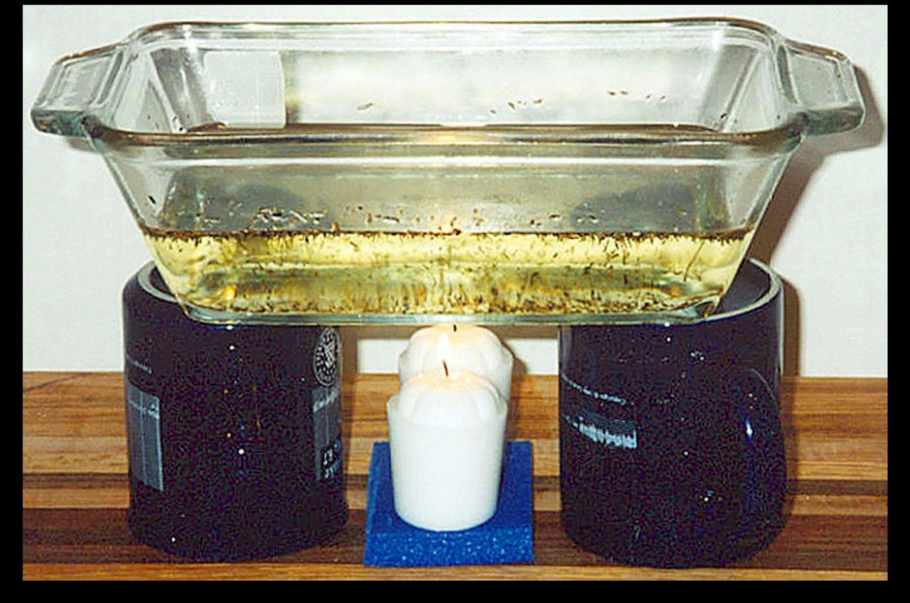
Investigation 1: Thermal Convection
Photograph by L. Braile
Notes:
4 min
a. Ask participants to bring their notebooks and pencils to the front of the room and gather around the thermal-convection apparatus.
Note: You should already have set up the apparatus in advance and started heating the vegetable oil at the beginning of the session to ensure that it’s properly heated and circulating when the investigation begins.
b. Divide the group into pairs. Direct participants to examine the apparatus and discuss their observations with their partners.

Slide 37
Investigation 1: Thermal Convection
What does each of these items represent in relation to Earth?
Pieces of wood
Vegetable oil
Heat source
Do you think the heat will cause any changes to occur in the system? If so, what do you think will change?
Notes:
5 min
a. Read through the questions on the slide.
b. Pairs: “Discuss these questions with your partners and then write down your answers in your science notebooks.”

Slide 38
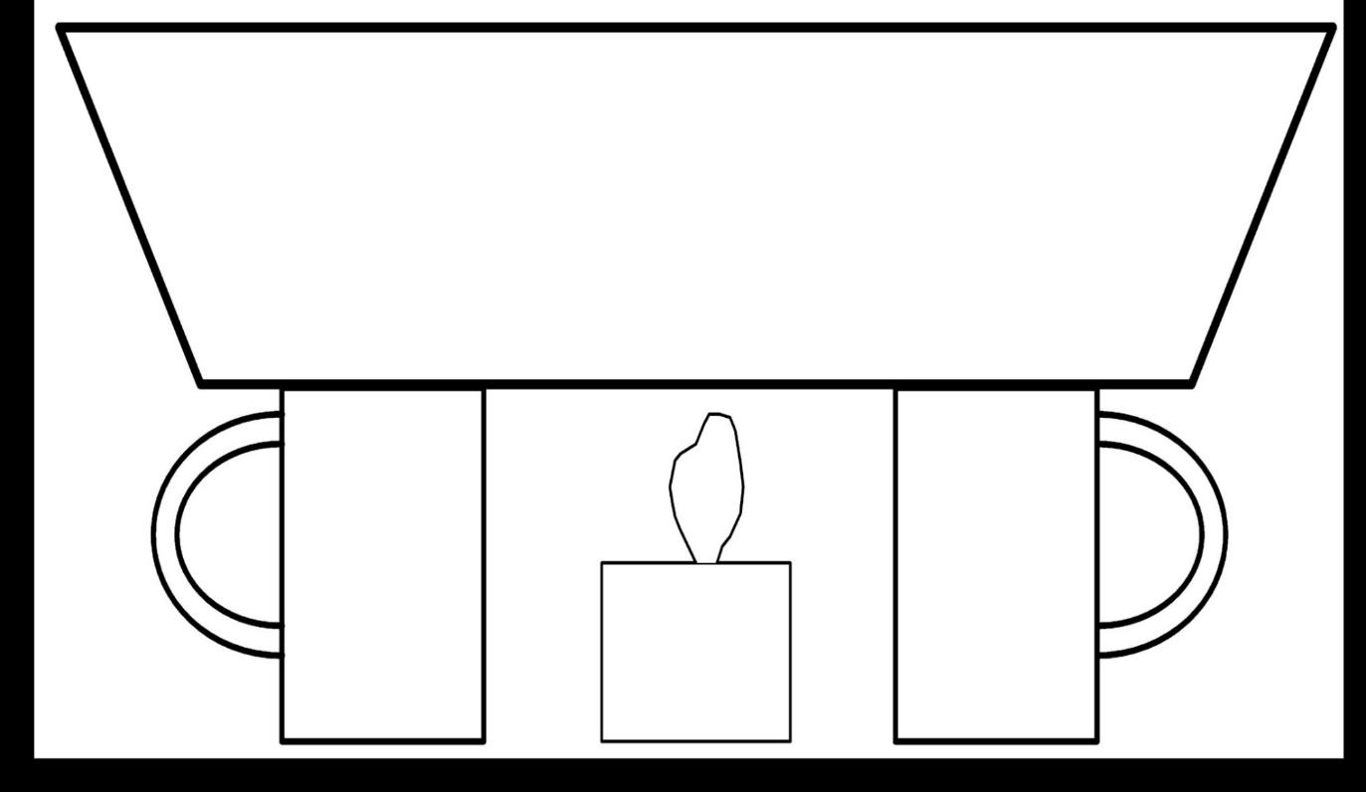
Investigation 1: Thermal Convection
Courtesy of L. Braile
Notes:
1 min
a. Distribute copies of the template (figure 4) from ECS lesson handout 2.1 (Earth’s Moving Mantle Demonstration).
b. Inform participants that they’ll use this template to make a sketch of the oil-flow directions in the baking dish.

Slide 39
Investigation 1: Thermal Convection
Using the convection template, draw a picture of what’s happening in the baking dish as the oil is heated from below.
Look at the dish from the top and the sides. Describe the patterns of movement you observe.
Where do you observe upward flow in the oil? What about sideways flow? Downward flow?
What’s happening to the wood pieces and the thyme?
How might these patterns of movement relate to tectonic plates on Earth?
Notes:
8 min
a. Read through the instructions on the slide.
b. “Work with your partner to draw a sketch of what’s happening in the baking dish. Then discuss the questions on the slide and record your answers in your notebooks.”

Slide 40
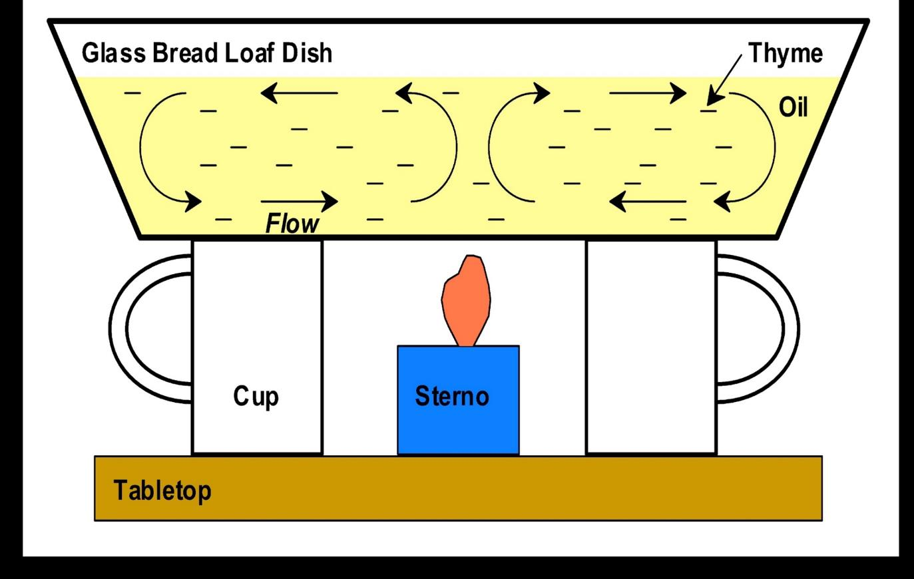
Investigation 1: Thermal Convection
Courtesy of L. Braile
Notes:
5 min
a. Have participants to return to their seats. Then draw their attention to the diagram on the slide.
b. Ask: “Do your sketches of the oil-flow directions in the baking dish look something like this illustration?”
c. Whole-group discussion: Call on pairs to share their observations of the oil flow in the baking dish and the patterns of movement they recorded in their science notebooks.
d. “So how do you think the patterns of movement in this experiment might relate to tectonic plates on Earth?”

Slide 41
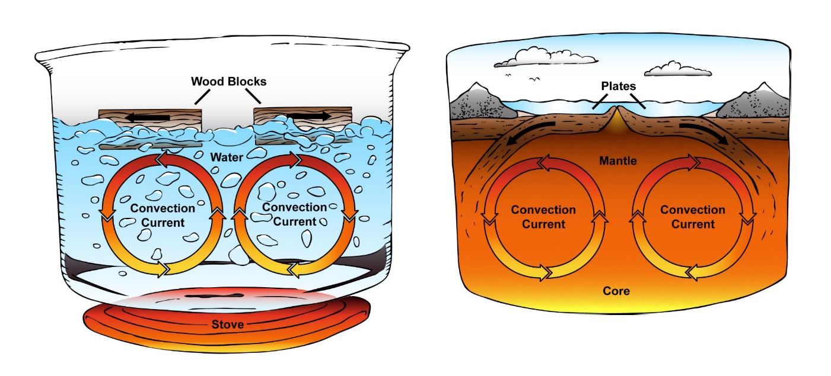
Investigation 2: Convection and Plate Movement
a)
b)
Courtesy of ClipartXtras.com
Geothermal heat rises from Earth’s core.
This rising heat forms convection cells within the mantle.
Tectonic plates are carried along on top of the mantle like suitcases on a conveyor belt.
Notes:
8 min
a. “The diagrams on this slide illustrate thermal convection in a pot of boiling water and within Earth’s mantle.”
b. Read the key science ideas at the bottom of the slide and explain that this is the most widely accepted theory of how tectonic plates move around Earth’s surface.
c. “How do you think this theory relates to the thermal-convection investigation we just completed? Let’s hear a few of your ideas.”
d. Explain that density plays a very important role in thermal convection. Like oil in a baking dish or water in a pot being heated from below, as the bottom layer of rock in the mantle absorbs heat from Earth’s core, it expands and becomes less dense. This causes the rock to rise toward the surface, or away from the center of Earth. When it reaches the surface, heat is released, and the rock begins to cool. As it cools and contracts, the density increases, and the rock sinks back toward the center of Earth, pushing the newly heated, less dense rock out of the way. The newly heated rock continues rising toward the surface, while the cooler rocker begins to heat again. This is the basic process involved in a convection cell.
e. “The rotating convection cell in the mantle (or asthenosphere) exerts a drag force on the overlying crust (or lithosphere). This drag force pulls the overlying tectonic plates along like suitcases on an airport conveyer belt, or pieces of wood floating on vegetable oil in our thermal-convection model.”
f. Emphasize that the thermal-convection model can promote a significant misconception that Earth’s mantle is composed of liquid like vegetable oil in a baking dish or water in a pot. But the mantle is NOT liquid. It consists of solid, dense, heated rock that can deform or flow very slowly, much like playdough or warm wax. Many people think that the mantle is a pool of liquid lava, but this is also a misconception. The mantle is composed of solid, hot, gooey rock that is capable of flowing very slowly, like the growth rate of a fingernail.

Slide 42
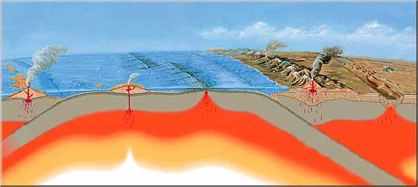
Investigation 2: Convection and Plate Movement
Trench
Continental Plate
Oceanic Plate
Midocean Ridge
Courtesy of USGS.gov
Seafloor
Spreading
Young, Warm, Rising: Oceanic Crust Formed
Seafloor
Subduction
Old, Cold, Sinking: Oceanic Crust Consumed
Stable Continent
Low Density Continental Crust Remains at Earth’s Surface
Notes:
1 min
a. “The illustration on this slide shows how mantle convection leads to plate tectonics.”
b. “Above the rising layer of mantle rock in a convection cell, tectonic plates are pulled apart, and new, warm crust is formed in the gap. This process is called seafloor spreading.”
c. “Above the falling layer of mantle rock in a convection cell, tectonic plates are pushed together, and old, cold crust is pulled back into the mantle. This process is called seafloor subduction.”
d. “While old, cold oceanic crust can sink back into the mantle, thicker continental crust is too low in density to sink. Oceanic crust is recycled over time, but continental crust stays afloat, riding on the mantle like pieces of balsa wood floating on vegetable oil, or whipped cream sitting on top of a latte.”

Slide 43
Reflect: Content Deepening Focus Question 1
What happens to Earth’s surface that causes mountains to form?
Notes:
5 min
a. Review the focus question on the slide.
b. “What ideas did our thermal-convection investigations give you for answering this question? Do you think thermal convection and the movement of tectonic plates might be involved in mountain building?”
c. Encourage participants to agree, disagree, ask questions, or add to the ideas others share.
d. During this discussion, record key ideas on chart paper.

Slide 44
Key Science Ideas
Layers of hardened lava and other materials from repeated volcanic eruptions change Earth’s surface and form mountains.
Earth’s thin outer layer (crust) is broken into sections called tectonic plates that fit together like puzzle pieces. These plates float on top of a layer of hot, slowly moving rock in Earth’s mantle that rises and falls in rotating thermal-convection cells that carry the plates like suitcases on a conveyor belt. The resulting plate movements may be involved in mountain formation.
Notes:
2 min
a. Review the key science ideas on the slide that provide an initial answer to the focus question. Emphasize that participants’ observations and evidence from volcano and tectonic-plate investigations helped shape these responses.
b. Whole-group discussion: “Does everyone agree with these ideas? Would you like to add or revise anything?”
c. Ask participants to copy these ideas into their science notebooks under the focus question.
d. Note that more information is needed to determine exactly how volcanoes and tectonic plates cause mountains to form.

Slide 45
Earth’s Changing Surface
Lesson 3a
Photo courtesy of Visible Earth
Notes:
Less than 1 min
a. “Next, we’ll explore ideas about Earth’s changing surface from lesson 3a.”

Slide 46
Content Deepening: Focus Question 2
Are the moving plates of Earth’s crust involved in building up Earth’s surface and forming mountains? If so, how?
Notes:
Less than 1 min
a. Read the focus questions on the slide.
b. Emphasize that these questions will guide student learning throughout ECS lesson 3a.
c. Have participants write the questions in their science notebooks and draw a box around them.

Slide 47
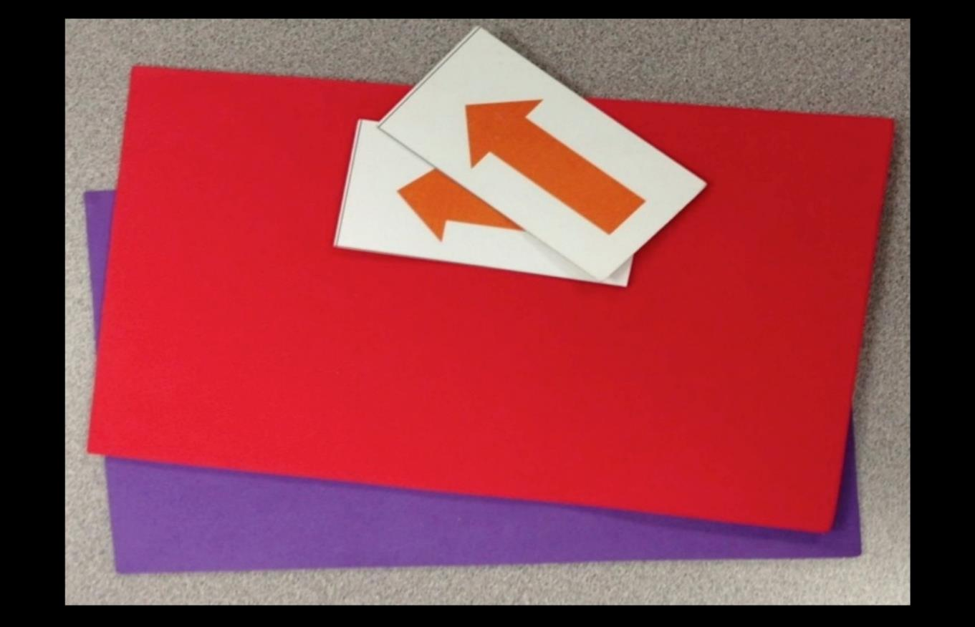
Investigation 3: Earth’s Moving Plates
Photo courtesy of BSCS.org
Notes:
1 min
a. Have participants pair up again; then distribute two foam mats and two construction-paper arrows to each pair.
b. “In this investigation, you and your partner will use the foam mats and arrows to explore the possible movements and interactions of tectonic plates.”

Slide 48
Investigation 3: Earth’s Moving Plates
Imagine the foam mats represent tectonic plates, and the table represents the hot, slowly moving rock underneath the plates.
Lay the mats next to each other on the table, making sure their sides are touching.
Discuss all of the possible directions Earth’s plates could move as they float on the layer of hot, slow-moving rock beneath them.
Push the foam mats in these directions, using the arrows to show the direction of plate movement.
Record your observations and drawings in your science notebooks.
Notes:
8 min
a. Read the directions on the slide.
b. “As you and your partner discuss the directions Earth’s plates could move, keep in mind that they could move in a number of different ways.”
c. “Use the foam mats to model how the plates might move, and use the arrows to show the direction of plate movement. Then write and draw your observations in your science notebooks.”
d. While pairs are working with their models, walk around the room and observe what they’re doing. If you see participants moving the mats in unusual ways, ask probe questions to guide their thinking.

Slide 49
Investigation 3: Earth’s Moving Plates
How many different ways can you move the foam mats?
What happens when you move the mats away from each other?
What happens when you push the mats toward each other?
What happens when you slide the mats sideways past each other?
Notes:
8 min
a. Whole-group discussion: Call on pairs to answer the first question on the slide and share their observations from the investigation. Probe participants’ responses (e.g., “What do you mean by ‘away from each other’?”; “What do you mean by ‘crashing together’?”) and elicit differing points of view (e.g., “Does everyone agree with these observations?”).
b. Following this discussion, read the other three questions on the slide one at a time and call on one or two participants to share their observations. Keep participants focused on what happens to the mats with each movement (e.g., When the mats are pushed toward each other, they get crumpled up). Remind participants that the mats represent Earth’s tectonic plates and therefore may not move or interact in some of the ways their models are capable of moving and interacting.

Slide 50
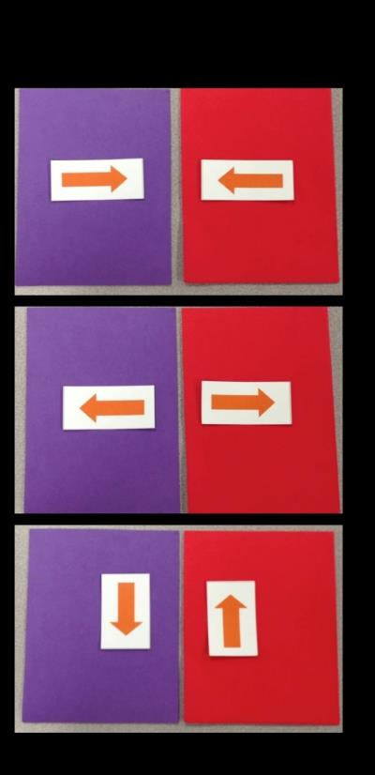
Investigation 3: Earth’s Moving Plates
How Earth’s Plates Move (Teacher Master)
 | Plates move toward each other and collide.
 | Plates move away from each other.
 | Plates move side to side (slide past each other).
Notes:
2 min
a. Review the summary slide and emphasize the three different directions the arrows are pointing.
b. “Does everyone agree that these are the three basic directions Earth’s tectonic plates could move?”
c. “Do you want to add or revise anything?”

Slide 51
Reflect: Content Deepening Focus Question 2
Are the moving plates of Earth’s crust involved in building up Earth’s surface and forming mountains? If so, how?
Notes:
8 min
a. Review the focus question on the slide.
b. “So based on our mat investigation, how would you answer this question? Share your ideas with your partner and make sure to include evidence from our mat investigation to support your answers.”
c. Whole-group share-out: Call on pairs to share their ideas and reasoning. Probe participants’ responses and elicit differing points of view.
d. “Does anyone agree or disagree, have a question to ask, or want to add on?”
e. During this discussion, record key ideas on chart paper.
f. “So can we all agree that mountains are most likely to form when tectonic plates collide? Do you have any other observations or ideas to add?”
Note: Some participants may also suggest that mountains can form where plates move apart, and/or slide side to side or past each other. This is actually correct, as the following slide will demonstrate.
g. “We’ll continue thinking about this focus question during our next investigation and see if we gather more information to add to our answer.”

Slide 52
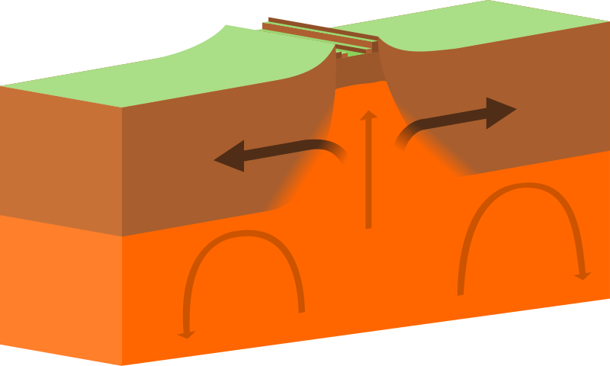
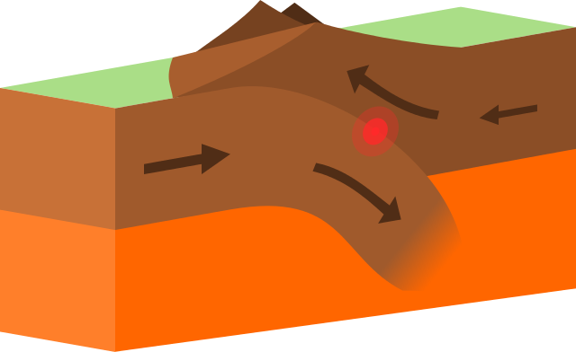
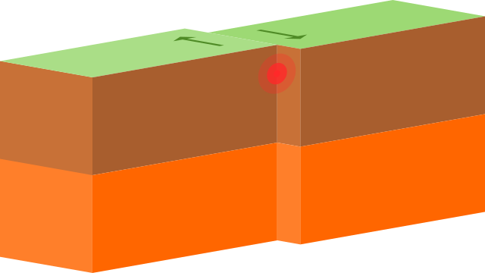
Types of Plate Boundaries
A. Divergent
B. Convergent
C. Transform
Courtesy of Domdomegg, Wikimedia
Notes:
3 min
a. “This slide shows three main types of plate boundaries: divergent, convergent, and transform. The arrows indicate the direction of plate movement in each diagram.”
b. “At a divergent boundary, tectonic plates move away from each other, which is called extension. At a convergent boundary, plates move toward each other, and at a transform boundary, plates slide past each other, which is called shear. This reflects the conclusions we reached about plate movements in our foam-mat investigation, doesn’t it?”
c. “Plate collisions at convergent boundaries are the most common cause of mountain formation. Remember what happened to the foam mats when you pushed them together?”
d. “Most convergent boundaries are also subduction zones, where one oceanic plate sinks back into the mantle under another plate. This process causes mantle melting and the formation of volcanic mountains. So mountains form not only when plates collide and crumple upward but when one plate sinks under another and melts.”
e. “Mountains can also form at divergent and transform boundaries, though this isn’t as common. As we talked about earlier, tectonic plates can pull apart above the rising layer of mantle in a convection cell. This process is called seafloor spreading. Heat from the rising mantle causes the crust to expand at this divergent boundary and grow into a midocean ridge or giant undersea mountain range.”
f. “At a transform boundary, mountains can form where a kink or bend in the fault line makes it difficult for two plates to slide past each other. As the plates crumple up against each other, mountains can form. Examples include the San Gabriel Mountains and the San Bernardino Mountains along the San Andreas Fault in Southern California.”

Slide 53
Key Science Ideas
Mountains form when Earth’s tectonic plates move toward each other and collide. This is called a convergent boundary.
Plate collisions at convergent boundaries are the most common cause of mountain formation.
Mountains can also form at divergent boundaries (where plates move apart) or transform boundaries (where plates slide past each other).
Undersea mountains form at divergent boundaries, and the San Gabriel Mountains formed at a transform boundary (the San Andreas Fault).
Notes:
Less than 1 min
a. Review the key science ideas on the slide that answer the focus question. Emphasize that participants’ observations and evidence from the foam-mat investigation helped shape these responses.
b. Whole-group discussion: “Does everyone agree with these ideas? Would you like to add or revise anything?”
c. Ask participants to copy these ideas into their science notebooks under the focus question.

Slide 54
Earth’s Changing Surface
Lesson 3b
Photo courtesy of Visible Earth
Notes:
Less than 1 min
a. “Next, we’ll explore ideas about Earth’s changing surface from lesson 3b.”

Slide 55
Content Deepening: Focus Question 2
Are the moving plates of Earth’s crust involved in building up Earth’s surface and forming mountains? If so, how?
Notes:
Less than 1 min
a. Review the focus question on the slide.
b. “This focus question from ECS lesson 3a will guide student learning throughout lesson 3b as well.”

Slide 56
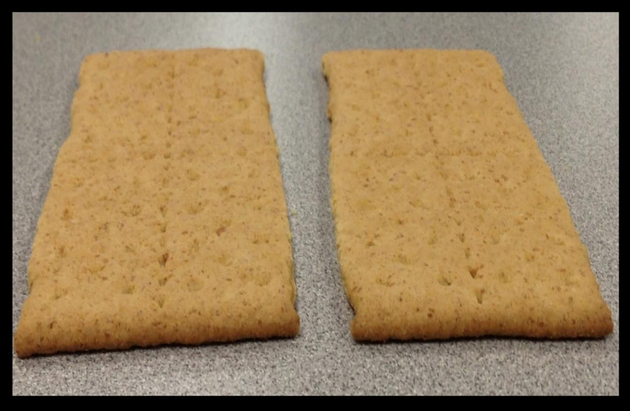
Investigation 4: Mountain Building
Photo courtesy of BSCS.org
Notes:
Less than 1 min
a. “The graham crackers on this slide have been dipped in water and are a little soggy.”
b. “Imagine that these soggy graham crackers are two tectonic plates that are moving toward each other at a convergent boundary.”

Slide 57
Investigation 4: Mountain Building
What do you think the two graham-cracker “plates” will look like if they collide?
Write your prediction in your science notebook and include a drawing of the graham crackers.
Notes:
5 min
a. Read the directions on the slide and ask participants to write the question in their science notebooks.
Note: As participants work on their predictions, toggle back to the previous slide so they can make a sketch of the graham crackers.
b. Make sure everyone has finished writing their predictions and drawing their sketches before advancing the slide.

Slide 58
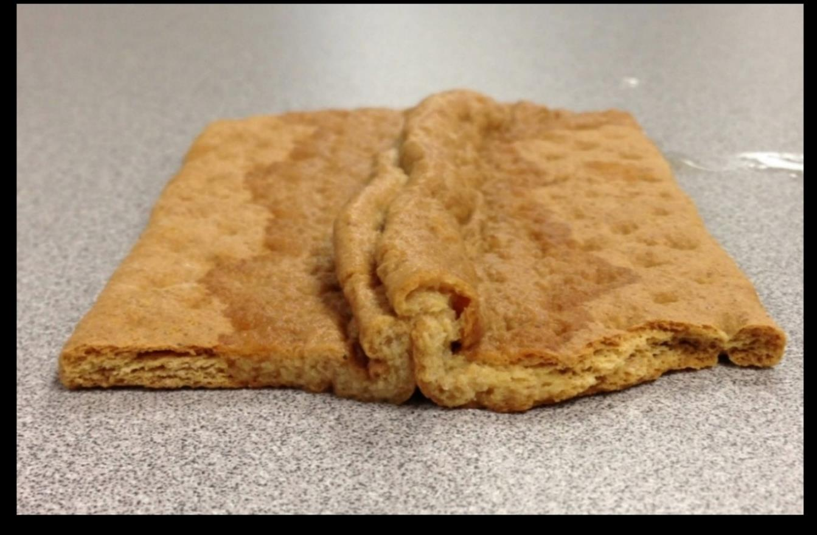
Investigation 4: Mountain Building
Photo courtesy of BSCS.org
Notes:
3 min
a. “The slide shows what happened to the graham crackers when they collided. Is this what you predicted?”
b. Whole-group discussion: Invite participants to share their predictions and observations.

Slide 59
Investigation 4: Mountain Building
Is the result of the graham-cracker collision similar to what happened with the foam mats when they collided? How so?
Notes:
4 min
a. Read the questions on the slide.
b. Invite several participants to share their ideas and observations. Remind them to use evidence from the investigations to support their answers.
c. Encourage participants to agree, disagree, ask questions, or add to the ideas others share.

Slide 60
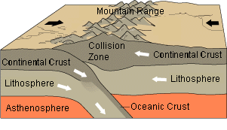
Investigation 4: Mountain Building
Courtesy of Wikimedia.org
Himalayan Mountain Belt:
Continent-versus-Continent Collision
Notes:
2 min
a. “This diagram is an example of a continent-versus-continent collision in which the sides of two tectonic plates crumple up and form a mountain range. A collision of this type between the Indian and Eurasian Plates formed the Himalayan Mountains.”
b. Compare this illustration with the photo of the crumpled-up graham crackers. Note that the two images are very similar in illustrating how plate collisions form mountains.
c. Emphasize that Earth’s tectonic plates move very slowly, and unlike the graham-cracker and foam-mat models, plate collisions form mountains and mountain ranges a tiny bit at a time over many, many years. This is why we can’t see mountains being built.

Slide 61
Reflect: Content Deepening Focus Question 2
Are the moving plates of Earth’s crust involved in building up Earth’s surface and forming mountains? If so, how?
Notes:
5 min
a. Review the focus question on the slide.
b. Ask: “How would you answer this question now?”
c. Invite participants to share their ideas for answering the question, using evidence from the mat and graham-cracker investigations to support their ideas.
d. “As others share their ideas and evidence, listen carefully and be prepared to agree, disagree, ask questions, or add new ideas and evidence.”
d. During this discussion, record key ideas on chart paper.

Slide 62
Key Science Ideas
Mountains form when Earth’s tectonic plates collide. Plate collisions can also cause the formation of volcanic mountains.
Plate collisions at convergent boundaries are the most common cause of mountain formation. But mountains can also form at divergent boundaries (where plates move apart) or transform boundaries (where plates slide past each other).
Earth’s tectonic plates move very slowly. Unlike graham crackers and foam mats, plate collisions form mountains a tiny bit at a time over a period of years.
Notes:
3 min
a. Review the key science ideas on the slide that answer the focus question. Emphasize that participants’ observations and evidence from the mat and graham-cracker investigations helped shape these responses.
b. Whole-group discussion: “Does everyone agree with these ideas? Would you like to add or revise anything?”
c. Ask participants to copy these ideas into their science notebooks under the focus question.

Slide 63
Earth’s Changing Surface
Lesson 4a
Photo courtesy of Visible Earth
Notes:
Less than 1 min
a. “Our next investigation is from ECS lesson 4a.”

Slide 64
Content Deepening: Focus Question 3
What evidence can we find to support the idea that mountains form when Earth’s crustal plates collide?
Notes:
Less than 1 min
a. Read the focus question on the slide.
b. “This focus question will guide student learning throughout ECS lesson 4a.”
c. Ask participants to write this question in their science notebooks and draw a box around it.

Slide 65
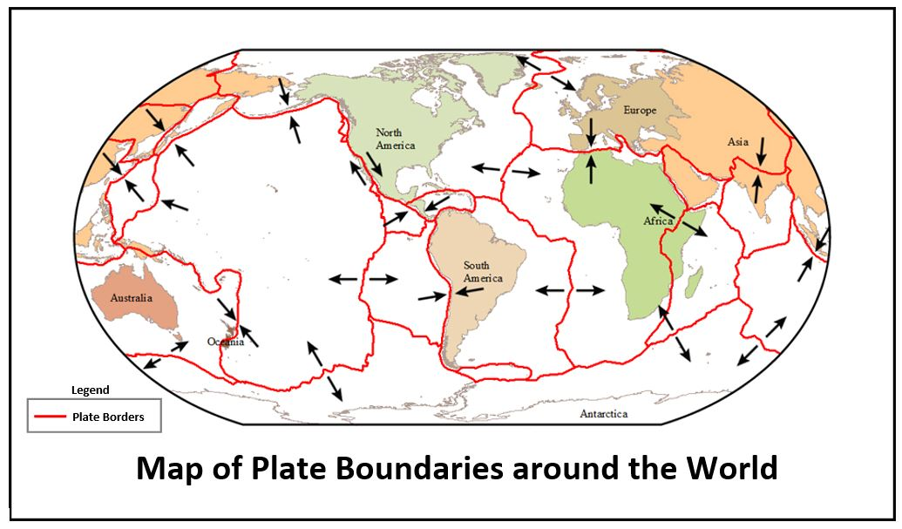
Investigation 5: Plate Boundaries
Courtesy of BSCS
Notes:
Less than 1 min
a. Have participants pair up with the same partners from previous investigations.
b. Direct participants to locate handout 4.1 (Map of Plate Boundaries around the World) in their lesson plans binders.
c. “This map shows the boundaries of Earth’s major tectonic plates.”

Slide 66
Investigation 5: Plate Boundaries
Examine the map on handout 4.1 (Map of Plate Boundaries around the World).
What do you notice about this map? How would you describe it?
In what ways does this map remind you of the cracked eggshell from our earlier investigation?
What do the red lines represent?
What do the arrows represent?
Notes:
7 min
a. Read the questions on slide.
b. Pairs: “Examine the map on your handouts and discuss these questions with your partners. Then write your answers in your science notebooks.”
c. Whole group: Invite a few participants to share their answers with the group.

Slide 67
Investigation 5: Plate Boundaries
How would you describe the tectonic plates on the map?
Are the plates large or small?
Do they touch one another?
Are the borders even or uneven?
What else do you notice?
Notes:
6 min
a. Read the questions on the slide
b. Pairs: “Discuss these questions with your partners and write your answers in your notebooks.”
c. Whole group: Invite a few participants to share their answers and observations with the group.

Slide 68
Investigation 5: Plate Boundaries
Courtesy of Hughrance, Wikimedia
Notes:
3 min
a. “This map shows Earth’s tectonic plates and their motion. Three types of plate boundaries are shown at the bottom of the slide. The green lines on the map represent divergent motion, the black lines represent transform motion, and the pink lines represent convergent motion.”
b. Pairs: Have participants pair up with an elbow partner, compare this map with the map they just examined, and share their observations.
c. Whole group: Invite a few participants to share their observations with the group.

Slide 69
Earth’s Changing Surface
Lesson 4b
Photo courtesy of Visible Earth
Notes:
Less than 1 min
a. “Next, we’ll explore ideas about Earth’s changing surface from lesson 4b.”

Slide 70
Content Deepening: Focus Question 3
What evidence can we find to support the idea that mountains form when Earth’s crustal plates collide?
Notes:
Less than 1 min
a. Review the focus question on the slide.
b. “In our final content deepening investigation, we’ll gather more information about plate boundaries to help us answer this question.”
c. “This focus question from lesson 4a will guide student learning throughout lesson 4b as well.”

Slide 71
Investigation 6: Map Comparisons
Courtesy of BSCS
Notes:
Less than 1 min
a. “For this investigation, you’ll work in pairs again. You’ll also need your plate-boundaries map from the previous investigation.”

Slide 72
Investigation 6: Map Comparisons
Courtesy of USGS
Notes:
Less than 1 min
a. Direct participants to locate handout 4.2 (Physical Map of the World) in their lesson plans binders.
b. “This map shows the topographic features of Earth’s surface, such as ocean basins, continents, and mountains.”

Slide 73
Investigation 6: Map Comparisons
Compare the plate-boundaries map (handout 4.1) with the physical map (handout 4.2). Then discuss these questions with your partner and write your answers in your notebook:
What do you observe when you compare the two maps?
What landforms do you see on the physical map in the same areas where Earth’s plates collide on the plate-boundaries map?
Notes:
7 min
a. Read the directions and questions on the slide.
b. Pairs: “Compare the two maps on your handouts and discuss the questions on the slide. Then write your answers in your science notebooks.”
c. Whole group: Invite a few participants to share their answers and observations with the group.

Slide 74
Investigation 6: Map Comparisons
Courtesy of BSCS
Notes:
2 min
a. “Next, we’ll compare this plate-boundaries map with another showing where volcanoes and earthquakes are located on Earth’s surface.”
b. “What do you predict you’ll see when you compare these maps?”

Slide 75
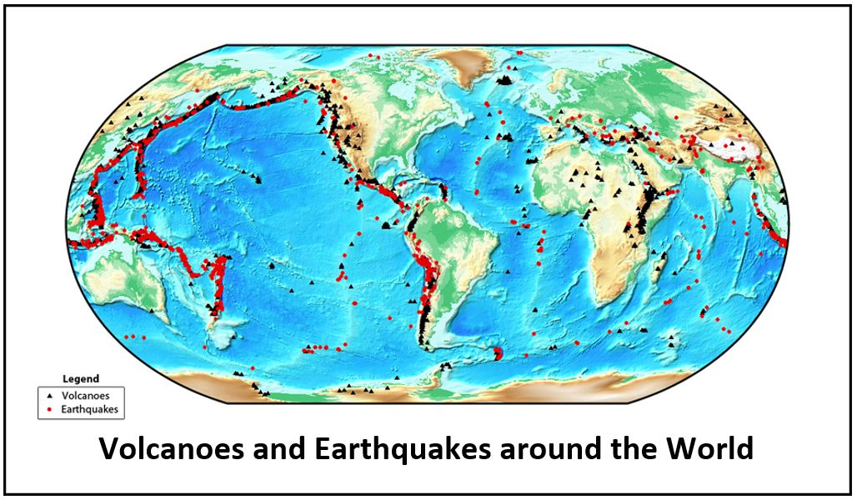
Investigation 6: Map Comparisons
Source: unknown
Notes:
Less than 1 min
a. Direct participants to locate handout 4.3 (Volcanoes and Earthquakes around the World) in their lesson plans binders.
b. “This map shows the distribution of volcanoes and earthquakes across Earth’s surface. The black dots represent volcanoes, and the red dots represent earthquakes.”

Slide 76
Investigation 6: Map Comparisons
Compare the plate-boundaries map (handout 4.1) with the map of volcanoes and earthquakes (handout 4.3). Then discuss these questions with your partner and write your answers in your notebook:
What patterns do you observe when you compare these maps?
What relationship do you notice between plate boundaries and the locations of volcanoes and earthquakes?
Is this what you predicted?
Notes:
7 min
a. Read the directions and questions on the slide.
b. Pairs: “Compare the two maps on your handouts and discuss the questions on the slide. Then write your answers in your notebooks.”
c. Whole group: Invite a few participants to share their answers and observations with the group.

Slide 77
Reflect: Content Deepening Focus Question 3
What evidence can we find to support the idea that mountains form when Earth’s crustal plates collide?
Notes:
5 min
a. Review the focus question on the slide.
b. Invite participants to share their ideas for answering the question, using observations and evidence from the map investigations.
c. Encourage participants to agree, disagree, ask questions, or add to the ideas others share.
d. During this discussion, record key ideas on chart paper.

Slide 78
Key Science Ideas
Earth’s tectonic plates move in three basic ways:
They move away from each other. (This is called extension.)
They move toward each other and collide.
They slide past each other. (This is called shear.)
All of these plate movements are involved in building up Earth’s surface and forming mountains, but most mountain ranges form where plates collide.
Most volcanoes and earthquakes occur at convergent plate boundaries, but they can also occur at divergent and transform boundaries.
Notes:
3 min
a. Review the key science ideas on the slide that answer the focus question. Emphasize that participants’ observations and evidence from the map investigations helped shape these responses.
b. Whole-group discussion: “Does everyone agree with these ideas? Would you like to add or revise anything?”
c. Ask participants to copy these ideas into their science notebooks under the focus question.

Slide 79
Summary: Today’s Focus Questions
What progress have we made in addressing our focus questions?
How can lesson analysis help us better understand how elicit, probe, and challenge questions can reveal and challenge student thinking?
What happens to Earth’s surface that causes mountains to form?
Are the moving plates of Earth’s crust involved in building up Earth’s surface and forming mountains? If so, how?
What evidence can we find to support the idea that mountains form when Earth’s crustal plates collide?
Notes:
8 min
a. Divide participants into two groups. Have Group 1 come up with some conclusions/key ideas related to focus questions 1 and 2. Have Group 2 do the same thing for focus questions 3 and 4.
b. Give each group 3 minutes to come up with ideas and conclusions.
c. Allow a 2-minute share-out for each group.

Slide 80
Homework
For tomorrow, read the STeLLA strategies booklet and complete the Z-fold summary chart for these Student Thinking Lens strategies:
Strategy 4: Engage students in analyzing and interpreting data and observations.
Strategy 5: Engage students in constructing explanations and arguments.
Don’t forget about the lesson plan reading-and-reporting assignment due on day 4.
Notes:
1 min
a. Forecast that tomorrow you’ll tackle two new, closely interconnected Student Thinking Lens strategies.
b. Have participants copy the homework assignment into their science notebooks.
c. Remind participants about their homework for Friday (becoming experts on the lesson plans assigned to them).

Slide 81
Reflections on Today’s Session
Complete the Daily Reflections sheet (handout 2.5 in PD program binder).
What value do you see in analyzing student thinking and practicing questions that elicit, probe, and challenge student thinking? What concerns do you have about enacting these practices?
Did you identify any science ideas that you are unclear about? If so, what helped you identify this uncertainty?
What questions do you have about the purposes and goals of the RESPeCT PD program?
Which norms are we successfully implementing? Which norms need more work?
Notes:
6 min
a. Make sure participants have at least 5 minutes to think about the questions on the reflections sheet (handout 2.5 in the PD program binder) and write down their reflections.

