Slide 1




RESPeCT PD pROGRAM
Day 4
RESPeCT Summer Institute
Notes:
5 min
Take care of any housekeeping issues.

Slide 2
Agenda for Day 4
Day-3 reflections
Importance of STL strategy 5: constructing explanations
Introducing Student Thinking Lens strategy 6
Lesson analysis: STL strategy 6
Review: STL strategies 1–6
Variation in Traits lesson plans review
Lunch
Content deepening: variation in traits
Summary, homework, and reflections
Notes:
3 min
Talk through the agenda for the day.

Slide 3
Trends in Reflections
Lesson Analysis | Science Content Learning
Notes:
5 min
Invite participants to look at your feedback on their reflections from day 3 and offer reactions, comments, or follow-up questions.

Slide 4
Today’s Focus Questions
Why is it necessary to engage students in using and applying new science ideas in a variety of ways and contexts?
How will the Student Thinking Lens strategies help you teach the Variation in Traits lessons?
How would biologists explain how a trait changes within a population over time?
How can multiplicative reasoning allow us to use mathematics to make predictions based on experimental data?
Notes:
1 min
Introduce the focus questions that will guide today’s work.
“Like STeLLA strategies 4 and 5, the goal of strategy 6 is to move student thinking forward toward deeper understandings of science ideas.”

Slide 5
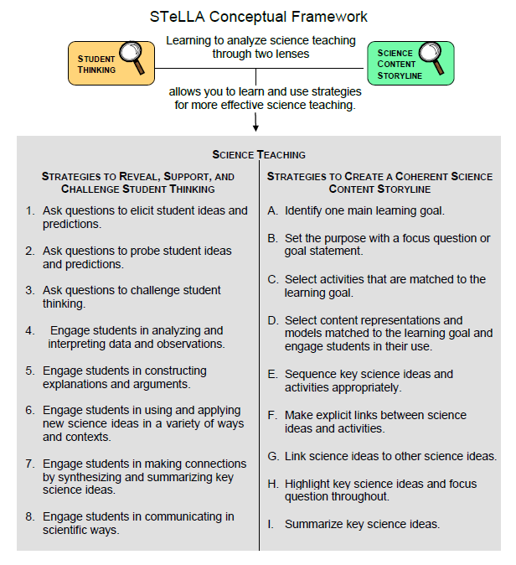
Notes:
1 min
Draw participants’ attention to the new strategy highlighted on the slide.
“Strategy 6 is the third STL strategy that is a type of activity designed to move student thinking forward.”

Slide 6
The Importance of Engaging Students in Constructing Scientific Explanations
Read handout 4.1 and your group-specific handout. Then complete the assigned task:
Group 1: Analyze a student explanation (handout 4.2).
Group 2: Summarize benefits for students of constructing scientific explanations (handout 4.3).
Group 3: Summarize the benefits for teachers of engaging students in constructing scientific explanations (handout 4.3).
Notes:
25 min
Note: If you need some time to catch up on day-3 activities, you can skip this slide. However, this activity is beneficial for reviewing strategy 5 (constructing explanations) and helping participants understand why explanation building is such important work in science and beyond.
Timing note: For this segment, allot 5 minutes for reading, 10 minutes to prepare for a group share-out, and 10 minutes for the share-out.
Divide participants into three groups or pairs. Assign each group a number (1, 2, 3).
Direct participants to three handouts:
Importance of Engaging Students in Constructing Scientific Explanations (handout 4.1 in PD program binder) (This handout describes what groups are to do with the following two handouts.)
Student Work from Zembal-Saul Book What’s Your Evidence? (handout 4.2 in PD binder) (Group 1’s task is linked to this handout.)
Benefits of Engaging Students in Constructing Scientific Explanations (handout 4.3 in PD binder) (Tasks for Groups 2 and 3 are linked to this handout.)
After participants have read the designated handouts for their groups and completed their assigned tasks, invite them to share out.

Slide 7
The CERA Framework for Constructing Scientific Explanations
Next, we’ll watch video clip of a 3rd-grade teacher instructing students how to construct scientific explanations.
Think about ideas this clip gives you for helping your students learn to construct scientific explanations by making a claim, supporting it with evidence and reasoning, and considering alternative explanations and strategies (CERA).
Link to Introducing the CER video clip.
Notes:
10 min
Note: This activity is optional but powerful.
“Let’s watch how one 3rd-grade teacher taught her students to construct scientific explanations. This is the teacher whose student writing Group 1 just read about. The class in this video clip has been studying simple machines (such as pulleys and levers).”
“We’re not going to analyze this video clip in terms of STeLLA strategies. Instead, think about ideas this clip gives you as to how you might introduce your students to the CERA framework for constructing scientific explanations, which involves making a claim, supporting it with evidence and reasoning, and considering alternative explanations and strategies.”
After watching the clip, discuss participants’ reactions and any ideas it gave them about how they might help their students learn to construct strong scientific explanations.
Note: Make sure participants are aware that in addition to using the CERA framework as a tool for teaching students how to develop scientific explanations and arguments (STeLLA strategy 5) in the classroom, they will be using the same framework for videocase-based lesson analysis of their science teaching in RESPeCT study groups throughout the school year.

Slide 8
Introducing STL Strategy 6
Engage students in using and applying new science ideas in a variety of ways and contexts.
What are the purpose and key features of this strategy?
Why do you think use-and-apply questions or activities are often shortchanged in science teaching?
Notes:
20 min
Small groups (10 min): Divide participants into two groups to make charts highlighting the purpose and key features of strategy 6: Engage students in using and applying new science ideas in a variety of ways and contexts. Encourage participants to refer to the STeLLA strategies booklet and STL Z-fold summary chart for this activity.
Whole group (10 min): Have groups present their charts in a whole-group share-out and compare them. Ask participants, “What differences and similarities do you notice when you compare your charts with those of other groups?”
Key ideas:
Strategy 6 is a time for “strategic telling” and making sure students are using science ideas accurately.
A use-and-apply question or activity occurs after students have experienced/encountered a new science idea. It provides an opportunity for students to use and apply the idea in a new context or novel way and/or link two or more ideas together.
A common misconception is that use-and-apply questions or activities assess student learning. Teachers often talk about asking these kinds of questions on tests. However, according to research findings published in How People Learn (National Academy of Sciences, 2000), application is part of the learning process, or developing a conceptual framework. If application is treated like assessment, students may encounter a use-and-apply question on a test without ever having had the opportunity to practice this way of thinking as part of their learning.

Slide 9
Lesson Analysis: Focus Question 1
Why is it necessary to engage students in using and applying new science ideas in a variety of ways and contexts?
Notes:
Less than 1 min
Highlight the focus question that will guide the lesson analysis work during this phase.

Slide 10
Lesson Analysis: Review Lesson Context
Read the lesson context for this video clip at the top of the transcript (handout 4.4 in your PD program binder).
Notes:
2 min
“Read the lesson context at the top of the video transcript (handout 4.4 in your PD program binders).”
Make sure participants understand the science content and activity that are the focus of this video clip.
Note: Refer to the content background document as needed throughout the lesson analysis.

Slide 11
Lesson Analysis: Identify Strategy 6
  What makes this a use-and-apply task?
  (Focus on task.)
  What do you notice about the types of questions the teacher asks during the clip?
Link to video clip: 4.1_mspcp_gr.3.variations.traits_wilde_L7_c1-2
Notes:
25 min
“As you watch the video, think about what makes activity in this clip a use-and-apply task. What science ideas should students be using and applying in each scenario? Also notice what kinds of questions the teacher asks.”
Show the video clip.
Individuals: “Think about the questions on the slide and mark the transcript as you identify the use of strategy 6.”
Whole group: Discuss participants’ responses to the questions.
Note: Make sure participants recognize that this clip isn’t a strong example of teacher questioning in a use-and-apply activity.
Ideal observations:
This is a use-and-apply task because students are considering a new set of circumstances they’re challenged to explain using the science ideas they’ve learned. Students must use the science idea that in different environments, different traits will be favored for survival. In use-and-apply tasks, challenge questions should be used if students aren’t applying the science ideas they’ve learned to explain the new situation (e.g., “How does your idea connect to what we’ve learned?”).
In both clip segments, the teacher begins by eliciting students’ ideas (see video segments 00:00:00–00:08; 00:01:34–01:45).
In the first clip segment, the teacher doesn’t probe or challenge student ideas that are elicited, missing an opportunity for students to clarify why the environment and variation in color matter.
At video segment 00:02:22, the teacher asks a good challenge question but missed an opportunity to push the student who responded to more clearly link her response to the science idea developed in the beetle simulation that different traits are favored for survival in different environments.
The use-and-apply task might have been stronger if the variation in trait that provided an advantage was something other than body color (as it was with the beetles). This might have allowed students to think about other ways that traits give organisms a survival advantage, leading to a more general science concept related to the impact of trait variations on survival patterns.

Slide 12
Lesson Analysis: Analyze Strategy 6 and Reflect
Analyze:
  What student thinking is revealed by engaging students in using and applying new science ideas? By providing a claim, evidence, and reasoning?
Reflect:
  What did you learn about strategy 6 from watching and analyzing this video clip?
Notes:
25 min
Individuals: “For the analysis question on the slide, study the video transcript and come up with a claim, evidence, and reasoning to support your claim.”
Whole-group share-out: As participants share their claims, evidence, and reasoning, encourage them to challenge one another by asking questions, disagreeing, and suggesting improvements or alternative explanations and arguments. (Refer to the norms at the heart of the RESPeCT program.)
Note: You may also want to ask participants whether they noticed in the transcript any missed opportunities for engaging students in using and applying new science ideas.
Reflect (1 min): Give participants time to think about the reflection question on the slide.
Whole-group discussion. Discuss the reflection question as a group. Make sure participants note specifically what they learned about strategy 6 from watching and analyzing this video clip.
Observations:
Video segments 00:00:33–00:35: Ally immediately linked this question to the desert simulation with the beetles, focusing on how the mice could blend in with the environment if they were “greenish” like grass. (Does she think mice can be green?)
Segments 00:00:15 and 00:00:45–00:54: Given that the desert simulation emphasized color variation in beetles, it’s interesting that two students in this conversation thought about a different trait variation: size. These students thought mice have an advantage over large predators because they can dig and go underground. However, they only observed that mice are small compared to predators; they didn’t talk about mice varying in size so that smaller mice might survive better than bigger ones.
Segment 00:01:17: This student had an interesting idea that the mice can get food (and grow stronger) while they’re blending in to hide from predators. He might have been suggesting that blending in is better than digging underground.
Segment 00:02:27: Lacey gave an appropriate reason for why the black mice would survive best, but the teacher’s follow-up question confused her and led to a focus on offspring being the same color as their parents rather than a focus on the main learning goal. A better follow-up question would have been, “Can you tell me more about that?” or “Why does it matter that the environment is mostly black?” This would have encouraged Lacey to talk more about the relationship between the environment and color variation in mice.

Slide 13
Check Your Understanding of Strategy 6
  Jot down your responses to this multiple-choice quiz:
  Use-and-apply tasks are used [before/during/after] new science ideas are introduced.
  For difficult content ideas, students might need to practice applying new ideas in [one/two/many] different contexts.
  [True/false]: Use-and-apply questions or activities are used primarily for student assessment at the end of a unit.
  It’s appropriate for teachers to ask [elicit/probe/challenge] questions during a use-and-apply activity.
  Teachers should [never/judiciously/always] tell students about science ideas they are missing or stating inaccurately.
Notes:
5 min
Note: This activity is optional if time is running short.
“To check your understanding of STL strategy 6, jot down your responses to this multiple-choice quiz.”
Have participants discuss their answers either in pairs or as a group. (If time is short, just read the answers aloud.)
Answer key:
After
Many
False
Challenge (and probe)
Judiciously (defined as “good or discriminating judgment; wise, sensible, or well advised”)

Slide 14
Reflect: Lesson Analysis Focus Question 1
Why is it necessary to engage students in using and applying new science ideas in a variety of ways and contexts?
Notes:
3 min
Individuals (1 min): “Think for a moment about how you would answer the focus question on this slide.”
Whole-group share-out (2 min): Have a few participants share their ideas.
Ideal responses:
The first time students try to use and apply new science ideas, they’ll struggle and make mistakes. This is helpful because it gives teachers an opportunity to diagnose where students are having trouble and clarify the concepts. Students truly understand and internalize new science ideas only after making multiple attempts at using and applying them.
Using and applying new science ideas in a variety of ways and contexts can help students see how important and useful these ideas are in explaining a variety of phenomena in the world around them.

Slide 15
Lesson Analysis: Focus Question 2
How will the Student Thinking Lens strategies help you teach the Variation in Traits lessons?
Notes:
Less than 1 min
Transition: “We’ll now shift our attention to the second lesson analysis focus question and spend some time summarizing what we’ve learned so far about Student Thinking Lens strategies 1–6. Then we’ll review the Variation in Traits lesson plans and highlight how these strategies are used in the lessons you’ll start teaching in January.”

Slide 16
Notes:
Less than 1 min
“These are the Student Thinking Lens strategies we’ve explored so far. You’ll get practice using them as you teach the lessons on forces and variation in traits next year.”

Slide 17
Review: Student Thinking Lens Strategies
Review the STL summary chart in the STeLLA strategies booklet and discuss these questions:
What pattern(s) do you see in this arrangement (organization) of the STL strategies?
How does this arrangement (organization) highlight the differences and similarities among the Student Thinking Lens strategies?
Notes:
3 min
Individuals: Have participants review STL strategies 1–6 on the summary chart in the strategies booklet (Summary of STeLLA Student Thinking Lens Strategies).
Whole group: Discuss the questions on the slide.
Key ideas:
Strategies 1–3 are types of questions, and strategies 4–6 are activities designed to move student thinking forward toward more-scientific understandings.
Some strategies are used at any time during the lesson (e.g., probe questions); others are used at specific times (e.g., elicit questions used before students have been introduced to new science ideas; use-and-apply activities used after students have been introduced to new science ideas).
Each strategy has it’s own specific purpose(s), but the strategies are closely connected to one another. That is, these strategies aren’t used in isolation; they’re complementary.

Slide 18
Lesson Analysis: Review Lesson Context
Read the lesson context for this video clip at the top of the transcript (handout 4.5 in your PD program binder).
Notes:
1 min
“Read the lesson context at the top of the video transcript (handout 4.5 in your PD program binders).”
Make sure participants understand the science content and activity that are the focus of this video clip.

Slide 19
Lesson Analysis: Identify Student Thinking Lens Strategies
  What Student Thinking Lens strategies can you identify in this video clip?
  After watching the video, study the transcript (handout 4.5) and fill in handout 4.6 (Identifying Student thinking Lens Strategies).
  Be ready to share your findings with the group, including any missed opportunities.
Link to video clip: 4.2_mspcp_gr.3.variations.traits_wilde_L6_c2
Notes:
30 min
Note: If absolutely necessary, you can skip this video analysis.
Orient participants to handout 4.6, Identifying Student Thinking Lens Strategies.
Make sure participants understand the context of the video clip (from the transcript).
Show the video clip.
Individuals: “Study the video transcript and complete handout 4.6, Identifying Student Thinking Lens Strategies.”
Whole group: “What STL strategies did you identify in the video transcript? Did you spot any missed opportunities?”
Note: See PD Leader Master: Identifying Student Thinking Lens Strategies (Answer Key) for possible responses and examples from the video clip. Participants may come up with different responses.
Observations:
There is a leading question at segment 00:01:07: “Let’s look up here. So who has the most check marks?”
The teacher also leads at segment 00:01:27 with the statement, “That’s true. But if this one’s got the most checks, I might lean towards that one.”
The teacher missed an opportunity to correct the student at segment 00:01:46 who erroneously says, “The gray mice still only has one check mark gone, and the brown mice also only have one check mark gone.” The data clearly show that the gray and the brown mice don’t have the same number of check marks.

Slide 20
RESPeCT PD Program School-Year Plan
Summer Institute
Content deepening: Variation in Traits (week 1) and Forces (week 2) |  | Lesson analysis: Introduction to the STeLLA framework and strategies
Fall Study-Group Sessions
Fall Teaching Rounds 1 and 2 | Use the STeLLA strategies while teaching lessons on forces. Analyze student thinking and science content storylines using video from our own classrooms. Deepen content knowledge of forces through lesson video analysis. |  | Forces
Spring Study-Group Sessions
Spring Teaching Rounds 1 and 2 | Use the STeLLA strategies while teaching lessons on variation in traits. Analyze student thinking and science content storylines using video from our own classrooms. Deepen content knowledge of variation in traits through lesson video analysis. |  | Variation in Traits
Notes:
1 min
“Before we share our reports about each of the Variation in Traits lesson plans and how they support you in practicing these Student Thinking Lens strategies, let’s review the plan for the school year.”
“In the fall you’ll teach the Forces lessons, and we’ll meet in our study group to analyze video clips and student work from these lessons. This analysis will help us deepen our understandings of the STeLLA strategies, the science content, the lesson plans, and our students’ thinking and learning.”
“Starting in January, you’ll teach the Variation in Traits lessons, and we’ll meet in our study group to analyze video clips and student work from these lessons. Do you have any questions?”
Important reminder: “Remember that we’re analyzing video clips of our own classroom teaching to help us all learn, not to evaluate and critique one another. Everyone is learning to use both new strategies and new lesson plans, so it’s predictable that our first attempts at teaching these lessons will have rough spots. We need to appreciate and acknowledge the courage each of us is demonstrating in sharing our initial efforts to teach these lessons. Please be assured that our analyses of the videos will focus on the strategies, the science content, and most importantly, how students are making sense of the lessons. We’re not going to focus on rough spots or management problems. We’re here to support one another and to learn and grow as science teachers.”

Slide 21
The RESPeCT Lesson Plans as a Study Tool: Part 1
The RESPeCT lesson plans are study tools designed to support your learning and for our study group to analyze.
This has two implications.
These lessons don’t represent a complete unit. You may need to add lessons to help your students achieve all the learning goals, and …
Notes:
2 min
Read through the information on this slide.
Elicit and respond to any comments or questions from participants.

Slide 22
The RESPeCT Lesson Plans as a Study Tool: Part 2
As a study tool, the lesson plans are highly scripted to model how they might be implemented.
Study this script in your lesson planning.
Adapt the plans and PowerPoint slides to make them work for you and your students (but don’t add or drop main activities).
You don’t have to be tied to the script as you teach! Using the slides as a guide can help free you from the script.
Notes:
2 min
Read through the information on the slide.
Elicit and respond to any comments or questions from participants.

Slide 23
Lesson Plan Conversation
The science content storyline across lessons
  Review the main learning goal for each lesson sequentially.
The science content storyline within lessons (5–8 min for each two-part lesson)
  How does this lesson fit into the arc of all the lessons?
  What are the main learning goal and focus question?
  What is the main activity (or activities)?
  How will the activity help students better understand the learning goal for the day?
  What STeLLA strategies are highlighted in the activity?
  What concerns or suggestions do you have regarding the activity?
Practical issues and questions
Notes:
60 min in conjunction with next slide
For step 1 on the slide, have participants describe the main learning goal for their assigned two-part lesson (parts A and B) and how it connects to lessons that precede and follow it. (5 min)
For steps 2 and 3, have participants report on their assigned two-part lesson.
Note: Rather than walking through every step in the lesson plan, participants should present the big picture using the questions in step 2 on the slide. They should bring up details only when they have some concern, question, or suggestion about a modification.
As participants give their reports, mark on a chart the Student Thinking Lens strategies that are highlighted in each lesson. (Use the chart on the next slide as a model.)
Note: Encourage participants to pick just one or two Student Thinking Lens strategies that are highlighted in the lesson. (Several strategies may be used in a lesson.)
Highlight the following ideal pattern and how STL strategies work together across lessons:
Elicit and probe strategies are very important in lesson 1.
Probe and challenge strategies are used throughout all the lessons.
Strategies 4 and 5 are highlighted in the middle lessons.
Strategy 6 is highlighted toward the end of a lesson, after students encounter new science ideas but before final unit assessments.
Timing note: Make sure you limit the time allotted for each lesson so you can get through them all. If you have 6 two-part lessons, you’ll have approximately 8 minutes for each lesson (4 minutes for part A, and 4 minutes for part B). If your lesson series has more than 6 two-part lessons, you’ll have to decrease the time for each lesson.

Slide 24
STL Strategies Highlighted in the VIT Lessons
Lesson | 1a | 1b | 2a | 2b | 3a | 3b | 4a | 4b | 5a | 5b | 6a | 6b | 7a | 7b
1. Elicit
2. Probe
3. Challenge
4. Analyze/ Interpret
5. Explain/ Argue
6. Use/Apply
7. Synthesize/ Summarize
Notes:
60 minutes in conjunction with slide 23
Use this slide in conjunction with the previous slide.

Slide 25

Variation in Traits
SCIENCE AND MATH CONTENT DEEPENING Grade 3
Notes:
Less than 1 min
“Let’s dig into our content deepening work for today.”
Note: Refer to the content background document and Common Student Ideas about Variation in Traits as needed throughout this phase.

Slide 26
Unit Central Question
Do all of the mice living in the same environment, such as a field or forest, have an equal chance of surviving? Why or why not?
Notes:
Less than 1 min
Revisit the unit central questions and announce that participants will use the science ideas they’ve learned about this week to answer these questions at the end of the session.

Slide 27
Content Deepening: Focus Question 1
How would biologists explain how a trait changes within a population over time?
Notes:
Less than 1 min
Review the focus question on the slide.
“Today we’ll continue exploring this focus question from our previous content deepening session.”

Slide 28
Explaining Changes over Time
Goal: To develop a full explanation for change in populations over time using evidence and major principles of natural selection
Notes:
Less than 1 min
Review the goal from the previous session.
“We started working toward this goal in our last content deepening session, and by the end of today’s session, we’ll have a complete explanation for change within populations over time.”

Slide 29
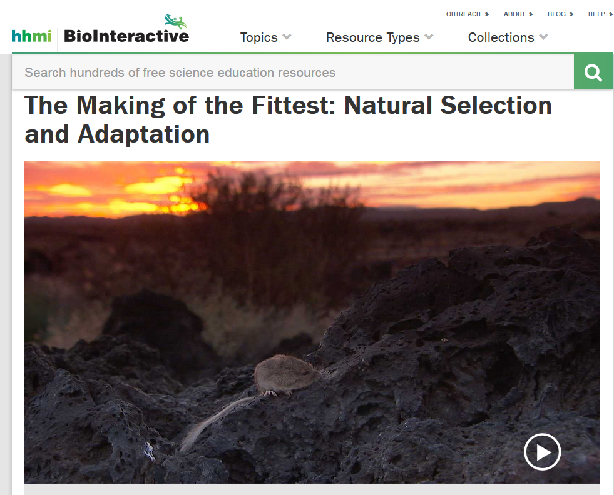
Investigation 1: Explaining Changes over Time
Used with permission from Howard Hughes Medical Institute
http://www.hhmi.org/biointeractive/making-fittest-natural-selection-and-adaptation
Notes:
10 min
“Next, we’ll watch the rest of the short film The Making of the Fittest: Natural Selection and Adaptation.”
Note: You may want to start over at the beginning of the video or continue from the 2:37 time mark.
Have participants locate their Natural-Selection Explanation Table (handout 3.11) from the previous session.
“As you watch the video, look for evidence that supports each principle of natural selection on the handout for changes in the fur-color trait in the rock pocket mouse population. Record this evidence on the handout.”
Show the video.
Following the video, distribute handout 4.7 (Transcript for The Making of the Fittest: Natural Selection and Adaptation).
Individuals: “Now read through the video transcript and identify evidence that supports each principle on the handout for the pocket mouse population and add any new evidence to the handout.”

Slide 30
Investigation 1: Explaining Changes over Time
Constructing a Natural-Selection Explanation
Principle | Definition | Evidence
Variation | (See handout for definitions.)
Inheritance
Selection
Adaptation
Notes:
7 min
Whole-group discussion: Compare the evidence participants collected from the video and the transcript.

Slide 31
Investigation 1: Explaining Changes over Time
Constructing a Natural-Selection Explanation
Principle | Definition | Evidence
Variation |  | The black rock pocket mice and the tan rock pocket mice in the video are the same species. In this population, one black mouse is born for every 100,000 tan mice.
Inheritance |  | New mutations cause black fur color (segment 3:24). Many genes control fur color (4:29). Most genes are identical, but dark and light rock pocket mice differ in one gene: MC1R (segment 4:55).
Selection |  | A survival advantage of 1% for dark rock pocket mice on a dark background would result in 95% of the mice being dark in 1,000 years. A survival advantage of 10% would cause the same change in the mouse population in only 100 years.
Adaptation |  | The video suggests that there are more dark-colored rock pocket mice on the dark lava flows than light-colored rock pocket mice. The same phenotype evolved in different groups of mice on different lava flows, and the genetic bases for these changes in phenotype are different.
Notes:
6 min
Review the evidence on the slide.
Individuals: Ask participants to compare the evidence on the slide with the evidence they recorded on their handouts and identify any information they didn’t consider in their own analyses.
Whole group: “What evidence do you see on this table that you didn’t consider?”

Slide 32
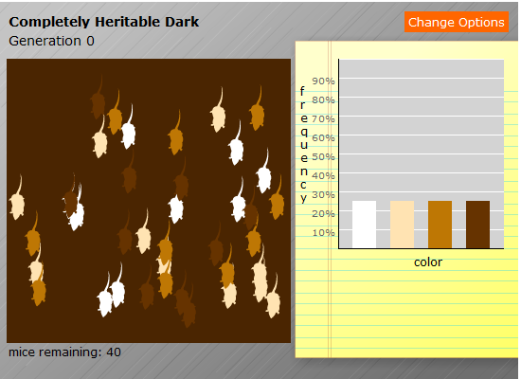
Investigation 2: Predator-Prey Simulation
Write the following heading in your science notebook:
Simulation 1: Dark background; mouse fur color inherited; color variation present
Courtesy of BSCS
Notes:
15 min
Note: You should already have set up the “Predator and Prey” interactive in advance (see instructions on overview page). If you didn’t log into the simulation earlier, do so now.
Introduce the predator-and-prey simulation in the BSCS Across the Sciences online course.
Ask participants to write the following information in their science notebooks: Simulation 1: Dark background; mouse fur color inherited; color variation present.
Select Option 1 in the simulation menu (click on the Change Options button) and have participants sketch the initial graph in their notebooks.
Run the simulation for one round of hunting. Then direct participants to sketch the resulting graph in their notebooks.
Run the simulation again for a second round of hunting and have participants sketch the resulting graph.
Following the simulation, ask participants, “What claim can you make based on the data in the graphs? Make sure to include your evidence.”
“What do you think will happen if the mouse’s environment changes? Let’s find out!”
Ask participants to write the following information in their science notebooks: Simulation 2: Light background; mouse fur color inherited; color variation present
Select Option 2 in the simulation menu (light background) and have participants sketch the initial graph in their notebooks. Complete two rounds of hunting and direct participants to sketch the resulting graphs in their notebooks.
Then ask participants to make a claim supported with evidence from the graphs that answers the question, “What happens if the environment changes?”

Slide 33
Investigation 2: Predator-Prey Simulation
What would happen if the fur-color variation wasn’t inherited or there was no variation in this trait at all?
Courtesy of BSCS
Courtesy of BSCS
Notes:
10 min
“What would happen if the fur-color variation wasn’t inherited or there was no variation in this trait at all? That’s what we’ll explore next.”
Select Option 3 (variation not inherited) and run the simulation again.
Then select Option 4 (no variation) and run the simulation.
Have participants add evidence from these simulations to the Natural-Selection Explanation Table (handout 3.11).

Slide 34
Lines of Evidence for Evolution
How do we know that evolution has occurred?
Fossil record
Structural similarities among organisms
Biogeography
Similarities among embryos different types of embryos
Similarities among DNA sequences of different organisms
Observations of evolutionary changes in the laboratory and in the wild
Notes:
6 min
Note: Initially show only the question at the top of the slide.
Individuals: “Now take out your content background documents and read the last four paragraphs of section 7, Natural Selection and Evolution. As you read, think about the lines of evidence that support the argument for change over time through natural selection.”
Whole group: Discuss the lines of evidence for change over time through natural selection presented in the reading and summarized on the slide. During this discussion, record participants’ ideas on chart paper.
Note: Reveal one line of evidence on the slide at a time as you present it.

Slide 35
Use and Apply Key Science Ideas
Evolution by natural selection depends on context.
Use the science ideas you’ve learned about to explain what this statement means.
Notes:
7 min
Read the statement on the slide.
Individuals: “Use the science ideas you’ve learned about to explain what this statement means. Write your explanations in your notebooks and make sure to include evidence and reasoning.”
Whole group: Invite participants to share their explanations, evidence, and reasoning with the group. Record participants’ ideas on chart paper.
Key ideas:
Natural selection is highly dependent on context.
A trait that works well in one environment may not work well in a different environment. This argues against evolution being goal directed and moving toward perfection.

Slide 36
Lesson 7: Focus Question
When mice survive long enough to have babies, what will the next generation look like?
Notes:
Less than 1 min
“Next, we’ll explore ideas about trait variation from lesson 7.”
Read the focus question on the slide.

Slide 37
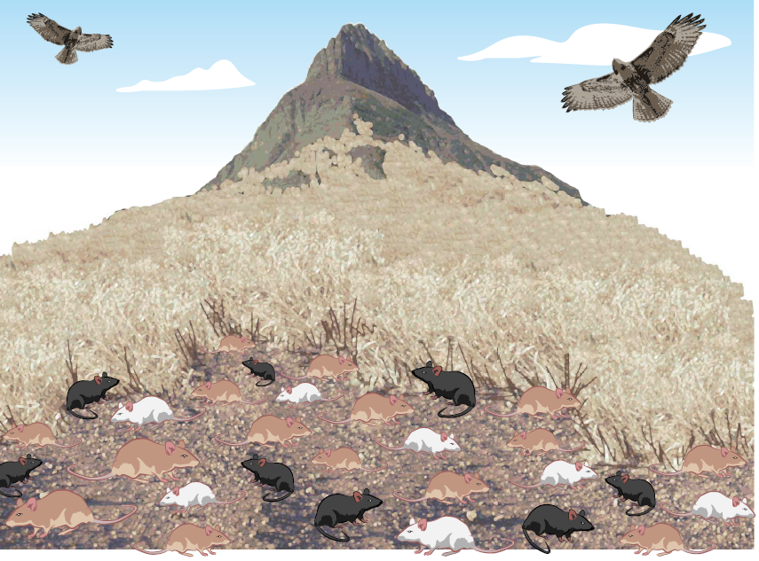
Investigation 3: Mice in a Field
Which color variation (tan, white, or black) will help the mice survive best in this environment?
Notes:
4 min
Have participants locate the scope and sequence document in their lesson plans binders and review the main learning goal for VIT lessons 7a/b.
“In a moment, I’ll tell you a story about mice living in a field near a mountaintop. As you listen to the story, think about which variation in the mice’s fur-color trait will give them a survival advantage in this environment. Jot down your ideas and key details about the story in your notebooks. ”
Tell participants the first part of the story: A lot of mice lived in a field near the top of a mountain. Most of the mice were light brown, or tan, in color, but this trait varied. Other mice were black or white. Hawks were the mice’s main predator. This means that the hawks liked to eat mice. As the hawks flew over the field, they would spot the mice and swoop down to catch them. Whenever a hawk caught a mouse, the hawk would eat it.

Slide 38
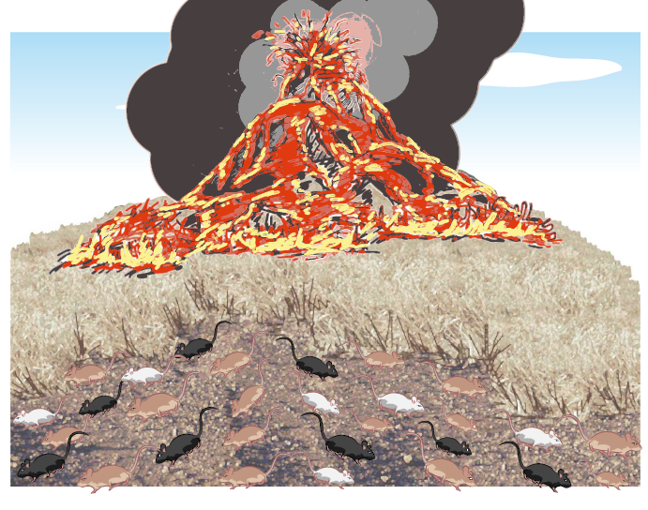
Investigation 3: Mice in a Field
Notes:
1 min
Tell participants the next part of the story: The mountain in our story was actually a volcano. One day the volcano erupted! Red-hot lava flowed out of the volcano and burned up all the trees and plants in its path. But the mice were able to run away and escape the lava. Weeks after the eruption, the ground was covered with lava that turned black as it hardened.

Slide 39
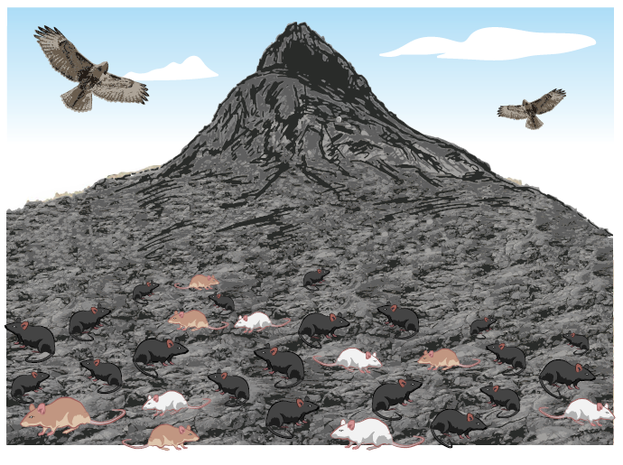
Investigation 3: Mice in a Field
Notes:
Less than 1 min
Tell participants the end of the story: A few years later, new plants started growing, and the ground was covered with seeds and nuts. Eventually, some of the mice came back looking for food. The hawks came back too, looking for mice to eat.

Slide 40
Investigation 3: Mice in a Field
Which mice do you think are more likely to survive in the changed environment? Why do you think so?
Share your predictions and reasoning using this sentence starter:
I predict the [tan/white/black] mice are more
likely to survive in the changed environment because ____________.
Notes:
3 min
Read the questions on the slide and invite participants to share their predictions using the sentence starter on the slide.
Note that in the lesson, students share their predictions in a Turn and Talk before recording their ideas in their notebooks.

Slide 41
Investigation 3: Mice in a Field
Lesson-7 focus question: When mice survive long enough to have babies, what will the next generation look like?
Share your predictions using this sentence starter:
I think the next generation of mice
will have [tan/white/black] fur
because ___________.
Notes:
7 min
Review the lesson-7 focus question on the slide and invite a few participants to share their predictions using the sentence starter on the slide.
Distribute handout 4.8 (Cartoon Summary of Mice in a Lava Environment) and tell participants that in lessons 7a and 7b, students complete a cartoon summary for each environment.
Individuals: Ask participants to complete the summary for the mice in the lava environment as a model student summary.
Whole group: Invite participants to share their summaries and compare their ideas.
Note: Alternatively, have participants share and compare their summaries with an elbow partner.

Slide 42
Reflect: Content Deepening Focus
Question 1
How would biologists explain how a trait changes within a population over time?
Notes:
5 min
Note: If there isn’t enough time for the writing activity, have a group discussion and highlight key ideas that answer the focus question.
Revisit the first content deepening focus question and ask participants to write an answer in their science notebooks. Encourage them to use available resources (e.g., Natural-Selection Explanation Table, content background document) as they work on this task.
Whole group: Invite one or two participants to share their answers with the group.

Slide 43
Unit Central Question
Do all of the mice living in the same environment, such as a field or forest, have an equal chance of surviving? Why or why not?
Notes:
5 min
Revisit the unit central questions and ask participants to answer it in their science notebooks using evidence and reasoning to support their claims.
Before having participants answer these questions, you may want to review key science ideas from this week’s content deepening sessions.

Slide 44
Analyze Strategy 6
Think about the mice simulation we conducted earlier. What made this a use-and-apply task?
How did this use-and-apply activity change your thinking about inheritance as a way of explaining changes in trait variation that occur over time in populations of living things?
Notes:
5 min
Ask participants to think about the questions on the slide and record their ideas in their science notebooks.
Whole group: Invite one or two participants to share their ideas with the group.
Ideal response to question 1:
The mice simulation was a use-and-apply task because participants were introduced to the major concepts of natural selection in previous activities and had to use and apply what they learned to make sense of their observations in the simulation.

Slide 45
Content Deepening: Focus Question 2
How can multiplicative reasoning allow us to use mathematics to make predictions based on experimental data?
Notes:
Less than 1 min
Introduce the second content deepening focus question and ask participants to write it in their notebooks.

Slide 46
Investigation 4: Beetles in the Desert
Experimental Data
Beginning population:
12 red beetles
12 green beetles
12 brown beetles
After a hunting event:
2 red beetles
4 green beetles
7 brown beetles
Notes:
4 min
“In an earlier session, we conducted a simulation from VIT lesson 3 showing which colored beetles would have a better chance of surviving in a desert environment. We used a piece of fabric to represent the environment, and we used different-colored pom-poms to represent the beetles. We counted the number of beetles of each color before the hunting began and then counted again at the end. The starting population of beetles was exactly the same for each color. This setup enables students to explain the scenario without using multiple comparisons or fractions.”
Distribute handout 4.9 (Using Math to Make Predictions).
“For today’s math content deepening investigation, we’ll use experimental data and results. So let’s say we start off with 12 red beetles, 12 green beetles, and 12 brown beetles. After a hunting event, 2 red beetles, 4 green beetles, and 7 brown beetles have survived.”
Ask participants, “What patterns do you notice in the data?” and record their observations on chart paper.
Highlight: Many students will simply say that the number of red beetles is smaller than the number of green beetles, which is smaller than the number of brown beetles (2 < 4 < 7). This is a justifiable use of additive reasoning, but it’s limited to scenarios in which all of the beetles have the same initial population.

Slide 47
Investigation 4: Beetles in the Desert
New population of beetles:
24 red beetles
18 green beetles
36 brown beetles
Based on the patterns you identified in the experimental data, how do you predict this new population of beetles will fare?
Notes:
7 min
“Let’s say we have a new population of beetles comprised of 24 red beetles, 18 green beetles, and 36 brown beetles. Based on the patterns you identified in the experimental data, how do you predict this new population of beetles will fare?”
Individuals: Have participants record their predictions and explanations on their handouts and answer the reflection question.
Whole group: Invite participants to share their predictions and explanations, as well as their answers to the reflection question. Elicit at least two different ways of thinking about this question. Then highlight the explanations below.
Possible explanations:
The initial red-beetle population doubled, so the number of beetles remaining should be double (i.e., 2(2) = 4 red beetles). The initial green-beetle population of 18 beetles is 1.5 times as large as the 12 beetles in the experimental population, so we expect the number of remaining beetles to be 1.5 times as large (i.e., 4(1.5) = 6 green beetles). The initial brown-beetle population of 36 is triple the experimental population of 12, so we anticipate the number of remaining beetles to be three times as many (i.e., 7(3) = 21 brown beetles).
One could consider the ratio of surviving beetles to the initial population (S:IP) for each color of beetle. From the experimental data, the ratios are 2:12, 4:12, and 7:12 for red, green, and brown beetles, respectively. You can then scale up the ratios to equivalent ratios with the given initial populations of the new set, yielding 4:24, 6:18, and 21:36 for red, green, and brown beetles, respectively.
In the experimental data, 2/12 of the red beetles survived, so we expect (2/12) of the 24 red beetles to survive in the new population: (2/12) of 24 is 4. Likewise, 4/12 of the green beetles survived in the experimental data, so we expect (4/12) of 18 green beetles to survive in the new population: (4/12) of 18 is 6. Finally, 7/12 of the brown beetles survived in the experiment, so we expect (7/12) of 36 brown beetles to survive in the new population: (7/12) of 36 is 21.

Slide 48
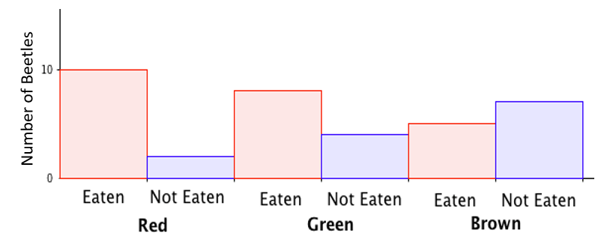
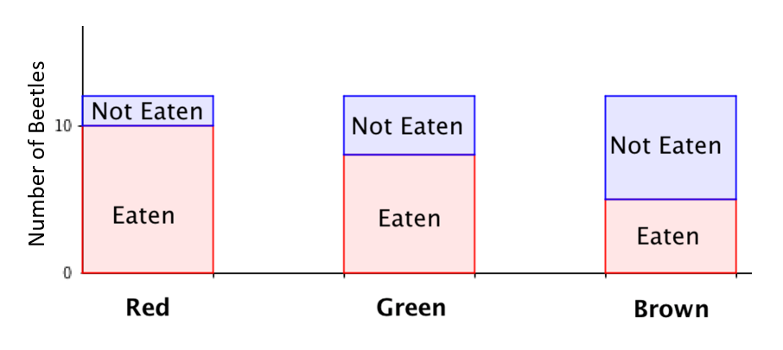
Investigation 4: Beetles in the Desert
Consider the diagrams below. Which way(s) of mathematical thinking does each diagram support most effectively?
New population:
24 red beetles
18 green beetles
36 brown beetles
Notes:
6 min
Think-Pair-Share: Give participants 1 or 2 minutes of think time to consider how they might use the diagrams on the slide to predict the number of surviving beetles in the new population. Then have them share their ideas with an elbow partner.
Whole group: Invite participants to share their ideas with the group. Try to elicit a broad range of ideas and then highlight the ideas below. Note that these ideas reflect the explanations on the previous slide.
Possible responses:
For the top graphic, envision doubling the size of the rectangles corresponding to red-beetle counts, scaling the rectangles for green-beetle counts to 1.5 times as large, and tripling the size of the rectangles for brown-beetle counts.
The ratio of surviving beetles to the initial population (S:IP) is less obvious in both graphics, since you have to take the additional step of imagining the combined red and blue rectangles for each color as representing the initial population.
The bottom graphic lends itself to reasoning about fractions if we view the blue rectangle as some fractional part of the entire stacked rectangle.

Slide 49
Investigation 4: Beetles in the Desert
Compare your predictions with the observed data below. Do your predictions match these results? How can you tell?
Observed Data
Beginning population:
24 red beetles
18 green beetles
36 brown beetles
After a hunting event:
3 red beetles
7 green beetles
28 brown beetles
Notes:
5 min
Think-Pair-Share: Ask participants to compare their predictions with the observed data and think about the questions on the slide. Then have them pair up and share their responses with an elbow partner.
Whole group: “What criteria did you use to determine whether your predictions matched the observed data?”

Slide 50
Investigation 4: Beetles in the Desert
Color | Exp. Count | Exp. Initial Population | Fraction Remaining | Obs. Initial Population | Predicted Remaining | Observed Remaining | Additive Comparison | Error
Red | 2 | 12 | 1/6 | 24 | 4 | 3 | 1 fewer | 1/24
Green | 4 | 12 | 1/3 | 18 | 6 | 7 | 1 more | 1/18
Brown | 7 | 12 | 7/12 | 36 | 21 | 28 | 7 more | 7/36
Notes:
10 min
Walk participants through the data on the slide and make sure they understand what it shows.
Ask, “What questions do you have about this table and what it shows?”
Note: The “Additive Comparison” column indicates the surviving beetles observed relative to predictions. The “Error” column indicates by what fraction of the observed initial population the prediction was off.
Pairs: Have participants work with an elbow partner to compare the accuracy of their predictions with the observed data and identify the specific criteria they’re using in this analysis. Circulate as pairs work on this task and challenge them to be specific and mathematical in their analyses (i.e., go beyond a general assessment such as “The predictions were pretty good but not exactly correct”).
Whole group: Discuss the results of participants’ comparisons and the criteria they used in their analyses.
Emphasize the following points during the group discussion:
An additive comparison of predicted results to observed counts for the red and green beetles suggests that the predictions were equally good: Each was off by 1 beetle (i.e., 4 red beetles predicted and 3 observed; 6 green beetles predicted and 7 observed). The difference for the red-beetle population was 1 out of 24, making it less erroneous than for the green population, which was a smaller population to start with.
Alternative comparisons not explicitly shown in the table: predicted 1/6 of the red-beetle population would survive, but only 1/8 did (red beetles did slightly worse than predicted). Likewise, predicted 1/3 of the green-beetle population would survive, and 7/18 did (green beetles did slightly better than predicted). Finally, predicted 7/12 of the brown-beetle population would survive, and a staggering 7/9 did.
If these results don’t seem that impressive, introduce larger initial populations and observe the difference between 7/12 of 8,400 beetles (4,900) and 7/9 of 8,400 beetles (6,533).

Slide 51
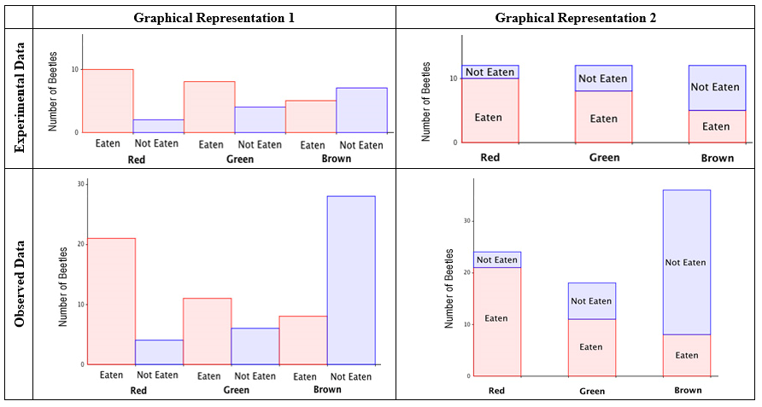
Investigation 4: Beetles in the Desert
Notes:
10 min
Distribute handout 4.10 (Comparing Mathematical Visual Representations of the Problem).
Point out that the first row shows two graphical representations of the experimental data and the second row shows two graphical representations of the observed data.
Ask participants to brainstorm different ways to think about multiplicative comparisons. Then work together to fill in the first three blanks on the handout.
Answers: (1) part-part comparison; (2a) part-whole comparison; (2b) part-part.
Pairs: Have participants pair up and discuss how they can use the graphics on the handout to highlight three ways of thinking about multiplicative comparisons, or fractions: (1) part-whole; (2) division–relative size; (3) multiplication-scaling.
Whole group: Invite pairs to share their ideas for answering the last question on the handout.
Ideal responses to question 3 on the handout:
The graphics in the second column can be used readily to highlight the part-whole view of fractions, since we can “see” the whole (i.e., the total number of beetles of each color) and the part with the whole (i.e., beetles not eaten or eaten depending on which part of the scenario is in focus).
The graphics in the first column can be readily used to highlight a division–relative-size meaning for fractions. By comparing how large the blue bars are in relation to the red bars, we can describe fractions to capture the relative sizes of the number of beetles not eaten compared to the number of beetles eaten. For instance, in the upper left-hand graph, we see the number of not-eaten red beetles is roughly 1/4 or 1/5 as large as the number of eaten red beetles. The number of not-eaten green beetles is half as large as the number of eaten green beetles. And the number of not-eaten brown beetles is roughly 4/3 as large as the number of eaten brown beetles.
To think about multiplication-scaling, we can look across the graphs. The scale on the vertical axis of the top row of graphs is different from the scale of the vertical axis on the bottom row of graphs, but we can still make comparisons. For instance, the number of eaten red beetles roughly doubles from the experimental data to the observed data. Likewise, the number of not-eaten red beetles roughly doubles from the experimental data to the observed data. So the fraction of red beetles that are eaten in experimental data is roughly the same as it is in the observed data. In contrast, the number of not-eaten brown beetles appears to more than triple from the experimental data to the observed data, while the number of eaten brown beetles doesn’t scale by that large of a factor (i.e., the number of brown beetles eaten almost doubled from the experimental data to the observed data).

Slide 52
Reflect: Content Deepening Focus
Question 2
How can multiplicative reasoning allow us to use mathematics to make predictions based on experimental data?
Notes:
5 min
Review the second content deepening focus question.
Individuals: Have participants answer the question in their science notebooks using up to four complete sentences.
Whole group: Invite participants to share their answers with the group. Make sure the following key ideas surface during the discussion:
Multiplicative reasoning is useful for making predictions based on given relationships between quantities (e.g., the number of beetles remaining relative to initial population of beetles).
There are several ways of thinking about multiplicative comparisons (e.g., part-whole, part-part, relative size, scaling).
Some graphics are more effective at highlighting different ways of thinking about multiplicative comparisons.

Slide 53
Today’s Focus Questions
Why is it necessary to engage students in using and applying new science ideas in a variety of ways and contexts?
How will the Student Thinking Lens strategies help you teach the Variation in Traits lessons?
How would biologists explain how a trait changes within a population over time?
How can multiplicative reasoning allow us to use mathematics to make predictions based on experimental data?
Notes:
2 min
Review today’s focus questions.
Individual think time (1 min): Ask participants to reflect on these questions and think about how they might revise their answers.

Slide 54
Let’s Summarize!
Lesson Analysis Strategy 6
What new understandings did you develop?
What do you still have questions about?
Lesson Plans Review
What new insight(s) did you gain?
What do you still have questions about?
Content Deepening
What did you learn?
What do you still have questions about?
Notes:
5 min
Individual think time (1 min): Give participants a minute to think about the questions on the slide and consider questions they still have. Challenge them to formulate a statement summarizing what they learned in each area.
Whole-class share-out: Have participants share at least two different statements about each of the areas on the slide. Elicit more if time allows.

Slide 55
Homework
Read in the STeLLA strategies booklet:
  Student Ideas and Science Ideas Defined
  Introduction to the Science Content Storyline Lens
  Science Content Storyline Lens, STeLLA Strategy A: Identify One Main Learning Goal
Complete strategy-A column on the Coherent Science Content Storyline Strategies Z-fold summary chart (front binder pocket).
Notes:
3 min
“Next week we’ll focus on the Science Content Storyline Lens strategies and explore a new content area: forces. To prepare, complete the homework tasks on the slide.”
Make sure participants copy the assignment into their science notebooks.”

Slide 56
Reflections on Today’s Session
Complete the Daily Reflections sheet (handout 4.11 in PD program binder).
This weekend you bump into a friend who knew you were attending RESPeCT this week. What would you say you’ve learned about the STeLLA Student Thinking Lens strategies and their potential impact on your teaching practice and/or student learning?
What do you understand better about traits, variation, survival of individuals, and changes in populations of organisms after this week’s session? What helped clarify your understanding?
Notes:
5 min
Give participants time to reflect on today’s session and write their responses to the questions on the Daily Reflections sheet (handout 4.11 in PD program binder).

Slide 57
Norms for Working Together: The Basics
Purpose: Build trust and develop a productive study group for all participants.
The Basics
Arrive prepared and on time; stay for the duration; return from breaks on time.
Remain attentive, thoughtful, and respectful; engage and be present.
Eliminate interruptions (turn off cell phones, email, and other electronic devices; avoid sidebar conversations).
Make room for everyone to participate (monitor your floor time).
Notes:
Hidden slide: Available for use at any time as needed.

Slide 58
Norms for Working Together: The Heart
Purpose: Build trust and develop a productive study group for all participants.
The Heart of RESPeCT Lesson Analysis and Content
Deepening
Keep the goal in mind: analysis of teaching to improve student learning.
Share your ideas, uncertainties, confusion, disagreements, questions, and good humor. All points of view are welcome.
Expect and ask questions to deepen everyone’s learning; be constructively challenging.
Listen carefully; seek to understand other participants’ points of view.
Notes:
Hidden slide: Available for use at any time as needed.

