Slide 1
RESPeCT PD pROGRAM
Day 3
RESPeCT Summer Institute
Notes:
5 min
Take care of any housekeeping issues.

Slide 2
Agenda for Day 3
Day-2 reflections
Focus questions
Purposes and key features of STL strategies 4 and 5
Lesson analysis: STL strategies 4 and 5
Lunch
Content deepening: variation in traits
Summary, homework, and reflections
Notes:
2 min
Talk through the agenda for the day.

Slide 3
Trends in Reflections
Lesson Analysis | Science Content Learning
Notes:
5 min
Invite participants to look at your feedback on their reflections from day 2 and offer reactions, comments, or follow-up questions.
Optional: Give participants an opportunity to refine the norms for working together.

Slide 4
Today’s Focus Questions
How can analyzing data and constructing explanations help students move forward toward deeper understandings of science ideas?
How can we design experiments to test for genetic and environmental causes of trait variation?
How would biologists explain how a trait changes within a population over time?
Notes:
2 min
Introduce the focus questions that will guide today’s session.
“The words moving forward are in bold on the slide because that’s our theme for today and the rest of the week. Yesterday we practiced asking elicit and probe questions, which are great for revealing student ideas. But what do we do with those ideas once we’ve elicited them? How do we support students in moving forward toward deeper understandings of science ideas?”

Slide 5
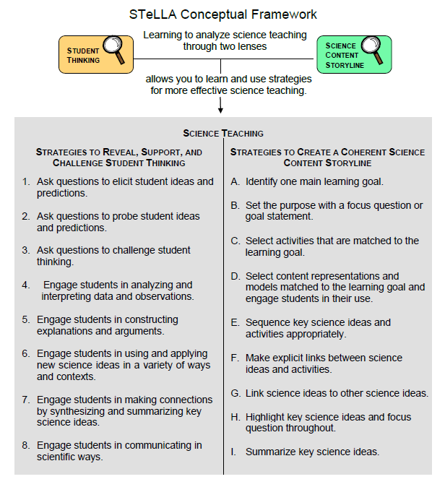
Notes:
1 min
Point out the strategies highlighted on the slide.
“We’ll continue working on understanding and using the Student Thinking Lens questioning strategies, but today we’ll focus on two closely related activity strategies. Strategy 4 engages students in analyzing and interpreting data and observations, and strategy 5 engages students in constructing explanations and arguments.”

Slide 6
The Student Thinking Lens: Moving Student Thinking Forward
How can we advance students’ science learning without just telling them about science ideas and expecting them to memorize the concepts?
By using STeLLA strategies 4–8 to engage students in making sense of the world around them.
Notes:
10 min
Initially, reveal only the question on the slide.
Have participants think about the question for a minute; then open up a brief conversation about it.
Ask the following questions to stimulate discussion if participants are struggling:
What was your experience as a science student in school or college?
How were you expected to learn science ideas? What learning methods were used?
Did you ever have the opportunity in science classes to make sense of the experiments you performed (instead of just recording the correct answers in a lab report)?
Did science teachers ever support your learning in ways that went beyond merely having you take lecture notes, read from a textbook, or record the correct answers in lab reports?
After discussing the questions, reveal the second part of the slide and emphasize the following points:
“Strategies 4 and 5 (as well as 6, 7, and 8) are designed to move student thinking forward by engaging students in sensemaking as they observe data. Rather than just spoon-feeding students science content to read or memorize, these activities lead them toward deeper understandings of science ideas as they construct meaning from evidence.”
“Telling students about science ideas is important, but teachers tend to tell students too much. Instead of doing the hard cognitive work for them, we need to create more opportunities for students to do the thinking and sensemaking themselves so they can truly understand the science concepts. So don’t be in such a hurry to tell students the right answers. Slow down and give them a chance to think!”

Slide 7
The Student Thinking Lens: Moving Student Thinking Forward
Strategies That Reveal Student Thinking | Strategies That Move Student Thinking Forward
1. Elicit questions
2. Probe questions
3. Challenge questions | 3. Challenge questions
4. Analysis and interpretation of data | 4. Analysis and interpretation of data
5. Construction of explanations | 5. Construction of explanations
6. Use and application of new ideas | 6. Use and application of new ideas
7. Synthesis and summarizing | 7. Synthesis and summarizing
8. Scientific communication | 8. Scientific communication
Notes:
5 min
Have participants look at the slide representation of the Student Thinking Lens strategies.
Ask: “What patterns do you notice?”
Key ideas:
Elicit and probe questions are designed only to reveal student thinking, not to challenge it.
The rest of the strategies reveal and challenge student thinking.

Slide 8
The Student Thinking Lens: From Questions to Activities
Look at the Summary of STeLLA Student Thinking Lens Strategies in the strategies booklet.
What distinguishes strategies 1–3 from the rest of the Student Thinking Lens strategies?
Notes:
5 min
Individuals: Have participants briefly examine the summary chart of STL strategies in the STeLLA strategies booklet (Summary of STeLLA Student Thinking Lens Strategies).
Note: Direct participants to the correct page in the strategies booklet or have them consult the table of contents.
Whole group: “How are the first three strategies different from the rest?”
Key ideas:
Strategies 1–3 are questions; the rest are activities.
Probe and challenge questions can and should be asked during all types of activities.

Slide 9
STL Strategies 4 and 5: Purposes and Key Features
Strategy 4
What are the purpose and key features?
Strategy 5
What are the purpose and key features?
Notes:
30 min
Small groups (12 min): Divide participants into two groups and assign one strategy to each group. Have one group create a poster charting the purpose and key features of strategy 4, and have the other group chart the purpose and key features of strategy 5. Each group should be prepared to answer the discussion question for the assigned strategy.
Whole-group share-out (18 min): Have groups report the purpose and key features of each strategy.
Key ideas:
Strategy 4 involves activities that engage students in organizing their data and/or observations and looking for patterns and meaning in them. They aren’t just “doing” activities or describing their observations.
Strategy 5 engages students in learning how to use logical thinking, evidence, and science ideas to construct explanations of scientific data or phenomena they have observed. It also engages them in critiquing various proposed explanations through scientific argumentation.
Remind participants that these strategies are closely related and will overlap in some activities. However, each has a specific purpose and unique attributes.

Slide 10
Relationships between Strategies 4 and 5
Discuss the question assigned to your group and be ready to share your ideas:
Group 1: How is analyzing/interpreting different from describing observations?
Group 2: How are strategy 4 and strategy 5 different? How are they related?
Group 3: How are scientific explanation and scientific argumentation related? How are they different? How are arguments in science different from arguments in everyday situations?
To support your responses, use the STeLLA strategies booklet and Quick Reference Tools for Strategies 4 and 5 (handout 3.1).
Notes:
15 min
Small groups (5 min): Divide participants into three small groups or pairs. Assign each group one question to discuss and tell participants to be ready to share their ideas with the entire group.
Emphasize: Participants should use the STeLLA strategies booklet and Quick Reference Tools for Strategies 4 and 5 (PD handout 3.1) to support their responses.
Whole-group share-out (10 min):
"What did you come up with for the first question?”
Key ideas for question 1: Analysis and interpretation involve moving beyond simply describing observations to doing something with the data, including (but not limited to) making comparisons, identifying relationships, and organizing data in ways that will reveal patterns (such as using charts, diagrams, and graphs).
“What did you come up with for the second question?”
Key ideas for question 2: Strategy 4 lays the groundwork for strategy 5. Before we can build a scientific explanation for a specific phenomenon, we need to make some observations, analyze the data to reveal patterns, and organize the data to gather the necessary evidence to support construction of a scientific explanation. A scientific explanation includes a claim that answers the question being studied, evidence that supports the claim, and reasoning that links the claim to the evidence and to science ideas.
“What did you come up with for the third question?”
Key ideas for question 3: A scientific explanation includes a claim that answers the question being studied, evidence that supports the claim, and reasoning that links the claim to the evidence and to science ideas. Scientific argument involves assessing the strength and quality of the evidence and reasoning in different scientific explanations for the same observations and determining which proposed explanation has the best supporting evidence, science ideas, and reasoning.

Slide 11
Practice Identifying Strategies 4 and 5
Examine student statements made during a science-class activity. Decide whether each statement represents the following:
An observation
An analysis or interpretation of the observations (e.g., describing a pattern) (strategy 4)
An attempt to construct an explanation that has a claim, evidence, and/or reasoning that uses science ideas (strategy 5)
An attempt to construct an argument (strategy 5)
Refer to Practice Identifying Strategies 4 and 5 (handout 3.2).
Notes:
15 min
“Before we view classroom video clips to identify and analyze strategies 4 and 5, we’re going to practice identifying observations, analyses, interpretations, explanations, and arguments from a handout of student statements. Learning to distinguish which strategy students are using in these examples will help us when we review the classroom videos, where the strategies aren’t always as clear cut.”
Refer participants to handout 3.2 in their PD program binders (Practice Identifying Strategies 4 and 5).
Pairs: Have participants work in pairs to analyze student statements in the handout.
Whole group: As participants discuss and clarify their analyses of the student statements, encourage them to refer frequently to the STeLLA strategies booklet and the Quick Reference Tools handout (PD handout 3.1).
Note: For examples of ideal participant responses, see PD Leader Master: Practice Identifying Strategies 4 and 5.

Slide 12
Lesson Analysis Focus Question
How can analyzing data and constructing explanations help students move forward toward deeper understandings of science ideas?
Notes:
Less than 1 min
Review the focus question that will guide today’s lesson analysis work.

Slide 13
Lesson Analysis: Review Lesson Context
Video Clip 1
Review the lesson context at the top of the transcript for video clip 1 (handout 3.3 in your PD program binder).
Notes:
2 min
“Now let’s see if we can recognize students analyzing and interpreting data in a classroom video clip.”
Review the lesson context at the top of the transcript for video clip 1 (handout 3.3 in PD binder), making sure participants understand both the content and activity in focus.
“In this clip, students compare data on colored pom-pom beetles that survive in different environment simulations.”

Slide 14
Lesson Analysis: Identify Strategy 4
Video Clip 1
Identify instances where the teacher or the students are engaged in analyzing and interpreting data and observations by
clarifying key observations,
identifying a pattern in the observations,
identifying what needs to be explained,
organizing data/observations, and/or
trying to make sense of the observations (analyzing, interpreting).
Discuss: How are these actions implemented in the video?
Link to video clip 1: 3.1_mspcp_gr.3.variations.traits_wilde_L5_c1
Notes:
25 min
“As we watch the video clip, we’ll identify actions that illustrate strategy 4. Be on the lookout for instances where the teacher or the students do something listed on the slide. That’s what we’ll discuss first.”
Show the video clip.
Individuals: “Think about the strategy 4 actions listed on the slide.”
Whole group: “Discuss the question on the slide. Make sure to support your claims with evidence from the video transcript.”
Observations:
At video segments 00:00:00–00:00:18; 00:01:16; 00:01:50; and 00:02:18, the teacher clarifies key observations by comparing the numbers of beetles of certain colors that survived in different environments.
At segments 00:00:32; 00:01:16; and 00:02:27, when the teacher asks, “What does that say?” or “What does that tell us?” she challenges students to begin making sense of the data.
To identify what needs to be explained, the teacher asks students to compare the numbers of beetles of different colors that survived in different environments (segments 00:00:32; 00:01:16; and 00:02:27).
The teacher also highlights what needs to be emphasized in this simulation by asking, “Why does a different piece of fabric mean that different beetles would get eaten?” (segment 00:02:42) and “Why do different fabrics mean different beetles are eaten?” (segments 00:03:14 and 00:03:28).
The teacher tries to guide students toward a scientific understanding when she says, “Good deal” (segment 00:01:40) after a student offers a scientifically accurate interpretation by saying that the blue beetles are better camouflaged in the rocky environment. The teacher clearly states that she expected more green beetles to survive in the green environment than in the rocky environment (segments 00:01:50–00:02:08) and expresses her surprise that no black beetles survived in the rocky environment (segment 00:02:18). However, she doesn’t engage students in discussing these unexpected results. Perhaps she thought it might distract them from developing the intended understandings. She also highlighted that Savannah provided a good summary explanation for why the fabric colors mattered (segment 00:03:14).

Slide 15
Lesson Analysis: Analyze Strategy 4 and Reflect
Video Clip 1
Analyze
What student thinking is revealed in the video clip by engaging students in analysis and interpretation?
Were any opportunities missed for engaging students in analyzing and interpreting data and observations?
Reflect
What did you learn about strategy 4 from analyzing this video clip?
Did the analysis process focus your attention on aspects you might not have noticed before? If yes, what is one example?
Notes:
25 min
Individuals: “For the first analysis question on the slide, study the transcript for video clip 1 and come up with a claim, evidence, and reasoning to support your claim. For the second analysis question, consider alternative moves the teacher could have made as you identify missed opportunities.”
Whole group: After participants have shared their analyses, ask, “Were there any missed opportunities for engaging students in analyzing and interpreting data?”
Reflect: Discuss the reflection questions on the slide, making sure participants share specifically what they learned about strategy 4.
Possible responses:
Student thinking revealed:
Claim: Students make a clear connection between the beetles’ ability to blend into their environment and the number of beetles that survived.
Evidence: Students observe that certain colors “popped out more” or “blended in more” (video segments 00:00:44–00:00:58; 00:04:47). Some students use the word camouflage to describe the results (segments 00:01:32; 00:03:36). Savannah explains how beetles of specific colors “might last a little longer” when they’re in the same color environment (segments 00:02:53–00:02:59). Students are even able to reason that what they expected to see (based on colors that pop out or blend in) differed from what actually happened (segments 00:04:01–00:04:42). On student suggests a possible reason for unexpected results: “Sometimes people just have really good vision” (00:03:36).
Missed opportunity: Although both the teacher and students comment on the unexpected results in the numbers of green and black beetles that survive in the different environments, no one attempts to explain why this occurred. This is a missed opportunity to make sense of the actual data and seems to sweep away or ignore data that doesn’t fit the expected pattern.

Slide 16
Strategy 5 Practice: Explanation and Argumentation
Analyze the genetics sample transcript in the strategies booklet to find evidence of students engaged in constructing explanations and arguments by
making a claim that answers the investigation question,
making a claim and supporting it with evidence,
making a claim and supporting it with science ideas,
using logical reasoning to explain why the evidence supports a claim, and/or
making an argument.
Notes:
10 min
“Strategy 5 is the focus of the next video clip, although you may also see evidence of strategy 4 being used.”
Have participants analyze the transcript example (under “About Weather” in the strategy 5 chapter) in the STeLLA strategies booklet and look for evidence of students engaging in constructing explanations and arguments.
Note: This is an important activity, but it can be cut if time is short.
“Before we view another classroom video, let’s practice analyzing the example of strategy 5 in the STeLLA strategies booklet. This example comes from a kindergarten lesson on weather. Read the sample transcript in the ‘About Weather’ section and see if you can find any evidence of the teacher engaging students in constructing explanations and arguments. Refer to the action list on the slide for guidance.”
Note: Emphasize that although the subject matter is different, the purpose of the task is to deepen participants’ understandings of how students can engage in different aspects of strategy 5.
Individual work time (5 min).
Whole-group share-out: Have participants share evidence from the transcript of students engaging in strategy 5, noting the specific action illustrated from the list on the slide.
Possible responses:
Students in the sample transcript demonstrate (a) making a claim, (b) supporting the claim with evidence, (c) using logical reasoning to support the claim, or (d) engaging in argumentation. (Note: Students aren’t yet using science ideas to support their claims, since this comes later in the lesson sequence.)
Student 1:
Claim: “I think our place is sunnier than Place B.”
Evidence: “Our place has more sunny days than cloudy days.… There were 18 sunny days this month and only five cloudy days.”
Student 2:
Claim: “Our weather is mostly sunny, [but] Place B isn’t sunny at all.”
Evidence: “Because 18 is more than five, so that means it’s sunny.… Almost all [of Place B’s] days are cloudy.”
Student 3:
Claim: “Weather isn’t the same everywhere.”
Evidence: “We found out about weather differences in these two places.… We have more sunny days than Place B.”
Logical reasoning: “There must be some difference between Pomona and Place B.… Maybe Place B is at a higher altitude, because we learned that it’s cooler at higher altitudes. Maybe it’s cooler because it’s cloudy.”
Student 4:
Argument: “I agree with [S3’s] idea that maybe Place B is at a higher altitude.”
Evidence: “I sometimes see clouds covering up Mount Baldy when it’s sunny down here.”
Student 5:
Argument: “Place B could be cloudy for another reason.”
Logical reasoning: “Maybe it’s more polluted in Place B. Pollution causes smog.”
Student 6:
Argument and evidence: “But it’s really polluted here, and we have a lot of sunny days.”
Student 2:
Argument: “I agree with S3 that weather isn’t the same everywhere, and I agree with his evidence. But I have a different reason.”
Evidence: “We went to San Francisco, and it was, like, cloudy and foggy every morning.”
Logical reasoning: “I think it was because it was right next to the ocean.”

Slide 17
Lesson Analysis: Review Lesson Context
Video Clip 2
Review the lesson context at the top of the transcript for video clip 2 (handout 3.4 in your PD program binder).
Notes:
1 min
“Now we’re going to look at another video clip and focus on identifying strategy 5: Engage students in constructing explanations and arguments.”
Read the context of the lesson at the top of the transcript for video clip 2 (handout 3.4 in the PD program binder).
Note: If you decide to replace Video Clip 3.2 with Video Clip 3.3, have participants use handout 3.5 (Transcript for Video Clip 3.3).

Slide 18
Lesson Analysis: Identify Strategy 5
Video Clip 2
Identify instances in the video clip where students are constructing explanations or arguments by
stating an explanation or claim,
using evidence from observations to support or develop the explanation/claim,
using science ideas to support or develop the explanation/claim,
using logical reasoning to develop the explanation/claim, and/or
engaging in argumentation (agreeing, disagreeing).
Discuss: How are these actions implemented in the video?
Link to video clip 2: 3.2 mspcp_gr.3.variations.traits_wilde_L4_c1-3
Link to optional video clip 3: 3.3 alternative_mspcp_gr.3.variations.traits_wilde_L6_c3-4
Notes:
25 min
“As you watch the video clip, identify instances where students are engaged in constructing explanations and arguments (strategy 5). You might notice examples of strategy 4 (analyzing and interpreting data), but focus on identifying strategy 5. Also notice the kinds of questions the teacher asks (elicit, probe, or challenge).”
Before showing the video clip, read the list of actions on the slide.
Individuals: “Think about the strategy 5 actions listed on the slide.”
Whole group: “Discuss the question on the slide. Make sure to support your claims with evidence from the video transcript.”
Emphasize: “Strategy 5 is designed to help move student thinking forward toward deeper understandings of science ideas, so we should see challenge questions as well as probe questions in the video clip.”
Observations:
At video segments 00:00:52; 00:01:02; and 00:01:19, students make claims and give reasoning related to camouflage (a science idea).
At segments 00:01:36 and 00:02:26, students make claims, but their reasoning is unclear. Perhaps they don’t understand the camouflage idea?
At segments 00:01:19 and 00:01:47, two students make claims and provide reasoning related to camouflage (a science idea), as well as logical reasoning and examples. The first student compares green beetles blending in with the grass and black beetles blending with the desert (00:01:19), and the second student uses apples and bananas as examples of how the red and yellow beetles might blend in (00:02:02).
At segment 00:03:03, a student makes a claim that color affects whether beetles get eaten and supports the claim with evidence from the simulation activity showing how many beetles survived (segment 00:03:11).

Slide 19
Lesson Analysis: Analyze Strategy 5 and Reflect
Video Clip 2
Analyze
What student thinking is revealed by engaging students in constructing explanations of genetics?
Were there any missed opportunities to support students in constructing explanations and arguments?
Reflect
What did you learn about strategy 5 from analyzing this video clip?
Did the analysis process focus your attention on aspects you might not have noticed before? If yes, what is one example?
Notes:
25 min
Individuals: “For the first analysis question on the slide, study the video transcript and come up with a claim, evidence, and reasoning to support your claim. For the second analysis question, consider alternative moves the teacher could have made as you identify any missed opportunities.”
Whole group: After participants have shared their analyses, ask, “Were there any missed opportunities for engaging students in constructing explanations and arguments?”
Reflect: Discuss the reflection questions on the slide, making sure participants share specifically what they learned about strategy 5.
Possible responses:
Claim: Students understand the idea that camouflaged animals have a survival advantage in their environment, but they struggle to support that claim with evidence.
Evidence: At video segments 00:00:52; 00:01:02; and 00:01:19, students share their claims that color variations among the beetles matter. Their evidence and reasoning are that some beetles blend into their environments better than others. They don’t explicitly give evidence indicating that fewer beetles that blend in get eaten, nor do they provide evidence from the simulation, even when the teacher prompts them to do so: “OK, let’s try and be using some of the evidence that we saw as well” (segment 00:01:09). The only student who refers to data from the simulation is the girl in the third segment (2c). During this exchange with the teacher, she finally provides evidence: “Maybe how many [beetles] survived or not” (segment 00:03:11).
Reasoning: Students in this clip don’t supply evidence unless the teacher asks questions that provide significant scaffolding. In the third video segment (2c), after the teacher asks specifically whether color affects whether beetles get eaten (segments 00:02:46–00:02:57 and 00:03:04), a student finally suggests a connection between the simulation observations and her claim, but this happened only after the teacher pointed at the data table and asked, “What here is showing you that?” (segment 00:03:04).
Alternatives: Overall, these clips suggest that students need more opportunities to support their claims with evidence so they develop a habit of always looking for data to support their claims.
Missed opportunities:
The teacher could have probed student thinking at segment 00:03:11 by saying, “Tell me more about that.” This would have engaged the student in making connections to the data without requiring the teacher to lead the student toward the supporting evidence.
At segments 00:00:52; 00:01:02; and 00:01:19, the teacher could have asked the challenge question, “How do you know that?” This might have pushed students to consider the simulation data.

Slide 20
Reflect: Key Ideas about Lesson Analysis
Lesson analysis slows down classroom events so we can focus on specific student thinking.
Making a claim based on evidence challenges us to listen carefully to what students are saying and understanding. When we make quick assessments, we might think they understand things they’re actually still struggling with.
Even though events happen fast in classroom teaching, we can get better at listening to students and making on-the-spot assessments of their understandings and confusion!
Notes:
2 min
“Let’s reflect on some key ideas you can take away from your lesson analysis experiences. These ideas may not reflect your personal experiences with lesson analysis so far, but hopefully you’ll see their value in the lesson analysis process over time.”
Read the key ideas on the slide.
Ask participants for their reactions to these ideas.

Slide 21
Summarizing Strategies 4 and 5
Create a word picture (a concept map, a thinking map, or other visual) to show how analysis and interpretation (strategy 4) are related to explanation and argumentation (strategy 5). Label any connecting arrows. Suggested words to use:
Analyze and interpret
Argument
Data
Evidence
Explanation
Logical thinking
Organize
Observe/observations
Patterns
Reasoning
Science ideas
Notes:
15 min
Note: Skip this activity if time is short.
Individuals: To summarize strategies 4 and 5, have participants work independently to create visuals that show how analysis and interpretation, (strategy 4) are related to explanation and argumentation (strategy 5).
Pairs: “Share and compare your visuals with a partner.”
Whole group: “What questions did this activity raise for you?”

Slide 22
Reflect: Lesson Analysis Focus Question
How can analyzing data and constructing explanations help students move forward toward deeper understandings of science ideas?
Notes:
5 min
Review today’s lesson analysis focus question.
Think-Pair-Share: “Think for a moment about this focus question and how you might convince parents or colleagues that analyzing data and constructing explanations moves student thinking forward toward deeper understandings of science ideas. Then share your ideas with an elbow partner.”

Slide 23
Variation in traits
SCIENCE CONTENT DEEPENING Grade 3
Notes:
Less than 1 min
“Now let’s dig into today’s content deepening work.”
Note: Refer to the content background document and the Common Student Ideas about Variation in Traits as needed throughout this phase.

Slide 24
Unit Central Question
Do all of the mice living in the same environment, such as a field or forest, have an equal chance of surviving? Why or why not?
Notes:
1 min
Remind participants of the unit central question that students will explore during the Variation in Traits lesson sequence.
“Today we’ll gather more information to help us answer this question. How do the investigations we’ve completed so far link to our unit central question?”

Slide 25
Review: Variation in Traits
Courtesy of Pixabay.com
Notes:
3 min
“This living graph is similar to the graphs you created during the Celebrate Variation activity in our first session.”
Ask participants how this graph relates to the investigations they conducted in previous sessions on trait variation.

Slide 26
Review: Types of Traits
Traits are features or characteristics that help biologists identify related groups of organisms.
Types of traits:
Physical traits
Behavioral traits
Molecular traits
Chemical pathways
Developmental pathways
Notes:
1 min
Review the definition of traits on the slide and the different types of traits found in living things.

Slide 27
Novelty-Seeking Behavioral Trait
Novelty-seeking behaviors are the tendency for people to be interested in and seek out new and sometimes risky experiences.
Do you have this trait? Let’s find out!
Notes:
5 min
“One type of behavioral trait involves seeking out new and sometimes risky experiences. This trait is referred to as novelty-seeking behavior.”
“Do you think you have this trait? Let’s find out!”
Distribute handout 3.6 (Novelty-Seeking-Behavior Survey) and read the question at the top of the page. Then ask participants to begin the survey.
After participants have completed their surveys, direct them to calculate their scores by counting the number of yes responses and giving themselves one point for each yes.
Whole-group share-out: Invite participants to share the results of their surveys with the group.

Slide 28
Novelty-Seeking Behavioral Trait
Notes:
5 min
Orient participants to the sample bar graph on the slide and ask the following questions:
“How does this graph show variation for the novelty-seeking behavioral trait?”
“To what extent do you think behavioral traits like novelty seeking are passed from parents to offspring?”
Note: If time allows, invite participants to reflect on how their own novelty-seeking score relates to the sample data.
Elicit a variety of ideas from participants for the second question.
Emphasize: “Biologists recognize two major origins of trait variation: (1) inherited changes that are encoded in genes and DNA, and (2) environmental causes that include life experiences, the chemical environment in the womb, and formal learning experiences.”
“Next, we’ll consider how scientists identify the causes of trait variation in populations of living things.”

Slide 29
Content Deepening: Focus Question 1
How can we design experiments to test for genetic and environmental causes of trait variation?
Notes:
2 min
Read the focus question on the slide.
Ask participants to write the question in their science notebooks and jot down their initial ideas.

Slide 30
Inherited Traits
Read section 5 (Inherited Traits) in the content background document (resources section in lesson plans binder).
Answer these questions in your notebook based on the reading:
What answer to the focus question appears in the reading?
What role do mutations play in causing trait variation?
Notes:
5 min
Individuals: Have participants read section 5 (Inherited Traits) in the content background document and answer the questions on the slide in their notebooks.
Note: For additional context on the finches, you may also want to have participants read the second half of section 4.
Whole group: Invite participants to share their responses.
Ideal responses:
Question 1: After measuring and analyzing beak depth in finches, researchers discovered that beak depth is an inherited trait. Parents with larger beaks that survived a drought passed on this trait to their offspring.
Question 2: The text says, “Variation can also occur because of mutations, or changes, in the DNA sequence. In some cases, a change happens within a gene sequence. Since genes contain the instructions for the production of proteins in the body, this change affects the specific proteins that are made, which can have a positive or negative effect on the organism, or no effect at all.”

Slide 31
NGSS Standards: Inheritance and Variation in Traits
3-LS3-1. Analyze and interpret data to provide evidence that plants and animals have traits inherited from parents and that variation of these traits exists in a group of similar organisms. [Clarification Statement: Patterns are the similarities and differences in traits shared between offspring and their parents, or among siblings. Emphasis is on organisms other than humans.] [Assessment Boundary: Assessment does not include genetic mechanisms of inheritance and prediction of traits. Assessment is limited to non-human examples.]
Notes:
Less than 1 min
Read the NGSS standard on the slide.

Slide 32
NGSS Standards: Inheritance and Variation in Traits
Disciplinary Core Ideas
LS3.A: Inheritance of Traits.
Many characteristics of organisms are inherited from their parents. (3-LS3-1)
Other characteristics result from individuals’ interactions with the environment, which can range from diet to learning. Many characteristics involve both inheritance and environment. (3-LS3-2)
LS3.B: Variation of Traits.
Different organisms vary in how they look and function because they have different inherited information. (3-LS3-1)
The environment also affects the traits that an organism develops. (3-LS3-2)
Notes:
2 min
Read the NGSS Disciplinary Core Ideas on the slide.
Ask participants, “How does our discussion about novelty-seeking behavior relate to these core standards?” [Answer: The standards talk about how both genetics and the environment can influence variation in traits.]
“We haven’t yet discussed how to determine the extent to which genetics and the environment influence a trait, but to prepare for answering this more difficult question, we’ll investigate inherited traits passed from parents to offspring.”

Slide 33
Lesson 6: Focus Questions
Do babies of living things have the same traits as their parents? How do you know?
Notes:
5 min
Read the focus question on the slide and ask participants to write it in their science notebooks.
“To help us answer these questions, we’ll conduct an investigation from lesson 6 in the Variation in Traits unit. In this activity, students compare the traits of a baby mouse with the traits of three adult mice and try to determine which adult mice are likely to be the parents.”
Direct participants to prepare for the investigation by quickly reading through lessons 6a and 6b in their lesson plans binders.

Slide 34
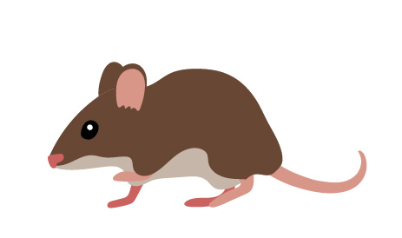
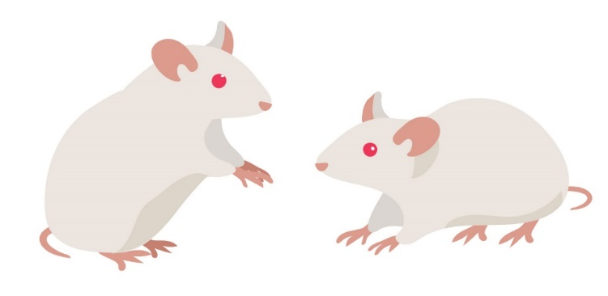
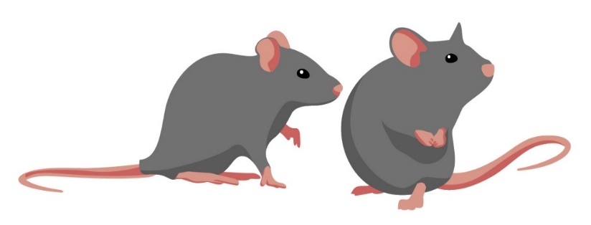
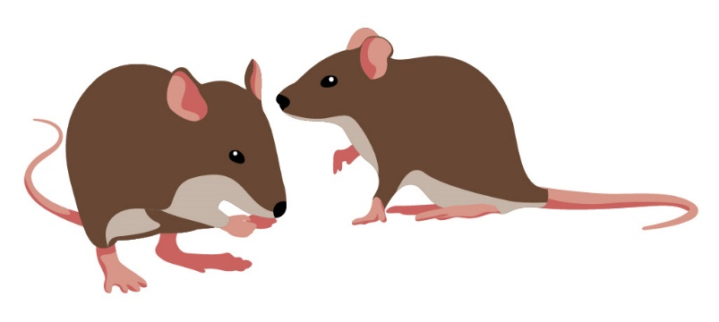
Investigation 1: Mouse Traits
Which pair of adult mice do you think might be the baby mouse’s parents? Why do you think so?
Baby Mouse
Possible Parents
Notes:
1 min
Read the questions on the slide and elicit participants’ predictions and reasoning.
“Let’s see if our predictions are right.”

Slide 35
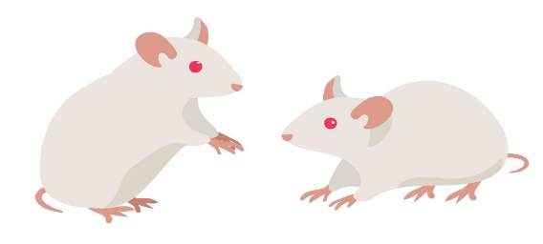
Data Table of Mouse Traits
Adult Mice | Number of Legs | Number of Ears | Fur Color | Length of Tail | Color of Eyes | Color of Nose
Notes:
10 min
“To find out which set of adult mice are the baby mouse’s parents, you’ll examine the traits of each set of mice and record your observations on a data table.”
Have participants pair up with an elbow partner. Then distribute handout 3.7 (Mouse Traits) to each pair and go over the instructions.
Pairs: Direct pairs to complete the data table for all three sets of adult mice and look for any patterns in the data that might help them determine which set of mice are most likely to be the baby mouse’s parents.
Whole group: “Based on the data you collected, which set of adult mice are most likely to be the brown mouse’s parents? What trait patterns did you identify that helped you reach this conclusion?”
Ideal response: The brown adult mice and the brown baby mouse share the most traits, so the brown adult mice are most likely the parents.
Individuals: Following the group discussion, have participants locate their STeLLA strategies booklets and read the chapter on strategy 4.
Turn and Talk: “Now I’d like you to discuss with your elbow partner how you can best engage students in analyzing and interpreting their data and observations from this activity. Then write your ideas in your notebooks.”
Whole group: Invite a few participants to share their ideas with the group.

Slide 36
NGSS Standards: Inheritance and Variation in Traits
Disciplinary Core Ideas
LS3.A: Inheritance of Traits.
Many characteristics of organisms are inherited from their parents. (3-LS3-1)
Other characteristics result from individuals’ interactions with the environment, which can range from diet to learning. Many characteristics involve both inheritance and environment. (3-LS3-2)
LS3.B: Variation of Traits.
Different organisms vary in how they look and function because they have different inherited information. (3-LS3-1)
The environment also affects the traits that an organism develops. (3-LS3-2)
Notes:
2 min
Briefly review the NGSS Disciplinary Core Ideas on the slide.
Ask participants, “What other core science ideas could come out of the mouse-traits activity?”
Possible responses:
The brown parents and the brown baby mouse shared many but not all traits. This is related to one of the NGSS disciplinary core ideas: “Many characteristics of organisms are inherited from their parents.”
Some mouse traits don’t vary (such as the number of legs and number of ears).

Slide 37
True or False?
Statement 1:
The babies of living things have traits exactly like their parents’ traits.
Discuss these questions :
Is this statement true or false? Why do you think so?
If it’s true, what is your evidence?
If it’s false, what would make it true?
Notes:
5 min
“Next, we’ll consider three statements about the traits of parents and offspring and decide whether each statement is true or false.”
Read the first statement on the slide and ask participants to write it in their science notebooks.
Turn and Talk: “Discuss the questions on the slide with an elbow partner; then write your answers in your notebooks.”
Whole-group share-out: Invite pairs to share their conclusions and reasoning with the group.

Slide 38
True or False?
Statement 2:
The babies of living things don’t have any of their parents’ traits.
Discuss these questions :
Is this statement true or false? Why do you think so?
If it’s true, what is your evidence?
If it’s false, what would make it true?
Notes:
5 min
Read the second statement on the slide and ask participants to write it in their science notebooks.
Turn and Talk: “Discuss the questions on the slide with an elbow partner; then write your answers in your notebooks.”
Whole-group share-out: Invite pairs to share their conclusions and reasoning with the group.

Slide 39
True or False?
Statement 3:
The babies of living things have some traits that are like their parents’ traits and some traits that are different from their parents’ traits.
Discuss these questions :
Is this statement true or false? Why do you think so?
If it’s true, what is your evidence?
If it’s false, what would make it true?
Notes:
5 min
Read the third statement on the slide and ask participants to write it in their science notebooks.
Turn and Talk: “Discuss the questions on the slide with an elbow partner; then write your answers in your notebooks.”
Whole-group share-out: Invite pairs to share their conclusions and reasoning with the group.
Ideal response: Participants should conclude that statements 1 and 2 are false, and statement 3 is true.

Slide 40
Reflect: Lesson-6 Focus Questions
Do babies of living things have the same traits as their parents? How do you know?
Notes:
1 min
Revisit the focus questions on the slide.
Whole-group discussion: “How can engaging students in analyzing and interpreting data and observations help them answer these focus questions?”

Slide 41
Reflect: Content Deepening Focus Question 1
How can we design experiments to test for genetic and environmental causes of trait variation?
Notes:
3 min
Review the first content deepening focus question.
Whole group: “What have we learned so far that can help us answer this question?”
“So do we all agree that one way we can test for genetic and environmental causes of trait variation is to measure a specific trait in parents and offspring?”
d. “Next, we’ll explore another way we can determine the extent to which genetics and the environment control variation in traits.”

Slide 42
Investigation 2: Genetics or Environment?
Focus question: How can we design experiments to test for genetic and environmental causes of trait variation?
Notes:
3 min
“One of the most powerful ways to approach this focus question is to explore traits in siblings who share identical DNA but were raised in different environments. By investigating traits in identical twins who were raised apart, we can determine whether genetics or the environment causes variation in a particular trait.”
“What might we learn from such a research approach? What might the results tell us?”
Emphasize that if a trait of identical twins shows variation, environmental differences must be the cause, since the twins share the same DNA.

Slide 43
Investigation 2: Genetics or Environment?
Height of Twin 1
Height of Twin 2
What would a graph look like for a trait in which all the variation is due to genetics?
What would a graph look like for a trait in which all the variation is due to environment?
Notes:
5 min
“Think about a graph that shows variations in height for 100 pairs of identical twins. For each pair, Twin 1’s height would be plotted on the y-axis, and Twin 2’s height would be plotted on the x-axis.”
Whole group: Walk participants through the hypothetical example of twin height variation and discuss the questions on the slide. Elicit a variety of predictions and ideas.
Individuals: Have participants draw two graphs in their science notebooks to illustrate their predictions. One graph should show genetics as the causal factor in the twins’ height variations, and the other graph should show environment as the causal factor.

Slide 44
Investigation 2: Genetics or Environment?
All of the twins’ height variation is due to genetics.
Height of Twin 1
Height of Twin 2
Notes:
Less than 1 min
“This slide shows what a graph would look like if genetics caused all of the trait variation in the identical twins. Does your graph reflect these results?”
“In this case, the height of one twin always matches the height of the other twin. The height trait shows a predictable pattern based on the identical genetic makeup of each twin, and environment plays no role at all in this trait.“

Slide 45
Investigation 1: Genetics or Environment?
All of the twins’ height variation is due to environment
Height of Twin 1
Height of Twin 2
Notes:
Less than 1 min
“This slide shows what a graph would look like if environment caused all of the trait variation in the identical twins. Does your graph reflect these results?”
“In this case, there is no identifiable pattern in the height trait of twins raised in different environments. None of the variation in this trait can be predicted based on the environment of each twin, and genetics plays no role in the variation.”

Slide 46
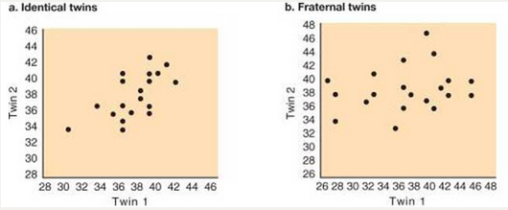
Investigation 2: Genetics or Environment?
This graph shows the association between the novelty-seeking scores of identical twins who were raised apart.
Notes:
5 min
“Now let’s look at novelty-seeking behavior among twins who were raised apart.”
“What does this graph tell us about the cause of variation in the novelty-seeking trait? Do you think the cause is genetics, the environment, or possibly both? How do you know?”
Pairs: Ask participants to discuss these questions with an elbow partner.
Whole group: Invite pairs to share their ideas and evidence with the group.
Ideal response:
The data show some relationship between the novelty-seeking scores for identical twins raised apart. This means that both genetics and the environment are involved in causing variation in this trait. This is true of many traits, as the NGSS Disciplinary Core Ideas indicate: “Many characteristics involve both inheritance and environment.”

Slide 47
Investigation 2: Genetics or Environment?
Studies suggest that about 40% of the variation in novelty-seeking behavior is controlled by genetics.
Twin and adoption studies suggest that 30 to 60% of the variation in many personality traits is due to inherited factors.
However, little is known about the genes involved or how they differ between people.
Little is also known about how genes interact with the developing brain and with environmental and experiential factors to generate behavior.
Notes:
Less than 1 min
Share the information on the slide about the causes of variation in behavioral traits like novelty seeking.

Slide 48
Investigation 2: Genetics or Environment?
In the twin studies, genetics was the constant, since the twins’ DNA was identical, and the environment varied.
Another way to determine the extent to which genetics and the environment cause variation in traits is to make environment the constant and let genetics be the variable.
Let’s find out how scientists have applied this approach to plants.
Notes:
Less than 1 min
Show the first point on the slide.
“In our previous examples, researchers measured trait variations in identical twins raised apart. In both the height and novelty-seeking studies, genetics was fixed or constant, and the environment varied.”
Show the second point on the slide.
“Another way to determine the extent to which genetics and the environment cause variation in traits is to make environment the constant factor and genetics the variable.”
“Let’s find out how scientists have applied this approach to plants.”

Slide 49
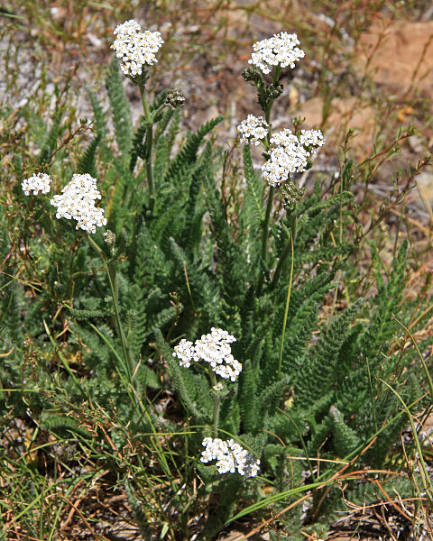
Investigation 2: Genetics or Environment?
Yarrow (Achillea lanulosa)
Photo courtesy of Wikimedia.org
Notes:
Less than 1 min
“In their research on trait variation in plants, scientists have found it especially useful to apply the approach we just discussed: keeping the environment constant and allowing genetics to vary. One of the plants scientists have studied is yarrow, a common landscape plant that grows throughout California.”

Slide 50
Investigation 2: Genetics or Environment?
Photo courtesy of Wikimedia.org
Photo courtesy of Wikimedia.com
Notes:
5 min
“Many decades ago, researchers traveled east to west across Northern California collecting plants at various elevations, from sea level to more than 10,000 feet. They noticed that the plants from higher elevations were quite short, and the plants from lower elevation were very tall. The researchers wondered whether genetics or the environment caused this variation in plant height. To answer this question, they gathered seeds from all of the plants they collected and grew them in the same garden at sea level. The experiment was designed with environment as the constant and genetics as the variable.”
“What do you think the results of the experiment would look like if genetics caused all of the variation in the height trait? What would the results look like if the environment caused all of the variation?”
Turn and Talk: “Share your ideas and reasoning with an elbow partner. Then write your predictions in your science notebooks.”
Whole group: Invite a few participants to share their predictions and reasoning with the group.

Slide 51
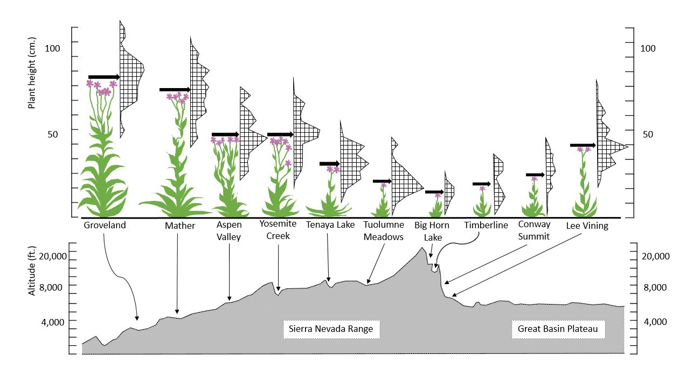
Investigation 2: Genetics or Environment?
Make a claim (with evidence) about whether genetics or the environment caused this variation.
Courtesy of Cal Poly Pomona
Notes:
5 min
“This slide shows the results of the plant experiment. Remember that all of the plants were grown in the same garden at sea level. The graph at the top of the slide shows plant height, and the graph at the bottom shows where the seeds originally came from.”
Individuals: “Study these graphs and then write a claim in your notebooks about whether genetics or the environment caused the variation in plant height. Make sure to include evidence and reasoning to support your claim.”
Whole group: Invite participants to share their claims, evidence, and reasoning with the group.
Ideal claim and evidence:
Claim: The variation in plant height seems to be strongly influenced by genetics.
Evidence: The evidence is that the height of plants grown in the common garden varied based on where the seeds came from. The seeds from higher elevations (e.g., Big Horn Lake) yielded the shortest plants, whereas the seeds from lower elevations (e.g. Groveland) yielded the tallest plants.

Slide 52
NGSS Standards: Inheritance and Variation in Traits
Disciplinary Core Ideas
LS3.A: Inheritance of Traits.
Many characteristics of organisms are inherited from their parents. (3-LS3-1)
Other characteristics result from individuals’ interactions with the environment, which can range from diet to learning. Many characteristics involve both inheritance and environment. (3-LS3-2)
LS3.B: Variation of Traits.
Different organisms vary in how they look and function because they have different inherited information. (3-LS3-1)
The environment also affects the traits that an organism develops. (3-LS3-2)
Notes:
3 min
Briefly review the NGSS Disciplinary Core Ideas on the slide.
“How have our investigations of trait variations in twins and yarrow plants affected your understandings of these core ideas? Write down your thoughts in your science notebooks.”

Slide 53
Ideas That Explain How Populations Change over Time
Change in populations over time
Variations affect which living things survive.
Environments can change.
All living things show variation for some traits.
Babies inherit traits from their parents.
Notes:
Less than 1 min
Read the information on the slide and review how the investigations participants have completed so far can help them explain how populations of living things change over time.
“Our next investigation will add another key idea to this growing list.”

Slide 54
Investigation 3: Counting Seeds
Assumptions:
All of the seeds from a piece of fruit survive, become adults, and make their own fruits.
The piece of fruit we have represents the last fruit of its kind on Earth.
All plants will die at the end of each year.
Each plant produces the same number of fruits per year.
One apple tree will produce 850 apples.
Notes:
10 min
Initially, show only the first assumption on the slide.
“In this investigation, we’ll use a mathematical model to test five assumptions about survival in plants.”
Read the first assumption on the slide and then reveal and read the other assumptions one at a time.
Have participants pair up with an elbow partner. Then distribute one copy of handout 3.8 (Counting Seeds) to each pair.
“To complete this handout, you’ll need one more piece of information: the number of apple seeds.”
Give each pair of participants an apple and cut it so they can count the number of seeds.
Ask participants to calculate the number of apple trees and the number of seeds for four generations and record this data on the handout.
Participants should notice that the numbers of trees and fruits increase rapidly. Have them complete several calculations on the handout; then display the Excel spreadsheet (handout 3.9, Increasing Seeds) and perform the remaining calculations. If you enter 5 for the number of seeds per fruit (row 5) under Generation 0 (column 3), the rest of the numbers for that column should fill in automatically. Then enter the number of fruits per plant (850 per assumption 5) in row 3 for Generation 1 and enter 5 seeds in row 5 for Generation 1. Continue this for all four generations.
Have participants record the remaining spreadsheet data on their handouts.

Slide 55
Investigation 3: Counting Seeds
Not all of these seeds will grow into apple trees!
New science idea: More offspring are born than survive.
Notes:
Less than 1 min
Show only the first point on the slide.
Ask, “Can you image what would happen if all of these apple seeds survived?”
Emphasize: Not all of these seeds will grow into apple trees!
Reveal the second point on the slide and introduce the new science idea: More offspring are born than survive.

Slide 56
Ideas That Explain How Populations Change over Time
Change in populations over time.
Variations affect which living things survive.
Environments can change.
All living things show variation for some traits.
Babies inherit traits from their parents.
More offspring are born than survive.
Notes:
Less than 1 min
Revisit the graphic on the slide that explains how populations of living things change over time.
Emphasize the new idea that has been added: More offspring are born than survive.
“In our final investigation, we’ll use all of these ideas to help us explain how changes in populations of living things happen over time.”

Slide 57
Reflect: Content Deepening Focus Question 1
How can we design experiments to test for genetic and environmental causes of trait variation?
Notes:
4 min
Review the focus question on the slide.
Individuals: Ask participants to answer the question in their science notebooks using evidence from the investigations to support their ideas.
Whole group: Based on the previous investigations, briefly summarize the key ways experiments can be designed to test for genetic and environmental causes of trait variation.
Key ways to design experiments:
Measure specific traits in parents and offspring.
Measure specific traits in populations by making either genetics or the environment the constant and making the other factor a variable.
Use a mathematical model to test assumptions about inheritance and survival.

Slide 58
Content Deepening: Focus Question 2
How would biologists explain how a trait changes within a population over time?
Notes:
Less than 1 min
Read the focus question on the slide.
“This focus question will guide the rest of our content deepening work today and into our next session.”
Have participants write this question in their science notebooks.

Slide 59
Investigation 4: Explaining Changes over Time
Goal: To develop a full explanation for change in populations over time using evidence and major principles of natural selection
Notes:
Less than 1 min
Read the goal on the slide.
“The science ideas we explore and the evidence we gather during the next investigation will help us accomplish this goal.”

Slide 60
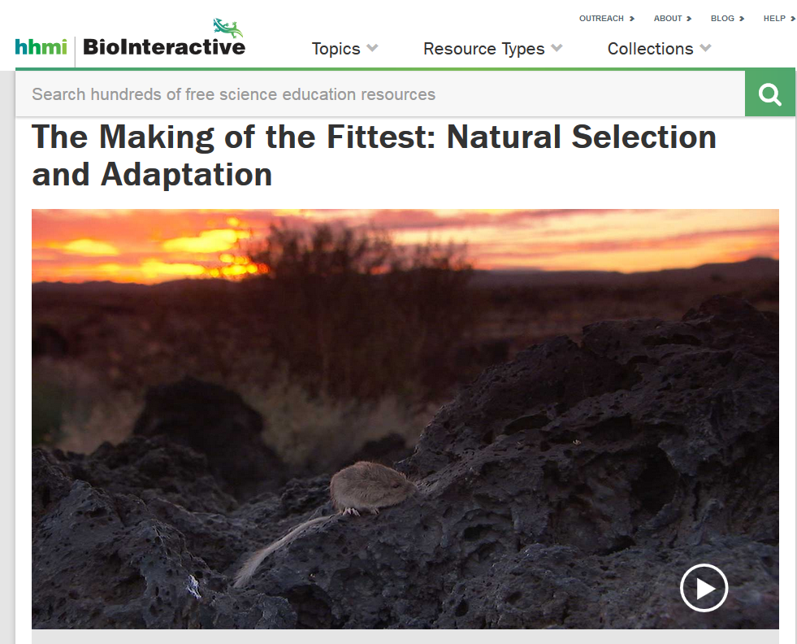
Investigation 4: Explaining Changes over Time
Used with permission from Howard Hughes Medical Institute
http://www.hhmi.org/biointeractive/making-fittest-natural-selection-and-adaptation
Notes:
10 min
“In this investigation, we’ll explore the evolution of fur color in rock pocket mice.”
Distribute handout 3.10 (Developing an Explanation for Mouse Fur Color) and have participants read the introduction silently.
Watch the beginning of The Making of the Fittest: Natural Selection and Adaptation and pause the video at the 2:37 time segment, where Dr. Nachman says, “Almost all of them.”
Individuals: Have participants complete step 2 on the handout using the science ideas about variation in traits that they’ve learned about so far.
Pairs: Have participants share their responses with an elbow partner.
Whole group: Discuss participants’ answers to questions 2a and 2b on the handout.
Notes:
Question 2a: Participants aren’t yet expected to have a fully developed answer to this question, so don’t discuss all of the elements of a complete answer at this point. Participants will revisit this question later in the activity when they examine the Natural-Selection Explanation Table (handout 3.11). Then they should be able to provide a complete explanation that incorporates the major principles of natural selection as follows:
Variation: Within a population of mice living on the lava flow, some individuals had the dark fur trait and others did not.
Inheritance: The variations in mouse fur color are inherited (passed from parents to offspring). The origin of the variation stems from random genetic mutations.
Selection: More offspring are born than can survive, leading to competition within a species. In certain environments, individual mice that have dark fur will survive and leave more offspring than mice with tan fur.
Adaptation: The frequency of the mice with dark fur and the alleles that cause dark fur will increase in the population over generations. In this case, the population will change from one with most individuals having tan fur to one with most individuals having dark fur.
Question 2b: Address the common student misconception that new traits arise as needed. The mutation for dark-colored fur in rock pocket mice didn’t occur simply because the mice needed it. Instead, the new trait arose due to random genetic mutations. Clarify that explanations for change based on the needs or wants of an individual are common but aren’t scientifically accurate. Direct participants to the Common Student Ideas document in the resources section of their lesson plans binders.

Slide 61
Investigation 4: Explaining Changes over Time
Constructing a Natural-Selection Explanation
Principle | Definition | Evidence
Variation | (See handout for definitions.)
Inheritance
Selection
Adaptation
Notes:
20 min
Distribute handout 3.11 (Natural-Selection Explanation Table). Point out that an acronym for the natural-selection principles is VISA.
Individuals: Have participants read the definitions on the handout and sections 6 and 7 on natural selection in their content background documents.
Pairs: “Pair up with an elbow partner and summarize how the information in the content background document and your experiences in our content deepening sessions support the definitions in the handout.”
“In our next content deepening session, we’ll watch the rest of the video and identify evidence for each natural-selection principle. You’ll record this evidence on your handout.”

Slide 62
Reflect: Content Deepening Focus Question 2
How would biologists explain how a trait changes within a population over time?
Notes:
Less than 1 min
Revisit the focus question on the slide.
“In the last activity, you summarized the progress we’ve made in answering this focus question. We’ll continue exploring this question in our next session.”

Slide 63
Content Deepening Reflections
In this content deepening session …
How were you engaged in analyzing and interpreting data?
How were you engaged in constructing explanations and arguments?
How did the investigations move your thinking forward toward more-scientific ideas about variation in traits?
Notes:
5 min
Pairs: Ask participants to pair up and discuss the questions on the slide.
Whole group: Invite participants to share their reflections with the group. During this discussion, challenge participants in the following ways:
Be clear about when they were simply observing and when they were analyzing and interpreting data and observations.
Identify the type of analysis they engaged in:
Using logic and evidence, and/or
Using logic, evidence, and science ideas

Slide 64
Summary: Moving Student Thinking Forward
How can we advance student thinking without simply telling students about science ideas and asking them to memorize the concepts?
Refer to our Effective Science Teaching chart from day 1. Which of these ideas do you want to highlight based on the strategies we’ve explored so far? Anything you want to add or modify?
Notes:
5 min
Have participants share ideas about the first question on the slide. Then ask, “What are some things we’ve discussed today that address this question?”
Refer participants to the Effective Science Teaching chart from day 1 and discuss the remaining questions on the slide. Modify the chart as participants share their ideas.

Slide 65
Today’s Focus Questions
How can analyzing data and constructing explanations help students move forward toward deeper understandings of science ideas?
How can we design experiments to test for genetic and environmental causes of trait variation?
How would biologists explain how a trait changes within a population over time?
Notes:
5 min
Review today’s focus questions.
Discuss: “The STeLLA strategies booklet claims that strategies 4 and 5 are ways of moving student thinking forward. How would you support or challenge that claim? In other words, are you convinced that letting students analyze data and construct explanations will help them move forward toward deeper understandings of science ideas?”
Ask: “What key ideas do you now have about how to address our content deepening focus question?”

Slide 66
Homework
Review strategy 6 in the STeLLA strategies booklet and complete the STL Z-fold summary chart for this strategy: Engage students in using and applying new science ideas in a variety of ways and contexts.
Be prepared to share your assigned lesson plan review.
Notes:
1 min
“Tomorrow we’ll focus on another strategy to help move student thinking forward toward deeper understandings of science ideas.”
Review the homework assignment and have participants copy it into their science notebooks.

Slide 67
Reflections on Today’s Session
Complete the Daily Reflections sheet (handout 3.12).
What new idea or insight did you have today related to strategy 4 (analyzing and interpreting data and observations) and strategy 5 (constructing explanations and arguments)?
What ideas do strategies 4 and 5 give you about things to try or change in your science teaching?
Answer one of these questions: (1) What important science idea are you taking away from our content deepening work today? Remember to state the idea in a complete sentence. (2) What question do you have about trait variation and inheritance (i.e., something you’re unclear or wonder about)?
Notes:
4 min
Have participants reflect on today’s session and answer the questions on the Daily Reflections sheet (handout 3.12 in PD program binder).
Note: To support this task, encourage participants to refer to the STeLLA strategies booklet, the charts they created for STL strategies 4 and 5, the Effective Science Teaching chart, and their STL Z-fold summary charts.

Slide 68
Norms for Working Together: The Basics
Purpose: Build trust and develop a productive study group for all participants.
The Basics
Arrive prepared and on time; stay for the duration; return from breaks on time.
Remain attentive, thoughtful, and respectful; engage and be present.
Eliminate interruptions (turn off cell phones, email, and other electronic devices; avoid sidebar conversations).
Make room for everyone to participate (monitor your floor time).
Notes:
Hidden slide—available for use as needed.

Slide 69
Norms for Working Together: The Heart
Purpose: Build trust and develop a productive study group for all participants.
The Heart of RESPeCT Lesson Analysis and Content Deepening
Keep the goal in mind: analysis of teaching to improve student learning.
Share your ideas, uncertainties, confusion, disagreements, questions, and good humor. All points of view are welcome.
Expect and ask questions to deepen everyone’s learning; be constructively challenging.
Listen carefully; seek to understand other participants’ points of view.
Notes:
Hidden slide—available for use as needed.

