Slide 1
RESPeCT PD pROGRAM
Day 2
RESPeCT Summer Institute
Notes:
3 min
Take care of any housekeeping issues.

Slide 2
Trends in Reflections
Lesson Analysis | Science Content Learning
Notes:
5 min
Give participants time to review your summary of their reflections from day 1 and offer reactions and comments or ask follow-up questions.

Slide 3
Norms for Working Together: The Basics
Purpose: Build trust and develop a productive study group for all participants.
The Basics
Arrive prepared and on time; stay for the duration; return from breaks on time.
Remain attentive, thoughtful, and respectful; engage and be present.
Eliminate interruptions (turn off cell phones, email, and other electronic devices; avoid sidebar conversations).
Make room for everyone to participate (monitor your floor time).
Notes:
5 min
Provide context: “Since we’ll be working together throughout the Summer Institute and the academic year, we need norms that will enable us to build trust and productivity as a group. Today we’ll start our analysis of other teachers’ classroom videos. In the fall, we’ll analyze videos from each other’s classrooms. For this work to be meaningful, we’ll need to push and challenge each other. This will require mutual respect and a common understanding of our goals.”
“Do you want to clarify or revise any of these norms?”
Note: Have participants locate the half-page sheet of norms they pasted into their science notebooks on day 1. Remind them to leave space for revising the norms.
Encourage participants to ask clarifying questions regarding the meaning of any of the norms and jot notes in their science notebooks.
Ask participants if they’re willing to live with these norms today, and let them know they’ll have an opportunity to revise them tomorrow. Remind them of this at the end of the session.

Slide 4
Norms for Working Together: The Heart
Purpose: Build trust and develop a productive study group for all participants.
The Heart of RESPeCT Lesson Analysis and Content Deepening
Keep the goal in mind: analysis of teaching to improve student learning.
Share your ideas, uncertainties, confusion, disagreements, questions, and good humor. All points of view are welcome.
Expect and ask questions to deepen everyone’s learning; be constructively challenging.
Listen carefully; seek to understand other participants’ points of view.
Notes:
5 min
“Now let’s review the norms at the heart of the RESPeCT PD program.”
“Do you want to clarify or revise any of these norms?”
“Do you want to add any norms to this list?”
d. Ask participants if they’re willing to live with these norms today, and announce that they’ll have an opportunity to revise them tomorrow.

Slide 5
Agenda for Day 2
Day-1 reflections
Focus questions
Review of STL strategies 1–3
STL lesson analysis: elicit and probe questions
STL lesson analysis: probe and challenge questions
Practice using elicit and probe questions
Lunch
Content deepening: variation in traits
Summary, homework, and reflections
Notes:
Less than 1 min
Talk through the agenda for the day.

Slide 6
Today’s Focus Questions
Lesson Analysis
Content Deepening
How can lesson analysis help us better understand how elicit, probe, and challenge questions can reveal and challenge student thinking?
How can variation in traits affect which individuals survive long enough in their environment to reproduce?
Notes:
1 min
Introduce the focus questions that will guide today’s session.
“Each day we’re going to have at least one lesson analysis focus question and one content deepening focus question.”
“Here are our focus questions for today’s session.”

Slide 7
Notes:
1 min
Point out the strategies highlighted on the slide.
“During today’s session, we’ll focus again on the first three Student Thinking Lens strategies: elicit, probe, and challenge questions.”

Slide 8
Probe versus Challenge Questions
Read the dialogue example for STL strategy 3 in the STeLLA strategies booklet.
With an elbow partner, try to justify why each question is labeled probe or challenge.
For help, refer to the STL Z-fold summary chart and the explanations, examples, and general questions for strategy 3 in the strategies booklet.
Be ready to share your ideas.
Notes:
10 min
Have participants look in the STeLLA strategies booklet at the dialogue example for STL strategy 3 that highlights probe and challenge questions.
The purposes of this activity are as follows:
1. To get participants’ heads back into the questioning strategies discussed on day 1.
2. To make sure participants understand the distinct purposes of probe and challenge questions:
Probe questions seek to understand what students are saying/writing and encourage them to explain their ideas more clearly or fully (not to change their thinking).
Challenge questions seek to engage students in ways that will challenge them to think, reconsider their ideas, change their initial ideas, and move toward more-scientific understandings.

Slide 9
Lesson Analysis Focus Question
How can lesson analysis help us better understand how elicit, probe, and challenge questions can reveal and challenge student thinking?
Notes:
Less than 1 min
“Today we’ll explore this focus question: How can lesson analysis help us better understand how elicit, probe, and challenge questions can reveal and challenge student thinking?”
“But first let’s discuss what lesson analysis involves.”

Slide 10
RESPeCT Lesson Analysis Protocol
1. Identify the strategy
What STeLLA lens and strategy was the teacher using in the video clip?
2. Analyze the video
What student thinking was made visible (or not)?
How did the use of the STeLLA strategy impact student thinking?
3. Reflect and apply
What did you learn from identifying and analyzing the strategy in the video?
Notes:
3 min
“This is the three-step protocol that will guide our video-based lesson analysis work. Although we’ll follow the protocol a bit more loosely during the Summer Institute, we’ll rely heavily on this explicit three-step format as we move into the fall study groups.”
Review the steps on the slide; then tell participants, “Framing our analysis in this way and following specific steps will help us focus more holistically on the teaching and the impact of the STeLLA strategies on student thinking and learning and the storyline students are constructing (i.e., the Student Thinking Lens and the Science Content Storyline Lens).”

Slide 11
Lesson Analysis Process
Review the lesson context:
What is the ideal student response to the focus question?
How is the clip situated in the content storyline?
Identify and discuss the strategy that is the focus of analysis for each clip.
Watch video clip(s).
Analyze the lesson using the lesson analysis protocol.
Reflect on the lesson analysis experience:
As a reviewer
As a teacher in the clip
Notes:
3 min
“The lesson analysis protocol includes this five-step process.”
Review the steps on the slide and note that in the study groups, these steps will be followed more explicitly than they will be during the Summer Institute.

Slide 12
Lesson Analysis: Viewing Basics
Viewing basic 1: Look past the trivial, or little things, that bug you.
Viewing basic 2: Avoid the “This doesn’t look like my classroom!” trap.
Viewing basic 3: Avoid making snap judgments about the teaching or learning in the classroom you’re viewing.
Note: Find out more about the viewing basics on page 1 of in the STeLLA strategies booklet.
Notes:
2 min
Ask: “Why is each of these viewing basics important? Which will be hardest for you?”
Tell participants they can find details on the viewing basics in the STeLLA strategies booklet and refer to this information later.
Highlight: “The videos we’ll be viewing throughout the program aren’t necessarily exemplary, but rather they provide real-world examples of teachers implementing the STeLLA strategies. Examples like these deepen our thinking because we can see the sometimes unintended results of teacher decisions and consider missed opportunities.”
Honor the videocase teachers! All of these courageous teachers are not only working hard to improve their own teaching practice but are also willing to make their practice public so that others can learn from it. None of them would claim to be exemplary science teachers.

Slide 13
Our First Video Clip
Video Clip 1
Context:
A 3rd-grade student (Marissa) is interviewed before the teacher begins instruction on variation in traits.
The student shares ideas about how trait variations might affect the survival of a litter of rabbits living in a snowy environment.
Photo courtesy of Pixnio.com
Notes:
2 min
Describe the context of the first video clip participants will watch. (See the top of the transcript—handout 2.1 in the PD program binder.)
“This student interview showcases the use of elicit and probe questions. Even though this clip doesn’t take place in the context of an actual classroom, the idea is to look at the quality and form of the questions. Our second video clip will feature probe and challenge questions in a classroom context.”

Slide 14
Identify Elicit and Probe Questions
Video Clip 1
Watch the video clip for examples of the interviewer or teacher asking students elicit and probe questions.
Identify the questions on your transcript and mark them E (elicit) and P (probe).
Share your evidence with the group.
Remember:
Not all questions will fall into the E and P categories.
Elicit questions start a conversation and ask for student ideas without expecting right answers.
Probe questions try to figure out what a student means.
Probe questions can paraphrase a student’s idea.
Link to video clip 1: 2.1_mspcp_gr.3.variations.traits_lathon_pre.marissa_c1
Notes:
20 min
Provide instructions for watching video clip 1 and using the transcript to identify questions that elicit (E) and probe (P) student ideas and predictions.
Remind participants that the purpose of watching the video clip is to deepen their shared understandings of these strategies and to build their individual and collective lesson analysis skills.
Individuals: Allow time for participants to review the video transcript and mark E and P questions.
Whole group: Discuss what participants found in the transcript. Encourage them to use evidence from the transcript and reasons from their Z-fold summary charts or the STeLLA strategies booklet to support their ideas. Participants should work to differentiate elicit and probe questions and distinguish them from other types of teacher questions or statements.
Examples of elicit questions:
Video segment 00:00:06: “How are they [the rabbits] different?”
Segment 00:00:30: “So if [the rabbits] were born in this habitat, or this area, and this was a predator, would any of them have a better chance of surviving than the others?”
Note: Although elicit questions are typically used in a classroom setting to elicit a variety of student ideas, this video clip shows an interview with a student conducted before the Variation in Traits unit began.
Examples of probe questions:
Video segment 00:00:13: “OK, so tell me about their skin.”
Segment 00:00:44: “Ah. So how does blending in help them survive better?”
Segment 00:00:51: “So which ones out of … out of that group might the predators see more easily?”
Segment 00:01:00: “How come the black ones?”
Segment 00:01:53: “How might they look different?”
Note: One question at video segment 00:01:33—“Knowing that these guys are harder to see, over years and years and year, what might these rabbits look like?”—might be interpreted as a challenge question in this interview because the interviewer is trying to guide Marissa toward make a connection she hasn’t mentioned between the predation she’s been talking about and its impact on future generations of rabbits. This question is pushing Marissa to go beyond her current thinking (not simply probing what she knows now.)

Slide 15
Analyze Student Thinking
Video Clip 1
Review the interview transcript.
What student thinking was revealed through the interviewer’s elicit and probe questions?
What did Marissa think what might happen to rabbits with different fur color living in a snowy environment?
Were there places you wished the interviewer had probed Marissa’s thinking more? Why?
Notes:
20 min
Give participants time to review the video transcript and develop an answer to one of the analysis questions on this slide. Encourage them to write down their answers.
For this first video analysis, do a round-robin and have each participant share. Ask probe and challenge questions to support participants in communicating their ideas clearly and completely:
Probe question: “Can you say more about what you mean by …?”
Challenge question: “Can you point to a specific place in the transcript that supports your idea?”
As participants share, encourage others to respond by asking questions like these:
Do others have additional evidence to support (or challenge) this idea?
Do others have a different interpretation?
Ideal response:
At video segment 00:00:30, the interviewer asks whether any of the bunnies might have a better chance of surviving than others. Marissa talks about how well the white rabbits blend into their environment and avoid being eaten by a predator (segments 00:00:38; 00:00:48). Then she seems to indicate that the brown and black bunnies would move to different habitats to avoid predators (00:01:22) and wouldn’t stay in the snowy environment: “The … the brown ones would live closer to, like, forests, and then the black bunnies would probably live close to dark places.” It would be nice to know more about Marissa’s thinking at this point. Students often believe that animals choose to live in an environment where they’re camouflaged, and they don’t understand that animals are camouflaged in their environment as the result of natural selection causing a change in populations over time.

Slide 16
Identify Probe and Challenge Questions
Video Clip 2
Now we’ll look at a classroom video and focus on identifying probe and challenge questions.
Read the context at the top of the video transcript (handout 2.2).
Identify probe (P) and challenge (C) questions and mark them on your transcript.
Mark “missed opportunity” (MO) next to places you would like to know more about student thinking.
Remember:
Not all questions will fall into these categories.
Probe questions try to figure out what a student means or is thinking. Challenge questions try to move student thinking toward a more scientifically accurate idea.
Link to video clip 2: 2.2_mspcp_gr.3.variations.traits_lathon_L1_c1
Notes:
20 min
Provide instructions for watching video clip 2 and using the transcript (handout 2.2) to identify questions that probe student ideas and predictions and challenge student thinking.
Encourage participants to refer to the strategy charts from day 1 (STL strategies 1–3), their Z-fold summary charts, and the STeLLA strategies booklet for help differentiating probe and challenge questions. Remind them that other types of questions (such as elicit questions) may appear in this video clip.
Set the context: Read the context for video clip 2 (at the top of the transcript).
Emphasize that the students in this class haven’t yet studied anything about variation in traits.
Show the video clip and allow time for participants to study the transcript before advancing to the next slide.

Slide 17
Identify Probe and Challenge Questions
Video Clip 2
What are good examples of probe questions in the video transcript (if any)?
What are good examples of challenge questions in the transcript (if any)?
Notes:
5 min
After each suggested probe or challenge question, ask participants the following:
“What makes this a probe/challenge question?”
“Did others mark this as a probe/challenge question?”
“Can you point to any of our resources (the Z-fold summary chart, our strategy charts from day 1, or the STeLLA strategies booklet) to support your answer?”
Don’t worry about debate and lack of agreement on some questions. The important thing is that participants clearly understand the difference between the purposes of probe and challenge questions. Sometimes it’s hard to tell whether the teacher in the video intended to find out what a student meant (probe) or move student thinking toward more-scientific understandings (challenge). The teacher may also be asking elicit questions to reveal student ideas and misconceptions.
Possible examples of probe questions:
Video segment 00:00:10: “OK, so talk to me about some of your differences, some of your variations. What did you find?” [Justification: This is a restated elicit question used to probe what the small group is thinking.]
Segment 00:00:22: “OK, so you said you can see dots on each paper … on each ladybug.” [Justification: The teacher paraphrases what a student says.]
Segment 00:01:19: “What do you think are some reasons that that might take place?”
Segments 00:01:41, 00:01:46: “So are you … are you saying that environment … could possibly have a … a reason for variation?”
Segment 00:01:51: “So tell me more about that. So environment. What other kind of big categories like that do you think might be a cause for variations in ladybugs?”
Segment 00:02:09: “OK, and tell me more about that. Why … why … why not purple? Why not pink?”
Segment 00:02:32: “OK. Can you think of any other … Other than environment, why else do you think that there might be a difference in variations?”
Segment 00:02:54: “Yeah, but why the … why the difference in spot … number of spots?”
Note: Some participants may question why segments 00:01:51 and 00:02:32 are probe questions rather than elicit or challenge questions. Both questions could reasonably be interpreted as elicit questions, since Ms. Lathon is looking for other ideas to explain why variations might exist rather than looking for one correct answer. However, neither question can be interpreted as a challenge question because Ms. Lathon hasn’t yet introduced any new science ideas and isn’t trying to change student thinking. She is simply trying to learn more about what students currently think and is building on what students’ have already said about why variations exist. She is probing their thinking, not attempting to move student thinking toward more scientifically accurate ideas.

Slide 18
Analyze Student Thinking
Video Clip 2
Select one of the following analysis questions:
What student ideas about variation in traits did the teacher’s use of probe questions reveal?
Did any probe questions lead students away from thinking about trait variation in ladybugs toward ideas that weren’t closely related?
Review the video transcript and develop an answer to the question. Write your response in your science notebook.
Be prepared to share your ideas with the group and engage in scientific discussion.
Notes:
10 min
Remind participants of the purposes of video analysis: to deepen understandings of STeLLA strategies; to develop their ability to analyze student thinking; and, ultimately, to improve student learning.
Individuals: “Select one analysis question on the slide; then review the transcript and develop an answer to this question. Write your responses in your science notebooks.”
Note: Participants will likely choose to answer the first question. The second question is more difficult but is an interesting one you might want to model if no one addresses it. (See ideal response below.)
Whole group: As participants share their responses to the questions, encourage discussion and ask the following questions:
Probe: “Can you say more about what you mean by …”
Challenge: “Can you point to a specific place in the transcript that supports your idea?”
“Do others have additional evidence to support or challenge this idea?”
“Do others have a different interpretation?”
Highlight these points as needed:
Ask probe questions when students make vague or abbreviated statements or when they simply name a vocabulary term. Do they really understand the concepts, or do they have misconceptions?
Don’t probe everything. Just probe responses that might reveal interesting student thinking related to the main learning goal.
Ideal responses:
Question 1: Probe questions revealed interesting student ideas related to trait variation.
Segment 00:01:51: The teacher’s probe question—“What other kind of big categories like [environment] do you think might be a cause for variations in ladybugs?”—led to a student noticing that some ladybugs are red and some are orange.
Segments 00:02:32 and 00:02:54: After the teacher’s first probe question—“Other than environment, why else do you think there might be a difference in variations?”— students noticed a variation in the number of spots on the ladybugs, and the next question—“Yeah, but why the …why the difference in spot … number of spots?”—led to an interesting student idea that this variation might be related to the age of the ladybugs (the older the ladybug, the more spots).
Question 2: The following probe questions weren’t related to the idea that ladybug traits vary and consequently led student thinking away from the key focus of the discussion:
At segment 00:02:01, a student noticed a variation in ladybug traits: Some ladybugs are orange, and some are red. The teacher responded at segment 00:02:09 with a broad probe question: “Tell me more about that.” But then the teacher added, “Why not purple? Why not pink?” This led students away from thinking about trait variations (why some ladybugs are red and others are orange) to thinking about why ladybugs are never purple or pink. The question revealed interesting student ideas, such as “[Pink or purple] wouldn’t look good for a ladybug” (segment 00:02:13), but these ideas weren’t related to trait variation.

Slide 19
Common Student Ideas
Video Clip 2
Locate Common Student Ideas about Variation in Traits (in lesson plans binder).
Read through the left-hand column.
Have you observed any of these common ideas among your students? (Mark these ideas with a red dot.)
Have you ever held any of these ideas yourself? (Mark these ideas with a blue dot.)
Can you think of other misconceptions you’ve held or observed in students?
Pairs: Share your observations with a partner.
Whole group: What patterns do you notice in the red and blue dots? What did this analysis make you think about?
Notes:
15 min
“Now let’s consider some commonly held student ideas (misconceptions). Then we can analyze whether any of these ideas appear in our video clips.”
Have participants locate the Common Student Ideas chart in the resources section of their lesson plans binders.
“This Common Student Ideas chart shows some commonly held student ideas that are interesting but aren’t scientifically accurate.”
Individuals: Have participants mark with a red sticker dot any ideas they’ve observed among their students, and mark with a blue sticker dot any ideas they’ve had themselves.
Pairs: Have participants discuss their observations with a partner.
Whole-group discussion: Ask participants to share which ideas they’ve observed in their students and themselves. During this share-out, apply sticker dots to the Common Student Ideas chart at the front of the room as participants to highlight patterns in the results. Then discuss the following questions:
“What conceptual patterns do you notice in the red and blue dots?”
“What reactions do you have to this analysis? What did it make you think about?”
Note: If time is short, skip this pattern analysis and discussion.
“We’ve recognized these common ideas in students or held them ourselves. It’s important to be aware of them when we’re analyzing student thinking in the video clips or planning and teaching lessons in the future.”
“Now let’s look for evidence of these common student ideas in a video clip.”

Slide 20
Common Student Ideas
Video Clip 2
Individuals: Read the scientific explanations for your assigned idea on the Common Student Ideas chart.
Pairs: Discuss these explanations briefly with a partner. What was new to you? Write on sticky notes any content questions you have and place them on the Parking Lot poster.
Notes:
10 min
Have participants count off in ones and twos (1, 2, 1, 2). “Ones” will focus on the odd-numbered ideas on the Common Student Ideas chart, and “twos” will focus on the even-numbered ideas.
Individuals: “Read the scientific explanations for your assigned idea on the Common Student Ideas chart.”
Pairs: “Discuss these explanations briefly with a partner. What was new to you? Write on sticky notes any content questions you have and place the notes on the Parking Lot poster.”

Slide 21
Lesson Analysis Basics
Analysis basic 1: Focus on student thinking and the science content storyline.
Analysis basic 2: Look for evidence to support any claims.
Analysis basic 3: Look more than once (in the video and transcript).
Analysis basic 4: Consider alternative explanations and teaching strategies.
Note: Find out more about the analysis basics on page 2 of the STeLLA strategies booklet.
Notes:
5 min
“Before we analyze the video clip, let’s think about our lesson analysis process.”
Review the analysis basics on the slide.
Note: Direct participants to page 2 in the strategies booklet if they have specific questions that require more information.
Why the analysis basics are important: “The analysis basics will help us dig deeper and learn more from our videocase analyses while keeping us focused on the ultimate goal of improved student learning.”
Note: This lesson analysis process is not about critiquing teachers but about improving student learning.
“We’ll use a more structured lesson analysis protocol when we begin reviewing each other’s videos in the fall study-group sessions.”

Slide 22
Analyze Questions That Probe and Challenge Student Thinking
Video Clip 2
Analysis question: What student thinking is made visible (or not) through the use of probe or challenge questions? Be specific. Consider whether you observed any of the common student ideas or correct scientific explanations in the video.
Individuals: Make notes or highlight questions/responses on the video transcript. Develop a claim to answer the question. Support the claim with
evidence from the transcript,
ideas from the Common Student Ideas chart, and/or
ideas from the STeLLA strategies booklet.
Whole group: Share claims and evidence.
Notes:
15 min
Remind participants of the purposes of video analysis: to deepen understandings of STeLLA strategies; to develop their ability to analyze student thinking; and, ultimately, to improve student learning.
Tell participants: “Remember to refer to your Common Student Ideas chart as you analyze the video clip.”
Individuals: Review the slide instructions before participants begin working independently on the tasks.
Whole group:
Have several participants share their claims and evidence.
Ask: “Did you recognize any of the common student ideas in the students’ responses?”
Ask: “What probe or challenge questions might you ask to better understand student thinking?”
Note: Remember to use probe and challenge questions as you interact with participants.

Slide 23
Identify Probe, Challenge, and Leading Questions
Video Clip 3
Now we’ll look at another classroom video. Read the context in the video transcript (top of handout 2.3).
Individuals: Mark the transcript to identify probe (P), challenge (C), or leading (L) questions. Then mark any missed opportunities (MO).
Remember:
Not all questions (or statements) will fall into these three categories: P, C, or L.
Review the viewing basics and analysis basics.
Whole-group share-out: Give reasons for marking the questions the way you did.
Link to video clip 3: 2.3_ mspcp_gr.3.variations.traits_wilde_L6_c1
Notes:
20 min
Read the context for this video clip at the top of the transcript (handout 2.3).
Provide instructions for watching video clip 3 and using the transcript to identify questions that probe student ideas and predictions and challenge student thinking. Participants should also be on the lookout for leading questions and missed opportunities. (Note: Leading questions provide hints or make it easy for students to give the “right” answer.) Remind participants that other types of questions (such as elicit questions) may appear in this video clip.
Show the video clip.
Individuals: Review the slide instructions before participants begin working independently on the tasks.
Whole group:
Challenge participants to clearly state their reasons for identifying a question as probe, challenge, or leading.
Encourage participants to provide evidence from the STeLLA strategies booklet to support their claims.
Examples of probe questions:
Video segment 00:00:31: “You think green. How come?”
Segment 00:01:50: “Why do you think green or light purple?”
Example of a challenge question:
Video segment 0:01:59.9: “When all those beetles had babies, what do you think the next generation will look like?” [Justification: The teacher is trying to get students to transition from thinking about the offspring of two green beetles to making a new connection to the offspring of a whole generation of beetles in this population.]

Slide 24
Analyze Student Thinking
Video Clip 3
Analysis question: What student thinking is made visible (or not) through the use of probe or challenge questions? Be specific.
Individuals: Develop a claim to answer the analysis question. Support the claim with
evidence from the video transcript,
ideas from the Common Student Ideas chart, and/or
ideas from the STeLLA strategies booklet.
Whole group: Share claims and evidence.
Notes:
10 min
Emphasize: “Remember to refer to your Common Student Ideas chart as you analyze the video.”
Individuals: Review the slide instructions before participants begin working independently on developing a claim to answer the analysis question.
Whole group:
Have several participants share their claims and evidence.
Ask: “Did you recognize any of the common student ideas in the students’ responses?”
Ask: “What probe or challenge questions might you ask to better understand student thinking?”
Note: Remember to use probe and challenge questions as you interact with participants.
Common student idea in the video clip: This clip relates to the common student idea that only the most common traits in a generation of living things will be passed on to the next generation, and less common traits will disappear. In other words, the dominant trait wins.
Claim: Students make predictions about the next generation of beetles based on the idea that the most-common trait in the population “wins” and takes over completely in the next generation. Students don’t consider that some beetles have a survival advantage over others or that beetles in the next generation will show variation in traits. They have an all-or-nothing perspective.
Evidence: All five students who made a prediction during the discussion (see video segments 00:01:46–00:01:53; 00:02:19–00:02:27; 00:02:48; 00:02:57; and 00:03:20–00:03:26) named just one or two colors (out of the five). Except for S2, they all picked green, light purple, or both because four of each of these two colors was more than blue (three), dark purple (three), and black (one). Their reasoning was that the most-dominant beetle colors from Round 7 would be the only colors in the next round. They didn’t use reasoning related to natural selection to argue that the green beetles would have a better chance of surviving than all of the other beetles because they’re better camouflaged against a green background. Students also didn’t predict that there would still be a variety of colors in the next round.
Reasoning: The teacher’s questioning helped lead students down this path. In segment 00:01:09, she originally posed the question, “When all those beetles had babies, what do you think the next generation will look like? So, with the baby beetles, what do we think that’ll look like?” But then she immediately shifted the question to “Which one would have the most?” and continued to use this new version of the question for the remainder of the clip (segments 00:01:25; 00:03:13; and 00:03:29).
Alternative: It would be better to stick with the original question: “When all those beetles had babies, what do you think the next generation will look like?” The teacher could also encourage students to look at the patterns on their data table as they went from Hunt 1 to Hunt 2 to Hunt 3. For each color of beetle, the numbers slowly changed, although some colors changed faster than others. But no color of beetle completely disappeared, even after seven hunt rounds (generations) in their green environment. The teacher could also ask challenge questions to focus students’ attention on the idea that green beetles have a survival advantage because of the green environment.

Slide 25
Summarize: Elicit, Probe, and Challenge Questions
What makes a good elicit question? A good probe question? A good challenge question?
What do you need to know to ask good elicit, probe, and challenge questions?
To ask good questions that make student thinking visible, you need a clear understanding of
the science concepts you are teaching, and
alternative ideas that students may hold.
Notes:
5 min
Pose the first question on the slide. If participants need support, point them to the descriptions of strategies 1, 2, and 3 in the STeLLA strategies booklet (especially the Summary of STeLLA Student Thinking Lens Strategies).
Pose the second question. Do participants come up with the idea that science-content knowledge is essential for asking good elicit, probe, and challenge questions?
Use the rest of the time to highlight the importance of knowing science content and being aware of common student ideas.

Slide 26
Reflect on Your Learning
Respond to these questions in a quick write:
What did you learn about student thinking from analyzing these videos?
How did the analysis process help you better understand the questioning strategies?
Be prepared to share your ideas.
Notes:
5 min
Ideally, participants will first respond to the questions in a quick write and then share their ideas with the group. But if time is running short, you can have them simply think for a minute and then share their ideas. But be sure to give them time to think before opening up the discussion.

Slide 27
Practice Elicit and Probe Questions: Interview Planning
The challenge: Pair up and practice using elicit and probe questions. First ask your partner an elicit question and then ask only probe questions to find out what your partner thinks.
To prepare:
Read your elicit question.
Read the common student ideas and scientific explanations that relate to your question.
Plan probe questions to clarify ideas you think might emerge.
Notes:
12 min
Describe the challenge: “Next, you and a partner will practice using elicit and probe questions by interviewing each other. The challenge is to ask your partner an elicit question and then follow up by asking only probe questions.”
Give each participant a different elicit question (from the PD leader master cards).
Direct participants to prepare for the interviews by following the slide instructions.
Note: Participants may refer to the Common Student Ideas chart as a resource for this activity.

Slide 28
Practice Elicit and Probe Questions: Interview Process
Ask your partner the elicit question.
Probe your partner’s thinking without providing any new information. (Keep going for at least 2 minutes!)
Debrief with your partner:
What probe questions did you ask?
Did you ask questions that weren’t probe questions?
What did your probe questions reveal about your partner’s understanding of the concept?
Switch roles and repeat the interview process, with the other partner asking the questions.
Notes:
12 min
Review the instructions on the slide.
“Each interviewer will have 5 minutes to ask questions. Try to keep going with your probe questions for at least 2 minutes.”
Interviewees: “Don’t pretend to be an elementary student; be yourself. Help your partner by pushing yourself to explain things in more depth than you actually understand. Try to come up with possible explanations that go beyond the surface vocabulary. Don’t worry about being wrong; this will actually make the task more like what you might encounter in the classroom.”

Slide 29
Group Discussion
How did the interviews go? What did you find difficult as an interviewer? As a responder?
Which probe questions revealed some interesting clarifications or elaborations?
Did any of your questions end up challenging your partner’s thinking? (Did your questions move your partner’s thinking toward a more scientifically accurate response?)
Notes:
6 min
Whole group: Discuss the questions on the slide.
If there’s time, ask participants, “How might it help your teaching to do more of this type of practice (with a partner or small group)?”

Slide 30
Variation in traits
SCIENCE CONTENT DEEPENING Grade 3
Notes:
Less than 1 min
“Now let’s begin our content deepening work for today.”
Note: Throughout this content deepening phase, refer as needed to the content background documen, and Common Student Ideas about Variation in Traits.

Slide 31
Unit Central Question
Do all of the mice living in the same environment, such as a field or forest, have an equal chance of surviving?
Notes:
Less than 1 min
Revisit the unit central question that students will think about during the Variation in Traits lesson sequence.
“Today we’ll continue exploring key science ideas about trait variation that will help us answer this question.”

Slide 32
Review: Focus Questions from Day 1
How do traits of living things help us understand how they’re grouped and related?
Why are trait variations important for the survival of living things?
How can we represent patterns of trait variation among individuals of a species?
Notes:
2 min
Review the previous content deepening focus questions on the slide.
“What key science ideas from our last session helped us answer these questions?”
Note: During this review, participants may refer to the answers and ideas they recorded in their science notebooks in the previous session.

Slide 33
Key Science Ideas: Review
Traits are features or characteristics that help biologists identify related groups of organisms.
Organisms have physical traits, molecular traits, behavioral traits, chemical pathways, and developmental pathways.
Organisms in a group share certain traits.
One reason groups of organisms share so many features is common ancestry.
All of the organisms that evolved from a common ancestor inherit shared traits.
Notes:
Less than 1 min
Review the key science ideas on the slide.

Slide 34
Variation in Traits Lesson Role-Play
Review lesson 2a in your lesson plans binder and assemble the materials listed on the overview page.
Pair up and decide who will be the teacher and who will be the student for this role-play.
Select a 10-minute segment of the lesson to enact.
Prepare for the role-play:
Students: Review the Common Student Ideas document (Resources section of binder) and be ready to use them! Also come up with two or three challenge questions the teacher might ask to move your thinking forward.
Teachers: Read anticipated student responses and teacher probe and challenge questions (columns 5 and 6 in the lesson plan). Be ready to use them!
Practice the role-play with your partner.
Notes:
20 min
Ask participants to locate lesson 2a in their lesson plans binders. Note that in this lesson, students measure and record the lengths of different plants (carrots and leaves). Participants will reflect on the math connections later on as a group.
Pairs: Review the steps on the slide and have participants pair up to complete the tasks, switching roles from last time. Make sure teachers and students know what tasks they should complete to prepare for the role-play.
“The instructions for this role-play are basically the same as last time, except that students are asked to prepare two or three challenge questions the teacher might ask to move their thinking forward. It’s often difficult for teachers to come up with challenge questions spontaneously, so if you’re the student in this role-play, your job is to come up with challenge questions that relate to ideas you’d expect your students to struggle with. Make sure to share these questions with your partner before you begin the role-play.”
Share any important lessons you may have learned from teaching the lesson.
Give pairs adequate time to prepare for and act out their role-plays.

Slide 35
Plants Show Trait Variation Too!
Discuss your assigned question in your small group and develop an answer. Record your answers and ideas in your science notebook.
How well does lesson 2a (content and activities) align with the lesson focus question, Do plants show variation in traits? How do we know?
How well does lesson 2a (content and activities) align with this content deepening focus question from last time: How can we represent patterns of trait variation among individuals of a species?
Notes:
7 min
Read the questions on the slide; then have participants split up into small groups.
Small groups: Assign one of the questions on the slide to each group. Direct groups to discuss their assigned question, develop an answer, and record their answers and ideas in their notebooks.
Whole-group share-out: Invite groups to share their ideas for answering their assigned question.

Slide 36
Common Core Math Standards
Grade 3: Measurement and Data
3.MD.3: Draw a scaled picture graph and a scaled bar graph to represent a data set with several categories. Solve one- and two-step “how many more” and “how many less” problems using information presented in scaled bar graphs.
3.MD.4: Generate measurement data by measuring lengths using rulers marked with halves and fourths of an inch. Show the data by making a line plot, where the horizontal scale is marked off in appropriate units—whole numbers, halves, or quarters.
Notes:
1 min
Read the Common Core standards on the slide.
Ask participants, “How might these math skills and concepts be emphasized during the science lesson? What about during a science-related math lesson?”
As participants share their ideas, record them on chart paper.

Slide 37
Variation in Traits: Summary Statements
Locate your content background document in your lesson plans binder (Resources section).
Read the section 3, “Variation in Traits.”
Identify a sentence in the reading that summarizes the key ideas and write it in your notebook.
Be prepared to share your sentence with the group.
Notes:
5 min
Individuals: Review the tasks on the slide and ask participants to complete them independently.
Whole group: Invite two or three participants to share their sentences with the group.

Slide 38
Content Deepening Focus Question
How can variation in traits affect which individuals survive long enough in their environment to reproduce?
Notes:
3 min
Read the focus question on the slide.
“This focus question will guide our content deepening work for the rest of the session. To help us answer this question, we’ll conduct investigations from lessons 3, 4, and 5 of the Variation in Traits unit.”
Individuals: Ask participants to write the focus question in their science notebooks.

Slide 39
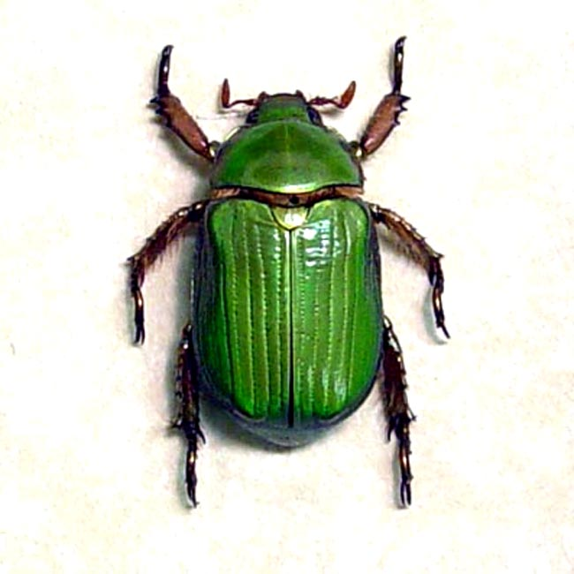
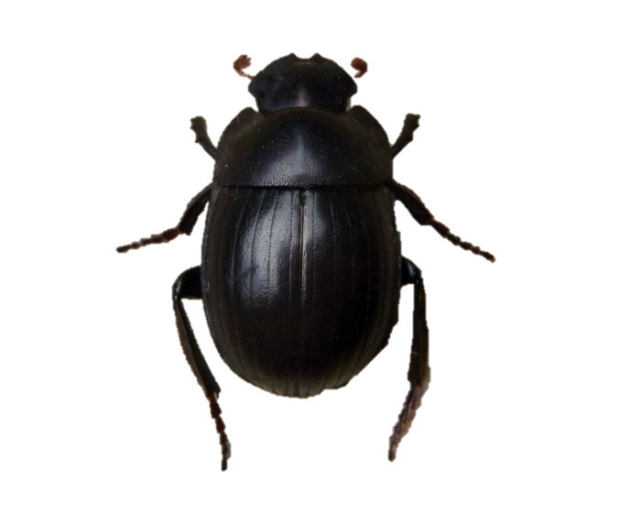
Lesson 3: Focus Question
Why do trait variations among desert beetles matter?
Photo courtesy of Pixabay.com
Photo used with permission from BSCS
Photo courtesy of Wikimedia.com
Our content deepening focus question: How can variation in traits affect which individuals survive long enough in their environment to reproduce?
Notes:
2 min
Note: Initially show only the focus question for lesson 3 and the beetle images on the slide.
Introduce the focus question for lesson 3 and ask participants to write it in their science notebooks. Then reveal the content deepening focus question at the bottom of the slide.
Ask participants, “What similarities and differences do you notice when you compare the focus question for lesson 3 and today’s content deepening focus question?”
Note: A more specific focus question was chosen for lesson 3 because it’s likely to be more engaging and easier for students to answer than the more generic content deepening focus question.

Slide 40
Investigation 1: Beetles in the Desert
Locate handout 3.2 (Beetles in the Desert) in your lesson plans binder.
Think about these questions as we read the story :
What living thing is this story about?
What are some of its traits?
Is there variation in the traits?
Notes:
6 min
“Next, we’ll read a story about beetles in the desert from lesson 3 of the Variation in Traits unit.”
Have participants locate handout 3.2 (Beetles in the Desert) in their lesson plans binders.
Highlight the questions on the slide that students will focus on during the lesson.
Ask one or two participants to read the story on the handout aloud.
Answer the questions on the slide as a group based on the reading.

Slide 41
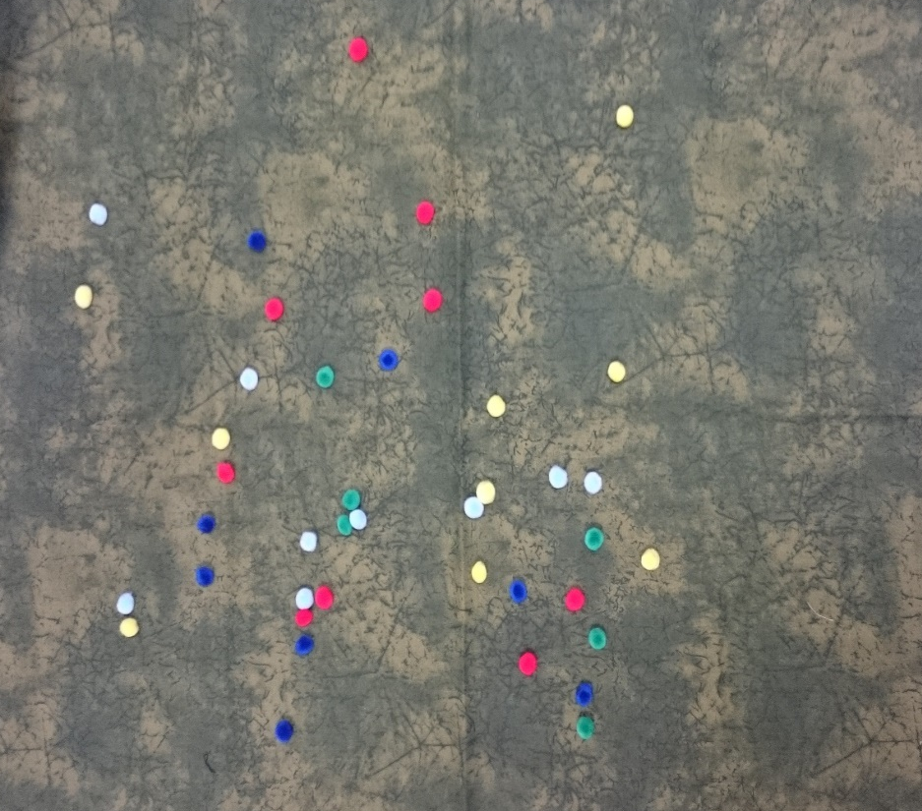
Investigation 1: Beetles in the Desert
The model represents what might happen to the beetles in nature.
Each colored pom-pom represents a beetle​.
Pinching my index finger and my thumb together represents a lizard eating a beetle.​
The fabric represents the desert​ environment where the beetles and lizards live.
Photo courtesy of Cal Poly Pomona
Notes:
6 min
Have participants locate handout 3.1 (Using the Model) in their lesson plans binders.
Read the overview on the handout and discuss what the various parts of the model represent. Display the materials from the lesson kit as you describe them.
Walk participants through rest of the instructions on the handout and explain the data table. Point out the data table you created on chart paper and make sure the rules are posted where participants can refer to them throughout the activity.

Slide 42
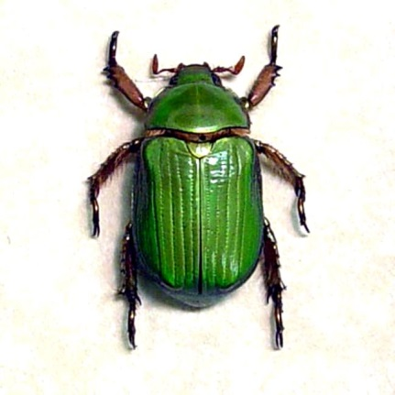
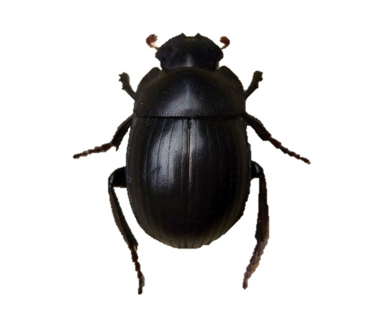
Investigation 1: Beetles in the Desert
Do you think some beetles will survive longer than other beetles in our desert environment?
List one or two reasons why you think a particular beetle might or might not survive longer than other beetles.
Photo used with permission from BSCS
Photo courtesy of Pixabay.com
Photo courtesy of Wikimedia.com
Notes:
2 min
“What do you think will happen to the beetles in our desert environment? Do you think some will survive longer than others? Which color beetles do you think will be eaten first, and which will be eaten last? Why do you think so?”
Turn and Talk: “Pair up with an elbow partner and briefly share your ideas and reasoning.”

Slide 43
Investigation 1: Beetles in the Desert
Write your prediction and reasoning in your science notebook using this sentence starter:
I predict that some beetles [will/won’t] survive longer than others in our desert environment because _______________.
Communicate in scientific ways during the group share-out:
I agree/disagree with your idea because …
I want to add …
I have a question about …
Notes:
3 min
Individuals: “Now write your predictions in your science notebooks using the sentence starter on the slide.”
Whole group share-out: “Let’s hear your predictions and reasoning. As others share their ideas, be prepared to agree or disagree, add your own ideas to the discussion, or ask questions using the sentence starters at the bottom of the slide. Communicating in scientific ways is an important STeLLA strategy we’ll learn about later in the program.”

Slide 44
Investigation 1: Beetles in the Desert
Roles and Responsibilities
Lizards: Your role is to hunt for pom-pom beetles. Keep your eyes closed when you aren’t hunting. Do not peek!
Counters: Your role is to count the number of pom-pom beetles in your assigned color on the fabric and report that number to the recorder.
Recorder: Your role is to record the number of pom-pom beetles on the class data table as the counters report this information.
Observers: Your role is to watch the simulation and record your observations in your notebooks.
Notes:
12 min
Using the materials from the lesson kit, set up the desert model according to the instructions in the handout. Don’t scatter the pom-poms on the fabric until just before the hunt begins.
Assign the roles on the handout and review the responsibilities for each role. Briefly review the rules before beginning the investigation.
Ask participants to describe the beetles’ environment and have the recorder write a description at the top of the data table.
Direct participants to get into their assigned positions and ask the lizards to close their eyes. Scatter the pom-poms on the fabric and have counters report the starting numbers of their assigned colors to the reporter. Then give lizards the command to hunt.
Make sure counters keep track of the number of beetles still on the fabric after each hunt. Then at the end of the round, ask them to count the remaining pom-pom beetles in their assigned colors on the fabric and report this data to the recorder to write on the table.
Note: Have lizards continue hunting for pom-pom beetles until only 15 are left on the fabric.

Slide 45
Investigation 1: Beetles in the Desert
Copy the data table into your notebook and answer these questions:
Did your prediction match the results of the investigation? What is your evidence?
Notes:
5 min
Individuals: Ask participants to copy the data table into their notebooks and answer the questions on the slide.
Whole-group share-out: As time allows, invite a few participants to share their answers and evidence.
Ask participants to summarize and interpret the results of the simulation. Ask elicit and probe questions to determine what they think the results mean.
Share your advice for managing this activity in the classroom.

Slide 46
Analogy Map
Part of Our Model | Is/Are Like | Part of the Real World | Because
Pom-poms | are like | different-colored beetles | both the beetles and the pom-poms are black, brown, red, green, and yellow.
 | are like | a lizard’s mouth
Picking up a pom-pom | is like
Fabric | is like
Notes:
7 min
“One of the STeLLA strategies we’ll be learning about later in this program is strategy D: Select content representations and models matched to the learning goal and engage students in their use.”
Emphasize: “It’s important that students link different aspects of a content representation or model to concrete aspects in the real world. An analogy map is one way we can help students make these connections.”
“The analogy map on this slide explains how and why parts of the desert model relate to parts of the real world.”
Distribute handout 2.4 (Beetles in the Desert—Analogy Map) and walk participants through the example on the first row.
Pairs: Have participants pair up and complete the rest of the analogy map.
Whole group: Invite pairs to share their answers for the remaining rows on the analogy map. Then display the answer key (handout 3.4, Beetles in the Desert—Analogy-Map Answer Key) on a document reader.

Slide 47
Analyzing the Desert Model
What are the strengths of the model?
Example: The pom-poms are the same colors as the beetles in the story.
What are the limitations of the model?
Example: Lizards in real life wouldn’t eat only six beetles.
Notes:
4 min
“One of the major themes of the Next Generation Science Standards is using and analyzing models. Let’s take a moment and analyze the strengths and limitations of the desert model.”
Turn and Talk: Have participants pair up and discuss the questions on the slide.
Whole-group discussion: “So what do you think are the key strengths and limitations of the desert model?”

Slide 48
Lesson 4: Focus Question
How can data help us explain why trait variations among desert beetles matter?
Notes:
Less than 1 min
Read the focus question on the slide and ask participants to write it in their science notebooks.
“In our next investigation from lesson 4 of the Variation in Traits unit, we’ll analyze the data we collected from our desert model and use it to help us explain why trait variations among desert beetles matter.”

Slide 49
Investigation 2: Analyzing the Beetle Data
Work with a partner to complete handout 2.5 (Calculating the Fraction of Beetles) using the data collected in the previous investigation.
Keep this focus question in mind: How can data help us explain why trait variations among desert beetles matter?
Color of Beetle | Beetles Eaten | >, <, or = | Beetles That Survived
 | Number of the color eaten Total number of the color |  | Number of the color not eaten Total number of the color
Notes:
6 min
Distribute handout 2.5 (Calculating the Fraction of Beetles) and explain that participants will need to use the data from the previous investigation to complete the handout.
Pairs: Have participants work with an elbow partner to complete the handout. Encourage them to keep the focus question for lesson 4 in mind as they work on this task.
Note that the timing of lesson 4 during the school year may create some teaching challenges if students haven’t yet studied fractions in depth. Share with participants how you handled these kinds of challenges in your classroom. One way to handle this is to walk students through the activity without spending much time talking about fractions. After students have learned more about fractions in math, teachers can revisit the fraction worksheet and discuss the results in more detail.

Slide 50
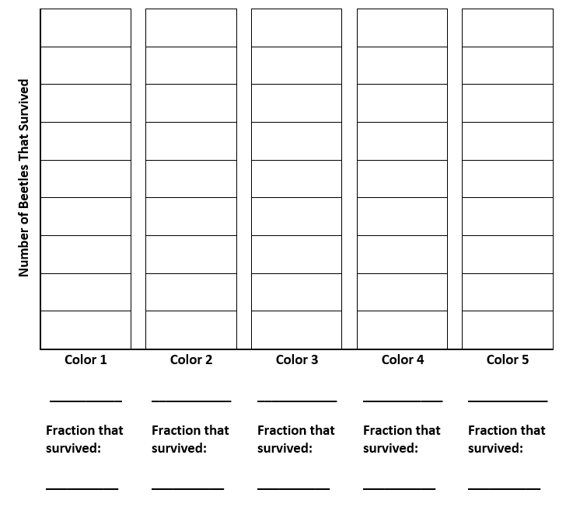
Investigation 2: Analyzing the Beetle Data
Notes:
4 min
“In a moment, you’ll create a bar graph like the one on this slide to represent in a visual way the number of beetles of each color that survived in our desert simulation. Each rectangle on the graph represents one beetle. The total number of beetles that were alive before the hunt was 45. If the number of beetles that survived at the end of the hunt are shaded in on the graph, the fraction is also represented. For example, if five yellow pom-pom beetles survived, then five rectangles on that bar of the graph would be shaded to represent the five surviving beetles out of the original nine. We could also represent this as the fraction 5/9.”
Have participants create a bar graph in their notebooks like the one on the slide and use their fraction data to shade in the graph for each color of beetle that survived.

Slide 51
Comparing Methods
Which method makes it easier for you to understand the data from our desert model? Why?
Sentence starter:
[Fractions/bar graphs] make it easier for me to understand the data from our desert model because ____________.
Notes:
1 min
Read the questions on the slide and ask participants how their students are likely to complete the sentence starter.

Slide 52
Constructing a Scientific Explanation
Do differences in the color of desert beetles affect whether they get eaten?
Scarab beetles
RES.C2.VIT.L3HO.003
Photo courtesy of Pixabay.com
Photo used with permission from BSCS
Photo courtesy of Wikimedia.com
Notes:
Less than 1 min
“Now let’s talk about how we might help students construct scientific explanations that will answer the question on the slide.”

Slide 53
Make a Claim
Do differences in the color of desert beetles affect whether they get eaten?
Make a claim and support it with evidence from our desert simulation (data table, fraction data, bar graph).
Link the evidence to the claim using logical reasoning and/or science ideas (traits, variation, natural selection, survival, the environment).
Sentence starters:
Differences in the color of desert beetles do affect whether they get eaten because _____________.
Differences in the color of desert beetles do not affect whether they get eaten because _____________.
Notes:
10 min
“Constructing a scientific explanation or claim and supporting it with evidence and reasoning is a key activity for students in science, mathematics, and English language arts. Using this CERA or claim-evidence-reasoning-alternative strategy makes each step of this process more explicit and gives students an opportunity to practice these essential skills.”
Read the question and instructions on the slide.
Individuals: Ask participants to make a claim that answers the question and write it in their science notebooks. The claim should include supporting evidence and reasoning as well. Participants may want to use the sentence starters on the slide to formulate their claims.
Pairs: Ask participants to share their claims and evidence with a partner and practice giving each other feedback.
Whole group: Invite a few participants to share their claims, evidence, and reasoning. Then ask them to come up with a sample claim they’d expect their students to make.
Sample student claim with evidence and reasoning: Differences in the color of desert beetles do affect whether they get eaten because the bar graph shows that more brown beetles survived than green beetles. I think that green beetles stood out more in the beige-colored desert environment and were easier for predators to see and catch. Beetles with the brown trait were harder for predators to see because they blended into their environment better. So variations in color make a difference in the desert beetles’ survival.

Slide 54
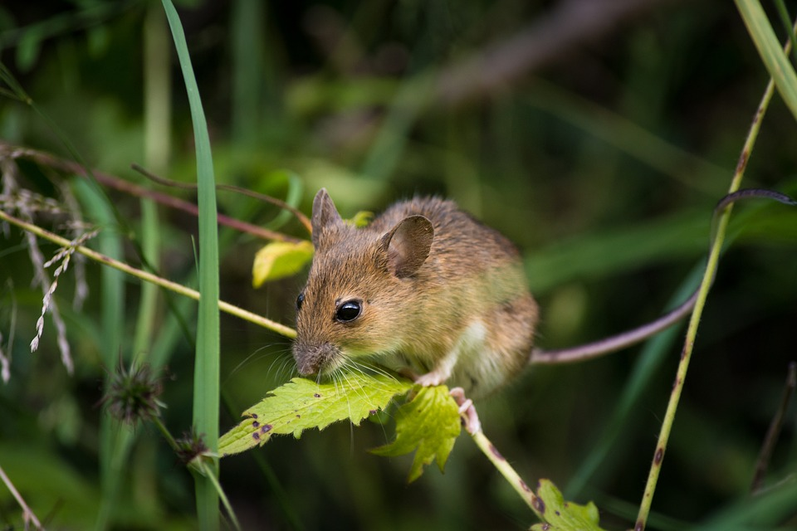
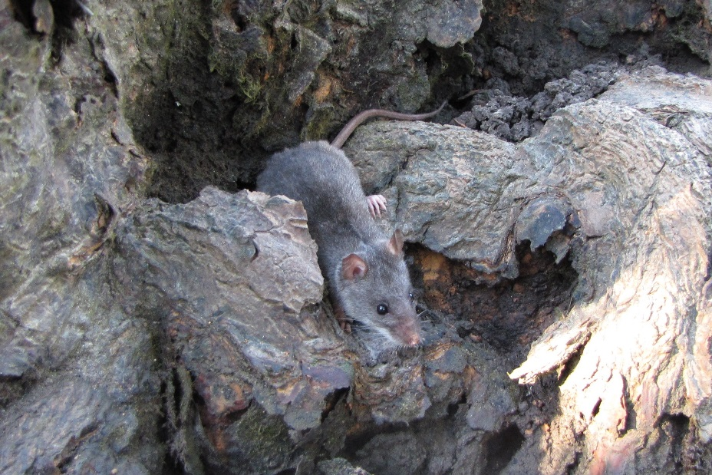
Unit Central Question
Do all of the mice living in the same environment, such as a field or forest, have an equal chance of surviving?
Photo courtesy of Pixabay.com
Photo courtesy of Wikimedia.org
Notes:
1 min
Revisit the unit central question on the slide.
Ask participants, “What have we learned so far from our content deepening investigations that can help us answer this question?”

Slide 55
Survival in a Changing Environment
Turn to the content background document in your lesson plans binder and read “Variation in Traits and the Environment” (section 4).
Summarize three main points from the reading.
Highlight two statements you disagree with or have questions about.
Write one idea for how the desert model could be used to illustrate the main points from the reading.
Notes:
4 min
“What do you think happens to living things with different trait variations when the environment changes? Let’s find out!”
Individuals: Direct participants to locate the content background document in their lesson plans binders and complete the tasks on the slide.
Whole group: Invite participants to share three main points from the reading and two statements they disagree with or have questions about.
“How do you think the desert model could be used to illustrate the main points from the reading?”

Slide 56
Lesson 5: Focus Question
What happens if the beetles’ environment changes?
Notes:
4 min
“What do you think will happen to the beetles in our desert model if their environment changes? That’s what we’ll explore in our final investigation from lesson 5a.”
Ask participants to write the focus question on the slide in their science notebooks.
Emphasize that to better understand biological diversity, students need to realize that both traits and the environment play important roles in the survival of organisms. Traits by themselves are neither intrinsically good nor bad but largely depend on the environment.
To orient participants to the next investigation, have them locate lesson 5a in their lesson plans binders and quickly read through the overview page, outline, and lesson plan.

Slide 57
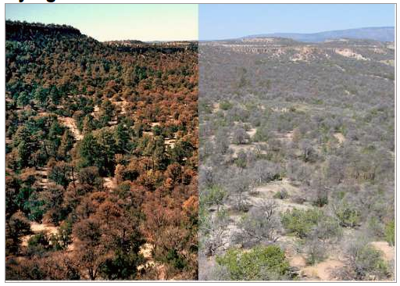
Investigation 3: Changing Environments
Drought before and after
RES.C2.VIT.L5HO.002
Photograph by Craig D. Allen
Notes:
1 min
Discuss various ways environments can change, including changes that occur because of droughts, flooding, and natural disasters.
Note that when environments change, it can affect which organisms survive and which don’t. Organisms that had a better chance of surviving in the original environment might not have an advantage in the changed environment.
“In this investigation, we’ll think about what might happen if the beetles’ environment becomes drier and even more desert-like.”

Slide 58
Investigation 3: Changing Environments
What do you predict will happen to the beetles when their environment changes?
Which colors of beetles do you think will be eaten more often, and which will survive more often?
Notes:
1 min
Introduce the questions on the slide.
Invite participants to share their predictions and reasoning.
As participants share, record their predictions on chart paper.

Slide 59
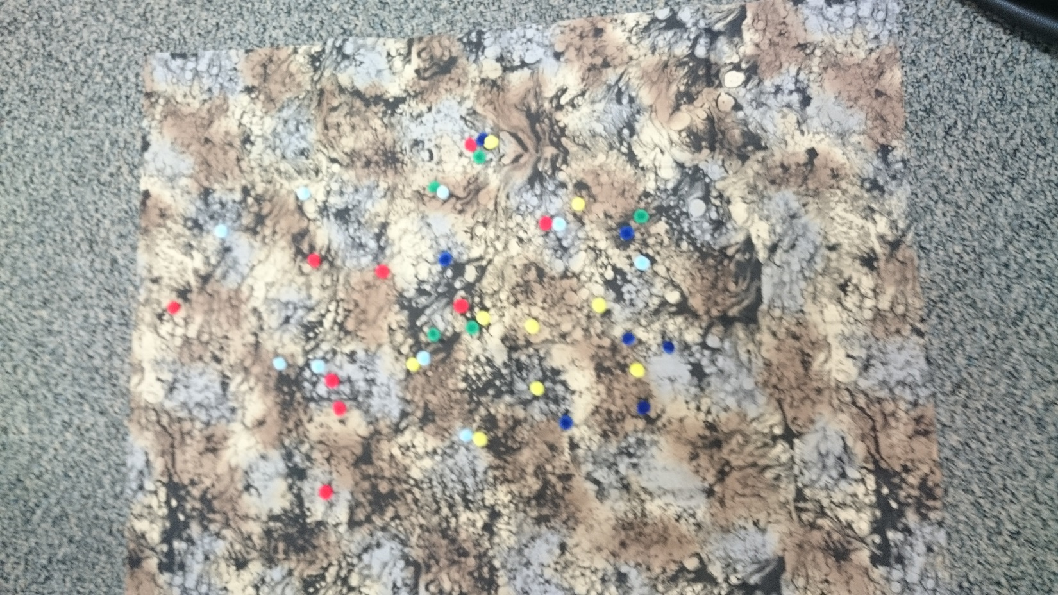
Investigation 3: Changing Environments
This new fabric represents a change in the beetles’ environment.
Photo courtesy of Cal Poly Pomona
Notes:
2 min
“To test your predictions, we’ll perform our desert simulation again, but this time, we’ll use a new piece of fabric that represents a change in the beetles’ environment.”
Set up the desert model using the new fabric and make sure the new data table is positioned next to the original data table for comparison.
Briefly review the rules of the simulation.

Slide 60
Investigation 3: Changing Environments
Lizards: Your role is to hunt for pom-pom beetles. Keep your eyes closed when you aren’t hunting. Do not peek!
Counters: Your role is to count the number of pom-pom beetles in your assigned color on the fabric and report that number to the recorder.
Recorder: Your role is to record the number of pom-pom beetles on the class data table as the counters report this information.
Observers: Your role is to watch the simulation and record your observations in your notebooks.
Notes:
10 min
Assign new roles to participants and review the responsibilities for each role.
Ask participants to describe the beetles’ changed environment and have the recorder write the description at the top of the new data table.
Direct participants to get into their assigned positions and ask lizards to close their eyes. Scatter the pom-poms on the new fabric and have counters report the starting numbers of their assigned colors to the reporter. Then give lizards the command to hunt.
Make sure counters keep track of the number of beetles still on the fabric after each hunt. Then at the end of the round (six hunts), ask them to count the remaining pom-pom beetles in their assigned colors on the fabric and report this data to the recorder to write on the table.

Slide 61
Investigation 3: Changing Environments
Notes:
5 min
Ask participants to calculate the fractions of beetles that survived in the changed environment and record this data in their science notebooks.
Note: Participants will need to copy the table from handout 2.5 (Calculating the Fraction of Beetles) into their notebooks to record this set of data.
Have participants create a new bar graph in their notebooks like the one on the slide, using their fraction data to shade in the graph for each color of beetle that survived.

Slide 62
Data Comparisons
Compare the data tables from both investigations and examine the results.
Compare the bar graphs from both investigations and examine the results.
Which comparison is more likely to help students understand the main points from the lesson and answer the focus question, What happens if the beetles’ environment changes?
Notes:
2 min
Note: Make sure the data tables are positioned side by side for this comparison.
“Let’s compare the results of our two investigations. First, compare the data tables and examine the results. Then compare the bar graphs and examine the results.”
“Which comparison is more likely to help students understand the main points from the lesson and answer the focus question, What happens if the beetles’ environment changes?”

Slide 63
Reflect: Lesson-5 Focus Question
What happens if the beetles’ environment changes?
Let’s work as a group to develop an ideal student response to this question.
Sentence starters:
Some beetles survive longer than others in their environment because …
If the environment changes, it will affect which beetles survive because …
Notes:
2 min
Note: If time is limited, this activity may be skipped.
Revisit the focus question for lesson 5 and work as a group to develop an ideal student response. Encourage participants to use the sentence starters on the slide.

Slide 64
Key Science Ideas
Both variations in the color trait of beetles and their environment affected which beetles survived longer.
Some beetles survived longer in the first environment because of their color trait.
When the environment changed, other beetles were more likely to survive because their color blended into the environment better.
Notes:
Less than 1 min
Review the key science ideas on the slide that summarize the results of today’s investigations.

Slide 65
Reflect: Content Deepening Focus Question
How can variation in traits affect which individuals survive long enough in their environment to reproduce?
Notes:
3 min
Revisit the content deepening focus question on the slide.
Individuals: Ask participants to answer the question in their science notebooks, using evidence from today’s investigations to support their ideas.
Whole group: If time allows, invite one or two participants to share their responses. Then ask participants to review the learning goals document and discuss which goals were addressed in this session.

Slide 66
Summary: Today’s Focus Questions
What progress have we made in addressing today’s focus questions?
How can lesson analysis help us better understand how elicit, probe, and challenge questions can reveal and challenge student thinking?
How can variation in traits affect which individuals survive long enough in their environment to reproduce?
Notes:
8 min
Divide participants into two groups. Have Group 1 come up with some conclusions/key ideas related to focus question 1. Have Group 2 come up with conclusions/key ideas for focus question 2.
Give each group 3 minutes to come up with ideas and conclusions.
Allow a 2-minute share-out for each group.

Slide 67
Homework
For tomorrow, read the STeLLA strategies booklet and complete the Z-fold summary chart for these two Student Thinking Lens strategies:
Strategy 4: Engage students in analyzing and interpreting data and observations.
Strategy 5: Engage students in constructing explanations and arguments.
Don’t forget about the lesson-plan reading-and-reporting assignment due on day 4.
Notes:
1 min
Forecast that tomorrow you’ll tackle two new, closely interconnected Student Thinking Lens strategies.
Have participants copy the homework assignment into their notebooks.
Remind participants about their homework for Friday (becoming experts on the lesson plans assigned to them).

Slide 68
Reflections on Today’s Session
Complete the Daily Reflections sheet (handout 2.6 in PD program binder).
What value do you see in analyzing student thinking and practicing questions that elicit, probe, and challenge student thinking? What concerns do you have about enacting these practices?
Did you identify any science ideas that you are unclear about? If so, what helped you identify this uncertainty?
What questions do you have about the purposes and goals of the RESPeCT PD program?
Which norms are we successfully implementing? Which norms need more work?
Notes:
6 min
Make sure participants have at least 5 minutes to think about the questions on the reflections sheet (handout 2.6 in the PD program binder) and write down their reflections.

