Slide 1




RESPeCT PD pROGRAM
Day 1
RESPeCT Summer Institute
Notes:
5 min
Greet participants as they enter the room.
Help them find their notebooks and table tents.

Slide 2
Before We Dig In: Essentials
On-time session starts and endings
Sign-in sheets
Restrooms
Sustenance (lunch and snack breaks)
Questions or special needs?
Notes:
20 min for slides 2–14 presentation (averaging approximately 1 min per slide)
Give everyone a big welcome to the RESPeCT PD program!
Fill participants in on the essential details listed on the slide.

Slide 3
What Is RESPeCT?
Reinvigorating Elementary Science through a Partnership with California Teachers
A partnership built for long-term success!
A professional development program
A leadership development program
A research study
Notes:
Approximately 1 min
Emphasize: The RESPeCT project began with three main components:
A professional development program
A leadership development program
A research study
The district now sustains RESPeCT as a professional development program.

Slide 4

The RESPeCT Partnership
PUSD
CPP
PUSD:
Pomona Unified School District
CPP:
California State Polytechnic University, Pomona
Photo courtesy of Pixabay.com
BSCS
BSCS:
Biological Sciences Curriculum Study
Notes:
Approximately 1 min
The original RESPeCT partners included the following:
Cal Poly: science, science education, and mathematics faculty, as well as the Center for Excellence in Mathematics and Science Teaching (CEMaST)
PUSD: district central administrators, principals, teacher specialists, and teachers
BSCS: an additional partner located in Colorado that provides expertise on science curriculum development, science teacher professional development, and research on science teaching and learning. Note: Established in 1958, BSCS stands for Biological Sciences Curriculum Study, but the organization now deals with all sciences, not just biology.
Students: Emphasize that students are at the center of this partnership. Their learning is what the project is all about.

Slide 5
The RESPeCT PD Program
  Builds on the successful Science Teachers Learning from Lesson Analysis (STeLLA) program
  Has a significant impact on student learning as demonstrated in two rigorous studies
  Teaches videocase-based lesson analysis
  Facilitates science-content deepening
Notes:
Approximately 1 min
Let participants know they’ll be learning more about the RESPeCT PD program and STeLLA teaching strategies as they experience firsthand what it means to perform videocase-based lesson analysis.

Slide 6
The RESPeCT PD Program
Extends the STeLLA approach by
  Addressing grade-level standards in Next Generation Science Standards (NGSS)
  Incorporating Common Core English language arts (ELA) and math standards
  Addressing more explicitly the needs of English language learners (ELLs)
  Addressing all grade levels, K–6
Notes:
Approximately 1 min
Read the information on the slide.
Emphasize the importance of these additions to the STeLLA approach. By integrating Common Core English language arts (ELA) and math standards into the science curriculum, the RESPeCT PD program enables teachers to invest more time in teaching science. The teaching strategies developed in the RESPeCT PD program are also valuable tools in other subject areas.

Slide 7
Goals of the RESPeCT PD Program
Deepen teachers’ science-content knowledge and knowledge of effective science teaching.
Develop teachers’ analytical skills to improve lesson-plan development and the teaching of science.
Support teachers in the practical use of new knowledge and analytical skills in their classrooms.
Improve students’ science learning.
Achieve sustainability by eventually reaching all
K–6 teachers.
Notes:
Approximately 1 min
The bottom line: improving students’ science learning—a goal that has been reached in two previous research studies of this approach.

Slide 8
Summer Institute Study-Group Leaders
Grade [Insert grade level here]
[Insert leader names here]
[Insert leader names here]
Notes:
Approximately 1 min
Modify this slide to include the grade level of your study group and the names of the Teacher Leaders who will be facilitating the study-group sessions.
Formally introduce yourselves to the group.

Slide 9

The Key
Each of us is key to the success of the
RESPeCT PD program!
Notes:
Approximately 1 min
Many people are involved in organizing, planning, and leading this program, but the teacher-participants are the key to its success.

Slide 10
Summer Institute Schedule
Notes:
Note: This is a transition slide.

Slide 11
Summer Institute: A Typical Daily Schedule
8:00 Getting started
8:30 Video-based lesson analysis
10:00 BREAK
10:10 Lesson analysis continued
12:00 LUNCH
12:45 Content deepening
2:00 BREAK
2:10 Content deepening continued
3:00 Wrap-up: homework, summary, reflections
3:30 Adjourn
Notes:
Approximately 1 min
A typical daily schedule includes the following:
Time spent on videocase lesson analysis
Time focused on content deepening
Short homework assignments
A morning and an afternoon break, with a 45-minute lunch break

Slide 12
Summer Institute at a Glance
Week 1: Content Area 1 (Variation in Traits)
  Student Thinking Lens—strategies to make student thinking visible
  Analysis of video teaching in content area 1
  Analysis of lesson plans to be taught second semester
  Content deepening in content area 1
Week 2: Content Area 2 (Forces)
  Science Content Storyline Lens—strategies to create coherence
  Analysis of video teaching in content area 2
  Analysis of lesson plans to be taught in the fall
  Content deepening in content area 2
Notes:
Approximately 1 min
During the Summer Institute, each grade level will focus on two content areas, with one week devoted to each area. Participants will deepen their science-content knowledge, study lesson plans in each content area, and analyze videocases of teachers presenting this content.

Slide 13
School-Year Schedule
Fall [Insert year here]
Teach the first lesson set.
Meet three times as a study group (4 hours each).
Meet an additional time to review the second lesson-set plans (2 hours).
Winter/Spring [Insert year here]
Teach the second lesson set.
Meet three times as a study group (4 hours each).
Note: The study group will determine meeting dates and times.
Notes:
Approximately 1 min
“The Summer Institute is just the beginning! During the school year, you’ll continue meeting with your grade-level study group.”

Slide 14
Your RESPeCT PD Program Materials
Your science notebook
STeLLA strategies booklet
RESPeCT PD program binder
RESPeCT lesson plans binder
Materials kit (1 per topic)
Notes:
Approximately 1 min
Transition slide: “In a moment we’ll break up into grade-level study groups and dig into the RESPeCT PD program! But first let’s review this list of materials you’ll receive in your designated meeting rooms.”

Slide 15
Transition to Grade-Level Study Groups
Any questions before we break up into our grade-level study groups?
Notes:
5 min
“Any questions before we head to our grade-level study groups?”
Send-off: “Have a great day and be sure to let us know if there is anything we can do to support you in getting the most out of this experience!”

Slide 16
Notebook Setup
Write your name on the front cover of the notebook.
Leave two or three pages for the table of contents. (You’ll add to the TOC each day throughout the program.)
Number your pages. (Front and back pages should be numbered separately.)
Use sticky tabs to divide your notebook into two main sections: Lesson Analysis and Content Deepening. (Each section will comprise about half the notebook.)
Keep a chronological record of your activity in each section. Add a title for each entry and enter in your TOC to easily locate.
Customize and decorate your notebook any way you wish.
Notes:
8 min
Welcome participants to the study group and introduce yourself as they arrive.
Help participants find their table tents and materials so they can get settled.
Direct them to the instructions for setting up their notebooks (Setting Up Your Summer Institute Notebook in the pretabs section of their PD program binders) and get them started working on this task. Interact informally with them and allow them to chitchat as they work.

Slide 17
Getting Started: Introductions
Quick-write exercise:
  Describe your experience learning science in school.
  What do you hope to learn through RESPeCT in the coming year?
Share your responses with a partner.
Introduce each other to the group.
Notes:
15 min
Individuals (3 min): Have participants write their responses to the questions on the slide in their notebooks. Emphasize that this is an independent writing exercise.
Pairs (3 min): Have participants pair up and share their responses to the questions. Encourage them to learn other things about their partners as well (e.g., school, years of teaching, favorite subjects to teach, hobbies).
Note: If the group has an odd number of participants, pair up with one of them.
Whole group (9 min): Have each participant introduce her or his partner, highlighting what that partner hopes to learn from the RESPeCT PD program. Model the first pair of introductions to demonstrate that they should be brief.
Note: If you weren’t able to pair up with someone, simply introduce yourself.
Monitor the time: Introductions should be longer than a sentence, but not the length of a full essay!

Slide 18
RESPeCT PD Program Goals
Business-as-Usual PD
Not closely linked to day-to-day classroom teaching
Rarely see other teachers practice
Learning about content separate from learning about teaching
RESPeCT PD Program
Learn science content in the context of analyzing teaching and student learning.
Engage with one another
in a collaborative analysis of content-specific videocases
of other teachers.
Learn science content in the context of analyzing teaching and student learning.
Notes:
2 min
Talk through this slide, emphasizing how RESPeCT PD is different from many other professional development opportunities.

Slide 19
RESPeCT PD Program Goals: Lesson Analysis PD
Business-as-Usual PD
Focus on what to do tomorrow and “cool” activities
Development not sustained over time
Effectiveness measured in terms of teachers’ enjoyment
RESPeCT Lesson Analysis PD
Learn how to select and carry out science activities based on analysis of science content and student thinking and learning.
Be supported in using new teaching knowledge throughout the year.
Measure effectiveness in terms of teacher and student learning.
Notes:
1 min
Highlight the goals of RESPeCT lesson analysis PD and how it differs from other professional development opportunities.

Slide 20
Norms for Working Together: The Basics
Purpose: Build trust and develop a productive study group for all participants.
The Basics
Arrive prepared and on time; stay for the duration; return from breaks on time.
Remain attentive, thoughtful, and respectful; engage and be present.
Eliminate interruptions (turn off cell phones, email, and other electronic devices; avoid sidebar conversations).
Make room for everyone to participate (monitor your floor time).
Notes:
3 min
“To do this kind of work together, we need to develop a strong study group where everyone feels safe sharing their ideas, questions, confusion, successes, and stumbles. Having a set of agreed-upon norms will help us build such a learning community.”
Read over these basic norms.
“What do you think? Are there any changes or additions you’d like to suggest?”

Slide 21
Norms for Working Together: The Heart
Purpose: Build trust and develop a productive study group for all participants.
The Heart of RESPeCT Lesson Analysis and Content
Deepening
Keep the goal in mind: analysis of teaching to improve student learning.
Share your ideas, uncertainties, confusion, disagreements, questions, and good humor. All points of view are welcome.
Expect and ask questions to deepen everyone’s learning; be constructively challenging.
Listen carefully; seek to understand other participants’ points of view.
Notes:
5 min
“This set of norms moves beyond the basics and targets the heart of RESPeCT PD program goals.”
Read the list.
“Is anything unclear? Do you have any changes or additions you’d like to suggest? Do you have any concerns about these norms?”
Direct participants to handout 1.1 (Norms for Working Together) and pass out the half-page copy of the norms for them to paste on the inside front cover of their notebooks.
Ask participants if they’re willing to live with these norms today; then tell them they’ll have an opportunity to revise them tomorrow.

Slide 22
Agenda for Day 1
Focus questions and ideas about effective science teaching
The case for the Science Content Storyline Lens (SCSL)
The case for the Student Thinking Lens (STL)
Content deepening: variation in traits
Lunch
Content deepening (continued)
STL strategies: elicit, probe, and challenge questions
Summary, homework, and reflections
Notes:
Less than 1 min
Talk through the agenda for the day.

Slide 23
Today’s Focus Questions
What is RESPeCT?
What are the STeLLA lenses and teaching strategies, and what is the evidence that they will make a difference in your science teaching?
How do traits of living things help us understand how they’re grouped and related?
Why are trait variations important for the survival of living things?
How can we represent patterns of trait variation among individuals of a species?
Notes:
1 min
“Each day we’re going to have at least one lesson analysis focus question and one content deepening focus question. These are today’s focus questions.”
Read the focus questions on the slide.

Slide 24
Ideas about Effective Science Teaching
What is your image of effective science teaching?
  What does it look like in action?
  What are key features of good science teaching?
Notes:
15 min
“Before we explore these questions, let’s create a list of ideas about effective science teaching.”
Individuals (3 min): “Take a few minutes to think and write about the questions on the slide.”
Whole group (10 min): Go around the group (round-robin) asking everyone to contribute an idea. Write the ideas on chart paper and title the chart “Effective Science Teaching.”
“Throughout the sessions, we’ll revisit this list to add new ideas, clarify our thinking, and make other modifications.”

Slide 25

Lesson Analysis Focus Question
What are the STeLLA lenses and teaching strategies, and what is the evidence that they will make a difference in your science teaching?
Student
Thinking Lens
Science
Content
Storyline Lens
Notes:
2 min
“This PD program will focus on two lenses as analytical tools to guide our learning: the Student Thinking Lens and the Science Content Storyline Lens.”
“Today we’re going to examine why these two lenses were chosen for our focus.”
“Let’s begin with the Science Content Storyline Lens.”

Slide 26
TIMSS Video-Study Questions
What does science teaching look like in different countries?
What can we learn from looking at science-teaching practice in higher-achieving countries?
Notes:
2 min
“A large video study of science teaching in different countries revealed the importance of the Science Content Storyline Lens.”
“The TIMSS video study explored the research questions on this slide.”
Background info:
TIMSS stands for Trends in Mathematics and Science Study.
TIMSS is known for its achievement studies comparing student performance in math and science internationally.

Slide 27
TIMSS Video-Study Comparisons
The study compared science teaching in the United States with science teaching in these higher-achieving countries:
Australia
Czech Republic
Japan
Notes:
2 min
“Australia, the Czech Republic, and Japan are higher-achieving countries in science compared to the United States.”
“In these countries, 100 eighth-grade lessons were randomly video recorded. The goal was to describe typical science teaching in each country.”

Slide 28
TIMSS Video-Study Results
Although each higher-achieving country had its own approach, they all had strategies for engaging students with core science concepts and ideas.
In US lessons, content played a less central role, and sometimes no role at all. Instead, lessons engaged students in carrying out a variety of activities.
Notes:
2 min
“The TIMSS video study showed these results.”

Slide 29
TIMSS Video-Study Results
Although each higher-achieving country had its own approach, they all had strategies for engaging students with core science concepts and ideas.
In US lessons, content played a less central role, and sometimes no role at all. Instead, lessons engaged students in carrying out a variety of activities.
Notes:
2 min
Call attention to the text highlighted in red to emphasize the difference between US science lessons and science lessons in higher-achieving countries.

Slide 30
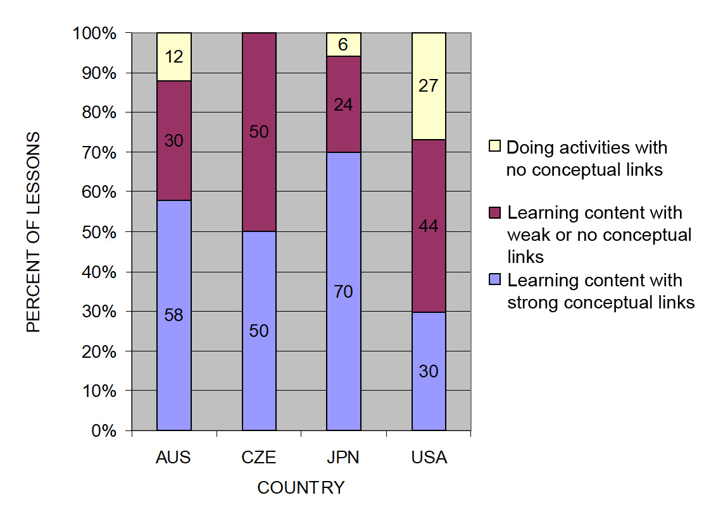
TIMSS: Conceptual Links
Source: TIMSS study
Notes:
3 min
Ask: “What do you notice from this graph? What do you make of this data?”
Emphasize: “In the US, more than a quarter of the lessons had no science content; whereas in the other countries, the majority of the randomly selected lessons (or typical lessons) had content with strong conceptual links.”
Example of a lesson with no science content: “What’s a science lesson with no content? In this research, a lesson with at least one complete statement of a science idea was scored as ‘learning content.’ Lessons with ‘no content’ had only topic-level mentions of science concepts. For example, one teacher started a lesson by telling students to take out their rockets and get to work. They had directions to follow, but the teacher’s only focus in his interactions with students was on how to build the rockets. At the end of the lesson, he told students to clean up and then dismissed them. This is a lesson with no science content!”
Other key ideas to highlight:
Each higher-achieving country engaged students with core science concepts and ideas (more consistently than the US).
All the higher-achieving countries linked ideas and activities (more consistently than the US).
In US lessons, the focus was on performing activities with less attention to content and even less attention to linking activities and science ideas.

Slide 31
What Makes a Difference?
Watch two video clips of 8th-grade science:
  A US classroom
  A Japanese classroom
What did you notice about these two classrooms?
In which classroom are students more likely to learn? Why do you think so?
Link to TIMSS US video clip: 1.1_TIMSS_US_Lesson3_c1
Link to TIMSS Japan video clip: 1.2_TIMSS_Japan_Lesson_c1_1
Notes:
20 min
Direct participants to the transcripts for Video Clips 1.1 and 1.2 (handouts 1.2 and 1.3) before showing each clip.
Show US classroom video: Ask participants to focus on what is going on with the science content and storyline.
Discuss: “What did you notice?”
Key ideas to emphasize and link back to the results include the following:
The teacher focuses on the activity and the procedure needed to complete the activity.
The teacher and students place no real focus on important science ideas.
There’s only a topic-level mention of science ideas (“pulleys,” “effort distance,” “resistance force”).
Show Japanese classroom video: Ask participants to focus on what is going on with the science content.
Discuss: “What did you notice?”
Key ideas to emphasize and link back to the results include the following:
Content ideas are made clear to students (focus question, pairs talk) before doing any activity.
Students are asked to talk about science ideas, not just procedures.
The lesson purpose is made clear to students.
Ending discussion: “In which classroom are students more likely to learn science concepts? Why?”
Note: Participants may be critical of both classrooms because student thinking isn’t made visible. This is true, but bring their focus back to the science content and storyline. They should see a clear distinction between the science content storylines in the Japanese and US lessons. Students in the Japanese classroom are more likely to learn because science-content ideas are made visible, and students are engaged in thinking about these ideas, not just science activities.

Slide 32
The TIMSS Findings Show …
Each higher-achieving country engaged students with core science concepts and ideas.
All the higher-achieving countries linked ideas and activities.
In US lessons, the focus was on performing activities with less attention to content and even less attention to linking activities and science ideas.
Notes:
1 min
Use this slide and the next to summarize key ideas from the TIMSS video study.

Slide 33
What Can We Learn from the Research?
A coherent science content storyline can …
make science ideas more prominent in science lessons,
  strengthen connections among science-content ideas,
  strengthen connections between science-content ideas and activities, and
improve lesson coherence by shaping science lessons as stories that make sense to students.
For more insights, see TIMSS Educational Leadership article, “What Science Teaching Looks Like: An International Perspective” (handout 1.4 in binder).
Notes:
1 min
After reading this slide, share with participants that the Science Content Storyline Lens addresses the need uncovered in the TIMSS video study: to strengthen the links between science ideas and lesson activities.
Encourage participants to read handout 1.4 (TIMSS Educational Leadership article) for further insight.

Slide 34
Discussion Questions
What new features can we add to our earlier description of effective science teaching?
Are there any ideas we should add to our list, modify, or delete?
Notes:
5 min
“What features on our list of ideas about effective science teaching are consistent with the TIMSS video-study findings?”
“Are there any ideas you’d like to add to our list, delete, or modify?”
Note: Use a different color to add/delete/modify ideas. Encourage participants to keep an open mind about changing their ideas. Provide opportunities for them to reflect on any changes and the reasons for those changes.
Transition: “During week 2 of the Summer Institute, we’ll focus on strategies for creating a strong, coherent science content storyline. This week, we’ll focus on the Student Thinking Lens. Right now, let’s consider the reasons for this focus.”

Slide 35
Lesson Analysis Focus Question
What are the STeLLA lenses and teaching strategies, and what is the evidence that they will make a difference in your science teaching?
Student
Thinking
Lens
Science
Content
Storyline
Lens
Notes:
Less than 1 min
“At this point, we’ll transition from a focus on the Science Content Storyline Lens (SCSL) to the Student Thinking Lens (STL).”
“We’ll be focusing on the Student Thinking Lens the rest of the day and throughout this week.”

Slide 36
Research on How Students Learn
Respond in your notebooks to the following question:
    Imagine that a seed is planted in the ground and grows into a tree. Where does most of the matter come from that makes up the wood and leaves of the tree?
We won’t share our responses with the whole group.
Notes:
3 min
Individuals: Have participants answer the question on the slide in their science notebooks.
Background for PD leaders: Participants will likely have the same misconceptions revealed in the video, but they may not yet be comfortable sharing their confusion. At this point, don’t ask them to share their ideas with the group. It will be interesting to see if some of them are willing to share their “wrong” ideas after they see the video.

Slide 37
Minds of Our Own
Minds of Our Own is a video that visually summarizes a large body of research on student learning in science classrooms.
As you watch, think about the following questions:
How do Harvard graduates answer the question about the mass of a tree? Is their response the same as or different from yours?
Does this give you any new ideas about effective science teaching?
Link to Minds of Our Own video clip.
Notes:
10 min
a. Read the information and instructions on the slide.
b. Watch the Minds of Our Own Lessons From Thin Air video. Total viewing time is approximately 10 minutes. (https://www.learner.org/series/minds-of-our-own/2-lessons-from-thin-air/?jwsource=cl)
MIT/Harvard interview—start at segment 3:30 and end at 5:40.
John preinterview, class, and post interview—start at segment 7:50 and end at 16:45.
Note: If time is short, stop after Phil Sadler. If you have enough time, you can show the entire segment from 3:30 to 16:45.

Slide 38
Discussion Questions
What did you notice in the Minds of Our Own video?
What does research on learning say to us about effective science teaching?
What new features can we add to our description of effective science teaching?
Notes:
15 min
There’s a lot to talk about in this video! Here are some additional questions you might pose:
Did John’s ideas about photosynthesis change through instruction?
What did the teacher say about his instruction?
What did the experts say?
How do the Harvard students’ responses compare with your own? What ideas does this give you about your own science learning experiences?
Key idea to emphasize: Research shows that we not only need to engage students in more thinking and sensemaking, but we also need to listen to their ideas—especially when they’re wrong—and use them to guide our instruction.
Modify the chart of ideas about effective science teaching as participants share features from the research.

Slide 39
What Can We Learn from the Research?
A Student Thinking Lens can …
reveal, support, and challenge student thinking throughout instruction;
provide opportunities for students to analyze and interpret data, as well as construct arguments and explanations;
engage students in making connections between ideas and activities; and
provide structures to teach students how to communicate in scientific ways.
For more insights, see “Synthesis of Research from How Students Learn: Science in the Classroom” (handout 1.5 in binder).
Notes:
2 min
“This slide nicely summarizes some of the ways we get students thinking and make their thinking visible.”
Note: Encourage participants to read handout 1.5 (“Synthesis of Research from How Students Learn: Science in the Classroom”) for further insight.
Transition: “Today we’ll start learning some particular strategies for making student thinking more prominent in science lessons.”
Background for PD leaders: The STeLLA conceptual framework addresses the need uncovered in this and other studies on how people learn and, more specifically, how students learn science.
If students’ initial knowledge is not engaged, they may fail to grasp the new concepts and information that are taught and may distort the new information to make it fit their prior experience.
This idea of learning with understanding has two parts: (1) factual knowledge must be placed in a conceptual framework (a big idea or a set of big ideas) organized in ways that enable students to use and apply that knowledge to make predictions, solve problems, explain new situations, and so forth; and (2) multiple representations that are rich in science ideas and details give concepts meaning.
This idea helps students monitor their developing understandings, engaging them in reflecting on their learning experiences, their changing ideas, and their remaining questions and musings.

Slide 40

Variation in traits
SCIENCE CONTENT DEEPENING Grade 3
Notes:
Less than 1 min
Note: Throughout this content deepening phase, refer as needed to Variation in Plants and Animals and Variation in Traits: Content Background Document and Variation in Traits: Learning Goals for Students and Teachers.
“Now let’s begin our content deepening work on variation in traits.”

Slide 41
Unit Central Question
Do all of the mice living in the same environment, such as a field or forest, have an equal chance of surviving?
Notes:
Less than 1 min
Introduce participants to the unit central question that students will answer in the Variation in Traits lesson sequence.
“Today we’ll explore some key science ideas that will help us answer this central question.”
“Write this question in your notebooks and draw a double-lined box around it.”
Note: Copying the unit central question into their notebooks will reinforce an important practice participants should follow with their students.

Slide 42
Content Deepening Focus Questions
How do traits of living things help us understand how they’re grouped and related?
Why are trait variations important for the survival of living things?
How can we represent patterns of trait variation among individuals of a species?
Notes:
Less than 1 min
Read the focus questions on the slide.
Ask participants to write the first question in their science notebooks.

Slide 43
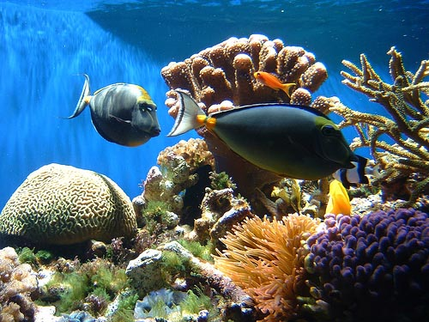

Thinking about Differences
What comes to mind when you hear the word diversity or variation?
Photo courtesy of Only_Point_Five
Photograph by Richard Foster
Notes:
1 min
“What do you think of when you hear words like diversity or variation? Let’s hear some of your ideas.”
Note: This elicit question is designed to uncover participants’ initial ideas. Don’t try to correct their ideas at this point or lead them to the right answers.
As participants share their ideas, record them on chart paper.

Slide 44
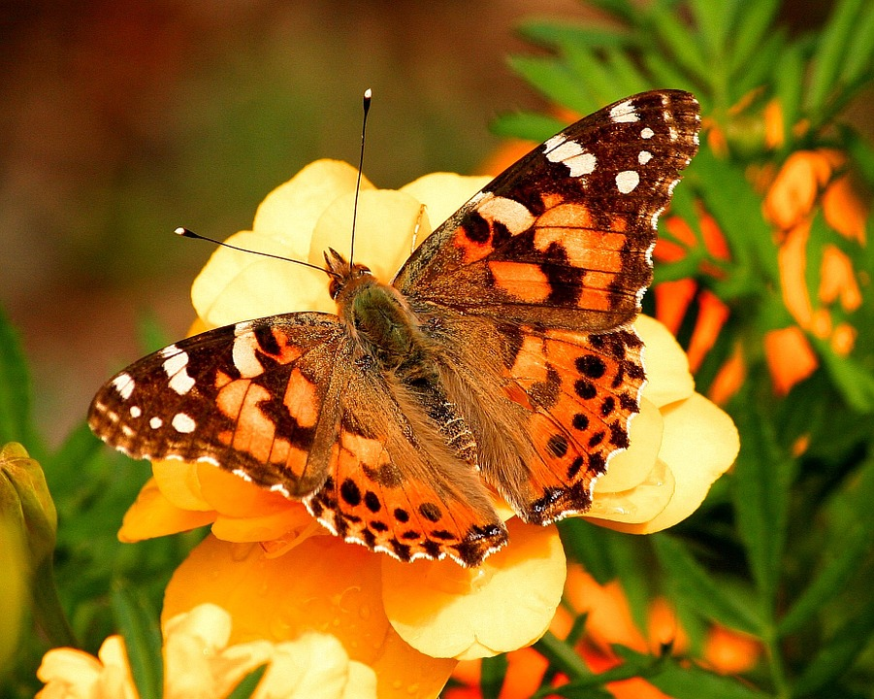
Traits and Trait Variations in Butterflies
As you watch the video clip, identify examples
of traits and variations among painted lady butterflies.
Record your observations and ideas in your notebook.
Photo courtesy of Pixabay.com
Link to YouTube video clip: https://www.youtube.com/watch?v=63B1lnqPa8k
Notes:
5 min
“As you watch a video clip about the life cycle of painted lady butterflies, look for examples of traits and trait variations in the butterflies and record your observations in your notebooks.”
Show the YouTube video from the beginning to segment 4:27.
Invite one or two participants to share their observations of butterfly traits and variations with the group.
Observations:
Some traits that vary are the size and shape of the caterpillars, the timing of the silk-button formation, and the timing of butterflies emerging from the chrysalis.

Slide 45
Traits and Trait Variation in Butterflies
What traits did all of the individual butterflies share?
Photo courtesy of Pixabay.com
Notes:
Less than 1 min
“What traits did all of the individual butterflies in the video share?”
Possible responses:
The number of legs
The number of body segments
The number of eyes
The life cycle
The basic pattern of colors in the same life stages.

Slide 46
Levels of Life
In the video clip, we identified trait variations among individual butterflies, but life has many levels of organization.
What do you think the phrase “levels of life” means?
Notes:
1 min
Note: This slide marks a transition into a discussion of trait variation at different levels of life.
“In the video clip, we identified several trait variations among individual butterflies, but life has many levels of organization.”
“What do you think the phrase “levels of life” means?”
Invite a few participants to share their initial ideas.

Slide 47
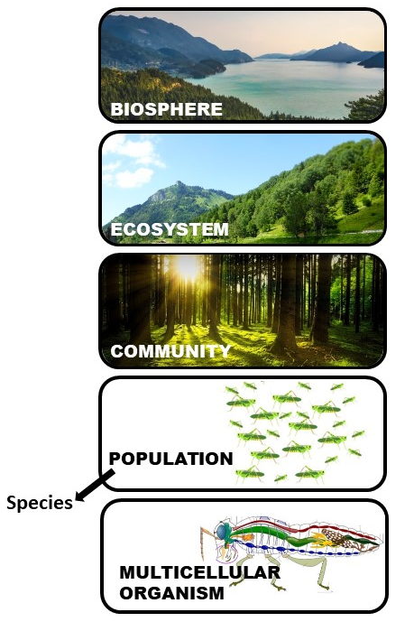
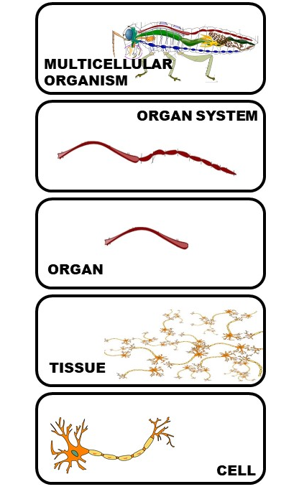
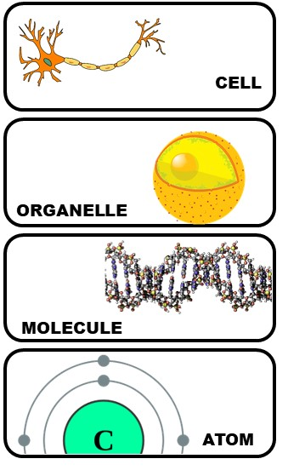
Levels of Life
Notes:
47
1 min
“Biologists study life at various levels of organization. Let’s briefly review the levels of life on the slide.”
Walk participants through the various levels of life on the slide, but don’t dwell on the details or differences between levels at this point.
“Variations can be observed at all of these levels, with the exception of the biosphere, since it’s unlikely we’ll find other biospheres in the universe.”
“Each higher level of life may have properties that aren’t necessarily predictable from lower levels. For example, cells may have certain functions and accomplish things that we wouldn’t necessarily be able to predict based on knowing which organelles and molecules make up the cells.”

Slide 48
Levels of Life
Biologists study diversity and variation across many levels of life, including …
  Different ecosystems
  Different species
  Different populations of the same species
  Different individuals within a population or species
  Different life stages within an individual
  Different cells within an individual
  The lessons in this unit will focus mainly on variation among individuals within a population or series.
Notes:
Less than 1 min
“Biologists study diversity and variation across many levels of life, such as across different ecosystems, species, populations within a species, individuals within a population or species, life stages within an individual, and cells within an individual.”
Emphasize that the lessons in the Variation in Traits unit will focus mainly on variation among individuals within a population or species.

Slide 49
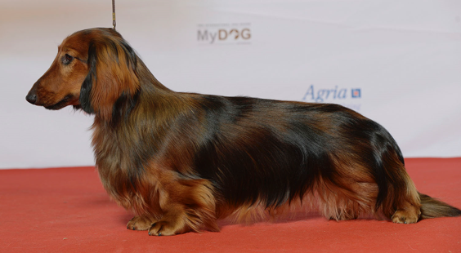
What Is a Trait?
Photo courtesy of Томасина / Wikimedia Commons
Look at this dachshund. What traits can you see?
What are some traits you can’t see?
Pairs: Come up with a definition of a trait.
Read section 2 (Defining Traits) in the content background document. Then revise your definition based on this new information.
Notes:
8 min
“Look at this photo of a dachshund. What traits do you see? What are some traits you can’t see?”
As participants share their observations, record five or six traits on chart paper.
Individuals: Ask participants to come up with a concise working definition of a trait. Direct them to write this definition in their notebooks.
Whole group: Invite a few participants to share their definitions with the group. As time allows, ask probe questions, such as “What do you mean when you say …?” “Can you define this more precisely?” and “Can you elaborate on that idea?”
After the discussion, have participants locate the content background document in their lesson plans binders and read the section titled “Defining Traits.” Then give them a minute or two to revise their definitions based on this information. Their revisions should be in their own words.
Emphasize from the reading that traits are features or characteristics of organisms that may be visible or hidden. They aren’t just physical features; they can also be behaviors, molecular characteristics like DNA, chemical pathways, or developmental pathways.

Slide 50
Categories of Traits
Work with a partner to create a thinking map showing categories of traits. Come up with at least one example for each category.
Notes:
6 min
Pairs (3 min): “Now I’d like you to work with an elbow partner to create a thinking map showing categories of traits. Come up with at least one example for each category. Your examples may include traits of dachshunds and other kinds of organisms.”
Whole-group discussion (3 min): “What categories of traits and examples did you come up with?”
Note: Ideally, pairs should come up with most or all of the following categories of traits and cite at least one example for each category :
External physical traits (e.g., fur color, eye color, hair length)
Internal physical traits (e.g., brain size, bone structure)
Behavioral traits (e.g., mother feeding offspring with milk)
Molecular traits (e.g., DNA)
Developmental pathways (e.g., stages of butterfly life)
Chemical pathways (e.g., how food is broken down and used)

Slide 51
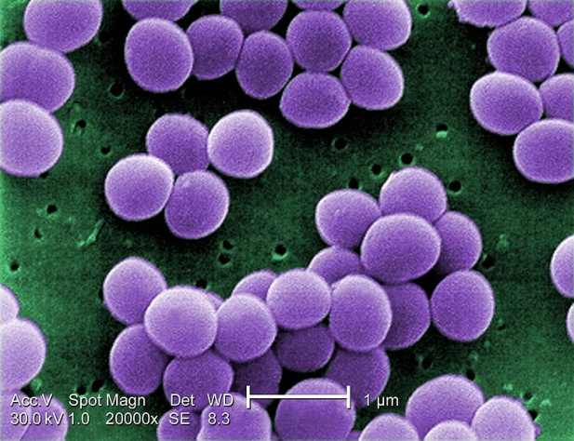
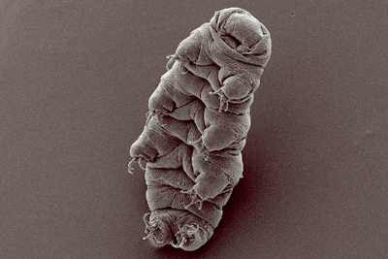
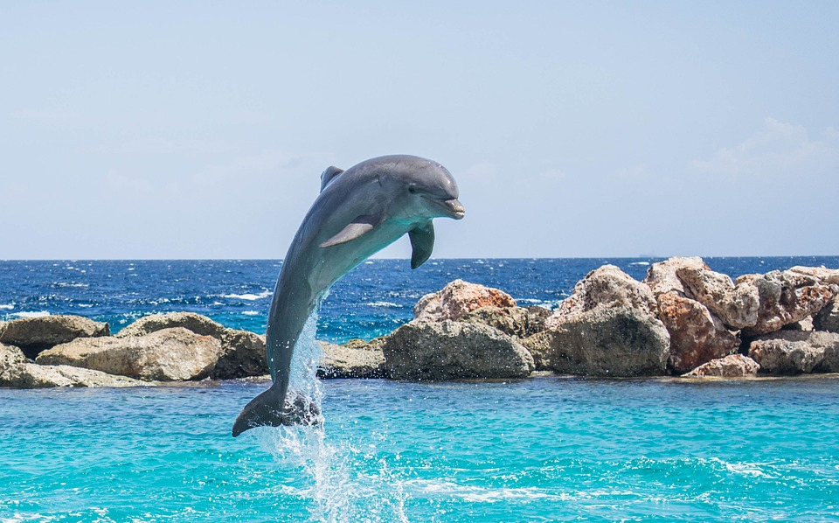
Identifying and Categorizing Traits
Photograph by Richard Foster
Courtesy of Raeky/ Commons Wikimedia
Courtesy of Goldstein lab / Commons Wikimedia
Photo courtesy of Pixabay.com
Notes:
7 min
Note: Hide the photographs during the synonym discussion. Then reveal one photo at a time in the following order: (1) dolphin, (2) tardigrade (water bear), (3) Staphylococcus aureus bacteria, and (4) human beings. Don’t reveal the next organism in the sequence until participants have listed traits for the current organism.
“What synonyms can you think of for the word trait? Let’s try to come up with three or four.”
Write the synonyms on the board; then ask participants which ones their students are most likely to use.
Next, reveal one photograph at a time (see note above) and ask participants to come up with three traits for each of the following organisms. Also share the notes of interest.
A dolphin
A tardigrade or water bear. (Note: These amazing organisms can survive in temperatures between −458 ºF to about 300 ºF, and they can live 30 years without food or water.)
A bacteria called Staphylococcus aureus. (Note: Some forms of this bacteria are resistant to antibiotics [methicillin-resistant Staphylococcus aureus] and cause outbreaks in schools and hospitals. Biologists categorize bacteria using common traits, such as the kinds of foods they eat and the chemicals they break down.)
Human beings
List the organisms on chart paper and record the traits participants come up with.
“Now let’s try to categorize these traits using the categories we listed earlier: physical traits, behavioral traits, molecular traits, developmental pathways, or chemical pathways.”

Slide 52
What’s in a Name?
Traits help biologists identify related groups of organisms.
Below are some groups of organisms. In your small group, come up with some traits that distinguish organisms in your assigned group from organisms in other groups.
Plant | Sunflower
Mammal | Conifer
Vertebrate | Fish
Reptile | Bird
Notes:
6 min
“Traits help biologists identify related groups of organisms like the ones on this slide. Let’s see if we can identify traits that distinguish each of these groups from other groups of organisms.”
Small groups (3 min): Have participants divide up into small groups of two or three. Then assign each pair or threesome one group of organisms on the slide to investigate. To find information about their assigned organism, participants may use a search engine on their smartphones. Direct them to come up with a list of traits that distinguish their group of organisms from other groups on the chart.
Whole-group discussion (3 min): Invite a few participants to share the traits they listed for their assigned group of organisms. Ask probe questions to find out why they think these traits distinguish their group of organisms from other groups.

Slide 53
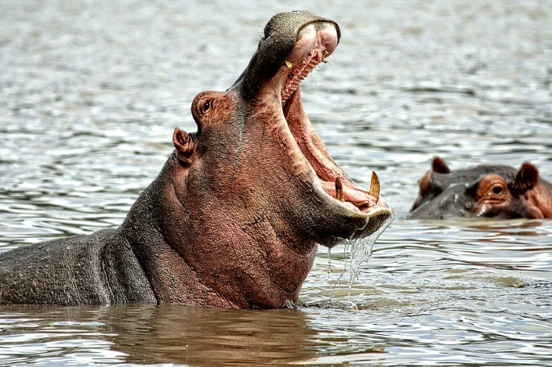
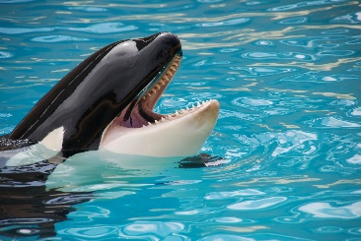
Assign Organisms to Groups
Which group or groups would you assign each organism to based on traits? What’s your evidence?
Photo courtesy of Pixabay.com
Photo courtesy of Pexels.com
Plant | Sunflower
Mammal | Conifer
Vertebrate | Fish
Reptile | Bird
Notes:
5 min
Note: Initially, display only the questions at the top of the slide.
“Next, we’ll use our knowledge of traits to assign different organisms to groups.”
Reveal the image of the hippo and the chart of organisms.
“Look at the organism chart on the slide and think about where you would place the hippo based on specific traits. Which group would be the most specific, or least inclusive? What evidence supports your decision?”
Next, reveal the image of the orca whale and ask participants to assign the organism to the least inclusive group on the chart based on specific traits. Make sure participants back up their answers with evidence.
Highlight the traits that hippos and the orcas have in common. Then ask, “What are some differences between these organisms? How might these differences help the two species live in their environment?”
Ideal responses:
Similarities: Hippos and whales are both mammals. This means they’re vertebrates with hair, they breathe air and have four-chambered hearts, they make heat internally, and females make milk. Both hippos and whales are large and heavy and have very little hair. Interestingly, they’re closely related in evolutionary history .
Differences:
Whales live in a water environment, while hippos live on land, although they also spend quite a bit of time walking or floating in water (but not swimming).
Hippos have legs (for walking and running); whales have fins (for swimming).
Hippos are herbivores that eats plants, whereas whales are carnivores that eat fish, seals, sharks, and other organisms.
Hippos have smaller teeth for grinding food and larger teeth for cutting food; whales use their teeth only for cutting food, and they swallow smaller fish whole.
The coloring of hippos and orcas is quite different. Orcas are black and white, while hippos are bluish gray or black with pink skin around the eyes and ears and on the belly.
Orcas form pods and are highly social, while hippos aren’t social at all.

Slide 54
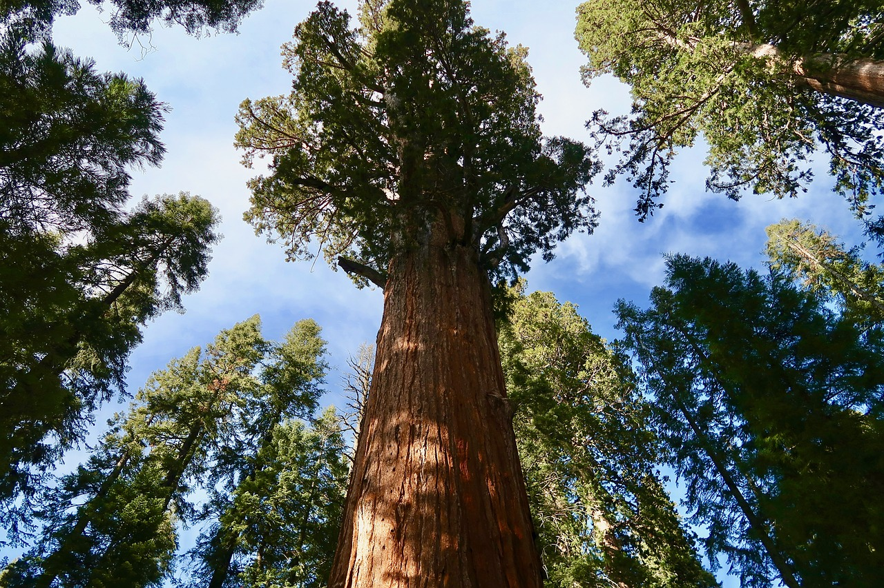
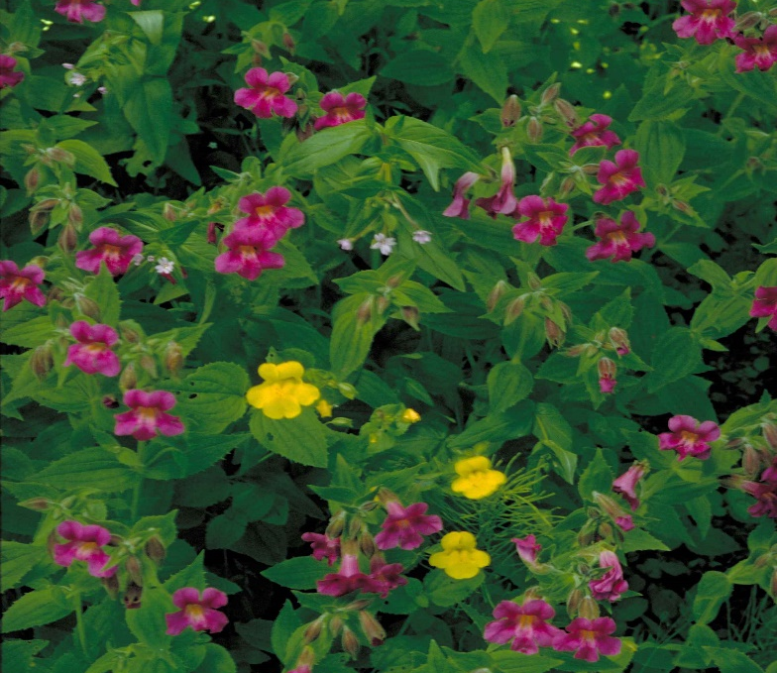
Assign Organisms to Groups
Assign each organism to a group or groups and state your evidence.
Plant | Sunflower
Mammal | Conifer
Vertebrate | Fish
Reptile | Bird
Photo courtesy of Pixabay.com
Photograph by Barnes Dr. Thomas G
Notes:
4 min
Note: Initially, display only the instructions and chart at the top of the slide and the image of the sequoia tree.
Ask participants to assign the sequoia tree to the most specific (least inclusive) group based on traits and include their evidence.
Next display the image of the monkeyflower bush and ask participants to assign the organism to the most specific (least inclusive) group based on traits. Make sure they support their choices with evidence.
Highlight the traits these plants have in common. Then ask, “What are some differences between sequoias and monkeyflower bushes? How might these differences help the two species live in their environment?”
Ideal responses:
Similarities: Both the sequoia tree and the monkeyflower bush are plants. This means they’re multicellular, make their own food, have cell walls made of cellulose, and produce and use a specific type of molecule called chlorophyll for photosynthesis.
Differences: Sequoia trees are conifers, which have needles instead of leaves and produce pine cones. They also don’t lose their needles in winter. Monkeyflower bushes aren’t conifers. They’re also much smaller than sequoias and produce colorful flowers.

Slide 55
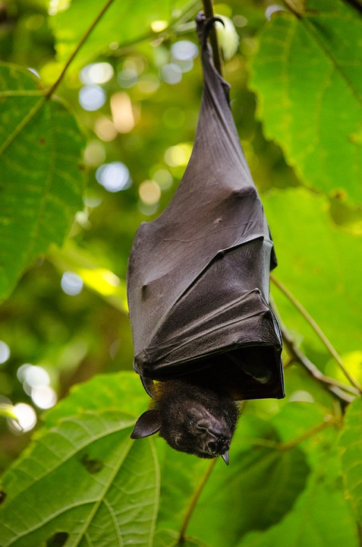
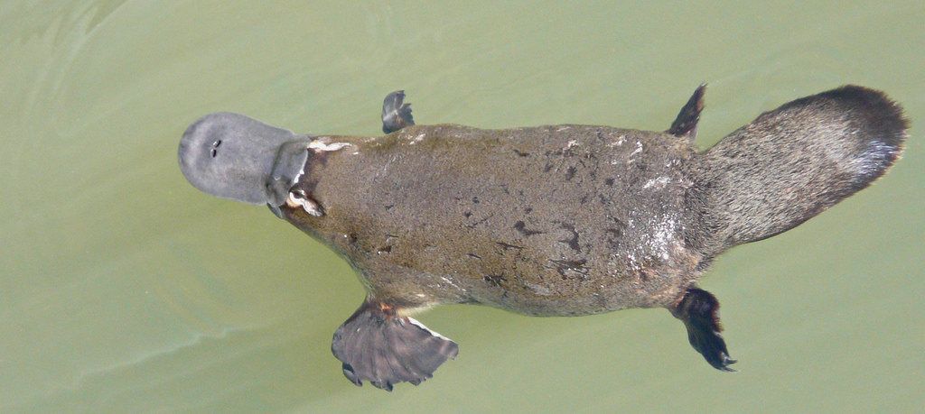
Assign Organisms to Groups
Assign each organism to a group or groups and state your evidence.
Plant | Sunflower
Mammal | Conifer
Vertebrate | Fish
Reptile | Bird
Photo courtesy of Brisbane City Council
Photo courtesy of Brisbane City Council
Notes:
4 min
Note: Initially, display only the instructions and chart at the top of the slide and the platypus photo.
Ask participants to assign the platypus to the most specific (least inclusive ) group based on traits and include their evidence.
Next display the photo of the bat and have participants assign the organism to the most specific (least inclusive) group based on traits. Make sure they support their choices with evidence.
Highlight the traits these animals have in common. Then ask, “What are some differences between platypuses and bats? How might these differences help the two species live in their environment?”
Ideal responses:
Similarities: Both platypuses and bats are mammals. This means they’re vertebrates with hair, they breathe air and have four-chambered hearts, they make heat internally, and females make milk.
Differences:
Platypuses are semiaquatic; bats aren’t.
Platypuses eat insect larvae, worms, and shrimp; bats primarily eat insects, as well as fruits, flower nectar, and blood.
Platypuses are egg-laying mammals; bats deliver their offspring.
Platypuses have legs; bats have webbed wings.
Platypuses live only in Australia and Tasmania; bats are present throughout most of the world.

Slide 56

Shared Traits That Define Related Groups
Key science idea: Shared traits help biologists define groups of organisms related by common ancestry.
Plants: Multicellular; make their own food; cell walls made of cellulose; produce and use specific type of chlorophyll
Animals: Multicellular; eat other organisms for food; no cell walls
Vertebrates: Most have a backbone; spinal cord; top of spinal cord becomes a brain
Mammals: Vertebrates with hair; breathe air; four-chambered hearts, make heat internally; females make milk
Reptiles: Vertebrates with dry scales; lungs; eggs with many membranes (amniotic eggs)
Notes:
Less than 1 min
“This slide and the next list some of the shared traits that define related groups of organisms.”
Instead of reading all of the traits, list two traits and then highlight the key science idea: Shared traits help biologists define groups of organisms related by common ancestry.

Slide 57
Shared Traits That Define Related Groups
Key science idea: Shared traits help biologists define groups of organisms related by common ancestry.
Fish: Vertebrates with gills; paired fins; scales; aquatic
Birds: Reptile-like vertebrates; feathers; make heat internally; two legs covered in scales; two wings
Conifers: Vascular land plants that make seeds and cones
Sunflowers: A group of species in the flowering plant family Compositae; calyces modified to structures called pappi; anthers connate (forming tubes) and styles modified to function as brushes in a specialized pollen presentation mechanism; ovaries, each containing a single basal ovule; production of sesquiterpene lactone
Notes:
Less than 1 min
a. List two of the traits on the slide and note that some traits become quite specialized in sunflowers.
b. Then highlight the key science idea again: Shared traits help biologists define groups of organisms related by common ancestry.

Slide 58
Common Ancestry
What do we mean when we say that organisms within a group are related by common ancestry?
Answer this question in your science notebook and be prepared to share your ideas with the group.
Notes:
2 min
“What do you think we mean when we say that organisms within a group are related by common ancestry?”
As participants share their ideas, record them on chart paper.
Emphasize: “Common ancestry explains why organisms have many shared features that give the impression they’re closely related.”
Note: During this discussion, make sure participants understand that heredity and evolutionary relationships are involved.

Slide 59
Make a Claim
Choose one of the organisms on handout 1.6 (Traits and Groups).
Review the traits for each group of organisms on the handout. Then make a claim stating which group your organism belongs to.
Support your claim with evidence.
Explain your scientific reasoning using science ideas about traits and groupings.
Notes:
10 min
Note: Participants may use available resources, such as the STeLLA strategies booklet, for this activity.
“For this next activity, you’ll work with a partner to develop a claim stating which group you think an organism belongs to and supporting your claim with evidence and reasoning.”
Have participants pair up; then give each pair a copy of handout 1.6 (Traits and Groups).
Pairs: Review the instructions on the slide and handout. Then answer any questions before pairs begin working on the tasks.
Whole group: Invite pairs to share their claims, evidence, and reasoning. Ask challenge questions as needed, such as “Can you use science ideas we’ve been talking about to further support your claim?” Encourage other participants to agree or disagree, add on, or ask questions.
Emphasize that developing an explanation by making a claim and supporting it with evidence and reasoning is an important skill in the NGSS and Common Core and is one of the Student Thinking Lens strategies they’ll explore in more detail later in the PD program. For now, note that one of the most difficult parts of developing an explanation is linking the claim to scientific reasoning and underlying science ideas. For example, the scientific reasoning that explains why dolphins are mammals is that all mammals at one point in time shared a common ancestor. This common ancestor must have had traits (such as having hair and a four-chambered heart, breathing air, generating heat, and making milk) that it passed on to the groups that evolved from it. This reasoning relates to one of the teacher learning goals for this session: One reason groups of organisms share so many features is common ancestry.
Ideal responses:
Question 2 (least inclusive group):
Dolphin: mammal
Lamprey: vertebrate (Note: The lamprey is interesting because it’s classified as a vertebrate but lacks a true backbone. Instead, it has a similar structure made out of cartilage.)
Snail: Animal
Penguin: Bird
Questions 3 and 4 (sample claim, evidence, and reasoning):
I claim that the penguin is a bird. My evidence is that penguins have the following traits of birds: They have vertebrae, feathers, two legs covered in scales, and two wings, and they make heat internally. My reasoning is that scientists put organisms into groups that share certain traits. Scientists believe that these traits have been passed down to them through common ancestors. Penguins have the same traits and the same ancestors as other organisms in the birds group. They aren’t mammals because they don’t share common ancestors or the traits of mammals, such as having hair or making milk.

Slide 60
Reflect: Content Deepening Focus Question 1
How do traits of living things help us understand how they’re grouped and related?
Notes:
3 min
Review the focus question on the slide.
Individuals: Have participants answer this question in their science notebooks.
Whole group: Invite one or two participants to share their answers and reasoning with the group.

Slide 61
Key Science Ideas
Traits are features or characteristics that help biologists identify related groups of organisms.
Organisms have physical traits, behavioral traits, molecular traits, chemical pathways, and developmental pathways.
Organisms in a group share certain traits.
One reason groups of organisms share so many features is common ancestry.
All of the organisms that evolved from a common ancestor inherit shared traits.
Notes:
Less than 1 min
Highlight the key science ideas on the slide.

Slide 62
Content Deepening: Focus Question 2
Why are trait variations important for the survival of living things?
Notes:
Less than 1 min
Read the focus question on the slide.
Ask participants to write the question in their science notebooks.

Slide 63
Traits and Survival
Select three species
from the same group
of organisms (such
as a hummingbird,
a crow, and a
red-tailed hawk).
Identify traits that
differ among the species and how these differences might affect the survival of each species.
Plant | Sunflower
Mammal | Conifer
Vertebrate | Fish
Reptile | Bird
Notes:
7 min
Note: Don’t spend too much time on this activity, since participants should understand the reasoning involved. To stay within the allotted time, you may need to reduce the number of species participants examine.
“The purpose of this next activity is to set the stage for understanding the origins of traits in different species.”
Direct participants to pair up for this activity.
Pairs: “Select three species from the groups of organisms listed on the slide. For example, you might choose a hummingbird, a crow, and a red-tailed hawk. Identify traits that differ among the species and describe how these differences might affect the survival of each organism. For instance, you might describe differences in the beaks, feet, and body size among the hummingbird, crow, and red-tailed hawk. Then describe how these trait variations might help each species survive in its environment. For example, the hawk is an active predator with a sharp, hooked beak that helps it tear apart and eat its prey. This trait enables the hawk to tear apart its prey, giving it a survival advantage.”
Whole group: Invite one pair of participants to share their descriptions and explanations with the group.

Slide 64
Reflect: Content Deepening Focus Question 2
Why are trait variations important for the survival of living things?
Notes:
3 min
Review the focus question on the slide.
Individuals: Ask participants to answer the question in their science notebooks and support their ideas with evidence from the activity they just completed.
Whole group: Invite one or two participants to share their explanations and evidence with the group.

Slide 65
NGSS Performance Standards
3-LS3-1. Analyze and interpret data to provide evidence that plants and animals have traits inherited from parents and that variation of these traits exists in a group of similar organisms. [Clarification Statement: Patterns are the similarities and differences in traits shared between offspring and their parents, or among siblings. Emphasis is on organisms other than humans.] [Assessment Boundary: Assessment does not include genetic mechanisms of inheritance and prediction of traits. Assessment is limited to non-human examples.]
3-LS4-2. Use evidence to construct an explanation for how the variations in characteristics among individuals of the same species may provide advantages in surviving, finding mates, and reproducing. [Clarification Statement: Examples of cause and effect relationships could be plants that have larger thorns than other plants may be less likely to be eaten by predators; and, animals that have better camouflage coloration than other animals may be more likely to survive and therefore more likely to leave offspring.]
Notes:
Less than 1 min
Highlight the NGSS performance standards on the slide.
Emphasize that the focus is on variation among offspring and their parents, as well as within species.

Slide 66
What Is a Species?
How would you define the word species?
Notes:
Less than 1 min
“How would you define the word species?”
As participants share their ideas, record them on chart paper.

Slide 67
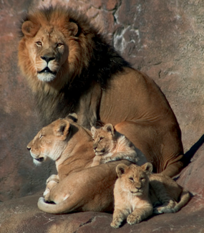
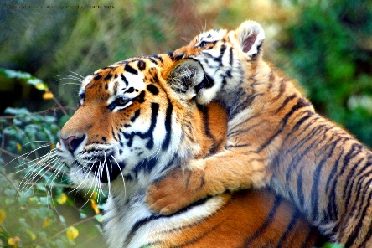
Defining a Species
Photo courtesy of Wikipedia.com
Photograph by Brent Dantley
A species is a group of individuals that can mate and produce fertile offspring under natural conditions.
Notes:
Less than 1 min
How many species do you see on the slide?
Note: Participants should identify two species: lion and tiger.
Read the definition on the slide and indicate that this is a common definition of a species.

Slide 68
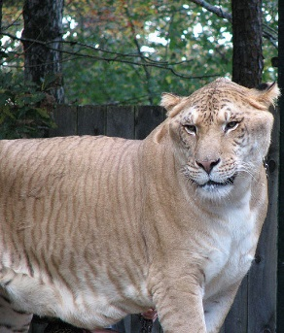
A “Special” Level of Life
Species: A group of individuals that can mate and produce fertile offspring under natural conditions.
Photo courtesy of Wikimeida.org
A liger is a cross between a lion and a tiger.
Notes:
Less than 1 min
“The animal on this slide is called a liger, which is a cross between a lion and a tiger. Ligers don’t exist naturally in the wild but are the result of crossbreeding practices. Due to crossbreeding, ligers often have birth defects and die prematurely.”
“Based on this evidence, do you still think lions and tigers represent two different species?”
Emphasize the words “under natural conditions” in the definition of species. Note that under natural conditions, lions and tigers don’t overlap, so it’s reasonable to classify them as two different species. However, defining species can be very difficult, especially since the common definition doesn’t apply to special groups of organisms like bacteria or ligers.

Slide 69
Summary Statements
Focus questions:
How do traits of living things help us understand how they’re grouped and related?
Why are variations in traits important for the survival of living things?
Think about the big ideas we’ve explored so far in this content deepening session and write two or three concise sentences in your science notebooks describing these ideas.
Notes:
3 min
Revisit the focus questions on the slide.
Individuals: “Think about the big ideas we’ve explored so far in this content deepening session and write two or three concise sentences in your notebooks describing these ideas.”
Whole group: Invite one or two participants to share their sentences with the group.

Slide 70
Content Deepening: Focus Question 3
How can we represent patterns of trait variation among individuals of a species?
Notes:
3 min
Read the focus question on the slide.
Individuals: Ask participants to write the focus question in their science notebooks and jot down their initial ideas.
Whole group: “What ideas do you have for ways we can represent patterns of trait variation with a species?”
“To gather information that will help us answer this question, we’ll explore trait variation within a species of plant.”

Slide 71
Celebrate Variation!
Work with a partner to identify about 15 or 20 individual plants of the same species and a trait you would like to measure. Examples of traits you could measure:
  The length of the longest stem on 10 rosemary plants
  The length of the biggest leaf on 15 rose stems
  The height of the flower on 20 dandelions
  The length of 20 different pea pods
Measure this trait for every individual in your sample population. Then record the data on the Plant Species Measurement table in your handout.
Notes:
20 min
“To find trait-variation patterns among individuals of a species, we need to work like scientists. This means collecting data on a specific trait from a sample population and then recording the data on a table. That’s what we’re going to do next.”
Walk participants through the steps on the slide; then distribute handout 1.7 (Celebrate Variation!). Have participants record their data on the Plant Species Measurements table in their handouts.
Option to save time: To save time, instead of having participants collect their data outside, bring in samples of the same kind of fruit, vegetable, or plant (e.g., 20 bananas, 20 carrots, 20 green beans) for participants to measure.

Slide 72
Create a Histogram
Determine the range in your sample by finding the difference between the largest and smallest measurement.
Divide the resulting range into 4 to 6 intervals.
Count the number of measurements that fall into each interval and record this data on the frequency distribution table in your handout (page 2).
Use the data in your frequency distribution table to create a histogram (bar graph) on your handout that illustrates the results. (See the sample histogram on page 1.)
Notes:
15 min
“Now that you and your partner have collected and recorded your data, let’s go over the steps for creating a histogram.”
Walk participants through the steps on the slide. Then display the sample frequency distribution table and histogram on the next two slides.
Note: As pairs work on their histograms, be available to answer questions and give direction as needed.
After participants have created their histograms, ask them to copy them onto chart paper and then display all the histograms for participants to see.

Slide 73
Sample Frequency Distribution Table
Length Range | Number of Individuals in That Range
6–10 mm | 2
11–15 mm | 6
16–20 mm | 10
21–25 mm | 4
26–30 mm | 3
31–35 mm | 1
Notes:
Less than 1 min
Show participants the sample frequency distribution table and note that it also appears in their handouts.

Slide 74
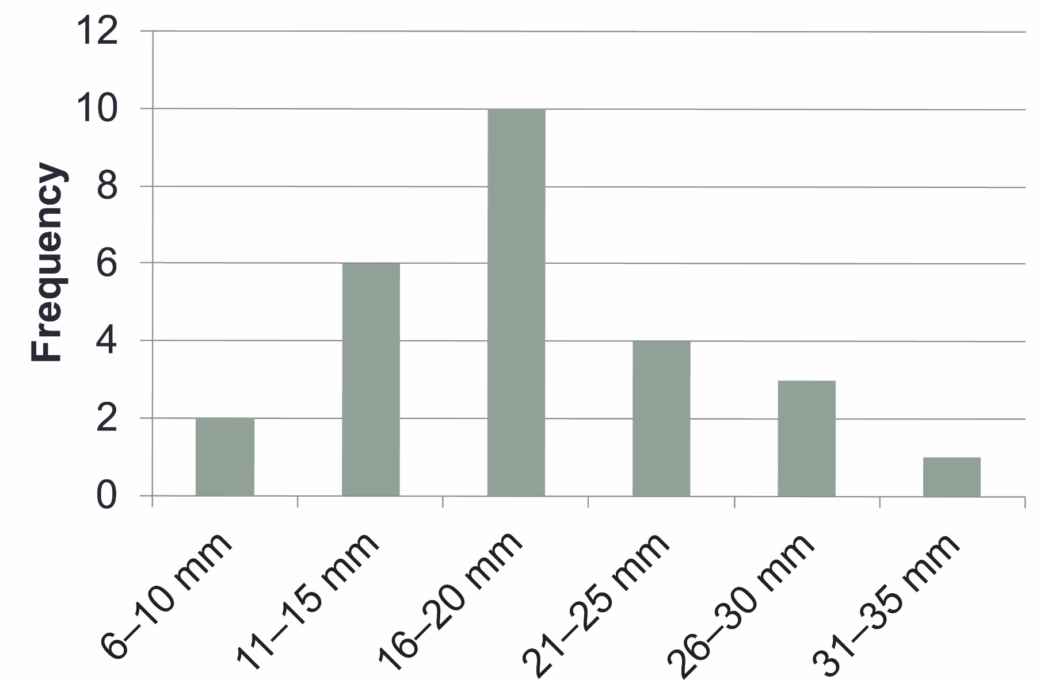
Sample Histogram
Notes:
Less than 1 min
Show participants this sample histogram and note that it also appears in their handouts. Highlight the information that should appear on the x- and y-axes.

Slide 75
Interpreting the Results
Sketch a copy of your histogram in your science notebook or on your worksheet.
Draw lines pointing out what you see in the data and use short phrases to describe your observations.
Then draw lines and use short phrases describing what you think the results mean.
Answer the questions on page 3 of your handout independently.
Notes:
7 min
Have participants complete the first three steps on the slide. Then have a brief group discussion about their observations and explanations.
During this discussion, keep participants focused on what they see in the data (observations of patterns) and what they think the results mean (inferences). Use probe questions to clarify their thinking as needed.
Highlight that a common trait-variation pattern is a bell-shaped curve that scientists call continuous variation. Later in the session, participants will contrast this trait-variation pattern with another pattern.
“What would the bar graph look like if the trait in our sample showed no variation?”
Note: Participants should recognize that the bar graph would have only one bar. This foreshadows what students will do in lesson 1.
“Now I’d like you to answer the questions on page 3 of your handouts, using what you already know about traits. Work on this task independently.”

Slide 76
Our Ideas and Questions about Inheritance
Let’s list our ideas and questions about trait inheritance on two charts:
Our Current Ideas about Inheritance
Our Questions about Inheritance
We’ll review and update these ideas and questions periodically.
Notes:
4 min
“Let’s list our ideas and questions about trait inheritance on two charts so we can review and update them during our content deepening sessions this week.”
“What do you think accounts for the differences in traits among individuals of the same species? Which types of traits are inherited, and what role might the environment play in some of the differences among individuals?”
Note: Keep this discussion brief.

Slide 77
Variation in Traits Lesson Role-Play
Review lesson 1a in your lesson plans binder and assemble the materials listed on the overview page.
Pair up and decide who will be the teacher and who will be the student for this role-play.
Select a 10-minute segment of the lesson to enact.
Prepare for the role-play:
Students: Read the Common Student Ideas document (Resources section of binder). Be ready to use them!
Teachers: Read anticipated student responses and teacher probe and challenge questions (columns 5 and 6 in the lesson plan). Be ready to use them!
Practice the role-play with your partner.
Notes:
20 min
Ask participants to locate lesson 1a in their lesson plans binders.
Orient participants to key features of the lesson plan, including overview page, the lesson outline, and the different phases and columns in the main lesson plan. Highlight the unit central question and lesson focus question on the overview page, the materials list, and other information they’ll need for the role-play, including where to find the anticipated student responses (column 5) and possible probe and challenge questions (column 6) in the main lesson plan.
Also show participants where to locate the Common Student Ideas document in the resources section of their lesson plans binders.
Emphasize that the lesson plans are meant to be used only as a guide to help teachers prepare for a lesson, not as a script to follow. These idealized plans demonstrate how the lessons might be implemented using embedded STeLLA strategies.
Share any important lessons you may have learned from teaching the lesson yourself.
Pairs: Review the steps on the slide and have participants pair up to complete the tasks. Make sure teachers and students know what they should read to prepare for the role-play.
Give pairs adequate time to prepare for and act out their role-plays.
“Tomorrow, you’ll switch roles and act out another lesson.”

Slide 78
Reflect: Content Deepening Focus Question 3
How can we represent patterns of trait variation among individuals of a species?
Notes:
5 min
Review the focus question on the slide.
Individuals: Ask participants to reflect on the question and record their current ideas in their science notebooks.
Whole group: Invite one or two participants to share their ideas with the group.

Slide 79
Key Science Ideas
Traits are features or characteristics that help biologists identify related groups of organisms.
Organisms have physical traits, behavioral traits, molecular traits, chemical pathways, and developmental pathways.
Organisms in a group share certain traits.
One reason groups of organisms share so many features is common ancestry.
All of the organisms that evolved from a common ancestor inherit shared traits.
Patterns of trait variation among individuals of a species are represented in different ways and can be recorded on frequency distribution tables and histograms.
Notes:
Less than 1 min
Review the key science ideas on the slide.

Slide 80
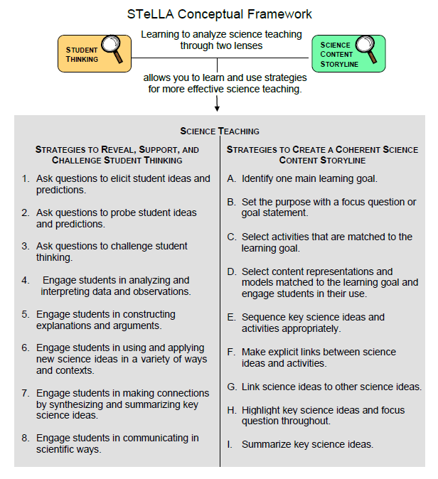
Lesson Analysis Focus Question
What are the STeLLA lenses and teaching strategies, and what is the evidence that they will make a difference in your science teaching?
Notes:
1 min
Read the focus question on the slide.
“This visual on this slide tells us a little about the first part of our focus question: What are the STeLLA lenses and teaching strategies? As you can see, there are eight specific science teaching strategies to support the Student Thinking Lens.”
Acknowledge: “I know you have existing frameworks (ideas and language) regarding teaching and learning, and I expect you’ll continuously draw from them throughout the Summer Institute.”

Slide 81
Lesson Analysis Focus Question
What are the STeLLA lenses and teaching strategies, and what is the evidence that they will make a difference in your science teaching?
Notes:
1 min
“Today we’ll begin learning about three of the Student Thinking Lens teaching strategies.”
Read the strategies highlighted on the slide.
“These three types of questions will help reveal, support, and challenge student thinking.”
Emphasize: “Even though we’re studying the strategies this summer, you’ll better understand them as you start trying them out in your teaching next fall.”

Slide 82
Strategies 1, 2, and 3: Questions That Elicit, Probe, and Challenge Student Thinking
Student Thinking Lens: Strategies to reveal, support, and challenge student thinking.
  Strategy 1: Ask questions to elicit student ideas and predictions.
  Strategy 2: Ask questions to probe student ideas and predictions.
  Strategy 3: Ask questions to challenge student thinking.
Read and fill in the purpose and key features of each strategy on your blank STL Z-fold summary chart. Then share your charts with a partner.
Notes:
20 min
Orient participants to the STeLLA strategies booklet. Forecast that you’ll come back to this resource repeatedly to ensure consistent use of ideas, meaning, and language that match the STeLLA conceptual framework.
Individuals: Have participants read about all three strategies and write on their blank STL Z-fold summary charts the purpose(s) and key features of each strategy. State that in the future, they’ll do this kind of reading and writing as homework.
Pairs: Have participants pair up and share their Z-fold summary charts. Encourage them to provide evidence from the readings to support their ideas and ask each other questions consistent with the norms for working together, such as “Where did you find that?” or “I interpreted that differently.

Slide 83
Elicit Questions
What are the purpose and key features of questions that elicit student ideas and predictions?
  Which question from the examples in the strategies booklet do you think would elicit the highest number of different student responses in your classroom? Why do you think so? (Cite ideas from the strategies booklet.)
Notes:
5 min
As a group, discuss the purpose and key features of questions that elicit student ideas and predictions. Write these features on chart paper and hang the chart where it can be referenced later.
Sample chart:
Key Ideas about Elicit Questions
Purpose: To reveal student ideas, predictions, misconceptions, and experiences before they learn about the content.
Key features:
Asked anytime, but often at the beginning of a lesson
Phrased in everyday language that students can understand even before studying the related content
Addressed to multiple students (usually the whole class)
Reveals a variety of student ideas
Useful to teachers in adapting instruction
Useful to students so they see that others have different ideas
Can be a prediction
Can set up a discrepant event

Slide 84
Probe and Challenge Questions
Probe Questions
What are the purpose and key features of questions that probe student ideas and predictions?
Challenge Questions
What are the purpose and key features of questions that challenge student thinking?
  Remember to cite ideas from the strategies booklet!
Notes:
13 min
Small groups (5 min): Split participants into two groups—one group for probe questions and one group for challenge questions. Have each group create a chart of the purpose and key features of the assigned strategy from the STeLLA strategies booklet (not from experience).
Whole group (8 min): Share the charts with the entire group. Encourage participants to add to, delete from, and modify them as needed to ensure they’re accurate and match the language in the strategies booklet.

Slide 85
Elicit versus Probe Questions
  What are some key differences between questions that elicit and questions that probe student ideas and predictions?
Notes:
5 min
Turn and Talk: “Discuss this question with an elbow partner.”
Whole-group share-out: Invite participants to share their ideas with the group.
Key ideas about elicit questions versus probe questions:
Elicit questions are addressed to the whole class; probe questions are addressed to individual students.
Elicit questions are used before students have studied a concept; probe questions can be asked at any time.
Elicit questions start a discussion; probe questions follow up on something a student has already said.

Slide 86
Elicit/Probe Questions versus Challenge Questions
  What are some key differences between questions that elicit and probe student ideas and predictions and questions that challenge student thinking?
Notes:
5 min
Turn and Talk: “Discuss this question with your elbow partner.”
Whole-group share-out: Invite participants to share their ideas with the group.
Key ideas about elicit/probe questions versus challenge questions:
Elicit and probe questions focus on understanding students’ existing ideas rather than trying to change students’ thinking.
In contrast, challenge questions are designed to push students’ thinking toward more-scientific understandings and support them in changing their thinking.

Slide 87
The RESPeCT Lesson Plans Binder
What comes before the lessons?
  Scope and sequence
  Learning goals
  California NGSS
  Student pretest/posttest
  Features analysis chart
  Working with English language learners (ELLs) in science
Overview of lesson format and structure:
  Lesson overview
  Lesson outline
  Detailed lesson plan
Notes:
5 min
Foreshadow: “In a moment, we’ll review the details of a homework assignment related to the lesson plans you’ll be teaching in the upcoming school year.”
“But before we look at the assignment, let’s review the organization and contents of the lesson plans binder.”
Use the slide to guide participants through the binder contents.

Slide 88
Let’s Summarize Today’s Work!
We thought about what constitutes effective science teaching.
We examined the rationale for the Science Content Storyline Lens and analyzed the US and Japanese video clips from the TIMSS video study.
We examined the rationale for the Student Thinking Lens and watched the video of the Harvard and MIT graduates and John and his teacher.
We deepened our understandings of traits and trait variation within species and learned how biologists organize living organisms into groups based on traits.
We read and talked about the purposes and key features of elicit, probe, and challenge questions.
Notes:
5 min
Remind participants of the various activities they’ve been involved in today.
Foreshadow: Let participants know that you’re going to ask them to reflect on what they’ve learned from these activities.

Slide 89
How Did Today’s Work Help You Think about Our Focus Questions?
What are the STeLLA lenses and teaching strategies, and what is the evidence that they will make a difference in your science teaching?
How do traits of living things help us understand how they’re grouped and related?
Why are trait variations important for the survival of living things?
How can we represent patterns of trait variation among individuals of a species?
Notes:
10 min
Note: If time is running short, you may want to skip the Turn and Talk or the entire slide.
Turn and Talk: “Discuss these questions with an elbow partner.”
Whole-group share-out: Invite participants to share their ideas with the group.

Slide 90
Extended Homework
Locate handout 1.8 (Extended Homework: RESPeCT Lesson Plan Analysis) in your PD program binder.
Between now and Friday, read the scope and sequence for the set of lessons and your assigned lesson plan in the lesson plans binder.
Be prepared to share your findings about your assigned lesson plan in a study-group conversation on Friday.
Notes:
5 min
Assign each participant one of the lessons in the Variation in Traits lesson-plan sequence. There are seven 2-part lessons in this content area. Each teacher should take responsibility for one 2-part lesson. That is, Teacher 1 will study lessons 1a and 1b; Teacher 2 will study lessons 2a and 2b; and so forth.
If the study group is small, figure out who will be assigned an extra lesson (or when you, as the PD leader, will cover any extra lessons).
If the study group is large, assign lessons to more than one teacher later in the sequence.
Go over the homework sheet (handout 1.8) with participants. If time allows, have them read the assignment sheet before discussing.

Slide 91
Reflections on Today’s Session
Complete the Daily Reflections sheet.
What were your first reactions to the STeLLA claim that it’s important to plan and analyze science teaching through the Student Thinking Lens and the Science Content Storyline Lens? What was convincing or not so convincing for you and why?
What new idea or question did the content deepening session get you thinking about?
Provide feedback about today’s session and the program so far (likes, dislikes, questions, concerns, suggestions).
Notes:
5 min
Review the questions on the Daily Reflections sheet (handout 1.9).
Ask participants to think about these questions and write down their reflections.

