Slide 1
RESPeCT PD pROGRAM
Day 6
RESPeCT Summer Institute
Notes:
5 min
a. Take care of any housekeeping issues.

Slide 2
Agenda for Day 6
Day-5 reflections
Review: Science content storyline
Today’s focus questions
Lesson analysis: STeLLA strategies B, I, and 7
Content deepening: Earth’s changing surface
Lunch
Content deepening (continued)
Lesson analysis: SCSL strategy C
Summary, homework, and reflections
Notes:
5 min
a. Go over the agenda for the day.

Slide 3
Trends in Reflections
Lesson Analysis | Science Content Learning
Notes:
7 min
a. Give participants time to review your feedback on their reflections from day 5 and offer reactions, comments, or follow-up questions.

Slide 4
Review: Science Content Storyline
In your notebooks, jot down …
things you remember from yesterday’s session,
ideas that seem important to you, and
question you have.
Be prepared to share one idea and question with the group.
3
2
1
Notes:
10 min
a. Point out the three tasks on the slide. Allow 4–5 minutes for participants to write their responses in their science notebooks.
b. Have each participant share one idea about the science content storyline that she or he thinks is really important.
c. Then ask participants to share their questions. If you can answer them quickly, go ahead and do so. If a question needs a more detailed response, write it down and schedule a time to address it.

Slide 5
Today’s Focus Questions
How can we begin and end a lesson to help students develop a coherent science content storyline?
How can selecting appropriate science activities help students develop a coherent science content storyline?
Do landforms ever change? What evidence do we have?
What causes landforms to change? What is our evidence?
Notes:
2 min
a. Introduce today’s focus questions.

Slide 6
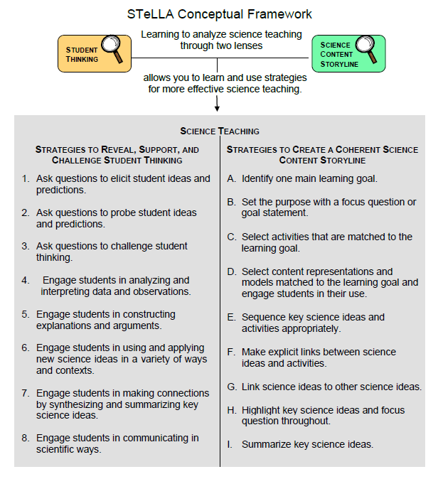
Notes:
1 min
a. “Today we’ll be looking at four new STeLLA strategies. Three of them are Science Content Storyline Lens strategies, and one is a Student Thinking Lens strategy. Throughout the session, think about how these strategies are different from one another and how they are closely linked to each other.”

Slide 7
Lesson Analysis: Focus Question 1
How can we begin and end a lesson to help students develop a coherent science content storyline?
Notes:
Less than 1 min
a. “Now let’s dig into our first focus question.”

Slide 8
Strategies B, I, and 7: Purposes and Key Features
Group 1: What are the purpose and key features of strategy B?
Why is a focus question or goal statement important for science content storyline coherence?
Group 2: What are the purpose and key features of strategy I?
Why is summarizing key science ideas important for science content storyline coherence?
Group 3: What are the purpose and key features of strategy 7?
How does strategy 7 compare with strategy I?
All groups: Make sure to cite ideas from the STeLLA strategies booklet in your answers.
Notes:
25 min
a. Pairs (3 min): Direct participants to retrieve their Z-fold summary charts and share with a partner what they learned from their homework assignment about STeLLA strategies B, I, and 7.
b. Small groups (12 min): Divide participants into three small groups and have them make charts that capture the purposes and key features of the three strategies.
Note: Challenge participants to imagine themselves in a Teacher Leader role. Ask them, “How would you explain these strategies to the teachers you’re leading?”
c. Whole group (10 min): Have small groups share their charts in a whole-group share-out.
Key ideas:
Make sure participants understand that a focus question is designed to do more than just get students interested in the lesson. It gets them thinking about a phenomenon or something else they’ve never thought about before. It also reveals important things about the knowledge and experiences they’re bringing to the lesson, it conceptually situates the learning, and it’s referred to throughout the lesson.
STeLLA strategies B, I, and 7 are like bookends that mark the beginning and end of a lesson. The science ideas used in the summary should match the focus question from the beginning of the lesson, and both the focus question and the summary should match the lesson’s main learning goal.

Slide 9
Discussion Questions: Strategy B
What is the difference between focus questions and goal statements?
Which do you think would be more useful in engaging student interest and making their thinking visible—focus questions or goal statements?
Notes:
7 min
a. Whole group: Discuss the questions on the slide as a group.
Key ideas:
A focus question is designed to be answered using the lesson’s main learning goal and supporting science ideas. A goal statement describes the main science idea to be learned.
Focus questions are always used in RESPeCT lesson plans because they are useful in engaging student interest, making their thinking visible, and eliciting initial ideas at the beginning of a lesson. When posed at the end of a lesson, focus questions challenge students to use new ideas developed during the lesson.

Slide 10
Discussion Questions: Strategies I and 7
What are various ways a lesson or unit can be synthesized and/or summarized?
How are strategies I and 7 similar and different?
SCSL strategy I: Summarize key science ideas.
STL strategy 7: Engage students in making connections by synthesizing and summarizing key science ideas.
Notes:
7 min
a. Whole group: Discuss the first question on the slide. Participants can refer to the information on strategy 7 in the STeLLA strategies booklet to identify a variety of ways in which key science ideas in a lesson can be synthesized.
b. Emphasize: “Toward the end of a unit, an entire lesson may be devoted to strategy 7, which engages students in synthesizing and summarizing science ideas across several lessons.”
c. Discuss the second question on the slide.
Key ideas:
In strategy I, the teacher creates a summary of key science ideas in the lesson. Strategy 7, however, engages students in synthesizing and summarizing key science ideas in the lesson. When students themselves perform this work, it makes their thinking visible, engages them in active sense making, and reveals to the teacher any misunderstandings or gaps in knowledge. Using both strategies brings coherence to a science lesson and is a powerful way to end it.
In strategy 7, summarizing involves making connections between key science ideas, which helps students synthesize the main learning goal or big idea in a lesson.
Summaries should focus on key science ideas, not activities; that is, focusing on “what we learned” versus “what we did.”
For a variety of reasons, a lesson sometimes ends before the main learning goal has been fully developed. However, summarizing work should still take place. For example, the teacher might say, “Our focus question today was How do plants get their food? What have we found out so far?” After students respond, the teacher could reply, “Yes, so far we’ve discovered that water and soil aren’t food for plants. But we still haven’t figured out what is food for plants. We’ll continue working on this question next time.”

Slide 11
Video-based Lesson Analysis
Next we’ll analyze a video clip from the beginning and end of a lesson on Earth’s changing surface.
Notes:
Less than 1 min
a. Transition: This slide marks the transition to video-based lesson analysis.

Slide 12
Lesson Analysis: Strategy B
In Analysis Guides B and I (handout 6.1), review the four criteria for strategy B: Setting the purpose.
Read the lesson context at the top of the video transcript (handout 6.2).
Watch the first video clip, keeping in mind the criteria for strategy B.
Analyze the transcript using the analysis guide.
How well does the beginning of this lesson match the criteria for strategy B?
Share and compare your analyses.
Link to video clip 1: 6.1_mspcp_gr.2_ecs_poulsen_L6_c3
Notes:
20 min
a. Have participants locate Analysis Guides B and I (handout 6.1 in PD program binder) and spend 1 or 2 minutes reading the criteria for strategy B: Setting the purpose.
b. Ask: “Do you have any questions about these criteria?”
c. Emphasize: “Keep the criteria for strategy B in mind as you watch the first clip from the beginning of a lesson on Earth’s changing surface.”
d. Individuals: Give participants a couple of minutes to read and think about the lesson context at the top of the video transcript (handout 6.2).
e. Show the video clip.
f. Whole group: “How well does the beginning of this lesson match the criteria for strategy B?
Note: During the discussion, be on the lookout for opportunities to clarify science-content ideas.
Ideal response:
At the beginning of the clip (segments 0:00:05, 0:00:16), the teacher poses focus questions, What does the surface of the Earth look like? Does it ever change? These questions match the criteria in the analysis guide because (1) they help students anticipate the main learning goal, (2) they’re worded in everyday language, and (3) they’re scientifically accurate. However, the first question is a bit vague and might lead students to focus on aspects of Earth’s surface that don’t relate to landforms (e.g., the land could be brown or green, or it could have trees or grass or roads and buildings). More specific questions might be better, such as What do the landforms on Earth’s surface look like? Do they ever change? but landforms is a science word that some students might not understand.

Slide 13
Lesson Analysis: Strategy I
In Analysis Guides B and I (handout 6.1), review the six criteria for strategy I: Summarizing key science ideas.
Review the lesson context at the top of the video transcript (handout 6.3).
Watch the second video clip, keeping in mind the criteria for strategy I.
Analyze the transcript using the analysis guide.
How well does the end of this lesson match the criteria for strategy I?
Share and compare your analyses.
Link to video clip 2: 6.2_mspcp_gr.2_ecs_poulsen_L6_c4
Notes:
20 min
a. Allow participants 1 or 2 minutes to read the six criteria in the analysis guide for strategy I: Summarizing key science ideas.
b. Ask: “Do you have any questions about these criteria?”
c. Emphasize: “Keep the criteria for strategy I in mind as you watch the next clip from the end of the same ECS lesson.”
d. Individuals: Give participants a couple of minutes to review the lesson context at the top of the video transcript (handout 6.3).
e. Show the second video clip.
f. Whole group: “How well does the end of this lesson match the criteria for strategy I? How well does the summary statement match the beginning of the lesson?”
Note: During the discussion, be on the lookout for opportunities to clarify science-content ideas.
Ideal responses:
In this video clip, the teacher works with students to summarize key science ideas from the ECS unit. The focus is on conceptual understanding.
The summary includes five big ideas, with an overarching focus on the concept of changes in landforms over time.
The science ideas in the summary help answer the focus questions. However, the ideas about water changing the land and change occurring over time aren’t strongly represented in the focus questions from the beginning of the lesson (What does the surface of the Earth look like? Does it ever change?).
Science ideas are scientifically accurate.
While students seem engaged in making sense of the summary statement, there are missed opportunities to include student ideas in the statement. Students mainly use yes-no statements.
Perhaps the focus question could better anticipate the five big ideas in the summary: How and why do landforms on Earth’s surface change over time? In addition, students could be more engaged and involved in making sense of the data table by taking turns summarizing key ideas for each row.

Slide 14
The ECS Lesson Plans: Reading and Analysis
Examine the main learning goal, the lesson focus question, and the lesson summary for your assigned ECS lesson plan (parts A and B).
Answer these questions in your notebooks, keeping in mind the analysis-guide criteria for strategies B and I:
What do you notice?
What do you wonder about?
Notes:
10 min
Note: This slide can be abridged or skipped if time is running short.
a. Read the instructions on the slide and assign a two-part lesson plan (parts A and B) to each participant.
b. Ask participants if they have any questions about the assignment.
c. Individual reading-and-analysis time (5 min): “Answer the slide questions in your notebooks, keeping in mind the analysis-guide criteria.”
d. Whole-group discussion (5 min): Briefly discuss participants’ observations and questions for their assigned lesson plans.
Note: Participants should see a close match between the main learning goal, the lesson focus question(s), and the summary. However, also welcome critiques and suggestions for improvement. Just make sure critiques are based on good understandings of the strategies involved.

Slide 15
Earth’s Changing Surface
SCIENCE CONTENT DEEPENING Grade 2
Notes:
Less than 1 min
a. Transition: This slide marks the transition to content deepening work.
Note: Throughout this content deepening phase, refer as needed to the content background document and Common Student Ideas about Earth’s Changing Surface.

Slide 16
Unit Central Questions
What does the surface of Earth look like? Does it ever change?
Notes:
Less than 1 min
a. Review the unit central questions on the slide.
b. Remind participants that these questions will guide student learning throughout the entire ECS unit.

Slide 17
Content Deepening Focus Questions
Do landforms ever change? What evidence do we have?
What causes landforms to change? What is our evidence?
Notes:
Less than 1 min
a. Review the content deepening focus questions on the slide.

Slide 18
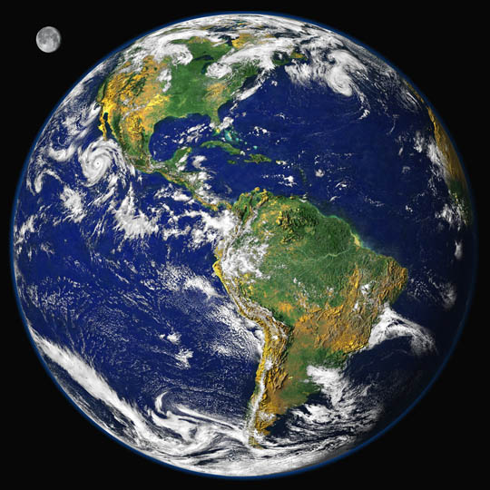
Earth’s
Changing
Surface
Content
Deepening
Developed by
Dr. Jeff Marshall
Geological Sciences
Cal Poly Pomona
Used by permission
Photo courtesy of Visible Earth
Notes:
Less than 1 min
a. “Today’s content deepening work will focus on science ideas about Earth’s changing surface from ECS lessons 3 and 4.”

Slide 19
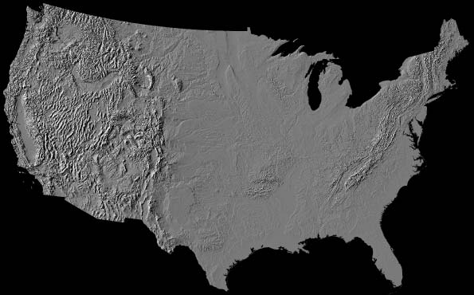
Earth’s Surface Terminology
Landform
Landscape
Geomorphic
Province
Photo courtesy of NPS.gov
Notes:
Less than 1 min
a. “Geomorphologists use the terms landform, landscape, and geomorphic province to describe features of Earth’s surface.”

Slide 20
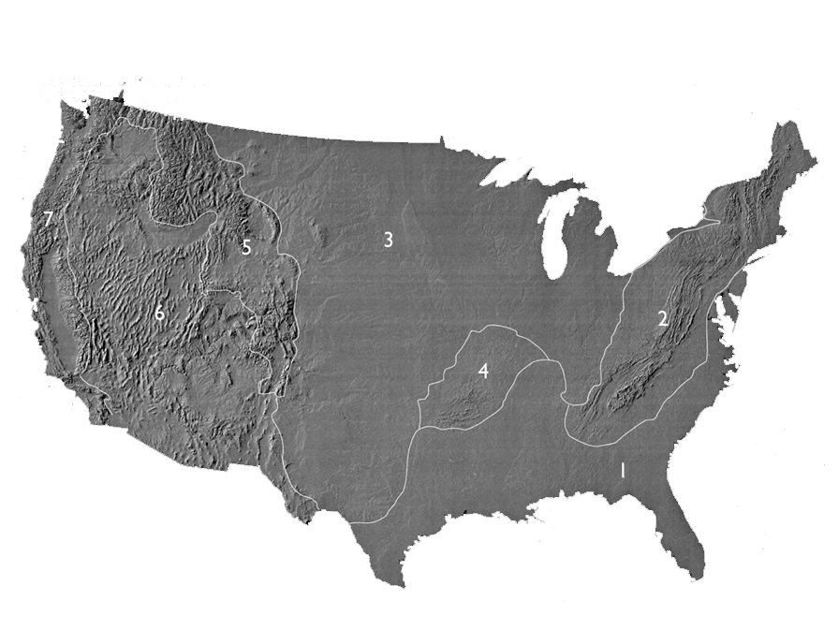
Geomorphic Provinces
Atlantic plain
Appalachian highlands
Interior plain
Interior highlands
Rocky Mountain system
Intermontane plateau
Pacific Mountain system
Photo courtesy of NPS.gov
Notes:
1 min
a. “In our last content deepening session, we used a relief map of the United States to study landforms in different locations and identify distinctive patterns. Based on these patterns, we can divide the North American continent into regional sectors called geomorphic provinces or physiographic provinces.”
b. “Geomorphic provinces are broad sectors of a continent that share a common geologic history and tectonic origin.”
c. “The geomorphic provinces represented on this slide are quite generalized, but next, we’ll examine a more detailed model of geomorphic provinces in the western United States.”

Slide 21
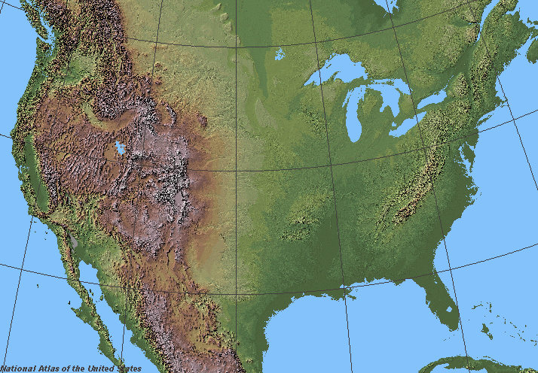
Geomorphic Provinces
Western
North
America
Photo courtesy of Wikimedia.org
Notes:
3 min
a. “This slide shows a digital elevation model of western North America.”
b. “What distinct surface patterns do you observe on this map?”
c. Ask participants to think about how they might divide this area into geomorphic provinces. Then invite them to briefly share their ideas.

Slide 22
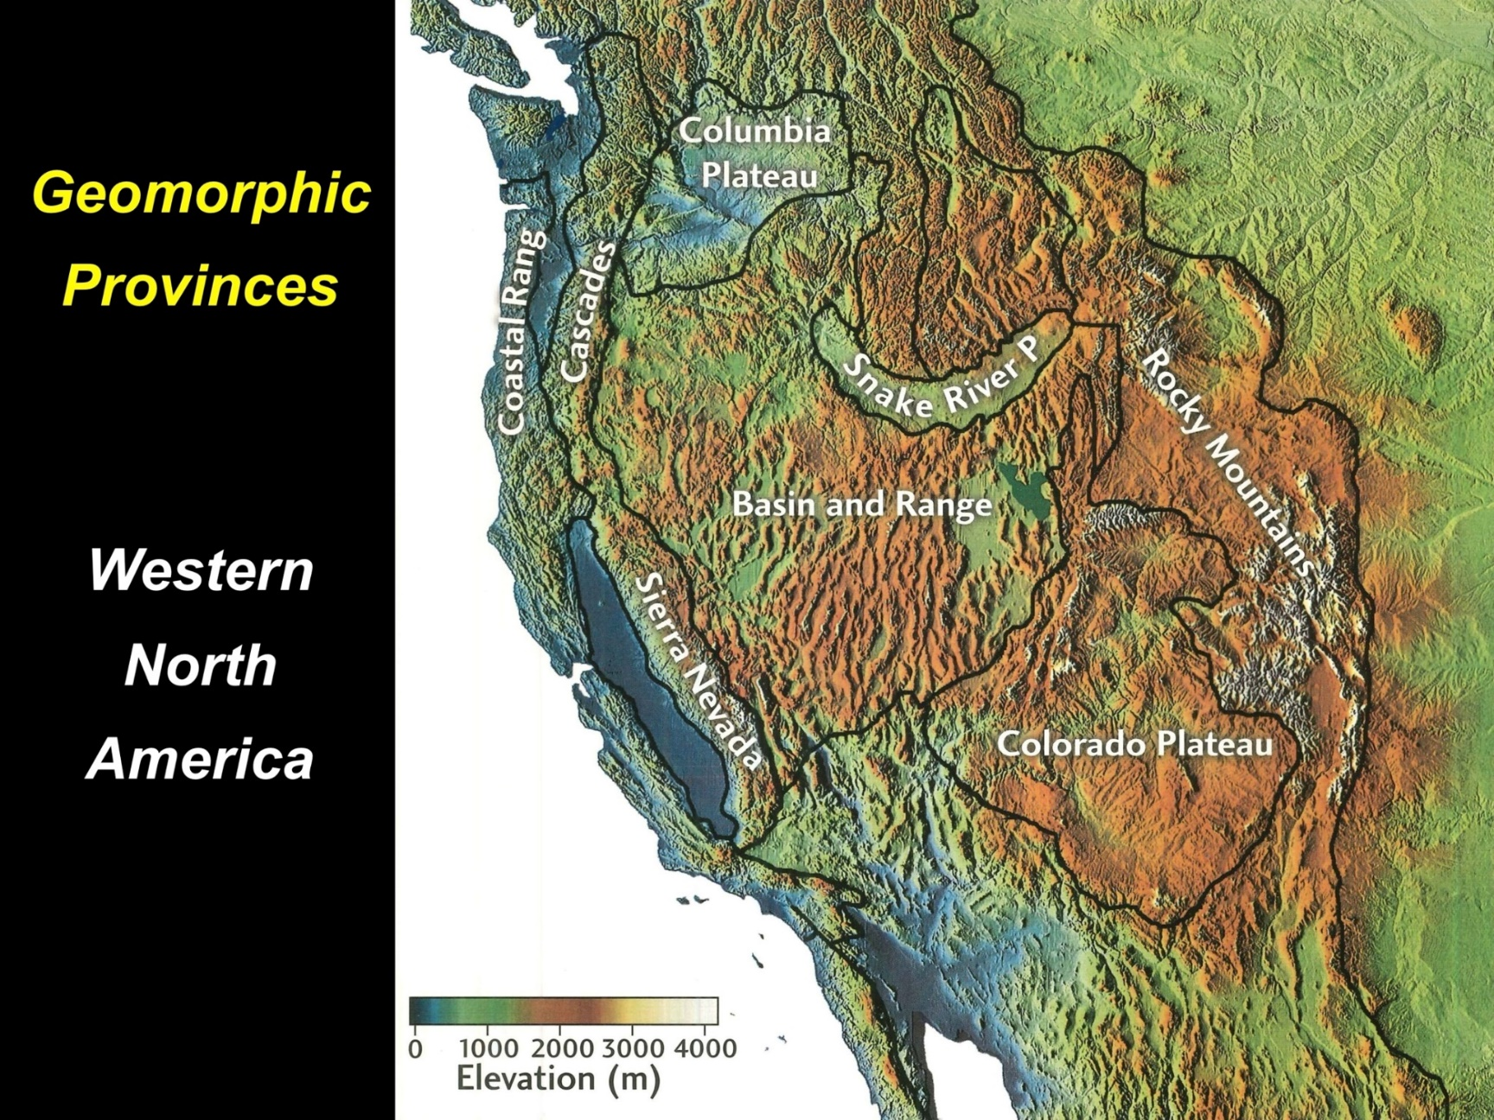
Geomorphic Provinces
Western
North
America
Source unknown
Notes:
3 min
a. “This slide shows the standard geomorphic provinces that geomorphologists have identified for western North America.”
b. “How does this model compare with the geomorphic divisions you came up with?”
c. “Next, we’ll zoom in on one province that stretches from eastern California across Nevada to central Utah.”

Slide 23
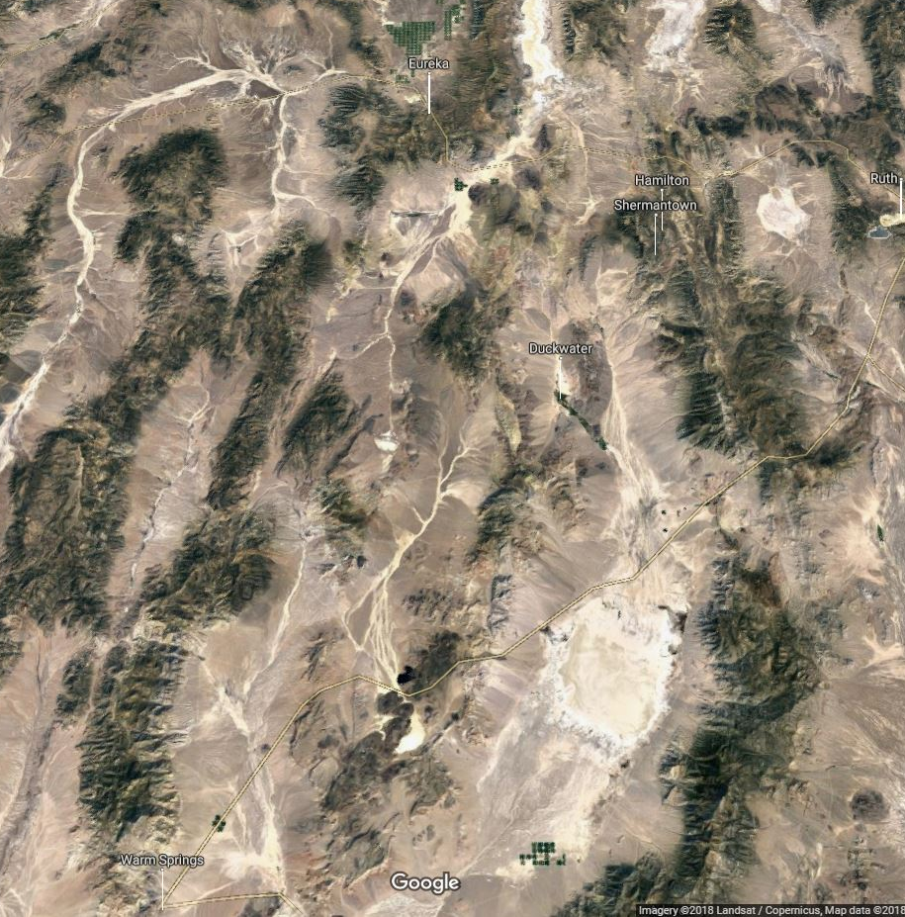
Geomorphic Provinces
Basin
and
Range
Photo courtesy of Imagery @2018 Landsat/Copernicus, Map Data @2018 Google
Notes:
Less than 1 min
a. “The image on this slide is a close-up view of a portion of the Basin and Range geomorphic province. This region is known for its parallel rows of rugged, snowy (Nevada) mountain ranges and deep desert valleys. The ranges and valleys are separated by extensional normal faults that accommodate tectonic stretching from west to east.”
b. “In this region, the North American continent is actually being pulled apart from both sides. This movement has resulted in a distinctive pattern of north-south-trending mountain ranges and intervening basins or valleys.”

Slide 24
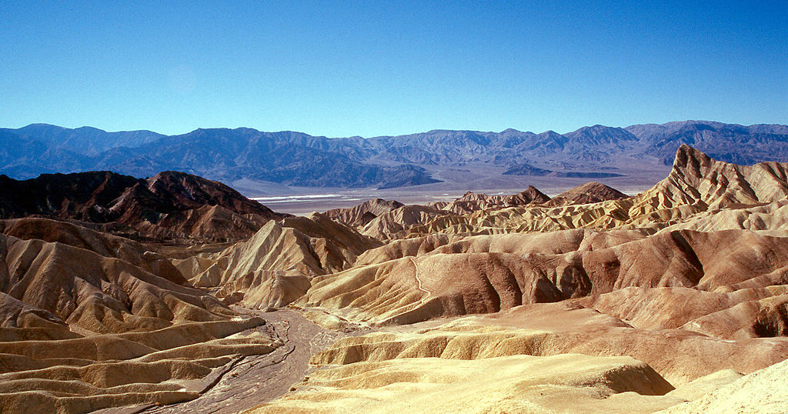
Horst and Graben Landscape
Photo courtesy of Wolfgangbeyer / Wikimedia Commons
Death Valley, California
Basin and Range Geomorphic Province
Notes:
3 min
a. “This is an example of a typical Basin and Range landscape within the western geomorphic province. The photo was taken from Zabriskie Point in Death Valley National Park, looking east across the desert basin toward the mountain range on the far side.”
b. “At the bottom of the valley is a desert playa lake, which is depression in the ground filled with water at certain times of the year. Alluvial fans, or accumulations of sediment, appear along the edges of the mountain range, and a fault runs along the foot of the mountains.”
c. Point out that in geomorphology, the term landscape refers to a regional assemblage of landforms that characterize a certain tectonic or climatic environment. Death Valley can be described as a horst and graben landscape. In German, horst and graben are geologic terms that describe extensional mountain ranges, or horst, and intervening basins, or graben.

Slide 25
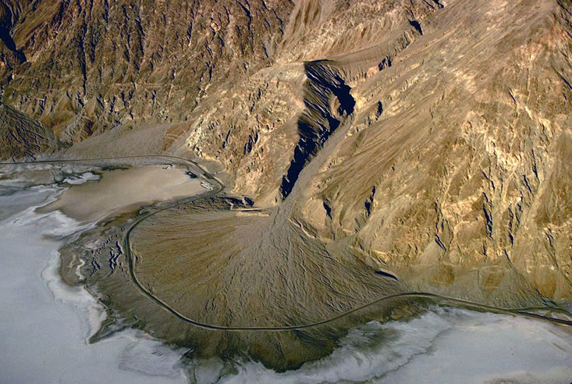
Alluvial Fan Landform
Photograph by Marli Miller/Geologypics.com
Death Valley, California
Notes:
2 min
a. “This photo of an alluvial fan is an example of a characteristic landform in a horst and graben landscape.”
b. “Alluvial fans are piles of sediment that accumulate at the mouth of a mountain stream where it empties into an adjacent valley or basin. This landform results from a sudden change in stream gradient crossing a mountain front. As the streambed builds up, it maintains a continuous longitudinal profile from a mountain canyon in the basin.”
c. Explain that landforms are local surface features that result from a specific natural process or set of processes. Many types of landforms exist around the world.

Slide 26
Earth’s Surface Terminology
Landform:
Landscape:
Geomorphic
Province:
Local feature of Earth’s surface formed by a
characteristic natural process or set of processes
(e.g., sand dune, cliff, sinkhole, moraine, crater,
gully, alluvial fan, stream channel, delta)
Regional assemblage of landforms that are typical
of a particular tectonic and/or climatic setting
(e.g., coastline, desert, savannah, volcanic belt,
tundra, karst, badland, tropical lowland)
Broad sector of a continent that has a common
geologic history and tectonic origin
(e.g., Colorado Plateau, Appalachian Piedmont,
Basin and Range, Rocky Mountains)
Photo courtesy of NPS.gov
Notes:
2 min
a. Read and discuss the definitions on the slide to summarize this investigation of Earth’s changing surface.

Slide 27
Earth’s Changing Surface
Lesson 3a
Photo courtesy of Visible Earth
Notes:
Less than 1 min
a. “Next, we’ll explore ideas about Earth’s changing surface from lesson 3a.”

Slide 28
Content Deepening: Focus Question 1
Do landforms ever change? What evidence do we have?
Notes:
Less than 1 min
a. Read the two-part focus question on the slide.
b. Emphasize that these questions will guide student learning throughout ECS lesson 3a.
c. Have participants write the questions in their science notebooks and draw a box around them.

Slide 29
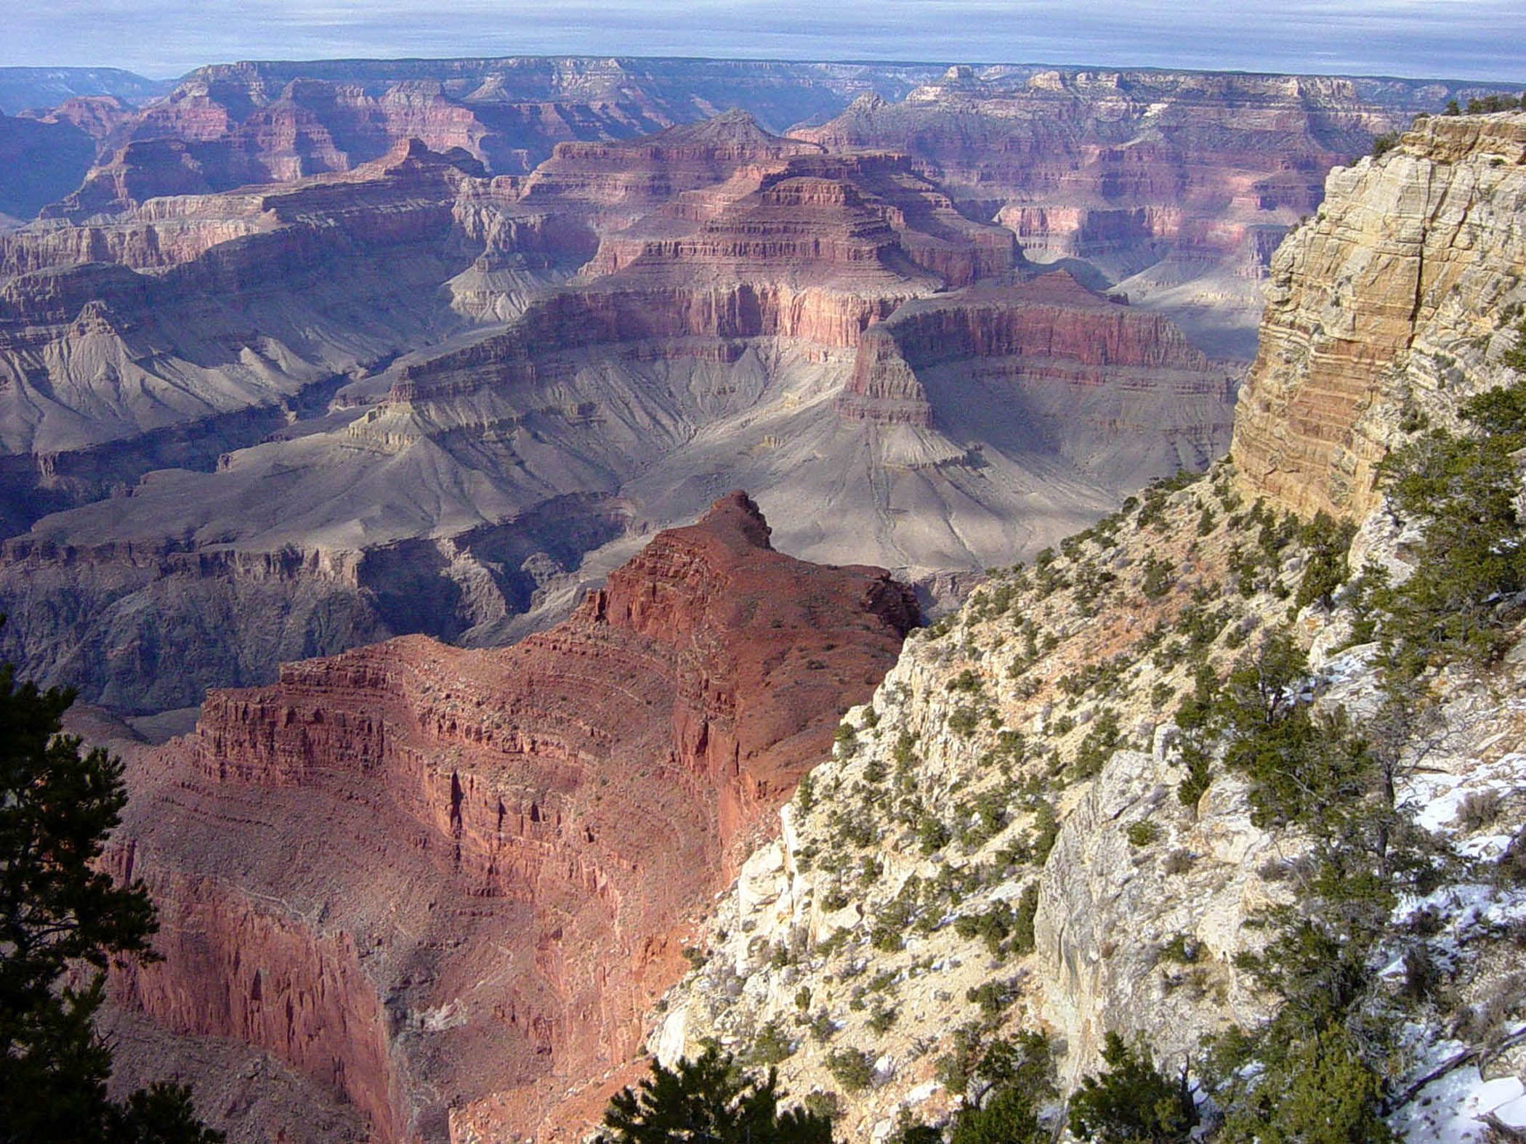
A Virtual Trip to the Grand Canyon
Have you ever been to the Grand Canyon? What do you notice about this picture?
Photo courtesy of NPS.gov
Notes:
25 min
a. Pose the questions on the slide and invite participants to briefly share their experiences and observations.
b. “Next, we’ll take a virtual tour of the Grand Canyon using Google Earth. On our tour, we’ll explore how landforms can change over time through erosional processes.”
c. Distribute handout 6.8 (Grand Canyon Explorers, Part 1) and inform participants that they’ll complete the handout at various intervals during the tour.
d. At this point, start the Google Earth tour on your computer.
Note: Alternatively, if you copied and pasted the slides into the PDLG PowerPoint document earlier, cue those slides now.
e. Pause the video at each stop on the tour so that participants can answer the questions on the handout.
Note: You may want to use the activity instructions from ECS lesson 3a as a guide.
f. Make sure to stop the video after the second clue appears in the Google Earth bubble. Then have participants answer the final question on the handout.
Note: You’ll resume the video when you conduct the investigation from lesson 3b.
g. Whole group: After participants have completed the handout, discuss their answers to the questions as a group.

Slide 30
Reflect: Content Deepening Focus Question 1
Do landforms ever change? What evidence do we have?
Notes:
5 min
a. Return to this slide after completing part 1 of the Google Earth Grand Canyon Tour (up through clue 2).
b. Review the two-part focus question on the slide.
c. Invite participants to share their answers and evidence from the Google Earth tour. As participants share their ideas, record them on chart paper. Elicit differing points of view and probe participants’ responses (e.g., “Can you say more about that?”).
d. Encourage participants to agree, disagree, ask questions, or add to the ideas others share.
e. Work together to reach s a consensus; then record it on chart paper.

Slide 31
Key Science Ideas
The Grand Canyon is 2 centimeters deeper than it was 50 years ago.
The Colorado River carries loose soil and rock with it as it flows through the canyon.
Notes:
Less than 1 min
a. Read the key science ideas on the slide.

Slide 32
Earth’s Changing Surface
Lesson 3b
Photo courtesy of Visible Earth
Notes:
Less than 1 min
a. “Next, we’ll explore ideas about Earth’s changing surface from lesson 3b.”

Slide 33
Content Deepening: Focus Question 1
Do landforms ever change? What evidence do we have?
Notes:
Less than 1 min
a. Review the two-part focus question on the slide.
b. Emphasize that these questions from lesson 3a will guide student learning throughout lesson 3b as well.

Slide 34
Our Virtual Trip to the Grand Canyon
Let’s continue our exploration of the Grand Canyon!
Photo courtesy of NPS.gov
Notes:
20 min
a. “Now let’s continue our virtual tour of the Grand Canyon.”
b. Distribute handout 6.9 (Grand Canyon Explorers, Part 2); then cue the Google Earth tour (or PowerPoint slides). Resume the tour after the second clue.
c. When the third clue pops up in the Google Earth bubble, stop the video and have participants answer the questions on the handout.
Note: You may want to use the activity instructions from ECS lesson 3b as a guide.
d. Whole group: Invite participants to share their answers to the first question on the handout.

Slide 35
Is the Grand Canyon Changing?
Do you think the Grand Canyon is changing? Why or why not?
Answer these questions using evidence from our first two clues:
The Grand Canyon is 2 centimeters deeper than it was 50 years ago.
The Colorado River carries loose soil and rock with it as it flows through the canyon.
Sentence starter: I think the Grand Canyon [is/is not] changing because ____________.
Notes:
5 min
a. Read the questions on the slide. Then review the first two clues from handout 6.8 (Grand Canyon Explorers, Part 1).
b. Call on a couple of participants to answer the questions using the sentence starter on the slide. Make sure they include evidence from the clues.
Ideal response:
The Grand Canyon is changing because it’s 2 centimeters deeper than it was 50 years ago.

Slide 36
What Is Causing the Change?
What do you think is causing the Grand Canyon to change?
Use all three of our clues to answer this question.
Sentence starter:
I think _______________ is causing the Grand Canyon to change.
Notes:
5 min
a. Read the question on the slide. Then review all three clues from handouts 6.8 and 6.9 (Grand Canyon Explorers, Part 1 and Part 2)
b. Call on a couple of participants to answer the questions using the sentence starter on the slide. Make sure they include evidence from the clues.
Ideal response:
I think erosion is causing the Grand Canyon to change. The Colorado River is carrying soil and rock from the canyon to Lake Mead, which is causing the canyon to get deeper over time. The rock and soil from the canyon are also gradually filling up Lake Mead.

Slide 37
Reflect: Content Deepening Focus Question 1
Do landforms ever change? What evidence do we have?
Notes:
5 min
a. “Now that we’ve finished our tour of the Grand Canyon, let’s use all of the evidence we gathered to revise our answers to the first focus question.”
b. Review the two-part focus question on the slide.
c. Invite participants to share their answers and evidence from the Google Earth tour. As participants share their ideas, record them on chart paper. Elicit differing points of view and probe participants’ responses (e.g., “Can you say more about that?”).
d. Encourage participants to agree, disagree, ask questions, or add to the ideas others share.
e. Work together to reach a consensus; then record it on chart paper.

Slide 38
Key Science Ideas
The Grand Canyon is 2 centimeters deeper than it was 50 years ago.
The Colorado River carries loose soil and rock with it as it flows through the canyon.
The soil and rock from the canyon are carried to Lake Mead and are slowly filling up the lake.
Landforms on Earth’s surface can change over time. These changes can happen very slowly.
Notes:
Less than 1 min
a. Read the key science ideas on the slide.

Slide 39
Earth’s Changing Surface
Lesson 4a
Photo courtesy of Visible Earth
Notes:
Less than 1 min
a. “Now let’s explore ideas about Earth’s changing surface from lesson 4a.”

Slide 40
Content Deepening: Focus Question 2
What causes landforms to change? What is our evidence?
Notes:
Less than 1 min
a. Read the two-part focus question on the slide.
b. Emphasize that these questions will guide student learning throughout lesson 4a.

Slide 41
What Might Have Caused the Changes?
Photo courtesy of W. Tyson Joye / NPS
Notes:
8 min
a. “What might have caused the changes that formed the Grand Canyon?”
b. Turn and Talk: “Discuss this question with an elbow partner and work together to develop an answer using descriptive terminology. Focus on the processes that that led to the formation of the canyon from beginning to end. And make sure to include evidence from our Grand Canyon investigation.”
c. Whole group: Invite pairs to share their ideas and evidence with the group. Record key ideas on chart paper.
d. During this discussion, elicit differing points of view and probe participants’ responses (e.g., “Can you say more about that?”). Encourage participants to agree, disagree, ask questions, or add to the ideas others share.
e. After the group reaches a consensus, record it on chart paper.

Slide 42
Clue Review
The Grand Canyon is slowly getting deeper. It’s 2 centimeters deeper today than it was 50 years ago!
The Colorado River carries loose soil and rock with it as it flows through the canyon.
The water is carrying this soil and rock to Lake Mead, where it’s filling up the lake.
What does all of this evidence mean?
Landforms can change!
Notes:
Less than 1 min
a. Review the clues that participants’ gathered during their Google Earth tour of the Grand Canyon.
b. Emphasize: “All of this evidence means that landforms can change.”

Slide 43
Making a Grand Canyon Model
What do you observe about the model?
What do you think the brown stuff represents?
What do you think the spray bottles represent?
Notes:
5 min
a. “To simulate how erosional processes formed the Grand Canyon, we’ll build a stream-table model.”
b. Ask participants to gather around the model. Then read the questions on the slide and invite participants to share their observations.

Slide 44
What Do You Predict?
What do you think will happen if a lot of rain falls on our model?
Notes:
4 min
a. “What do you think will happen if a lot of rain falls on our model?”
b. Invite participants to share their predictions with the group. During this share-out, record key predictions on chart paper. Elicit differing points of view and probe participants’ responses (e.g., “Can you say more about that?”). Encourage participants to agree, disagree, ask questions, or add to the ideas others share.
c. Work together to reach a consensus; then record it on chart paper.

Slide 45
What Happens When It Rains?
What do you think will happen if a lot of rain falls on our model?
What happened when it rained on our model?
Is this what you predicted would happen?
Notes:
8 min
a. Select a couple of volunteers and give each of them a spray bottle filled with water. Ask them to spray “rain” over the top and sides of the model.
b. “Make sure to look carefully at the entire model as the rain is falling on it. Write key observations in your science notebooks and make sketches of what’s happening to the model.”
c. After 2 or 3 minutes, ask the volunteers to stop spraying the model.
d. Invite participants to describe what happened to the model when the rain fell on it. Record key observations on chart paper. Elicit differing points of view and probe participants’ responses (e.g., “Can you say more about that?”). Encourage participants to agree, disagree, ask questions, or add to the ideas others share.
e. Work together to reach a consensus; then record it on chart paper.

Slide 46
Earth’s Changing Surface
Lesson 4b
Photo courtesy of Visible Earth
Notes:
Less than 1 min
a. “For our final investigation, we’ll explore ideas about Earth’s changing surface from lesson 4b.”

Slide 47
Content Deepening: Focus Question 2
What causes landforms to change? What is our evidence?
Notes:
Less than 1 min
a. Review the two-part focus question on the slide.
b. Emphasize that these questions from lesson 4a will guide student learning throughout lesson 4b as well.

Slide 48
What Do You Predict?
What do you think will happen when a river begins to flow over our model?
Notes:
7 min
a. “What do you think will happen to our model if a river flows over it?”
b. Invite participants to share their predictions with the group. During this share-out, record key predictions on chart paper. Elicit differing points of view and probe participants’ responses (e.g., “Can you say more about that?”). Encourage participants to agree, disagree, ask questions, or add to the ideas others share.
c. After the group reaches a consensus, record it on chart paper.

Slide 49
What Happens When a River Flows?
What do you think will happen when a river begins to flow over our model?
What happened when the river flowed over our model?
Is this what you predicted would happen?
Notes:
10 min
a. “Let’s find out what happens when our simulated river starts flowing. Look carefully at how the water flows over the entire model.”
b. Open the valve on the drip system to get the water flowing over the model. After a few minutes, shut off the valve and ask participants to describe what’s happening to the model.
c. Give participants a minute or two to record their observations in their science notebooks and make a drawing of the model.
d. Then open the valve for another minute or two before shutting it off.
e. Discuss the questions on the slide and record participants’ observations on chart paper. Elicit differing points of view and probe participants’ responses (e.g., “Can you say more about that?”). Encourage participants to agree, disagree, ask questions, or add to the ideas others share.
f. Work together to reach a consensus; then record it on chart paper.

Slide 50
Comparing Similarities and Differences
How is our model like the Grand Canyon?
How is our model not like the Grand Canyon?
Notes:
7 min
a. Read the questions on the slide.
b. Turn and Talk (3 min): “Share your ideas with an elbow partner and work together to develop an answer for these questions.”
c. While pairs are working on the task, create a two-column chart on chart paper. For the first column, write the heading “How Our Model Is Like the Grand Canyon,” and for the second column, write the heading “How Our Model Is Not Like the Grand Canyon.”
d. Whole-group discussion (2 min): Invite pairs to share their answers to the questions. Record key similarities and differences on the chart.
e. During this discussion, elicit differing points of view and probe participants’ responses (e.g., “Can you say more about that?”). Encourage participants to agree, disagree, ask questions, or add to the ideas others share.
f. Work together to reach a consensus on the similarities and differences between the model and the Grand Canyon. Ask participants if they want to make any final changes to the chart.

Slide 51
Reflect: Content Deepening Focus Question 2
What causes landforms to change? What is our evidence?
Notes:
6 min
a. Review the two-part focus question on the slide.
b. Individuals: Have participants answer the questions in their science notebooks.
c. Whole group: Invite participants to share their answers with the group. Record key ideas and evidence on chart paper.

Slide 52
Lesson Analysis: Focus Question 2
How can selecting appropriate science activities help students develop a coherent science content storyline?
Notes:
1 min
a. Read the focus question on the slide.
b. “To help us answer this focus question, we’re going to explore STeLLA strategy C: Select activities that are matched to the learning goal.”

Slide 53
Strategy C: Purpose and Key Features
According to the strategies booklet, what are the purpose and key features of strategy C: Select activities that are matched to the learning goal?
Notes:
25 min
a. Ask participants to locate the section on strategy C in the STeLLA strategies booklet.
b. Have one participant lead the group in creating a chart that summarizes the purpose and key features of strategy C: Select activities that are matched to the learning goal.
c. Ask: “What does the strategies booklet say about science activities that are fun and engaging for students?
Ideal responses:
Activities should be selected because they can support students in understanding the main learning goal, not because they’re fun or easy to do.
Avoid activities that are only topically related (e.g., something about landforms); instead, activities should focus on a specific science idea that is closely linked to the main learning goal (e.g., Landforms on Earth’s surface change over time. These changes can happen very slowly).
Activities should not just be interesting supplements to the science content storyline; they should help develop it.
d. Follow-up: “Think back on science-lab activities in high school or college. Did these activities play a key role in helping you better understand the science concepts presented in textbooks or lectures? Or were they more like add-on activities that were only loosely related to the science concepts being taught?”

Slide 54
Lesson Analysis Question
Main Learning goal: Landforms, including bodies of water, look different in different places.
Focus question: How does the land look different in different places?
Analysis question: Is the activity well matched to the main learning goal?
Notes:
2 min
a. For this lesson analysis, participants will view a set of three video clips from one ECS lesson.
b. Review the main learning goal, focus question, and activity on the slide. Then introduce the analysis question: Is the activity well matched to the main learning goal?

Slide 55
Lesson Analysis: Strategy C
Write this main learning goal at the top of Analysis Guide C (handout 6.4):
Landforms, including bodies of water, look different in different places.
For this analysis, we’ll watch three video clips from the same ECS lesson.
Before each clip: Read the lesson context at the top of the corresponding video transcript.
After each clip: Complete part 1 of the analysis guide.
Links to video clips: 6.3_mspcp_gr.2_ecs_poulsen_L2_c1; 6.4_mspcp_gr.2_ecs_poulsen_L2_c2-c3; 6.5_mspcp_gr.2_ecs_poulsen_L2_c4
Notes:
60 min
Note: Refer to the ECS content background document as needed throughout this lesson analysis.
a. Have participants locate Analysis Guide C (handout 6.4) in their PD binders and write the main learning goal at the top of the page. Then orient them to part 1 of the analysis guide.
b. Before each video clip: Have participants read the lesson context at the top of the corresponding video transcript (handout 6.5 for clip 3, handout 6.6 for clip 4, and handout 6.7 for clip 5).
c. Show each video clip.
d. After each clip (individuals or pairs): Allow time for participants to review the analysis guide, write down science ideas revealed in the activity, and assess how well matched these ideas are to the main learning goal.
Note: For sample responses to part 1 of the analysis guide for each clip, refer to PD Leader Master: Analysis Guide C: Selecting Activities Matched to the Learning Goal (Answer Key).

Slide 56
Lesson Analysis: Strategy C
Discuss these questions with a partner:
Were the activities well matched to the learning goal? Provide evidence to support your response.
Suggest ways to improve the match between the activities and the main learning goal (part 2, Analysis Guide C).
Be prepared to share your ideas in a group discussion.
Notes:
10 min
a. Pairs: “Discuss the questions on the slide and be ready to share your ideas with the group.”
b. Whole group: Assess how well the activities in the video clips matched the main learning goal, and ask participants to offer suggestions for improving the match.
Ideal responses:
Slide question 1: The activity is well matched to the main learning goal. Using a relief map, students compare landforms in various locations in the United States and identify similarities and differences. Then they create a graphic organizer to help them think about these similarities and differences. The teacher uses probe questions to help student clarify their thinking about the evidence they found on their relief maps and in reference books.
Slide question 2: The teacher helps students stay focused on the learning goal by coming back to the focus question frequently during the lesson and having students complete a summary chart of their findings. However, the match between the activity and learning goal could be improved by having students discuss the similarities and differences as a class rather than just writing about them.

Slide 57
Lesson Analysis: Strategy C
Study the video transcripts again and gather evidence to answer these questions:
What kept students focused on the main learning goal?
What distracted students from the learning goal?
Notes:
5 min
a. Read the questions on the slide.
b. Individuals: Direct participants to look for evidence in the video transcripts that will help them answer these questions.
c. Whole group: Ask one or two participants to share their ideas and evidence in response to the questions.

Slide 58
Practice: Strategy C
Main learning goal: Changes in the land can sometimes happen very quickly, but most of the time, they happen very slowly over long periods of time. The land looks different everywhere.
Candidate activities:
Students watch a video clip of a landslide and talk about what caused it.
Students look at photographs of places all over the world and talk about their observations.
Questions:
How well does the activity match the main learning goal?
How might the activity be changed to better match the main learning goal?
Notes:
7 min
Note: This activity may be skipped if time is running short.
a. Individuals (2–3 min): “Think about how well the activities on the handout are matched to the main learning goal. Be prepared to give a rationale for your choices.”
b. Whole group: Invite participants to share their ideas and reasoning with the group.
Ideal responses:
In the first activity, the focus is on changes in landforms that happen quickly and slowly over time, not necessarily what caused the changes. The activity could be improved by having students discuss whether the landslide changes happened quickly or slowly and provide evidence to support their ideas.
In the second activity, the focus is on landforms, so it’s important to encourage students to talk about what they see in the photographs that relates specifically to landforms. Otherwise, they may focus on buildings, people, roads, and plant life. The teacher should also select pictures that show a variety of landforms, including landforms that rise high above Earth’s surface (mountains, hills), landforms that cut deep into the ground (valleys, canyons), and landforms that are flat (plateaus, plains).

Slide 59
Today’s Focus Questions
How can we begin and end a lesson to help students develop a coherent science content storyline?
How can selecting appropriate science activities help students develop a coherent science content storyline?
Do landforms ever change? What evidence do we have?
What causes landforms to change? What is our evidence?
Notes:
Less than 1 min
a. Remind participants of today’s focus questions.

Slide 60
Summarize Today’s Work
Hold up three fingers when you have all of these in mind:
One idea you’re taking away about strategy C: Select activities that are matched to the learning goal
One idea you’re taking away about strategies B, I, and 7:
Set the purpose with a focus question or goal statement (strategy B)
Summarize key science ideas (strategy I)
Engage students in making connections by synthesizing and summarizing key science ideas (strategy 7)
One science idea about Earth’s changing surface that you’re taking away from today’s content deepening work.
Notes:
7 min
Individuals: Read the instructions on the slide and give participants enough time to come up with three ideas to summarize today’s work.
Whole group: In a round-robin, invite participants to share a key idea for each category on the slide. (Allow participants to pass if they wish.)

Slide 61
Homework
In the STeLLA strategies booklet, read about SCSL strategy D:
Select content representations and models matched to the learning goal and engage students in their use.
Fill in the appropriate column on your SCSL Z-fold summary chart.
Notes:
Less than 1 min
a. Go over the homework assignment and have participants write it in their notebooks.
b. Make sure participants understand each part of the assignment.

Slide 62
Reflections on Today’s Session
How are STeLLA strategies B, I, 7, and C related to one another?
What new insights or questions have emerged about Earth’s surface and how it changes over time?
Only two more days are left of our time together at the Summer Institute. What burning questions do you think should be answered before the end of the week?
Notes:
7 min
a. Allow participants at least 5 minutes to think about today’s session and write their reflections and feedback on the Daily Reflections sheet (handout 6.10 in PD program binder).

