Slide 1
RESPeCT PD pROGRAM
Day 5
RESPeCT Summer Institute
Notes:
5 min
a. Take care of any housekeeping issues.

Slide 2
Agenda for Day 5
Day-4 reflections
Focus questions
Review strategy 6: use and apply
What Is the Science Content Storyline Lens?
Introducing SCSL strategy A
Lesson analysis: SCSL strategy A
Lunch
Content deepening: Earth’s changing surface
Summary, homework, and reflections
Notes:
2 min
a. Talk through the agenda for the day.

Slide 3
Trends in Reflections
Lesson Analysis | Science Content Learning
Notes:
5 min
a. Give participants time to review your feedback on their reflections from day 4 and offer reactions, comments, or follow-up questions.

Slide 4
Norms for Working Together: The Basics
Purpose: Build trust and develop a productive study group for all participants.
The Basics
Arrive prepared and on time; stay for the duration; return from breaks on time.
Remain attentive, thoughtful, and respectful; engage and be present.
Eliminate interruptions (turn off cell phones, email, and other electronic devices; avoid sidebar conversations).
Make room for everyone to participate (monitor your floor time).
Notes:
5 min
a. Review the norms as a group.
b. Ask: “Any comments or suggested changes? How are we doing with applying these norms?”

Slide 5
Norms for Working Together: The Heart
Purpose: Build trust and develop a productive study group for all participants.
The Heart of RESPeCT Lesson Analysis and Content Deepening
Keep the goal in mind: analysis of teaching to improve student learning.
Share your ideas, uncertainties, confusion, disagreements, questions, and good humor. All points of view are welcome.
Expect and ask questions to deepen everyone’s learning; be constructively challenging.
Listen carefully; seek to understand other participants’ points of view.
Notes:
5 min
a. Review these norms as a group.
b. Ask: “Any comments or suggested changes? Which of these norms do you think we could get better at applying individually and as a group?”
c. Remind participants: “These norms will become increasingly important during the Summer Institute and throughout the academic year as we analyze one another’s classroom videos and learn together.”

Slide 6
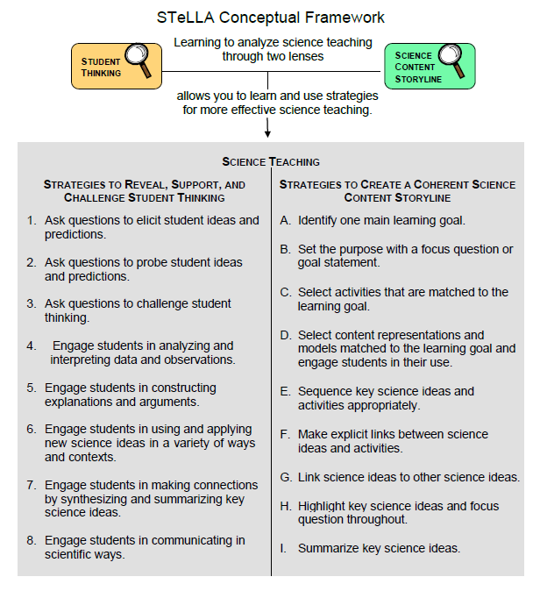
Notes:
1 min
a. Transition: This slide marks the transition from the STL strategies to the Science Content Storyline Lens strategies.
b. “Throughout the PD program, we’ll continue learning about the Student Thinking Lens (STL) strategies, but today we’ll transition to the Science Content Storyline Lens strategies.”
c. Highlight the SCSL strategies on the slide.

Slide 7
Focus for the Week
Content area 2: Earth’s changing surface (ECS)
Science Content Storyline Lens
Strategies A, B, C, D, F, G, H, and I
Video-based lesson analysis (ECS lessons)
ECS lesson plans review (last day)
Academic-year schedule (last day)
Video recording
Study-group sessions
Notes:
1 min
a. “This week we’ll focus on a new content area: Earth’s changing surface. We’ll also examine the Science Content Storyline Lens strategies and the ECS lessons you’ll be teaching in the fall, analyze video clips of those lessons, and deepen your science-content knowledge related to the lesson plans.”
b. “On the last day of the RESPeCT PD program, we’ll review the lesson plans and the schedule for the academic year.”
c. “You may notice that we skip strategy E: Sequence key science ideas and activities appropriately. This strategy will be addressed during the school year as you teach the STeLLA lesson plans and analyze how they’re sequenced within each lesson and across lessons.”

Slide 8
Today’s Focus Questions
What is the Science Content Storyline Lens (SCSL)?
Why is one main learning goal essential for science content storyline coherence?
What does the surface of Earth look like?
How can we make models out of sand to show the shapes of different landforms?
How does the land on Earth’s surface look different in different places?
Notes:
1 min
a. Introduce the focus questions that will guide today’s work.

Slide 9
Check Your Understanding of Strategy 6
Jot down your responses to this multiple-choice quiz:
Use-and-apply tasks are used [before/during/after] new science ideas are introduced.
For difficult content ideas, students might need to practice applying new ideas in [one/two/many] different contexts.
[True/false]: Use-and-apply questions or activities are used primarily for student assessment at the end of a unit.
It’s appropriate for teachers to ask [elicit/probe/challenge] questions during a use-and-apply activity.
Teachers should [never/judiciously/always] tell students about science ideas they are missing or stating inaccurately.
Notes:
7 min
Note: Display this slide only if it wasn’t used on day 4.
a. “To check your understanding of STL strategy 6, jot down your responses to this multiple-choice quiz in your science notebooks.”
b. Have participants discuss their answers either in pairs or as a group. (If time is short, just read the answers aloud.)
Answer key:
1. After
2. Many
3. False
4. Challenge (and probe)
5. Judiciously (defined as “good or discriminating judgment; wise, sensible, or well advised”)

Slide 10
Use and Apply Your Content Deepening Knowledge
Scenario: You light a candle for dinner and notice the wax melting as you’re eating. What do you think is happening to the matter in the candle?
Use and apply what you learned about matter last week to answer this question. Write down your explanation in your science notebook using bullet points. Make sure to include science ideas in your explanation.
Then share your ideas with a partner and note any questions that arise.
Notes:
8 min
a. Introduce the use-and-apply scenario on the slide.
b. Individuals (3 min): “Reflect on what you learned about matter last week; then jot down your explanation in your science notebooks using bullet points. Make sure to include science ideas in your explanations.”
c. Turn and Talk (2 min): Have participants pair up with an elbow partner and share their solutions for the use-and-apply scenario.
d. Whole-group share-out (3 min): “What ideas do you have for solving this mystery?”
Ideal response:
The burning candle is an example of physical and chemical changes in matter. First, when heat is added to the solid candle wax, the wax melts into liquid wax. This is a physical change. A chemical change occurs as the liquid wax turns into a gas through combustion (by means of the burning wick). Wax is mostly made of hydrogen and carbon atoms (called hydrocarbons), which recombine with oxygen from the air during a chemical reaction and change into water vapor (H₂0) and carbon dioxide (CO₂) as the candle burns. Over time, the mass of the candle decreases as the matter (wax) changes into different gases.
Common problems:
Participants might focus only on the physical change: solid wax melting into liquid wax.
Participants might focus on the candle flame and think about combustion, but they might not be able to explain the chemical change.
Most participants will be unfamiliar with the chemical structure of wax (hydrocarbons) and won’t know that as it burns during combustion, hydrocarbons recombine to form water vapor and carbon dioxide. This is the hardest part of the example to understand.

Slide 11
Planning Science Lessons: Quick Write
What is generally your thinking process when you plan your science lessons?
Be prepared to share your ideas with the group.
Notes:
6 min
Note: This activity is a lead-in for thinking about specific SCSL strategies. When planning science lessons, are participants thinking primarily about (1) SCSL issues, such as learning goals, (2) student misconceptions (an STL issue), which is a great start but doesn’t include SCSL strategies, or (3) activities and/or classroom management and timing issues?
a. Individuals: Direct participants to take 2–3 minutes to write down the key things they think about when planning science lessons.
b. Whole group: Ask participants to share their reflections with the group.
c. Tell participants: “The Science Content Storyline Lens strategies should provide some new or additional ways of thinking about planning your science lessons.”

Slide 12
Lesson Analysis: Focus Question 1
What is the Science Content Storyline Lens (SCSL)?
What is a science content storyline, and why is it important?
What is challenging about developing a science content storyline?
Notes:
7 min
a. Small groups: Direct half the group to focus on the first bulleted question on the slide, and the other half to focus on the second. Allow groups 2 minutes to think about their assigned questions as they review “Introduction to the Science Content Storyline Lens” in the STeLLA strategies booklet.
b. Whole group: Have each group share out their ideas and responses to these questions.
c. As you listen to participants, make sure that what they’re saying is consistent with the strategies booklet. If you aren’t sure they’re interpreting the text accurately, ask them to identify the specific text they are drawing from.

Slide 13
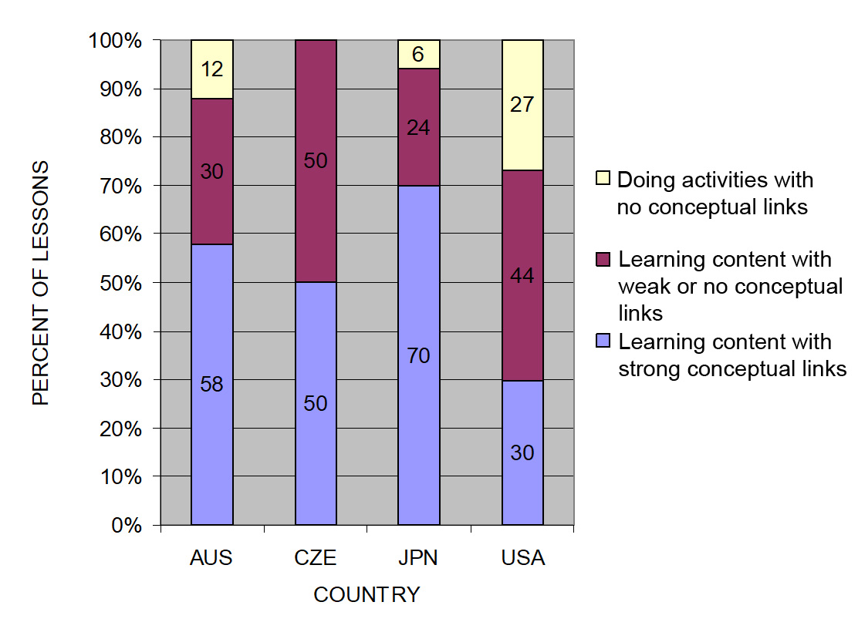
The TIMSS Video Study Findings and the Science Content Storyline Lens
Source: TIMSS study
Notes:
2 min
a. Emphasize the research basis for the Science Content Storyline Lens and its importance. Remind participants that the data on the slide was presented on day 1 of the PD program.
b. Ask: “What does this graph reveal about US science lessons compared with higher-achieving countries?”
Ideal response: According to the study, US science lessons didn’t do as well linking science ideas to lesson activities; in fact, many lessons were activity focused and included significantly fewer science ideas compared to other countries.
c. Summarize: Point to strategies F and G on the STeLLA strategies poster: Make explicit links between science ideas and activities (strategy F) and link science ideas to other science ideas (strategy G). These strategies and the idea of a Science Content Storyline Lens grew out of the TIMSS research findings.
d. “Today we’ll begin our study of the Science Content Storyline Lens, with a focus on strategy A: Identify one main learning goal.”

Slide 14
Lesson Analysis: Focus Question 2
Why is one main learning goal essential for science content storyline coherence?
Notes:
1 min
a. Read the focus question on the slide.

Slide 15
Notes:
1 min
a. “Now let’s dig into SCSL strategy A!”
b. “As you can see, strategy A is the first of nine Science Content Storyline Lens strategies. It appears first because it’s the foundation on which all the other SCSL strategies are built. This will become clearer as we delve into the other strategies and see how important it is that each of them is matched to the lesson’s main learning goal.”

Slide 16
Purpose and Key Features of Strategy A
Review your SCSL Z-fold summary chart and share with a partner the purpose and key features of strategy A: Identify one main learning goal.
Remember to cite passages from the STeLLA strategies booklet.
Be prepared to share with the group.
Notes:
25 min
a. Pairs: “Share with a partner what you wrote on your Science Content Storyline Lens Z-fold summary chart about the purpose and key features of strategy A.”
b. Whole group: Have one or two participant volunteers lead the group in creating a chart that describes the purpose and key features of strategy A.
c. Transition: “Next, we’ll review the difference between a science idea and the main learning goal of a lesson. Then you’ll practice identifying and clarifying this distinction.”

Slide 17
A Main Learning Goal Is …
A big science idea that you want students to learn
A big idea that shows the relationship among science ideas
The focus of the lesson (or series of lessons)
Stated in a complete sentence (for planning purposes)
Stated by the teacher, a student, a text, or a multimedia resource
A support for teacher planning
Notes:
1 min
a. “This slide lists some key ideas about the definition of a main learning goal.”
b. Read through the ideas.
c. Emphasize: “Notice the parenthetical reference to ‘lessons’ in the third bullet point. Each lesson should have only one main learning goal, but you might need two or more lessons to help students accomplish a difficult goal. So it’s often necessary to spend more than one lesson on a specific learning goal.”

Slide 18
A Main Learning Goal Is NOT …
A topic or phrase
An activity
A question
A performance task or objective
A supporting detail, definition, or fact
A student misconception or idea that isn’t scientifically accurate
Notes:
1 min
a. Review what is not considered a main learning goal.

Slide 19
Definitions: One Main Learning Goal and Science Ideas
Read these sections in the STeLLA strategies booklet: (1) STeLLA Strategy A: Identify One Main Learning Goal, and (2) Student Ideas and Science Ideas Defined.
Based on these readings, what are the differences between a main learning goal and a science idea?
Notes:
10 min
a. Have participants locate these two readings in the strategies booklet: (1) STeLLA Strategy A: Identify One Main Learning Goal, and (2) Student Ideas and Science Ideas Defined.
b. “After you read these sections in the strategies booklet, we’ll discuss the differences between a science idea and a main learning goal.”
c. Individuals (3 min): Give participants time to read the specified sections in the strategies booklet.
d. Whole group (7 min): Discuss the question on the slide.
e. Emphasize: “While you might incorporate several science ideas that support the main learning goal of a lesson, be careful not to plan an ‘all about’ lesson with too many different science ideas that will likely come across to students as a bunch of disconnected facts to be memorized.”

Slide 20
Practice Identifying Student Ideas and Science Ideas
Identify any student ideas and science ideas in this list:
Erosion and deposition
Water dissolves soil and rock, and they disappear.
Water carries rock and soil from one place to another.
Erosion happens at different rates depending on the type of material and the force necessary to move it.
Rocks are really hard, so they don’t change.
Trees are landforms too, because they’re part of the land.
Mountains, hills, lakes, and rivers
Notes:
5 min
a. “Next, we’ll practice identifying student ideas and science ideas just to make sure you understand the way we’re defining these terms.”
Note: As needed, refer participants to the section in the strategies booklet where student ideas are defined (Student Ideas and Science Ideas Defined).
b. Individuals: “First, identify examples of science ideas on the slide. If you need help, refer to the document in your lesson plans binders titled Common Student Ideas about Earth’s changing surface. Then identify examples of student ideas on the slide.”
c. Whole group: Discuss participants’ responses and the correct answers (see answer key).
Answer key:
Science ideas: 3, 4
Student ideas: 2, 5, 6

Slide 21
Practice Identifying Student Ideas and Science Ideas in a Class Discussion
Identify one student idea and one science idea in this class discussion:
T: What do you think is happening to the stream-table model?
S1: It’s getting wet.
S2: The water is moving the sand, so that means the river
can make a canyon.
S3: The water is dissolving the sand, and it’s disappearing.
T: Is the sand really disappearing? What about here ? [Point to the end of the stream table.] What do you see?
S3: Sand. So it isn’t dissolving.
S2: The water is just moving it.
Notes:
5 min
a. “It’s a little trickier to recognize student ideas and science ideas in class discussions because students sometimes give only one- or two-word answers to teacher questions. But if you link the teacher’s question with the student’s response, you can sometimes find a science idea or a student idea.”
Note: In the RESPeCT PD program, we encourage students to speak in complete sentences as much as possible.
b. “Let’s practice linking the teacher’s questions with student responses in the sample discussion on the slide.”
c. Pairs: “Work with a partner to see if you can identify one student idea and one science idea in this discussion.”
d. Whole-group share-out: Have participants share the ideas they identified in the sample discussion. Then review the answers (see answer key below).
e. Emphasize: “Here’s some food for thought: To make student thinking more visible, why not require students to speak in complete sentences during classroom discussions about science ideas?”
Answer key:
Student ideas/misconceptions:
“Water is dissolving the sand, and it’s disappearing.”
Science ideas:
Water is moving the sand.
Water [the river] is forming a canyon.

Slide 22
Science Ideas That Support the Main Learning Goal
Main learning goal: Water changes the land.
Supporting ideas:
Water can break down rock.
Water can carry soil and rocks of all shapes and sizes.
Water can carry rocks and soil from one place to another.
Water deposits soil and rock in places like deltas.
Notes:
6 min
a. Display only the main learning goal on the slide.
b. Pairs: “Work with a partner to come up with two or three science ideas that might support the development of this main learning goal. Use the Earth’s Changing Surface Content Background Document and the Common Student Ideas chart as resources.”
c. Whole group: Have pairs share the supporting science ideas they came up with.
d. Next, reveal the list of possible supporting science ideas one by one on the slide and compare them with participants’ ideas.
e. Highlight: “Some of these supporting science ideas could also be a main learning goal for a lesson.”

Slide 23
Practice Identifying Main Learning Goals
Small groups or pairs: Use the criteria in Analysis Guide A (handout 5.1 in binder) to analyze a list of candidate main learning goals related to Earth’s changing surface (handout 5.2: Practice Identifying One Main Learning Goal).
Select candidates from the list that you think are good main learning goals for the focus of the lesson and record the reasons for your choices on handout 5.2.
Whole group: Discuss and justify your selections.
Notes:
10 min
a. Direct participants to locate handout 5.1 (Analysis Guide A: Identifying One Main Learning Goal) and handout 5.2 (Practice Identifying One Main Learning Goal) in their PD program binders.
b. Small groups/pairs: Have participants form small groups or pairs and use the criteria from Analysis Guide A to analyze the list of possible learning goals on handout 5.2.
c. Direct participants to write yes or no on the handout to indicate whether the statement is or is not a good candidate for a lesson’s main learning goal. Then have them state the reason for each assessment using criteria from the analysis guide.
d. Whole-group share-out: Have participants share and discuss their selections.
e. Be sure to highlight what distinguishes a main learning goal from supporting science ideas, topics, phrases, activities, questions.
f. Also use this discussion to clarify science content.
Note: For answers, see PD Leader Master: Practice Identifying One Main Learning Goal (Answer Key).

Slide 24
Lesson Analysis: Strategy A
Next we’ll watch a sequence of three video clips from a single lesson on Earth’s changing surface.
Analysis question for all three clips: Does this lesson have one main learning goal?
Follow-up questions:
If yes, what is it?
If no, what do you think is happening in the lesson?
Notes:
1 min
Make sure participants understand that they will be viewing a sequence of three video clips from the same lesson on Earth’s changing surface.
b. “For all three clips, we’ll answer the analysis question, Does this lesson have one main learning goal?”
c. “If the answer is yes, what is the learning goal? If no, why do you think that’s the case? What do you think is happening in the lesson?”
goal?

Slide 25
Lesson Analysis: Review Lesson Context, Video Clip 1
Read the lesson context on the video transcript (handout 5.3 in PD program binder).
As you watch the clip, keep the analysis question in mind: Does this lesson have one main learning goal?
If yes, what is it?
If no, what do you think is happening in the lesson?
Link to video clip 1: 5.1_mspcp_gr.2_ecs_poulsen_L5_c2
Notes:
5 min
a. Have participants read the lesson context at the top of the video transcript (handout 5.3 in PD program binder). (Less than 1 min)
b. Read the information on the slide. (Less than 1 min)
c. Show the video clip. (4 min)

Slide 26
Lesson Analysis: Analyze the Video, Video Clip 1
Study the video transcript and write down any science ideas the students and/or the teacher put on the table.
Pair up and compare the science ideas you identified. Then discuss the analysis question: Does this lesson have one main learning goal?
If yes, what is it?
If no, what do you think is happening in the lesson?
As a group, discuss what the main learning goal might be. Support your answers using your analysis of the science ideas you identified.
Notes:
25 min
a. Before participants analyze the video transcript, remind them of these key points: (1 min)
A science idea is a full-sentence idea that students could take away as something they learned during the lesson.
Science ideas are sometimes identified by linking the teacher’s question with the student’s response.
b. Individuals (8 min): “Study the video transcript and write in your notebooks any science ideas you identify in the discussion.”
c. Pairs (5 min): “Pair up and compare the science ideas you identified. Then discuss the questions on the slide.”
d. Whole group (11 min): Have participants share what they think might be the main learning goal of this lesson, using their analyses of the science ideas they identified.
e. List the possible learning goals on chart paper.
f. Let participants know they’ll revisit this list of possible main learning goals for the lesson after they watch the remaining video clips.
Examples of science ideas:
Water can change the land.
Water can carry rocks and dirt from one place to another.
Water is strong and powerful.
Water carries rocks and dirt from the Grand Canyon to Lake Mead.
Implied main learning goal:
Water changes the land by moving rocks and soil from one place to another.

Slide 27
Lesson Analysis: Review Lesson Context, Video Clip 2
Read the lesson context on the video transcript (handout 5.4 in PD binder).
As you watch the clip, keep the analysis question in mind: Does this lesson have one main learning goal?
If yes, what is it?
If no, what do you think is happening in the lesson?
Link to video clip 2: 5.2_mspcp_gr.2_ecs_poulsen_L5_c3
Notes:
5 min
a. Have participants read the lesson context at the top of the video transcript (handout 5.4 in PD binder). (Less than 1 min)
b. Review the instructions on the slide. (Less than 1 min)
c. Show the video clip. (4 min)

Slide 28
Lesson Analysis: Analyze the Video, Video Clip 2
Study the video transcript and write down any student ideas and science ideas you identify.
Pair up and compare the student ideas and science ideas you identified. Then discuss this question: Are these ideas consistent with the possible main learning goal you identified for video clip 1?
As a group, discuss the possible main learning goal for this lesson. Make sure to support your answers using your analysis of the science ideas you identified.
Notes:
25 min
a. Review the definitions of a science idea and a student idea. Remind participants that students can express correct science ideas and inaccurate student ideas at the same time. (1 min)
b. Individuals (8 min): “Study the video transcript and write in your notebooks any student ideas and science ideas you identify.”
c. Pairs (5 min): “Pair up and compare the student ideas and science ideas you identified. Then discuss the question on the slide.”
d. Whole group (11 min): Have participants share out what they think might be the main learning goal of this lesson, using their analyses of the science ideas they identified to support their suggestions.
e. List the possible learning goals on chart paper.
f. Let participants know they’ll revisit this list of possible main learning goals for the lesson after they watch one more video clip.
Examples of student ideas:
Video segments 00:02:13–02:37: The student observes that rocks and soil “got lower” as a result of the water flowing over the model. This might be an accurate science idea if lower means “downstream.”
Segments 00:05:12–05:22: The student observes that the soil and rocks are “disappearing” into the water.
Examples of science ideas:
Water can change the land.
Water from rain and rivers can form lakes and rivers and canyons.
Water makes the land muddy.
The shape of a river can change (zigzag).
Rivers can flow into places they haven’t been before.
Water can move rocks and soil, making them go “lower” [downstream?].
Implied main learning goal:
Water changes the land by creating lakes, rivers, and canyons and by moving rocks and soil.

Slide 29
Lesson Analysis: Review Lesson Context, Video Clip 3
Read the lesson context on the video transcript (handout 5.5 in PD binder).
As you watch the clip, keep the analysis question in mind: Does this lesson have one main learning goal?
If yes, what is it?
If no, what do you think is happening in the lesson?
Link to video clip 3: 5.3_mspcp_gr.2_ecs_poulsen_L5_c4
Notes:
5 min
a. Have participants read the lesson context at the top of the video transcript (handout 5.5 in PD binder). (Less than 1 min)
b. Review the instructions on the slide. (Less than 1 min)
c. Show the video clip. (4 min)

Slide 30
Lesson Analysis: Analyze the Video, Video Clip 3
Study the video transcript and write down any student ideas and science ideas you identify.
Pair up and compare the student ideas and science ideas you identified. Then discuss this question: Are these ideas consistent with the possible main learning goal you identified for clips 1 and 2?
As a group, discuss the possible main learning goal for this lesson. Make sure to support your answers using your analysis of the science ideas you identified.
Notes:
24 min
a. Individuals (8 min): “Study the video transcript and write in your notebooks any student ideas and science ideas you identify.”
b. Pairs (5 min): “Pair up and compare the student ideas and science ideas you identified on the transcript. Then discuss the question on the slide.”
c. Whole group (11 min): Have participants share what they think might be the main learning goal of this lesson. Make sure they use their analyses of the science ideas they identified to support their suggestions.
d. List the science ideas and possible learning goals on chart paper.
e. Ask: “Did the three video clips develop coherence across the lesson or include too many ideas that didn’t support the main learning goal?”
Examples of science ideas:
Water changes the land.
Water turns dirt to mud and breaks down rocks.
Fast water in rivers is very powerful.
Water from rivers can break down some of the Grand Canyon.
Water can move rocks and soil from one place to another, which causes the land to change over time.
A model can show what happens in the real world.
Implied main learning goal:
Water can move rocks and soil from one place to another, which causes the land to change over time.
Ideas consistent with implied MLGs in clips 1 and 2? Yes.
MLG in clip 1: Water changes the land by moving rocks and soil from one place to another.
MLG in clip 2: Water changes the land by creating lakes, rivers, and canyons and by moving rocks and soil.
MLG in clip 3: Water can move rocks and soil from one place to another, which causes the land to change over time.

Slide 31
One Main Learning Goal?
Based on your analysis of these three video clips, does this lesson have one main learning goal? What do you think it is?
Use the criteria questions in Analysis Guide A to analyze the main learning goal identified in these clips.
Are there any supporting science ideas that don’t closely match the main learning goal?
Notes:
15 min
a. Whole group: Discuss the first question on the slide and reach a consensus on the main learning goal for the lesson.
Ideal response: Water can change the land by moving rocks and soil from one place to another.
b. Pairs: Have participants work in pairs to answer the criteria questions in Analysis Guide A for this agreed-upon main learning goal. Also have them identify any supporting science ideas that don’t closely match the main learning goal.
c. Whole group: Discuss participants’ responses to the questions in Analysis Guide A and question 3 on the slide.
Ideal responses to questions on the slide:
One main learning goal? Yes. The MLGs for all three clips are closely aligned to the learning goal of the lesson: Water can change the land by moving rocks and soil from one place to another.
Note: The actual learning goal for this lesson is Water can change landforms over time. The issue of time doesn’t seem to be addressed in clips 1 and 2, and the teacher only briefly mentions it in a summary statement in clip 3.
Ideal responses to questions in Analysis Guide A:
Question 1: Yes, the MLG is stated in a full sentence and represents a big science idea students can take away at the end of the lesson.
Question 2: Students may already know the science content reflected in the learning goal. There is some evidence in clip 1 that the idea of water moving rocks and soil was addressed in a previous lesson. However, it isn’t clear that all students understand this idea.
Question 3: Yes, the MLG is an important science idea worthy of 40 minutes of instruction time.
Questions 4: Yes, students have misconceptions or confusion about the science ideas. In clip 1, students don’t seem certain that water can move rocks (segments 00:00:26; 00:00:32).
Question 5: Yes, the main learning goal challenges student thinking and misconceptions.
Questions 6 and 7: Yes, the learning goal is grade-level appropriate and scientifically accurate.

Slide 32
Examine Earth’s Changing Surface: Lesson 2
Locate the scope and sequence chart for the ECS lessons (lesson plans binder, pretabs section).
Examine the main learning goals for lessons 2a and 2b. Then read the supporting science ideas in the Science Content Storyline column.
What two patterns do students identify in these lessons?
Keep these patterns in mind as the storyline develops in the lesson sequence.
Notes:
5 min
Note: This slide is optional if time is running short. It’s designed to help participants see how the lesson plans are written to highlight the main learning goal and science ideas that support the main learning goal.
a. Have participants examine the main learning goals for ECS lessons 2a and 2b in the scope and sequence chart of their lesson plans binders. Then have them review the supporting science ideas in the Science Content Storyline column.
b. Ask: “What two patterns do students identify in these lessons?”
c. Encourage participants to keep the identified patterns in mind throughout the lesson sequence.
Ideal responses:
The main learning goals for lessons 2a and 2b emphasize that the land looks different in different places. Students identify the following two patterns:
In some places, the land rises high above Earth’s surface, and in other places, the land cuts deep into the surface.
Some places on Earth’s surface are flat, while other places have bodies of water.

Slide 33
Earth’s changing Surface
SCIENCE CONTENT DEEPENING Grade 2
Notes:
Less than 1 min
a. “Now let’s begin our investigation of Earth’s changing surface.”
Note: Throughout this content deepening phase, refer as needed to Earth’s Changing Surface Content Background Document and Common Student Ideas about Earth’s Changing Surface.

Slide 34
Unit Central Questions
What does the surface of Earth look like? Does it ever change?
Notes:
Less than 1 min
a. Read the unit central questions on the slide.
Note: Alternatively, have participants locate lesson 1a in their lesson plans binders and read the unit central questions on the overview page.
b. Emphasize that these questions will guide student learning throughout the entire ECS unit.
c. Tell participants that the information they gather during the content deepening investigations this week will help them answer these questions.
d. Have participants write these questions in their science notebooks and draw a double-lined box around them. This practice reinforces the process they’ll follow with students in the lessons.

Slide 35
Content Deepening Focus Questions
What does the surface of Earth look like?
How can we make models out of sand to show the shapes of different landforms?
How does the land on Earth’s surface look different in different places?
Notes:
Less than 1 min
a. Review the content deepening focus questions on the slide.

Slide 36
Earth’s
Changing
Surface
Content
Deepening
Developed by
Dr. Jeff Marshall
Geological Sciences
Cal Poly Pomona
Used by permission
Photo courtesy of Visible Earth
Notes:
Less than 1 min
a. “Today’s content deepening work will focus on science ideas about Earth’s changing surface from ECS lessons 1 and 2.”

Slide 37
How We Think about Landscapes and Landforms
How would you describe the landscape of your home area?
What is your favorite kind of natural landscape on Earth? Why?
Share a story about visiting a place like this. What was it like?
Notes:
20 min
a. Read the three questions on the slide.
b. Individuals (5 min): “Briefly answer these questions in your science notebooks.”
c. Whole-group share-out (10 min): In a round-robin, call on participants to share their answers to the questions. During this share-out, record participants’ descriptions on chart paper. You may want to list nouns in one column and adjectives in another column.
e. Following the share-out, briefly summarize some key descriptions, focusing on the diversity of landscapes (e.g., flat urban landscape; rural farm; high, snowy mountains; tropical beach at sunset). Also highlight some of the words participants used for landscapes, landforms, and topographic shapes. Then ask participants the following questions and add key ideas to the chart:
What is the difference between landscapes and landforms?
What landforms did we include in our personal stories?
What were some good examples of description language we used to describe these landforms?
What other words could we use to describe landscapes, landforms, and topographic shapes?
Do you think that 2nd graders will be able to describe landscapes and landforms in this way? What difficulties might they have?
Examples of descriptive terminology:
Landscapes
Mountains
Deserts
Coastlines
Cities
Landforms
Peaks
Ridges
Hills
Valleys
Canyons
Gullies
Plains
Prairies
Plateaus
Coastlines
Shores
Cliff
Beaches
Headlands
Deltas
Islands
Lakes
Ponds
Rivers
Streams
Topographic shapes
Steep
Sloping
Gentle
Flat
Rough
Rugged
Jagged
Abrupt
Smooth
Low
High

Slide 38
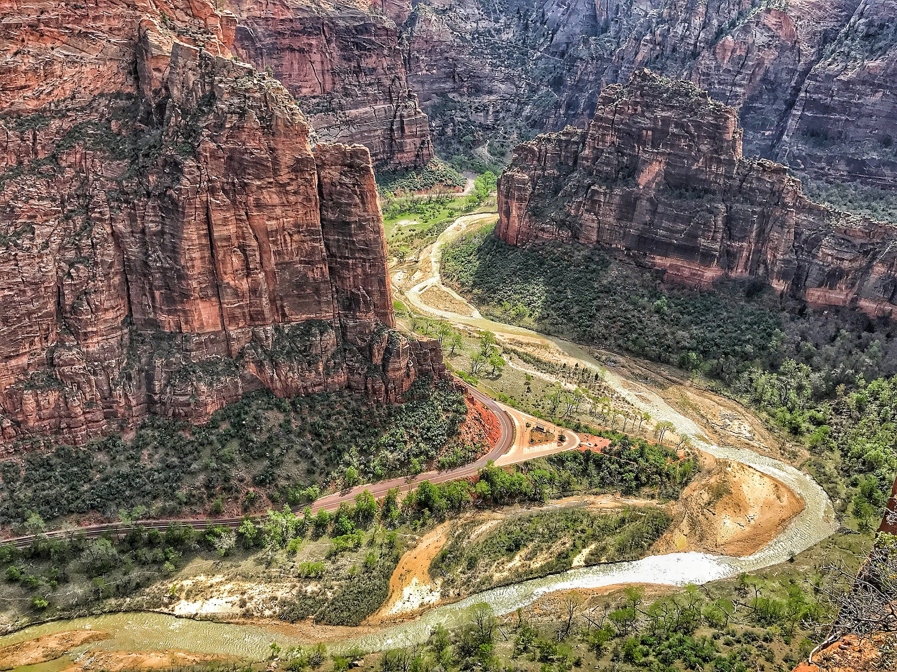
What Is Geomorphology?
Photo courtesy of Pexels.com
Notes:
Less than 1 min
a. “Let’s spend a few minutes exploring some key science ideas related to Earth’s changing surface. The first idea we’ll learn about is geomorphology.”

Slide 39
What Is Geomorphology?
Geomorphology is the geologic study of Earth’s surface and the natural processes that shape and change its form. The word geomorphology comes from the Greek words Gaea (“Earth”), morphe (“shape”), and logos (“reason”).
Photo courtesy of Pexels.com
Notes:
Less than 1 min
a. Read the definition on the slide and explain that the word geomorphology is derived from the three Greek words: Gaea, which means “Earth,” morphe, which means “shape,” and logos, which means “reason.”

Slide 40
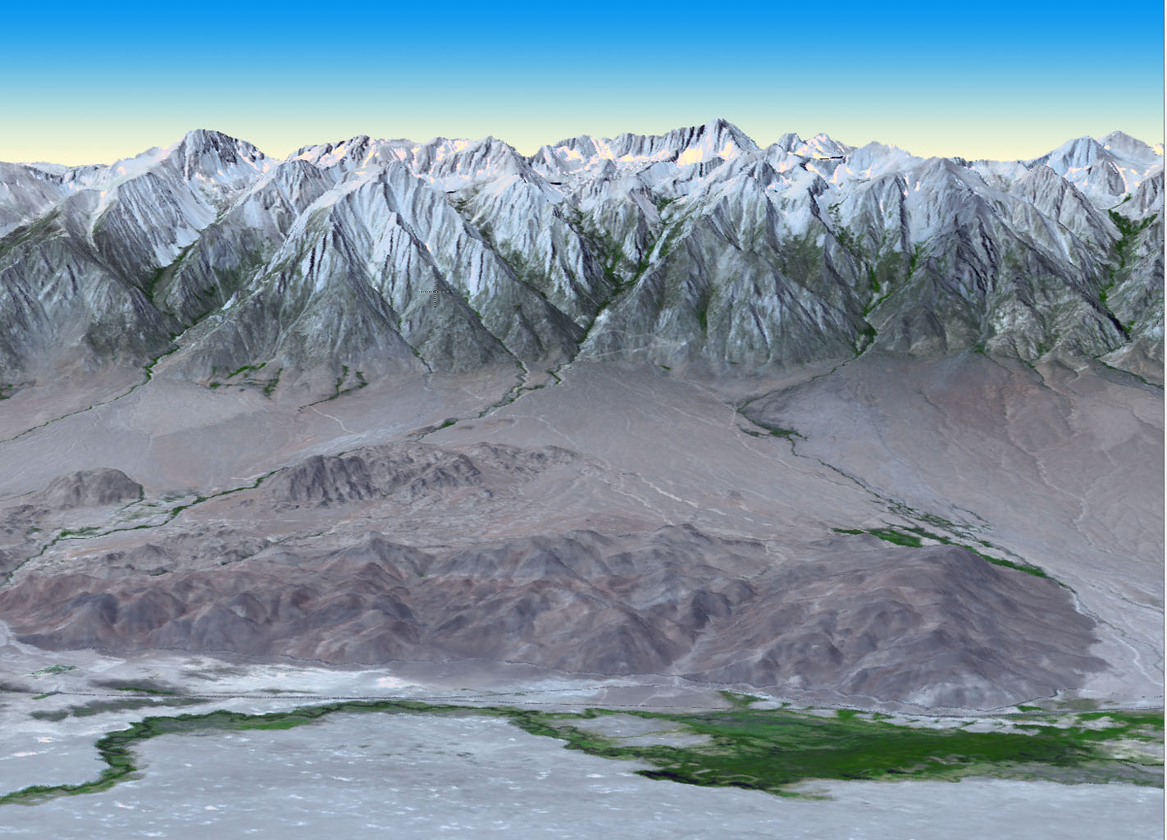
What Is Topography?
Sierra Nevada Mountains
and Owens Valley, California
Topography refers to the shape of Earth’s surface.
Photo courtesy of NASA/GSFC/METI/ERSDAC/JAROS, and U.S./Japan ASTER Science Team
Notes:
Less than 1 min
a. Explain to participants that the term topography refers to the shape of Earth’s surface.
b. “This image shows the dramatic topographic relief of the Sierra Nevada Mountains, with Mount Whitney towering more than 14,000 feet above sea level, and the adjacent Owens Valley reaching only 4,000 feet in elevation.”

Slide 41
Topography: The Shape of Earth’s Surface
Sierra Nevada Mountains
and Owens Valley, California
Topography is the result of
competing natural processes that
build up and wear down Earth’s surface
at the same time.
Photo courtesy of NASA/GSFC/METI/ERSDAC/JAROS, and U.S./Japan ASTER Science Team
Notes:
Less than 1 min
a. Emphasize that topography is the result of competing natural processes that build up and wear down Earth’s surface at the same time. Tectonics is a process that builds up Earth’s surface, and erosion is a process that wears it down.

Slide 42
Topography: The Shape of Earth’s Surface
Source unknown
Earth’s surface is a 3-D grid of points.
(x = Easting, y = Northing, z = Elevation)
Notes:
Less than 1 min
a. “A geomorphologist thinks of Earth’s surface as a 3-D grid or net of points. Each point is defined by its x, y, and z coordinates. The x coordinate describes the distance east and west, the y coordinate describes the distance north and south, and the z coordinate describes elevation or the distance up and down.”

Slide 43
Topography: The Shape of Earth’s Surface
Source unknown
The elevation (z) of any point can change over time by building up or wearing down.
Notes:
Less than 1 min
a. “Over time, the elevation or z coordinate of any point can change by either building up from tectonic processes or wearing down from erosional processes.”

Slide 44
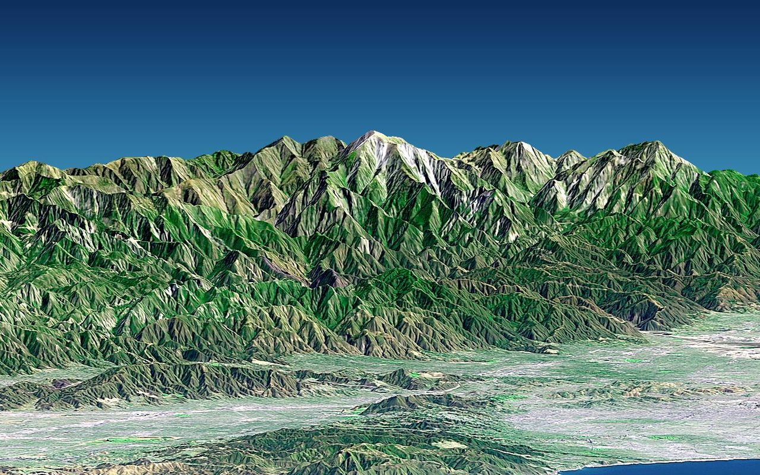
Topography: The Shape of Earth’s Surface
San Gabriel Mountains
Southern California
Photo courtesy of NASA/JPL/NIMA
The surface of Earth is continually changing, and the landscapes we see around us are only snapshots.
Notes:
Less than 1 min
a. “This slide shows a digital elevation model of the San Gabriel Mountains rising above the Pomona Valley. Mount Baldy (also known as Mount San Antonio) towers more than 10,000 feet above sea level.”
b. “The surface of Earth is continually changing, or evolving, and the landscapes we see around us are only momentary snapshots or freeze-frames in a full-length movie.”

Slide 45
Earth’s Changing Surface
Tectonics + Erosion = Earth’s Surface Form
Photo courtesy of NASA/JPL/NIMA
The surface of Earth is continually changing, and the landscapes we see around us are only snapshots.
Notes:
Less than 1 min
a. “Earth’s surface form is the result of tectonic processes that build up the land and erosional processes that wear down the land at the same time.”

Slide 46
Earth’s Changing Surface
Lesson 1a
Photo courtesy of Visible Earth
Notes:
Less than 1 min
a. “Next, we’ll explore science ideas about Earth’s changing surface from ECS lesson 1a.”

Slide 47
Content Deepening: Focus Question 1
What does the surface of Earth look like?
Notes:
1 min
a. Read the focus question on the slide.
b. Emphasize that this question will guide student learning throughout ECS lesson 1a.
c. Have participants write the question in their science notebooks and draw a box around it.

Slide 48
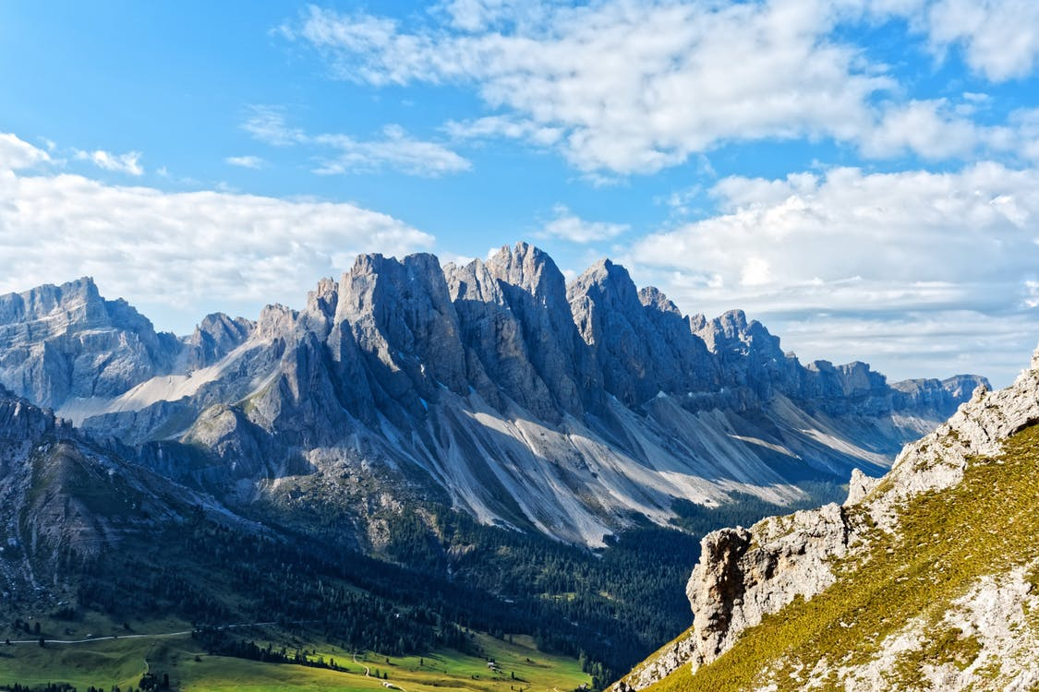
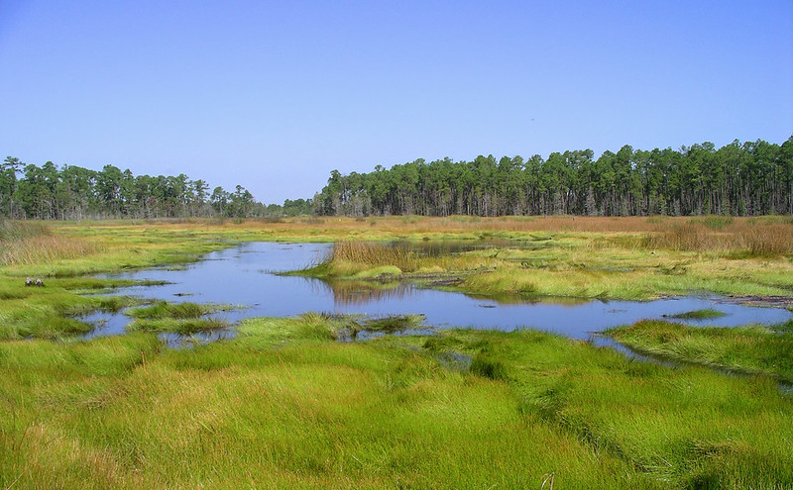
Describe the Surface of Earth
Photo courtesy of Pexels.com
Photo courtesy of Gretchen L. Grammer / Flickr
Notes:
8 min
a. “How would you describe the surface of Earth in each of these photos?”
b. Turn and Talk: “Discuss this question with an elbow partner and develop an answer using descriptive terminology for the landforms and their shape.”
c. Whole-group share-out: Invite participants to share their descriptions with the group. Probe their responses (e.g., “Can you say more about that?”) and elicit differing points of view (e.g., “Does everyone agree with that observation?”). Accept all responses at this point, but note whether participants are describing landforms or living things on Earth’s surface.

Slide 49
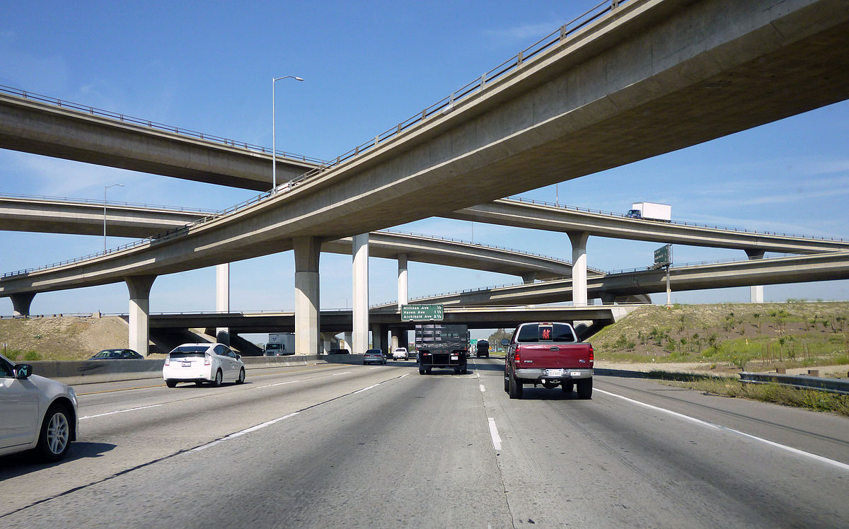
Describe the Surface of Earth
Photo courtesy of Andy Arthur/Wikimedia Commons
Photo courtesy of Coolcaesar/Wikipedia Commons
Photo courtesy of Daquella Manera /Wikimedia Commons
Notes:
8 min
a. “How would you describe the surface of Earth in each of these photos?”
b. Turn and Talk: “Discuss this question with an elbow partner and develop an answer using descriptive terminology for the landforms and their shape.”
c. Whole-group share-out: Invite participants to share their descriptions with the group. Probe their responses (e.g., “Can you say more about that?”) and elicit differing points of view (e.g., “Does everyone agree with that observation?”). Accept all responses at this point, but note whether participants are describing landforms or living things on Earth’s surface.
d. Emphasize that the structures in these photos are mostly human made, not the natural surface of Earth. Explain that geomorphologists don’t include human-made structures in their definition of Earth’s surface.

Slide 50
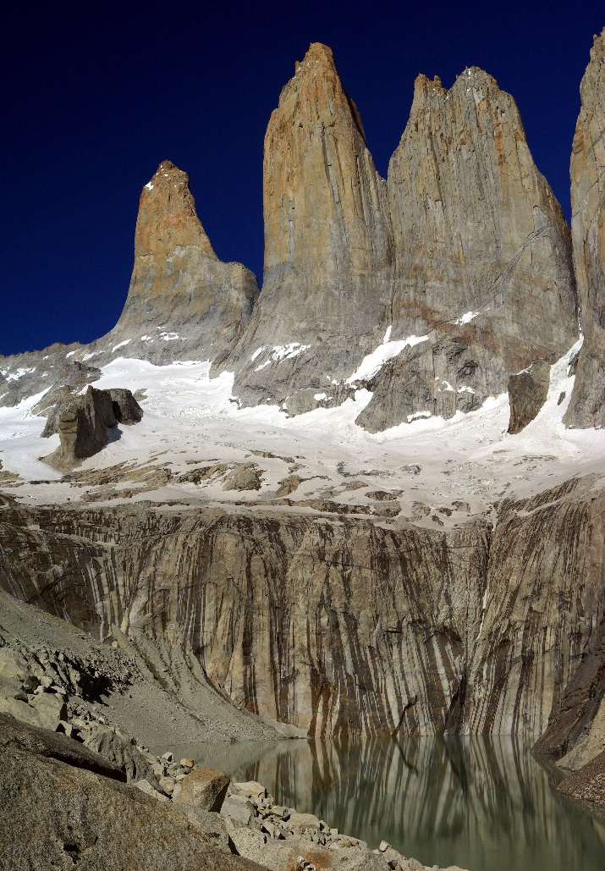
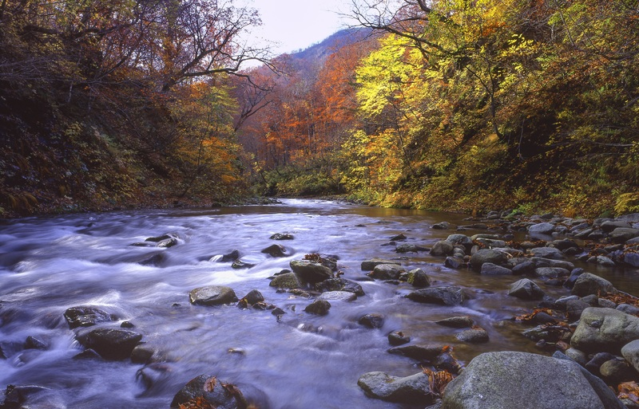
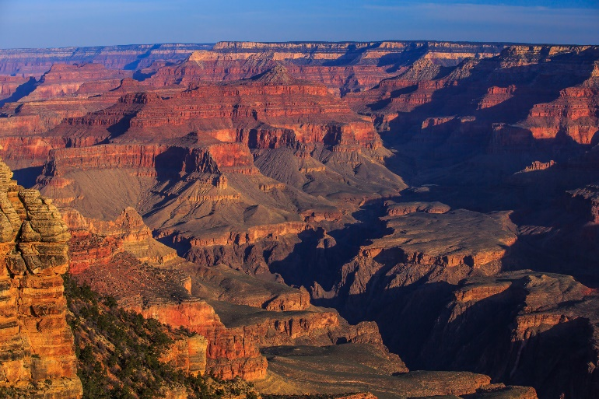
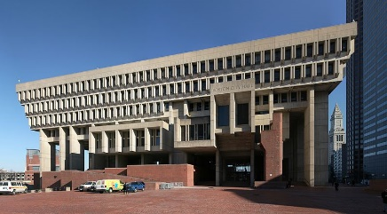
Is it Natural, or Did Someone Make It?
Photo courtesy of Pxhere.com
Photo courtesy of Steve Bennett/Wikipedia Commons
Photo courtesy of Daniel Schwen/Wikipedia Commons
Photo courtesy of Murray Foubister/Wikipedia Commons
Notes:
5 min
a. “Which of these pictures show the natural surface of Earth, and which show something people have built on the surface? How do you know?”
b. Probe participants’ ideas (e.g., “Can you say more about that?”) and elicit differing points of view (e.g., “Does everyone agree with that observation?”). Then ask, “What would your 2nd graders think?”
c. Remind participants that geomorphologists don’t include human-made structures in their definition of Earth’s surface.

Slide 51
Reflect: Content Deepening Focus Question 1
What does the surface of Earth look like?
Notes:
5 min
a. Review the focus question on the slide.
b. “Reflect on this question for a moment and then share your ideas with the group. Make sure to support your ideas with evidence from our investigations so far.”
c. During this discussion, record participants’ ideas on chart paper. Ask probe questions (e.g., “Can you say more about that?”) and elicit differing points of view (e.g., “Does everyone agree with that observation?”).
d. Work toward a consensus about what the surface of Earth looks like and record it on chart paper.

Slide 52
Earth’s Changing Surface
Lesson 1b
Photo courtesy of Visible Earth
Notes:
Less than 1 min
a. “Now let’s explore science ideas about Earth’s changing surface from ECS lesson 1b.”

Slide 53
Content Deepening: Focus Question 2
How can we make models out of sand to show the shapes of different landforms?
Notes:
1 min
a. Read the focus question on the slide.
b. Emphasize that this question will guide student learning throughout ECS lesson 1b.
c. Have participants write the question in their science notebooks and draw a box around it.

Slide 54
What Landform Do You See?
Photo courtesy of Pexels.com
Notes:
5 min
a. “Before we think about how we can make landform models out of sand, let’s practice identifying and describing some different landforms.”
b. “Look at this image from our earlier investigation. What landform do you see?”
b. As participants share their observations, record them on chart paper. Probe participants’ responses (e.g., “How do you know this is a landform?”) and elicit differing points of view (e.g., “Does everyone agree with that observation?”).
c. Ask participants, “How would 2nd graders describe this landform?”
Key idea:
Landform descriptions shouldn’t include life-forms, such as trees or grass.

Slide 55
What Landform Do You See?
Photo courtesy of Gretchen L. Grammer/Flickr
Notes:
5 min
a. “Look at another image from our earlier investigation. What landform do you see?”
b. As participants share their observations, record them on chart paper. Probe participants’ responses (e.g., “How do you know this is a landform?”) and elicit differing points of view (e.g., “Does everyone agree with that observation?”).
c. Ask participants, “How would 2nd graders describe this landform?”
Key idea:
Landform descriptions shouldn’t include life-forms, such as trees or grass.

Slide 56
Landforms
What is a landform?
What are some examples of landforms?
Photo courtesy of Pixabay.com
Notes:
7 min
a. Read the questions on the slide.
b. Turn and Talk: “Talk about these questions with an elbow partner and see if you can come up with a definition and several examples of landforms.”
c. Whole-group share-out: Invite pairs to share their definitions and examples with the group. Record participants’ ideas on chart paper.
d. Ask the group, “Can anyone add to or revise this definition of a landform? Can you think of other examples?”
e. Work together to reach a consensus on the definition of a landform and record it on chart paper.

Slide 57
Let’s Build Landforms!
Look at your group’s landform picture cards and decide which landform each of you will make. (Each group member will make only one landform.)
Use the sand on your tray to build your landform model. Shape the sand with your hands.
Use your landform picture card as a guide to help you make your landform.
When you’ve finished making your model, place the correct label on your landform.
Notes:
25 min
a. “Now that we’ve defined what landforms are and have identified a number of examples, let’s build some models of different landforms out of sand.”
b. Have participants gather in small groups of four. Distribute a laminated set of four different landform picture cards (from handout 5.6) to each group, along with the corresponding landform labels (from handout 5.7). Then give each group a blue plastic tablecloth to spread across the surface the group will be using and four trays of dampened sand.
c. Tell participants that the blue tablecloth represents water, and the sand represents land.
d. Read through the instructions on the slide. Emphasize that each group member should make only one landform, so groups will need to divvy up the landform picture cards. Each group member should also have only one tray of sand for creating the landform model.
Note: Make sure that all nine landforms have been divvied up among the groups: mountain, hill, plain, valley, canyon, plateau, river, lake, and delta. If any of the landforms hasn’t been selected, ask a volunteer to swap out his or her landform with that one.
e. Remind participants to attach the correct landform label to their model when they’re finished.
f. Whole-group share-out: Invite participants to share their landform models with the group. Then have them examine all of the models and discuss these questions:
What are some of the best examples of landforms among our models?
Which landforms were easiest to make?
Which landforms were more difficult to make?

Slide 58
Reflect: Content Deepening Focus Question 2
How can we make models out of sand to show the shapes of different landforms?
Notes:
4 min
a. Review the focus question on the slide.
b. Use this opportunity to debrief on the activity and elicit feedback from participants by asking the following questions:
How well did our landform models represent the actual landforms?
How could we have demonstrated the shapes of different landforms more accurately?
What other ideas do you have about how we could represent the shapes of different landforms?
What difficulties do you think your students will have with this activity?

Slide 59
Earth’s Changing Surface
Lesson 2a
Photo courtesy of Visible Earth
Notes:
Less than 1 min
a. “Next, we’ll explore science ideas about Earth’s changing surface from ECS lesson 2a.”

Slide 60
Content Deepening: Focus Question 3
How does the land on Earth’s surface look different in different places?
Notes:
Less than 1 min
a. Read the focus question on the slide.
b. Emphasize that this question will guide student learning throughout ECS lesson 2a.
c. Have participants write the question in their science notebooks and draw a box around it.

Slide 61
Land Detectives
Find Seattle, Washington, and Atlanta, Georgia, on your relief map and study each place carefully.
What do you notice?
What landforms does each place have?
Notes:
8 min
a. “Next, we’re going to become land detectives and investigate how the surface of Earth looks in different locations on a relief map.”
b. Have participants form small groups. Then give each group a plastic relief map of the United States.
c. Ask participants to find Seattle and Atlanta on their relief maps. Hold up one of the relief maps and point to each location.
d. Read the questions on the slide and ask participants to discuss these questions in their small groups.
e. While groups are discussing the questions, draw a Venn diagram on chart paper, with one circle labeled Seattle overlapping another circle labeled Atlanta. (See the sample diagram in ECS handout 2.1—Land Detectives—in the lesson plans binder.)
f. Whole-group discussion: Invite participants to share their ideas for answering the questions on the slide. Record key ideas on chart paper.

Slide 62
Land Detectives
How is the land in Seattle and Atlanta the same?
How is it different?
What does our Venn diagram show us?
Notes:
5 min
a. “Now we’re going to use a Venn diagram to compare the land in Seattle, Washington, and Atlanta, Georgia. Think about what you observed about these locations on the relief map. How is the land the same in both places? How is it different?”
b. Elicit ideas from participants and write descriptive terms and landform names on the Venn diagram.
Write the unique features of a particular location in the circle for that city.
If both locations share features or characteristics, write them in the overlapping area of the diagram.
c. Ask participants, “Does everyone agree with this idea? Do you have any corrections or additions to make to our diagram?”
d. After finalizing the Venn diagram, discuss what it reveals about the land in each location.

Slide 63
Earth’s Changing Surface
Lesson 2b
Photo courtesy of Visible Earth
Notes:
Less than 1 min
a. “Our last investigation will focus on science ideas about Earth’s changing surface from ECS lesson 2b.”

Slide 64
Content Deepening: Focus Question 3
How does the land on Earth’s surface look different in different places?
Notes:
Less than 1 min
a. Review the focus question on the slide.
b. “This question will guide student learning throughout ECS lesson 2b as well.”
c. Have participants write the question in their science notebooks and draw a box around it.

Slide 65
Land Detectives
Find Chicago, Illinois, and Salt Lake City, Utah, on your relief map and study each place carefully.
What landforms does each place have?
How is the land the same in both places?
How is the land different?
Look for evidence to answer our focus question, How does the land on Earth’s surface look different in different places?
Notes:
6 min
a. “Let’s investigate two new locations on our relief maps.”
b. Read the instructions and questions on the slide.
c. Ask participants to discuss these questions in their small groups.
d. While groups are discussing the questions, draw a Venn diagram on chart paper, with one circle labeled Chicago overlapping another circle labeled Salt Lake City. (See the sample diagram in ECS handout 2.4—Land Detectives—in the lesson plans binder.)

Slide 66
Land Detectives
How is the land in Chicago and Salt Lake City the same?
How is it different?
Notes:
4 min
a. Use the new Venn diagram to compare the land in Chicago and Salt Lake City. Ask participants to think about what they observed about these locations on the relief map. How is the land the same in both places? How is it different?
b. Elicit ideas from participants and write descriptive terms and landform names on the Venn diagram.
Write the unique features of a particular location in the circle for that city.
If both locations share features or characteristics, write them in the overlapping area of the diagram.

Slide 67
Making Claims
Use these sentence starters to develop claims about how Chicago and Salt Lake City are the same and different:
The same: Both Chicago and Salt Lake City have __________. The land in Chicago and Salt Lake City is the same because _____________.
Different: Chicago has _______, but Salt Lake City doesn’t. Salt Lake City has ________, but Chicago doesn’t. The land in Chicago and Salt Lake City is different because _______________.
Notes:
5 min
a. “Now I’d like you to use the sentence starters on this slide to make claims about how landforms in Chicago and Salt Lake City are the same and different. Make sure to support your claims with evidence.”
b. Invite participants to share their claims and evidence by complete the sentence starters. Record their claims and evidence on chart paper.
c. Ask the group, “Does everyone agree with this claim and evidence? Do you have any corrections or additions you’d like to make?”
d. Work together to reach a consensus on each claim.
e. Ask, “What challenges do you predict your 2nd graders will have arriving at these conclusions?”

Slide 68
Reflect: Content Deepening Focus Question 3
How does the land on Earth’s surface look different in different places?
Notes:
5 min
a. Review the focus question on the slide.
b. Individuals: Answer this question in your science notebooks using evidence from our relief maps, Venn diagrams, and landform models to support your ideas.
c. Whole group: Invite participants to share their ideas and evidence with the group.

Slide 69
Key Science Ideas
Some places on Earth have landforms like mountains, hills, or plateaus that rise high above the surface.
Other places have valleys and canyons that cut into Earth’s surface.
Some places are flat with very little change in elevation, like plains.
Some places have many bodies of water, such as rivers and lakes, and others places don’t.
Notes:
Less than 1 min
a. Review the key science ideas on the slide.

Slide 70
Today’s Focus Questions
What is the Science Content Storyline Lens (SCSL)?
Why is one main learning goal essential for science content storyline coherence?
What does the surface of Earth look like?
How can we made models out of sand to show the shapes of different landforms?
How does the land on Earth’s surface look different in different places?
Notes:
1 min
a. Review the focus questions addressed during today’s session.

Slide 71
Summary: Today’s Lesson Analysis Work
Reflect on today’s session:
STL strategy 6: use and apply
The Science Content Storyline Lens (SCSL)
Science ideas and student ideas
SCSL strategy A: identify one main learning goal
Based on our work today, do you have any suggestions for modifying our image of effective science teaching?
Notes:
3 min
a. Individual think time (1 min): Ask participants to reflect on the work they accomplished during today’s lesson analysis and then think about the question on the slide.
b. Whole-group share-out (2 min): Invite participants to share their ideas for modifying the image of effective science teaching based on today’s work. Revise the chart as needed.

Slide 72
Summary: Today’s Content Deepening Work
Name one main learning goal for today’s content deepening work.
OR
Name one supporting science idea you learned about Earth’s changing surface today.
OR
Name one common student idea (misconception) about Earth’s changing surface.
Notes:
3 min
Individual think time (1 min): Present the options on the slide and give participants 1 minute to come up with a statement that summarizes today’s content deepening work in one of these areas.
b. Whole-group round-robin (2 min): Go quickly around the room and have each participant share one summarizing statement. Push for complete sentences!

Slide 73
Homework
Read in the STeLLA strategies booklet:
SCSL strategy B: Set the purpose with a focus question or goal statement
SCSL strategy C: Select activities that are matched to the learning goal
SCSL strategy I: Summarize key science ideas
STL strategy 7: Engage students in making connections by synthesizing and summarizing key science ideas
Fill in the appropriate columns on your SCSL Z-fold summary charts.
Notes:
3 min
a. Review the homework assignment on the slide and have participants write it in their notebooks.
b. Make sure participants are clear about the reading and writing tasks.

Slide 74
Extended Homework
Locate handout 5.8 (Extended Homework) in your PD program binder.
Between now and Friday, read your assigned two-part lesson plan (parts A and B).
Be prepared to share your findings in a study-group conversation on our last day.
Notes:
3 min
a. Go over the information on the slide.
b. Have participants review the Extended Homework assignment sheet (handout 5.8), which provides further details about the assignment.
c. Remind participants that they’re responsible for reading parts A and B of their assigned lesson plan.
d. Assign a two-part lesson plan to each participant.
e. Ask if there are any questions about the assignment.
f. Emphasize: The group share-out on the last day of the PD program (day 8) should focus on the assignment-sheet questions (section 2). Participants won’t have time to share all the details of each lesson plan.

Slide 75
Reflections on Today’s Session
Reflect on lesson analysis: In what way(s) did our lesson analysis work and/or our study of SCSL strategy A (one main learning goal) stretch your thinking? Give an example to support your response.
Reflect on content deepening: Describe how our content deepening work today helped you clarify a science-content idea.
Feedback: Provide feedback about today’s session and the program so far (likes, dislikes, questions, concerns, suggestions).
Notes:
7 min
a. Allow at least 5 minutes for participants to think about today’s session and write their reflections and feedback on the Daily Reflections sheet (handout 5.9 in PD program binder).

