Slide 1
RESPeCT pd pROGRAM
Day 3
RESPeCT Summer Institute
Notes:
5 min
a. Take care of any housekeeping issues.

Slide 2
Agenda for Day 3
Day-2 reflections
Focus questions
Purposes and key features of STL strategies 4 and 5
Lesson analysis: STL strategies 4 and 5
Lunch
Content deepening: properties of matter
Summary, homework, and reflections
Notes:
2 min
a. Talk through the agenda for the day.

Slide 3
Trends in Reflections
Lesson Analysis | Science Content Learning
Notes:
5 min
a. Invite participants to look at your feedback on their reflections from day 2 and offer reactions, comments, or follow-up questions.
b. Optional: Give participants an opportunity to refine the norms for working together.

Slide 4
Today’s Focus Questions
Lesson Analysis
Content Deepening
How can analyzing data and constructing explanations help students move forward toward deeper understandings of science ideas?
Are physical changes reversible at room temperature? What is your evidence?
Are atoms created or destroyed when matter undergoes a physical or chemical change? How can you prove your ideas?
Notes:
2 min
a. Introduce the focus questions that will guide today’s session.
b. “The words move forward are in bold on the slide because that’s our theme for today and the rest of the week. Yesterday we practiced asking elicit and probe questions, which are great for revealing student ideas. But what do we do with those ideas once we’ve elicited them? How do we support students in moving forward toward deeper understandings of science ideas?”

Slide 5
Notes:
1 min
a. Point out the strategies highlighted on the slide.
b. “We’ll continue working on understanding and using the Student Thinking Lens questioning strategies, but today we’ll focus on two closely related activity strategies. Strategy 4 engages students in analyzing and interpreting data and observations, and strategy 5 engages students in constructing explanations and arguments.”

Slide 6
The Student Thinking Lens: Moving Student Thinking Forward
How can we advance students’ science learning without just telling them about science ideas and expecting them to memorize the concepts?
By using STeLLA strategies 4–8 to engage students in making sense of the world around them.
Notes:
10 min
a. Initially, reveal only the question on the slide.
b. Have participants think about the question for a minute; then open up a brief conversation about it.
c. Ask the following questions to stimulate discussion if participants are struggling:
What was your experience as a science student in school or college?
How were you expected to learn science ideas? What learning methods were used?
Did you ever have the opportunity in science classes to make sense of the experiments you performed (instead of just recording the correct answers in a lab report)?
Did science teachers ever support your learning in ways that went beyond merely having you take lecture notes, read from a textbook, or record the correct answers in lab reports?
d. After discussing the questions, reveal the second part of the slide and emphasize the following points:
“Strategies 4 and 5 (as well as 6, 7, and 8) are designed to move student thinking forward by engaging students in sensemaking as they observe data. Rather than just spoon-feeding students science content to read or memorize, these activities lead them toward deeper understandings of science ideas as they construct meaning from evidence.”
“Telling students about science ideas is important, but teachers tend to tell students too much. Instead of doing the hard cognitive work for them, we need to create more opportunities for students to do the thinking and sensemaking themselves so they can truly understand the science concepts. So don’t be in such a hurry to tell students the right answers. Slow down and give them a chance to think!”

Slide 7
The Student Thinking Lens: Moving Student Thinking Forward
Strategies That Reveal Student Thinking | Strategies That Move Student Thinking Forward
1. Elicit questions
2. Probe questions
3. Challenge questions | 3. Challenge questions
4. Analysis and interpretation of data | 4. Analysis and interpretation of data
5. Construction of explanations | 5. Construction of explanations
6. Use and application of new ideas | 6. Use and application of new ideas
7. Synthesis and summarizing | 7. Synthesis and summarizing
8. Scientific communication | 8. Scientific communication
Notes:
5 min
a. Have participants look at the slide representation of the Student Thinking Lens strategies.
b. Ask: “What do you notice?”
Key ideas:
Elicit and probe questions are designed only to reveal student thinking, not to challenge it.
The rest of the strategies reveal and challenge student thinking.

Slide 8
The Student Thinking Lens: From Questions to Activities
Look at the Summary of STeLLA Student Thinking Lens Strategies in the strategies booklet.
What distinguishes strategies 1–3 from the rest of the Student Thinking Lens strategies?
Notes:
5 min
a. Individuals: Have participants briefly examine the summary chart of STL strategies in the STeLLA strategies booklet (Summary of STeLLA Student Thinking Lens Strategies).
Note: Direct participants to the correct page in the strategies booklet or have them consult the table of contents.
b. Whole group: “How are the first three strategies different from the rest?”
Key ideas:
Strategies 1–3 are questions; the rest are activities.
Probe and challenge questions can and should be asked during all types of activities.

Slide 9
STL Strategies 4 and 5: Purposes and Key Features
Strategy 4
What are the purpose and key features?
Strategy 5
What are the purpose and key features?
Notes:
30 min
a. Small groups (12 min): Divide participants into two groups and assign one strategy to each group. Have one group create a chart listing the purpose and key features of strategy 4, and have the other group chart the purpose and key features of strategy 5. Each group should be prepared to answer the discussion question for the assigned strategy.
b. Whole-group share-out (18 min): Have groups report on the purpose and key features of each strategy.
Key ideas:
Strategy 4 involves activities that engage students in organizing their data and/or observations and looking for patterns and meaning in them. They aren’t just “doing” activities or describing their observations.
Strategy 5 engages students in learning how to use logical thinking, evidence, and science ideas to construct explanations of scientific data or phenomena they have observed. It also engages them in critiquing various proposed explanations through scientific argumentation.
Remind participants that these strategies are closely related and will overlap in some activities. However, each has a specific purpose and unique attributes.

Slide 10
Relationships between Strategies 4 and 5
Discuss the question assigned to your group and be ready to share your ideas:
Group 1: How is analyzing/interpreting different from describing observations?
Group 2: How are strategy 4 and strategy 5 different? How are they related?
Group 3: How are scientific explanation and scientific argumentation related? How are they different? How are arguments in science different from arguments in everyday situations?
To support your responses, use the STeLLA strategies booklet and Quick Reference Tools for Strategies 4 and 5 (handout 3.1).
Notes:
15 min
a. Small groups (5 min): Divide participants into three small groups or pairs. Assign each group one question to discuss and tell participants to be ready to share their ideas with the entire group.
b. Emphasize: Participants should use the STeLLA strategies booklet and Quick Reference Tools for Strategies 4 and 5 (PD handout 3.1) to support their responses.
c. Whole-group share-out (10 min):
“What did you come up with for the first question?”
Key ideas for question 1: Analysis and interpretation involve moving beyond simply describing observations to doing something with the data, including (but not limited to) making comparisons, identifying relationships, and organizing data in ways that will reveal patterns (such as using charts, diagrams, and graphs).
“What did you come up with for the second question?”
Key ideas for question 2: Strategy 4 lays the groundwork for strategy 5. Before we can build a scientific explanation for a specific phenomenon, we need to make some observations, analyze the data to reveal patterns, and organize the data to gather the necessary evidence to support construction of a scientific explanation. A scientific explanation includes a claim that answers the question being studied, evidence that supports the claim, and reasoning that links the claim to the evidence and to science ideas.
“What did you come up with for the third question?”
Key ideas for question 3: A scientific explanation includes a claim that answers the question being studied, evidence that supports the claim, and reasoning that links the claim to the evidence and to science ideas. Scientific arguments involve assessing the strength and quality of the evidence and reasoning in different scientific explanations for the same observations and determining which proposed explanation has the best supporting evidence, science ideas, and reasoning.

Slide 11
Practice Identifying Strategies 4 and 5
Examine student statements made during a science-class activity. Decide whether each statement represents the following:
An observation
An analysis or interpretation of the observations (e.g., describing a pattern) (strategy 4)
An attempt to construct an explanation that has a claim, some evidence, and/or reasoning that uses science ideas (strategy 5)
An attempt to construct an argument (strategy 5)
Refer to Practice Identifying Strategies 4 and 5 (handout 3.2).
Notes:
15 min
a. “Before we view classroom video clips to identify and analyze strategies 4 and 5, we’re going to practice identifying observations, analyses, interpretations, explanations, and arguments from a handout of student statements. Learning to distinguish which strategy students are using in these examples will help us when we review the classroom videos, where the strategies aren’t always as clear cut.”
b. Refer participants to handout 3.2 in their PD program binders (Practice Identifying Strategies 4 and 5).
c. Pairs: Have participants work in pairs to analyze student statements in the handout.
d. Whole group: As participants discuss and clarify their analyses of the student statements, encourage them to refer frequently to the STeLLA strategies booklet and the Quick Reference Tools handout (PD handout 3.1).
Note: For examples of ideal participant responses, see PD Leader Master: Practice Identifying Strategies 4 and 5.

Slide 12
Lesson Analysis Focus Question
How can analyzing data and constructing explanations help students move forward toward deeper understandings of science ideas?
Notes:
Less than 1 min
a. Review the focus question that will guide today’s lesson analysis work.

Slide 13
Lesson Analysis: Review Lesson Context
Video Clip 1
Review the lesson context at the top of the video transcript (handout 3.3 in your PD program binder).
Notes:
2 min
a. “Now let’s see if we can recognize students analyzing and interpreting data in a classroom video clip.”
b. Review the lesson context at the top of the transcript for video clip 1 (handout 3.3 in PD binder), making sure participants understand both the content and activity in focus.

Slide 14
Lesson Analysis: Identify Strategy 4
Video Clip 1
Identify instances where the teacher or the students are engaged in analyzing and interpreting data and observations by
clarifying key observations,
identifying a pattern in the observations,
identifying what needs to be explained,
organizing data/observations, and/or
trying to make sense of the observations (analyzing, interpreting).
Discuss: How are these actions implemented in the video?
Link to video clip 1: 3.1_mspcp_gr.2_matter_griffin_L2_c4-c6
Notes:
25 min
a. “As we watch the video clip, we’ll identify actions that illustrate strategy 4. Be on the lookout for instances where the teacher or the students do something listed on the slide. That’s what we’ll discuss first.”
b. Show the video clip.
c. Individuals: “Think about the strategy 4 actions listed on the slide.”
d. Whole group: “Discuss the question on the slide. Make sure to support your claims with evidence from the video transcript. Think about whether the teacher guided student thinking toward more-scientific understandings.”
Observations:
Clarifying key observations: video segments 00:00:34; 00:00:36; 00:00:57; 00:01:35–01:40; 00:02:50
Identifying a pattern in observations: segments 00:01:02; 00:02:41–02:44; 00:02:57
Identifying what needs to be explained: segment 00:03:03
Organizing observations: segment 00:02:44
Interpreting data: segments 00:00:38–00:46; 00:01:14–01:28; 00:01:55–02:29; 00:03:05–03:36
Ideal responses:
At video segment 00:00:38, the teacher asks a question (“Why is it turning back into a solid?”) that challenges students to connect their observations of the three materials to the idea that heat has to be removed—the substance must be cooled—for a liquid to turn back into a solid.
At segment 00:01:55, the teacher uses another challenge question (“Who has an idea of whether or not the ice melted at a higher temperature or a lower temperature?”) to guide students toward the idea that different substances have different melting points. However, the connection wasn’t made in this clip.
Content note: Ice melts at 32 degrees Fahrenheit, so it wasn’t necessary to turn the hot plate up to 300 degrees. The teacher’s action confused some students, who thought the ice melted at a higher temperature than the other substances instead of a lower temperature.

Slide 15
Lesson Analysis: Analyze Strategy 4 and Reflect
Video Clip 1
Analyze
What student thinking is revealed in the video clip by engaging students in analysis and interpretation?
Were any opportunities missed for engaging students in analyzing and interpreting data and observations?
Reflect
What did you learn about strategy 4 from analyzing this video clip?
Did the analysis process focus your attention on aspects you might not have noticed before? If yes, what is one example?
Notes:
25 min
a. Individuals: “For the first analysis question on the slide, study the transcript for video clip 1 and come up with a claim, evidence, and reasoning to support your claim. For the second analysis question, consider alternative moves the teacher could have made as you identify missed opportunities.”
b. Whole group: After participants have shared their analyses, ask, “Were there any missed opportunities for engaging students in analyzing and interpreting data?”
c. Reflect: Discuss the reflection questions on the slide, making sure participants share specifically what they learned about strategy 4.
Observations:
Possible claim: Matter changes to a liquid, or melts, when it’s heated and changes back to a solid when heat is removed. [Most students understand that the three substances melt when they’re heated. They also observe that the first two substances are beginning to change back to solids after the heat is removed. ]
Evidence: At segment 00:02:41, a student observes that all three substances melt and freeze. Other students observe that matter gets stickier as it changes back to a solid (Michaela at video segments 00:00:05–00:15; Rowan at segment 00:01:14). And at segments 00:00:44 and 00:01:14, students connect cooling with the crayon wax changing from a liquid to a solid.
Missed opportunities:
The teacher missed an opportunity to organize the temperature data on the data table and engage students in making sense of the patterns in the data. At segment 00:01:55, before asking the question “So who has an idea of whether or not the ice melted at a higher temperature or a lower temperature?” the teacher could have entered the temperature of the melting ice on the data table. This would have involved clarifying the meaning of melting point —the temperature of the water when the ice melted—in contrast to the hot-plate temperature (300 degrees).
There are also missed opportunities to probe student thinking. At segment 00:02:22, the student correctly answered that the melting temperature of ice is lower than 300 degrees, but her reasoning isn’t clear. A probe question could have prompted her to elaborate. The student at segment 00:03:05 has a good explanation for why the melting point of water is 63 degrees in this experiment, but this idea wasn’t explored further.
The teacher missed another opportunity to emphasize the pattern that cooling is involved in changing liquids to solids, and heating is involved in changing solids to liquids. After one student observed that all three substances freeze and melt (segment 00:02:41), the teacher could have linked this comment to the temperature data and asked a question that would have challenged the student to analyze the data: “Yes, all three substances melt and freeze, but do they melt and freeze in the same way? What does our data table tell us?”

Slide 16
Strategy 5 Practice: Explanation and Argumentation
Analyze the sample transcript in the strategies booklet to find evidence of students engaged in constructing explanations and arguments by
making a claim that answers the investigation question,
making a claim and supporting it with evidence,
making a claim and supporting it with science ideas,
using logical reasoning to explain why the evidence supports a claim, and/or
making an argument.
Notes:
10 min
a. “Strategy 5 is the focus of the next video clip, although you may also see evidence of strategy 4 being used.”
b. Have participants analyze the second transcript example (under “About Weather” in the strategy 5 chapter) in the STeLLA strategies booklet and look for evidence of students engaging in constructing explanations and arguments.
Note: This is an important activity, but it can be cut if time is short. The sample dialogue comes from a lesson on weather for 1st graders or kindergarteners. Keep in mind that in an actual classroom conversation, most students wouldn’t provide such complete explanations or arguments, so the teacher would need to use questioning strategies and sentence starters to help students develop stronger explanations and arguments.
c. “Before we view another classroom video, let’s practice analyzing an example of strategy 5 in the STeLLA strategies booklet. Read the sample transcript in the ‘About Weather’ section and see if you can find any evidence of the teacher engaging students in constructing explanations and arguments. Refer to the action list on the slide for guidance.”
d. Individual work time (5 min).
e. Whole-group share-out: Have participants share evidence from the transcript of students engaging in strategy 5, noting the specific action illustrated from the list on the slide.
Ideal responses:
Students in the sample transcript aren’t yet using science ideas to support their claims. This will come later in the lesson sequence. In the following examples, students (a) make a claim, (b) provide evidence to support the claim, (c) use logical reasoning to support the claim, or (d) engage in argumentation.
Student 1:
Claim: “I think our place is sunnier than Place B.”
Evidence: “Our place has more sunny days than cloudy days.… There were 18 sunny days this month and only five cloudy days.”
Student 2:
Claim: “I think that our weather is sunny during November.… Place B isn’t sunny at all.”
Evidence: “Because 18 is more than five, so that means it’s sunny. [In Place B,] almost all their days are cloudy.”
Student 3:
Claim: “I think that the weather isn’t the same everywhere.”
Evidence: (1) “We found out about the weather differences in these two places.” (2) “We have more sunny days than Place B.”
Logical reasoning: “There must be a difference between Pomona and Place B that causes us to have more sunny days than Place B. Maybe Place B is at a higher altitude, because we learned that it’s cooler at higher altitudes. Maybe it’s cooler because it’s cloudy.”
Student 4:
Argument: “I agree with the idea that maybe Place B is at a higher altitude.”
Evidence: “I sometimes see clouds covering up Mount Baldy when it’s sunny down here.”
Student 5:
Argument: “Place B could be cloudy for another reason.”
Logical reasoning: “Maybe it’s more polluted in Place B. Pollution causes smog.”
Student 6:
Argument and evidence: “But it’s really polluted here, and we have lots of sunny days.”
Student 2:
Argument: “I agree with S3 that weather isn’t the same everywhere, and I agree with his evidence, but I have a different reason.”
Evidence: “We went to San Francisco, and it was, like, cloudy and foggy every morning.”
Logical reasoning: “I think it was because it was right next to the ocean.”

Slide 17
Lesson Analysis: Identify Strategy 5
Video Clip 2
Identify instances in the video clip where students are constructing explanations or arguments by
stating an explanation or claim,
using evidence from observations to support or develop the explanation/claim,
using science ideas to support or develop the explanation/claim,
using logical reasoning to develop the explanation/claim, and/or
engaging in argumentation (agreeing, disagreeing).
Discuss: How are these actions implemented in the video?
Link to video clip 2: 3.2_mspcp_gr.2_matter_fowler_L5_c7-c9
Notes:
25 min
a. “As you watch the video clip, identify instances where students are engaged in constructing explanations and arguments (strategy 5). You might notice examples of strategy 4 (analyzing and interpreting data), but focus on identifying strategy 5. Also notice the kinds of questions the teacher asks (elicit, probe, or challenge).”
b. Before showing the video clip, read the list of actions on the slide.
c. Individuals: “Think about the strategy 5 actions listed on the slide.”
d. Whole group: “Discuss the question on the slide. Make sure to support your claims with evidence from the video transcript.”
e. Emphasize: “Strategy 5 is designed to help move student thinking forward toward deeper understandings of science ideas, so we should see challenge questions as well as probe questions in the video clip.”
Observations:
At video segments 00:03:19–03:29, Ashlynn makes a claim that matter (atoms and molecules) isn’t created or destroyed when it changes from a liquid to a solid but stays the same.
Ashlynn supports her claim using observational evidence: “The Legos in the ice and the water were the same” (segment 00:03:34); the Lego ice and water molecules were balanced on the scale (segment 00:03:42); and the Lego ice and water molecules were the same weight (00:03:46).
At segments 00:03:19–04:03, Ashlynn uses science ideas to support her claim. She doesn’t explicitly mention atoms and molecules, but when she responds to the teacher’s question at 00:03:19, we can assume that’s what she’s referring to.
At segment 00:03:59, Ashlynn uses logical reasoning to develop her explanation by showing that if atoms or molecules had been created or destroyed, the balance scale would have tipped, indicating that the Lego ice and water molecules had different weights.

Slide 18
Lesson Analysis: Review Lesson Context
Video Clip 2
Review the lesson context at the top of the transcript for video clip 2 (handout 3.4 in your PD program binder).
Notes:
1 min
a. “Now we’re going to look at another video clip and focus on identifying strategy 5: Engage students in constructing explanations and arguments.”
b. Read the context of the lesson at the top of the transcript for video clip 2 (handout 3.4 in the PD program binder).

Slide 19
Lesson Analysis: Analyze Strategy 5 and Reflect
Video Clip 2
Analyze
What student thinking is revealed by engaging students in constructing explanations of the conservation of matter?
Were there any missed opportunities to support students in constructing explanations and arguments?
Reflect
What did you learn about strategy 5 from analyzing this video clip?
Did the analysis process focus your attention on aspects you might not have noticed before? If yes, what is one example?
Notes:
25 min
a. Individuals: “For the first analysis question on the slide, study the video transcript and come up with a claim, evidence, and reasoning to support your claim. For the second analysis question, consider alternative moves the teacher could have made as you identify any missed opportunities.”
b. Whole group: After participants have shared their analyses, ask, “Were there any missed opportunities for engaging students in constructing explanations and arguments?”
c. Reflect: Discuss the reflection questions on the slide, making sure participants share specifically what they learned about strategy 5.
Observations:
Possible claim: Matter isn’t created or destroyed when it changes from a solid to a liquid or from a liquid to a solid. [Students understand that the state of matter (whether the water is frozen or at room temperature) doesn’t contribute to either bottles’ weight, which confirms the idea that matter is neither created nor destroyed.]
Evidence: Students seem to agree that both the ice and the water weigh the same, as well as the Lego ice and water molecules (video segments 00:00:18–00:26; 00:00:47; 00:02:08; 00:02:38; 00:02:40). At segment 00:02:06, Jilissa notes that no matter how you arrange the Legos on the balance, they still balance (weigh the same). It isn’t clear whether students understand that the Legos represent atoms and molecules. The teacher is the only person who actually uses the words atoms and molecules in this clip (e.g., segments 00:02:44; 00:03:19). Ashlynn seems to understand how their evidence supports the idea that matter isn’t gained or lost when ice changes to water (segments 00:03:19–03:59).
Missed opportunities to construct explanations or arguments:
At video segment 00:00:31, the teacher could have challenged students to explain their observations about water and ice by asking, “So was any matter lost or gained when the water in the bottle froze and changed to ice? Make a claim and support it with evidence.”
When one group says that the number of atoms is different, and another group says it’s the same (segments 00:01:35–01:36), the teacher could have used this opportunity to present an alternative explanation for students to consider.
At segments 00:02:16–02:22, after Jilissa shares her idea that the Legos weigh the same no matter how you arrange them on the balance scale, the teacher could have challenged students to disagree instead of just asking, “You guys agree?” For example, the teacher could have challenged students to construct an argument by asking, “Can anyone think of a way to rearrange the Legos so that they don’t weigh the same? What does this tell us about atoms and molecules?”

Slide 20
Reflect: Key Ideas about Lesson Analysis
Lesson analysis slows down classroom events so we can focus on specific student thinking.
Making a claim based on evidence challenges us to listen carefully to what students are saying and understanding. When we make quick assessments, we might think they understand things they’re actually still struggling with.
Even though events happen fast in classroom teaching, we can get better at listening to students and making on-the-spot assessments of their understandings and confusion!
Notes:
2 min
a. “Let’s reflect on some key ideas you can take away from your lesson analysis experiences. These ideas may not reflect your personal experiences with lesson analysis so far, but hopefully you’ll see their value in the lesson analysis process over time.”
b. Read the key ideas on the slide.
c. Ask participants for their reactions to these ideas.

Slide 21
Summarizing Strategies 4 and 5
Create a word picture (a concept map, a thinking map, or other visual) to show how analysis and interpretation (strategy 4) are related to explanation and argumentation (strategy 5). Label any connecting arrows. Suggested words to use:
Analyze and interpret
Argument
Data
Evidence
Explanation
Logical thinking
Organize
Observe/observations
Patterns
Reasoning
Science ideas
Notes:
15 min
Note: Skip this activity if time is short.
a. Individuals: To summarize strategies 4 and 5, have participants work independently to create visuals that show how analysis and interpretation (strategy 4) are related to explanation and argumentation (strategy 5).
b. Pairs: “Share and compare your visuals with a partner.”
c. Whole group: “What questions did this activity raise for you?”

Slide 22
Reflect: Lesson Analysis Focus Question
How can analyzing data and constructing explanations help students move forward toward deeper understandings of science ideas?
Notes:
5 min
a. Review today’s lesson analysis focus question.
b. Think-Pair-Share: “Think for a moment about this focus question and how you might convince parents or colleagues that analyzing data and constructing explanations moves student thinking forward toward deeper understandings of science ideas. Then share your ideas with an elbow partner.”

Slide 23
Properties of matter
SCIENCE CONTENT DEEPENING Grade 2
Notes:
Less than 1 min
a. “Next, we’ll focus on deepening our science-content understandings of matter.”
Note: Throughout this content deepening phase, refer as needed to the Properties of Matter Content Background Document and Common Student Ideas about Properties of Matter.

Slide 24
Unit Central Questions
What is matter made of? How can matter change?
Courtesy of Pixabay.com
Notes:
6 min
a. Review the unit central questions on the slide and ask participants to locate the initial answers they wrote in their science notebooks last time.
b. Individuals (3 min): “Take a moment to review your initial ideas for answering these questions. Then revise your answers in your science notebooks based on what we learned about matter in our previous content deepening session.”
c. Whole group (3 min): Invite participants to share their answers and ideas. Record key ideas on chart paper and ask probe and challenge questions related to matter, atoms, and molecules.

Slide 25
Review: What Is Matter?
Matter is anything that has mass and takes up space (or has volume). Matter exists as a liquid, a solid, or a gas. The arrangement and movement of molecules is different in each phase or state of matter.
Photo courtesy of BSCS
Photo courtesy of Pixabay.com
Photo courtesy of Pixabay.com
Notes:
3 min
a. Review the key ideas about matter on the slide.
b. “In previous sessions, we explored water as an example of matter. We know that a water molecule is made up of two hydrogen atoms and one oxygen atom, and that water molecules are arranged and move differently as a solid and a liquid. In a liquid, for instance, the molecules are loosely attracted to one another and move around more freely, flowing or sliding past each other. How would you describe the arrangement and movement of molecules in a solid like ice?”
Ideal response: In a solid, the molecules are tightly arranged in a rigid structure and vibrate in place. This is how a solid retains its shape and form.

Slide 26
Content Deepening Focus Questions
Are physical changes reversible at room temperature? What is your evidence?
Are atoms created or destroyed when matter undergoes a physical or chemical change? How can you prove your ideas?
Notes:
Less than 1 min
a. Read the focus questions on the slide.
b. Pairs: Have participants pair up with an elbow partner and share their initial ideas for answering the first focus question.
c. Whole group: Invite participants to share their ideas with the group. During this share-out, record key ideas on chart paper.

Slide 27
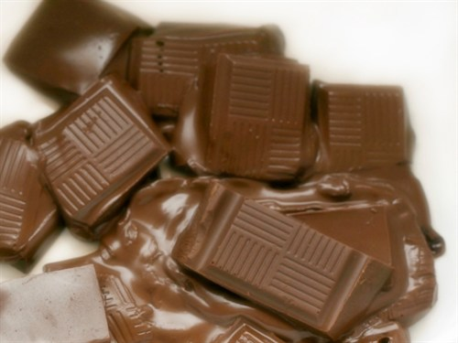
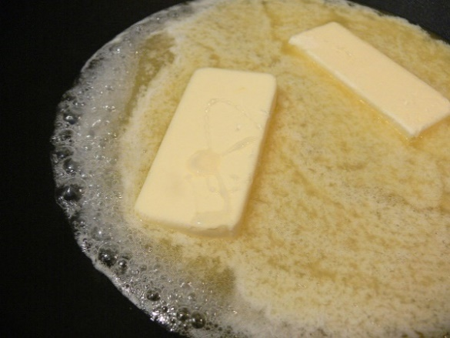
Investigating Physical Changes in Matter
Watch closely as these substances melt and record your observations in your science notebooks.
Photo courtesy of Planet-science.com
Photo courtesy Chris Dlugosz / Wikimedia Commons
Photo courtesy of Jessica Merz / Wikimedia Commons
Keep our first focus question in mind: Are physical changes reversible at room temperature? What is your evidence?
Notes:
25 min
Note: Make sure to turn the griddle on, set it at low to medium heat, and let it warm up before the demonstration. Don’t place the beakers containing the chocolate, crayons, and butter on the griddle until the demonstration begins. Caution participants not to get too close to the heated griddle or beakers.
a. “In lessons 1 and 2 of this unit on matter, our students will explore physical changes that happen when heat is added to different kinds of matter. Today we’ll explore some of these changes as well. Make sure to keep our first two-part focus question in mind throughout this investigation: Are physical changes reversible at room temperature? What is your evidence?”
b. Have participants gather around the table for the demonstration. Place the three beakers containing the chocolate, crayons, and butter on the preheated griddle. The griddle should be warm enough to begin melting the substances. Ask participants to observe the substances melting and record their observations in their science notebooks.
Note: If the chocolate and crayons aren’t melting quickly enough, you may need to increase the temperature to 200 or 300 degrees.
c. As each substance reaches its melting point, remove it from the griddle and place it on a pot holder to cool at room temperature. After removing all three substances from the heat, turn off the griddle.
d. While the substances are cooling, advance to the next slide and discuss the question.

Slide 28
What Would Your Students Say?
How would your students describe the characteristics of solid butter and liquid butter? What science words might they use?
Think about this for a moment. Then write a possible student response in your science notebook.
Photo courtesy of Jessica Merz / Wikimedia Commons
Notes:
10 min
a. “As we give these substances time to cool, let’s consider the questions on the slide: How would your students describe the characteristics of solid butter and liquid butter? What science words might they use? Reflect on this for a moment; then write a possible student response in your science notebooks.”
b. Whole-group discussion: Invite participants to share their ideas with the group. Feel free to contribute ideas based on your own classroom experiences. How do you think your own students would describe these substances? What science vocabulary do you think they’d use?
c. After the group discussion, ask participants to examine the three substances that are cooling and share their observations. At this point, the crayons will likely be changing back to a solid, but the chocolate and butter may still be liquids.

Slide 29
NGSS Disciplinary Core Idea
Different properties [of matter] are suited to different purposes.
How might solid butter and liquid butter be suited to different purposes?
At what temperature range do you think liquid butter would change back to solid butter?
How might this temperature range differ from the temperature necessary for liquid water or melted chocolate to change back to a solid?
Photo courtesy of Jessica Merz / Wikimedia Commons
Notes:
7 min
a. Read the NGSS disciplinary core idea on the slide and ask participants the following questions:
How might solid butter and liquid butter be suited to different purposes?
At what temperature range do you think liquid butter would change back to solid butter?
How might this temperature range differ from the temperature necessary for liquid water or melted chocolate to change back to a solid?
b. Elicit a variety of ideas from participants.

Slide 30
Unit Central Questions
What is matter made of? How can matter change?
Courtesy of Pixabay.com
Notes:
Less than 1 min
a. Review the unit central questions on the slide.
b. “Let’s see if we can gather some additional data that will help us develop a more complete answer to our second unit central question.”
c. “But first, let’s review what we’ve learned so far about changes in matter.”

Slide 31
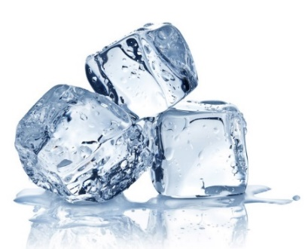
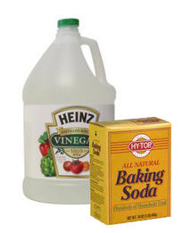
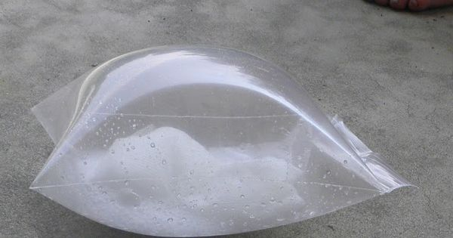
Review: Physical and Chemical Changes
What is a physical change? What happens to the molecules in a physical change?
What is a chemical change? What happens to the molecules during a chemical reaction?
Photos courtesy of BSCS
Notes:
10 min
a. “In our previous content deepening sessions, we investigated two types of changes in matter: physical changes and chemical changes.”
b. “Who can describe what a physical change is? What happens to the molecules of a substance in a physical change? Does the substance itself change into something different? ”
c. During this discussion, use probe and challenge questions to make participants’ thinking visible and ensure scientific accuracy.
Ideal response:
When heat is added to solid matter like ice, the molecules speed up, break away from their rigid structure, and begin moving around more freely as a liquid. In a liquid state, water molecules are still attracted to one another, but they can flow or slide past each other. Conversely, when heat is removed from liquid matter, the molecules slow down and join together in a rigid structure, where they vibrate in place as a solid. These physical changes in matter are reversible, so substances can change back and forth from solids to liquids and from liquids to solids when heat is added or removed. In physical changes the substance itself doesn’t change into a different substance; only the arrangement and movement of the molecules change.
d. “Who can describe what a chemical change is? What happens to the atoms and molecules of a substance in a chemical change? Does the substance itself remain the same or change into something different? “
e. During this discussion, use probe and challenge questions to make participants’ thinking visible and ensure scientific accuracy.
Ideal response:
Substances like vinegar and baking soda can undergo a chemical change when they’re mixed together. The atoms of each molecule separate and recombine (rearrange) in different ways to form entirely new molecules or substances (types of matter) with different properties than the original substances. One of the substances produced in a chemical reaction between vinegar and baking soda is carbon dioxide (CO₂). This invisible gas is proof that a chemical change has occurred.

Slide 32
Reflect: Content Deepening Focus Question 1
Are physical changes reversible at room temperature? What is your evidence?
Notes:
7 min
a. Review the focus questions on the slide.
b. Individuals: Ask participants to answer these questions in their science notebooks, using evidence from the demonstration of melting and freezing and science ideas from previous content deepening sessions.
c. Whole group: Invite a few participants to share their answers to the focus questions. Record key ideas on chart paper.

Slide 33
Content Deepening: Focus Question 2
Are atoms created or destroyed when matter undergoes a physical or chemical change? How can you prove your ideas?
Notes:
7 min
a. Read the focus questions on the slide.
b. “This focus question requires us to prove something about molecules even though we can’t see them. But the beauty is that this is possible!”
c. Pairs: Have participants pair up with an elbow partner and discuss their ideas for answering this question and ways they could prove their ideas are right. Encourage participants to consider examples of physical and chemical changes from content deepening work over the past few days.
d. Whole group: Invite participants to share their initial ideas for answering the focus question and ways they could prove their ideas are right. Record participants’ ideas on chart paper.

Slide 34
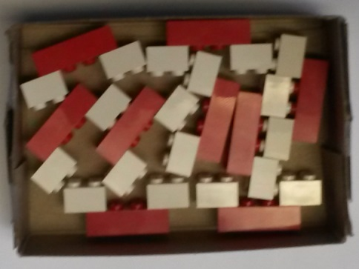
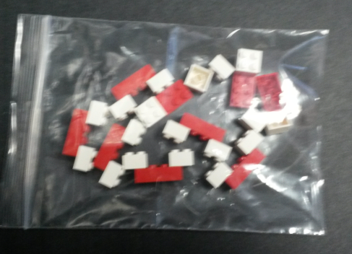
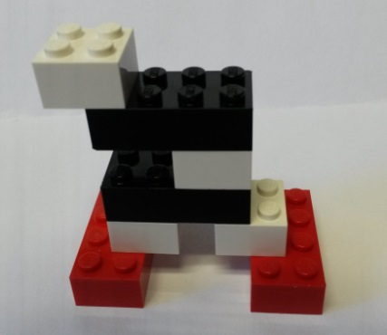
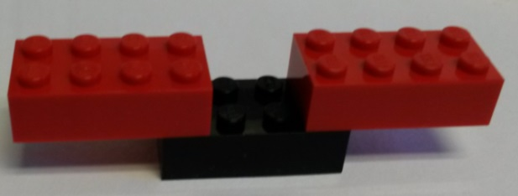
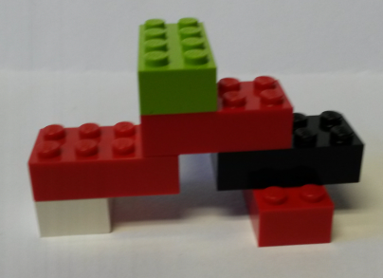
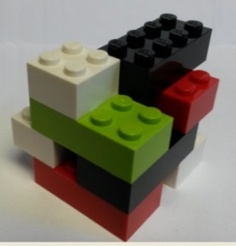
Let’s Design an Experiment!
Physical Change
Add Heat
Remove Heat
Chemical Change
Photos courtesy of BSCS
Notes:
10 min
a. “Since we can’t see molecules, we’ll use our Lego model again to help us design an experiment that will help us prove our ideas about whether atoms are created or destroyed when matter undergoes a physical or chemical change.”
b. Using the Lego images on the slide, work together as a group to design an experiment that will accomplish the specified goal.
Note: Accept all ideas at this point. The next few slides will help you acquaint participants with a specific experimental method.
c. During this design process, you may need to probe participants’ understandings of the following key science ideas:
In a physical change, the molecules aren’t rearranged. They simply occupy more or less space based on their arrangement and movement.
In a chemical change, a reaction occurs in which the atoms of the original substances separate and recombine or rearrange to form new molecules or substances with different properties.
In both types of change, the number of atoms before the change equals the number of atoms after the change. This can be measured!

Slide 35
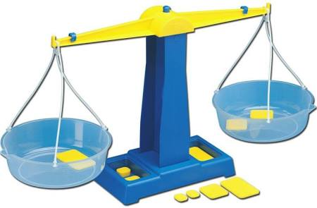
Testing Our Ideas: Physical Changes
Are atoms created or destroyed when matter undergoes a physical or chemical change? How can you prove your ideas?
Courtesy of BSCS
Notes:
Less than 1 min
a. “First, let’s focus on physical changes in matter. Using a balance, we’ll test our ideas or hypotheses and make observations to determine with confidence whether atoms are created or destroyed or remain the same when matter undergoes a physical change.”

Slide 36
Testing Our Ideas: Physical Changes
Both teams: Set up your balance scales. Then using Team 1’s Legos, build a total of 12 Mickey Mouse water molecules.
Team 1: Place 6 Lego water molecules on one side of your balance and 6 molecules on the other side.
Team 2: Wipe any condensation off your frozen water bottle. Then place the frozen bottle on one side of your balance and the bottle at room temperature on the other side.
Both teams: Observe and interpret the weight results.
Notes:
15 min
a. Divide the group into two teams. Give the first team a balance scale, 24 white (hydrogen) Legos, and 12 red (oxygen) Legos. Give the second team a balance scale, one bottle of frozen water, and one bottle of room-temperature water.
b. Direct teams to follow the instructions on the slide.
Both teams should set up their balance scales and then Team 2 should help Team 1 build a total of 12 Mickey Mouse Lego water molecules (six each).
Team 1 should weigh their Lego water molecules by placing six molecules on one side of their balance and six molecules on the other side.
Team 2 should weigh their water bottles by placing the frozen bottle on one side of their balance and the room-temperature bottle on the other side. It may be easier if they lay the bottles on their sides instead of placing them upright. Note: Make sure participants wipe any condensation off the outside of the frozen bottle to avoid skewing the results.
Both teams should observe, record, and interpret the results.
Whole group: Ask participants how these experiments relate to the focus question, Are atoms created or destroyed when matter undergoes a physical or chemical change? Did the results prove their ideas or hypotheses?
Ideal response:
Since both sides of each balance are equal or level, this proves that atoms aren’t created or destroyed when water undergoes a physical change. The molecules of solid water are exactly the same weight as the molecules of liquid water. Matter is conserved, so the scales balanced.

Slide 37
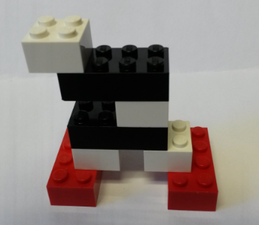
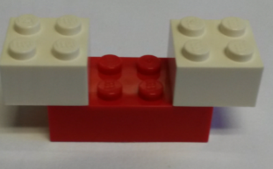
Testing Our Ideas: Chemical Changes
Team 1: Build Lego models of the two reagent molecules (vinegar, baking soda). Place your molecules on one side of the balance scale.
Team 2: Build Lego models of the three product molecules (sodium acetate, water, carbon dioxide). Place your molecules on the other side of the balance scale.
Photos courtesy of BSCS
Notes:
7 min
a. “Next, we’ll focus on chemical changes in matter and use a balance to determine whether atoms are created or destroyed or remain the same when matter undergoes a chemical change.”
b. Walk teams through the following instructions:
Set up one balance scale.
Have Team 1 build Lego models of the two reagent molecules shown on the slide.
Vinegar molecule: four white (hydrogen) Legos, two red (oxygen) Legos, and two black (carbon) Legos
Baking-soda molecule: one lime-green (sodium) Lego, one white (hydrogen) Lego), three red (oxygen) Legos, and one black (carbon) Lego
Have Team 2 set up their balance scale and build Lego models of the three products of the neutralization reaction shown on the slide.
Sodium-acetate molecule: one lime-green (sodium) Lego, three white (hydrogen) Legos, two red (oxygen) Legos, and two black (carbon) Legos
Water molecule: two white (hydrogen) Legos and one red (oxygen) Lego
Carbon-dioxide molecule: one black (carbon) Lego and two red (oxygen) Legos
Direct Team 1 to place their two reagent Lego molecules on one side of the balance scale, and have Team 2 place their three product molecules on the other side.
Ask the teams to observe, record, and interpret the results.

Slide 38
Testing Our Ideas: Chemical Changes
Both teams: Place 1 teaspoon of baking soda in each freezer bag. Place 2 tablespoons of vinegar in each vial and secure the cap. Wipe off any vinegar on the outside of the vials. Then place the vials in the freezer bags and seal them.
Team 1: Place one of the sealed freezer bags on one side of the balance. Don’t open the bag or take the cap off the vial.
Team 2: Without opening the second bag, pop the cap off the vial and mix the vinegar with the baking soda. When the bag puffs up with gas, place the bag on the other side of the balance.
Notes:
10 min
a. “Next, we’ll weigh the actual substances in this chemical change and see if we get the same results.”
b. Walk teams through the following instructions for preparing identical freezer bags containing baking soda and vinegar:
Place 1 teaspoon of baking soda in each bag.
Place 2 tablespoons of vinegar in each plastic vial. Then secure the lids and wipe any vinegar off the outside of each vial.
Place the vials in the freezer bags and remove as much air from the bags before sealing them.
Have Team 1 place one of the freezer bags on one side of the balance scale without mixing the substances together. Caution participants not to pop off the cap on the vial of vinegar.
For the second freezer bag, have Team 2 pop the cap off the vial of vinegar and mix the substances together without opening the bag. (Make sure participants understand that the bag should remain sealed.) After the chemical reaction occurs and the bag puffs up with gas, have Team 2 place the bag on the other side of the balance scale.
Ask the teams to observe, record, and interpret the results.
c. Whole group: Ask participants how this experiment relates to the focus question, Are atoms created or destroyed when matter undergoes a physical or chemical change? Did the results prove their ideas or hypotheses?
Ideal response:
Since both sides of the scale are balanced (equal), this proves that atoms aren’t created or destroyed when a chemical change occurs. The reagent molecules (before the reaction) are exactly the same weight as the product molecules (after the reaction). Matter is conserved, so the scale balanced.

Slide 39
Reflect: Content Deepening Focus Question 2
Are atoms created or destroyed when matter undergoes a physical or chemical change? How can you prove your ideas?
Notes:
7 min
a. Review the two-part focus question on the slide.
b. Individuals: Ask participants to answer these questions in their science notebooks, using the data they just collected from the experiments on physical and chemical changes.
c. Whole group: Invite a few participants to share their answers to the focus questions. Record key ideas on chart paper.

Slide 40
NGSS Connections
Disciplinary core ideas (2-PS1-1; 2-PS1-4):
Different kinds of matter exist and many of them can be either solid or liquid, depending on temperature. Matter can be described and classified by its observable properties.
Heating or cooling a substance may cause changes that can be observed. Sometimes these changes are reversible, and sometimes they are not.
How did today’s content deepening activities address these core ideas?
How would addressing these ideas in the classroom be valuable for our students?
Notes:
10 min
a. Review the NGSS disciplinary core ideas on the slide. Then ask participants, “How did today’s content deepening activities address these core ideas? How would addressing these ideas in the classroom be valuable for our students?”
b. Individuals: Ask participants to think about these questions and then write their ideas in their science notebooks.
c. Whole group: Invite participants to share their responses with the group. Record key ideas on chart paper.

Slide 41
Unit Central Questions
What is matter made of? How can matter change?
Courtesy of Pixabay.com
Notes:
5 min
a. Review the unit central questions on the slide.
b. Ask participants, “How would you answer these questions based on today’s content deepening work? What new ideas can you add?”
c. Avoid adding on to participants’ responses. Simply ask probe and challenge questions to ensure that participants express their ideas about matter in scientifically accurate ways.
Note: Ideally, participants will mention the arrangement and movement of molecules in physical changes and the rearrangement of atoms and molecules in chemical changes without losing or gaining any atoms (conservation of matter). If needed, ask participants the challenge question, “Can the changes in matter be qualified?”

Slide 42
Summary: Moving Student Thinking Forward
How can we advance student thinking without simply telling students about science ideas and asking them to memorize the concepts?
Refer to our Effective Science Teaching chart from day 1. Which of these ideas do you want to highlight based on the strategies we’ve explored so far? Anything you want to add or modify?
Notes:
5 min
a. Have participants share ideas about the first question on the slide. Then ask, “What are some things we’ve discussed today that address this question?”
b. Refer participants to the Effective Science Teaching chart from day 1 and discuss the remaining questions on the slide. Modify the chart as participants share their ideas.

Slide 43
Today’s Focus Questions
Lesson Analysis
Content Deepening
How can analyzing data and constructing explanations help students move forward toward deeper understandings of science ideas?
Are physical changes reversible at room temperature? What is your evidence?
Are atoms created or destroyed when matter undergoes a physical or chemical change? How can you prove your ideas?
Notes:
5 min
a. Review today’s focus questions.
b. Discuss: “The STeLLA strategies booklet claims that strategies 4 and 5 are ways of moving student thinking forward. How would you support or challenge that claim? In other words, are you convinced that letting students analyze data and construct explanations will help them move forward toward deeper understandings of science ideas?”
c. Ask: “What key ideas do you now have about how to address our content deepening focus questions?”

Slide 44
Homework
Review strategy 6 in the STeLLA strategies booklet and complete the STL Z-fold summary chart for this strategy: Engage students in using and applying new science ideas in a variety of ways and contexts.
Be prepared to share your assigned lesson plan review.
Notes:
2 min
a. “Tomorrow we’ll focus on another strategy to help move student thinking forward toward deeper understandings of science ideas.”
b. Review the homework assignment and have participants copy it into their science notebooks.

Slide 45
Reflections on Today’s Session
Complete the Daily Reflections sheet (handout 3.5).
What new idea or insight did you have today related to strategy 4 (analyzing and interpreting data and observations) and strategy 5 (constructing explanations and arguments)?
What ideas do strategies 4 and 5 give you about things to try or change in your science teaching?
Answer one of these questions: (1) What important science idea are you taking away from our content deepening work today? Remember to state the idea in a complete sentence. (2) What question do you have about matter and how it can change (i.e., something you’re unclear or wonder about)?
Notes:
3 min
a. Have participants reflect on today’s session and answer the questions on the Daily Reflections sheet (handout 3.5 in PD program binder).
Note: To support this task, encourage participants to refer to the STeLLA strategies booklet, the charts they created for STL strategies 4 and 5, the Effective Science Teaching chart, and their STL Z-fold summary charts.

Slide 46
Norms for Working Together: The Basics
Purpose: Build trust and develop a productive study group for all participants.
The Basics
Arrive prepared and on time; stay for the duration; return from breaks on time.
Remain attentive, thoughtful, and respectful; engage and be present.
Eliminate interruptions (turn off cell phones, email, and other electronic devices; avoid sidebar conversations).
Make room for everyone to participate (monitor your floor time).
Notes:
Hidden slide—available for use as needed.

Slide 47
Norms for Working Together: The Heart
Purpose: Build trust and develop a productive study group for all participants.
The Heart of RESPeCT Lesson Analysis and Content Deepening
Keep the goal in mind: analysis of teaching to improve student learning.
Share your ideas, uncertainties, confusion, disagreements, questions, and good humor. All points of view are welcome.
Expect and ask questions to deepen everyone’s learning; be constructively challenging.
Listen carefully; seek to understand other participants’ points of view.
Notes:
Hidden slide—available for use as needed.

