Slide 1
Properties of Matter Lesson 4b
What Happens When Solid Matter Becomes Liquid Matter and Liquid Matter Becomes Solid Matter? Why Do These Changes Happen?

Slide 2
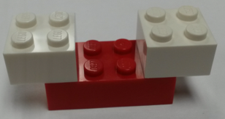
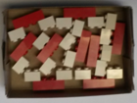
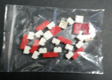
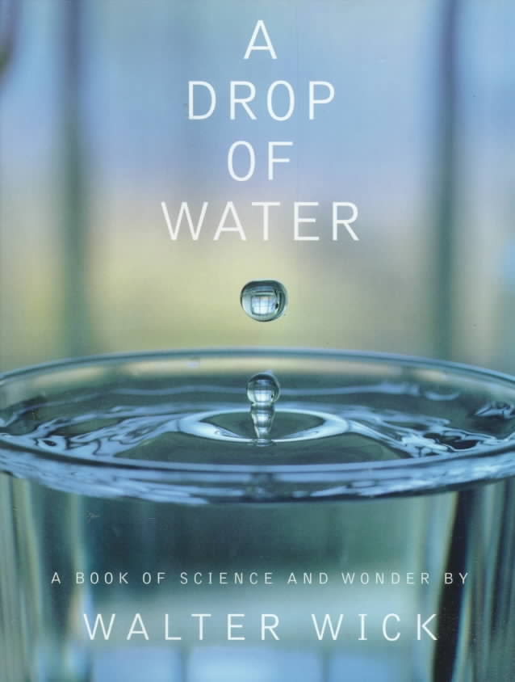
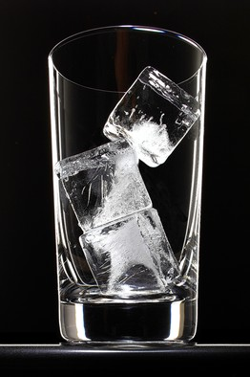
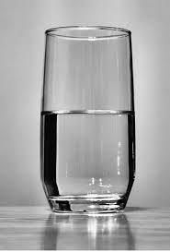
What Have You Learned So Far?
Photos courtesy of BSCS

Slide 3
Today’s Focus Questions
What happens when solid matter becomes liquid matter and liquid matter becomes solid matter? Why do these changes happen?

Slide 4
A Human Model of Matter
Today you’ll become human models of matter!
As models of water molecules, you’ll act out what happens when a solid changes to a liquid and a liquid changes to a solid.
How would you move if you were a water molecule?

Slide 5
A Human Model of Matter
In your group, come up with a plan for acting out how water molecules behave in a solid and a liquid.
Make these decisions:
How close should we stand as molecules of solid water and liquid water?
How should we all move as molecules of solid water and liquid water?

Slide 6
Our Human Model of Matter
How did you move as molecules in solid water or ice?
How did you move as molecules in liquid water?
What happens to molecules when solid matter becomes liquid matter?
What happens to molecules when liquid matter becomes solid matter?

Slide 7
Our Human Model of Matter
Do you think our human model shows how water molecules move and change in real life?
How is our model like or not like what happens in real life?

Slide 8
Our Focus Questions
What happens when solid matter becomes liquid matter and liquid matter becomes solid matter? Why do these changes happen?

Slide 9
Constructing a Scientific Explanation
Your scientific explanation should answer our focus questions.
Explain what happens when solid matter becomes liquid matter and liquid matter becomes solid matter. Then explain why you think these changes happen.
Write in complete sentences using science ideas about matter and molecules.
Include examples and observations (evidence) from our lesson investigations to support your ideas.
Give the reasons for your thinking.

Slide 10
Constructing a Scientific Explanation
Use these sentence starters:
When solid matter becomes liquid matter, _______.
When liquid matter becomes solid matter, _______.
I think solids become liquids because ___________.
I think liquids become solids because ___________.
Word bank:
Water molecules Vibrate in place
Solid/Liquid Move around freely
Add heat Move faster
Take heat away Move slower

Slide 11
Our Focus Questions
What happens when solid matter becomes liquid matter and liquid matter becomes solid matter? Why do these changes happen?

Slide 12
Let’s Communicate in Scientific Ways!
Give evidence for your ideas.
Listen to others' ideas and ask questions.
Agree or disagree with others' ideas.
Add onto someone else's ideas.
Let your ideas change and grow.
Make sure to state your ideas in complete sentences!

Slide 13
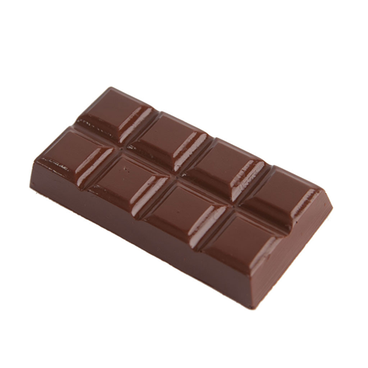
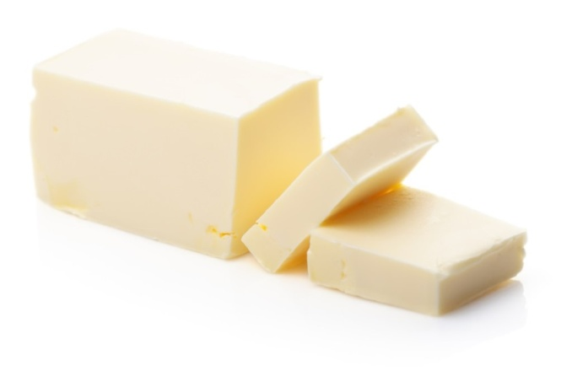
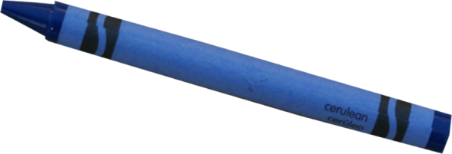
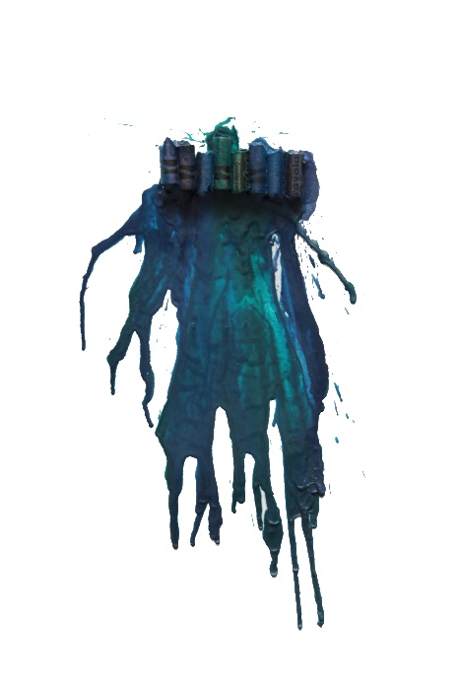
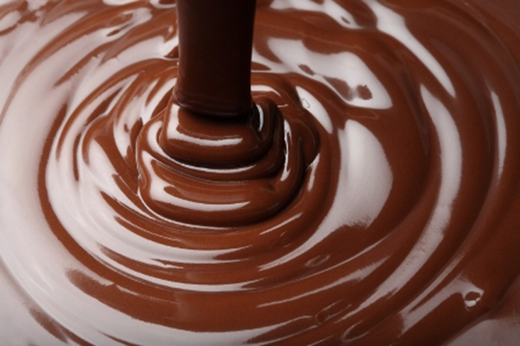
A Final Challenge!
Photo courtesy of BSCS
Photo courtesy of BSCS
Photo courtesy of BSCS
Photo courtesy of BSCS
Photo courtesy of BSCS
Photo courtesy of Creatingkeepsakes.com

Slide 14
A Final Challenge!
What do you think happens when butter becomes melted butter and then becomes solid butter again? Think about our evidence from lesson 1.
What do you think happens when chocolate and crayon pieces become liquid and then become solid again? Think about our evidence from lesson 2.
Why do you think these changes happen?

Slide 15
Key Science Ideas
Heating and cooling (removing heat) can cause changes in matter.
When heat is added to a solid, the molecules move faster. When they move fast enough to break away from their rigid structure, they flow around more freely as a liquid.
When heat is removed from a liquid and the matter cools, the molecules slow down, join together in a rigid structure, and vibrate in place as a solid.

Slide 16
Next Time
In our next lesson, you’ll show what you know about matter by creating a comic strip that explains what matter is made of and how it can change.
Are you ready to be creative scientific thinkers?

