Slide 1
Properties of Matter Lesson 4a
How Does Heat Cause Matter to Change from a Solid to a Liquid and from a Liquid to a Solid?

Slide 2
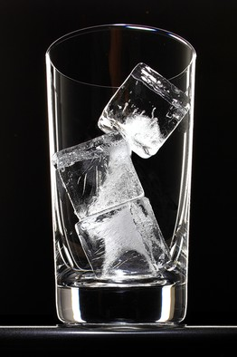
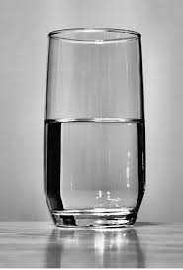
Review: Solid Water and Liquid Water
Are the molecules in liquid water the same as the molecules in ice cubes (solid water)?
Photo courtesy of BSCS
Photo courtesy of Derek Jensen/Wikimedia

Slide 3
Review: Solid Water and Liquid Water
Do the molecules in liquid water and solid water (ice) move in the same way or in different ways?
Photo courtesy of BSCS
Photo courtesy of Derek Jensen/Wikimedia

Slide 4
Review: How Solids and Liquids Move
In a solid, the molecules can only vibrate in place.
In a liquid, the molecules can move around more freely.

Slide 5
Today’s Focus Question
How does heat cause matter to change from a solid to a liquid and from a liquid to a solid?

Slide 6
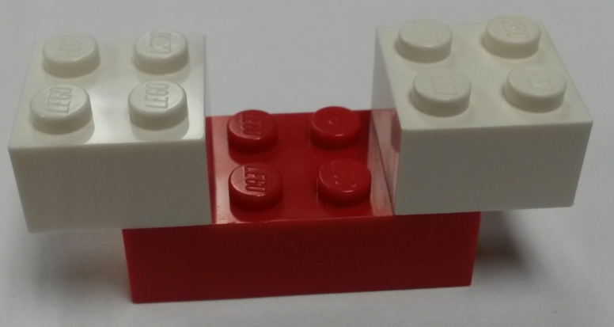
Our Lego Model
Why do you think we used Lego bricks instead of real water molecules to learn about how matter changes from a solid to a liquid and from a liquid to a solid?
Photo courtesy of BSCS

Slide 7
Our Lego Model
Water molecules are much too small for us to see!
Using a model helped us imagine how these tiny molecules move in a liquid and a solid.
Photo courtesy of BSCS

Slide 8
Why Scientists Use Models
Scientists uses models because things in real life are too small, too big, too dangerous, or too far away to observe firsthand.
Models help scientists learn about things in the real world, just like our Lego model helped us learn about water molecules.
When scientists use models, they want the models to show as accurately as possible how things work in real life.

Slide 9
My Lego Model—Analogy Map
Part of the Model | Is/Are Like … | Part of the Real World | Because …
One Lego brick |  | An atom | The Lego brick is one small piece, and an atom is one small piece of something.
 |  | A molecule
Two white Lego bricks and one red Lego brick stuck together
The Lego bricks in the cardboard box |  |  | The molecules in a solid can’t move very much, just like the Legos in the box.
 |  | Liquid water
Lego bricks jiggling or vibrating in place |  |  | The molecules in a solid vibrate in place too.
Lego bricks moving around freely

Slide 10
How Heat Changes Matter
LIQUID
SOLID
Add Heat
Remove Heat

Slide 11
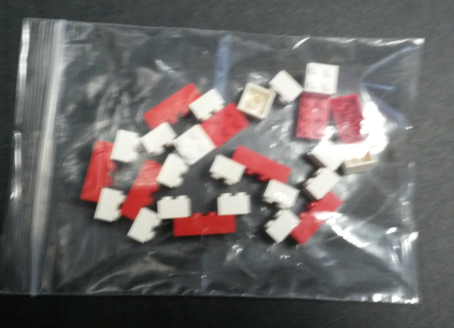
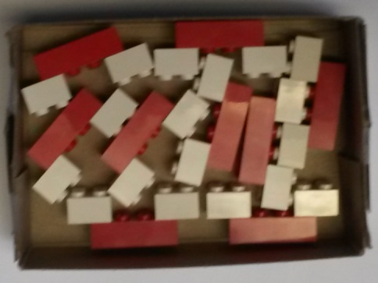
How Adding Heat Changes Matter
LIQUID
SOLID
Add Heat
Photos courtesy of BSCS

Slide 12
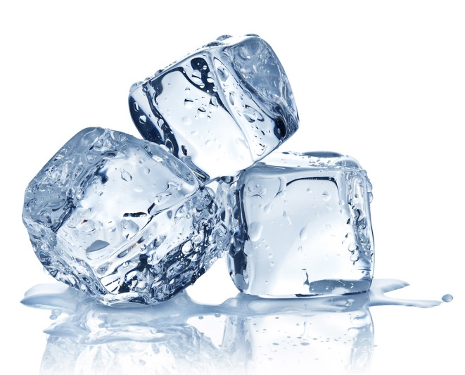
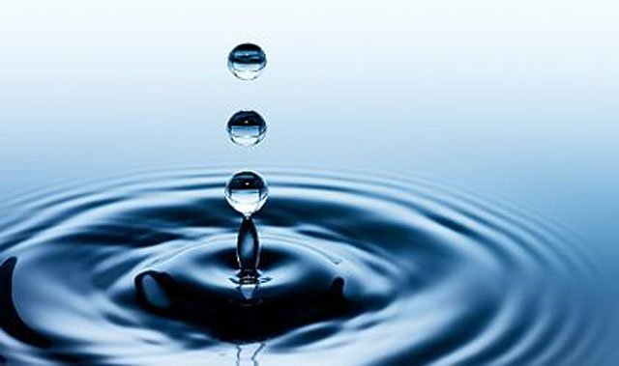
How Adding Heat Changes Matter
Solid Water Add Heat Liquid Water
Vibrate in Place
Add Heat
Add Heat
Move Freely
Photos courtesy of BSCS

Slide 13
How Removing Heat Changes Matter
LIQUID
SOLID
Remove Heat
Photos courtesy of BSCS

Slide 14
Let’s Summarize!
Our focus question: How does heat cause matter to change from a solid to a liquid and from a liquid to a solid?
Using science ideas about matter, work with an elbow partner to write 1 or 2 sentences that answer this question.
Word bank:
Water molecules Vibrate in place
Solid/Liquid Move around freely
Add heat Move faster
Take heat away Move slower

Slide 15
Next Time
Today we learned more about how heat causes matter to change from a solid to a liquid and from a liquid to a solid.
Next time, you’ll show what you know about how solid and liquid matter change and why!

