Slide 1




Properties of Matter Lesson 3a
What Is Liquid Water Made Of? What Is Solid Water (Ice) Made Of?

Slide 2
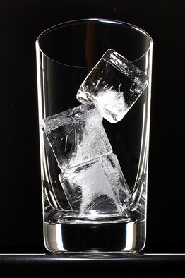
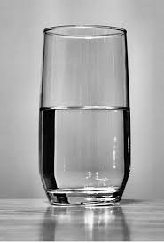
What Causes Matter to Change?
What causes matter to change from a solid to a liquid or from a liquid to a solid?
Photo courtesy of BSCS
Photo courtesy of Derek Jensen / Wikimedia

Slide 3

Key Science Ideas
Scientists talk about how heat causes matter
to change.
Adding heat changes a solid to a liquid.
Removing heat changes a liquid to a solid.
If the matter is warmer, it has more heat.
If the matter is cooler, it has less heat.

Slide 4
Unit Central Questions
  What is matter made of? How can matter change?

Slide 5
Today’s Focus Questions
What is liquid water made of? What is solid water (ice) made of?

Slide 6

A Drop of Water
What do you think you
might see if you could
shrink small enough to
fit inside a tiny drop
of water?
Would the solid water
and the liquid water
look the same at this
size or scale?
Photo courtesy of BSCS

Slide 7
A Drop of Water
A drop of water is made up of very tiny particles called molecules.
There are more than three hundred trillion molecules in the smallest droplet of water on the head of a pin.
A molecule of water is so tiny that we would never be able to see it, not even under a microscope!
The atoms that make up matter are just as small.

Slide 8
Lego Water Molecules
Our focus questions: What is liquid water made of? What is solid water (ice) made of?
To help us answer these questions, we’re going to build some water molecules!
In your small group, build 10 water molecules like the one on the handout.
Look at the picture of the water molecule on the handout to help you.
When your group has built all 10 of your water molecules, have one teammate raise a hand.

Slide 9
Molecules in Liquid Water and Ice Cubes
Are the molecules in liquid water the same as the molecules in ice cubes? Why do you think so?
How do you think the molecules might be arranged or “put together” in liquid water and the ice cubes? Are they arranged in the same way or in a different way?

Slide 10
Let’s Summarize!
Our focus questions: What is liquid water made of? What is solid water (ice) made of?
In your science notebook, write Liquid Water at the top of one page and Solid Water at the top of another page.
On the first page, draw a picture to show what you think liquid water is made up.
On the second page, draw a picture to show what you think solid water, or ice, is made of.
Use your Lego-model handout as a resource.

Slide 11
Next Time
In our next lesson, we’ll use our Lego models to help us think about how molecules in liquid water and solid water (ice) are arranged and how they move.
Do you think they’re arranged and move
in the same ways or different ways?
We’ll explore these ideas next time!

