Slide 1
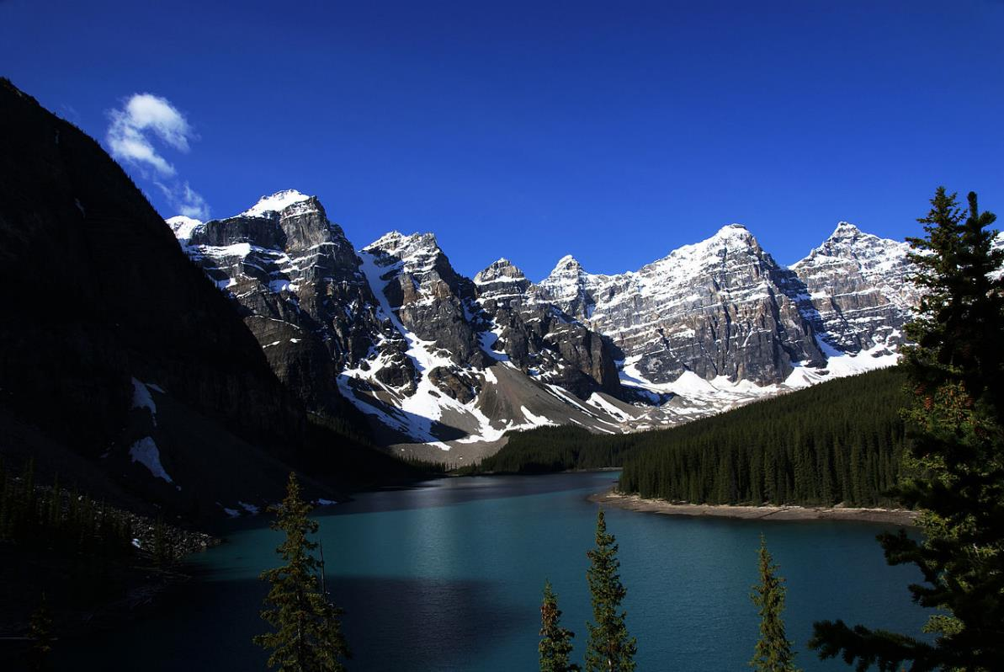
Mountain
Photo courtesy of Bede735/Wikimedia Commons

Slide 2
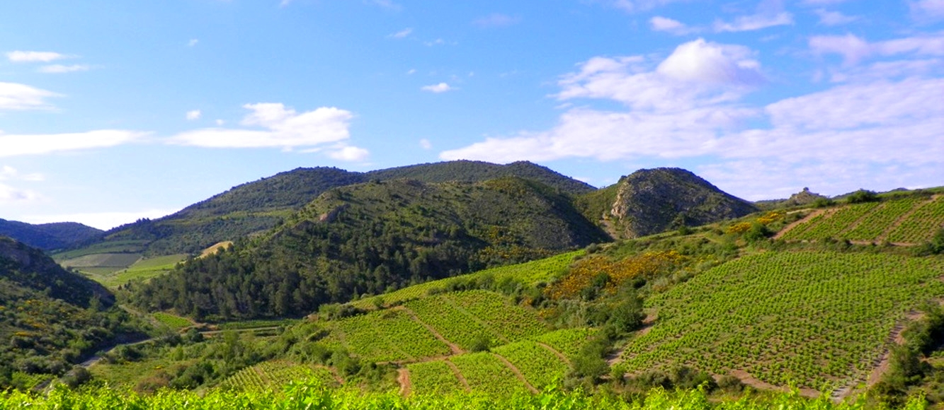
Hill
Photo courtesy of www.zoqy.net/Wikimedia Commons

Slide 3
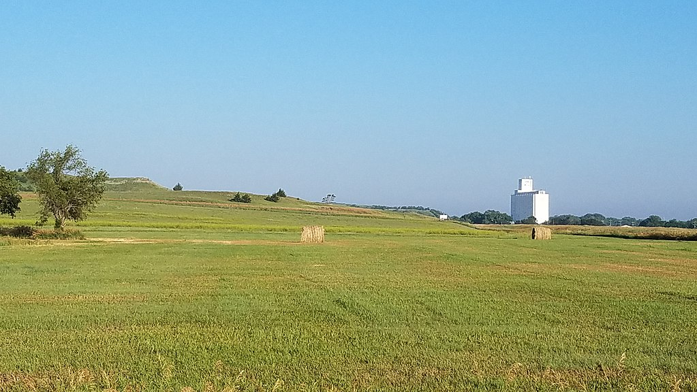
Plain
Photo courtesy of IveGoneAway/Wikimedia Commons

Slide 4
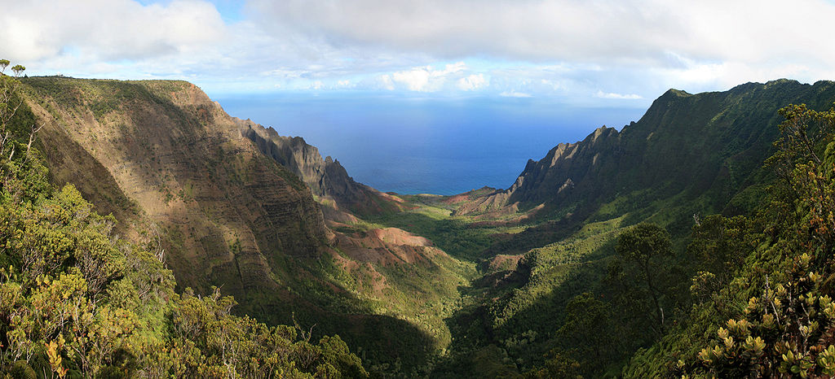
Valley
Photo courtesy of Gh5046/Wikimedia Commons

Slide 5
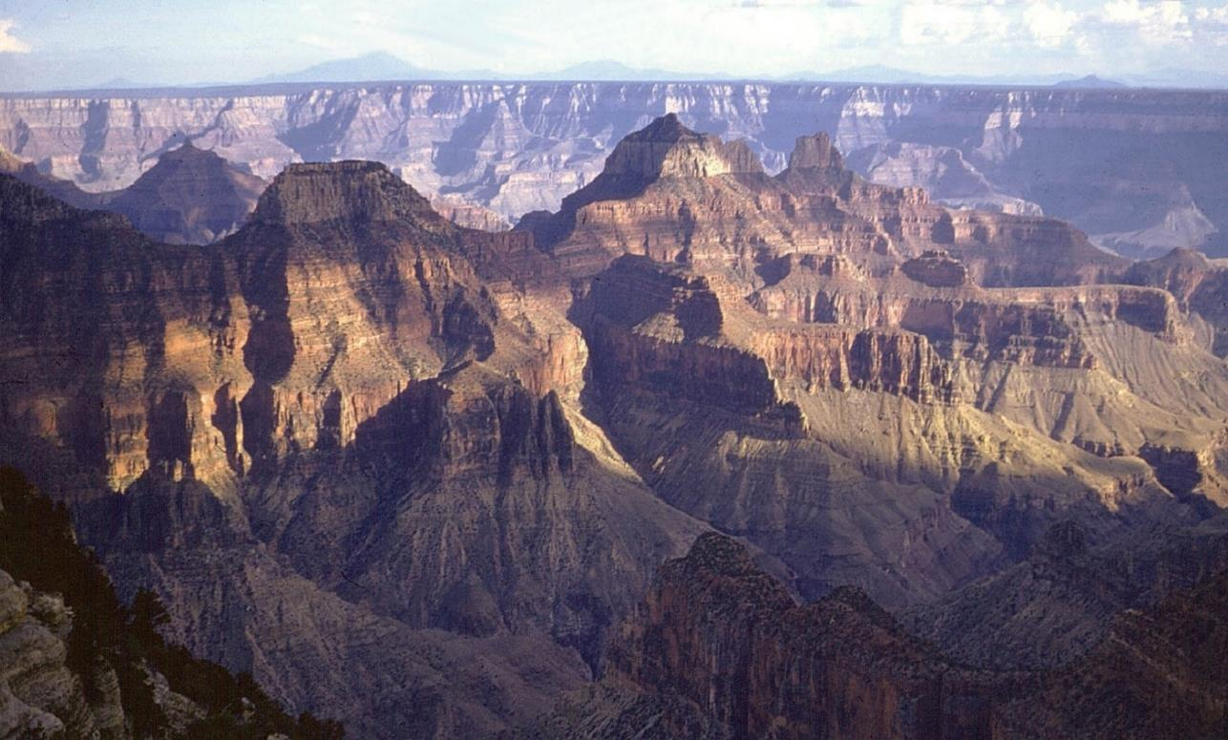
Canyon
Photo courtesy of Pixabay.com

Slide 6
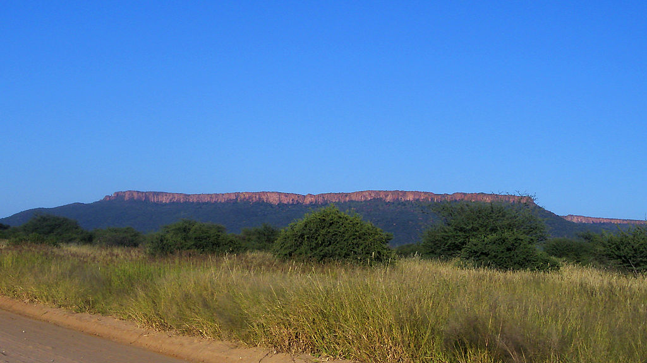
Plateau
Photo courtesy of Robert Raderschatt/Wikimedia Commons

Slide 7
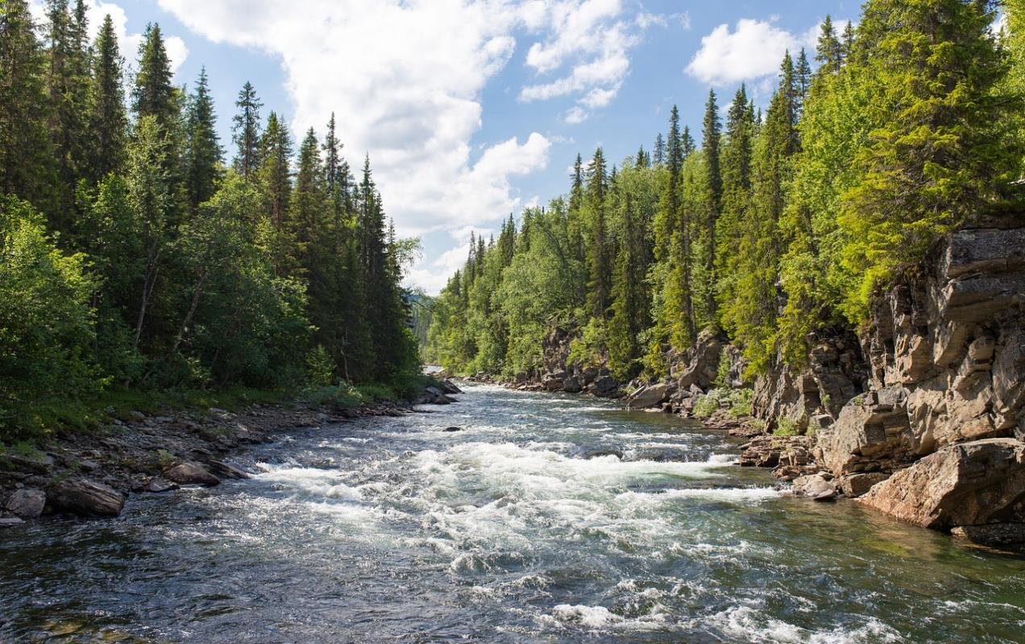
River
Photo courtesy of Pixabay.com

Slide 8
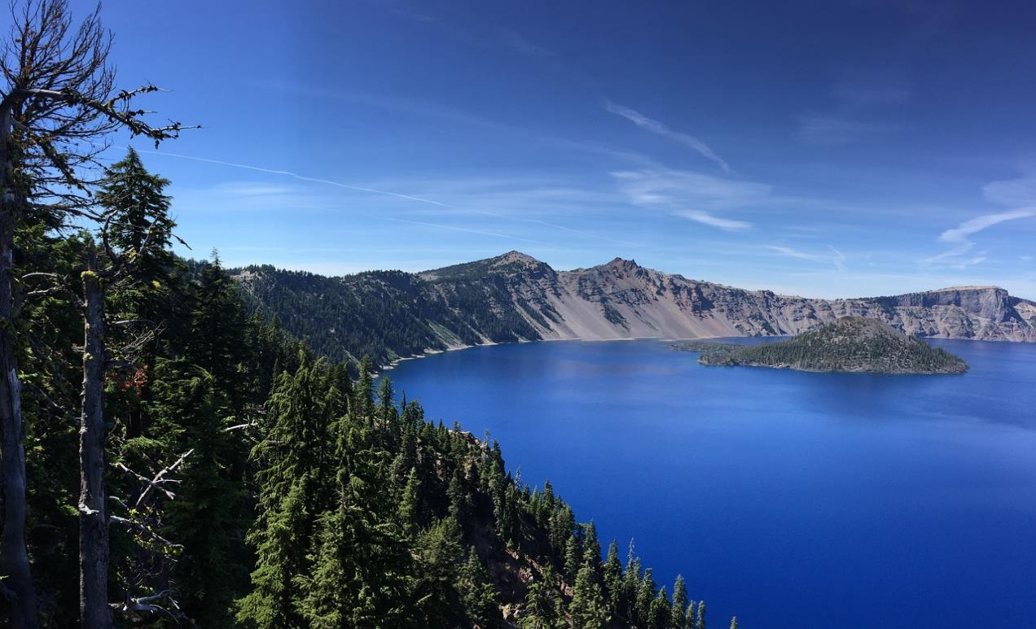
Lake
Photo courtesy of Pixabay.com

Slide 9
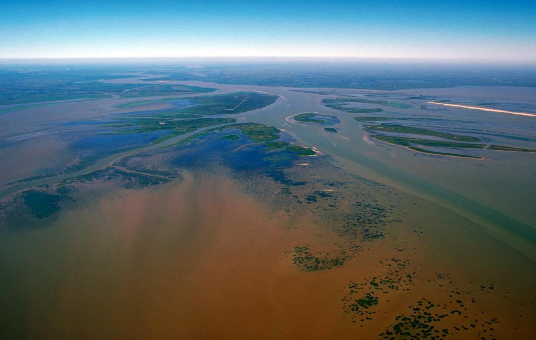
Delta
Photo courtesy of Arthur Belala/Wikimedia Commons

