Slide 1
Earth’s Changing Surface Lesson 5a
How Quickly or Slowly Do Landforms Change? How Do We Know?

Slide 2
Can We See Landforms Change?
Photo courtesy of W. Tyson Joyce/NPS

Slide 3
How Scientists Collect Data
Scientists collect all kinds of data to figure out how fast or slow landforms are changing.
They can measure landforms every year and compare the measurements to see if they’re different.
They can also take pictures to see whether a landform has changed over time.

Slide 4
Today’s Focus Questions
How quickly or slowly do landforms change over time? How do we know?

Slide 5
Our First Landform Example
Photo courtesy of Arthur Belala/Wikimedia Commons

Slide 6
Our Second Landform Example
Photo courtesy of W. Tyson Joyce/NPS

Slide 7
How Fast Do Landforms Change?
Work in pairs to investigate two landforms :
The Grand Canyon
The Mississippi River delta
Read the information on the handouts and study the photos and maps.
Decide whether these landforms are changing quickly or slowly.
Look for evidence in the readings to support your ideas.
Be ready to share your ideas and evidence.

Slide 8
How Fast Do Landforms Change?
Slowly
Quickly
Which landform do you think is changing slowly?
Which landform do you think is changing quickly?
What evidence did you use to make your decisions?

Slide 9
Key Science Ideas
Flowing water can cause landforms to change very slowly, like the Grand Canyon and the Mississippi River delta.
Flowing water can also cause landforms to change very quickly, like during a flood.
So landforms can change quickly or slowly over time depending on how much water is flowing.

Slide 10
Our Focus Questions
How quickly or slowly do landforms change over time? How do we know?

Slide 11
Let’s Summarize!
Our focus questions: How quickly or slowly do landforms change over time? How do we know?
Answer these questions in your notebook using this sentence starter:
I think landforms change [slowly/quickly/both]. My evidence is __________________.
Circle one of the options (slowly, quickly, or both). Make sure to use evidence from today’s readings to support your ideas.

Slide 12
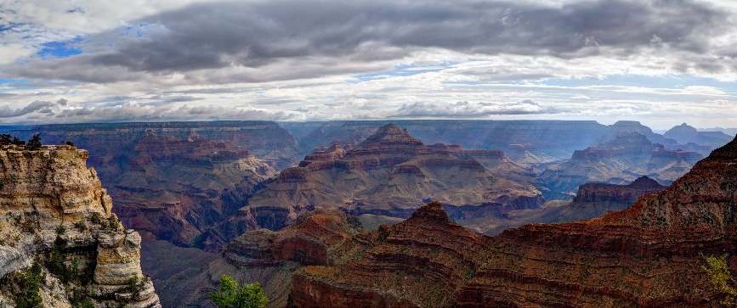
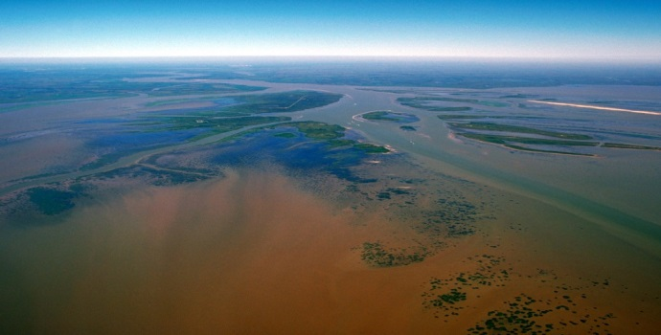
Key Science Ideas
Landforms change over time.
Some changes happen quickly, like during a flood.
Some changes happen very slowly over time, like when deltas or canyons form.
We can’t always see these changes happening.
Photo courtesy of W. Tyson Joyce/NPS
Photo courtesy of Arthur Belala/Wikimedia Commons

Slide 13
Next Time
Today we learned about landform changes that happen very slowly over time, such as when rivers form deltas or carve out canyons.
Next time, we’ll investigate changes that can happen very quickly.

