Slide 1
Earth’s Changing Surface Lesson 4b
What Causes Landforms to Change? What Is Our Evidence?

Slide 2
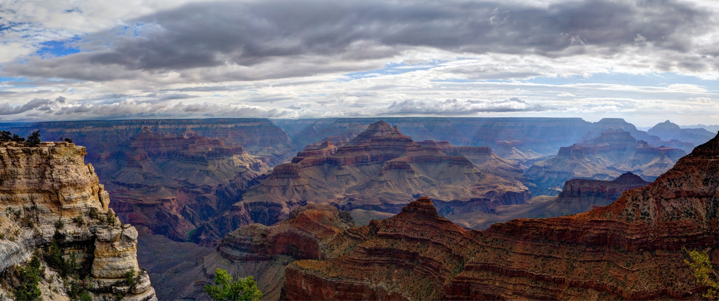
What Causes Landforms to Change?
What ideas do you have so far? Think about what happened when the rain fell on our model.
Photo courtesy of W. Tyson Joye/NPS

Slide 3
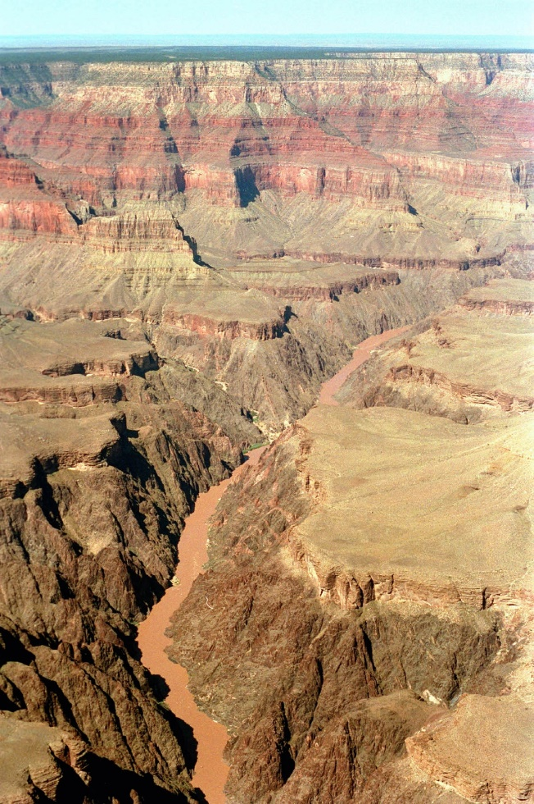
Our Questions and Wonderings
Do you still have any questions or wonderings after our last investigation?
Photo courtesy of NPS.gov

Slide 4
Today’s Focus Questions
We’ll continue thinking about these focus question from our last lesson:
What causes landforms to change? What is our evidence?

Slide 5
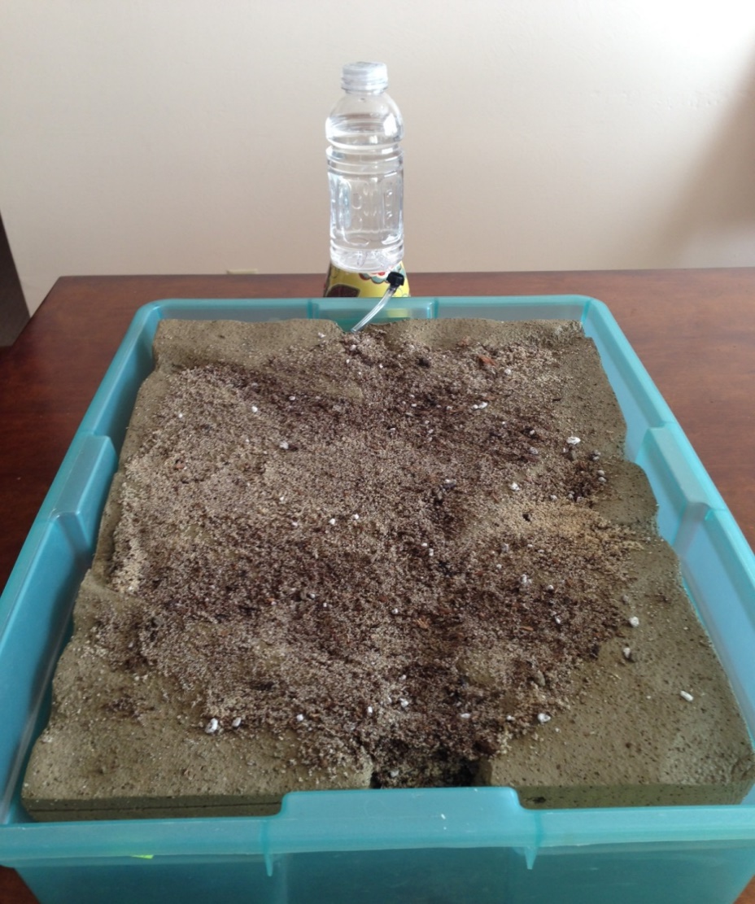
Our Model
Photo courtesy of BSCS

Slide 6
What Do You Predict?
What do you think will happen when a river begins to flow over our model?
Make a sketch of the model and write your prediction on page 1 of your handout.

Slide 7
What Did You Observe?
What happened when the river flowed over our model?
What happened to the sand and soil?
Is this what you predicted?

Slide 8
Your Ideas
How is our model like the Grand Canyon?
How is our model not like the Grand Canyon?
Do you think water can change the Grand Canyon? Why or why not?

Slide 9
Let’s Summarize!
Our focus questions: What causes landforms to change? What is our evidence?
Share your ideas and evidence with an elbow partner.
Be ready to share with the class.

Slide 10
Next Time
Think about this: If it took 50 years for the Grand Canyon to get 2 centimeters deeper, it will take more than 500 years for it to get 30 centimeters deeper!
In our next lesson, we’ll use what we’ve learned so far to investigate how quickly or slowly landforms change.

