Slide 1
Earth’s Changing Surface Lesson 3A
Do Landforms Ever Change? What Evidence Do We Have?

Slide 2
Key Science Idea
Landforms look different in different places.

Slide 3
Today’s Focus Questions
Do landforms ever change? What evidence do we have?

Slide 4
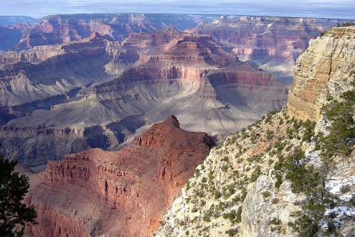
A Virtual Trip to the Grand Canyon
Have you ever been to the Grand Canyon?
What else do you notice about this picture?
Photo courtesy of NPS.gov
Notes:
Follow the cues in the lesson plan for starting the Google Earth Grand Canyon Tour.

Slide 5
Our Virtual Trip to the Grand Canyon
What did we learn from our virtual trip to the Grand Canyon?
What evidence did we find that can help us decide whether the canyon is changing?
Photo courtesy of NPS.gov

Slide 6
Is the Grand Canyon Changing?
Do you think the Grand Canyon is changing? Why or why not?
Share your ideas with an elbow partner.
Make sure to include evidence from our clues.

Slide 7
Let’s Summarize!
Our focus questions: Do landforms ever change? What evidence do we have?
What evidence have we gathered so far to help us answer this question?

Slide 8
Key Science Ideas
The Grand Canyon is 2 centimeters deeper than it was 50 years ago.
The Colorado River carries loose soil and rock with it as it flows through the canyon.

Slide 9
Next Time
What other clues can we gather to help us decide whether the Grand Canyon is changing?

