Slide 1
Earth’s Changing Surface Lesson 2b
How Does the Land on Earth’s Surface Look Different in Different Places? How Can Representations Like Relief Maps Help Us Compare Different Places in the United States?

Slide 2
Review: Relief Maps
What did we learn about relief maps last time? Why are they special?
What science word did we learn that describes how high or low the land is in different places?

Slide 3
Review: Relief Maps
Relief maps are special maps that help scientists find landforms in different places.
Relief maps show how high or low the land is in different places. Scientists use the word elevation to describe high or low places on Earth’s surface.
A high elevation means the land rises high above Earth’s surface. A low elevation means the land is low or flat or at sea level.

Slide 4
Today’s Focus Questions
How does the land on Earth’s surface look different in different places?
How can representations like relief maps help us compare different places in the United States?
These focus questions are like the ones from last time, but the second question is a little different.

Slide 5
Land Detectives Review
As land detectives, what did we discover last time?
What locations did we investigate?
When we compared the landforms in these locations, what did we find?
How were the landforms the same in both locations?
How were the landforms different in both locations?

Slide 6
Let’s Be Land Detectives!
Find Chicago and Salt Lake City on your relief map and look at the landforms in each place. Make sure to touch the map to help you find the landforms.
Think about how the landforms in both places are similar or different.
Record the landforms on your handouts (on the Venn diagrams) and complete the sentences.
Look for 2 pieces of evidence that can help us answer the focus question on the handout. Your evidence can include examples of landforms.

Slide 7
The Same or Different?
Let’s answer these questions using evidence from our relief maps and Venn diagrams:
How are the landforms in Chicago and Salt Lake City the same?
How are they different?

Slide 8
Our Focus Questions
How does the land on Earth’s surface look different in different places?
How can representations like relief maps help us compare different places in the United States?

Slide 9
Let’s Summarize!
Use evidence from your relief map and Venn diagram to complete this sentence in your science notebook:
I think the land on Earth’s surface [does/does not] look different in different places because ______________.
Circle either does or does not to show which answer you’ve chosen.

Slide 10
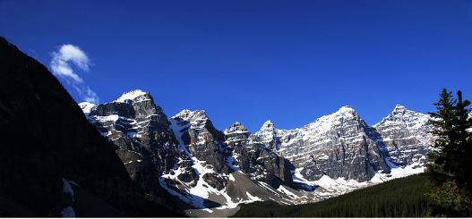
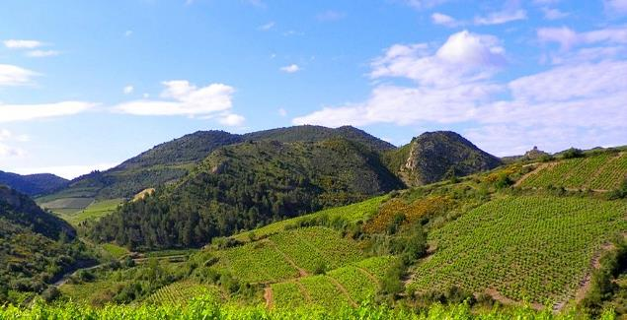
Let’s Summarize!
Some places on Earth have landforms like mountains, hills, or plateaus that rise high above the surface.
Photo courtesy of Bede735/Wikimedia Commons
Photo courtesy of zogy.net/Wikimedia Commons
Photo courtesy of Robert Raderschatt/Wikimedia Commons

Slide 11
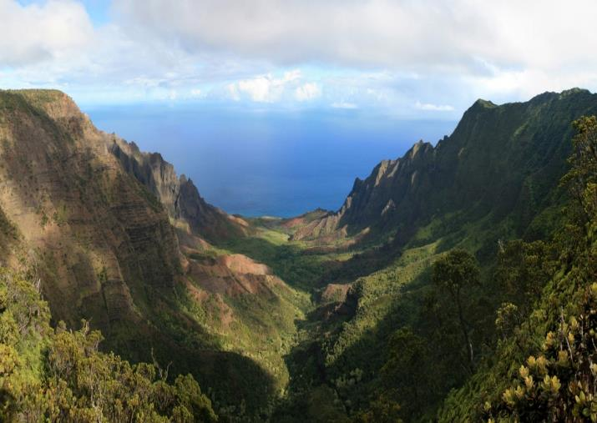
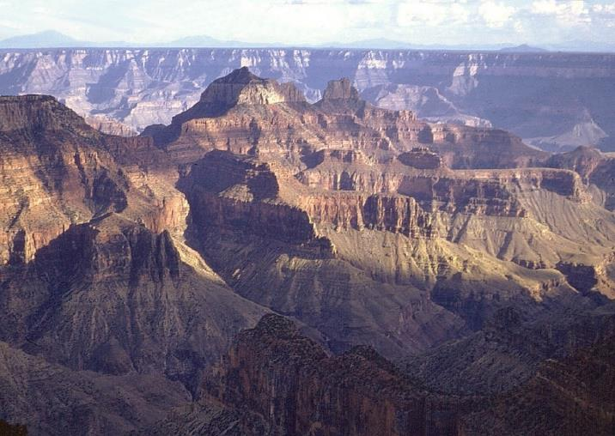
Let’s Summarize!
Other places have valleys and canyons that cut into Earth’s surface.
Photo courtesy of Gh5046/Wikimedia Commons
Photo courtesy of Pixabay.com

Slide 12
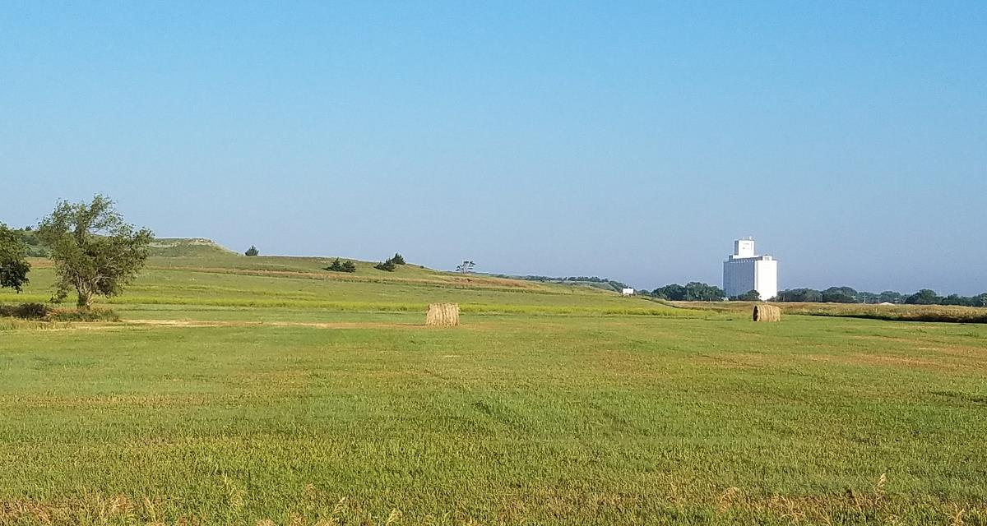
Let’s Summarize!
Some places are flat with very little change in elevation, like plains.
Photo courtesy of IveGoneAway/Wikimedia Commons

Slide 13
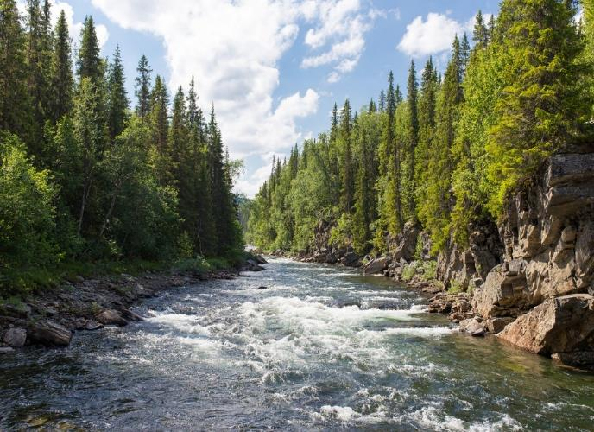
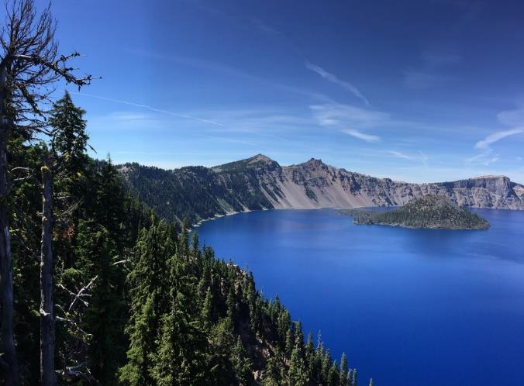
Let’s Summarize!
Some places have many bodies of water, such as rivers and lakes, and others places don’t.
Photo courtesy of Pixabay.com
Photo courtesy of Pixabay.com

Slide 14
Next Time
From our relief-map investigations, we know that Earth’s surface has many types of landforms.
We also know that the land looks different in different places.
Next time we’ll think about this question: Do landforms ever change?

