Slide 1
RESPeCT PD pROGRAM
Day 3
RESPeCT Summer Institute
Notes:
5 min
a. Take care of any housekeeping issues.

Slide 2
Agenda for Day 3
Day-2 reflections
Focus questions
Purposes and key features of STL strategies 4 and 5
Lesson analysis: STL strategies 4 and 5
Lunch
Content deepening: sound
Summary, homework, and reflections
Notes:
2 min
a. Talk through the agenda for the day.

Slide 3
Trends in Reflections
Lesson Analysis | Science Content Learning
Notes:
5 min
a. Invite participants to look at your feedback on their reflections from day 2 and offer reactions, comments, or follow-up questions.
b. Optional: Give participants an opportunity to refine the norms for working together.

Slide 4
Today’s Focus Questions
Lesson Analysis
Content Deepening
How can analyzing data and constructing explanations help students move forward toward deeper understandings of science ideas?
What does a good soundmaker consist of? What is your evidence?
Notes:
2 min
a. Introduce the focus questions that will guide today’s session.
b. “The words moving forward are in bold on the slide because that’s our theme for today and the rest of the week. Yesterday we practiced asking elicit and probe questions, which are great for revealing student ideas. But what do we do with those ideas once we’ve elicited them? How do we support students in moving forward toward deeper understandings of science ideas?”

Slide 5
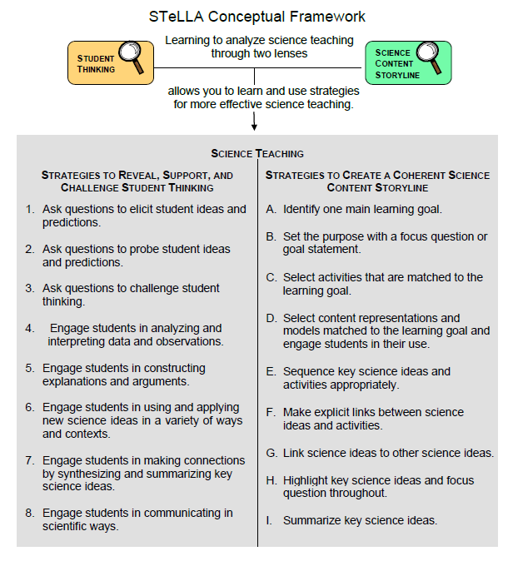
Notes:
1 min
a. Point out the strategies highlighted on the slide.
b. “We’ll continue working on understanding and using the Student Thinking Lens questioning strategies, but today we’ll focus on two closely related activity strategies. Strategy 4 engages students in analyzing and interpreting data and observations, and strategy 5 engages students in constructing explanations and arguments.”

Slide 6
The Student Thinking Lens: Moving Student Thinking Forward
How can we advance students’ science learning without just telling them about science ideas and expecting them to memorize the concepts?
By using STeLLA strategies 4–8 to engage students in making sense of the world around them.
Notes:
10 min
a. Initially, reveal only the question on the slide.
b. Have participants think about the question for a minute; then open up a brief conversation about it.
c. Ask the following questions to stimulate discussion if participants are struggling:
What was your experience as a science student in school or college?
How were you expected to learn science ideas? What learning methods were used?
Did you ever have the opportunity in science classes to make sense of the experiments you performed (instead of just recording the correct answers in a lab report)?
Did science teachers ever support your learning in ways that went beyond merely having you take lecture notes, read from a textbook, or record the correct answers in lab reports?
d. After discussing the questions, reveal the second part of the slide and emphasize the following points:
“Strategies 4 and 5 (as well as 6, 7, and 8) are designed to move student thinking forward by engaging students in sensemaking as they observe data. Rather than just spoon-feeding students science content to read or memorize, these activities lead them toward deeper understandings of science ideas as they construct meaning from evidence.”
“Telling students about science ideas is important, but teachers tend to tell students too much. Instead of doing the hard cognitive work for them, we need to create more opportunities for students to do the thinking and sensemaking themselves so they can truly understand the science concepts. So don’t be in such a hurry to tell students the right answers. Slow down and give them a chance to think!”

Slide 7
The Student Thinking Lens: Moving Student Thinking Forward
Strategies That Reveal Student Thinking | Strategies That Move Student Thinking Forward
1. Elicit questions
2. Probe questions
3. Challenge questions | 3. Challenge questions
4. Analysis and interpretation of data | 4. Analysis and interpretation of data
5. Construction of explanations | 5. Construction of explanations
6. Use and application of new ideas | 6. Use and application of new ideas
7. Synthesis and summarizing | 7. Synthesis and summarizing
8. Scientific communication | 8. Scientific communication
Notes:
5 min
a. Have participants look at the slide representation of the Student Thinking Lens strategies.
b. Ask: “What patterns do you notice?”
Key ideas:
Elicit and probe questions are designed only to reveal student thinking, not to challenge it.
The rest of the strategies reveal and challenge student thinking.

Slide 8
The Student Thinking Lens: From Questions to Activities
Look at the Summary of STeLLA Student Thinking Lens Strategies in the strategies booklet.
What distinguishes strategies 1–3 from the rest of the Student Thinking Lens strategies?
Notes:
5 min
a. Individuals: Have participants briefly examine the summary chart of STL strategies in the STeLLA strategies booklet (Summary of STeLLA Student Thinking Lens Strategies).
Note: Direct participants to the correct page in the strategies booklet or have them consult the table of contents.
b. Whole group: “How are the first three strategies different from the rest?”
Key ideas:
Strategies 1–3 are questions; the rest are activities.
Probe and challenge questions can and should be asked during all types of activities.

Slide 9
STL Strategies 4 and 5: Purposes and Key Features
Strategy 4
What are the purpose and key features?
Strategy 5
What are the purpose and key features?
Notes:
30 min
a. Small groups (12 min): Divide participants into two groups and assign one strategy to each group. Have one group create a poster charting the purpose and key features of strategy 4, and have the other group chart the purpose and key features of strategy 5. Each group should be prepared to answer the discussion question for the assigned strategy.
b. Whole-group share-out (18 min): Have groups report the purpose and key features of each strategy.
Key ideas:
Strategy 4 involves activities that engage students in organizing their data and/or observations and looking for patterns and meaning in them. They aren’t just “doing” activities or describing their observations.
Strategy 5 engages students in learning how to use logical thinking, evidence, and science ideas to construct explanations of scientific data or phenomena they have observed. It also engages them in critiquing various proposed explanations through scientific argumentation.
Remind participants that these strategies are closely related and will overlap in some activities. However, each has a specific purpose and unique attributes.

Slide 10
Relationships between Strategies 4 and 5
Discuss the question assigned to your group and be ready to share your ideas:
Group 1: How is analyzing/interpreting different from describing observations?
Group 2: How are strategy 4 and strategy 5 different? How are they related?
Group 3: How are scientific explanation and scientific argumentation related? How are they different? How are arguments in science different from arguments in everyday situations?
To support your responses, use the STeLLA strategies booklet and Quick Reference Tools for Strategies 4 and 5 (handout 3.1).
Notes:
15 min
a. Small groups (5 min): Divide participants into three small groups or pairs. Assign each group one question to discuss and tell participants to be ready to share their ideas with the entire group.
b. Emphasize: Participants should use the STeLLA strategies booklet and Quick Reference Tools for Strategies 4 and 5 (PD handout 3.1) to support their responses.
c. Whole-group share-out (10 min):
“What did you come up with for the first question?”
Key ideas for question 1: Analysis and interpretation involve moving beyond simply describing observations to doing something with the data, including (but not limited to) making comparisons, identifying relationships, and organizing data in ways that will reveal patterns (such as using charts, diagrams, and graphs).
“What did you come up with for the second question?”
Key ideas for question 2: Strategy 4 lays the groundwork for strategy 5. Before we can build a scientific explanation for a specific phenomenon, we need to make some observations, analyze the data to reveal patterns, and organize the data to gather the necessary evidence to support construction of a scientific explanation. A scientific explanation includes a claim that answers the question being studied, evidence that supports the claim, and reasoning that links the claim to the evidence and to science ideas.
“What did you come up with for the third question?”
Key ideas for question 3: A scientific explanation includes a claim that answers the question being studied, evidence that supports the claim, and reasoning that links the claim to the evidence and to science ideas. Scientific argument involves assessing the strength and quality of the evidence and reasoning in different scientific explanations for the same observations and determining which proposed explanation has the best supporting evidence, science ideas, and reasoning.

Slide 11
Practice Identifying Strategies 4 and 5
Examine student statements made during a science-class activity. Decide whether each statement represents the following:
An observation
An analysis or interpretation of the observations (e.g., describing a pattern) (strategy 4)
An attempt to construct an explanation that has a claim, evidence, and/or reasoning that uses science ideas (strategy 5)
An attempt to construct an argument (strategy 5)
Refer to Practice Identifying Strategies 4 and 5 (handout 3.2).
Notes:
15 min
a. “Before we view classroom video clips to identify and analyze strategies 4 and 5, we’re going to practice identifying observations, analyses, interpretations, explanations, and arguments from a handout of student statements. Learning to distinguish which strategy students are using in these examples will help us when we review the classroom videos, where the strategies aren’t always as clear cut.”
b. Refer participants to handout 3.2 in their PD program binders (Practice Identifying Strategies 4 and 5).
c. Pairs: Have participants work in pairs to analyze student statements in the handout.
d. Whole group: As participants discuss and clarify their analyses of the student statements, encourage them to refer frequently to the STeLLA strategies booklet and the Quick Reference Tools handout (PD handout 3.1).
Note: For examples of ideal participant responses, see PD Leader Master: Practice Identifying Strategies 4 and 5.

Slide 12
Lesson Analysis Focus Question
How can analyzing data and constructing explanations help students move forward toward deeper understandings of science ideas?
Notes:
Less than 1 min
a. Review the focus question that will guide today’s lesson analysis work.

Slide 13
Lesson Analysis: Review Lesson Context
Video Clip 1
Review the lesson context at the top of the transcript for video clip 1 (handout 3.3 in your PD program binder).
Notes:
2 min
a. “Now let’s see if we can recognize students analyzing and interpreting data in a classroom video clip.”
b. Review the lesson context at the top of the transcript for video clip 1 (handout 3.3 in PD binder), making sure participants understand both the content and activity in focus.

Slide 14
Lesson Analysis: Identify Strategy 4
Video Clip 1
Identify instances where the teacher or the students are engaged in analyzing and interpreting data and observations by
clarifying key observations,
identifying a pattern in the observations,
identifying what needs to be explained,
organizing data/observations, and/or
trying to make sense of the observations (analyzing, interpreting).
Discuss: How are these actions implemented in the video?
Link to video clip 1: 3.1_mspcp_gr1_sound_derose_L3_c1
Notes:
25 min
a. “As we watch the video clip, we’ll identify actions that illustrate strategy 4. Be on the lookout for instances where the teacher or the students do something listed on the slide. That’s what we’ll discuss first.”
b. Show the video clip.
c. Individuals: “Think about the strategy 4 actions listed on the slide.”
d. Whole group: “Discuss the question on the slide. Make sure to support your claims with evidence from the video transcript.”
Observations:
Identifying what needs to be explained:
At video segment 00:58, the teacher identifies what needs to be explained by asking students, “Where did the vibration [sound] start?” The question clarifies that sounds require a source.
At segments 01:22 and 01:30, students identify the source of the sound/vibration as the tuning fork (the teacher).
At segment 01:31, the teacher asks students to identify where the vibration went.
At segment 01:40, students indicate that the vibration traveled to the ear (Piper).
Trying to make sense of the observations (analyzing and interpreting):
At video segment 02:09, the teacher helps students make sense of their observations by asking, “Did that Slinky look like anything to you?” You could argue that the teacher is prompting (leading) students to look for a pattern of repeating vibrations in the Slinky.
At segments 02:18–02:31, a student observes, “It bounced off of the tuning fork and went to the ear … and the Slinky was bouncing, so it was the vibration bouncing off of it … to get to the ear.”
At this point, the teacher could have asked these challenge questions: “What does that look like? Tell us more about how you’re thinking about that.”

Slide 15
Lesson Analysis: Analyze Strategy 4 and Reflect
Video Clip 1
Analyze
What student thinking is revealed in the video clip by engaging students in analysis and interpretation?
Were any opportunities missed for engaging students in analyzing and interpreting data and observations?
Reflect
What did you learn about strategy 4 from analyzing this video clip?
Did the analysis process focus your attention on aspects you might not have noticed before? If yes, what is one example?
Notes:
25 min
a. Individuals: “For the first analysis question on the slide, study the transcript for video clip 1 and come up with a claim, evidence, and reasoning to support your claim. For the second analysis question, consider alternative moves the teacher could have made as you identify missed opportunities.”
b. Whole group: After participants have shared their analyses, ask, “Were there any missed opportunities for engaging students in analyzing and interpreting data?”
c. Reflect: Discuss the reflection questions on the slide, making sure participants share specifically what they learned about strategy 4.
Possible claim: Students aren’t successful in identifying the repeating pattern of vibrations in the Slinky model.
Evidence: 02:18–02:27
Reasoning: The student knows that sound moves as a vibration from the source to the ear but doesn’t identify this as a repeating pattern.
Missed opportunity: At video segment 01:52, after summarizing what students said, the teacher could have clarified student thinking by asking whether the Slinky itself moved to the other end. The teacher doesn’t clarify that the vibrations (started with her hand pushing the Slinky) travel in a repeating pattern through the Slinky. This pattern provides students with evidence that the vibrations move from one end of the Slinky to the other.

Slide 16
Strategy 5 Practice: Explanation and Argumentation
Analyze the weather sample transcript in the strategies booklet to find evidence of students engaged in constructing explanations and arguments by
making a claim that answers the investigation question,
making a claim and supporting it with evidence,
making a claim and supporting it with science ideas,
using logical reasoning to explain why the evidence supports a claim, and/or
making an argument.
Notes:
10 min
a. “Strategy 5 is the focus of the next video clip, although you may also see evidence of strategy 4 being used.”
b. Have participants analyze the transcript example for strategy 5 (“About Weather”) in the STeLLA strategies booklet and look for evidence of students engaging in constructing explanations and arguments.
Note: This is an important activity, but it can be cut if time is short.
c. “Before we view another classroom video, let’s practice analyzing an example of strategy 5 in the STeLLA strategies booklet. Read the sample transcript in the ‘About Weather’ section and see if you can find any evidence of the teacher engaging students in constructing explanations and arguments. Refer to the action list on the slide for guidance.”
d. Individual work time (5 min).
e. Whole-group share-out: Have participants share evidence from the transcript of students engaging in strategy 5, noting the specific action illustrated from the list on the slide.
Observations:
The example from the strategies booklet highlights the levels at which students make claims: (1) making a claim, (2) making a claim with evidence, and (3) making a claim with evidence and reasoning (using logic and science ideas). The teacher uses questioning strategies to support students in piecing together claims, evidence, and reasoning.
The transcript also shows students making arguments by presenting alternative explanations for their observations. As students think through possible alternative explanations for the phenomena they observe, they weigh evidence, engage in logical reasoning, and apply science ideas.
These are ideal examples of constructing explanations and arguments. It’s unlikely that most 1st graders would construct such complete explanations or arguments. The teacher would likely need to use questioning strategies and sentence starters to help students develop their explanations and arguments.

Slide 17
Lesson Analysis: Review Lesson Context
Video Clip 2
Review the lesson context at the top of the transcript for video clip 2 (handout 3.4 in your PD program binder).
Notes:
Less than 1 min
a. “Now we’re going to look at another video clip and focus on identifying strategy 5: Engage students in constructing explanations and arguments.”
b. Read the context of the lesson at the top of the transcript for video clip 2 (handout 3.4 in the PD program binder).

Slide 18
Lesson Analysis: Identify Strategy 5
Video Clip 2
Identify instances in the video clip where students are constructing explanations or arguments by
stating an explanation or claim,
using evidence from observations to support or develop the explanation/claim,
using science ideas to support or develop the explanation/claim,
using logical reasoning to develop the explanation/claim, and/or
engaging in argumentation (agreeing, disagreeing).
Discuss: How are these actions implemented in the video?
Link to video clip 2: 3.2_mspcp_gr1_sound_doody_L5_c2
Notes:
25 min
a. “As you watch the video clip, identify instances where students are engaged in constructing explanations and arguments (strategy 5). You might notice examples of strategy 4 (analyzing and interpreting data), but focus on identifying strategy 5. Also notice the kinds of questions the teacher asks (elicit, probe, or challenge).”
b. Before showing the video clip, read the list of actions on the slide.
c. Individuals: “Think about the strategy 5 actions listed on the slide.”
d. Whole group: “Discuss the question on the slide. Make sure to support your claims with evidence from the video transcript.”
e. Emphasize: “Strategy 5 is designed to help move student thinking forward toward deeper understandings of science ideas, so we should see challenge questions as well as probe questions in the video clip.”
Observations:
At video segment 01:42, the student answers the teacher’s question, “So where did the sound go?” by making a claim: “Everywhere.”
At segment 02:49, the student answers the teacher’s question (“What would be our proof or our evidence that the sound didn’t stop at Odessa’s ear?”) by providing evidence (“It went to Giovanni, and all them could hear it too”) and supporting it with logical reasoning.
Students’ comments at segments 02:09 (“Because the sound wave”) and 02:18 (“Our evidence [is] that the air carried the sound.”) don’t answer the teacher’s question (“How do we know that the sound went past Odessa?”); therefore, they don’t represent a claim.

Slide 19
Lesson Analysis: Analyze Strategy 5 and Reflect
Video Clip 2
Analyze
What student thinking is revealed by engaging students in constructing explanations of sound?
Were there any missed opportunities to support students in constructing explanations and arguments?
Reflect
What did you learn about strategy 5 from analyzing this video clip?
Did the analysis process focus your attention on aspects you might not have noticed before? If yes, what is one example?
Notes:
25 min
a. Individuals: “For the first analysis question on the slide, study the video transcript and come up with a claim, evidence, and reasoning to support your claim. For the second analysis question, consider alternative moves the teacher could have made as you identify any missed opportunities.”
b. Whole group: After participants have shared their analyses, ask, “Were there any missed opportunities for engaging students in constructing explanations and arguments?”
c. Reflect: Discuss the reflection questions on the slide, making sure participants share specifically what they learned about strategy 5.
Observations:
At video segments 03:28–03:58, students seem to understand that sound travels everywhere, but they don’t support their answers with evidence, logical reasoning, or argumentation.
Alternative: The teacher could have students use sentence starters with CER language (claim, evidence, reasoning):
“My idea is _______.”
“My evidence is______.”
“My reason is _______.”

Slide 20
Reflect: Key Ideas about Lesson Analysis
Lesson analysis slows down classroom events so we can focus on specific student thinking.
Making a claim based on evidence challenges us to listen carefully to what students are saying and understanding. When we make quick assessments, we might think they understand things they’re actually still struggling with.
Even though events happen fast in classroom teaching, we can get better at listening to students and making on-the-spot assessments of their understandings and confusion!
Notes:
2 min
a. “Let’s reflect on some key ideas you can take away from your lesson analysis experiences. These ideas may not reflect your personal experiences with lesson analysis so far, but hopefully you’ll see their value in the lesson analysis process over time.”
b. Read the key ideas on the slide.
c. Ask participants for their reactions to these ideas.

Slide 21
Summarizing Strategies 4 and 5
Create a word picture (a concept map, a thinking map, or other visual) to show how analysis and interpretation (strategy 4) are related to explanation and argumentation (strategy 5). Label any connecting arrows. Suggested words to use:
Analyze and interpret
Argument
Data
Evidence
Explanation
Logical thinking
Organize
Observe/observations
Patterns
Reasoning
Science ideas
Notes:
15 min
Note: Skip this activity if time is short.
a. Individuals: To summarize strategies 4 and 5, have participants work independently to create visuals that show how analysis and interpretation, (strategy 4) are related to explanation and argumentation (strategy 5).
b. Pairs: “Share and compare your visuals with a partner.”
c. Whole group: “What questions did this activity raise for you?”

Slide 22
Reflect: Lesson Analysis Focus Question
How can analyzing data and constructing explanations help students move forward toward deeper understandings of science ideas?
Notes:
5 min
a. Review today’s lesson analysis focus question.
b. Think-Pair-Share: “Think for a moment about this focus question and how you might convince parents or colleagues that analyzing data and constructing explanations moves student thinking forward toward deeper understandings of science ideas. Then share your ideas with an elbow partner.”

Slide 23
Sound
SCIENCE CONTENT DEEPENING Grade 1
Notes:
Less than 1 min
a. “Now let’s work on deepening our science-content understandings of sound and its properties.”
Note: Refer to the Sound Content Background Document and the Common Student Ideas about Sound as needed throughout this phase.

Slide 24
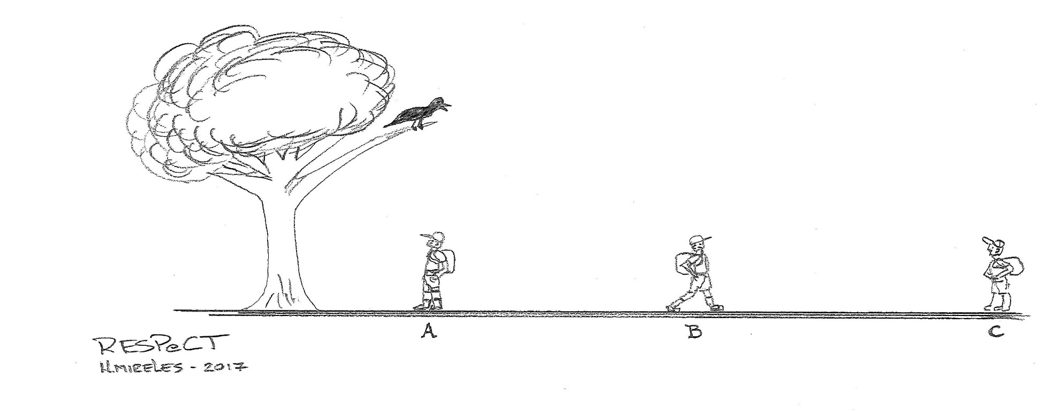
Review: Sound and Sound Intensity
What is the source of sound in this diagram?
How does sound travel from the source to the man standing at the base of the tree?
What happens to the intensity of the sound as the man walks away from the source? Why?
Courtesy of Hector Mireles
Notes:
5 min
a. “In our last content deepening session, we talked about the intensity of sound. First, let’s review some key ideas about sound. What is the source of sound in this diagram?”
Ideal response: The bird is the source of the sound, or specifically vibrations from the bird’s vocal chords.
b. “How does sound travel from the source to the man standing at the base of the tree?”
Ideal response: When the bird makes a sound, it causes the air around it to vibrate. These vibrations travel through the air as sound waves in all directions. When the vibrations reach the ears of the man standing at the base of the tree, his eardrums vibrate, and the brain interprets these vibrations as sound.
c. “What happens to the intensity of the sound as the man walks away from the source? Why?”
Ideal response: As the man walks away from the source, the sound waves become more spread out. As the distance increases, the intensity and energy of the sound diminish, and the sound becomes softer (quieter).
d. During this discussion, allow participants to refer to resources from the previous session as needed (e.g., science notebooks, handouts, and the content background document).

Slide 25
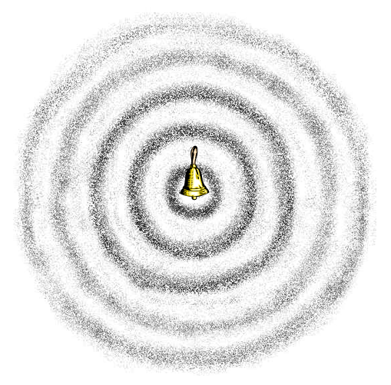
Drawing Sound Waves
Circular Wavefront
The source (bell) is at the center (inner circle).
Circles (sound waves) travel away from the source in all directions.
A person receives a sound when a circle reaches his or her ears.
The distance between the circles is always the same. It represents wavelength.
Courtesy of BSCS
Notes:
2 min
a. “As we discussed last time, there are many methods we can use to draw sounds, such as drawing lines, waves, or notes, but the best method is the circular wavefront convention.”
b. Review the following ideas:
The source is at the center of the diagram in the innermost circle.
Circles moving away from the center represent sound waves traveling away from the source in all directions.
The circles farther away from the source are bigger because these sound waves traveled away from the bell at an earlier time. The larger circles indicate weaker sound waves.
The energy in larger circles is spread out more thinly.
A person receives the sound when the circle reaches his or her ears.
Ears capture less sound energy farther from the source, so the sound is less intense.
The distance between the circles is always the same. That represents the wavelength.
c. Remind participants that in a real three-dimensional world, the circles would actually be spherical shells.

Slide 26
Review: Who Will Receive More Sound?
Draw sound waves on the handout.
Who will receive more sound when the bell rings? Why?
Who will receive less sound? Why?
Courtesy of BSCS
Notes:
8 min
a. “Next, you’ll use the circular wavefront convention to draw sound waves and explain why a sound gets softer as you move away from the source.”
b. Distribute handout 3.5 (Who Will Receive More Sound?).
c. Individuals: Direct participants to draw sound waves on the handout and then explain who will receive more sound or less sound when the bell rings.
d. Whole group: Invite participants to share their diagrams and explanations with the group. Ask probe and challenge questions to clarify participants’ thinking.
Ideal responses:
As the sound waves/vibrations move away from the source (the bell) in all directions, they become more spread out as the distance from the source increases. As a result, the intensity and energy of the sound diminish, and the sound becomes softer. Closer to the source, the sound is louder because the vibrations are larger and the intensity and energy of the sound is greater.
The people on the diagram who are closest to the bell receive more sound energy, so the sound they perceive will be louder. Farther away from the source, the circles are so large and the sound waves are so spread out, that listeners will receive much less sound energy and hear a much softer sound.
The guy who is farthest from the bell might not hear any sound at all if the sound waves are too spread out and the sound energy has diminished too much.

Slide 27
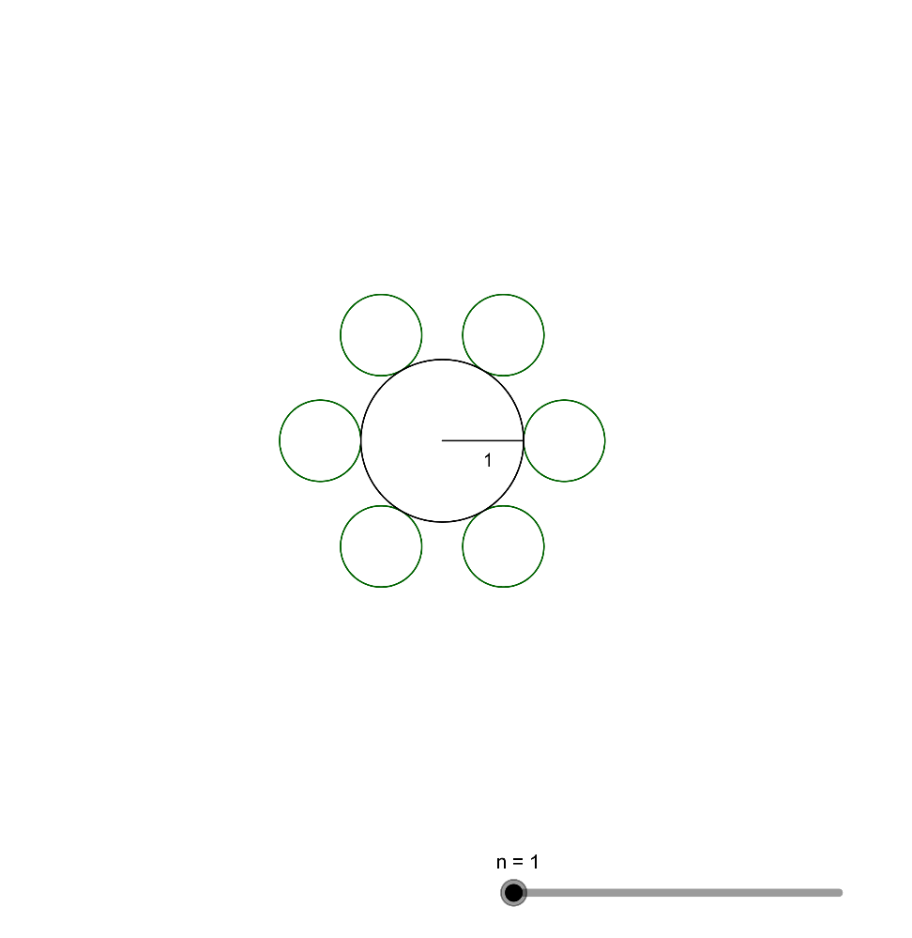
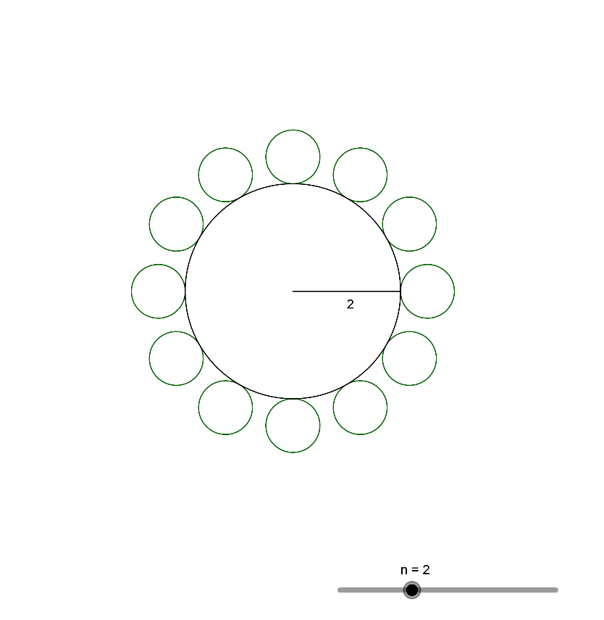
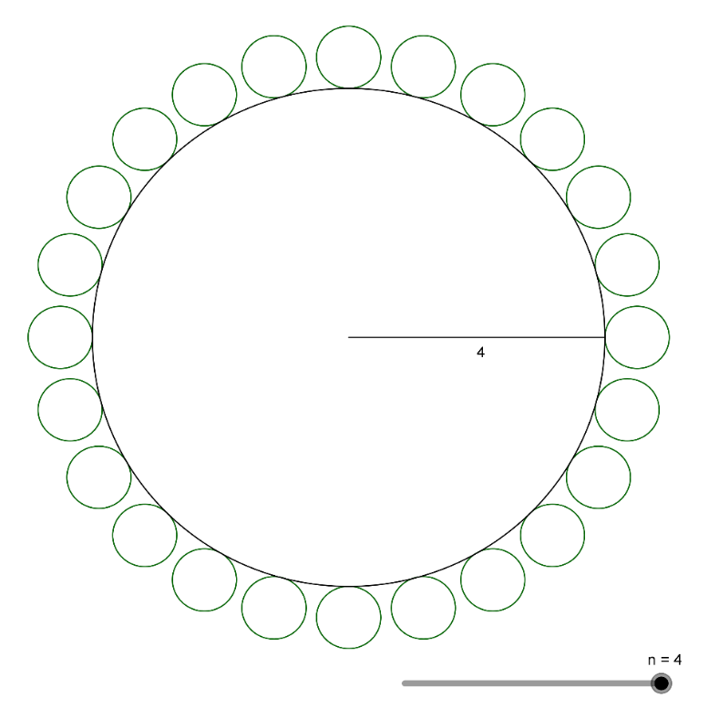
Math Challenge: Portions of Sound Energy
Teams:
Discuss the scenarios on the handout and work toward a solution for each scenario together.
Be prepared to share your solutions with the group and explain how you reached them.
Notes:
50 min
a. “We’ve explored why sounds get softer as we move farther away from the source. Next, we’ll engage in a little math challenge to help us figure out how much sound energy listeners receive at varying distances from the source.”
b. Distribute handout 3.6 (Math Challenge: Portions of Sound Energy) and walk participants through the instructions.
c. Note that participants will use the graphical representations on the handout to illustrate the effect of sound moving in all directions and why sound gets softer as the distance from the source increases. The representation will also show the effect of background noise on sound at greater distances.
d. Small groups: Have participants work through the handout in teams of three or four. Allow 5–10 minutes for teams to discuss each scenario and arrive at a solution that answers each question. (See the correct responses to the questions in the solutions section below.)
e. Whole group: Ask each team to share their solutions for each question on the handout. Challenge team members to explain how they arrived at their solutions. Ask probe and challenge questions to clarify participants’ ideas and reasoning (e.g., “What unit of sound energy would each person receive in each scenario?” “How does this unit of sound relate to the question?”). Encourage participants to listen carefully to one another’s ideas and agree or disagree, ask questions, and add on.
f. After the discussion, direct each team to revise their solutions based on the feedback they received. Than have them graph their results on the chart on the last page of the handout and answer the challenge questions. (Each team should create only one graph.)
Solutions:
Scenario 1: For n = 1, 60 units is divided by 6 (the number of listeners). Each listener receives 10 units of sound energy (60/6 = 10).
Scenario 2: For n = 2, 60 units is divided by 12 (the number of listeners). Each listener receives 5 units of sound energy (60/12 = 5).
Scenario 3: For n = 4, 60 units is divided by 24 (the number of listeners). Each listener receives 2.5 units of sound energy (60/24 = 2.5).
Challenge questions:
As the circle gets larger, each person around the circle gets a smaller share of the original sound energy. Eventually, the portion of energy is so small that it becomes indistinguishable from background noise (air conditioner, noisy playground, freeway).
Sound gets softer as we move farther away from the source because the sound waves spread out more, and the intensity and energy of the sound diminishes.
If we had very big ears, we would receive a larger portion of the sound energy.
If everyone receives 4 units of sound energy from the nearby freeway, the sound from the soundmaker would be very hard to hear for those in n = 4 who receive only 2.5 units of energy, since that sound is softer than the freeway sound.

Slide 28
Content Deepening Focus Questions
What does a good soundmaker consist of? What is your evidence?
Notes:
3 min
a. Introduce the focus questions on the slide.
b. Elicit ideas from participants based on prior knowledge and experience.
c. As participants share, record their ideas and evidence on chart paper.

Slide 29
Characteristics of Good Soundmakers
An oscillator that is free to vibrate between 20 and 20,000 Hz (for human ears to hear it)
A resonator that has a large volume of air (resonance space) near an oscillator and one frequency with greater amplification than other frequencies
Notes:
Less than 1 min
a. Review the characteristics of good soundmakers on the slide.
b. “Today we’ll test the characteristics of five homemade soundmakers to determine whether they satisfy the criteria for good soundmakers.”
c. “All good soundmakers have an oscillator that vibrates and a resonator that amplifies the sound.”
d. Have participants copy these characteristics into their science notebooks to refer to during the investigation.

Slide 30
Musical Sound versus Noise
Musical sound: Consists of many frequencies, but a resonator captures and amplifies a few frequencies and filters out the rest.
A good musical instrument produces sound consisting of a few strong frequencies related to one another in a simple way (harmonicity).
Musical sound “sings” like a note. We can hum along with them, and it’s very clear if we’re on or off key. Professional instruments are designed this way.
Noise: Consists of all frequencies sounding off at the same time. Examples: Air rushing by an object (“shshshshshshsh”); water rushing along a creek and splashing on rocks; keys thrown on a desk surface; a radio that isn’t tuned to station.
Notes:
4 min
a. “Anyone can make a sound!”
b. Throw your keys on the desk to demonstrate this point.
c. “But some sounds are louder, more uniform, more repeatable, more memorable, and more sustainable than other sounds. To understand what constitutes a good soundmaker from a poor soundmaker, we have to distinguish between musical sound and noise.”
d. Read through the distinctions between musical sound and noise on the slide.
e. Emphasize: “Soundmakers that generate musical sounds amplify a few select frequencies and filter out the rest. Musical sounds “sing” notes we can hum along with, but noise consists of all frequencies sounding off at the same time.”
f. Have participants write key distinctions in their science notebooks to refer to during the following investigation.

Slide 31
Investigation: Musical Sound or Noise?
Work with a partner to test the five different soundmakers.
Make a sound with each soundmaker and use our criteria to decide whether the soundmaker is producing a musical sound or noise.
Discuss these questions and record your responses:
What is vibrating (oscillating) in the soundmaker?
What is amplifying the sound (resonator)?
Is the sound musical or noisy? How do you know?
Notes:
3 min
a. “Next, you’ll work with a partner to test five different soundmakers: a tuning fork, a plastic container with a rubber band stretched across the top, a graduated cylinder containing water, a stadium horn called a vuvuzela, and a clucker.”
b. “Using the criteria we just discussed, you and your partner will produce a sound with each soundmaker and decide whether the sound is musical or noisy. In other words, you’ll distinguish good soundmakers from poor soundmakers.”
c. “As you test each soundmaker, discuss the questions on the slide and write your responses in your notebooks.”
d. Have participants copy the questions into their science notebooks. Then demonstrate how to make sounds with each soundmaker.

Slide 32
Investigation: Musical Sound or Noise?
Strike the tuning fork on the palm of your hand and hold it in the air. What do you hear?
Strike the tuning fork again, but this time, place it upright on a hard surface (a resonator). What do you hear?
Courtesy of Hector Mireles
Notes:
8 min
a. Have participants pair up with an elbow partner. Then give each pair a tuning fork.
b. Note that tuning forks are harder to use than they appear.
c. Walk participants through the following steps for making sounds with their tuning forks:
Strike the tuning fork on a firm object like the palm of your hand, the corner of your knee, your ankle, or the sole of your shoe.
Do not strike the tuning fork against a table, a chair, or any other hard surface because this will damage it. You also shouldn’t strike it against anything metallic. This will create a series of sharp rings instead of the correct sound.
The strike must be abrupt or brisk, like striking a drum. Don’t let the arms of the tuning fork touch anything immediately after striking them.
If you strike the tuning fork correctly, the arms will move as if they’re squeezing a piece of air between them.
d. Give participants an opportunity to practice making sounds with the tuning fork before beginning their investigation.
e. Review the instructions on the slide and then have pairs begin the investigation. Remind them to discuss the three questions in their notebooks and write down their answers.
f. Whole group: Following the investigation, invite a few pairs to briefly share their observations and answers to the questions.
g. Emphasize: “If you hold a vibrating tuning fork in the air, you can hear it only if you place it near your ear. If you hold the base of the tuning fork on a hard surface, such as a table, a file cabinet, or a box, the object becomes a resonator and amplifies the sound so that everyone in the room can hear it. If used correctly, a tuning fork is a good soundmaker that produces a musical sound.”

Slide 33
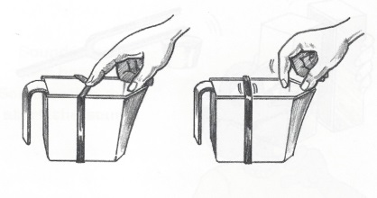
Investigation: Musical Sound or Noise?
Place the rubber band around the container and stretch it across the opening. Then pluck the rubber band to make a sound. What do you hear?
Next, take the rubber band off the container and stretch it around your fingers using approximately the same tension. What do you hear?
Courtesy of BSCS
Notes:
10 min
a. Give each pair a plastic container and a rubber band.
b. Direct participants to place the rubber band around the container and stretch it across the opening. Then have them hold the container by the rim without touching the base and pluck the rubber band to make a sound.
c. Then have participants take the rubber band off the container and stretch it around their fingers. Have them pluck the rubber band and see if they can produce the same sound.
d. Remind pairs to discuss the three questions in their notebooks and write down their answers.
e. Whole group: Following the investigation, invite a few pairs to briefly share their observations and answers to the questions.
f. Emphasize that the vibrating rubber band acts as an oscillator, and the container acts as a resonator. A tighter rubber band will produce a higher pitch. This primitive soundmaker should produce a sound that’s more musical than noisy, making it a good soundmaker. When the rubber band is simply stretched across participants’ fingers instead of a container, it will produce a poor-quality sound with low volume. Without the container acting as a resonator, the rubber band isn’t a good soundmaker.

Slide 34
Investigation: Musical Sound or Noise?
Using the funnel, slowly pour the bottle of water into the graduated cylinder. (Make sure to place the tray under the cylinder to catch any spills.)
Listen to the sound the water makes as it rises from the bottom of the cylinder to the top. What do you hear?
Courtesy of Hector Mireles
Notes:
8 min
a. Give each pair a graduated cylinder, a small funnel, a bottle of water, and a tray to catch spills.
b. Have participants place the tray under the cylinder and then pour water into the cylinder using the funnel.
c. Ask participants to pay close attention to the sound the water makes as it rises from the bottom of the cylinder to the top.
d. Remind pairs to discuss the three questions in their notebooks and write down their answers.
e. Whole group: Following the investigation, invite a few pairs to briefly share their observations and answers to the questions.
f. Emphasize that the oscillator in this soundmaker is the gurgling water, and the resonator is the column of air or resonance space in the cylinder that gets smaller as the water rises. The gurgle of water at the bottom of the cylinder isn’t very musical. However, the spout hits the surface of the water and creates a noisy sound that is somewhat filtered. As the water rises to the top of the cylinder, a lot of frequencies seem to increase in pitch, but the resonator selects and amplifies some of them. The graduated cylinder is a very, very primitive soundmaker and isn’t very loud.

Slide 35
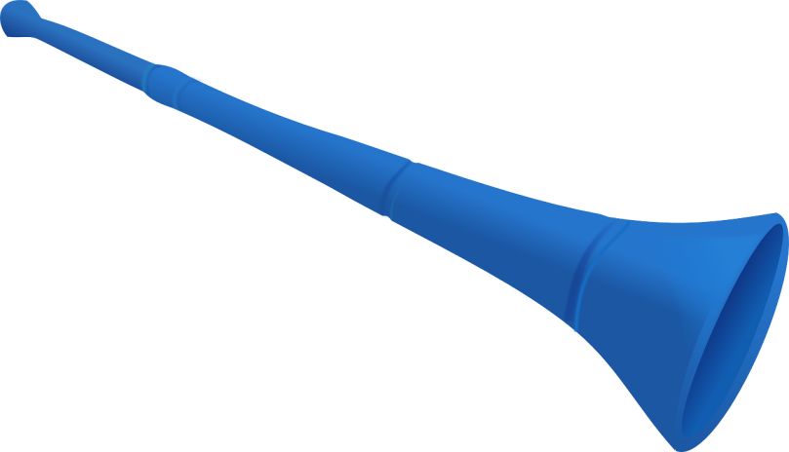
Investigation: Musical Sound or Noise?
Make a buzzing sound with your lips. Press your lips together and blow through them like playing a trumpet. Think of an elephant making a trumpeting sound with its trunk!
Now make a buzzing sound with your vuvuzela! What do you hear?
Courtesy of Pixabay.com
Notes:
8 min
a. Distribute a vuvuzela to each pair of participants.
b. First, have participants make a buzzing sound with their lips.
Note: To make this sound, participants should press their lips together and blow hard through them, a bit like playing a trumpet. It may also help to think of an elephant making a trumpeting sound with its trunk.
c. Next, have participants press their lips together and blow into the mouthpiece of the vuvuzela. The horn should create a loud honking sound.
d. Ask participants to compare the sound they made with their lips and the sound they made with the vuvuzela.
e. Remind pairs to discuss the three questions in their notebooks and write down their answers.
f. Whole group: Following the investigation, invite a few pairs to briefly share their observations and answers to the questions.
g. Emphasize: “In the first instance, your buzzing lips were the oscillator, and the volume of air in your mouth acted as a resonator. When you blew into the vuvuzela, your lips were acting as an oscillator again, and the volume of air in the neck of the vuvuzela was the resonator. The horn creates a more musical sound than your buzzing lips alone, and the bell-shaped end of the vuvuzela selects a sequence of frequencies.”

Slide 36
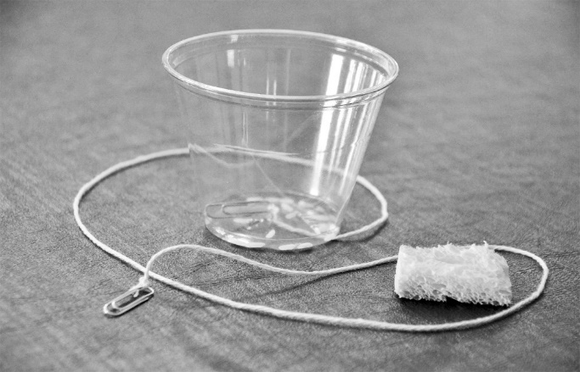
Investigation: Musical Sound or Noise?
Make a sound with the clucker by holding the cup upside down, placing the moist sponge around the string, and sliding the sponge down the string.
Then set the cup down and simply rub the sponge on the string.
Photo courtesy of BSCS
Notes:
8 min
a. Give each pair a clucker and demonstrate again how to make a sound by holding the cup upside down (with the string dangling down from inside the cup), placing the moist sponge around the string, and sliding the sponge down the string.
b. Direct pairs to first make a sound with their cluckers. Then have them set the cup down and simply rub the sponge on the string. Ask them to compare the results.
c. Remind pairs to discuss the three questions in their notebooks and write down their answers.
d. Whole group: Following the investigation, invite a few pairs to briefly share their observations and answers to the questions.
e. Emphasize that the string in this soundmaker is the oscillator, and the volume of air beneath the cup is the resonator. When the clucker is used correctly, the wet sponge rubbing against the string causes the string to vibrate, and as the string touches the cup, these vibrations generate many frequencies that the resonator amplifies. The sound the clucker produces is musical only if the cup is in direct contact with the string.

Slide 37
Investigation: Musical Sound or Noise?
Which soundmaker produced a musical sound? What’s your evidence?
Which soundmaker produced noise? What’s your evidence?
Which of the five soundmakers met the criteria for a good soundmaker?
Remember: A good soundmaker has a vibrating component (an oscillator) and a neighboring resonator (volume of air) that amplifies the sound.
Notes:
5 min
a. Read the questions on the slide and discuss the results of the investigation.
b. Ask probe and challenge questions to help participants correctly identify the oscillator and resonator in each soundmaker and recognize the importance of the resonator (air, table, etc.) in producing a musical sound rather than noise (or no sound at all).
Key ideas:
A good soundmaker consists of a vibrating component (oscillator), such as string, lips, water, the metal arms of a tuning fork, and a rubber band, and a neighboring volume of air (resonance space) that acts as a resonator to amplify selected frequencies while filtering out other frequencies.
The tuning fork vibrating on a hard surface, the plastic container with a rubber band, the vuvuzela, and the clucker are all examples of good soundmakers. The tuning fork held in the air, rubber bands around fingers, buzzing lips, and the sponge rubbing the string are examples of poor soundmakers.

Slide 38
Reflect: Content Deepening Focus Questions
What does a good soundmaker consist of? What is your evidence?
Notes:
6 min
a. Review the focus questions on the slide.
b. Pairs: Have participants pair up and answer the focus questions based on the results of today’s investigation.
c. Whole group: Invite pairs to share their ideas and evidence with the group. Record key ideas and evidence on chart paper.
d. Ideal response: All good soundmakers must have a vibrating component (an oscillator) and a volume of air, or resonance space, that acts as a resonator and amplifies certain frequencies more than others. For humans to hear the sound, the frequency must fall between 20 and 20,000 Hz.

Slide 39
STeLLA Strategies 4 and 5
How did you engage in analyzing and interpreting data and observations in this session (strategy 4)?
How did you engage in constructing explanations and arguments (strategy 5)?
How did our soundmaker investigation help move your thinking forward toward more-scientific understandings of sound?
Notes:
6 min
a. “As we wrap up today’s content deepening work, let’s think about how we applied STeLLA strategies 4 and 5 in our investigation of various soundmakers.”
b. Read the questions on the slide.
c. Pairs: Have participants discuss these questions with an elbow partner and write their answers in their science notebooks.
d. Whole group: Invite participants to share their responses with the group.
e. During this share-out, challenge participants to be clear about when they were simply observing something and when they were actually analyzing and interpreting data and observations. Also challenge participants to identify which type of analysis they were doing: (1) Using logic and evidence (data), and/or (2) using evidence, science ideas, and logic.

Slide 40
Summary: Moving Student Thinking Forward
How can we advance student thinking without simply telling students about science ideas and asking them to memorize the concepts?
Refer to our Effective Science Teaching chart from day 1. Which of these ideas do you want to highlight based on the strategies we’ve explored so far? Anything you want to add or modify?
Notes:
5 min
a. Have participants share ideas about the first question on the slide. Then ask, “What are some things we’ve discussed today that address this question?”
b. Refer participants to the Effective Science Teaching chart from day 1 and discuss the remaining questions on the slide. Modify the chart as participants share their ideas.

Slide 41
Summary: Today’s Focus Questions
Lesson Analysis
Content Deepening
How can analyzing data and constructing explanations help students move forward toward deeper understandings of science ideas?
What does a good soundmaker consist of? What is your evidence?
Notes:
5 min
a. Review today’s focus questions.
b. Discuss: “The STeLLA strategies booklet claims that strategies 4 and 5 are ways of moving student thinking forward. How would you support or challenge that claim? In other words, are you convinced that letting students analyze data and construct explanations will help them move forward toward deeper understandings of science ideas?”
c. Ask: “What key ideas do you now have about how to address our content deepening focus questions?”

Slide 42
Homework
Review strategy 6 in the STeLLA strategies booklet and complete the STL Z-fold summary chart for this strategy: Engage students in using and applying new science ideas in a variety of ways and contexts.
Be prepared to share your assigned lesson plan review.
Notes:
1 min
a. “Tomorrow we’ll focus on another strategy to help move student thinking forward toward deeper understandings of science ideas.”
b. Review the homework assignment and have participants copy it into their science notebooks.

Slide 43
Reflections on Today’s Session
Complete the Daily Reflections sheet (handout 3.7).
What new idea or insight did you have today related to strategy 4 (analyzing and interpreting data and observations) and strategy 5 (constructing explanations and arguments)?
What ideas do strategies 4 and 5 give you about things to try or change in your science teaching?
Answer one of these questions: (1) What important science idea are you taking away from our content deepening work today? Remember to state the idea in a complete sentence. (2) What question do you have about sound (i.e., something you’re unclear or wonder about)?
Notes:
4 min
a. Have participants reflect on today’s session and answer the questions on the Daily Reflections sheet (handout 3.7 in PD program binder).
Note: To support this task, encourage participants to refer to the STeLLA strategies booklet, the charts they created for STL strategies 4 and 5, the Effective Science Teaching chart, and their STL Z-fold summary charts.

Slide 44
Norms for Working Together: The Basics
Purpose: Build trust and develop a productive study group for all participants.
The Basics
Arrive prepared and on time; stay for the duration; return from breaks on time.
Remain attentive, thoughtful, and respectful; engage and be present.
Eliminate interruptions (turn off cell phones, email, and other electronic devices; avoid sidebar conversations).
Make room for everyone to participate (monitor your floor time).
Notes:
Hidden slide—available for use as needed.

Slide 45
Norms for Working Together: The Heart
Purpose: Build trust and develop a productive study group for all participants.
The Heart of RESPeCT Lesson Analysis and Content Deepening
Keep the goal in mind: analysis of teaching to improve student learning.
Share your ideas, uncertainties, confusion, disagreements, questions, and good humor. All points of view are welcome.
Expect and ask questions to deepen everyone’s learning; be constructively challenging.
Listen carefully; seek to understand other participants’ points of view.
Notes:
Hidden slide—available for use as needed.

