Slide 1
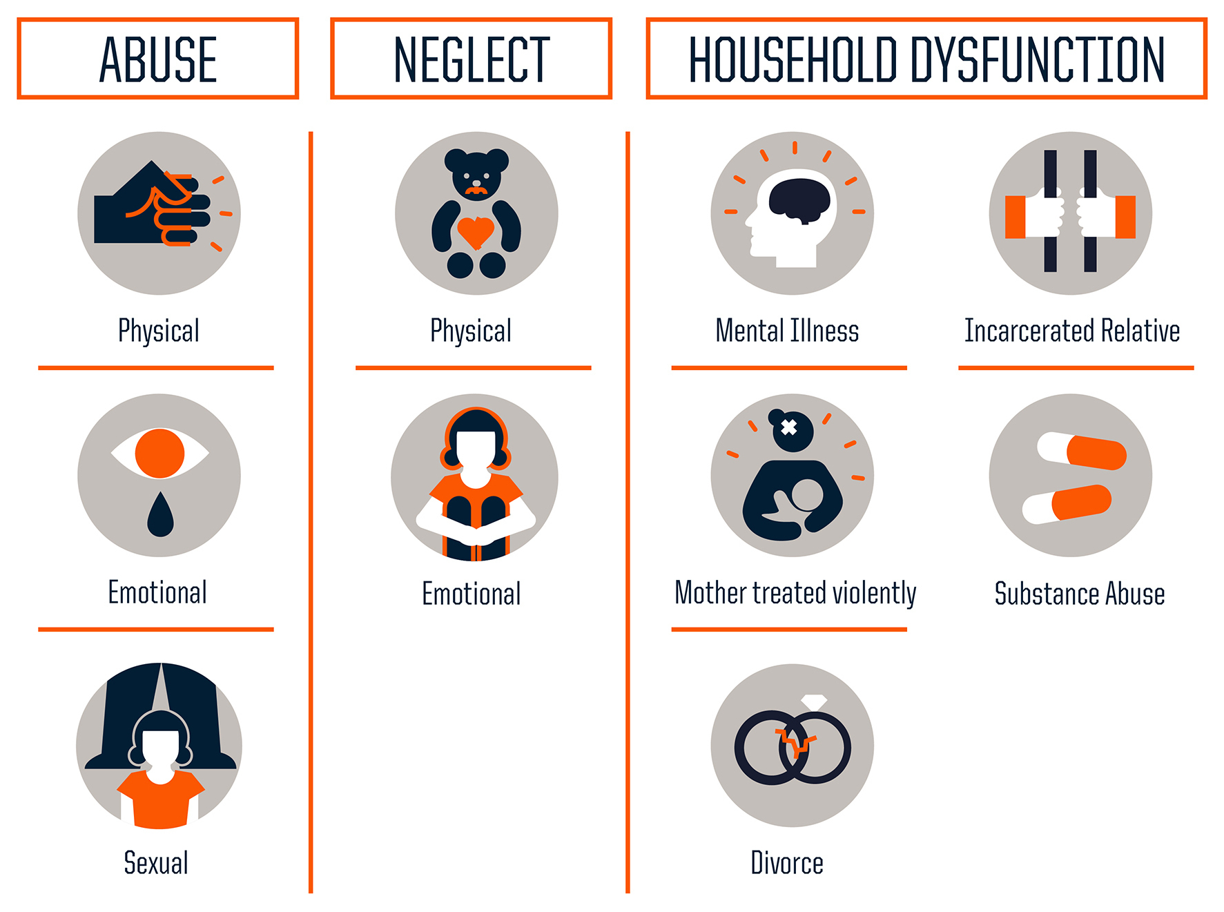
Adverse Childhood Experiences
Among Incoming Cal Poly Pomona Students
R. Saldivar¹, L. Murkar², I. Altamirano², L. Dial²
J. Fuqua², R. Baumsteiger², A. Auslander³, E. Kiresich⁴, & J. Jellyman³
¹ Sociology, ² Psychology, ³ Biological Science, & ⁴ Nutrition, California State Polytechnic University, Pomona (CPP)
Introduction
Results
Results
Adverse childhood experiences (ACEs) are traumatic or potentially traumatic events that occur before the age of 18.
There are 10 types of ACEs (or adversity) that can be divided into 3 categories: (i) abuse (e.g., verbal), (ii) neglect, and (iii) household dysfunction such as mal- treatment, witnessing violence, and living in an environment that is harmful to development (Figure 1).
ACEs are associated with increased risk of a wide range of health conditions from depression, coronary heart disease, and stroke. In fact, it is related to increased risk of premature mortality and worse well-being^{1,2, 3, 4}.
The current study is designed to determine the estimated prevalence of ACEs among a subgroup of Cal Poly Pomona (CPP) freshman and transfer students. It also examined whether ACEs is associated with current mental health, in the group.
ACEs were experienced by many respondents (Figures 2-4 and Table 1.
ACE | %
Did you live with anyone who had a problem with drinking or using drugs, including prescription drugs? | 30%
Did you experience unwanted sexual contact...? | 20%
Did you lose a parent through divorce abandonment, death or other reason? | 18%
Did a parent or adult in your home ever hit, beat, kick, or physically hurt you in any way? | 15%
Did you feel that you didn’t have enough to eat, had to wear dirty clothes, or had no one to protect or take care of you? | 14%
Did your parents or adults in your home ever hit, punch, beat, or threaten to harm each other? | 12%
Did you live with anyone who went to prison? | 12%
Students who have one or more ACE(s)
75% of respondents reported at least one ACE (Figure 2).
Figure 1. Three categories of ACEs or adversity.
Figure 2. Percentage of students who responded 'Yes' (red) or 'No' (blue) to the question about whether they feel love from their family.
Did a parent or adult in your home ever swear at you, insult you, or put you down?
Table 1. Percentage of students who responded 'Yes' to 7 of the 10 ACE questions.
49% of respondents reported being verbally abused at home (Figure 3).
Discussion
The study findings indicate many students have experienced adverse childhood experiences (ACEs) in their lifetime.
A large majority of the subgroup had experienced at least one ACE, and almost every ACE was associated with mental health (e.g., depression and anxiety).
The actual prevalence of ACEs may be underestimated, as individuals might be reluctant to disclose sensitive information or may not recognize that they experienced verbal abuse or parental mental illness.
Further analysis is needed to determine whether different demographic groups have experienced more ACEs and have higher rates of mental health issues (e.g., anxiety and depression).
Figure 3. Percentage of students who responded 'Yes' (red) or 'No' (blue) to the question regarding verbal abuse.
Methods
Did you live with anyone who was depressed, mentally ill, or attempted suicide?
Participants: An email was sent out to all CPP students inviting incoming freshman and transfer students to participate in our study. Of the 1,478 students who responded to the survey, 512 qualified and completed the survey. They qualified if they were at least 18 years of age and an incoming freshman or transfer student in Fall 2023.
Demographics: Gender at birth: 62% female. Ethnicity (select all that apply): Latino or Hispanic (48%) and non-Latino White (34%) were most frequent.
Survey: 10 questions were included about childhood adversity (ACEs) and current mental health including 2 anxiety items ("Feeling nervous, anxious, or on edge" and "Not being able to stop or control worrying") and 2 depression items ("Little interest or pleasure in doing things" and "Feeling down, depressed, or hopeless.")
This project is part of a larger study in which participants were offered biometrics testing, nutrition, exercise, and positive psychology wellness help through CPP. The CPP IRB approved the study.
Frequencies were calculated. Pearson correlations were run to determine if ACEs correlate with current mental health..
38% of respondents reported living with someone with a mental illness (Figure 4).
Figure 4. Percentage of students who responded 'Yes' (red) and 'No' (blue) to the question about living with someone with a mental illness.
Did you feel that no one in your family loved you or thought you were special?
References
21% of respondents reported feeling no love from their family (Figure 5).
Merrick MT, Ford DC, Ports KA, Guinn AS. Prevalence of adverse childhood experiences from 2011-2014 Behavioral Risk Factor Surveillance System in 23 states. JAMA Pediatrics. 2018; 172: 1038.
Centers for Disease Control and Prevention. Leading causes of death by age group 2017. https://www.cdc.gov/.
Brown DW, Anda RF, Tiemeier H, et al. Adverse childhood experiences and the risk of premature mortality. American Journal of Preventive Medicine 2009; 37: 389–96.
Underwood, J. W., Conley, A. H., & Waters, J. M. (2024). The Impact of Adverse Childhood Experiences on College Student Stress and Well-being. Journal of College Student Retention: Research, Theory & Practice.
Figure 5. Percentage of students who responded 'Yes' (red) and 'No' (blue) to the question about feeling no family love.
Almost all ten ACEs were positively correlated with two anxiety items (“Feeling nervous, anxious, or on edge” and “Not being able to stop or control worrying”) and two depression items ("Little interest or pleasure in doing things" and "Feeling down, depressed, or hopeless"), with p values of .05 or less.
Acknowledgement
This work was supported by CPP Project Hatchery (Team Wellspring) and a Preventing and Responding to Adverse Childhood Experiences (ACEs) Associated Health Conditions and Toxic Stress in Clinics through Community Engagement grant from the California Department of Health Care Services.

