Slide 1
Cornerstone System Implementation & Coaching Forward

Slide 2
Performance Management Implementation Timeline
Configuration Complete
Organizational Check in – Check Up
Coach the Coach
Ready for launch.
Fully configured.
Performance Coaching
Technical Office Hours.
Every MPP has had a check in and/or given one.
Nov 15
Jan 10
Feb
22
April 5
Mar 15
May 17
1X1s w/ VPs
MPP Training
Goals
Individual consultations with the head of each division.
3 hours
Technology & Coaching Framework.
5 Sessions
Every MPP puts their goals in the system.
Every MPP is expected to use the system for Performance check-ins and Reviews

Slide 3
Cornerstone Implementation & Coaching Forward Agenda
What’s Changing
Cornerstone Features
Coaching Forward with Cornerstone
Coaching Forward Process
Benefits of Coaching

Slide 4
What’s changing?
CSU Competencies, Goals, and Performance Reviews

Slide 5
CSU Competencies
Leadership Competencies
Team Building
Mission Oriented
Strategic Thinking and Alignment
Core Competencies
Integrity
Communication
Accountability

Slide 6
Performance Reviews
Goals
Part of the evaluation rating
goals and competencies will be rated equally
can be managed throughout the evaluation period
Competencies
Can be used in the performance evaluation and have been
Align to the CSU wide competencies
Cornerstone Reviewer can:
Add a co-planner to the performance evaluation
Download copies of performance evaluation
Cornerstone Reviewer and Reviewee can:
Reference check-ins and goals while completing the self-review and manager evaluation
Add attachments to the performance evaluation (up to three)

Slide 7
The Cornerstone Performance Management system

Slide 8
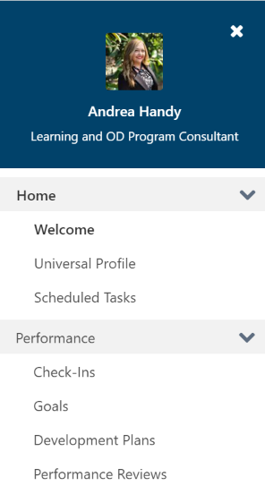
Cornerstone Features
Goals
Development Plans
Check-Ins
Performance Reviews
Help
Universal Profile

Slide 9
Universal Profile

Slide 10
Kudos

Slide 11
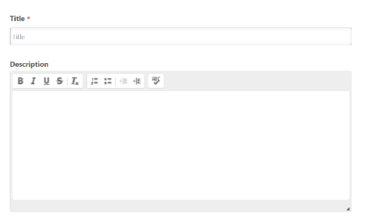
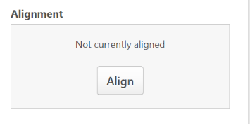
Goals - How to Create a Goal
Step 1 Click on create
Step 2. Fill out your goal title and description
Step 3: Align your goals if needed

Slide 12
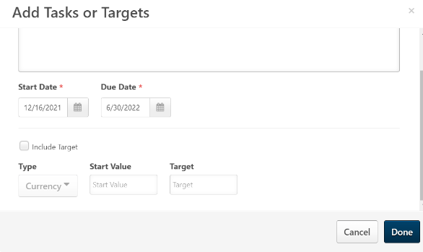
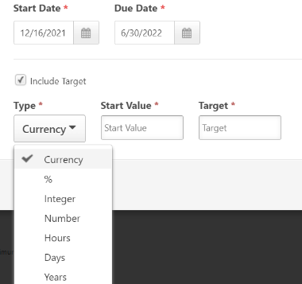
Goals – How to Create a Goal
Step 4: Add Tasks and Targets to reach your goal
Step 5: (Optional) Include Target and Type
Step 6: Submit your goal

Slide 13
Manage Shared and Dynamic Goals

Slide 14
Goals

Slide 15
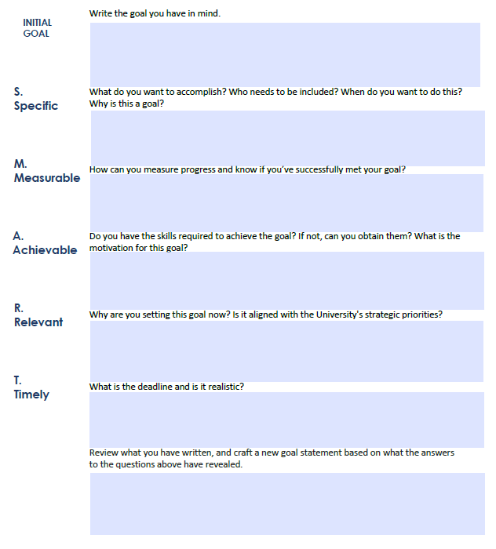
Goal Activity

Slide 16
Development plans
Key improvement over previous iteration of performance review process
Allows team member to partner with leader to create a strategy to increase their skills and capacity
Great opportunity to invest in employee and increase their confidence

Slide 17
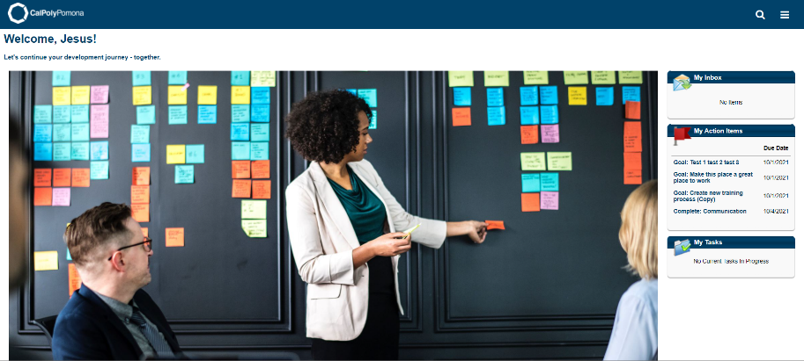
Development plans – Hamburger Menu

Slide 18
Development plans button

Slide 19
DEVELOPMENT PLANS

Slide 20
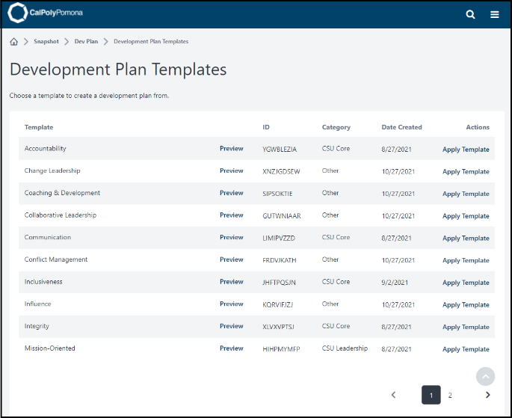
DEVELOPMENT PLAN TEMPLATES

Slide 21
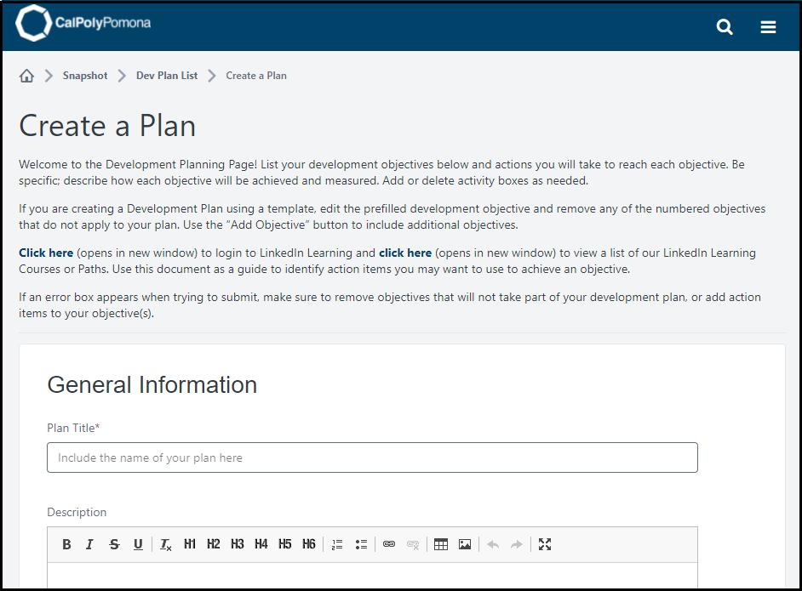
Creating Development plans

Slide 22
Performance Reviews

Slide 23
Performance Review Workflow

Slide 24
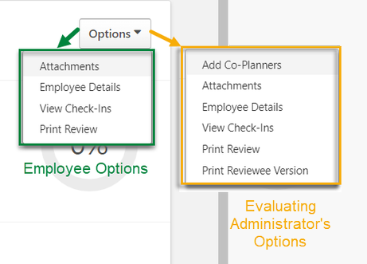
Performance Evaluation

Slide 25
Where do we start? Coaching and Check-In's

Slide 26
Performance: Check-ins
Check-ins help managers create an engaging and productive work environment by:
Being involved in their employees’ work lives
Helping employees set goals and prioritize their projects
Holding employees accountable for their performance
Gallop, 2014

Slide 27
Coaching is…..
Discovering
Active Listening
Observing
Reflecting
Empowering
“Coaching is unlocking a person’s potential to maximize their own performance. It is helping them to learn rather than teaching them.”
‐ John Whitmore

Slide 28
Coaching Isn’t
Mentoring
Teaching
Therapy
Consulting

Slide 29
Benefits of Coaching
Increased or improved
Actions towards achieving goals
Self-reliance
Job and life satisfaction
Contribution to the team and the organization
Responsibility and accountability for actions and commitments
Ease of work and productivity with others
Effective communications
-Ken Blanchard Companies

Slide 30
4 Parts of the Coaching Process
1. POINT
Purpose, Outline, Input, Transition
2. Relationship & Discovery
Rapport
Discover the past state
Discover the current state
Discover the future state
3. Action Items & Accountability
Recap conversation
WWWHF - "Who Will do What by When and How will you Follow up?"
4. Document
Tools & Resources for Documenting

Slide 31
What's the P.O.In.T.?
P – Purpose​
What are you trying to accomplish in your time together?
O – Outline​
What are you going to cover?
In – Employee Input​
What would they like to discuss?
T - Transition
What comes next?

Slide 32
Purpose and Outline
Purpose
Creates a clear intention for the meeting
Ensures that everyone is working toward the same goal
Can be shared both in invitation and to open a discussion
Relating purpose to team member’s best interest will create buy-in
“The purpose of our meeting is…”
Outline
Flows naturally from the purpose statement
References the agenda items for your meeting
Creates clarity

Slide 33
Input and Transition
Input
Furthers the goal of creating buy-in by making the team member a part of the process
Solicit their suggestions on topics to cover
It’s critical to welcome any suggestion
Their suggestions will give you insight into their perspective and priorities
“What have I missed that you’d like to discuss?”
Transition
Segue into the next part of the conversation (Discovery)

Slide 34
P.O.In.T. Individual Activity
Choose what type of Check- In you want to have with your employee
Well – Being
Coaching
One on One
Customize
Use your participant guide to complete the purpose and outline
Share with the group in the chat

Slide 35
Discovery Don’ts and Do’s
Use this time to do a lot of telling
Get sidetracked and off course (go back to the P.O.In.T of the conversation)
Make assumptions
Make judgements
Fix the problem
Use this time to build, strengthen, or repair the relationship
Ask open ended questions
Listen with the intent to understand NOT to be understood
Prepare the questions you might ask (past, present and future)
Approach questions with curiosity

Slide 36
Discovery
Scenario:
Darryl is meeting with Oscar to review his six-month evaluation. Darryl is at the “discovery” portion of the conversation.
What might Darryl ask Oscar about the past six months?
What might Darryl ask Oscar about the current state?
What might Darryl ask Oscar about the future state?

Slide 37
Discovery Scenario 1
Scenario:
Michael is a new HEERA manager that reports to Kelly. Michael has requested a meeting with Kelly to discuss some challenges he is experiencing.
What are some past tense questions Michael might ask?
What questions can Michael ask to understand the current state?
What might Michael ask Kelly to understand what the ideal future state would be?

Slide 38
Discovery Scenario 2
Scenario:
Dwight is a HEERA manager who reports to Angela, and he has recently taken on additional roles and responsibilities and has missed multiple deadlines and deliverables over the last two months. Angela has scheduled a meeting with Dwight to have a discussion.
What are some past tense questions Dwight might ask?
What questions can Dwight ask to understand the current state?
What might Dwight ask Angela to get to the ideal future state?

Slide 39
Discovery Practice – Breakout
Choose one of the three scenarios
Determine who will be the employee and who will be the manager
Role play the scenario – The manager will ask the questions and the employee will answer the questions - 5 Minutes
Get feedback – 1 Minute
Switch roles
Use your participant guide for scenarios

Slide 40
Action Items and Accountability
Recap conversation
Provide a summary together
W.W.W.H.F
W – Who
W – does What
W – by When
HF – How will you Follow up?

Slide 41
Document
What kind of tools do you use to document conversations and commitments (action items)?
Why is documentation an important best practice?

Slide 42
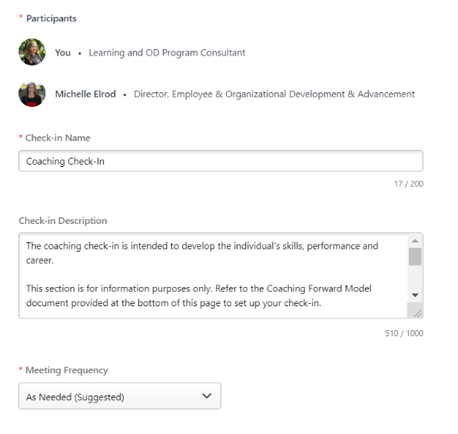
Check-In Features
There are 4 types of Check-Ins
One on One Check-In
Coaching Check-In
Customize your Own Check-In
Wellbeing Check In

Slide 43
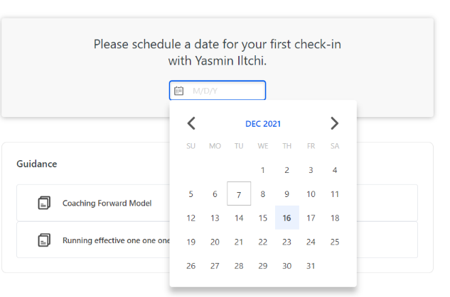
Check in Steps
Choose
Choose your check in type
Complete
Complete the necessary fields
Click
Click continue ,choose your suggested date, and submit
Schedule
Schedule your check-in, in your outlook calendar

Slide 44
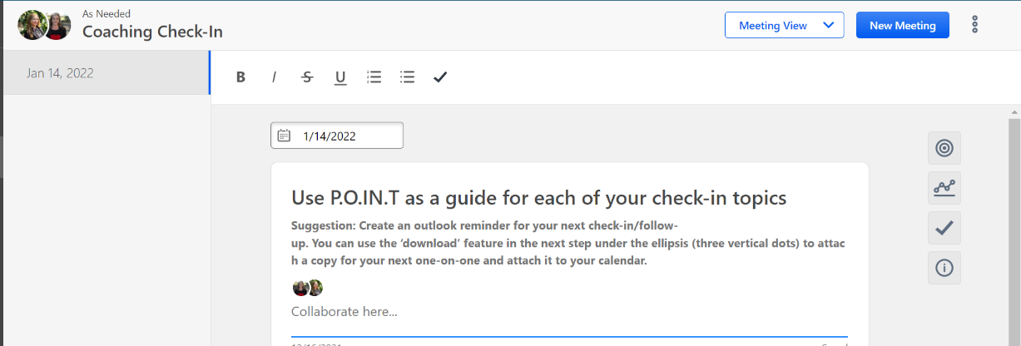
Check in – Collaborate

Slide 45
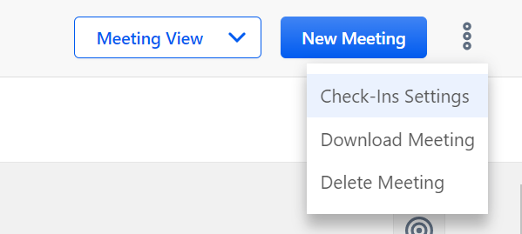
Check In – Download Meeting
The Download Meeting Feature allows you to download and save or print your check in details and notes

Slide 46
Check in – Additional Features
Goals
Development Plan
Follow Up Activities
Guidance

Slide 47
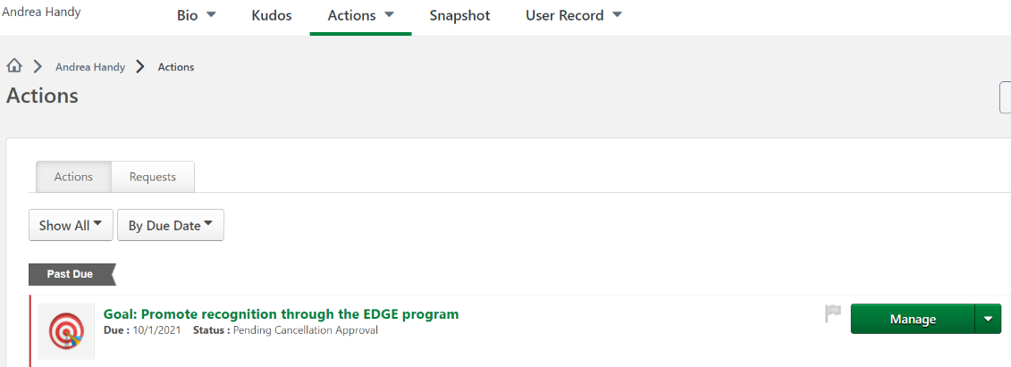
Universal Profile Actions

Slide 48
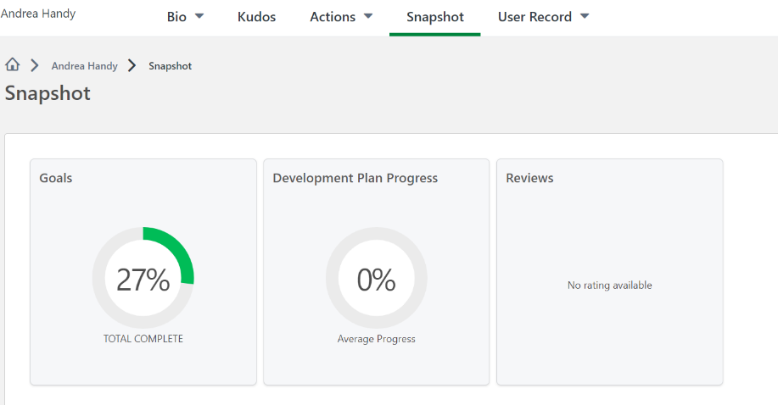
Universal Profile Snapshot

Slide 49
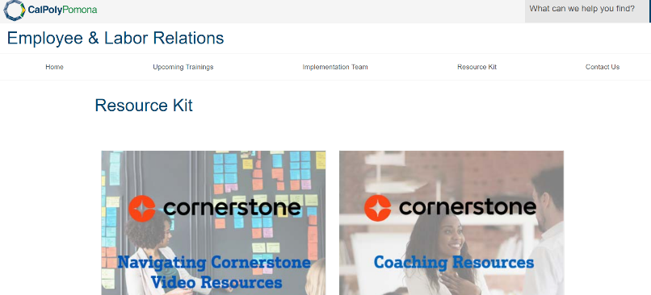
Online Help and Resources
CPP Cornerstone Website
How to Videos
Coaching Resources
https://www.cpp.edu/eoda/employee-labor/crnerstone-platform/resource-kit/index.shtml

Slide 50
Building Your Coaching Skills
Please watch this video
https://www.linkedin.com/learning-login/share?account=56973593&forceAccount=false&redirect=https%3A%2F%2Fwww.linkedin.com%2Flearning%2Fmanager-as-coach%2Fbuilding-your-coaching-skills%3Ftrk%3Dshare_video_url%26shareId%3DQXVqhCDzR26J3pFVxZ3x1w%253D%253D

Slide 51
Best practices for Coaching forward with Cornerstone
When in doubt, ask a question
Be patient with yourself and your team members
Reach out when you need help

Slide 52
Coach the Coach Sessions
Performance Goals – March 2, 2022, at 1:00 p.m. - 3:00 p.m.
Feedback and Recognition – April 5, 2022, at 1:00 p.m. – 3:00 p.m.
Resources and Open forum - May 19, 2022, at 10:00 a.m. – 12:00 p.m.
Development Plans - June 20, 2022, at 1:00 p.m. – 3:00 p.m.
Reviews - July 21, 2022, at 10:00 a.m. – 12:00 p.m.
Check ins – August 23, 2022, at 10:00 a.m. – 12:00 p.m.

Slide 53
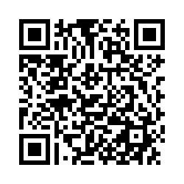
Questions? Final Thoughts?
What if you were 20% more engaged?
What if your team was 20% more engaged?
What is one action you can take to be more engaged?
WHAT
WHY
WHERE
WHEN
WHO
HOW
November 2016
© 2016 UCR HR - Employee & Organizational Development
53

