Slide 1
Coach the Coach Session

Slide 2
What’s the P.O.In.T?
P – Purpose​: What are you trying to accomplish in your time together?
O – Outline: What are you going to cover?
In – Employee Input​: What would they like to discuss?
T - Transition: What comes next?

Slide 3
Learning Outcomes
Learn a consistent and structured method of goal setting using SMART goals
Utilize available resources to build your SMART Goal and receive support to enter your goal in the Cornerstone System
Understand your role to support and encourage staff to set more strategic and effective goals

Slide 4
Understanding Your Role When it comes to goals

Slide 5
SMART Goals: Key Points
Reviewee should create their own goals
As part of this process, reviewee will collaborate with reviewer
Reviewee will also be responsible for updating goals
Discussions in one-on-one meetings should touch on goals to ensure that both reviewer and reviewee are on the same page

Slide 6
SMART Goals

Slide 7
Breaking Down SMART Goals
S-Specific: You need to be clear on what you want to accomplish
M-Measurable: The goal should be quantifiable. For example, generating one lead a month.
A- Achievable: The goal should not be too easy or too hard. Set ambitious but realistic targets
R-Relevant: The target should align with your business goals
T-Timebound: Set a timeframe and/or a clear deadline for achieving your goals

Slide 8
SMART Goal Example
Beginning Goal Example: I’m going to become a writer.​
Specific: I’m going to write a sci-fi novel.​
Measurable: My novel will be at least 300 pages.​
Achievable: I will write 2,500 words per week, which is a stretch, but doable if I cut out TV three nights per week.​
Relevant: I’ve always dreamed of becoming a professional writer.​
Time-bound: I will start writing tomorrow on March 3rd, and finish by June 30th, 2023 .​
Revised SMART Goal Example: I’m going to write a 300-page science fiction novel in 6 months, finishing by June 30th, 2023 at the latest. I will do this by writing 2,500 words per week.​

Slide 9
What’s Missing?
Develop and implement vehicle replacement plan to increase the average Miles per Gallon on the total fleet to 25 MPG.
Develop a quality improvement process for the sanitary sewer system that reduces the failure rate by 12/31/11.
I’d like to get a promotion.

Slide 10
Goal Sharing Exercise

Slide 11
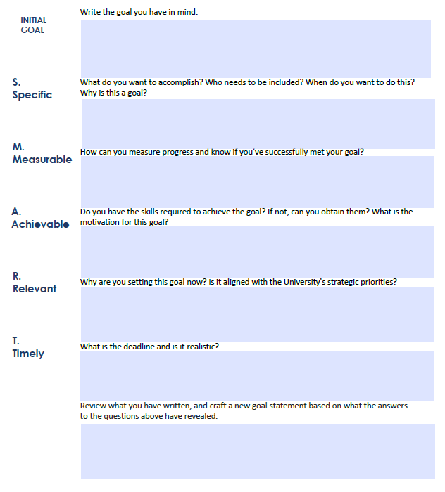
Goal Activity

Slide 12
Cornerstone Demo

Slide 13
Review - What’s the P.O.In.T?
P – Purpose​: What are you trying to accomplish in your time together?
O – Outline: What are you going to cover?
In – Employee Input​: What would they like to discuss?
T - Transition: What comes next?

Slide 14
Coach the Coach Sessions
Performance Goals – March 2, 2022, at 1:00 p.m. - 3:00 p.m.
Feedback and Recognition – April 5, 2022, at 1:00 p.m. – 3:00 p.m.
Resources and Open forum - May 19, 2022, at 10:00 a.m. – 12:00 p.m.
Development Plans - June 20, 2022, at 1:00 p.m. – 3:00 p.m.
Reviews - July 21, 2022, at 10:00 a.m. – 12:00 p.m.
Check ins – August 23, 2022, at 10:00 a.m. – 12:00 p.m.

