Slide 1
Spring 2024 Advising & Registration
College of Education & Integrative Studies

Slide 2
Orientation Agenda
Welcome!
Topics:
Advising at CPP
Changing majors
Quick overview of ECS and LS subplan/options
Advising tools
Spring course recommendations
Register!

Slide 3
Zoom Etiquette
Make sure your first and last name is visible as your screen name. You can also include your preferred pronouns.
Mute yourself when you are not talking.
Make sure your audio is on, as well as your video. If you need to step away for a moment, turn your camera off but then turn it back on when you return.
Use the Chat feature within Zoom for questions that you would like the speakers to answer.
To protect both your and others' privacy, there should be only one entry per student logged into the Zoom session. If there are multiple entries (such as other family/guests logged in), they will be asked to exit the session.
Notes:
Pronoun examples: They/Them/Theirs, She/Her/Hers, He/Him/His, etc.

Slide 4
Advising
CEIS Student Success Center

Slide 5
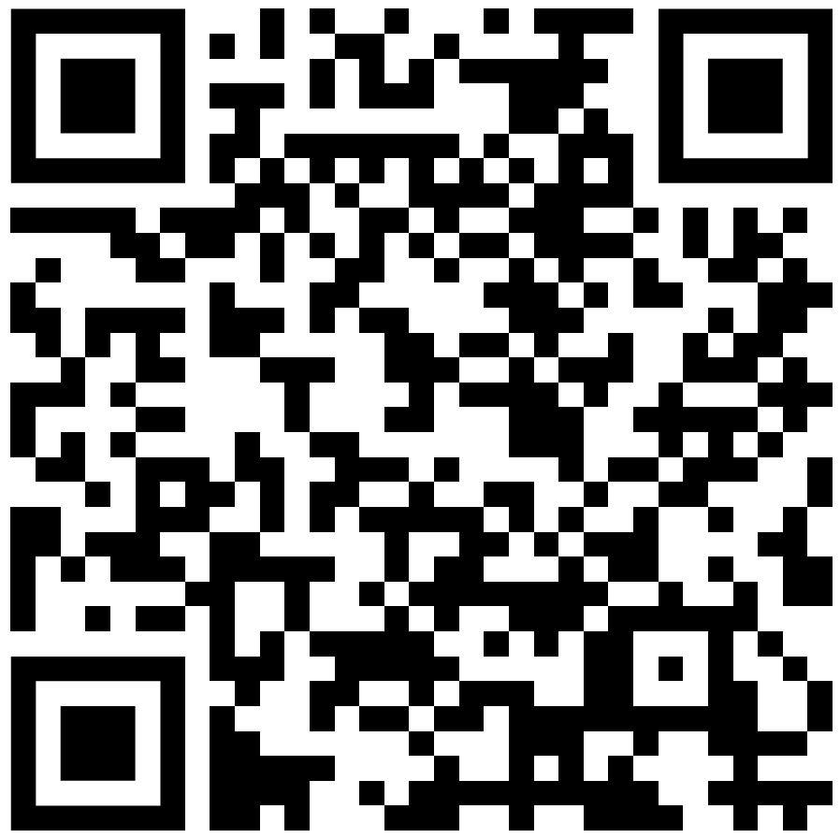
Your Advisors
CEIS Student Success Center
Building 94 Room 275
ceisadvising@cpp.edu
Early Childhood Studies
Liberal Studies
Berlinda Crawford
Pronouns: She/her/ella
bacrawford@cpp.edu
Marlene Melinte
Pronouns: She/her/ella
mmelinte@cpp.edu
Guide you through understanding your curriculum
Teach you how to use advising tools
Provide tips on how to improve your GPA
Interpret university policies and procedures
Connect you with campus resources
Equip you with the knowledge to make wise academic decisions
Appointments
& Drop-in hours
@ceisadvising

Slide 6
ECS Subplan/Options
Teaching
Child Development Permit- Master Teacher
Preparation for the Multiple Subjects (elementary) credential program after BA
Non-Teaching
Careers related to early childhood but are not teaching, and generally require graduate or professional school after BA.
Childlife, School counselor, Child Psychologist, Speech-Language Pathologist, Home Visitor, Early Interventionist
Dual Language preschool teacher
Multilingual Teaching
Child Development Permit-Master teacher
PK – Grade 3
Childcare teacher or Director
Head Start Teacher
Preparation for Bilingual authorization as part of Multiple Subjects (elementary) credential program after BA.
ITEP
Integrated Teacher Preparation Program for Mild/Moderate and Extensive Support Needs.
Combined BA and preliminary special education credential.
Preparation for the Multiple Subjects (elementary) credential program after BA.
Only for transfer students with Elementary Education Associates Degree. All other associate and non-associate degree students should complete one of the other teaching pathways.
Spanish/English
Notes:
You can change your subplan/option by filling out the ”Change of Major or Option” eform located on the Registrar’s Office website.
This form can be submitted as early as summer 2024 (after you’ve completed a semester at CPP)

Slide 7
LS Subplan/Options
Pre-Credential
Preparation for the Multiple Subjects (elementary) credential program after BA.
General/Liberal Studies
Graduate school or a professional career in nonprofit, corporate, public health, education, and more.
Examples: School counselor, Marriage & Family Therapist, Occupational Therapist, Social Worker, college professor, etc.
ITEP
Integrated Teacher Preparation Program for Mild/Moderate and Extensive Support Needs.
Combined BA and preliminary special education credential.
Notes:
You can change your subplan/option by filling out the ”Change of Major or Option” eform located on the Registrar’s Office website.
This form can be submitted as early as summer 2024 (after you’ve completed a semester at CPP)

Slide 8
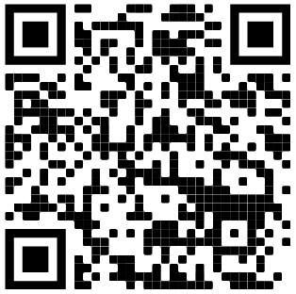
Changing Majors or Subplan/Options
Registrar's Office e-form: "Change of Major or Option" link
Changing Your Major:
Find the requirements to change into other majors on the Change of Major Tool:
You can submit the e-form after spring 2024.
Register for courses that best align with the Major and Subplan/Option that you intend to complete.
Connect with a Career Counselor in spring for career path questions and concerns.
Changing Your Subplan/Option:
You can submit the e-form after spring semester.
This change is not considered a Change of Major, so it you will usually not have requirements to meet (except for ITEP programs).

Slide 9
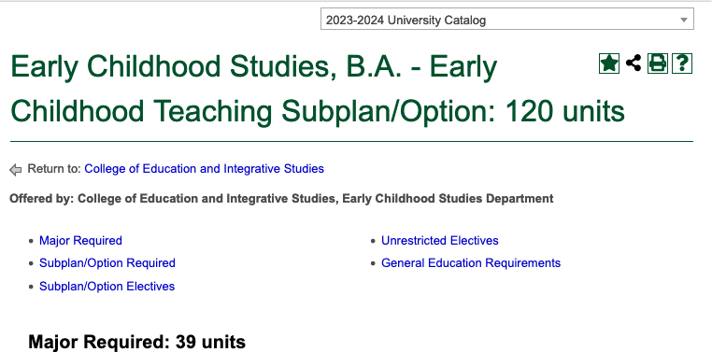
Your Curriculum Sheet
Academic Programs Curriculum Sheets
Also printable from the CPP University Catalog
While you stay in your major (ECS or LS), you will continue using the same curriculum (2023-24) all the way through graduation.
Notes:
You can find the curriculum to any major on the catalog.
Be sure to use the appropriate catalog year, which should align with the academic year that you started the program, and then continue using the SAME curriculum year through graduation.

Slide 10
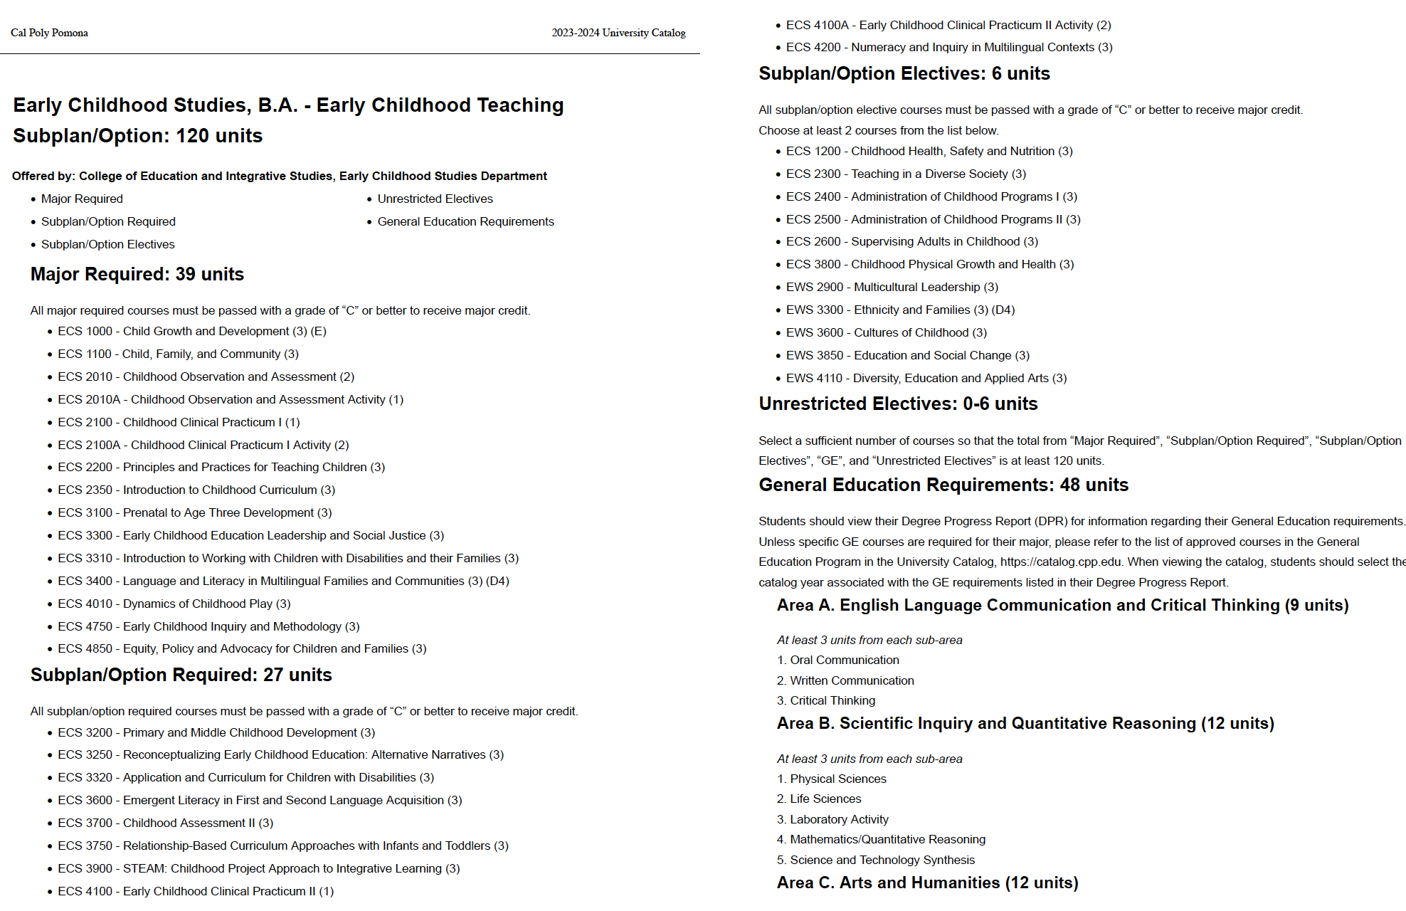
Your Curriculum Sheet
Requirement Areas
Major Required​
Major Electives​
Option/Emphasis Required courses​
Option/​Emphasis Electives​
Unrestricted Electives​
General Education​

Slide 11
2023 General Education Curriculum
GE Area A (9 units)
Written Communication (Grade of "C-" or better)
Critical Thinking (Grade of "C-" or better)
GE Area B (12 units)
Physical Sciences
Life Sciences
Lab Activity
Mathematics /Quantitative Reasoning (Grade of "C-" or better)
Science and Technology Synthesis (upper division)
GE Area C (12 units)
Visual and Performing Arts
Literature, Modern Languages, Phil. and Civilization
Second course in C1 or C2
Arts and Humanities Synthesis (upper division)
Oral Communication (Grade of "C-" or better)
GE Area D (9 units)
GE Area E (3 units)
Lifelong Learning and Self-Development
GE Area F (3 units)
Ethnic Studies
U.S. History and American Ideals
U.S. Constitution and CA Government
Social Science Synthesis (upper division)

Slide 12
How many credits should you register for today?
Spring
12 units
Summer
6 units
Year
30 units
Fall
12 units
Full-time Students
12-15 units
GE Synthesis Course(s)
B5, C3, D4
Major courses
$2,477
Spring
15 unit
Summer
3 units
Year
30 units
Fall
15 units
7 units or more = $3,719.11
Part-time Students
1-6 or 7-11 units
GE Synthesis Course(s)
B5, C3, D4
Major courses
$1,627
Spring
15 units
Summer
0 units
Year
30 units
15 units
Fall
1 – 6 units = $2,513.11
7 units or more = $3,719.11
Disclaimer: Tuition cost examples are for academic year 2023-24.
See Student Accounting & Cashiering Services for cost details and for future term tuition costs.
Notes:
One important thing to keep in mind when you’re deciding how many credits you should take is that everything that you register for today can be undone.
If you decide to drop half of your classes, you can freely do so anytime before Feb. 2nd, but the last day to drop and receive 100% refund is Jan. 19th
Reminder that add/drop ends Feb 2nd, so you can attend the first full week of classes before making a decision about whether to take 12 or 15 credits.

Slide 13
Upper Division General Education - Transfers
GE gives you a well-rounded education.
You need to take 48 units of General Education.
39 units of lower-division (LD) courses which are 1000-2000 level
9 units of upper-division (UD) courses which are 3000-4000 level
GE Area B5
GE Area C3
GE Area D4
Recommended UD courses for future elementary teachers:
GE B5 – GSC 3500 Natural Disasters
GE C3 – HST 3370 History of California
GE D4 – GEO 3510 Geography of California, or
ECS 3400 Language and Literacy in Multilingual Families and Communities
Notes:
The CPP General Education requirements are designed to complement your major courses to help you succeed in your chosen field, adapt to a changing workplace, be an engaged citizen in your community, and become a lifelong learner.
You may have completed all of your GE before you transferred, but you must still take 9 units of upper division courses.
One important note for transfer students is that CPP changed the GE structure this year, but fall 2021 transfer students should follow the 2020-21 GE pattern you see here.
When you see Area F on your academic planning documents: Ignore it, this is an incoming freshman requirement

Slide 14
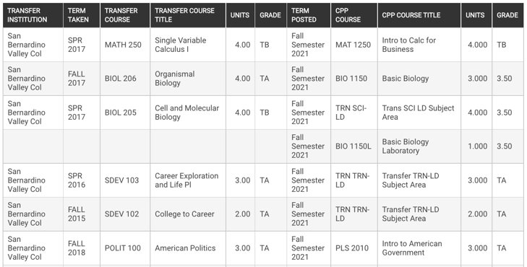
Advising Tools
Transfer Credit Report​
BroncoDirect Student Center – Academics section dropdown menu
Where you can see a record of your transfer coursework and how it fulfills CPP requirements​
Degree Progress Report
BroncoDirect Student Center – Academics section dropdown menu
Where you can see which requirements for your degree that you’ve satisfied and which requirements you have left to complete
Notes:
And additional tool that will be helpful for you to use as you register for classes is your Transfer Credit Report. Your transfer credit report is a record of the courses that you are transferring into the institution and what requirements those courses will fulfill here. It will also include test scores such as AP and IB scores as well.
Depending on when you submitted your final transcripts to Cal Poly Pomona, your TCR may not be completed by the time of your orientation date. To help your advisor know what classes you’ve taken, have a copy of your unofficial transcripts handy during advising and registration.
The MOST important tool that you will have is the Degree Progress Report (DPR)!

Slide 15
Instruction Modes: At-a-Glance
MODE | WHEN
Face-to-Face | In-person at set times (on-campus)
Fully Asynchronous | Online work with no set meeting time
Fully Synchronous | Online at set times (via zoom)
Hybrid-Synchronous | Class days that are in-person and synchronous (via zoom)
Hybrid-Asynchronous | Class days that are in-person and asynchronous work
Bisynchronous | Class days that are synchronous and asynchronous work
HyFlex | Choice of in-person, synchronous and asynchronous
Notes:
Instruction modes are pre-set so you don’t get to choose how to attend.

Slide 16
Before you leave us today:
Register for 12-15 units.
Review your curriculum and ask questions.
Know how to find us, your advisors, and how to contact us with questions.

Slide 17
After Advising Today
Remember to check
your CPP email and
Billy Chat text messages
Registration Continues
Add/Drop Period: January 8 - February 2 (unit max 18 credits)
Last day to drop and receive 100% refund: Jan 19
Tuition & Fees: Due January 20
Remaining balance is due on February 9 for students with a Financial Aid ‘Classes Saved’ service indicator.
Spring semester begins January 20 - May 10.
Finals week begins May 11 - 17.
If you have questions or concerns, contact the CEIS Student Success Center:​
@ceisadvising @cppceis CEISadvising@cpp.edu |  | CEIS SSC website for advising appointments and drop-in hours

Slide 18
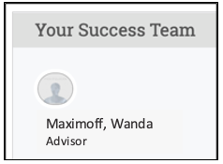
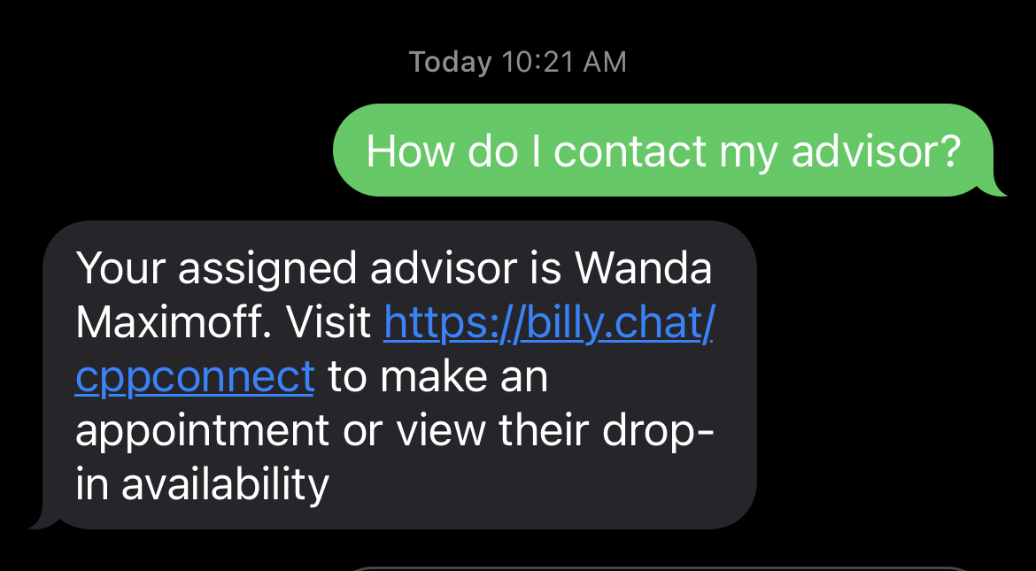
How to Find Your Advisor
If you forget your advisor’s name:
You can find your advisor's name in BroncoDirect and CPP Connect.
You can text Billy Chat to get the name of your assigned advisor.
Appointments & Drop-in Advising
You will be able to begin scheduling appointments with us on January 20th through CPP Connect.
Drop-in hours are kept updated on our CEIS SSC website.

Slide 19
Additional Support
E-Student Services: Registration Troubleshooting, Transcript Troubleshooting, and Financial Aid Questions
Hours Today: 8:00 a.m. to 5:00 p.m.
Office of Admissions Virtual Drop In (10 a.m. - 12:30 p.m.)
Building 121, 1st floor, blue counter
Queue Links: www.cpp.edu/ssb-queue
For questions after today: Contact the Bronco Advising Center
Hours: Monday to Friday, 8 a.m. to 5 p.m.
Email: bac@cpp.edu
Phone: (909) 869-4600
Check website for updated hours: https://www.cpp.edu/bac
Notes:
Save these slides for future reference!

