Slide 1
Interactive Pedagogy for 3D-Optimization Challenges in Engineering: A Focus on Student Comprehension
Erick Zelaya, Sr. Multimedia Developer, Center for the Advancement of Faculty Excellence (CAFE) Eric Davis, Instructional Designer, Center for the Advancement of Faculty Excellence (CAFE)

Slide 2
Agenda
Who we are, what we do
The Linear Programming MLO
Survey Data
Performance Data
Future Development
Q&A

Slide 3
Who Are We
Erick Zelaya, Sr. Multimedia Developer
Center for the Advancement of Faculty Excellence (CAFE)
California State Polytechnic University, Pomona
Eric Davis, Instructional Designer
Center for the Advancement of Faculty Excellence (CAFE)
California State Polytechnic University, Pomona
Special Acknowledgements
Shokoufeh Mirzaei, Ph.D, Chair & Professor of Industrial and Manufacturing, College of Engineering Afsaneh Nouri Houshyar, Ph.D, Assistant Professor of Industrial and Manufacturing, College of Engineering

Slide 4
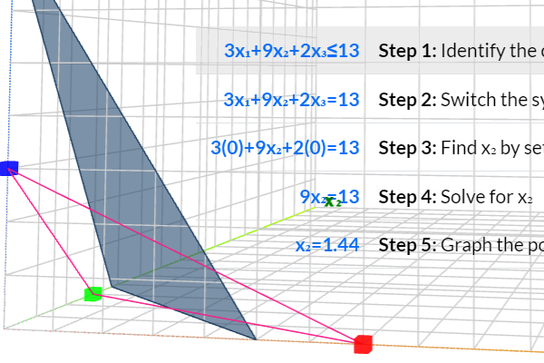
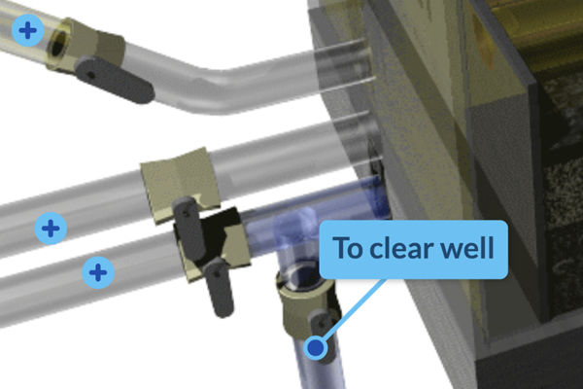
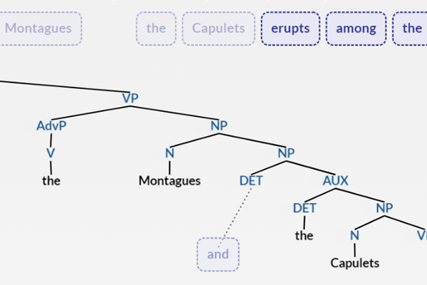
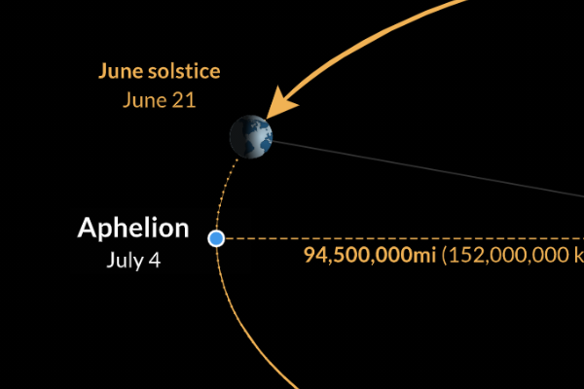
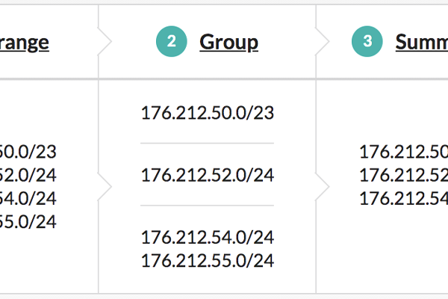
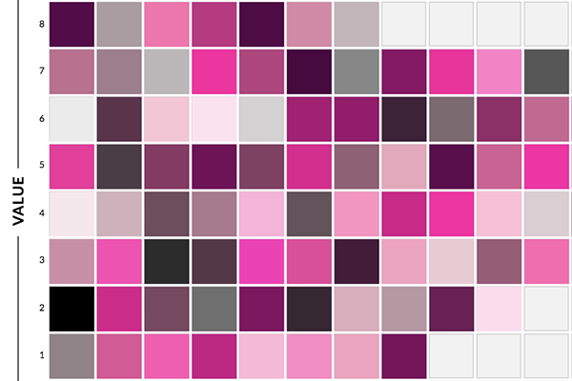
Multimedia Learning Objects (MLO) Repository: www.cpp.edu/cafe/learning-objects
Notes:
Linear Programming - this activity is in the form of a 3d graph. Students walk through each step of completing a linear programming problem starting with graphing a constraint, graphing an objective function, and finally finding the optimal solution.
Gravity Filter Operation - this activity is in the form of a 3d graph. Students walk through each step of completing a linear programming problem starting with graphing a constraint, graphing an objective function, and finally finding the optimal solution.
Syntactic Tree Structures - This practice exercise helps students develop skills in syntactically analyzing sentences, identifying their key constituents, and creating hierarchical tree diagrams of such sentences.
Equinoxes and Solstices – allows students to learn why the Earth has seasons and what causes these conditions over the course of the year.
IPv4 Supernetting - This activity helps students to analyze and summarize groups of CIDR blocks into the fewest possible number of CIDR blocks for a given network.
Color Theory - Students get an in depth understanding of color theory through a series of interactive exercises covering: the basics of color theory, the color wheel, formal qualities of color through the Munsell Color System, and color schemes.
Spanish Morphology - Words are made of morphemes, the smallest meaningful units in a language. This tool helps students to visualize how morphemes combine to form words in Spanish.
Transcription and Repression - By arranging transcriptional regulators and a generic repressor to control gene expression of two genes, students are able to demonstrate how different transcription factors and repressors are used to increase or decrease gene expression of two model genes.

Slide 5
2D Optimization vs 3D Optimization
Notes:
Explain how the challenge for Dr. Shokoufeh of explaining the 3D optimization since a 3D space is not necessarily easy to visualize.

Slide 6
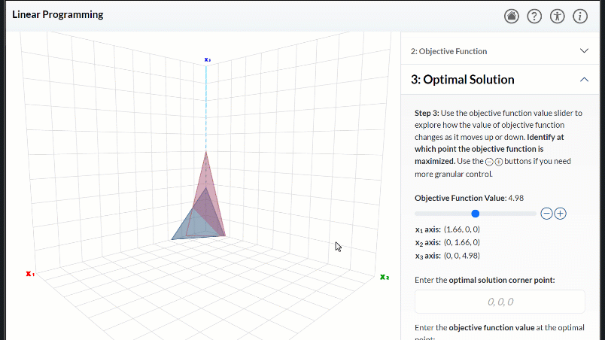
Linear Programming MLO
By the end of this activity, you will be able to find the optimal solution in a 3-dimensional optimization problem using the graphical method.
Notes:
Background on the Linear Programming MMLO.
Dr. Shoukoufeh Mirzaei’s request and what the original problem was.
Our solution: This activity is in the form of a 3d graph. Students walk through each step of completing a linear programming problem starting with graphing a constraint, graphing an objective function, and finally finding the optimal solution (through the 3d visualization).

Slide 7
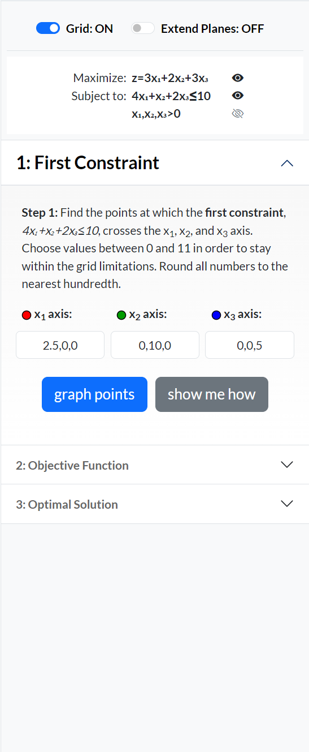
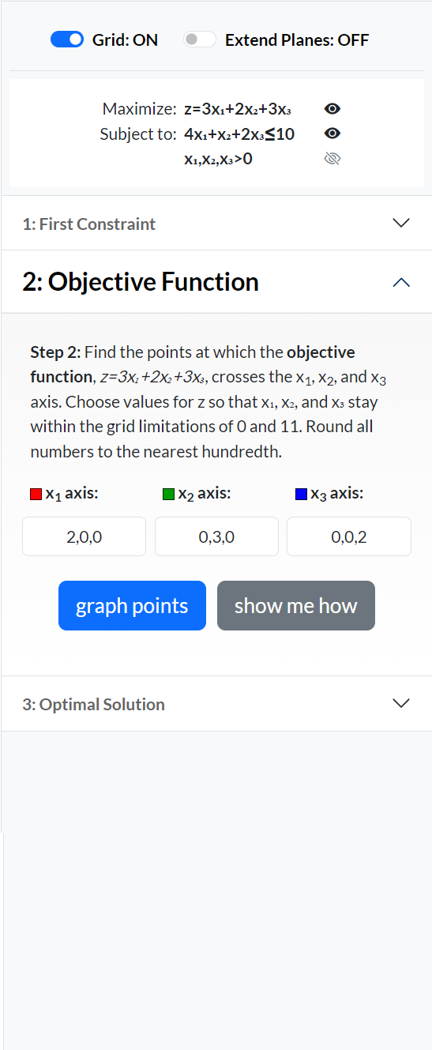
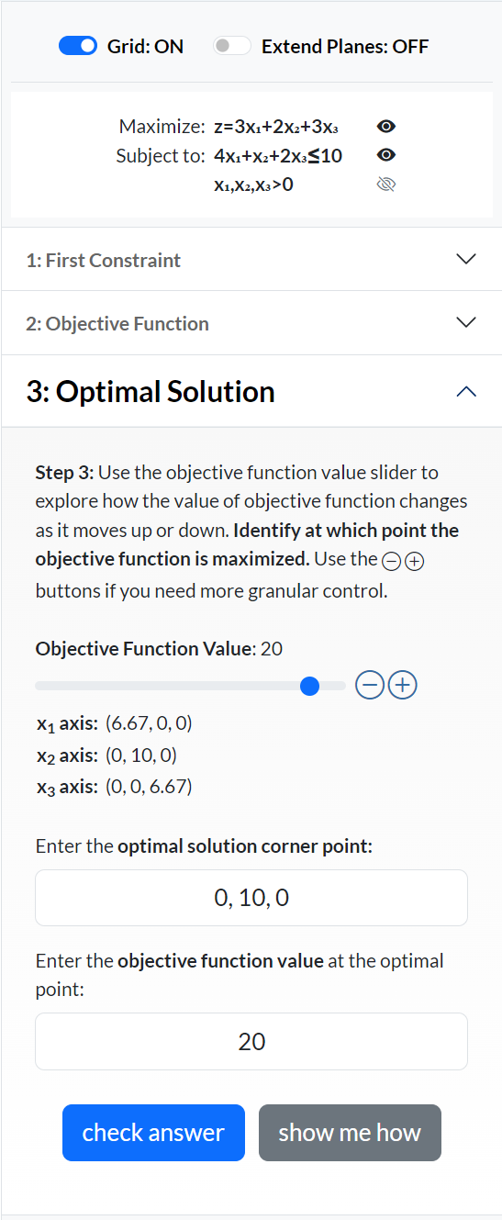
Problem Walk-through
1
2
3
Notes:
Our approach, based on the same idea used for Subnetting and Supernetting applications.
Generate a random problem, based on parameters that make it function as a real-world problem.
Walk student through each step, figuring piece by piece.
Generate a solution to each step that explains to the student how to solve.
Provide a 3D visual that students can move around to see graph from different angles.

Slide 8
Problem Explanations On-Demand
Notes:
Each part of the problem provides a dynamically generated solution, specifically developed on-the fly, for the problem that is being worked on. Solutions are generated as step-by-step explanations that tell students how to solve a problem along with detailed explanations.

Slide 9
Realtime 3D Display
Notes:
Background on the Linear Programming MMLO.
Dr. Shoukoufeh’s request and what the original problem was.
Our solution.

Slide 10
Time spent using the MLO
1-5 minutes
5-10 minutes
10-20 minutes
>20 mins

Slide 11
Before/After Survey: I can confidently solve for the objective function value (z) within the feasible solution region of a 3D optimization problem.

Slide 12
Before/After Survey: I can confidently identify the optimal solution corner point within the feasible solution region of a 3D optimization problem.

Slide 13
Before/After Survey: I am comfortable using online learning resources.

Slide 14
Before/After Survey: I am likely to use interactive learning activities in the future.

Slide 15
Before/After Survey: To what extent were the differences in your ratings a result of using the MLO?

Slide 16
Ease of Use: Interface
The feedback provided by the Linear Programming MLO when I got the wrong answer was helpful.
The explanations provided by the Linear Programming MLO helped me to complete the activity.

Slide 17
Ease of Use: Engagement
I would recommend the Linear Programming MLO to other students.
I found the Linear Programming MLO engaging (i.e. interesting to use).

Slide 18
Ease of Use: Effectiveness
The Linear Programming MLO helped me to learn better compared to if I didn't use it.
It was easy to figure out how to use the Linear Programming MLO.

Slide 19
Student Performance Data: Pre-test/Post-test
percent of students
test score
Notes:
The overall scores increased from pre-test to post-test. The mean score increased by 1.25 points, and the standard deviation also increased. This indicates that the scores were more spread out after the test. There were a few students who scored much lower on the post-test than on the pre-test, while others scored much higher.
It is important to note that this is just a small sample of data, and it is difficult to draw any general conclusions from it. However, it does suggest that the intervention may have been effective in improving student performance. More data would be needed to confirm this.

Slide 20
Student Performance Data: Pre-test/Post-test
percent of students
test score
Notes:
The overall scores increased from pre-test to post-test. The mean score increased by 1.25 points, and the standard deviation also increased. This indicates that the scores were more spread out after the test. There were a few students who scored much lower on the post-test than on the pre-test, while others scored much higher.
It is important to note that this is just a small sample of data, and it is difficult to draw any general conclusions from it. However, it does suggest that the intervention may have been effective in improving student performance. More data would be needed to confirm this.

Slide 21
Student Comments
"I do like that it helped me see the graph I am working on better and I feel like it helped my understand the idea of the '3-D Effect' a lot better than I did before.“
"I like how we can see things visually“
"The complete visualization of the graph of an LP helped me to better understand the constraints and feasible region of a problem“
"I found it most helpful how it shows you step by step“
"Pop up comment boxes to help walk you through the learning process"

Slide 22
Equity Through Practice

Slide 23
Future Development
Be more meticulous about course implementation​
Gather more student performance data​
Improve survey questions​
Continued mobile and usability improvements​
AI implementations, other technologies, ummm….

Slide 24
Demonstration
elearning.cpp.edu/learning-objects/linear-programming
Notes:
Sample problem: https://elearning.cpp.edu/learning-objects/linear-programming/?page=activity&ofunc=2x+3y+2z&c1func=3x+4y+z%E2%89%A412

Slide 25
Contacts
Erick Zelaya
eezelaya@cpp.edu
Eric Davis
eadavis@cpp.edu
www.linkedin.com/in/eadavis-id
Try the Linear Programming MLO
elearning.cpp.edu/learning-objects/linear-programming
Peruse our other MLOs
elearning.cpp.edu/learning-objects

