Slide 1
Transfer Success: Paving the Way for Men of Color Transfer Students
Reggie Robles, Associate Director, Male Success Initiatives

Slide 2
Agenda
Problem Question
Enrollment and Graduation Rates
Transfer Success
Program Structure
Our Students
Transfer Day
Spring Semester
Q&A

Slide 3

Problem Question
Why are Latino and Black men transfer students not graduating at higher rates?

Slide 4
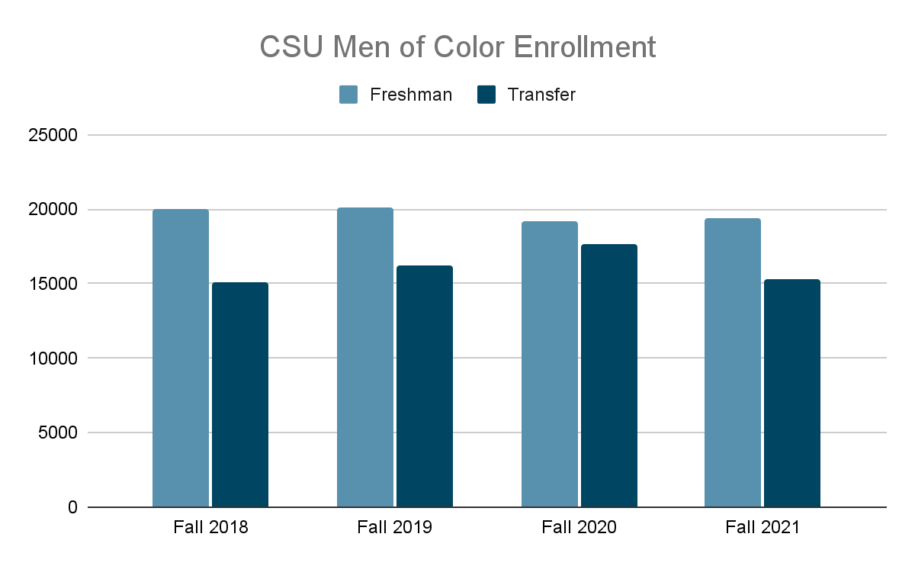
Enrollment Rates

Slide 5
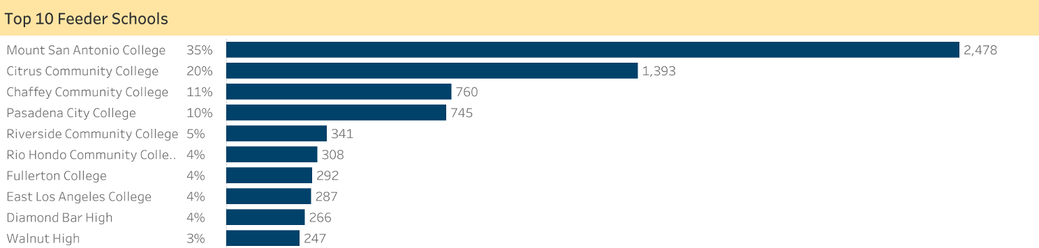
Enrollment and Graduation Rates

Slide 6
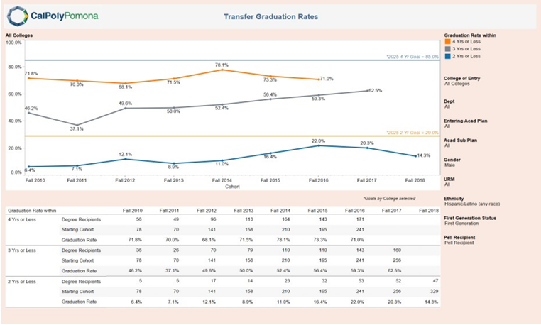
Men of Color Graduation Rates

Slide 7

Transfer Success Program
Serves as a pipeline for men of color from community colleges to see Cal Poly Pomona (CPP) as a viable, natural, and meaningful option for the undergraduate degrees. The purpose of the MSI Transfer Success program is to create a seamless transition from the Community College to CPP. This program focuses on academic success, sense of belonging & community, leadership development, and faculty/staff mentorship for students who identify as men of color transfer.

Slide 8

Program Structure

Slide 9
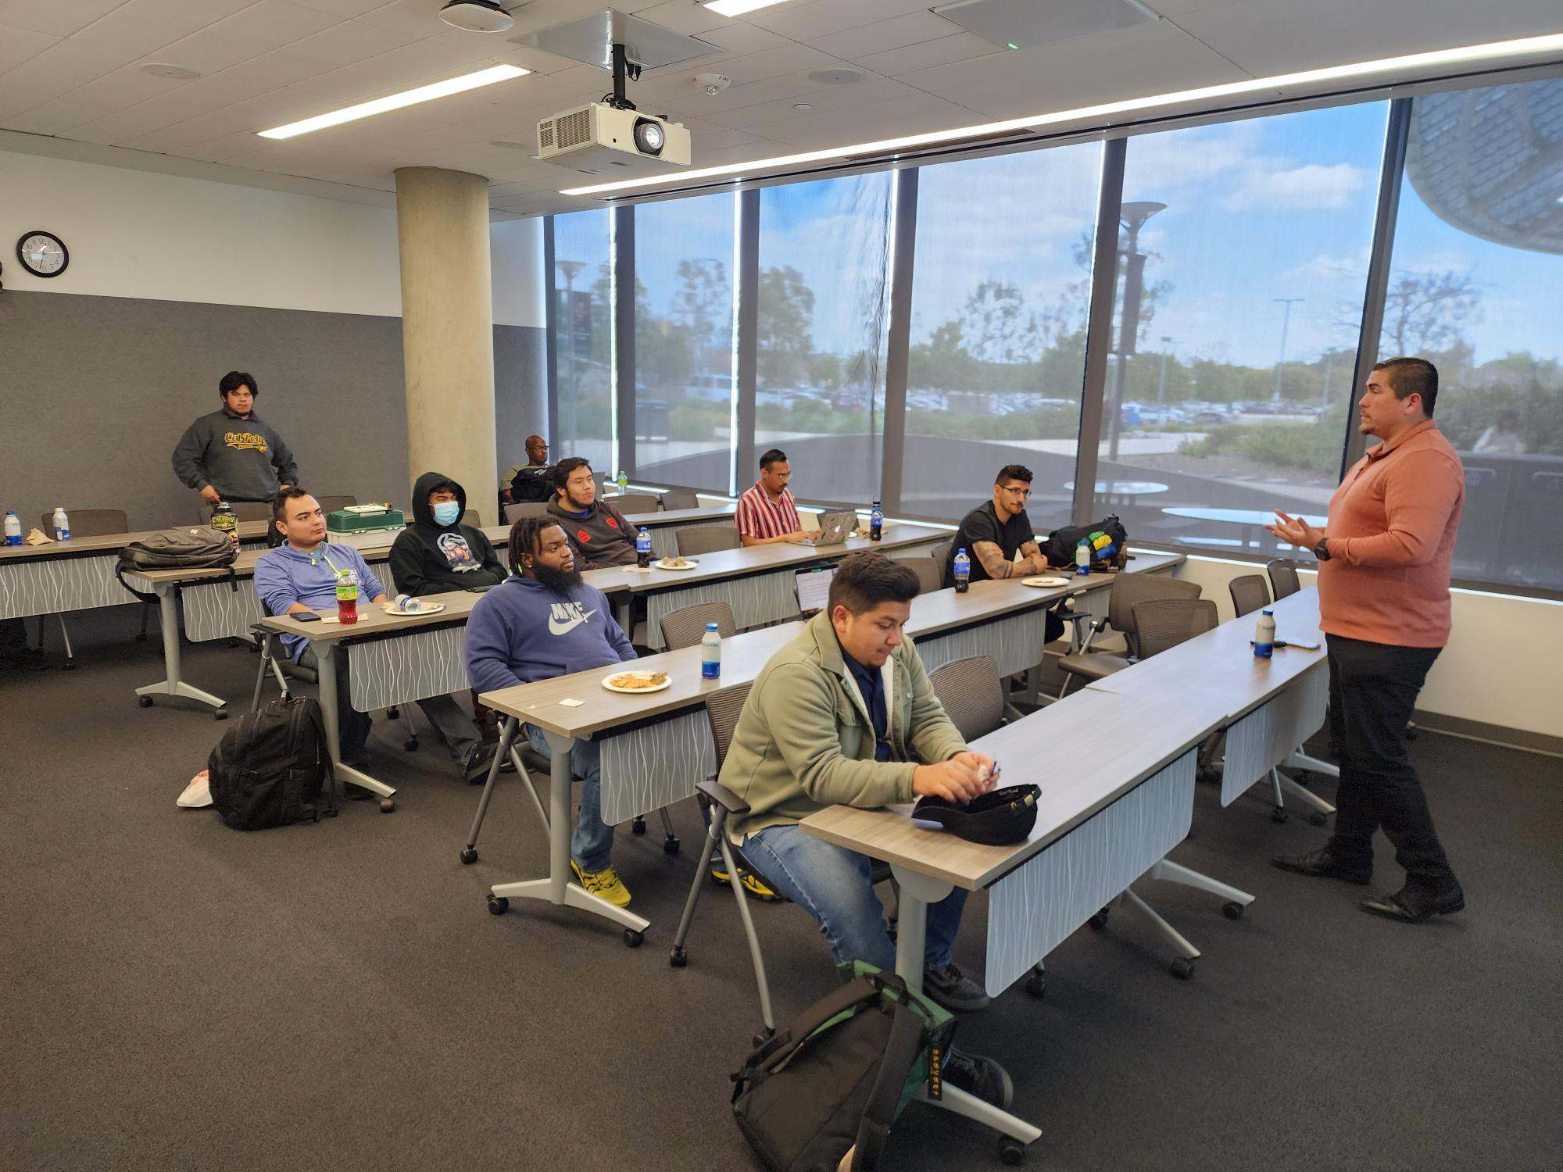
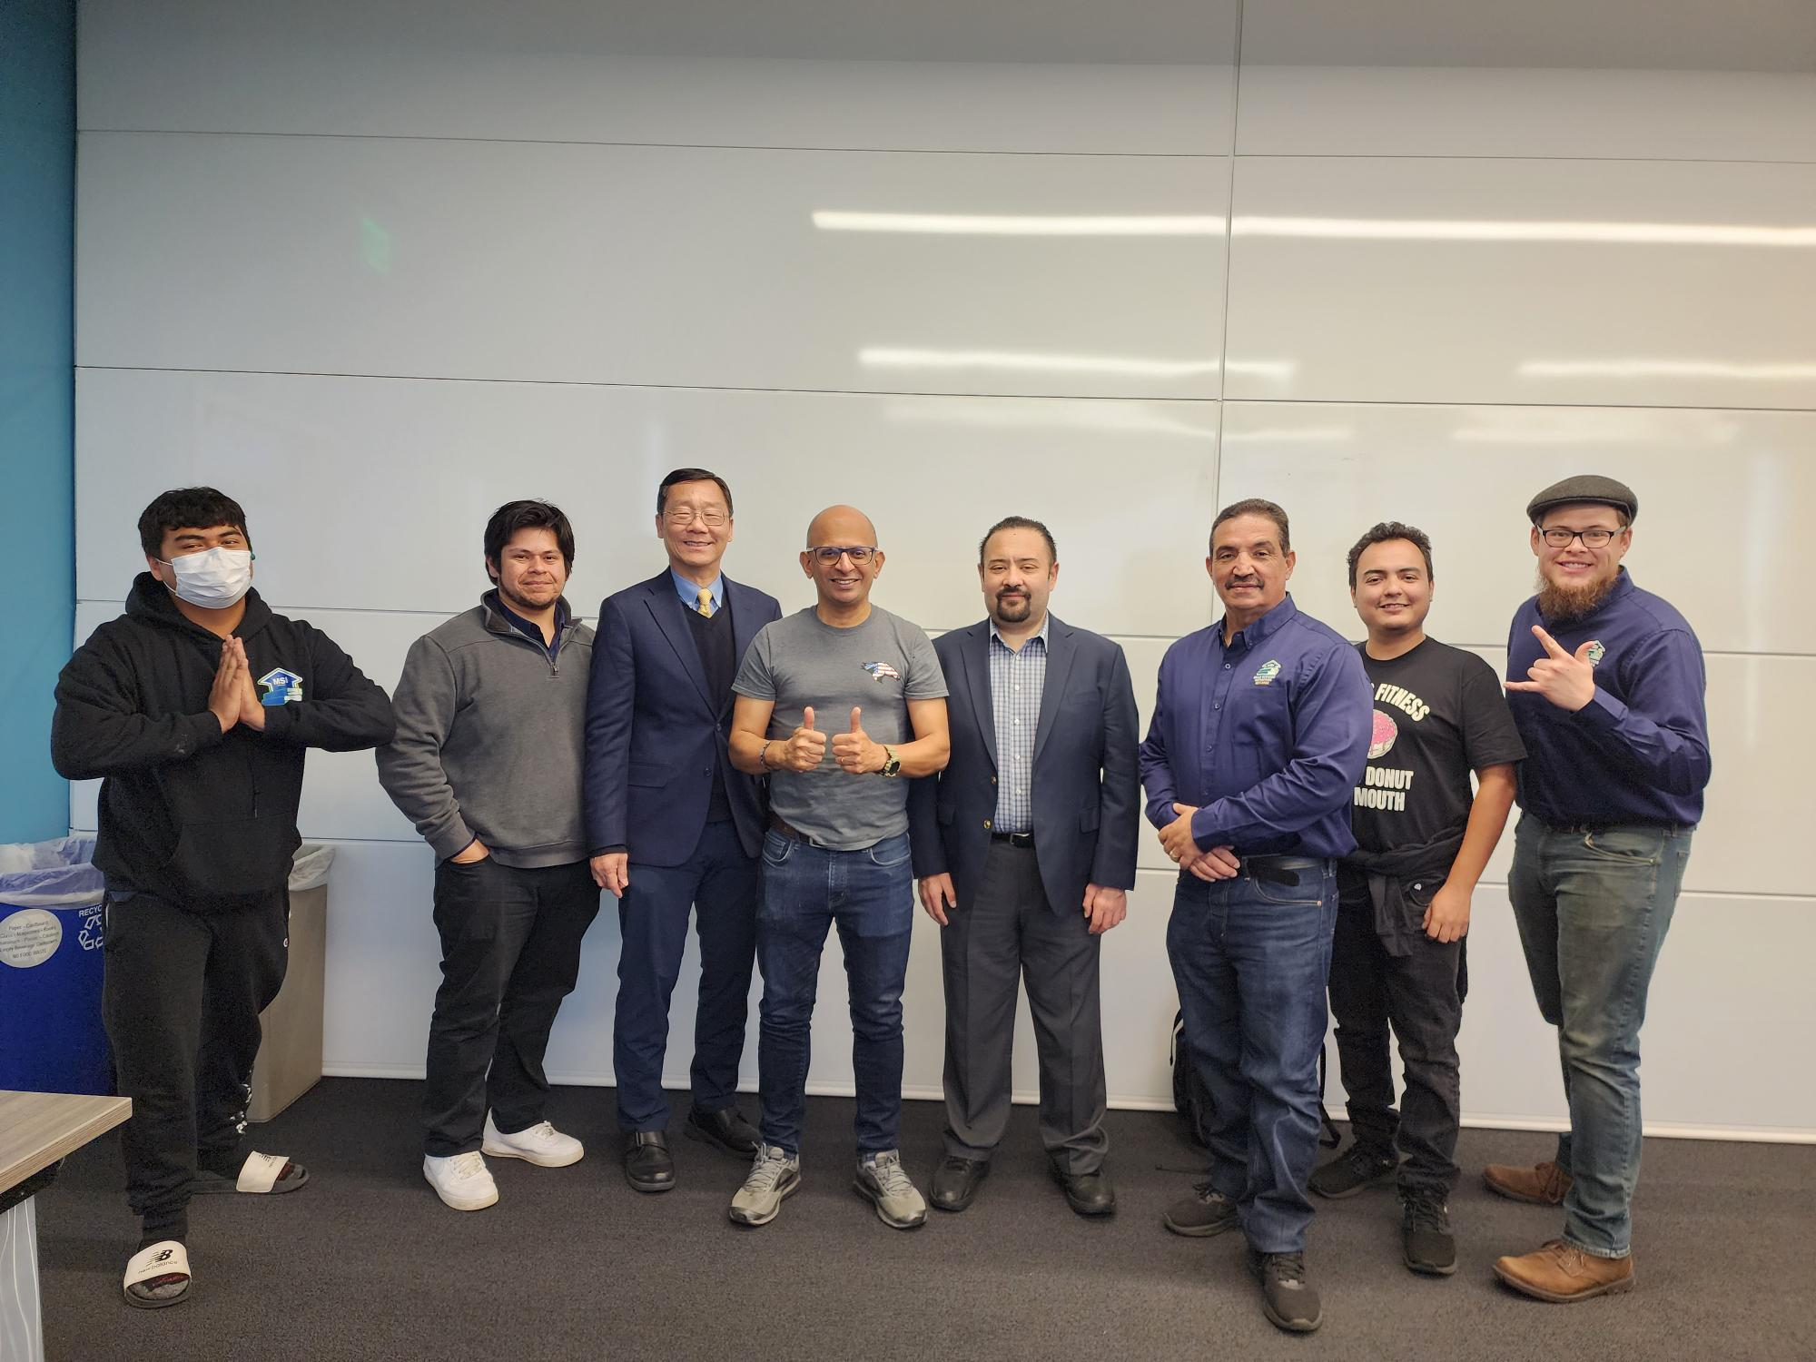
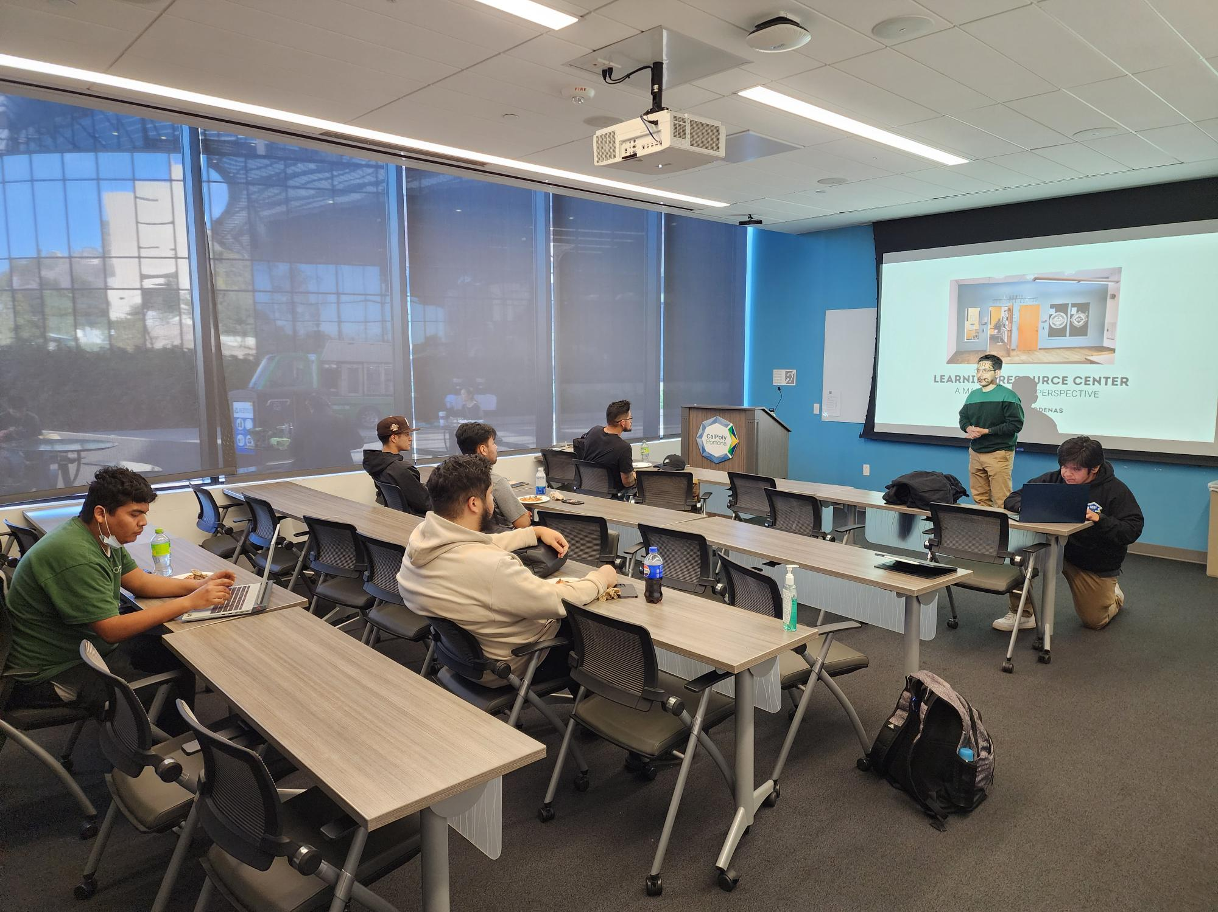
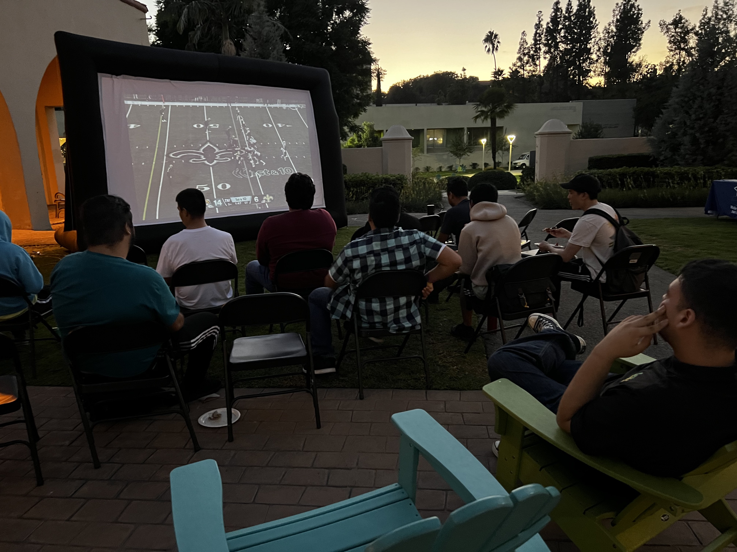
9Slide 9

Slide 10
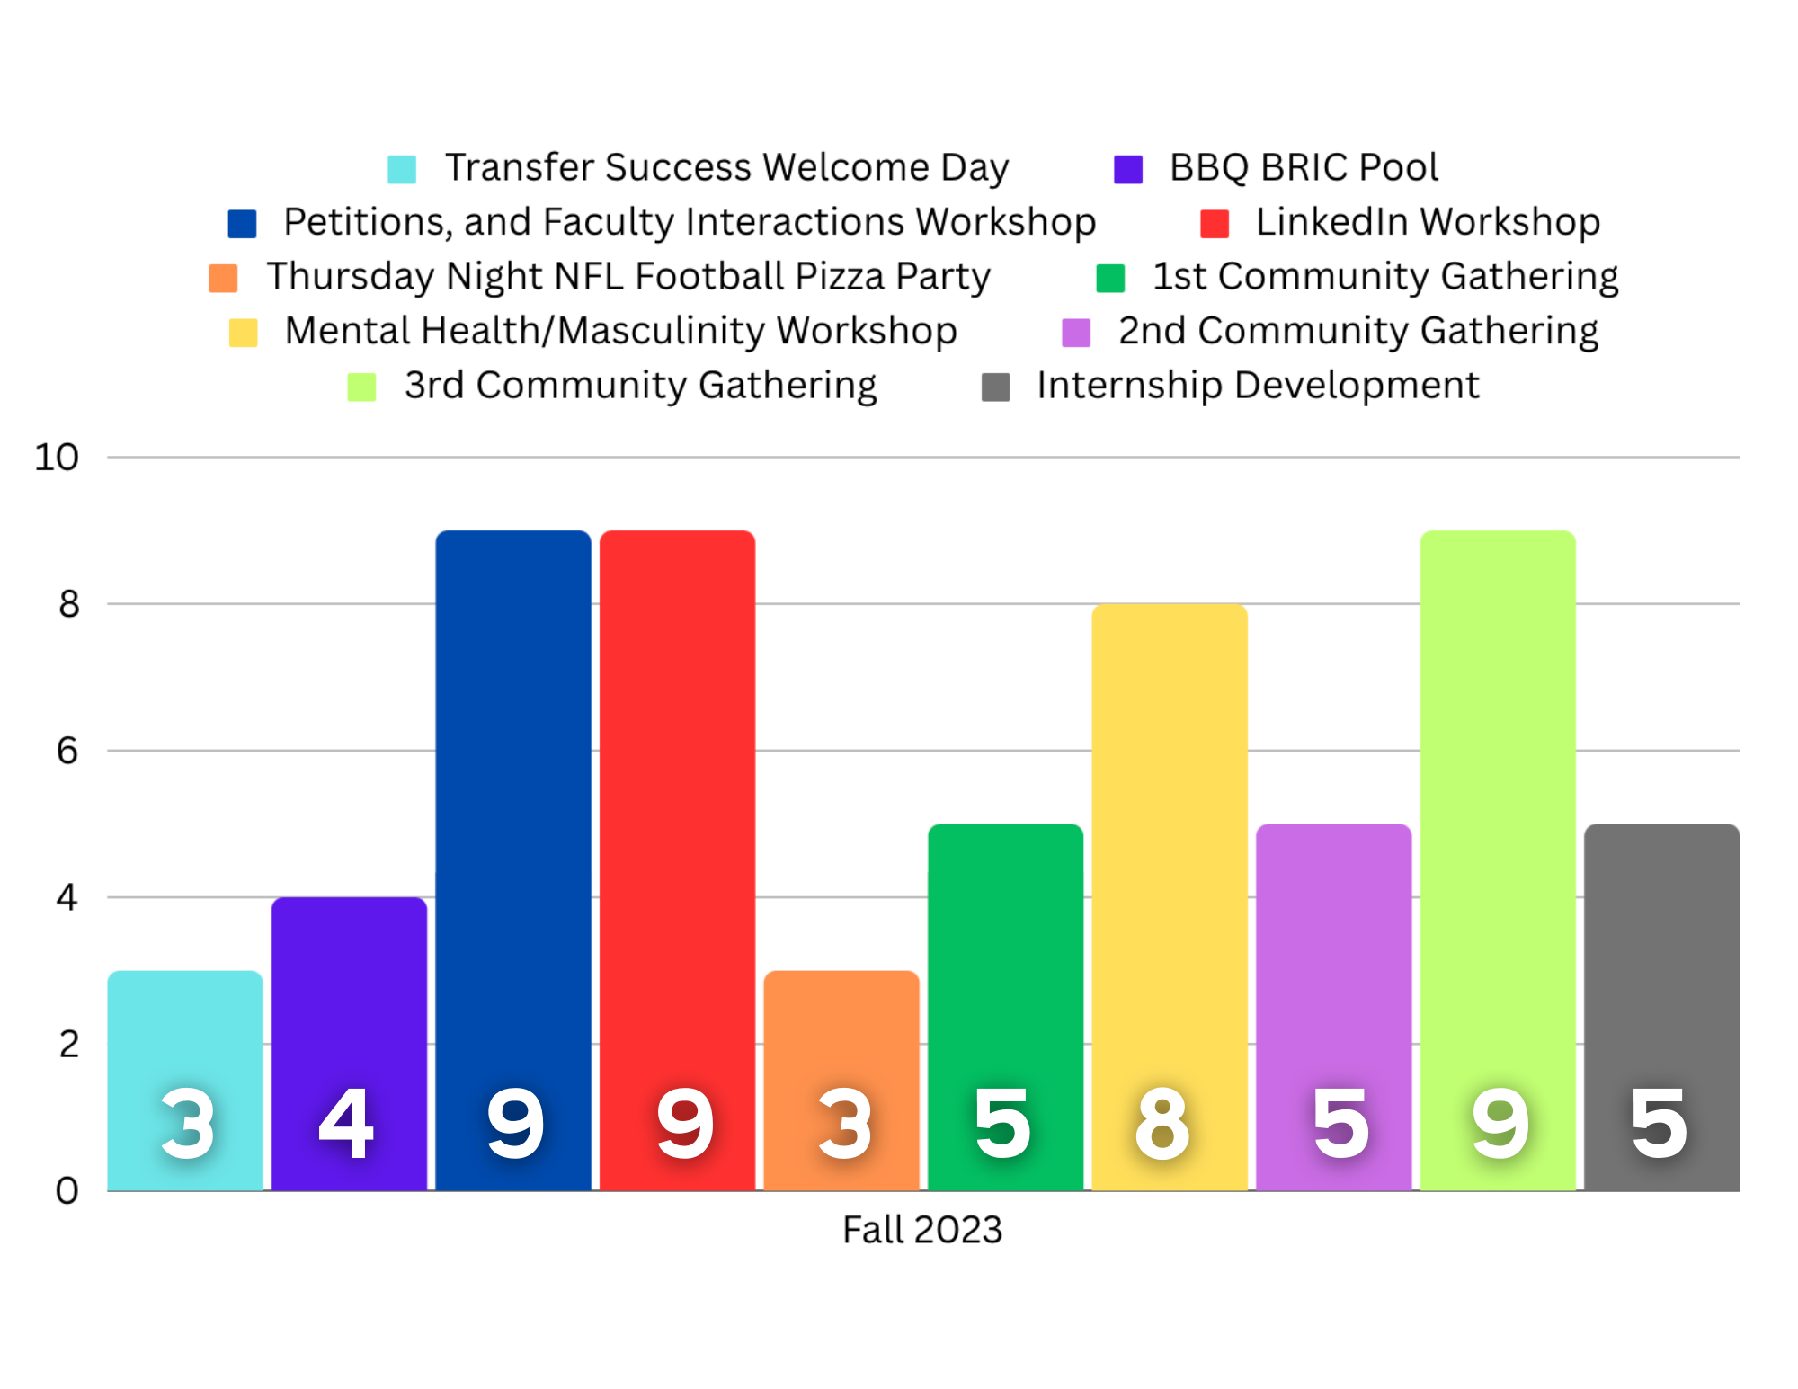
10

Slide 11
CPP Men of Color Transfer Day
9 AM​ | Welcome​
9:30 AM​ | Opening Keynote​
10:00 AM​ | Admissions Process​
11:00 AM​ | Campus Tour​
12:00 PM​ | Lunch​
1:00 PM​ | Student Panel / ProStaff Panel​
2:00 PM​ | PolyTransfer / MSI Transfer Success​
2:30 PM​ | Community Activity​
3:25 PM ​ | Closing Remarks​
3:50 PM​ | Group Photo​

Slide 12
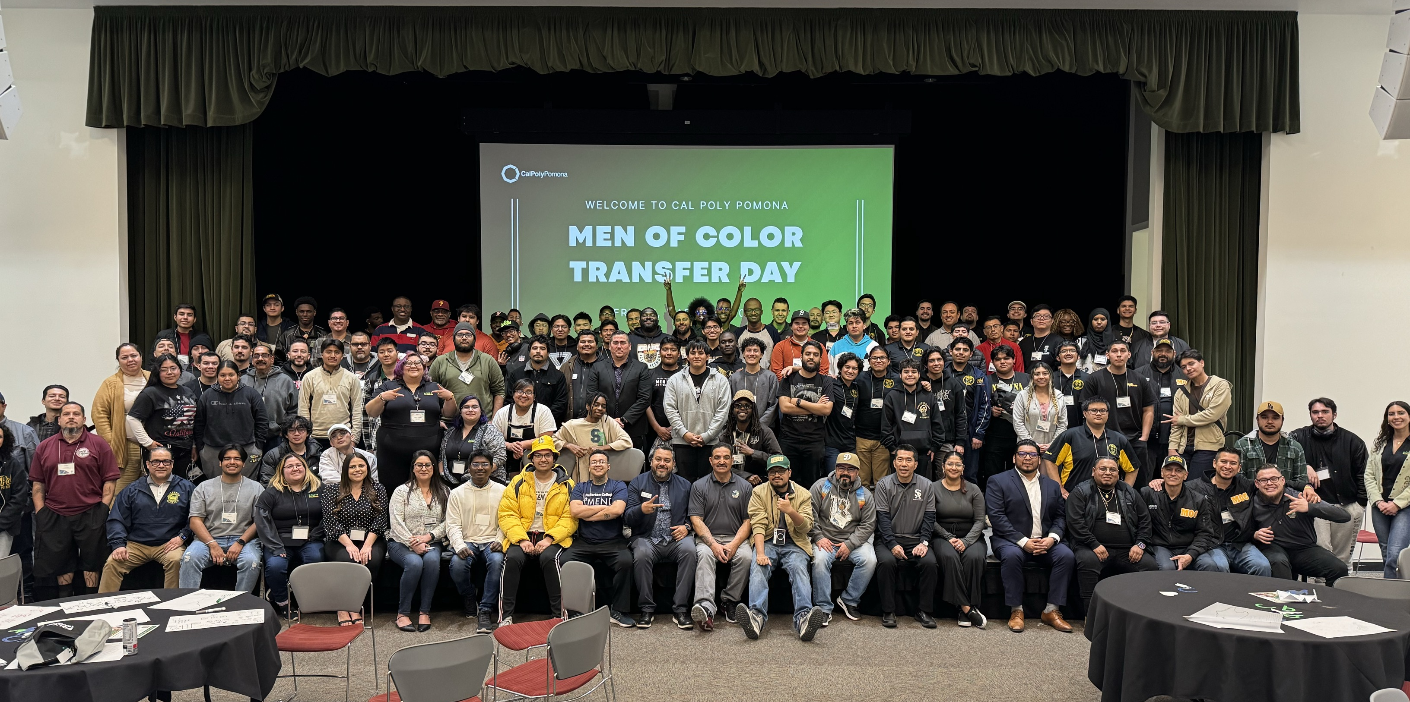
CPP Men of Color Transfer Day
Total Students | 126 students
# of Community Colleges Represented | 19 Community Colleges
# of students ready to transfer | 73 students

Slide 13
Spring Semester
25 Students Enrolled
  13 students added
90% consistent engagement
  45% increase
Faculty Interaction begins
Students vocalizing needs
Having food as incentive
CSU YMOC Consortium Grant

Slide 14

Thank you!

