Slide 1
Lightning Talks
Group C, Campus Vista
April 19, 2024

Slide 2

The Flexible Course
Sarah Wallin-Huff, Department of Music, Cal Poly Pomona

Slide 3
What I Teach: “History of Technology in Music”
Upper Division Synthesis Course
Large Class Sizes: F2F classes are typically 50-75 students; Asynchronous class is typically 100-125 students
I must accommodate a wide variety of learning styles, backgrounds, and individual goals
GE: any major, of any background and experience, is welcome.
Students don’t need any prior musical, historical, or technological knowledge, only the willingness to read and challenge their thinking.
A broad look at the interactions between humans and music, based on technological evolution, spanning the past 40,000 years.
The course aims to identify historical patterns and real-world applications through past case studies.
A required course that may not necessarily align with the student's educational goals

Slide 4
Assignments to Facilitate Critical Thinking
The Building Blocks:
Low-stakes quizzes designed to reinforce each chapter’s basic details
The Connective Tissue:
Correlation Activities ask the student to articulate how two selected chapters relate to and reinforce each other
Broad Conclusions:
The midterm and final exams are open-book, take-home assessments designed to evaluate students' comprehensive knowledge of important historical progressions
Personalized Learn-By-Doing Activity:
Students must choose to complete 1 out of 3 possible Semester Projects
A Research Essay, a 10-minute Lecture, or an Applied Project
Topic may be anything that interests the student, provided it combines history, technology (old or new), and music

Slide 5
Flexible Grading Structure
Assignments (30%) | Attendance + Discussions (15%) | Semester Project (30%) | Midterm + Final (25%)
A student may utterly fail one entire column and still pass the class with a B or a C
  Choosing to do so, however, does make accomplishing the other columns more difficult
Averaging several assignments or exams together in one grade allows for early academic challenges to be mitigated by subsequent improvement, ultimately balancing out initial low scores
Students can earn significant extra credit by answering a variety of reinforcement questions provided in the textbook
  Extra credit points may be used to supplement grades in the Assignments and Attendance/Discussions categories

Slide 6
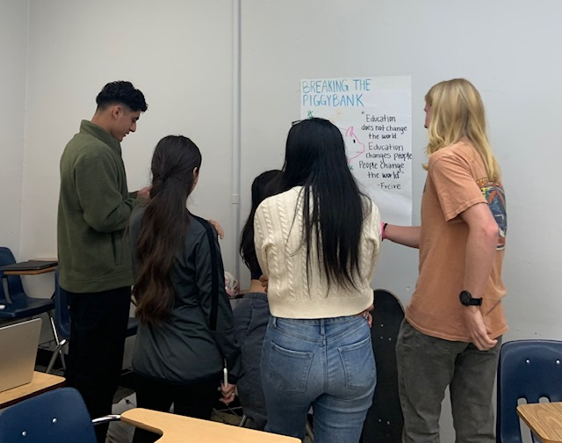
Strategies for Fostering Student’s Sense of Belonging in a Freshman Course
Estela G. Ballón and Will Cowan, Liberal Studies
Rendon (1994) Validation theory
Student from underrepresented backgrounds often experience both isolation and a lack of a sense of belonging in college contexts.
"An enabling, confirming and supportive process initiated by in- and out-of-class agents that foster academic and interpersonal development.”
Strayhorn (2018) Sense of Belonging
“Sense of belonging refers to perceived social support on campus, a feeling or sensation of connectedness, the experience of mattering or feeling cared about, accepted, respected, valued by and important to the group (e.g. campus community) or others on campus (e.g. faculty, peers).” (p.3)

Slide 7
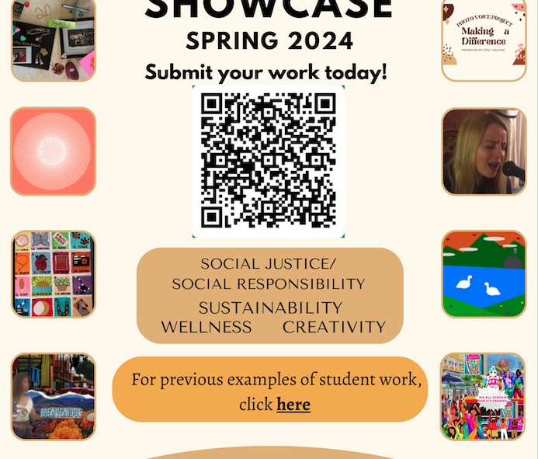
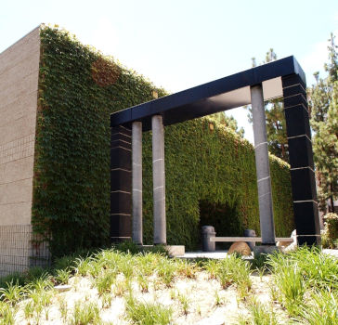
Cultivating perceptions of campus membership for a Freshman Course
Estela G. Ballón and Will Cowan, Liberal Studies
Examples:
Special welcome or check-in by department chair or senior faculty
Special invitation to departmental signature events by student leaders
On campus activities (when possible as a group with instructor) such as visit to campus W. Keith and Janet Kellogg Art Gallery for art assignment
Sharing snacks during informal reflection activities
Attending a CPP sporting event as a group

Slide 8

Culturally Relevant Curriculum and Co-curricular Activities
Estela G. Ballón and Will Cowan, Liberal Studies
Examples:
Museum visit options: The Cheech Marin Center for Chicano Art; The African American Museum of Beginnings; Pomona Murals tour; Pomona 2nd Saturday ArtWalk; W. Keith and Janet Kellogg Art Gallery;
Books—Persepolis: The story of childhood; Bless Me Ultima; Braiding Sweetgrass: Indigenous wisdom, scientific knowledge and teachings of plants; Persepolis: The story of childhood; The Best We Could Do; I’m Not Your Perfect Mexican Daughter
Critical assignments that challenge dominant narratives and thinking .

Slide 9
Feeling Like a Writer: How Can Writing Teachers Help Students Recognize Their Distinct Writing Identities?
Karen Tellez-Trujillo, Ph.D., English and Modern Languages, Cal Poly Pomona​
www.karentrujillo.com * ktrujillo@cpp.edu

Slide 10
Identify success in writing aside from traditional modes of assessment.
Reflect on writing improvement.
  Discussion.
  Formative assessment.
  In response to drafts.

Slide 11

Discussions
What does it mean to be a writer?
What does a writer look like?
What does a writer’s writing look like?
What does writing improvement look like?

Slide 12

Discoveries
The more time students spend in drafts, in workshops, and in reflection, the more they say they identify as writers. The writing is in the doing - whether it is in writing that feels like a success or writing that feels like it needs more attention.

Slide 13

Thank you! ktrujillo@cpp.edu

Slide 14
Stephanie
Marin-Rothman
Lecturer, Biology
Fellow, CDIP
Ed.D. Candidate,
Science Education,
Indiana University semarin@cpp.edu
The Effects of Active Learning on Motivation and Grades Among a Diverse Student Population: Mixed Methods Action Research of Large, Online, Introductory Biology Courses
Problem: Equity gaps
Literature: Active learning closes equity gaps
Literature: Active Learning increases motivation
Active Learning
Motivation
+
Grades
Equity Gaps

Slide 15
Active Learning
Skeletal notes
You-pick assignments
Peer interaction
RQ 1: In what ways do active learning practices impact my online biology students’ motivation?
RQ 2: How does the impact of active learning on motivation and grades differ among my diverse biology student population?

Slide 16
Research Questions | Data Source | Timeline for collection | Data Analysis
Q1: In what ways do active learning practices impact my online biology students’ motivation? | Expectancy-Value-Cost Survey of Student Motivation (K. Barron et al., 2017) | Pre-class Post-class | Qs 1-10: Paired sample t-test Qs A & B: Thematic analysis
 | Follow-up Interviews | Post-class | Thematic analysis
 | Researcher journal | Weekly through term | Thematic analysis
Q2: How does the impact of active learning on motivation and grades differ among my diverse biology student population? | Expectancy-Value-Cost Survey of Student Motivation (K. Barron et al., 2017) | Pre-class Post-class | Qs 1-10: Regression analysis Qs A & B: Thematic analysis
 | Follow-up Interviews | Post-class | Thematic analysis
 | Demographic questions Gender 1st gen status Race/ethnicity Pell eligibility | Post-class | Regression analysis
 | Final Grades | Post-class | Regression analysis

Slide 17
Engaging Learners with a Growth Mindset
CPP Equity in Practice Symposium! Lightning Talk
Michi Fu, Ph.D.
April 19, 2024

Slide 18

Pre-course Engagement
Engagement email:
  Dear Intro to Psychology Students,
  Thank you for taking PSY 2201 together. I am excited to be your instructor for the fall semester. Although we are engaging in learning during uncertain times, I believe we can all use this time well to learn information that will be helpful in our personal lives. I have confidence we can utilize the technological resources to make learning fruitful even though we may not be in the traditional classroom environment together. I believe that learning together will be easier as the semester goes on when the readings, lectures and assignments come together to reveal the concepts and their applicability to various aspects of our lives. I hope you will enjoy learning about knowledge and strategies that are highly applicable to your daily lives and possibly to your future professions as well. I wish to help everyone be successful and can be reached through virtual office hours, email and telephone. Looking forward to our semester together.
  Regards,
  Dr. Michi Fu
One-minute video
  Teaching philosophy
  Grow
  How to get a hold of meth mindset perspective

Slide 19

Intros/Interviews & Community Building
Name pronunciation & gender pronoun(s)
Major/minor
What have you heard about the class?
Why are you (really) taking the class?
What do you hope to learn?
How do you learn best?

Slide 20

In-Class Engagement Exercises
Canvas discussion board at onset (probes for reading comprehension & application)
Reflection activities for more introverted learning & communication styles (e.g., applying readings to own lived experiences)
Dyads (e.g., applying concepts from microaggressions)
Small group activities (e.g., gender exercise of going home)
Reward for participation (extra credit)

Slide 21

Thank you! michifu@cpp.edu

