Slide 1
Embracing Intersectionality Enhancing Student Success at Cal Poly Pomona
Presenters: Jeanette Baez & Armando Madrid
Equity In Practice Symposium, Cal Poly Pomona, April 19th, 2024

Slide 2
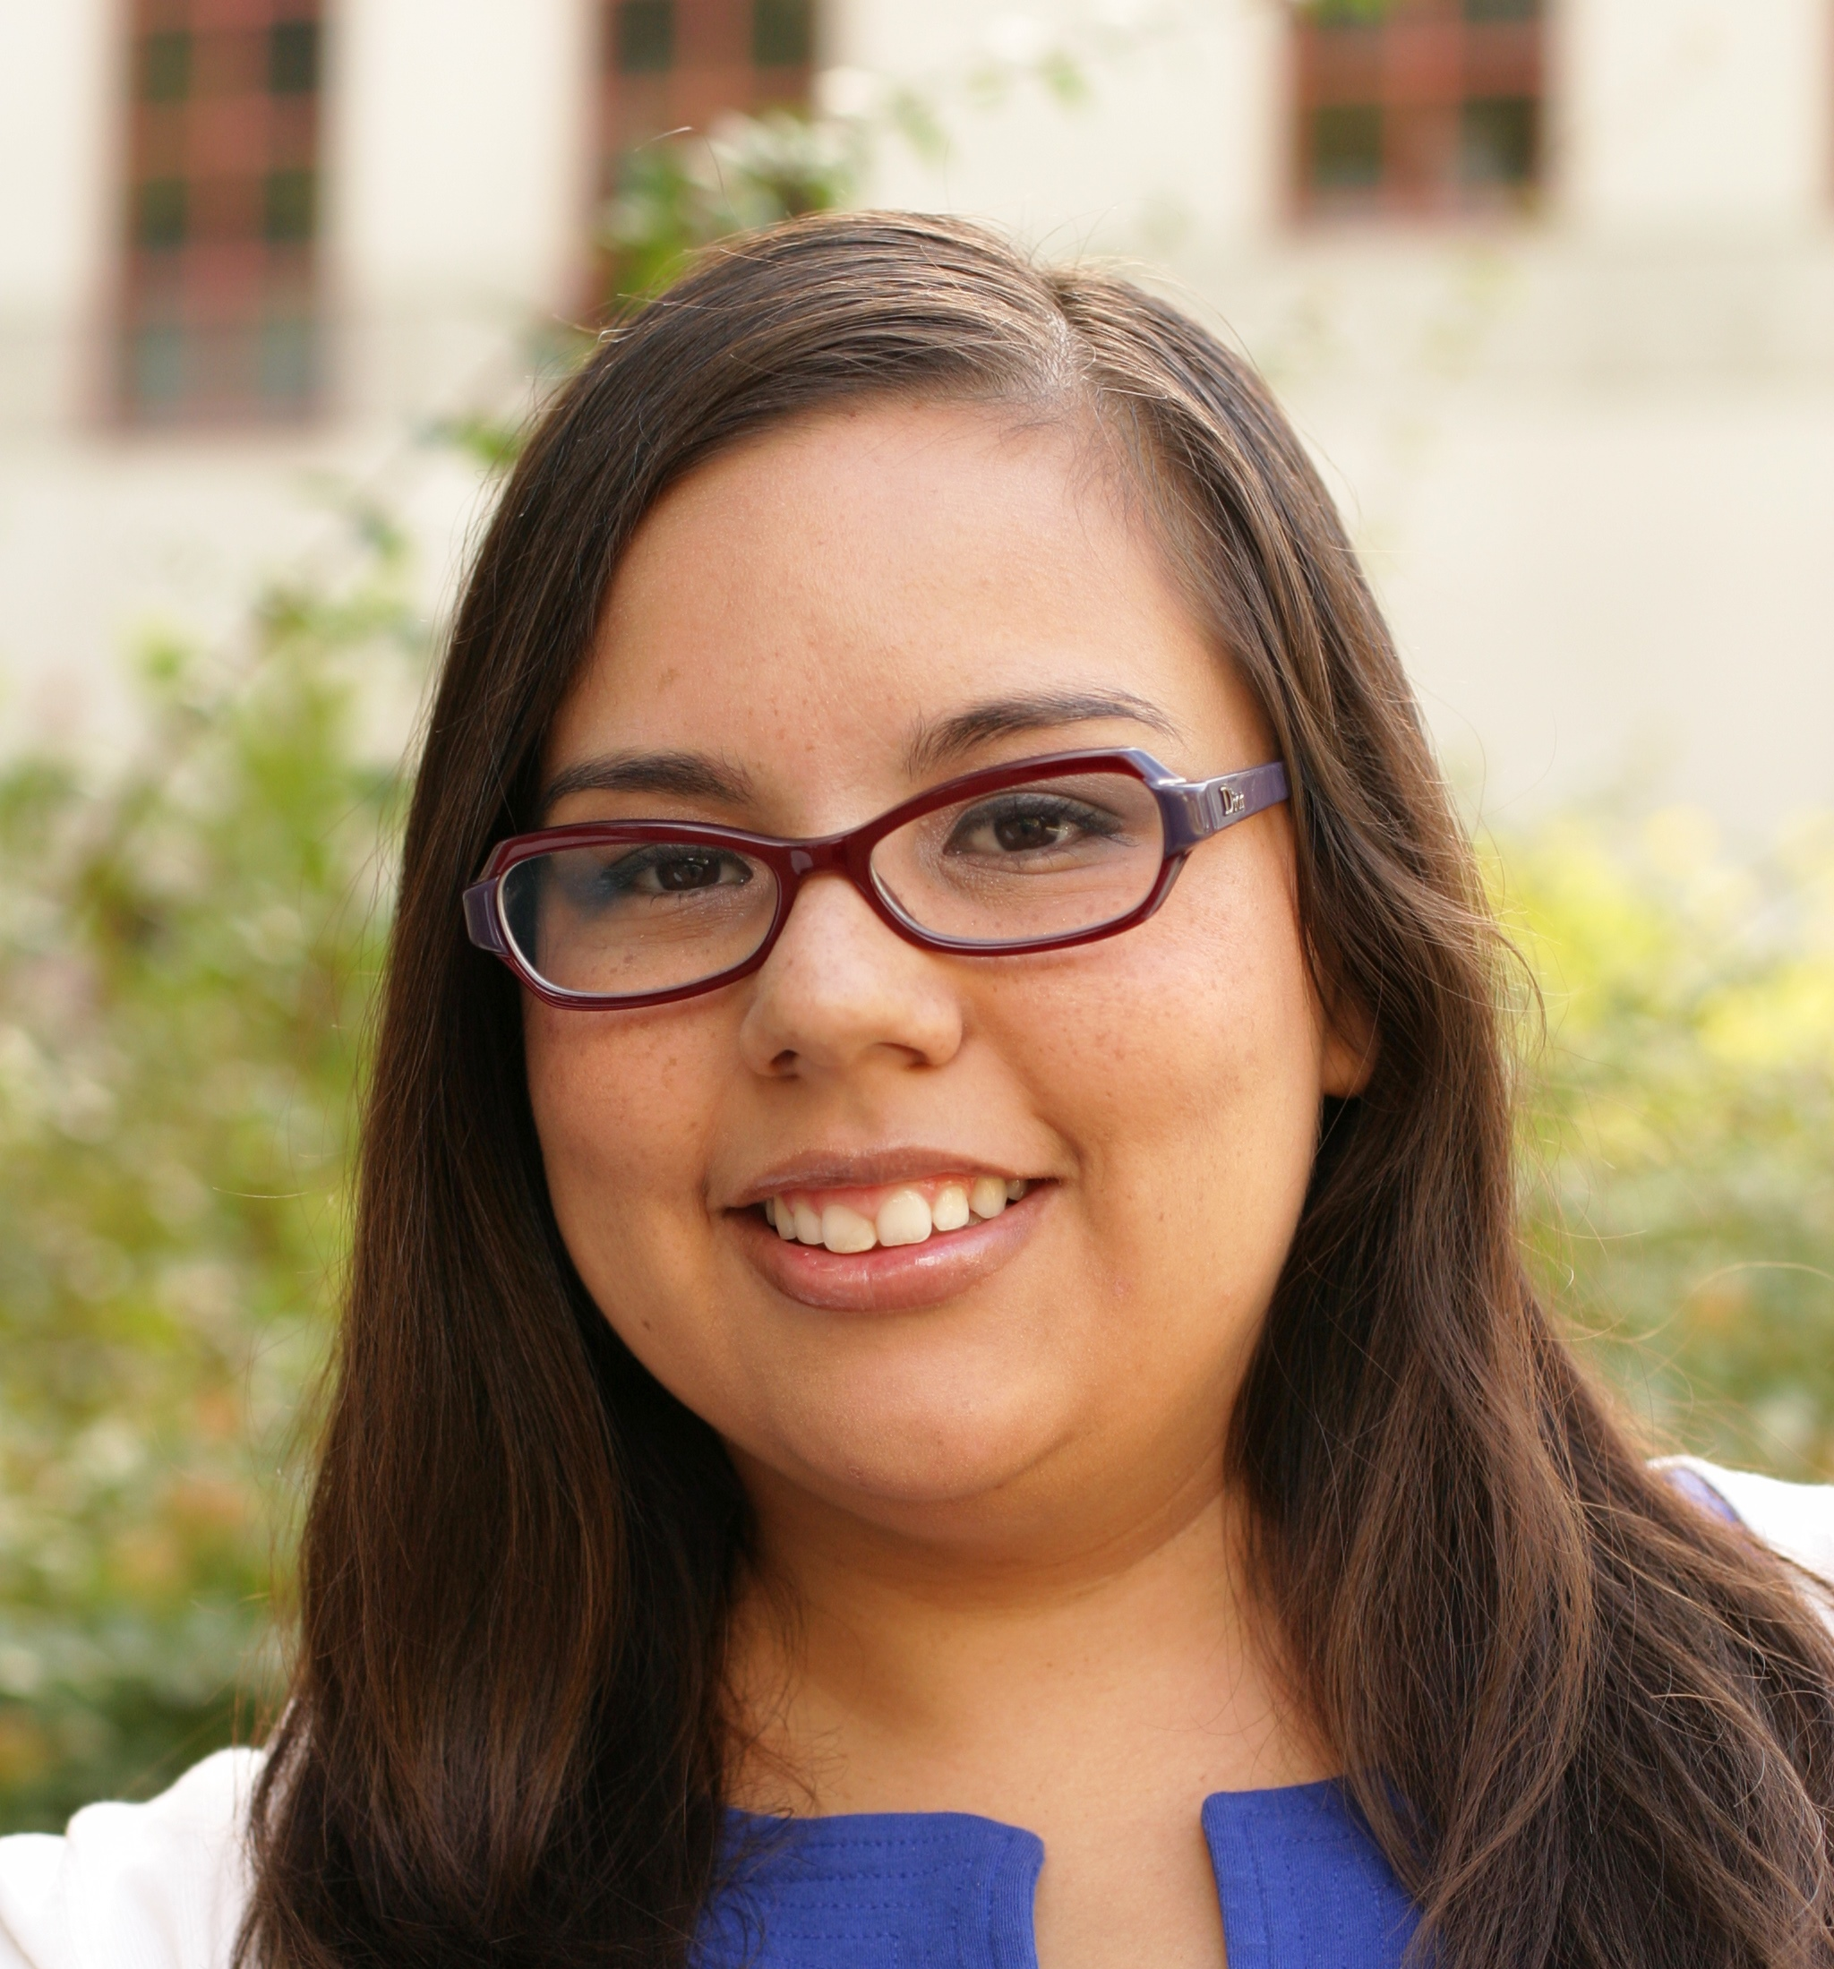
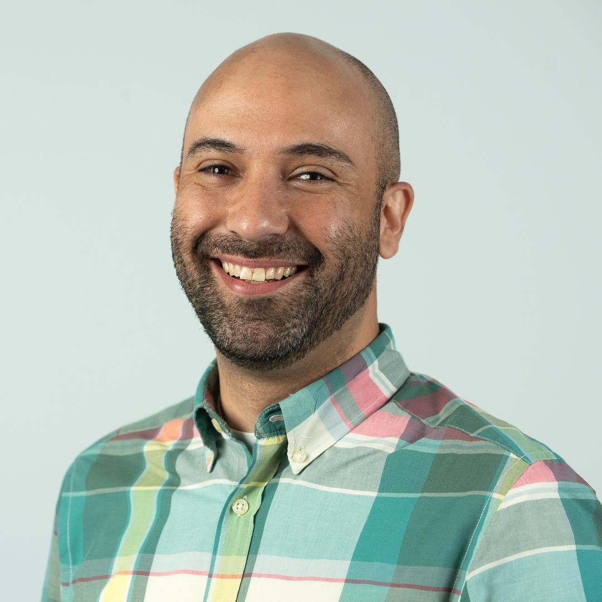
About the Presenters
Jeanette G. Baez
Assistant Vice President, Institutional Research, Planning & Analytics
AVP Baez supports evidence-based decision making by providing timely and relevant data insights to strengthen and increase college access and student success. She regularly collaborates on projects with leadership across the institution, serves on various university committees, supports accreditation efforts and strategic planning, and oversees the development of dashboards to inform evidence-based decisions. Major data initiatives she has led at Cal Poly include analyses pertaining to the development of multi-factor admissions, CSU Graduation Initiative 2025 efforts, Executive Order 1110, and program impaction.
Armando Madrid, Ed.D.
Associate Dean, Student Equity & Belonging
Their main goal is to foster an equitable and inclusive campus community where students become self-advocates and empower one another to reach their goals. Dr. Madrid oversees various programmatic departments that at their root celebrate the intersectional identities of our students, such as the Male Success Initiatives (MSI), Student Support and Equity Programs (SSEP) which includes our EOP Program, Renaissance Scholars, and Undocumented Student Services, the Veteran’s Resource Center (VRC), and the Centers for Transformation, Retention, Equity, and Empowerment (TREE), which comprises CPP’s cultural and identity centers.

Slide 3
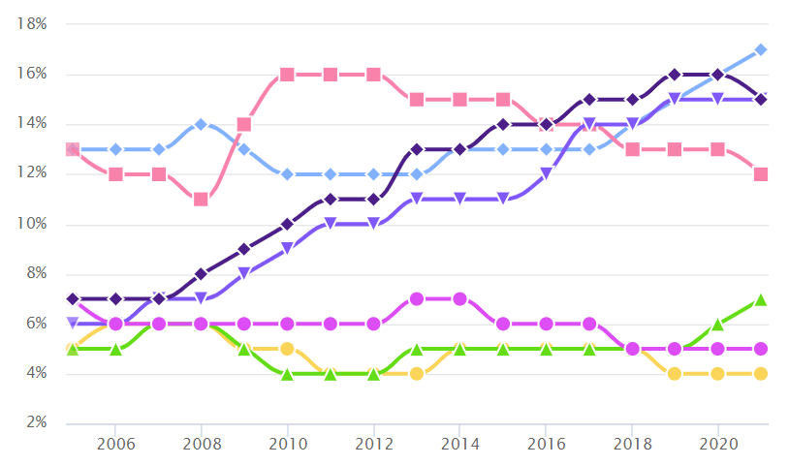
Our undergraduate student population has increasingly become more diverse
URM ONLY
URM, FIRST-GEN, PELL
URM & PELL
PELL ONLY
URM & FIRST-GEN
FIRST-GEN & PELL
FIRST-GEN ONLY
Data source: CSU Student Success Dashboard: How are our student populations changing?
Notes:
Stars represent growth.
75% of undergraduates identify as URM, First Gen, and/or Pell (compared to 56% in 2005). 25% are not URM, not First Gen, and not Pell.
17% identify as URM only (compared to 13% in 2005).
15% identify as URM, First Gen, and Pell (compared to 7% in 2005).
15% identify as URM and Pell (compared to 6% in 2005).

Slide 4
Educational outcomes have historically differed by student demographics
Although freshmen 4-year graduation rates have increased for our Black & Latinx students, limited progress has been made for 6-year graduation rates
ASIAN
WHITE
- ALL -
LATINX
BLACK

Slide 5
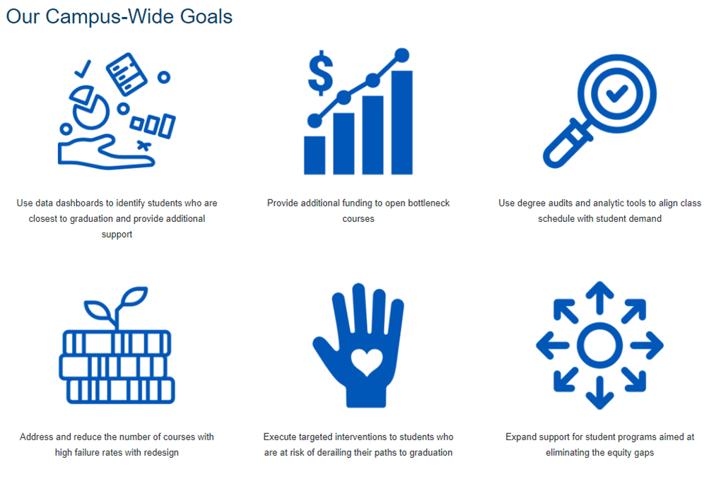
Division of Student Affairs – Addressing Equity Gaps
GI 2025 Initiative
Division of Student Affairs (DSA) Priorities:
Engage our diverse student population through intentional and transformative programs, services, and events.
Develop student support and interventions that are equity minded and culturally relevant where students become empowered to discover and achieve their goals by developing self-advocacy skills.

Slide 6
Cultural & Identity Initiatives: Addressing the unique needs, experiences, & identities of CPP students
Cal Poly Pomona is committed to becoming a student-ready and anti-racist institution that provides scholars with the academic, personal, and career-related resources needed to thrive. As a result, cultural and identity initiatives on college campuses make a powerful difference in student learning and retention and fosters an environment that promotes leadership development, critical thinking, a sense of belonging, cultural identity, and academic growth—all components for engagement in the learning process (Wilson, 2020; Howard, 2019; Patton, 2013).
Cultural & Identity Enrichment Programs
Cultural & Identity Retention Centers
Sample Services:
Cultural and identity educational workshops, programs, discussions, and training
Assistance with campus resource navigation
Community outreach and engagement
Sample Services:
Academic coaching
Culturally relevant tutoring and academic support
Mentorship programs
Student success workshops
Co-create retention initiatives with Academic Affairs
Culturally relevant and student-centered programming and celebrations
Community building and engagement
Cultural and identity graduations
Cultural and Identity Educational Workshops, Programs, Discussions, and Training

Slide 7
Culturally Relevant and Identity-Conscious Programming: TREE and MSI
The Center for Transformation, Retention, Equity, and Empowerment (TREE) is comprised of six centers or branches:
Black Resource Center (BRC)
Asian Pacific Islander Student Center (APISC)
Cesar E. Chavez Center for Higher Education (CECCHE)
Native American Student Center (NASC)
Pride Center
Womxn’s Resource Center (WRC)
TREE's top services this academic year have included:
Cultural/identity events
Study hall and academic support in the centers
Student Success Coaching by Retention Coordinators
MSI is focused on the delivery of quality programs that promote integrative learning, discovery, and creativity, as well as enhance student learning, development, and success. Through holistic and culturally relevant programming, cross-campus and interdepartmental support networks, and innovative services, MSI strives to close the gaps of retention and graduation rates among men of color at CPP.
MSI services this academic year have included:
Men of Color Student Retreat
Transfer Day
Black Men of Excellence (BME) and Latino Men of Excellence (LME) cohorts
Project Success (3-unit GE course, peer and staff mentoring)

Slide 8
More Students Are Engaging Than Before
There has been a three-fold increase in students engaging in cultural and identity centers along with an increase in the number of average visits.
Context
Full time staff hired at majority of centers
Continued partnership with BAC
Coaching with CPP Connect
Focus on implementing retention models
9.1
TREE and MSI became a standalone departments
Assistant Coordinators hired
Directors were hired to lead departments
Charge to incorporate student retention model
Hybrid programming

Slide 9
Amount of Engagement Has Increased Over Time
In Fall 2023, the number of check-ins exceeded 16k, compared to 3k in 2021.

Slide 10
Over Half of Students Visit between 1-3 Times
Additionally, about 28% of students visit more than one of the Centers for TREE/MSI.

Slide 11
Who we’re reaching & opportunities for greater impact
An intersectional lens allows us to identify which groups of students are visiting TREE/MSI
Notes:
Percentage represents those within the group who have checked-in to one of the centers.
Left side represents above average usage when combined in total.
Excluded groups in this graph where there were fewer than 10 individuals within the group as the percentages can be biased.

Slide 12
Persistence is higher for users vs. non-users
Even students who visit one time during the semester have slightly higher persistence rates than those who do not visit TREE/MSI
Notes:
Persistence is defined as those who enroll in the subsequent spring semester or graduated/applied for graduation that fall, or subsequent spring/summer.

Slide 13
Usage had the greatest impact for Black & Latinx students
Black and Latinx students had the largest gains in persistence rates for most subpopulations
Non-users
Users

Slide 14
Looking Ahead
Need for more disaggregate data (i.e., APIMEDA diaspora)
MSI Senior Coordinator to lead APIMEDA Men of Excellence cohort
Success Coaching to continue at all centers
Mapping of student experience by identities
Equity & Practice Symposium
Centers for T.R.E.E. & Identity-Conscious Student Success Coaching Model (poster presentation by Wendy Cordoza, Associate Director for TREE)
MSI Transfer Success (concurrent presentation by Reggie Robles, Associate Director of MSI)

Slide 15
Questions?
Contact Us:
Jeanette Baez, jgbaez@cpp.edu
Armando Madrid, Ed.D., amadrid1@cpp.edu
Additional Resources:
cpp.edu/tree/
cpp.edu/msi/
analytics.cpp.edu

